Slide 1
‘Disorder’, ‘disease’, ‘illness’, ‘sickness’: is there a difference? Lecture in BMI199: What is Biomedical Informatics? Sept 24, 2020 on-line, University at Buffalo
Werner CEUSTERS, MD
Departments of Biomedical Informatics and Psychiatry,
UB Institute for Healthcare Informatics,
Ontology Research Group, Center of Excellence in Bioinformatics and Life Sciences,
University at Buffalo, NY, USA

Slide 2
Data generation and use
Science
Research
data
organization
model development
observation &
measurement
further R&D
(instrument and
study optimization)
add
verify
use
Δ = outcome
Generic
beliefs
application

Slide 3
Representation and what it is about
Representation
data
organization
What representation is about
model development
observation &
measurement
further R&D
(instrument and
study optimization)
add
verify
use
Generic
beliefs
application

Slide 4
Two important science- and research- related disciplines
Ontology
Terminology

Slide 5
Two important science- and research- related disciplines
Ontology
What entities exist?
How do entities relate to each other?
Terminology
What entities, if any at all, are denoted by words or terms?
‘Earth’ ‘Aarde’ ‘La Terre’
Reality first
Representation first

Slide 6
Canonical case: faithful representation
Reality
Representation
‘Earth’
‘Aarde’
‘La Terre’
…
denotes
means
represents

Slide 7
Delusions, fantasies, imaginations, …
Reality
Representation
‘unicorn’

Slide 8
Delusions, fantasies, imaginations, …
Reality
Representation
‘unicorn’

Slide 9
Delusions, fantasies, imaginations, …
Terminology
Reality
Representation
‘unicorn’
Graphics

Slide 10
Delusions, fantasies, imaginations, …
Conceptualism
Terminology
Reality or
Imagination
Representation
‘unicorn’
Graphics
unicorn concept

Slide 11
Semiotic / semantic triangle (Ogden & Richards, 1923: The meaning of ‘meaning’)
concept
term
referent

Slide 12
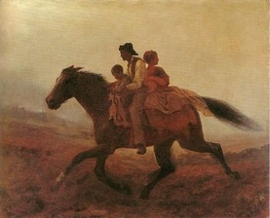
Prehistoric ‘psychiatry’: drapetomania
disease which causes slaves to suffer from an unexplainable propensity to run away
…
concept
term
referent
painting by Eastman Johnson. A Ride for Liberty: The Fugitive Slaves. 1860.
‘drapetomania’

Slide 13
What is the case ?
Reality
Representation
‘disorder’
‘disease’
‘illness’
‘sickness’

Slide 14
What is the case ?
Reality
Representation
‘disorder’
‘disease’
‘illness’
‘sickness’
U1
Synonymy

Slide 15
What is the case ?
Reality
Representation
U1
‘disorder’
‘disease’
‘illness’
‘sickness’
U2

Slide 16
What is the case ?
Reality
Representation
U1
‘disorder’
‘disease’
‘illness’
‘sickness’
U2
U3
U4

Slide 17
What is the case ?
Reality
Representation
U1
‘disorder’
‘disease’
‘illness’
‘sickness’
U2
U3
U4

Slide 18
How can we find out?

Slide 19
1. Terminological inquiry

Slide 20
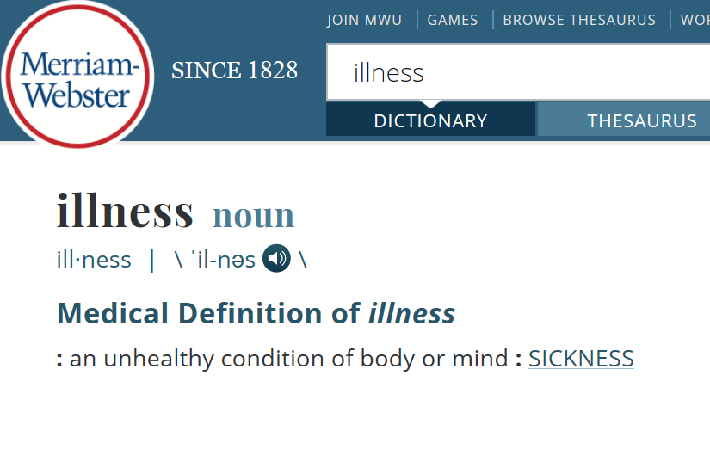

Slide 21
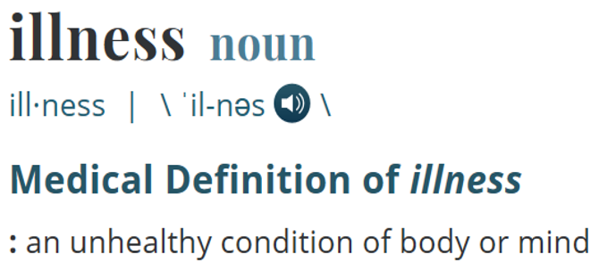
What is the case ?
Reality
Representation
‘illness’
ilness

Slide 22
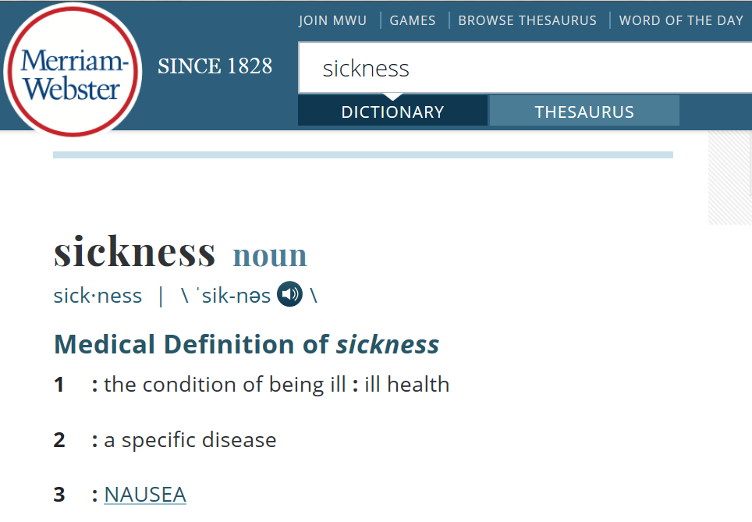

Slide 23
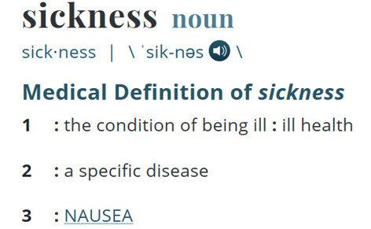
What is the case ?
Reality
Representation
‘illness’
Specific disease
=?
Homonymy
nausea
‘sickness’
illness
Synonyms?

Slide 24
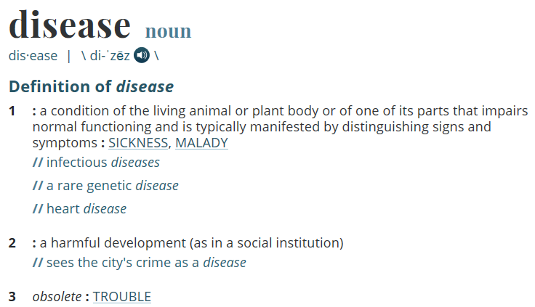

Slide 25
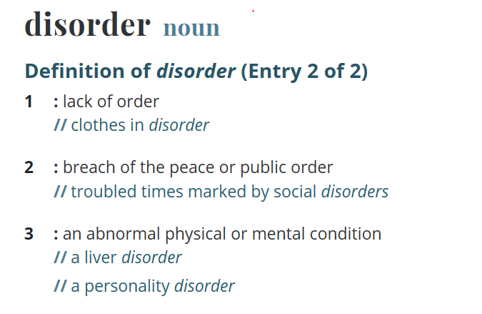

Slide 26
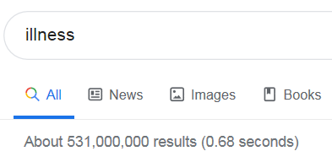
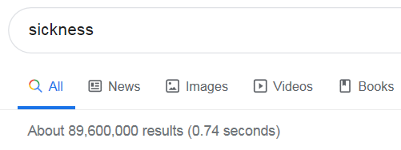
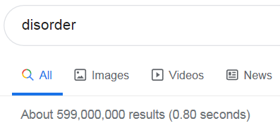
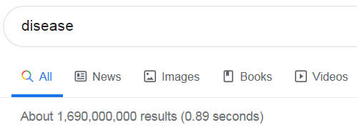
How often are the words used in Google? (Sept 2019)
(Sept 2020)
3
4
287,000,000
103,000,000
2
1
516,000,000
1,240,000,000

Slide 27
2. Metaphysical inquiry

Slide 28
2. Metaphysical inquiry
Define terms precisely so that what is intended by (ideally) all uses of the corresponding terms in the language under scrutiny falls under it;
Investigate how what is intended by these uses relate to each other.

Slide 29
The objective Bio-Psycho-Social perspective
‘T_{o}-Disease’:
a health problem that consists of a physiological malfunction that results in an actual or potential reduction in physical capacities and/or a reduced life expectancy
‘T_{o}-Illness’:
a subjectively interpreted undesirable state of health, consisting of subjective feeling states (e.g., pain, weakness), perceptions of the adequacy of their bodily functioning, and/or feelings of competence
‘T_{o}-Sickness’:
a social entity in virtue of the poor health or the health problem(s) of an individual defined by others with reference to the social activity of that individual
Twaddle, A. (1994a). Disease, illness and sickness revisited.
In: A. Twaddle & L. Nordenfelt. (Eds.) Disease, Illness and Sickness: Three Central Concepts in the Theory of Health
(pp. 1–18). Link€oping: Studies on Health and Society, 18.

Slide 30
The subjective Bio-Psycho-Social perspective
T_{s}-Disease:
when there are negative bodily occurrences as conceived of by the medical profession.
T_{s}-Illness:
when there are negative bodily occurrences as conceived of by the person himself.
T_{s}-Sickness:
when there are negative bodily occurrences as conceived of by the society and/or its institutions.
‘Occurrence’ here means ‘process’, ‘state’ or ‘event’.
Bjørn Hofmann. On the Triad Disease, Illness and Sickness.
Journal of Medicine and Philosophy 2002, Vol. 27, No. 6, pp. 651–673

Slide 31
Overlap in the subjective Bio-Psycho-Social perspective
T_{s}-Illness (patients)
6
3
4
1
5
7
2
T_{s}-Disease
(MDs)
T_{s}-Sickness
(society)
Bjørn Hofmann. On the Triad Disease, Illness and Sickness.
Journal of Medicine and Philosophy 2002, Vol. 27, No. 6, pp. 651–673

Slide 32
3. Ontological inquiry
OGMS:
Ontology for General Medical Science

Slide 33
The ontological approach
Reality
Representation
Entity1
‘term1’
‘term2’
Entity2
‘term3’
Entity3

Slide 34
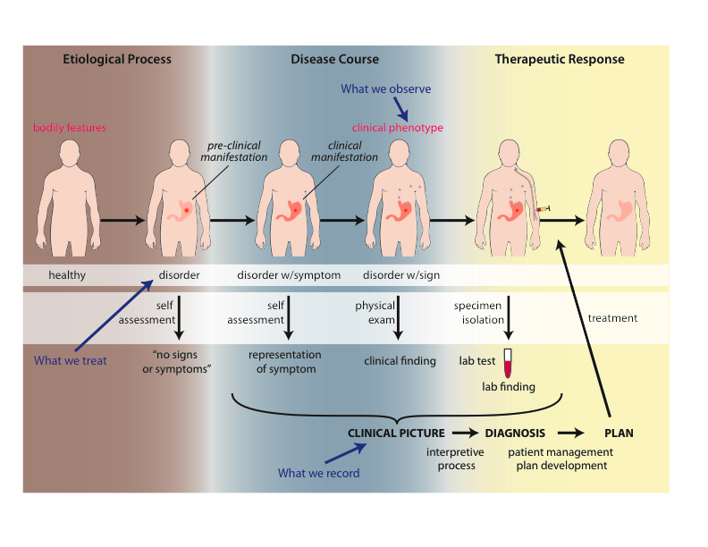
What happens in the body
Scheuermann R, Ceusters W, Smith B. Toward an Ontological Treatment of Disease and Diagnosis. 2009 AMIA Summit on Translational Bioinformatics, San Francisco, California, March 15-17, 2009;: 116-120.
Notes:
font was too small, color inside green boxes was hardly readable

Slide 35
Bodily features
Bodily component:
Your heart, your liver, a bacterium inside you
Your left nostril, the lumen of your stomach
…
Bodily quality:
Your body temperature, your height
The size of a tumor
…
Bodily process:
The beating of your heart, your respiration, your thinking
The growth of bacteria inside you, sneezing, the development of a tumor.
…

Slide 36
The biological perspective of OGMS Disorder / Disease / Disease course
Disease
Disease
Course
(pathological
processes)
Disorder
Scheuermann R, Ceusters W, Smith B. Toward an Ontological Treatment of Disease and Diagnosis. 2009 AMIA Summit on Translational Bioinformatics, San Francisco, California, March 15-17, 2009;: 116-120. Omnipress ISBN:0-9647743-7-2

Slide 37
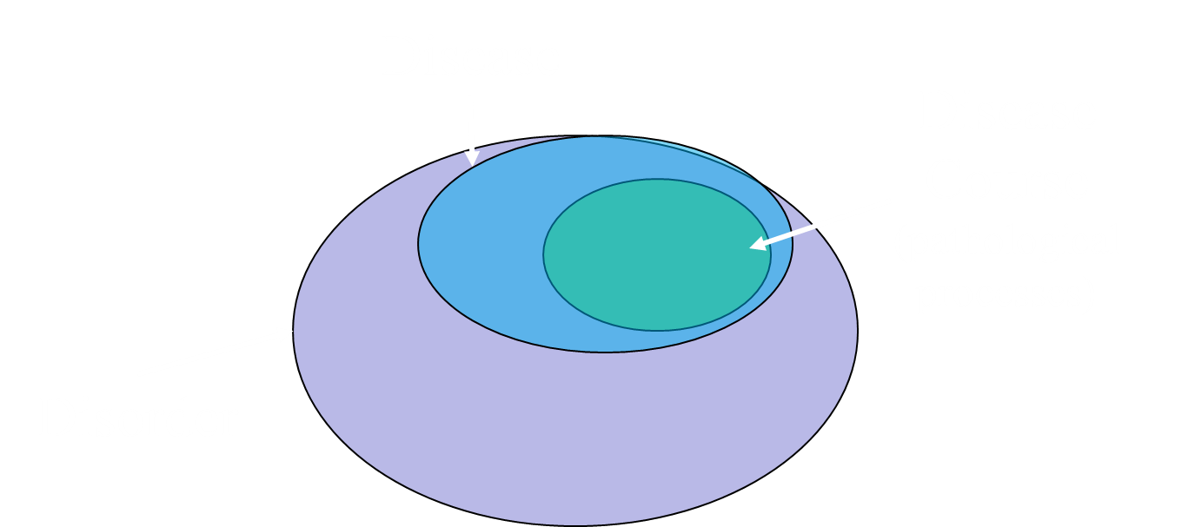
Key OGMS definitions
DISORDER | A causally relatively isolated combination of physical components that is (a) clinically abnormal and (b) maximal, in the sense that it is not a part of some larger such combination.
DISEASE | A DISPOSITION (i) to undergo PATHOLOGICAL PROCESSes that (ii) exists in an ORGANISM because of one or more DISORDERs in that ORGANISM.
DISEASE COURSE | The totality of all PROCESSes through which a given DISEASE instance is realized.
Scheuermann R, Ceusters W, Smith B. Toward an Ontological Treatment of Disease and Diagnosis. 2009 AMIA Summit on Translational Bioinformatics, San Francisco, California, March 15-17, 2009;: 116-120. Omnipress ISBN:0-9647743-7-2

Slide 38
Foundational Terms (1)
Disorder =def. – A causally linked combination of physical components of the extended organism that is
(a) clinically abnormal and
(b) maximal, in the sense that it is not a part of some larger such combination.

Slide 39
Extended organism
Harth R. War and peace in the human gut: probing the microbiome
https://biodesign.asu.edu/sites/default/files/news/AthenaHostcooperation7.png

Slide 40
Clinically abnormal
something is clinically abnormal if:
is not part of the life plan for an organism of the relevant type (unlike aging or pregnancy),
is causally linked to an elevated risk either of pain or other feelings of illness, or of death or dysfunction, and
is such that the elevated risk exceeds a certain threshold level.

Slide 41
Foundational Terms (2)
Disorder =def. – A causally linked combination of physical components of the extended organism that is
(a) clinically abnormal and
(b) maximal, in the sense that it is not a part of some larger such combination.
Pathological Process =def. – A bodily process that is a manifestation of a disorder and is clinically abnormal.

Slide 42
Foundational Terms (3)
Disorder =def. – A causally linked combination of physical components of the extended organism that is (a) clinically abnormal and (b) maximal, in the sense that it is not a part of some larger such combination.
Pathological Process =def. – A bodily process that is a manifestation of a disorder and is clinically abnormal.
Disease =def. – A disposition (i) to undergo pathological processes that (ii) exists in an organism because of one or more disorders in that organism.

Slide 43
Dispositions become ‘realized’ under certain circumstances
object | disposition | circumstance | realization
vase | breakability | falling | breaking
banana | to ripen | warmth | ripening
me | irritability | student doesn’t do homework | i get angry
…
human being | to die | lack of oxygen | human dies
osteoporotic hip | fragility | bump into table | hip fractures
bacterium in blood | to multiply | weak immune system | bacterial sepsis
…

Slide 44
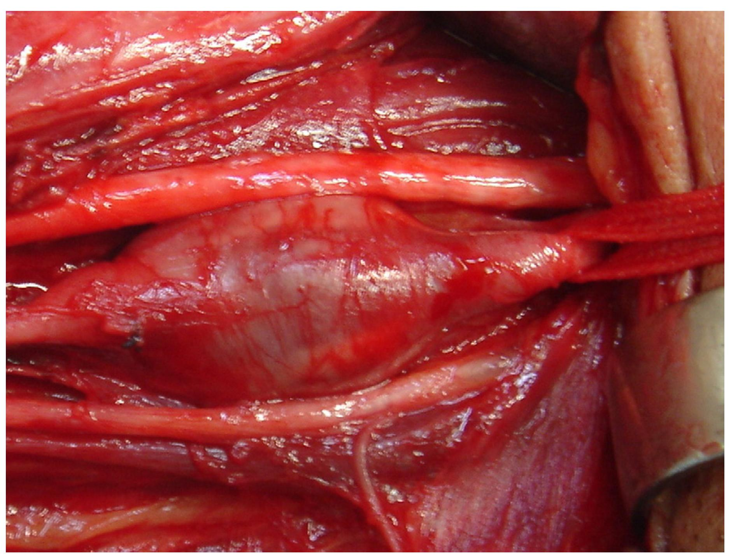
Arterial aneurysm
Jornal Vascular Brasileiro Print version ISSN 1677-5449 J. vasc. bras. vol.12 no.4 Porto Alegre Oct./Dec. 2013 Epub Dec 15, 2013
http://dx.doi.org/10.1590/jvb.2013.054
Subclavian and axillary arterial aneurysms: two case reports
Fernando Pinho Esteves¹ , André Ventura Ferreira¹ , Vanessa Prado dos Santos² , Gabriel Santos Novaes¹ , Álvaro Razuk Filho¹ , Roberto Augusto Caffaro¹

Slide 45
Arterial Aneurysm
Disposition – atherosclerosis
realized in
Pathological process – fatty material collects within the walls of arteries
produces
Disorder – artery with weakened wall
bears
Disposition – of artery to become distended
realized_in
Pathological process – process of distending
produces
Disorder – arterial aneurysm
bears
Disposition – of artery to rupture
realized in
Pathological process – (catastrophic event) of rupturing
produces
Disorder – ruptured artery, arterial system with dangerously low blood pressure
bears
Disposition – circulatory failure
realized in
Pathological process – exsanguination, failure of homeostasis
produces
Death

Slide 46
Hemorrhagic stroke
http://www.tomfit247.com/2013/05/stroke-what-is-it-what-causes-it-and.html

Slide 47
Hemorrhagic stroke
Disorder – cerebral arterial aneurysm
bears
Disposition – of weakened artery to rupture
realized in
Pathological process – rupturing of weakened blood vessel
produces
Disorder – Intraparenchymal cerebral hemorrhage
bears
Disposition (disease) – to increased intra-cranial pressure
realized in
Pathological process – increasing intra-cranial pressure, compression of brain structures
produces
Disorder – Cerebral ischemia, Cerebral neuronal death
bears
Disposition (disease) – stroke
realized in
Symptoms – weakness/paralysis, loss of sensation, etc

Slide 48
Disease course
The totality of all PROCESSes through which a given DISEASE instance is realized.

Slide 49
Assignment
Read the CDC webpage with title ‘Coronavirus Disease 2019 (COVID-19) 2020 Interim Case Definition, Approved April 5, 2020’
https://wwwn.cdc.gov/nndss/conditions/coronavirus-disease-2019-covid-19/case-definition/2020/
Pick freely ten biomedical terms of your choice used in the criteria section of the webpage. Classify each term under one of the categories on the next slide. Motivate your choice of category on the basis of the definitions or examples provided for these categories in this lecture C8. Use at least six different categories, and at least once each of disorder, disease and disease course.
Email your Word-document to wceusters@gmail.com not later than Monday Sept 28 – 9AM.

Slide 50
Categories you can pick from
Bodily component (see slide 34 and R3)
Bodily quality (see slide 34 and R3)
Bodily process (see slide 34 and R3)
Pathological process (see slide 40 and R3)
Etiological process (see R3)
Sign (see R3)
Symptom (see R3)
Disorder (see slide 37 and R3)
Disease (see slide 41 and R3)
Disease course (see slide 47 and R3)

Slide 51
Format of your response file
Nr | Term | Category | Motivation
1
2
3
4
5
6
7
8
9
10

Slide 52
Examples
Nr | Term | Category | Motivation
1 | stool | Bodily component | Stool is a physical component produced in the body. It is not clinically abnormal and therefore not a disorder or a sign.
2 | Black stool | Sign | Stool is not supposed to be black and is an indication that there is bleeding in the GI system [1]. It is observable by a clinician and clinically significant as demanded by the definition for ‘sign’.
3 | …
…
[1] https://www.webmd.com/digestive-disorders/black-tarry-stool-reasons#1

Slide 53
Assessment
You can get a very high score even if all your categories are wrong, but your motivation for selecting them is well-defended.
I want to see:
That you did a serious effort,
That you researched terms from the CDC webpage you did perhaps not completely understand,
That your motivation contains arguments based on the definitions or examples.
You get no credit for terms which are not in the designated area.
You get no credit for guessing or absent motivation or for not satisfying the criteria outlined on slide 48.

