Slide 1
Is there a job market for biomedical informaticists? Lecture in BMI199: What is Biomedical Informatics? Dec 3, 2020 online, University at Buffalo
Werner CEUSTERS, MD
Departments of Biomedical Informatics and Psychiatry,
UB Institute for Healthcare Informatics,
Ontology Research Group, Center of Excellence in Bioinformatics and Life Sciences,
University at Buffalo, NY, USA

Slide 2
Career options in healthcare informatics

Slide 3
Some useful job search sites
https://www.indeed.com/salaries/medical%20informatics
https://www.monster.com/jobs/search/?q=healthcare-informatics&intcid=skr_navigation_nhpso_searchMain
https://www.ziprecruiter.com/Salaries/Biomedical-Informatics-Salary
https://www.glassdoor.com/Job/biomedical-informatics-jobs-SRCH_KO0,22.htm

Slide 4
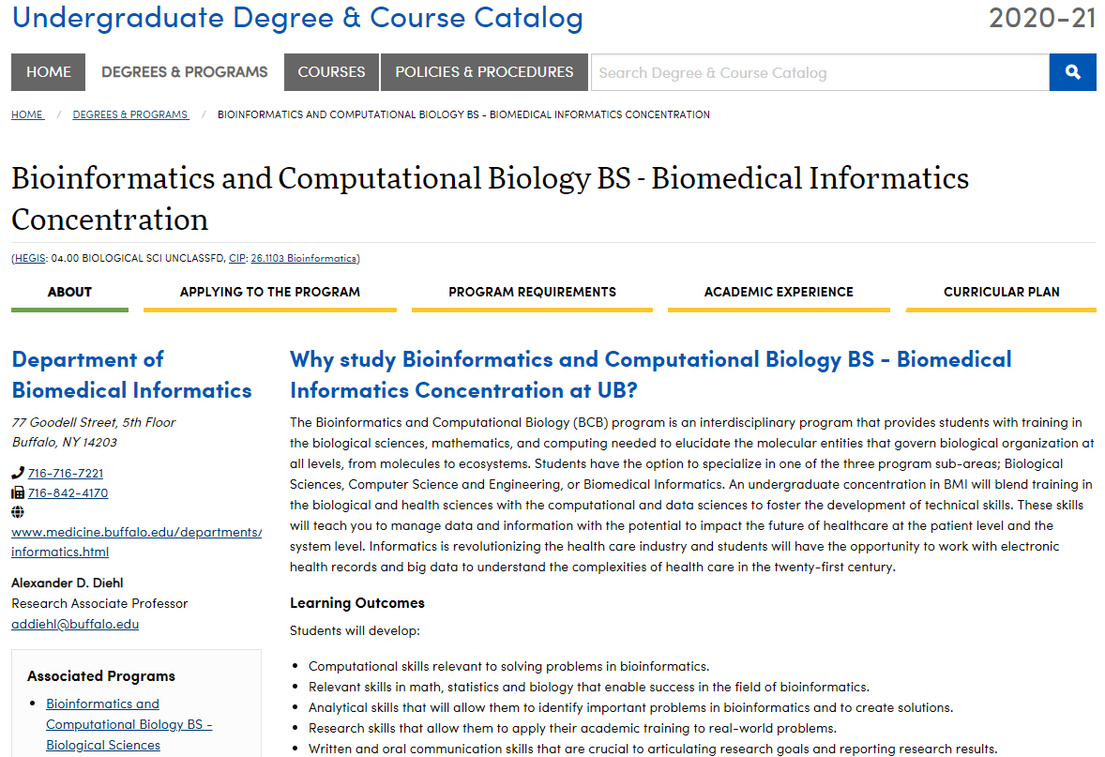

Slide 5
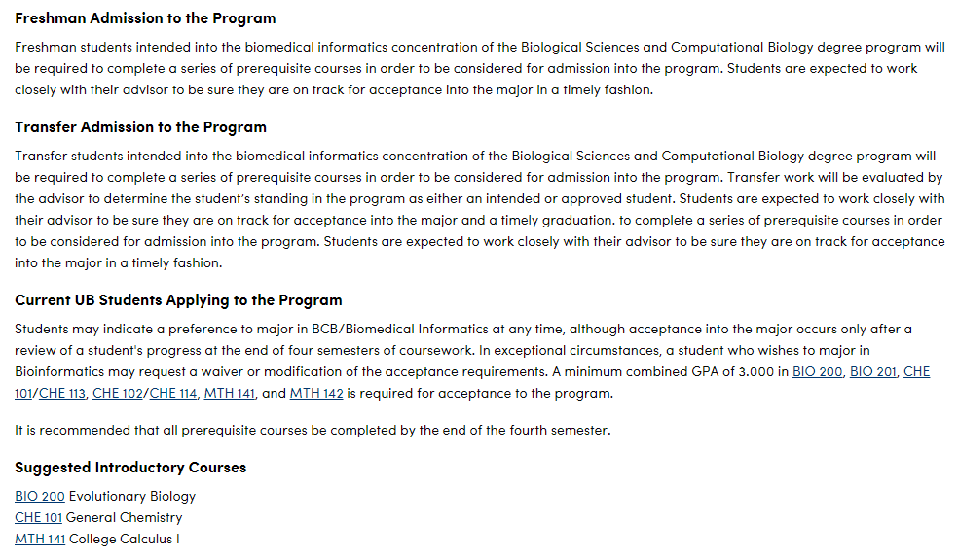

Slide 6
BS in BMI - Prerequisite courses
BIO 200 Evolutionary Biology
BIO 201 Cell Biology
BIO 211 Cell Biology Lab
CHE 101/CHE 113 General Chemistry
CHE 102/CHE 114 General Chemistry
CHE 203/CHE 205 Organic Chemistry
CHE 204/CHE 206 Organic Chemistry
MTH 141 College Calculus I
MTH 142 College Calculus II
CSE 115 Introduction to Computer Science for Majors I

Slide 7
BS in BMI – required courses
BCH 403 Biochemical Principles
BCH 410 Biomedical Genetics
BCH 419 Introduction to Bioinformatics & Computational Biology
BCH 494 Senior Capstone
BMI 402 Biomedical Informatics: Science and Enabling Technology
BMI 498 Undergraduate Research
CSE 116 Introduction to Computer Science for Majors II
MTH 411 Probability or STA 301 Intro to Probability
MTH 412 Introduction to Statistical Inference or STA 302 Introduction to Statistical Inference
PHY 101 College Physics I
PHY 151 College Physics I Lab
PHY 102 College Physics II
PHY 152 College Physics II Lab
6 credits of Upper Division Track Electives
BMI 401 Introduction to Biomedical Informatics
4 credits of CSE electives

Slide 8
BMI Master and beyond
http://medicine.buffalo.edu/departments/biomedical-informatics/education/masters/curriculum.html
http://medicine.buffalo.edu/departments/biomedical-informatics/education/phd.html

