Slide 1
What makes a chemical compound a medicinal drug?
Why are (some) drugs so expensive?
Lecture in BMI199: What is Biomedical Informatics?
Nov 19, 2020 online, University at Buffalo
Werner CEUSTERS, MD
Departments of Biomedical Informatics and Psychiatry,
UB Institute for Healthcare Informatics,
Ontology Research Group, Center of Excellence in Bioinformatics and Life Sciences,
University at Buffalo, NY, USA

Slide 2
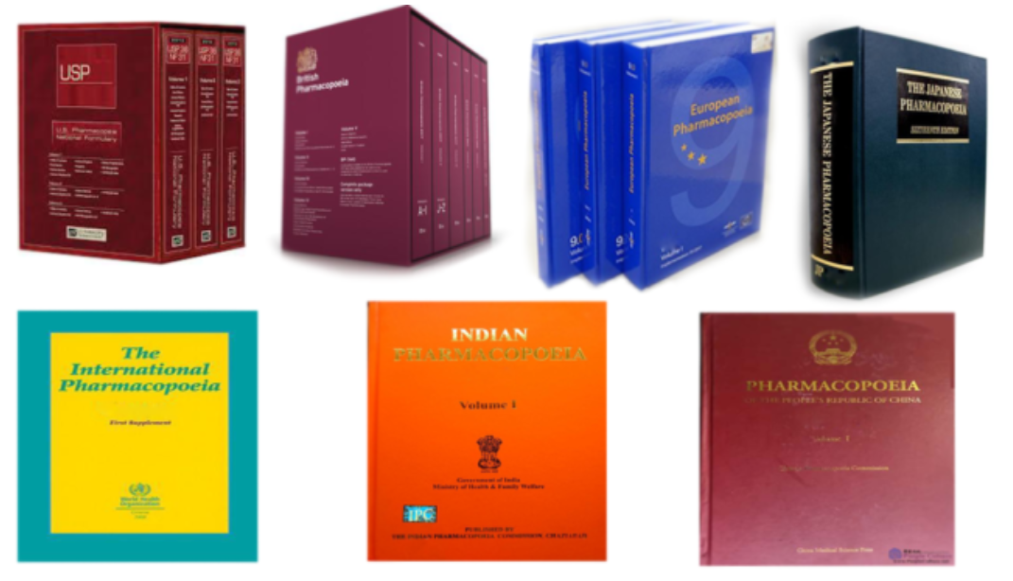
FDA glossary
Drug:
  A substance recognized by an official pharmacopoeia or formulary.
https://www.fda.gov/drugs/drug-approvals-and-databases/drugsfda-glossary-terms
https://pharmaeducation.net/list-of-pharmacopoeia/

Slide 3
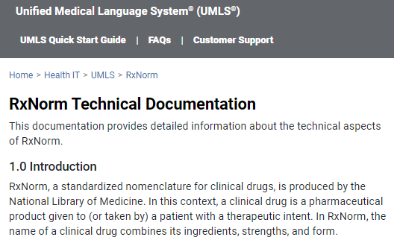
The odd view of librarians
https://www.nlm.nih.gov/research/umls/rxnorm/docs/techdoc.html#:~:text=RxNorm%2C%20a%20standardized%20nomenclature%20for,ingredients%2C%20strengths%2C%20and%20form.

Slide 4
FDA glossary
Drug:
  A substance recognized by an official pharmacopoeia or formulary.
  A substance intended for use in the diagnosis, cure, mitigation, treatment, or prevention of disease.
  A substance (other than food) intended to affect the structure or any function of the body.
  A substance intended for use as a component of a medicine but not a device or a component, part or accessory of a device.
Drug Product:
  The finished dosage form that contains a drug substance, generally, but not necessarily in association with other active or inactive ingredients.
https://www.fda.gov/drugs/drug-approvals-and-databases/drugsfda-glossary-terms

Slide 5
FDA legal definition
Drug substance:
  an active ingredient that is intended to furnish pharmacological activity or other direct effect in the diagnosis, cure, mitigation, treatment, or prevention of disease or to affect the structure or any function of the human body, but does not include intermediates use in the synthesis of such ingredient.
Drug product:
  a finished dosage form, for example, tablet, capsule, or solution, that contains a drug substance, generally, but not necessarily, in association with one or more other ingredients.
https://www.govinfo.gov/content/pkg/CFR-2012-title21-vol5/pdf/CFR-2012-title21-vol5-part314.pdf

Slide 6
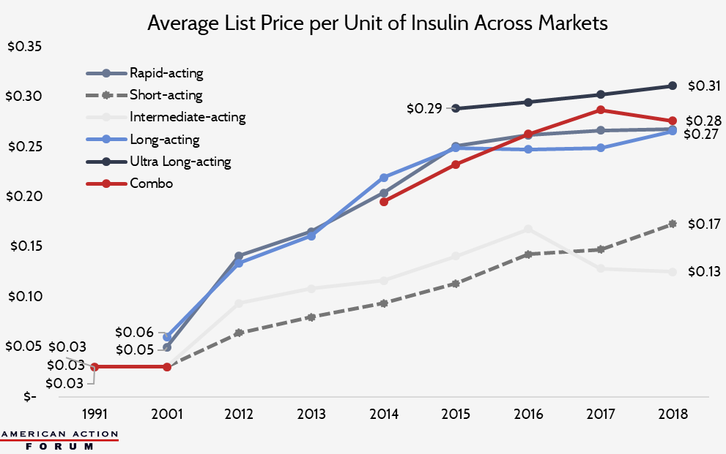
Drug prices on the rise: insulin
https://www.americanactionforum.org/research/insulin-cost-and-pricing-trends/

Slide 7
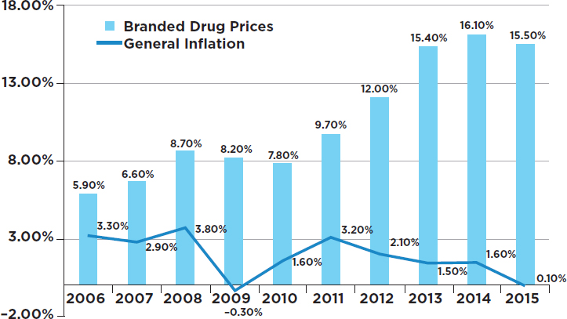
Drug prices versus inflation
https://www.nap.edu/read/24946/chapter/5#76

Slide 8
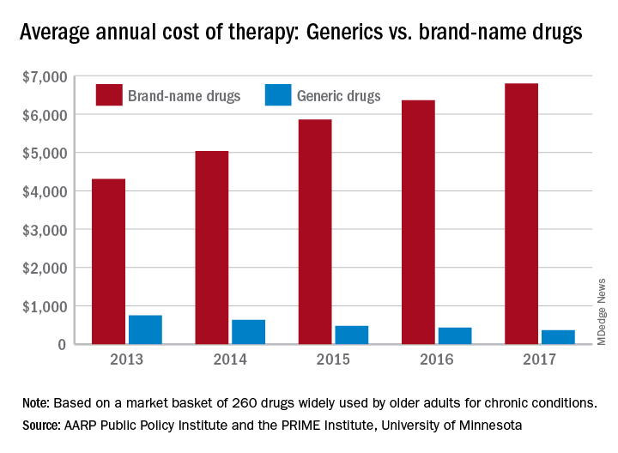
https://www.the-hospitalist.org/hospitalist/article/198828/business-medicine/cost-gap-widens-between-brand-name-generic-drugs

Slide 9
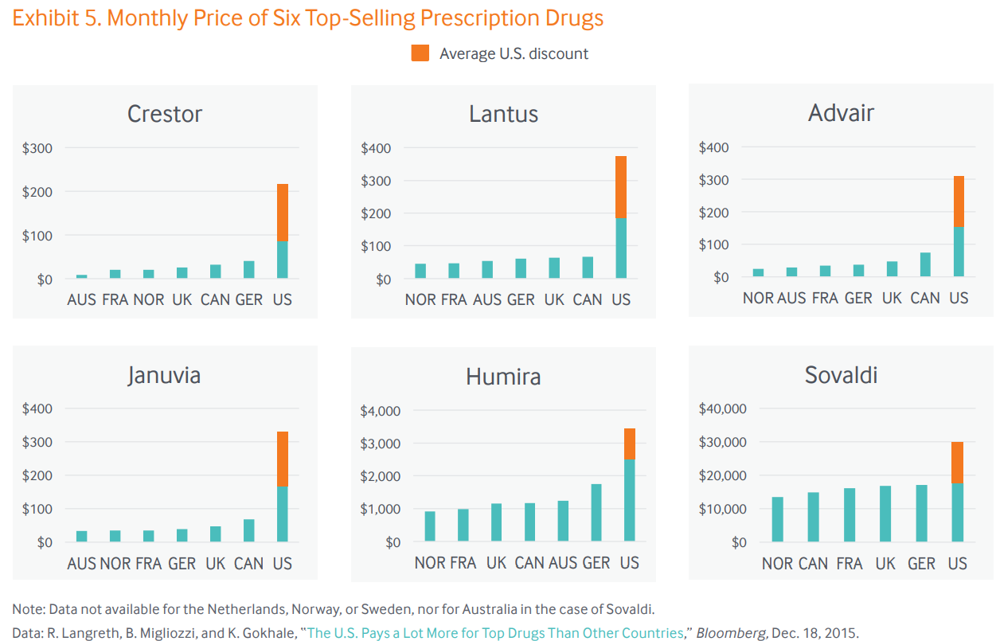

Slide 10
Causes for the high cost of prescription drugs (1)
High cost of development
…
Vincent Rajkumar, S. The high cost of prescription drugs: causes and solutions. Blood Cancer J. 10, 71 (2020). https://doi.org/10.1038/s41408-020-0338-x

Slide 11
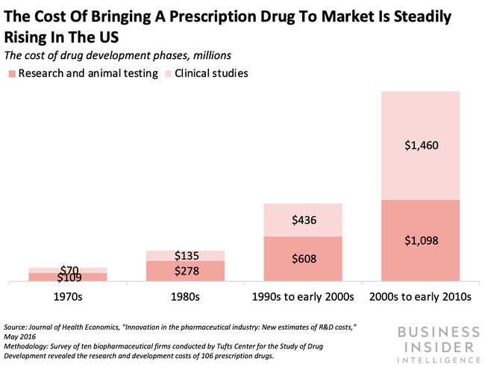

Slide 12
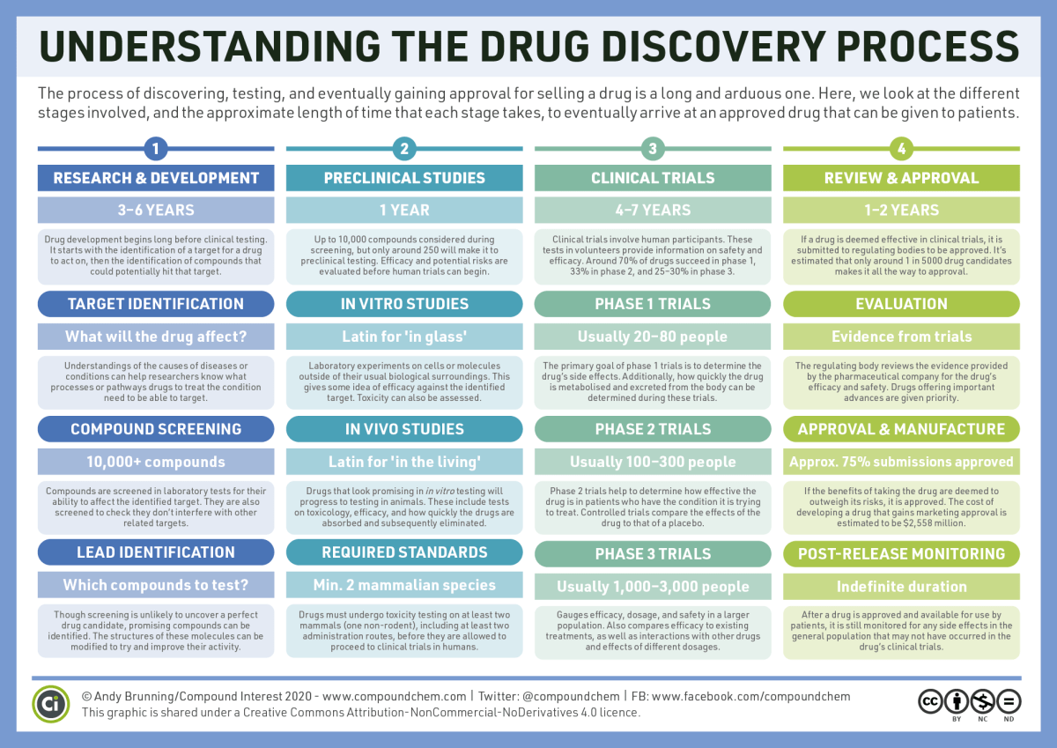
https://www.compoundchem.com/2016/01/16/drug-discovery/

Slide 13
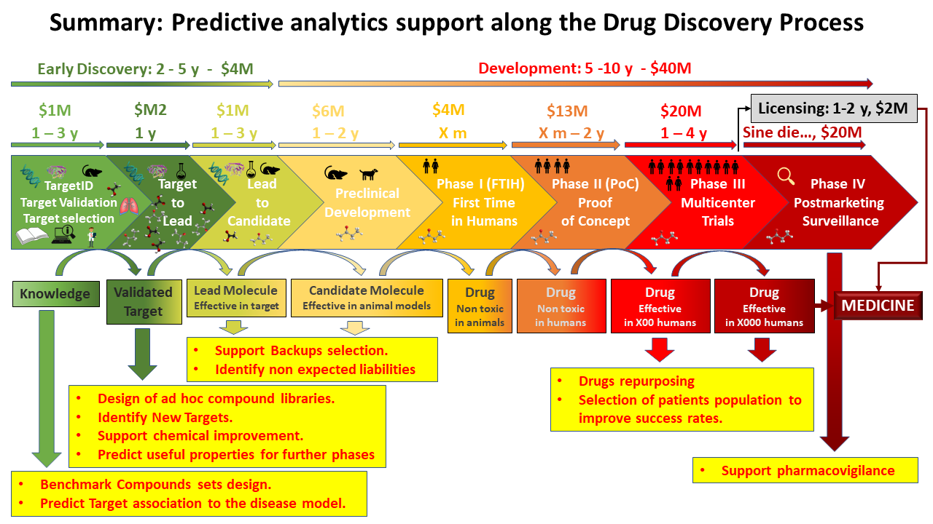
Informatics and predictive analytics
https://doctortarget.com/machine-learning-applied-drug-discovery/

Slide 14
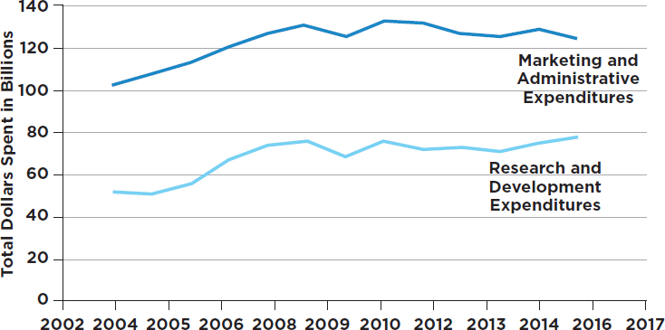
Marketing versus development costs
https://www.nap.edu/read/24946/chapter/5#76

Slide 15
Causes for the high cost of prescription drugs (2)
High cost of development
Monopoly
Seriousness of the disease
Lobbying power of pharmaceutical companies
Vincent Rajkumar, S. The high cost of prescription drugs: causes and solutions. Blood Cancer J. 10, 71 (2020). https://doi.org/10.1038/s41408-020-0338-x

Slide 16
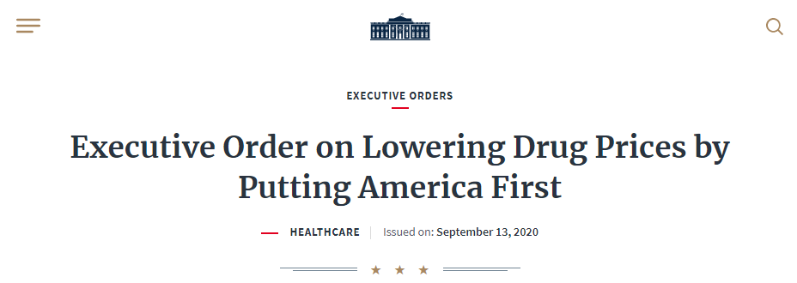
https://www.whitehouse.gov/presidential-actions/executive-order-lowering-drug-prices-putting-america-first/
By the authority vested in me as President by the Constitution and the laws of the United States of America, it is hereby ordered as follows:
Section 1. Purpose. Americans pay more per capita for prescription drugs than residents of any other developed country in the world. It is unacceptable that Americans pay more for the exact same drugs, often made in the exact same places. Other countries’ governments regulate drug prices by negotiating with drug manufacturers to secure bargain prices, leaving Americans to make up the difference — effectively subsidizing innovation and lower-cost drugs for the rest of the world. The Council of Economic Advisers has found that Americans finance much of the biopharmaceutical innovation that the world depends on, allowing foreign governments, many of which are the sole healthcare payers in their respective countries, to enjoy bargain prices for such innovations. Americans should not bear extra burdens to compensate for the shortfalls that result from the nationalized public healthcare systems of wealthy countries abroad.

Slide 17
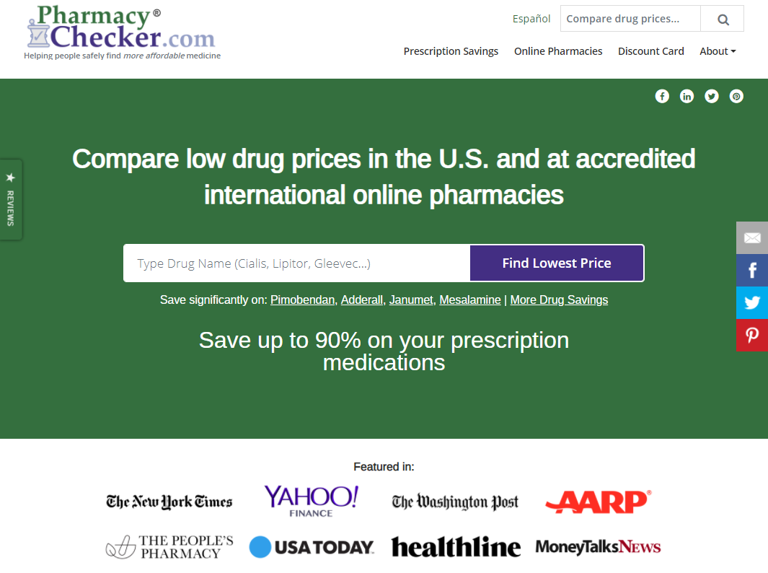
https://www.pharmacychecker.com/

Slide 18
Comparing drug prices
http://www.bing.com/
www.google.com

Slide 19
Pharmacychecker files lawsuit
‘PharmacyChecker.com brings this action under the Sherman Act, 15 U.S.C.§ 1, for injunctive relief and damages arising from a conspiracy among the defendants—Alliance for Safe Online Pharmacies (ASOP), Center for Safe Internet Pharmacies (CSIP), LegitScript, National Association of Boards of Pharmacy (NABP), and Partnership for Safe Medicines (PSM)—and their constituent members to suppress competition in the markets for online pharmacy verification services and comparative drug pricing information. The defendants, who are a network of overlapping nonprofit organizations and private firms that are funded or backed by pharmaceutical manufacturers and large pharmacy interests, are using shadow regulation—private agreements with key internet gatekeepers—to manipulate and suppress the information available to consumers seeking information about lower-cost, safe prescription medicine. PharmacyChecker.com has now effectively been excluded from the market as a result of the defendants’ shadow regulation.’
Case 7:19-cv-07577 Document 1 Filed 08/13/19 Page 1 of 46
https://www.eff.org/document/pharmacychecker-v-nabp-complaint

Slide 20
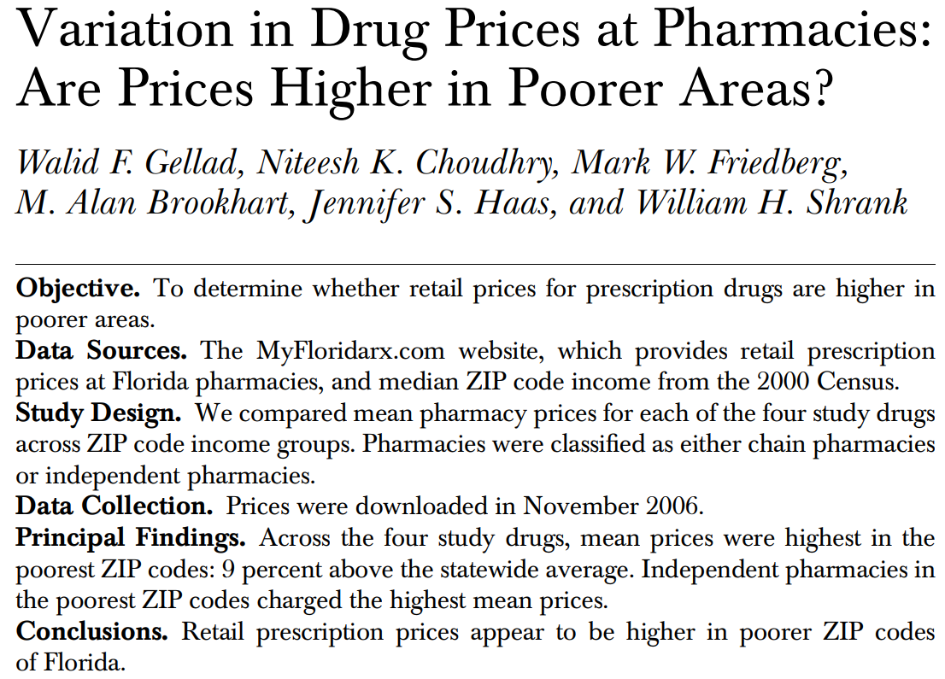
https://www.ncbi.nlm.nih.gov/pmc/articles/PMC2677057

Slide 21
Assignment A11
Task description:
  Access https://www.pharmacychecker.com/drug-price-comparisons.asp (or similar site, e.g. GoodRx, …).
  Students must perform enough searches on drugs, thereby playing with different drugs, quantities and zip-codes, to be able to detect what pricing policies are used by distinct pharmacies and to provide arguments what factors for price setting seem to be used within specific brands of pharmacies.
  Findings must be documented in an Excel spreadsheet and procedures, difficulties encountered and conclusions in a Word document.
  Files submitted must be named ‘A11-XXX.docx’ and ‘A11-XXX.xlsx’ (‘XXX’ replaced by your Ubitname) and be properly formatted as files of these types.
  Send your work by email to wceusters@gmail.com not later than Nov 23 – 9AM.

Slide 22
Some suggestions for exploring relationships
https://www.drugs.com/medical_conditions.html
https://www.irs.gov/statistics/soi-tax-stats-individual-income-tax-statistics-2018-zip-code-data-soi
https://www.drugs.com/pharmaceutical-companies.html
Do not compare generics with brands, but you may compare different brands with the same active ingredient.

