Slide 1
Wearable Devices and The Internet of Things Lecture in BMI199: What is Biomedical Informatics? Nov 12, 2020 online, University at Buffalo
Werner CEUSTERS, MD
Departments of Biomedical Informatics and Psychiatry,
UB Institute for Healthcare Informatics,
Ontology Research Group, Center of Excellence in Bioinformatics and Life Sciences,
University at Buffalo, NY, USA

Slide 2
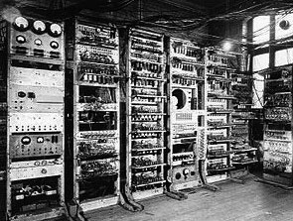
1949: The Manchester Mark I First Digital Computer
https://www.britannica.com/technology/Manchester-Mark-I

Slide 3
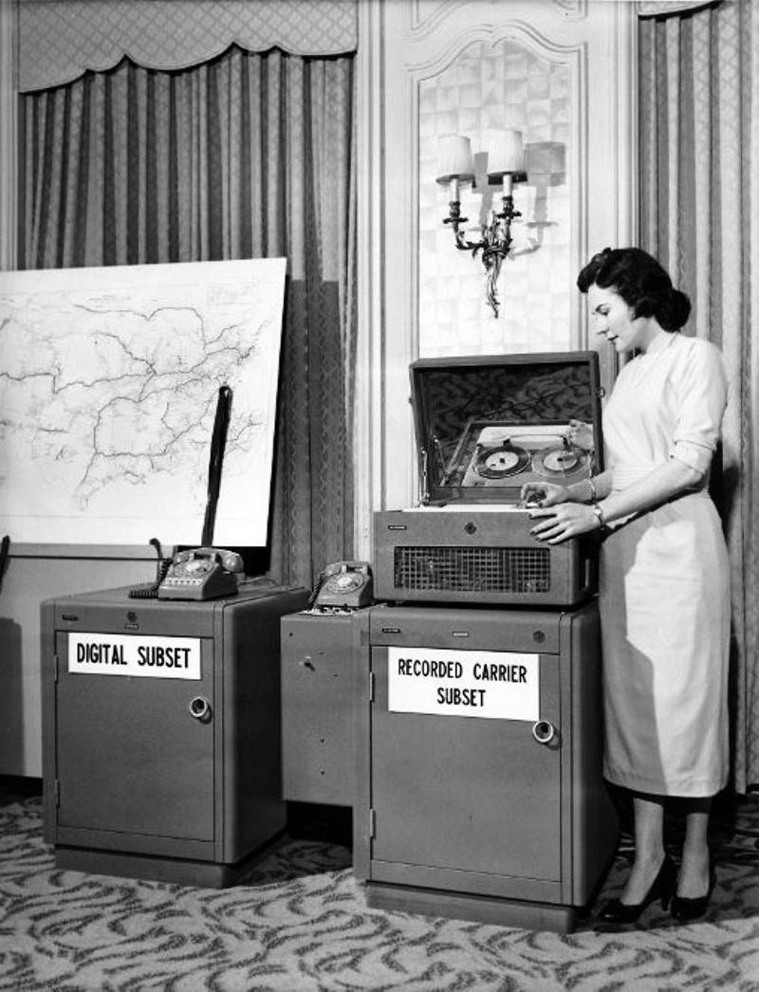
1958 First modem (AT&T)
Asynchronous data links
https://www.computerhistory.org/timeline/networking-the-web/

Slide 4
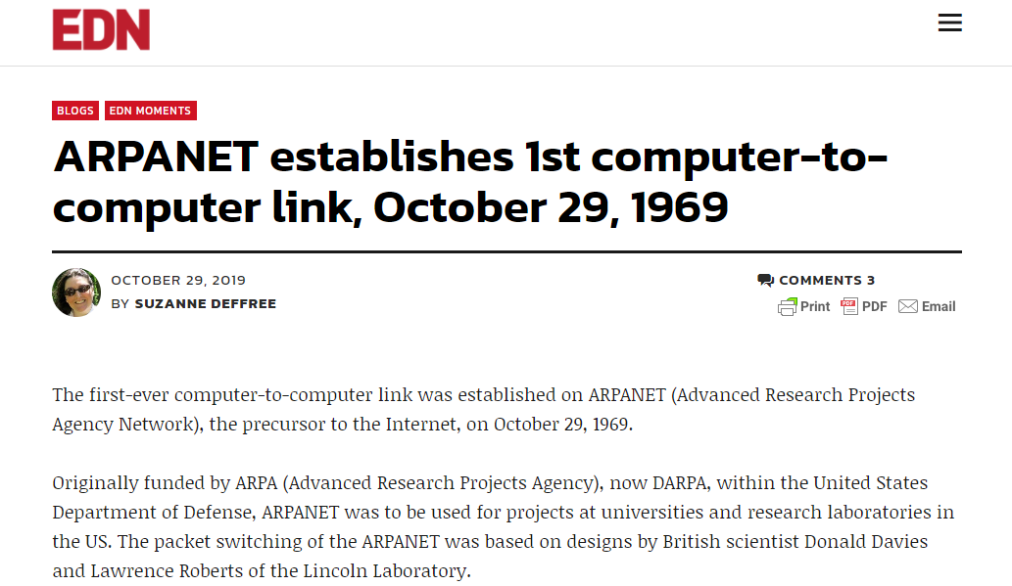
ARPANET
https://www.edn.com/arpanet-establishes-1st-computer-to-computer-link-october-29-1969/

Slide 5
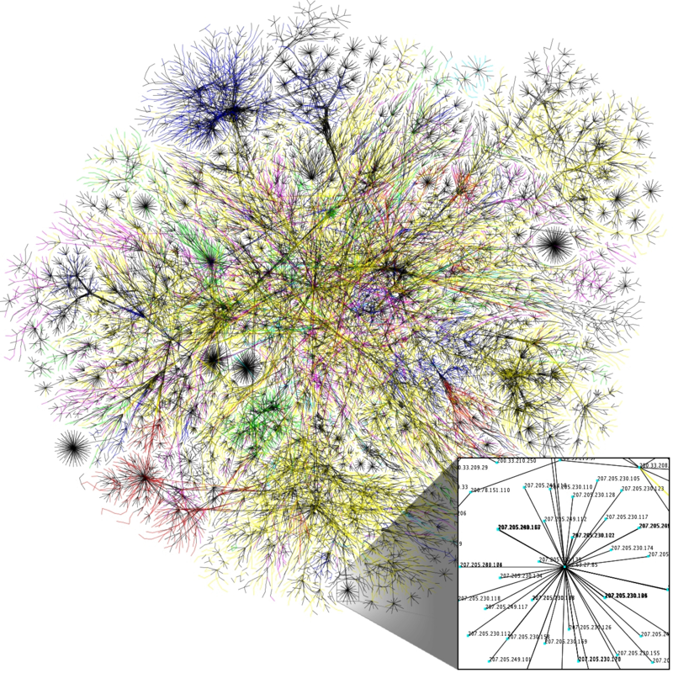
Emergence of other computer networks and merging into ‘The Internet’ (1980)
NPL network
Merit Network
CYCLADES
X.25 and public data networks
UUCP and Usenet
…
https://commons.wikimedia.org/wiki/File:Internet_map_1024_-_transparent,_inverted.png

Slide 6
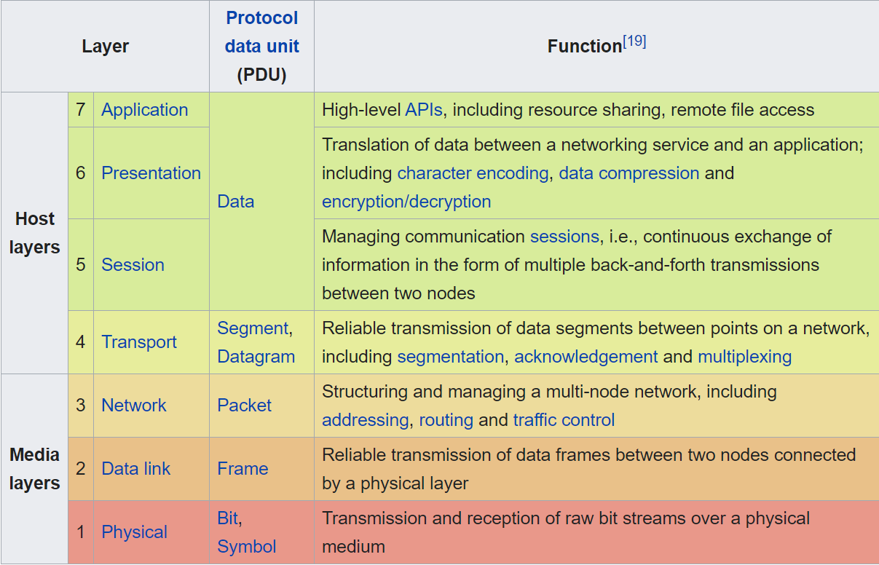
Open Systems Interconnection model (OSI model – ISO 1980)

Slide 7
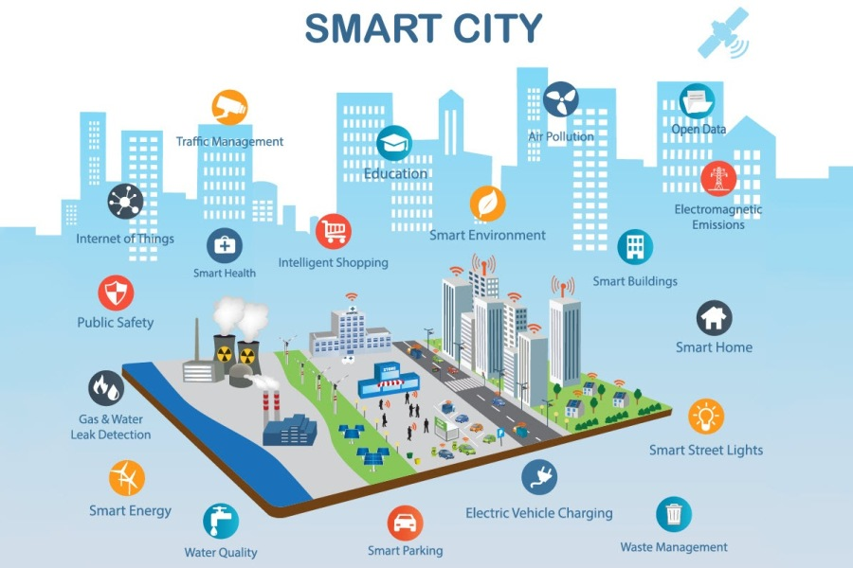
https://www.bebee.com/producer/@an-ela-bogdan/how-internet-of-things-is-changing-our-world-for-the-better
(photo by Charlotte Anderson, Axis Communication)

Slide 8
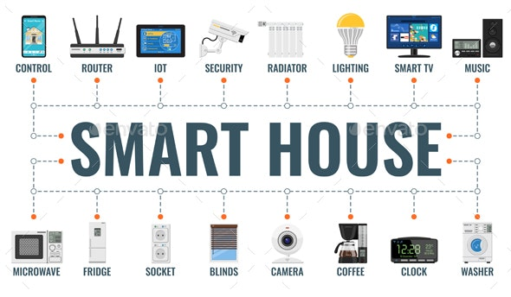
https://graphicriver.net/item/smart-house-and-internet-of-things/28972829

Slide 9
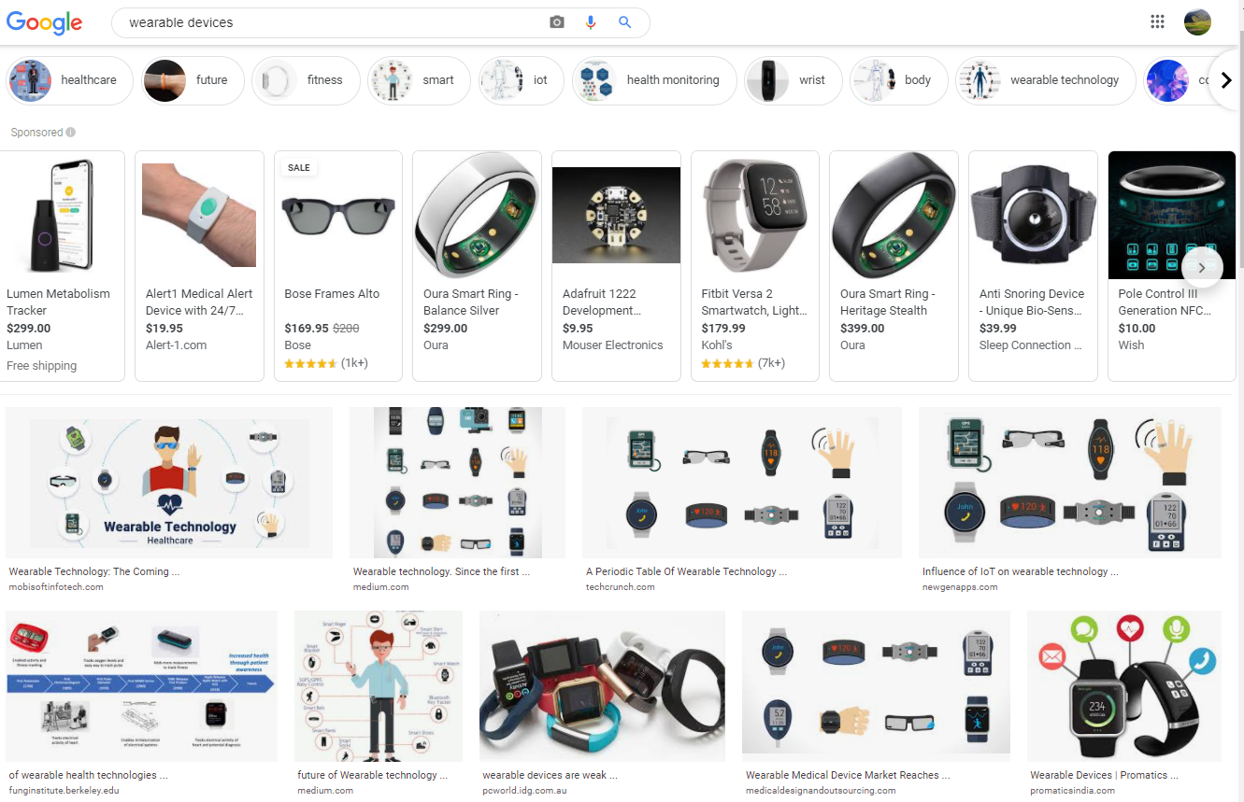
‘Wearable devices’ on Google (Nov 2020)

Slide 10
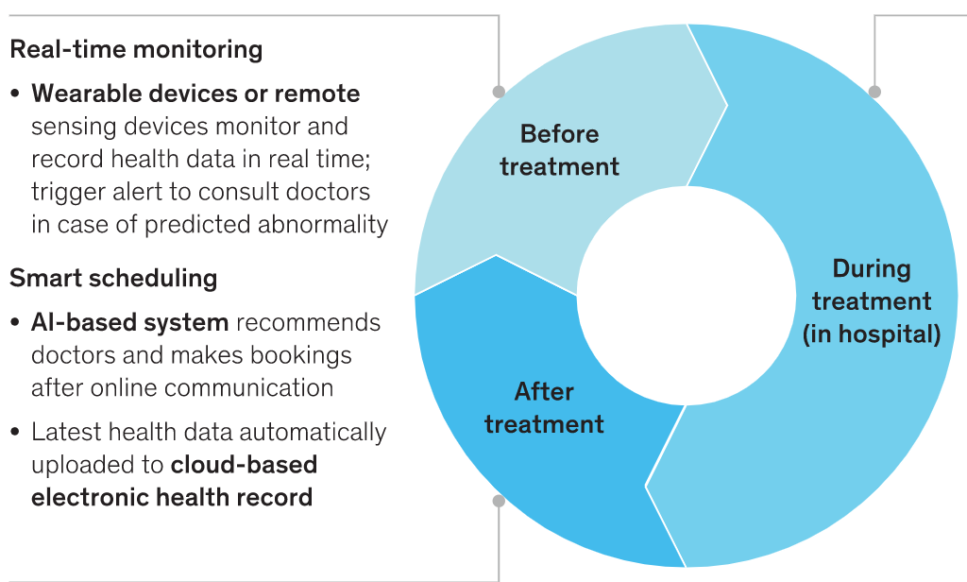
‘Smart’ Healthcare
Bo Chen, Axel Baur, Marek Stepniak, and Jin Wang
Finding the future of care provision: The role of smart hospitals. May 31, 2019McKinsey & Company
https://www.mckinsey.com/industries/healthcare-systems-and-services/our-insights/finding-the-future-of-care-provision-the-role-of-smart-hospitals

Slide 11
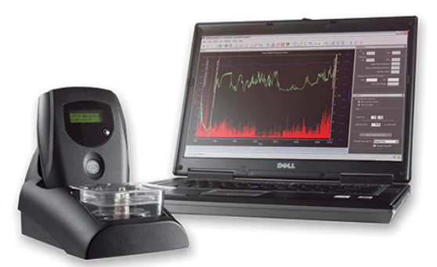
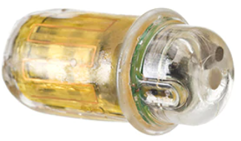
SmartPill™ motility capsule
Assists in localizing transit abnor-malities to a specific GI region by collecting data from the entire GI tract. As the SmartPill™ motility capsule travels through the patient's GI tract, it measures pressure, pH and temperature to provide you with valuable diagnostic infor-mation, including gastric emptying and total GI transit times in your patients.
MotiliGI™ software provides data analysis tools, offering physicians a variety of test reporting and exporting options to aid in the identification of motility disorders. The software calculates gastric emptying time, small bowel transit time, colonic transit time, combined small/ large bowel transit time, and whole gut transit time in graphical and statistical formats, and presents this data in a summary report.
www.medtronic.com

Slide 12
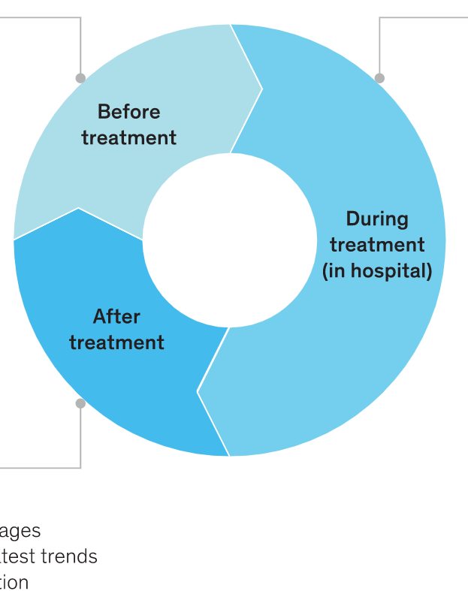
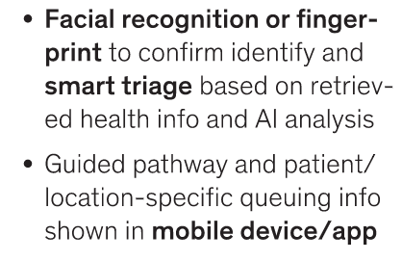
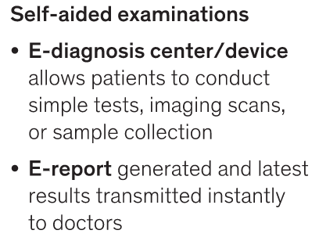
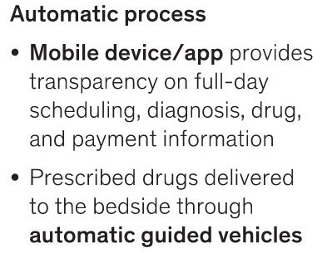
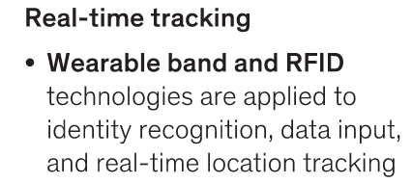
‘Smart’ Healthcare
Bo Chen, Axel Baur, Marek Stepniak, and Jin Wang
Finding the future of care provision: The role of smart hospitals. May 31, 2019McKinsey & Company

Slide 13
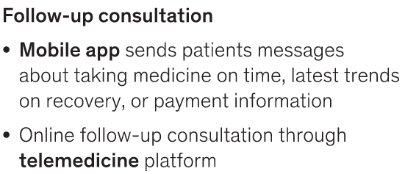
‘Smart’ Healthcare
Bo Chen, Axel Baur, Marek Stepniak, and Jin Wang
Finding the future of care provision: The role of smart hospitals. May 31, 2019McKinsey & Company
https://www.mckinsey.com/industries/healthcare-systems-and-services/our-insights/finding-the-future-of-care-provision-the-role-of-smart-hospitals

Slide 14
https://www.fda.gov/news-events/press-announcements/fda-approves-pill-sensor-digitally-tracks-if-patients-have-ingested-their-medication

Slide 15
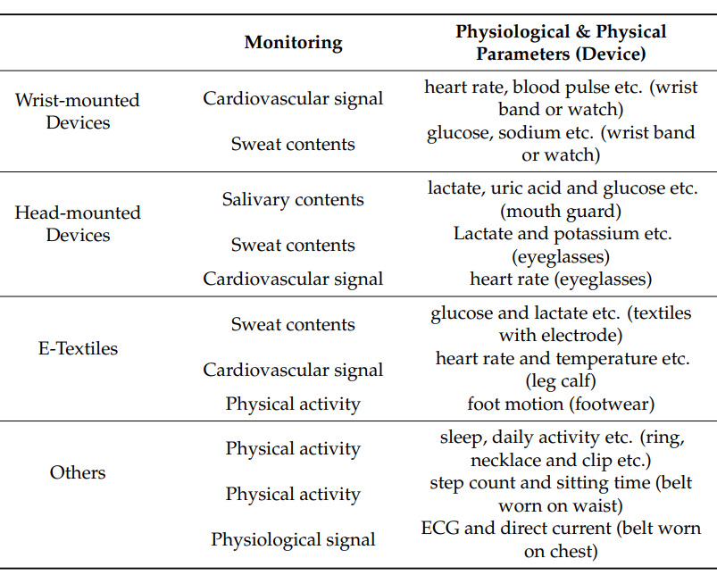
Guk K, Han G, Lim J, et al. Evolution of Wearable Devices with Real-Time Disease Monitoring for Personalized Healthcare. Nanomaterials (Basel). 2019;9(6):813. Published 2019 May 29. doi:10.3390/nano9060813

Slide 16
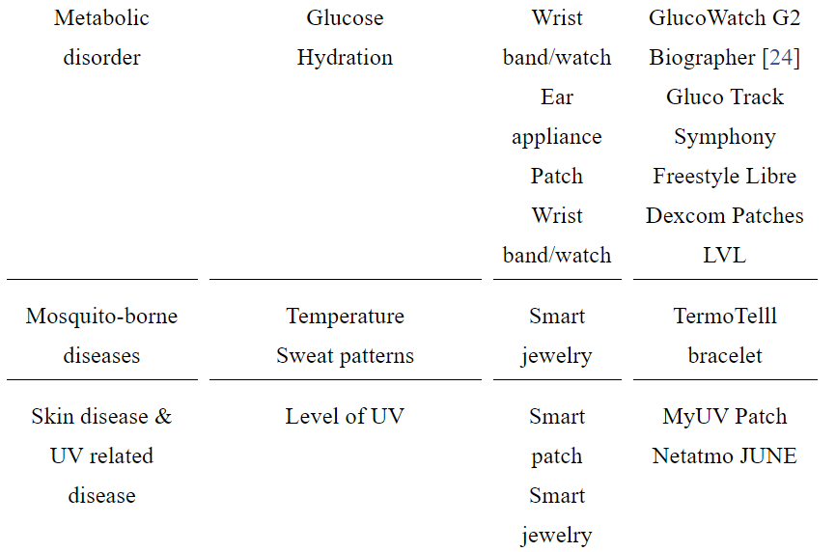
Commercially available WDs (1)
Guk K, Han G, Lim J, et al. Evolution of Wearable Devices with Real-Time Disease Monitoring for Personalized Healthcare. Nanomaterials (Basel). 2019;9(6):813. Published 2019 May 29. doi:10.3390/nano9060813

Slide 17
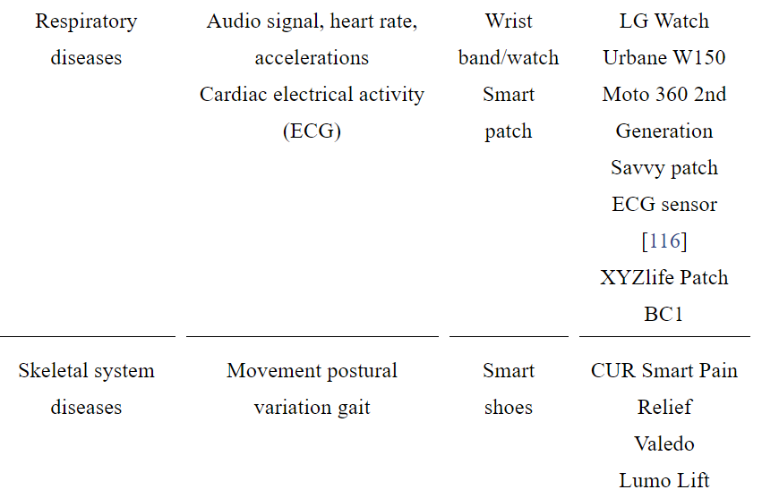
Commercially available WDs (2)
Guk K, Han G, Lim J, et al. Evolution of Wearable Devices with Real-Time Disease Monitoring for Personalized Healthcare. Nanomaterials (Basel). 2019;9(6):813. Published 2019 May 29. doi:10.3390/nano9060813

Slide 18
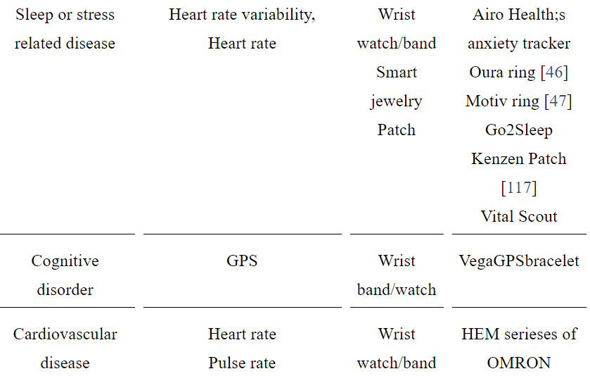
Commercially available WDs (3)
Guk K, Han G, Lim J, et al. Evolution of Wearable Devices with Real-Time Disease Monitoring for Personalized Healthcare. Nanomaterials (Basel). 2019;9(6):813. Published 2019 May 29. doi:10.3390/nano9060813

Slide 19
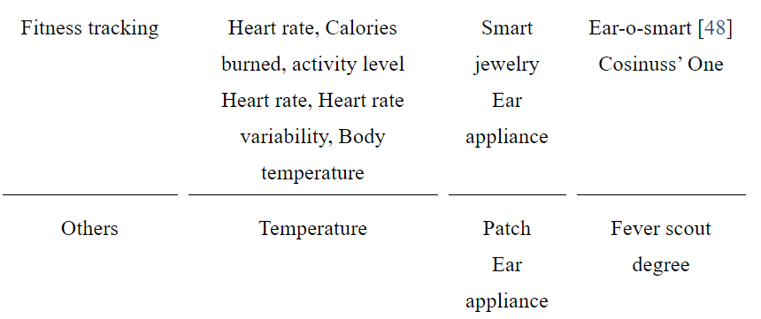
Commercially available WDs (4)
Guk K, Han G, Lim J, et al. Evolution of Wearable Devices with Real-Time Disease Monitoring for Personalized Healthcare. Nanomaterials (Basel). 2019;9(6):813. Published 2019 May 29. doi:10.3390/nano9060813
Guk K, Han G, Lim J, et al. Evolution of Wearable Devices with Real-Time Disease Monitoring for Personalized Healthcare. Nanomaterials (Basel). 2019;9(6):813. Published 2019 May 29. doi:10.3390/nano9060813

Slide 20
Wearable Health Care Devices Survey (1)
About 30% (1266/4551) of US adults use wearable health care devices.
Nearly half (47.33%) use the devices every day.
A majority (82.38% weighted) is willing to share the health data from wearables with their care providers.
Most willing:
Women (16.25%),
White individuals (19.74%),
Adults aged 18-50 years (19.52%),
Some level of college education or college graduates (25.60%),
annual household incomes greater than US $75,000 (17.66%).
Chandrasekaran, Ranganathan et al. “Patterns of Use and Key Predictors for the Use of Wearable Health Care Devices by US Adults: Insights from a National Survey.” Journal of medical Internet research vol. 22,10 e22443. 16 Oct. 2020, doi:10.2196/22443

Slide 21
Wearable Health Care Devices Survey (2)
The use of wearables declines with age.
US adults more likely to adopt and use wearables for tracking or monitoring their health:
those who reported feeling healthier,
were overweight,
enjoyed exercise,
reported higher levels of technology self-efficacy.
Chandrasekaran, Ranganathan et al. “Patterns of Use and Key Predictors for the Use of Wearable Health Care Devices by US Adults: Insights from a National Survey.” Journal of medical Internet research vol. 22,10 e22443. 16 Oct. 2020, doi:10.2196/22443

Slide 22
Key issues
Privacy
Security
Confidentiality

Slide 23
Key issues
Confidentiality:
the obligation of professionals who have access to (health) data or communication to hold that information in confidence.
Privacy:
the right of an individual to be let alone and to make decisions about how personal information is shared.
Security:
the capabilities available to protect privacy and confidentiality of (health) information.

Slide 24
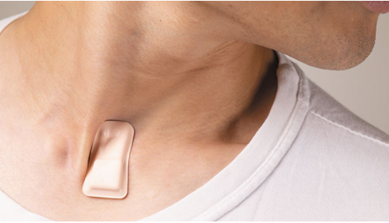
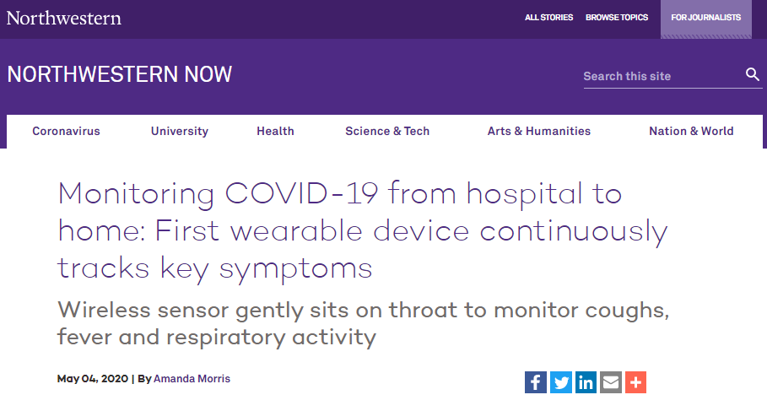
Assignment A10: Read R10
https://news.northwestern.edu/stories/2020/04/monitoring-covid-19-from-hospital-to-home-first-wearable-device-continuously-tracks-key-symptoms/

Slide 25
Assignment A10
Task description:
Several claims are made about what you could do with the device. The claims are highlighted in ‘R10 – Monitoring COVID.docx” on UBLearns.
Pick one claim and, inspired by what you have learned from previous lectures, find in the scientific literature arguments that support the claim and arguments against the claim.
Come then to a conclusion which to a certain degree is in support or against the claim, and identify further areas of research that must be conducted to come to a definite conclusion. Motivate why.
Send your work in a Word doc to wceusters@gmail.com not later than Nov 16 – 9AM.

Slide 26
Instructions
Each claim may be chosen by at most 2 students.
Use the template uploaded to UBLearns under the name ‘A10-XXX.docx’.
All sections in the template must be used.
Use Endnote for proper citation in the ‘Numbered’ style.
You MUST have citations for sections 2 and 3. If for one or other section you can’t find arguments from the literature, document your search procedure so that you can prove there are no arguments (and not just didn’t bother to find any). Then provide your own arguments.
Everything you write is in 10p Times Roman, single line spacing.
No space maximum or minimum, but negative credit for unjustified presence or absence of assertions.
Anything else outlined during class.
Change name of the document by replacing ‘XXX’ with your ubitname and make sure it stays Word-compatible.

