Slide 1
Informatics tools for disease outbreak detection and tracking
Lecture in BMI199: What is Biomedical Informatics?
Oct 29, 2020 on-line, University at Buffalo
Werner CEUSTERS, MD
Departments of Biomedical Informatics and Psychiatry,
UB Institute for Healthcare Informatics,
Ontology Research Group, Center of Excellence in Bioinformatics and Life Sciences,
University at Buffalo, NY, USA

Slide 2
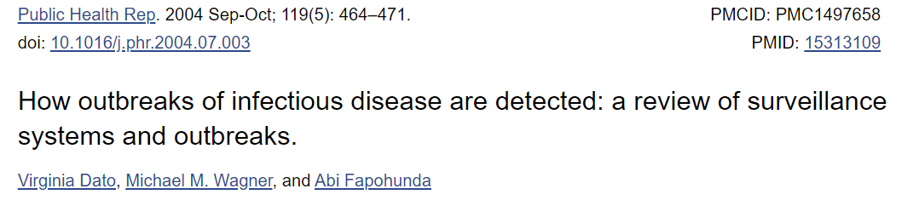
To learn how outbreaks of infectious disease are detected and to describe the entities and information systems that together function to identify outbreaks in the U.S., the authors drew on multiple sources of information to create a description of existing surveillance systems and how they interact to detect outbreaks. The results of this analysis were summarized in a system diagram. The authors reviewed a sample of recent outbreaks to determine how they were detected, with reference to the system diagram. The de facto U.S. system for detection of outbreaks consists of five components: the clinical health care system, local/state health agencies, federal agencies, academic/professional organizations, and collaborating governmental organizations. Primary data collection occurs at the level of clinical health care systems and local health agencies. The review of a convenience sample of outbreaks showed that all five components of the system participated in aggregating, analyzing, and sharing data. The authors conclude that the current U.S. approach to detection of disease outbreaks is complex and involves many organizations interacting in a loosely coupled manner. State and local health departments and the health care system are major components in the detection of outbreaks.
https://www.ncbi.nlm.nih.gov/pmc/articles/PMC1497658/

Slide 3
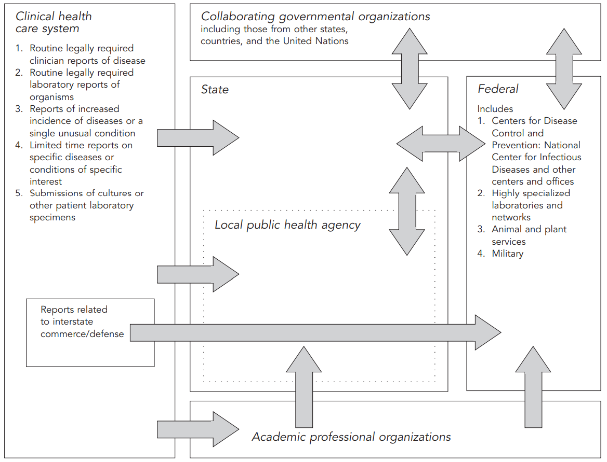
Dato V, Wagner MM, Fapohunda A. How outbreaks of infectious disease are detected: a review of surveillance systems and outbreaks. Public Health Rep. 2004;119(5):464-471. doi:10.1016/j.phr.2004.07.003

Slide 4
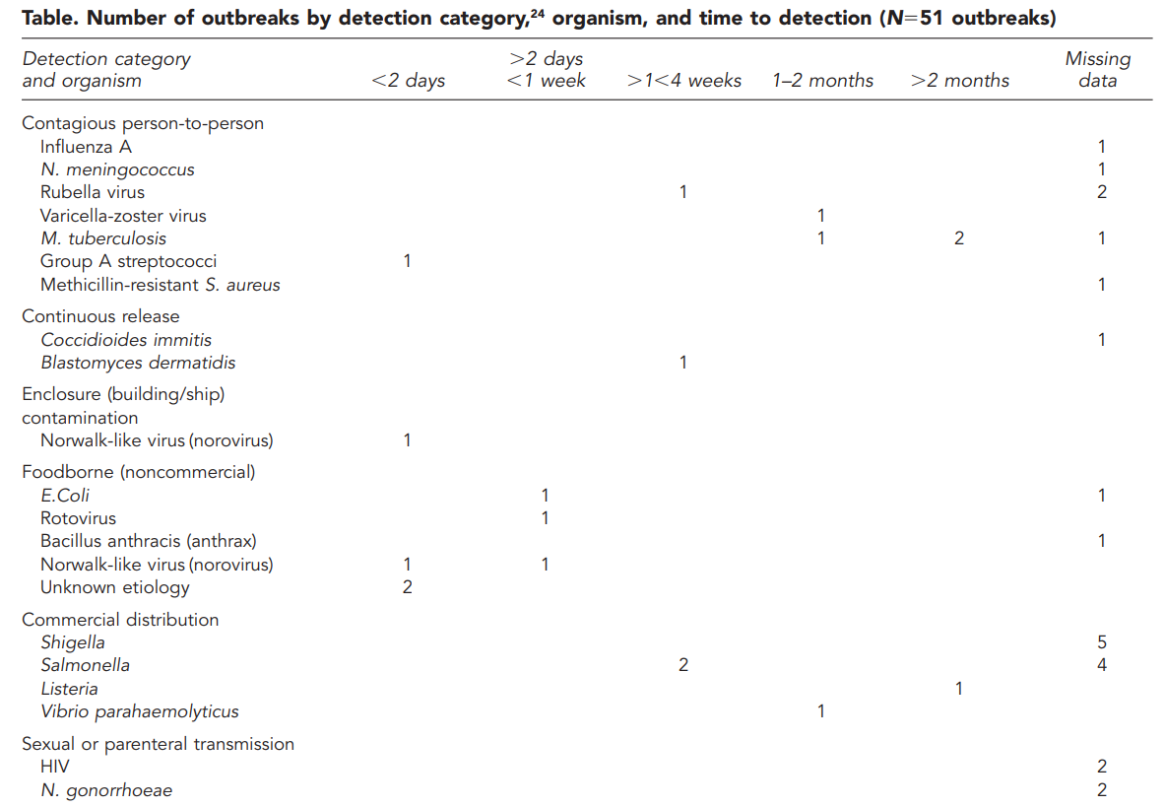
https://www.ncbi.nlm.nih.gov/pmc/articles/PMC1497658/

Slide 5
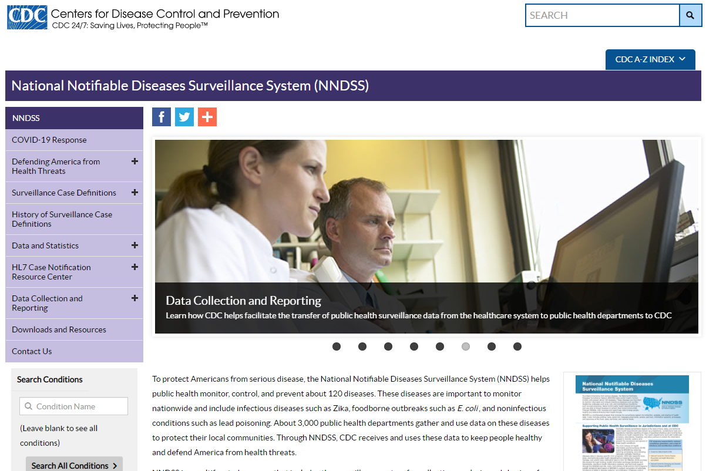
https://wwwn.cdc.gov/nndss/

Slide 6
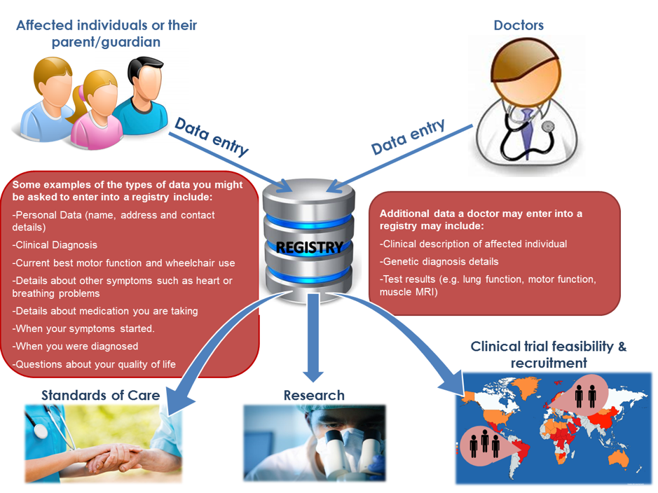
Disease registries a different story
https://treat-nmd.org/patient-registries/

Slide 7
Initial reporters of outbreak to CDC
health care providers (24.6%),
infection control practitioners (11.7%),
Health departments (30.5%),
existing surveillance systems (5.0%),
foreign ministries of health (2.7%),
nongovernmental organizations (2.0%),
the WHO (1.5%)
the Indian Health Service (1.1%).
Ashford DA, Kaiser RM, Bales ME, Shutt K, Patrawalla A, McShan A, et al. Planning against biological terrorism: lessons from outbreak investigations.
Emerg Infect Dis 2003;9:515-9.

Slide 8
Study conclusions (2003)
the current system detects outbreaks in diverse ways,
many outbreaks are first detected by individuals outside of “formal” surveillance systems,
many outbreaks are detected after very long delays (exceeding weeks to months).
Newly emerging infections present special challenges because they cannot be added as reportable diseases or routinely studied in specialized networks until after they are first detected.
It is not a surprise that astute individuals have played the major role in the detection of emerging infections.
https://www.ncbi.nlm.nih.gov/pmc/articles/PMC1497658/

Slide 9
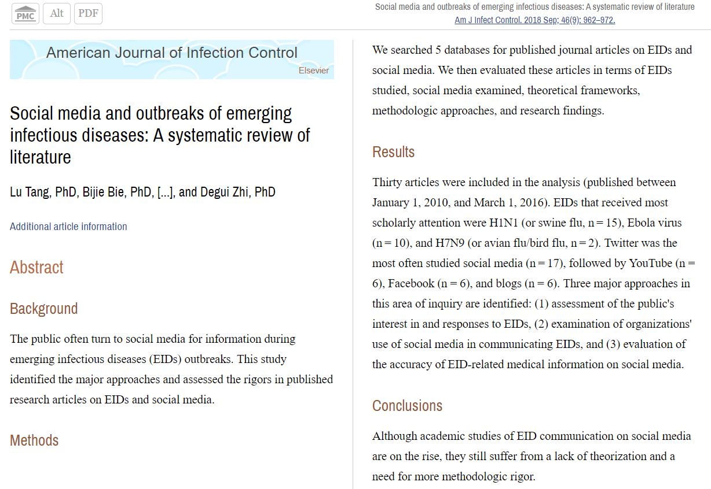

Slide 10
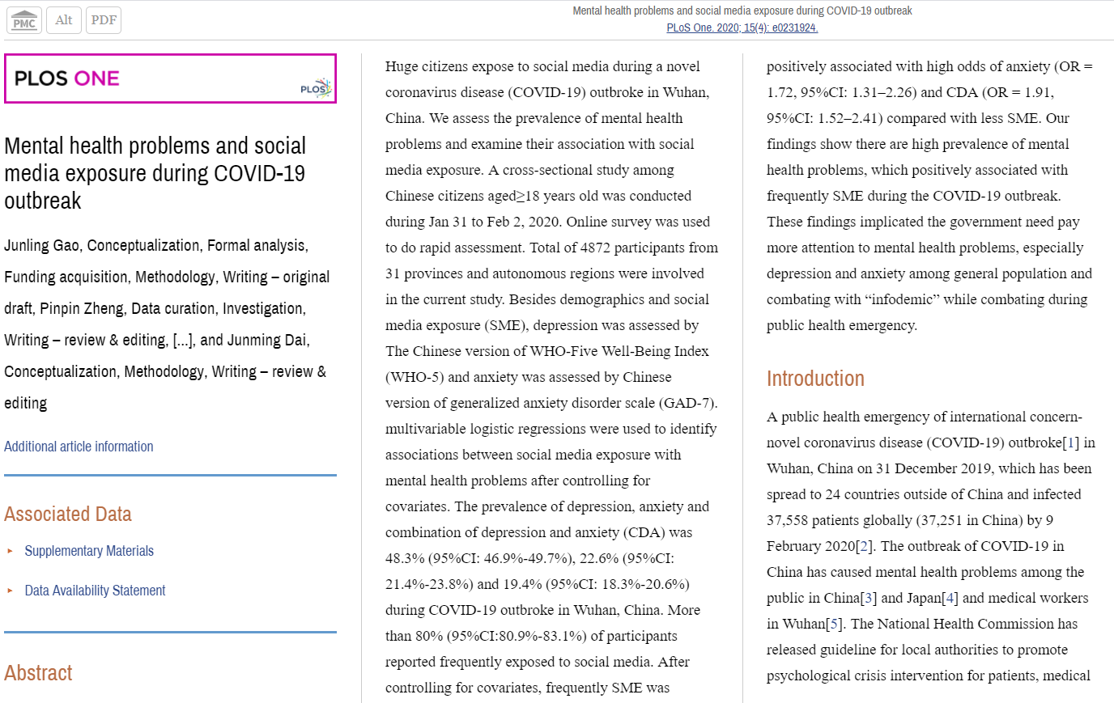
Social media as a source of disease

Slide 11
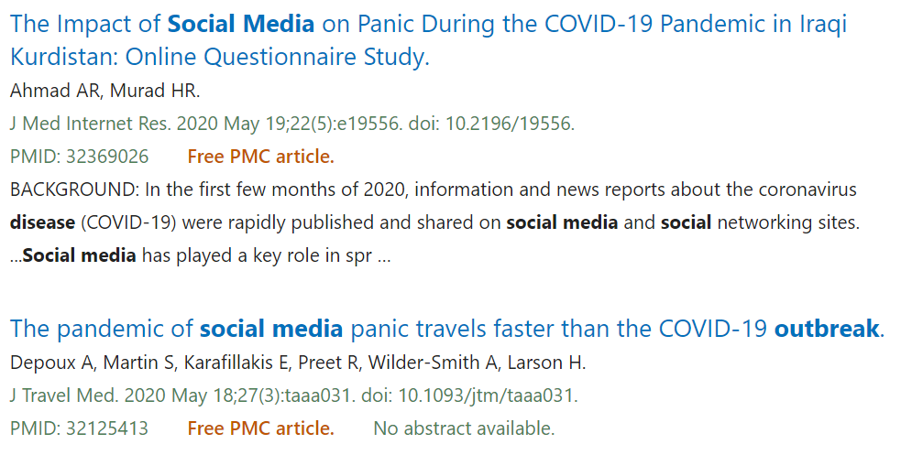
It can become worse …

Slide 12
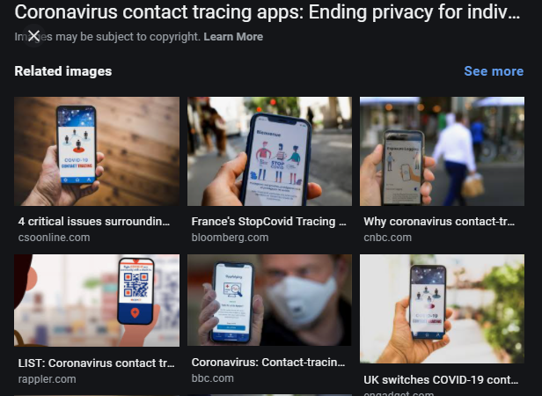

Slide 13
Contact tracking
{"SCANDATE":"2020-10-16T00:00:00.000Z”
“SCANNERDEVICEID":"1FF0FE87-8657-4010-90F3-A15F0C0571AE”
“SCANNERDEVICE_ZIPCODE":"797XX”
“LOCATION_OP_HOURS":"“
“USERDEVICEID":"297580DA-68C5-42B3-839A-4EA86E3375B5”
“TYPE_OF_SCAN":"Checkin”
“USERID":"CCD996B7-6F2E-4607-9A30-8E9AC4330BBE”
“RISKLEVEL":"“
“ACCESSLEVEL":"Public”
“READINGTYPE":"Manual”
“SYMPTOMS":false,"DIAGNOSED":false,"CONTACT":false,"NEAR":false,"RESULT":"Approved"},

Slide 14
Contact tracking
{"SCANDATE":"2020-10-15T11:49:40.595Z”
“SCANNERDEVICEID":"7C6BF1FB-7392-415B-844A-7C93812F2DEA”
“SCANNERDEVICE_ZIPCODE":"“
“LOCATION_OP_HOURS":"“
“USERDEVICEID":"0A3E4FFD-70DD-4EC6-AA50-408C18F7621B”
“TYPE_OF_SCAN":"Checkin”
“USERID":"2E66E715-9E58-4432-BEE3-D87764FB7008”
“RISKLEVEL":"Fail”
“ACCESSLEVEL":"Private”
“READINGTYPE":"Gate”
“TEMP":97.7,"SYMPTOMS":true,"DIAGNOSED":false,"CONTACT":true,"NEAR":false,"RESULT":"Declined"},

Slide 15
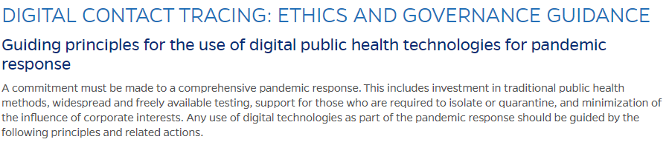
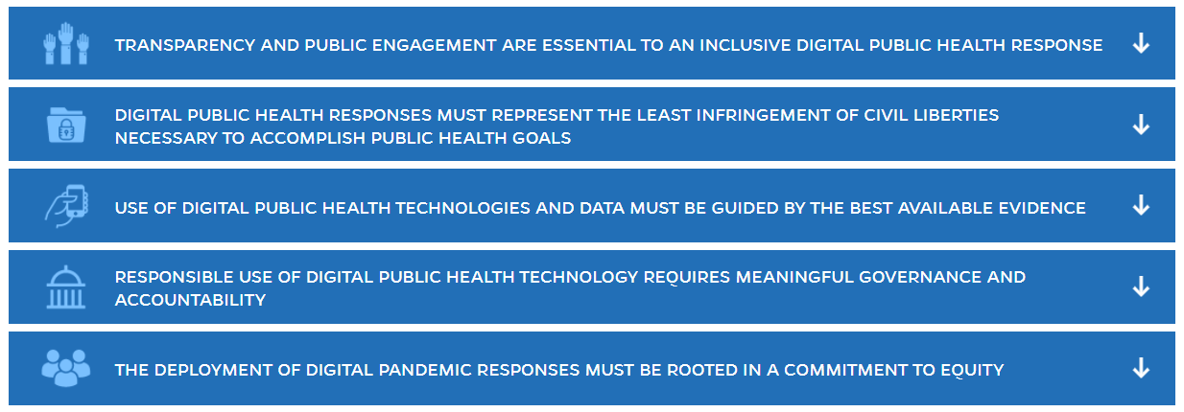
https://coronavirus.jhu.edu/contact-tracing/principles

Slide 16
Required reading for this class:
Hugh Gusterson.
Will U.S. University Students Spread COVID-19?
Sapiens, July 20, 2020
https://www.sapiens.org/column/conflicted/will-u-s-university-students-spread-covid-19/

Slide 17
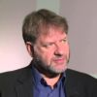
‘Universities are planning to open across the United States with strategies based on fantasy documents and magical thinking.’
Hugh Gusterson is a professor of anthropology at the University of British Columbia, Vancouver. With a Ph.D. from Stanford University, he has conducted fieldwork among nuclear weapons scientists, anti-nuclear activists, and polygraphers. He writes about nuclear culture, drone warfare, counterinsurgency, international security, and ethics.
https://www.sapiens.org/column/conflicted/will-u-s-university-students-spread-covid-19/

Slide 18
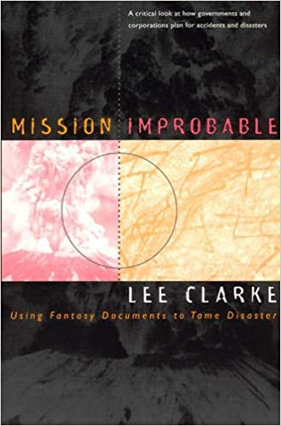
‘Fantasy documents’
Mission Improbable: Using Fantasy Documents to Tame Disaster
How does the government or a business plan for an unimaginable disaster-a meltdown at a nuclear power plant, a gigantic oil spill, or a nuclear attack? Lee Clarke examines actual attempts to "prepare" for these catastrophes and finds that the policies adopted by corporations and government agencies are fundamentally rhetorical: the plans have no chance to succeed, yet they serve both the organizations and the public as symbols of control, order, and stability. These "fantasy documents" attempt to inspire confidence in organizations, but for Clarke they are disturbing persuasions, soothing our perception that we ultimately cannot control our own technological advances.
Mission improbable: Using fantasy documents to tame disaster. L Clarke. University of Chicago Press, 1999

Slide 19
‘Magical thinking’
Magical thinking: the belief that one’s ideas, thoughts, actions, words, or use of symbols can influence the course of events in the material world.
Magical thinking presumes a causal link between one’s inner, personal experience and the external physical world. Examples include beliefs that the movement of the Sun, Moon, and wind or the occurrence of rain can be influenced by one’s thoughts or by the manipulation of some type of symbolic representation of these physical phenomena.
Brian Vandenberg. Magical Thinking, Psychology, Encyclopedia Britannica. August 2016.
https://www.britannica.com/science/magical-thinking

Slide 20
His prediction
Once the virus has a foothold on campus, it will inevitably spread, since, in the words of one law professor, “when it comes to COVID-19, a college campus is like a cruise ship, a cinema multiplex, and a restaurant all rolled into one.”

Slide 21
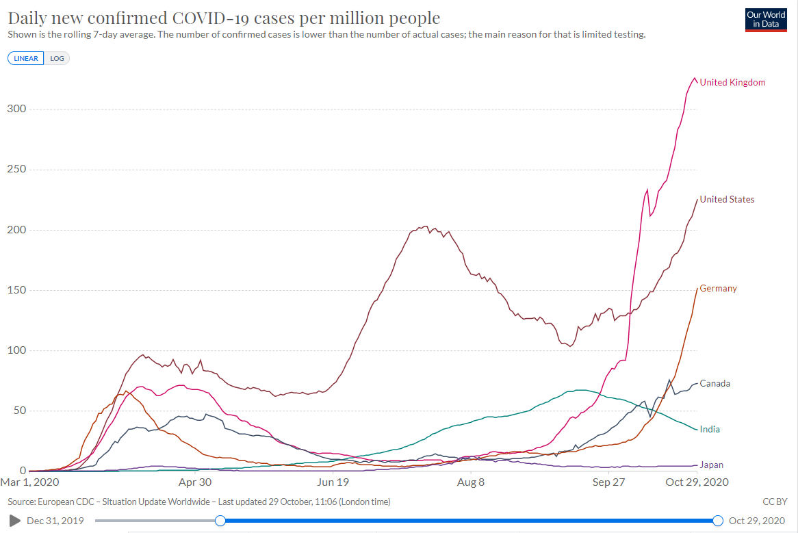
Was he right?

Slide 22
His – and your – thoughts
Are UB’s plans ‘fantasy documents based on magical thinking?’
What do the plans require us to do?
Are the plans successful?
  … because the rules are followed?
  … despite the rules not being followed?
  https://www.sapiens.org/column/conflicted/will-u-s-university-students-spread-covid-19/

