Slide 1
Clarity in Language I
Snomed CT
Lecture in BMI199: What is Biomedical Informatics?
Oct 8, 2020 on-line, University at Buffalo
Werner CEUSTERS, MD
Departments of Biomedical Informatics and Psychiatry,
UB Institute for Healthcare Informatics,
Ontology Research Group, Center of Excellence in Bioinformatics and Life Sciences,
University at Buffalo, NY, USA

Slide 2
Semiotic / semantic triangle
(Ogden & Richards, 1923:
The meaning of ‘meaning’)
concept
term
referent

Slide 3
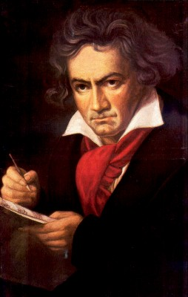
The semantic/semiotic triangle:
Ludwig van Beethoven
that great German composer that became deaf
…
concept
term
referent
‘Beethoven’

Slide 4
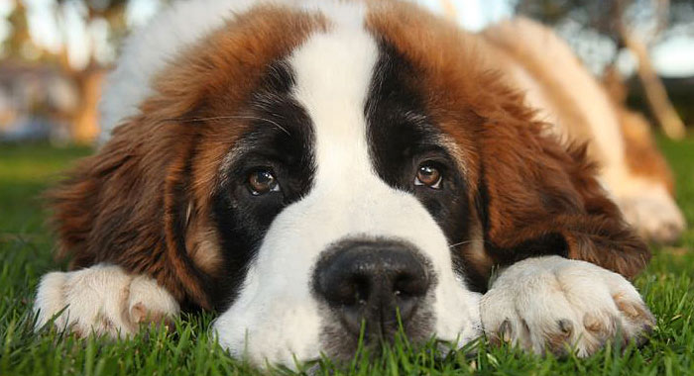
The semantic/semiotic triangle:
The dog from the ‘Beethoven’ movie
…
concept
term
referent
‘Beethoven’
https://celebritydogwatcher.com/2019/02/most-famous-movie-dogs/

Slide 5
The semantic/semiotic triangle:
What we think about such entities
concept
concept
What terms we use for such entities
entities
term
referent
term
referent

Slide 6
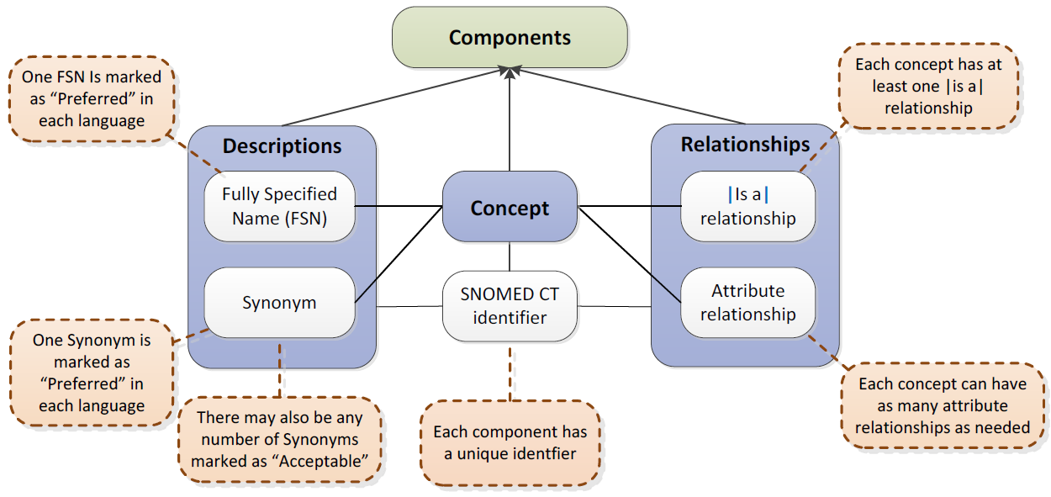

SNOMED CT structure
IHTSDO. SNOMED CT Starter Guide July 2014

Slide 7
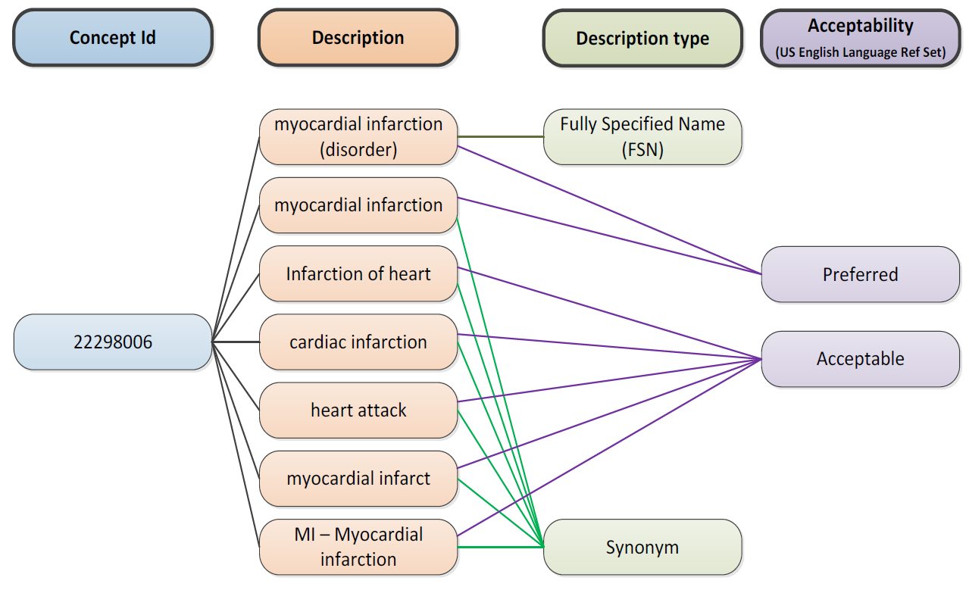
SNOMED CT Descriptions
IHTSDO. SNOMED CT Starter Guide July 2014

Slide 8
Graph theoretical structure
A
Edges
Nodes
B
C
D
E
F
G
H
I
J
K
L

Slide 9
Taxonomic tree
A
…
B
All nodes represent groups (X, Y, …) the members of which have something (S_{x}, S_{y}) similar in some way.
All edges represent the same relation r which expresses some classificatory principle which is such that if X r Y holds, then the members of X have similarities S_{x} and S_{y}.
D
E
G
H
I

Slide 10
Taxonomic tree as sets
A
B
D
E
G
H
I

Slide 11
Taxonomic tree with non-taxonomic relations
A
B
C
D
E
F
G
H
I
J
K
L

Slide 12
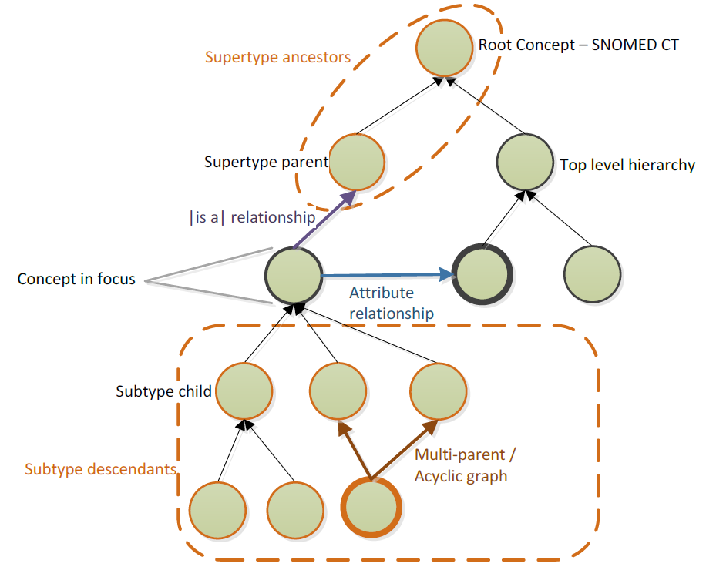
SNOMED CT Relationships

Slide 13
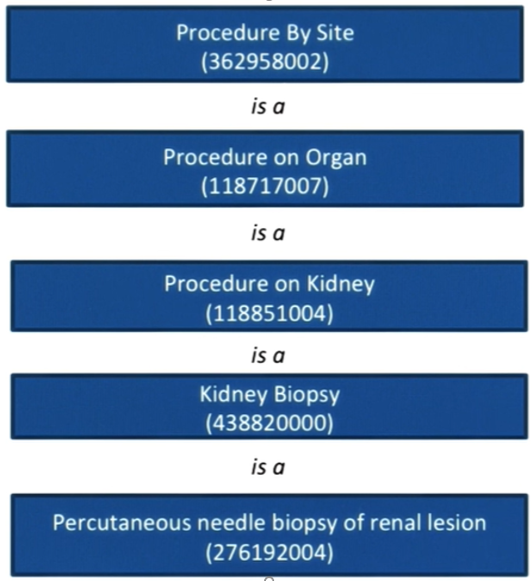
Use of taxonomy

Slide 14
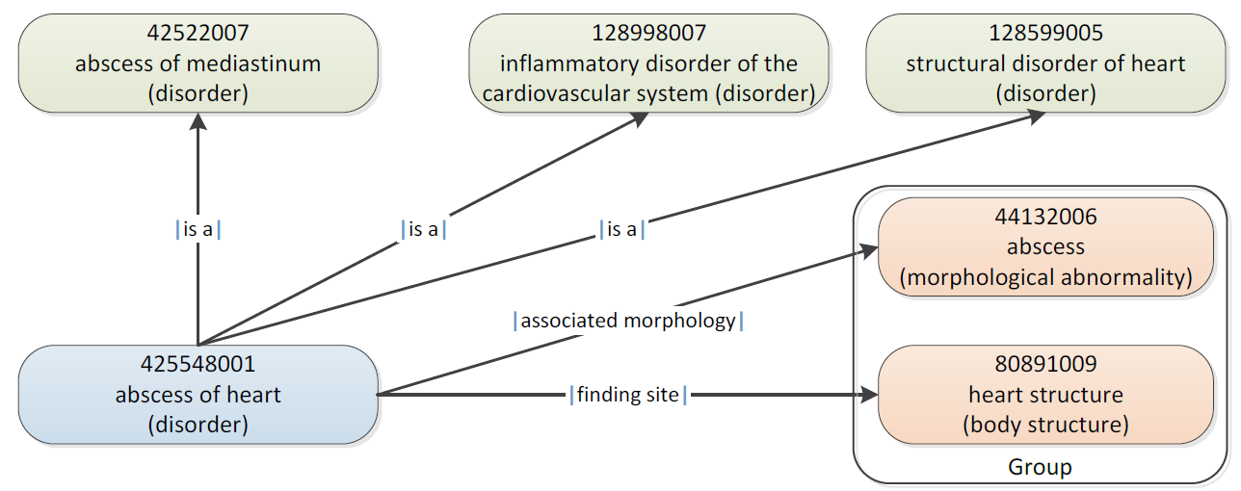
SNOMED CT Defining relationships
IHTSDO. SNOMED CT Starter Guide July 2014

Slide 15
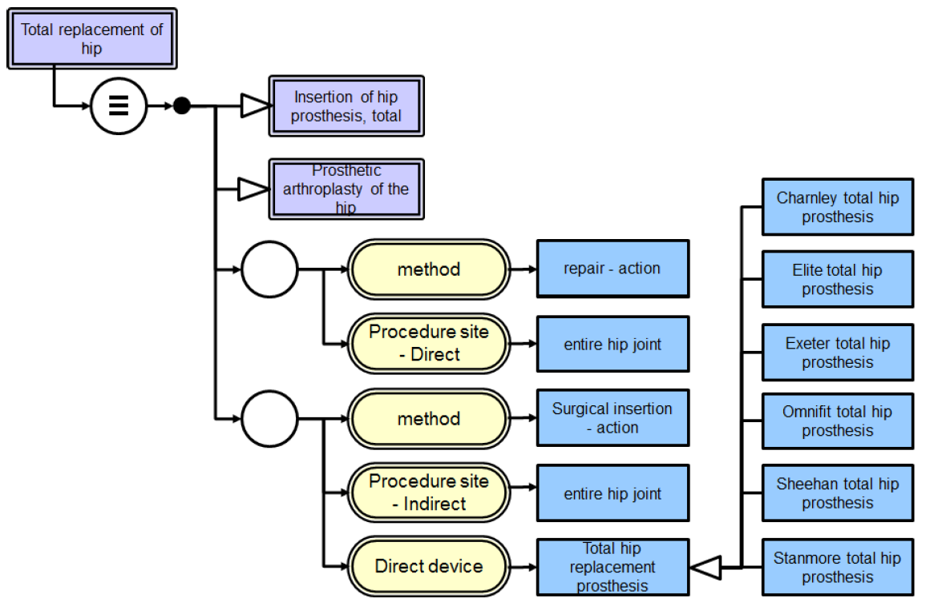
SNOMED CT’s Description Logic
IHTSDO. SNOMED CT Starter Guide July 2014

Slide 16
Assignment
A6. Students will organize themselves to form four groups of atmost 7 persons. Each group will collaborate on-line to perform a different and focused analysis on the presence of covid 19 terms in SNOMED CT (https://browser.ihtsdotools.org/?perspective=full&conceptId1=404684003&edition=MAIN/2020-07-31&release=&languages=en ) following instructions provided in C12.
ONE student of each group will send me the results, thereby clearly identifying the students who participated and who will present in class, in a document of indicated type to wceusters@gmail.com not later than Oct 12 – 9AM, cc-ing all students who collaborated in the group.

Slide 17
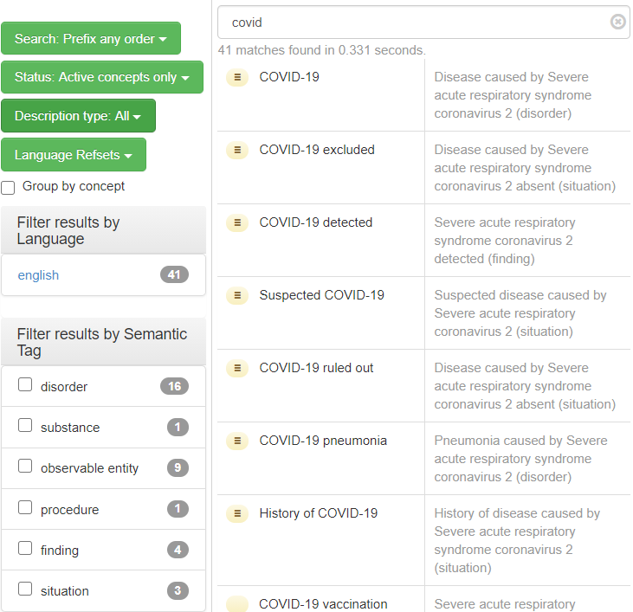
Start

Slide 18
Group 1
For the concept
  ‘Acute hypoxemic respiratory failure due to disease caused by Severe acute respiratory syndrome coronavirus 2 (disorder)’:
Build up the complete taxonomy up to ‘Disease (disorder)’ under the ‘inferred’ perspective.
Ignore all parents ending with ‘(finding)’.
Use an Excel spreadsheet in the way demonstrated.
Suggestion: it is easy to make mistakes. Therefor, each one of you should do it, compare results, then correct.

Slide 19
Example for Group 1
https://browser.ihtsdotools.org/?perspective=full&conceptId1=22298006&edition=MAIN/2020-07-31&release=&languages=en

Slide 20
Group 2
Find amongst the 16 covid-related disorders those disorders which at some higher point in their inferred taxonomy have a supertype which has itself multiple immediate parents of which at least one has the semantic tag ‘disorder’ and at least one other the semantic tag ‘finding’)
Give for each such covid-related disorder the supertype which exhibits these criteria, and for that supertype the immediate parents that satisfy these criteria.
Format of Word document:
  [covid-related disorder 1]
    Supertype: [FSN of the supertype that satisfies the criteria]
      Supertype parent – disorder: [FSN of immediate parent with semantic tag ‘(disorder)’]
      Supertype parent – finding: [FSN of immediate parent with semantic tag ‘(finding)’]
  [covid-related disorder 2]
    …

Slide 21
For group 2
positive demonstration using ‘vegan anemia’,
  https://browser.ihtsdotools.org/?perspective=full&conceptId1=234360003&edition=MAIN/2020-07-31&release=&languages=en
negative one using ‘covid 19’
  https://browser.ihtsdotools.org/?perspective=full&conceptId1=840539006&edition=MAIN/2020-07-31&release=&languages=en

Slide 22
Group 3
For the concept
  ‘Acute hypoxemic respiratory failure due to disease caused by Severe acute respiratory syndrome coronavirus 2 (disorder)’:
Follow the complete inferred taxonomy up to ‘Disease (disorder)’ but, in contrast to group 1, write down all associative relationships encountered on your way up, and count how many times you encountered each one.
Use an Excel document listing the encountered associations:
Finding site (attribute) | Heart structure (body structure) | 3
…

Slide 23
Example for Group 3
https://browser.ihtsdotools.org/?perspective=full&conceptId1=22298006&edition=MAIN/2020-07-31&release=&languages=en

Slide 24
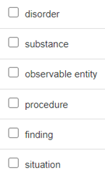
Group 4
Try to find a combination of covid-19 related concepts that when combined in one graph using the taxonomy and associative relationships includes all concepts that correspond to the semantic tags.
If there is no such combination, demonstrate
why it does not work with one or other tag
and try to make a combination without that
semantic tag.
Use a Word document as demonstrated.

