Slide 1
Elements of Epidemiology
Lecture in BMI199: What is Biomedical Informatics?
Oct 1, 2020 on-line, University at Buffalo
Werner CEUSTERS, MD
Departments of Biomedical Informatics and Psychiatry,
UB Institute for Healthcare Informatics,
Ontology Research Group, Center of Excellence in Bioinformatics and Life Sciences,
University at Buffalo, NY, USA

Slide 2
Epidemiology
‘about’
‘people’
‘study’
‘Epidemiology is:
the study of the distribution and determinants of health-related states and events in specified populations, and
the application of this study to prevention and control of health problems.’
Last JM, editor. Dictionary of epidemiology. 4th ed. New York: Oxford University Press; 2001. p. 61.

Slide 3
Basic Assumptions of Epidemiology
Diseases do not occur randomly.
The causes and nature of diseases and the spread of diseases depend on certain observable factors.
Modification of these causes can result in prevention and control of diseases.
Gordis, Leon. Epidemiology (5). Saint Louis, US: Saunders, 2013. ProQuest ebrary. Web. 2 March 2017

Slide 4
Key terms
Determinants: factors that influence health: biological, chemical, physical, social, cultural, genetic and behavior;
Distribution: of determinants over time, populations, and places;
Health-Related States and Events: diseases, causes of death, health-related behaviors (smoking, exercise), reaction to preventive programs, provision and utilization of health services;
Specified Populations: includes populations with identifiable characteristics such as occupation, race/ethnicity;
Prevention and Control: the aim of public health: to protect and restore health.
Gordis, Leon. Epidemiology (5). Saint Louis, US: Saunders, 2013. ProQuest ebrary. Web. 2 March 2017

Slide 5
Earliest Example of Geographical Information System Methods by John Snow (1854 Cholera outbreak)
Location of
Historic
Broad Street
Pump
http://www.ph.ucla.edu/epi/snow/mapsbroadstreet.html

Slide 6
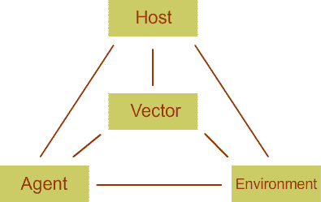
Epidemiologic Triad of Disease (ETD)
https://newonlinecourses.science.psu.edu/stat507/node/25/

Slide 7
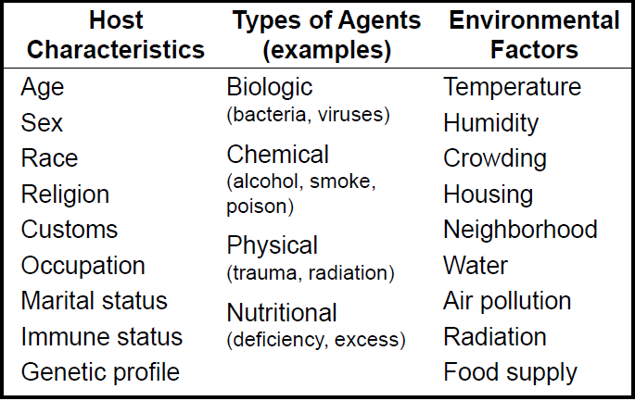
Sorts of disease determinants
Gordis, Leon. Epidemiology (5). Saint Louis, US: Saunders, 2013.

Slide 8
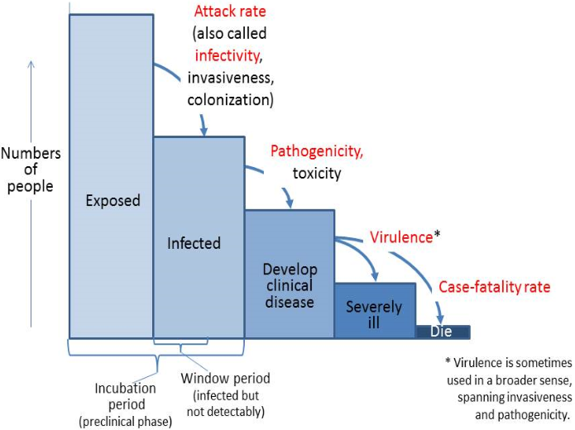
Stages of disease progression
https://www.med.uottawa.ca/sim/data/Pub_Infectious_e.htm#ID_hist

Slide 9
Disease Patterns
Endemic: Habitual presence of a disease in a geographic area or population.
Epidemic: Unusually frequent occurrence of a disease in a geographic area.
Pandemic: Worldwide epidemic.

Slide 10
Basic epidemiologic measures

Slide 11
Numerator / Denominator (1)
Numerator:
  Representation of cases exhibiting a certain characteristic;
    e.g.: count of persons with disease X
Denominator:
  Representation of the population in perspective of which the numerator is expressed;
    e.g.: count of citizens of Buffalo.
  Ideally: should be reflective of the population who could have been included in the numerator had they the characteristic of interest → population at risk.

Slide 12
Numerator / Denominator (2)
Example:
          a = people in NYS
          b = people with
          c = overweight
          people in
          Buffalo
          d = males
e
f
i
g
h
j
k

Slide 13
Numerator / Denominator (3)
Counts: a, b, c, d, …

Slide 14
Numerator / Denominator (3)
Counts: a, b, c, d, …
Ratios:
a) f/h ; i/k
b) j/b ; g/c

Slide 15
Numerator / Denominator (3)
Counts: a, b, c, d, …
Ratios:
a) f/h ; i/k
b) j/b ; g/c
→ difference?
Ratios:
a) numerator & denominator are unrelated
→ ‘ratio strictu sensu’
b) numerator counts are included in denominator counts
→ ‘proportion’

Slide 16
Measures of Disease occurrence
Form | Expressed | Description | Example
Count | a | Number of occurrences | Number of covid cases
Ratio | a:b | Division of two numbers not necessarily related | Number of covid cases to females
Proportion | a/(a+b) | Division of two numbers that are related. Numerator is a part of denominator | Number of covid cases per 100 thousand residents of Florida
Rate | a/(a+b)/t or a/(a+b)*t | Ratio or proportion where time is included in the denominator | Number of new covid cases per 100,000 residents of Buffalo in week
Adopted from Gordis, Leon. Epidemiology (5). Saint Louis, US: Saunders, 2013.

Slide 17
Incidence
The number of new cases or events occurring in a defined population during a specified time period.
If the event is occurrence of disease → morbidity.
If the event is death due to disease → mortality.
This is the one you need for doing the 9-day incidence calculation in the assignment!

Slide 18
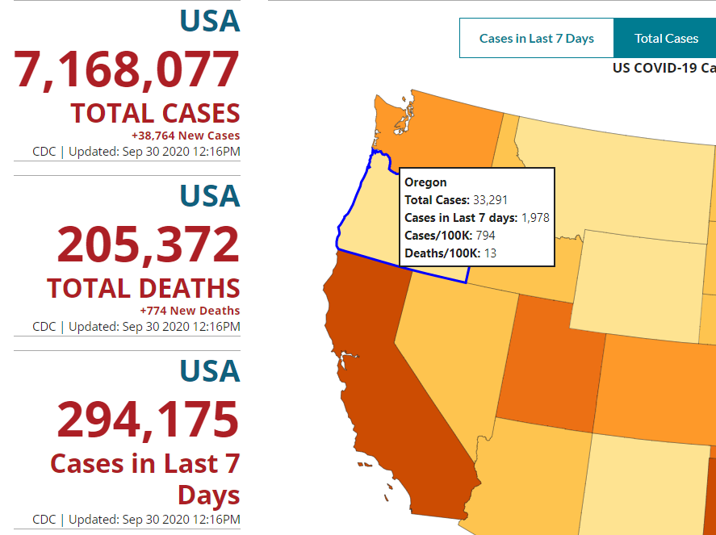
7 (last) day covid-19 incidence for Oregon

Slide 19
Identifying new cases
Define population;
Determine who has and who does not have the disease;
Follow the people who do not have the disease for a time period;
At the end of time period find out who had the disease in the population.
Testing !!!!

Slide 20
Incidence Rate
Special type of proportion that includes specification of time.
Represents the probability of having the disease in a defined population.
The basic measure of disease occurrence.

Slide 21
Calculation of Incidence rate
Number of new cases of disease occurring during a specified period of time
------------------------------------------------
Number of persons at risk for the disease during the same period
x K
Gordis, Leon. Epidemiology (5). Saint Louis, US: Saunders, 2013.

Slide 22
What is needed to calculate incidence rate
Case definition –What is considered disease?
Numerator = Number of Events
Denominator = Defined Population at Risk
Specified period
Constant (unit multiplier, “K”): e.g. per 100,000
Gordis, Leon. Epidemiology (5). Saint Louis, US: Saunders, 2013.

Slide 23
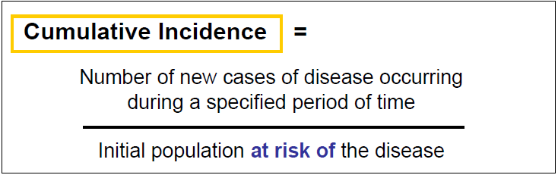
Cumulative Incidence
Cumulative incidence is a measure of disease frequency that addresses the question "How far has the disease spread during a specified period of time?" It is calculated using the following formula:
Gordis, Leon. Epidemiology (5). Saint Louis, US: Saunders, 2013.

Slide 24
Incidence Rate Cumulative
Incidence
Number of new cases of disease occurring during a specified period of time
--------------------------------------
Number of persons at risk for the disease during the same period
Number of new cases of disease occurring during a specified period of time
-----------------------------------
Initial population at risk for the disease
In a constant population, the number of persons at risk decreases with each new case!

Slide 25
Observational Data leading to Prevention
http://www.ph.ucla.edu/epi/snow.html

Slide 26
Prevalence
Prevalence is the total number of individuals in a population who have a disease or health condition at a specific period of time, usually expressed as a percentage of the population.
Gordis, Leon. Epidemiology (5). Saint Louis, US: Saunders, 2013. ProQuest ebrary. Web. 2 March 2017

Slide 27
Prevalence
Prevalence is the total number of individuals in a population who have a disease or health condition at a specific period of time, usually expressed as a percentage of the population.
Two types:
  Point Prevalence
  Period Prevalence
Gordis, Leon. Epidemiology (5). Saint Louis, US: Saunders, 2013. ProQuest ebrary. Web. 2 March 2017

Slide 28
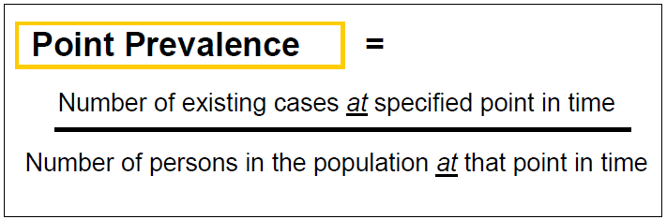
Point Prevalence
Proportion of the population with a particular disease at a particular point in time
Gordis, Leon. Epidemiology (5). Saint Louis, US: Saunders, 2013. ProQuest ebrary. Web. 2 March 2017

Slide 29
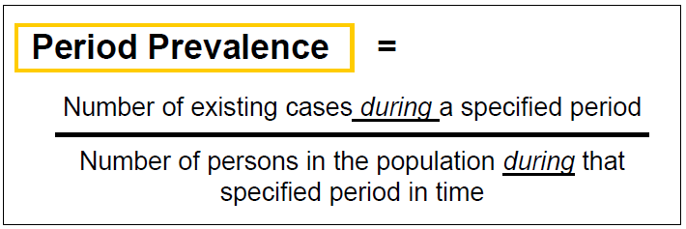
Period Prevalence
The proportion of the population with a particular disease during a specified period in time
Gordis, Leon. Epidemiology (5). Saint Louis, US: Saunders, 2013. ProQuest ebrary. Web. 2 March 2017

Slide 30
Covid-19 period prevalence
for Oregon

Slide 31
Why do we need point and period prevalence?
Point Prevalence:
  useful for conditions that need to be compared in different periods of time in different healthcare settings
Period Prevalence
  Useful for conditions that ‘come and go’…
    1-week -Hay fever or other allergy
    1-month -Depression symptoms
    1-year -Low-back pain
    5-year -Genital herpes recurrence

Slide 32
Are incidence and prevalence related?
incidence = # new cases,
prevalence = # existing cases,
➔ Prevalence rate = Incidence rate x average Duration of disease
(P = I x D)
Assumptions for this to be correct:
  Prevalence relatively constant
  Incidence and outflow (cure and death) relatively equal
  < 10% of population has the disease

Slide 33
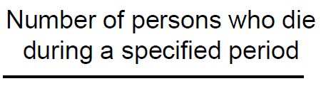
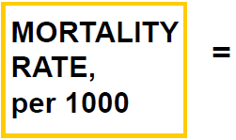
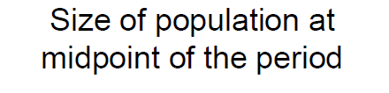
Mortality rate

Slide 34
Covid-19 mortality rate for Oregon

Slide 35
Age adjusted Mortality Rate: Direct Method
Total Expected Death rates of different age groups
-----------------------------------------X1000
Age Adjusted Death Rate =
Total Standard Population

Slide 36
Assignment
A5. Students will visit https://www.cdc.gov/coronavirus/2019-ncov/cases-updates/cases-in-us.html for three consecutive days,
will write down for the USA and for California, Texas and Florida the variables requested in a predefined Excel spreadsheet made available on UB Learns.
They will use that spreadsheet to compute some variables based on the statistics explained in class C10.
Students must follow the instructions and demo provided in class precisely.
Email the Excel-document back to wceusters@gmail.com not later than Monday Oct 5 – 9AM.

