Slide 1
Research in biomedical informatics: methods and techniques Lecture in BMI199: What is Biomedical Informatics? Oct 17, 2019 5 Diefendorf, University at Buffalo
Werner CEUSTERS, MD
Departments of Biomedical Informatics and Psychiatry,
UB Institute for Healthcare Informatics,
Ontology Research Group, Center of Excellence in Bioinformatics and Life Sciences,
University at Buffalo, NY, USA

Slide 2
Assignment
Read prior to W9: Kulikowski CA, Shortliffe EH, Currie LM, et al. AMIA Board white paper: definition of biomedical informatics and specification of core competencies for graduate education in the discipline. J Am Med Inform Assoc. 2012;19(6):931–938. doi:10.1136/amiajnl-2012-001053.
Break students into 5 groups.
Groups will evaluate the presentation on its merits with respect to the criteria advanced in Lecture c8.
Groups will assess whether the presenter is likely to exhibit the skills and competencies discussed in the paper.

Slide 3
Biomedical Informatics
Definition:
Biomedical informatics (BMI) is
the interdisciplinary field
that studies and pursues the effective uses of biomedical data, information, and knowledge
for scientific inquiry, problem solving, and decision making,
driven by efforts to improve human health.
CA Kulikowski, EH Shortliffe, LM Currie, PL Elkin, LE Hunter, TR Johnson, IJ Kalet, LA Lenert, MA Musen, JG Ozbolt, JW Smith, PZ Tarczy-Hornoch, JWilliamson; AMIA Board white paper: definition of biomedical informatics and specification of core competencies for graduate education in the discipline, Journal of the American Medical Informatics Association, Volume 19, Issue 6, 1 November 2012, Pages 931–938, https://doi.org/10.1136/amiajnl-2012-001053

Slide 4
Definition of ‘research’
careful or diligent search.
studious inquiry or examination; especially :
investigation or experimentation
aimed at
- the discovery and interpretation of facts,
- revision of accepted theories or laws in the light of new facts,
- or practical application of such new or revised theories or laws.
the collecting of information about a particular subject.
http://www.merriam-webster.com/dictionary/research

Slide 5
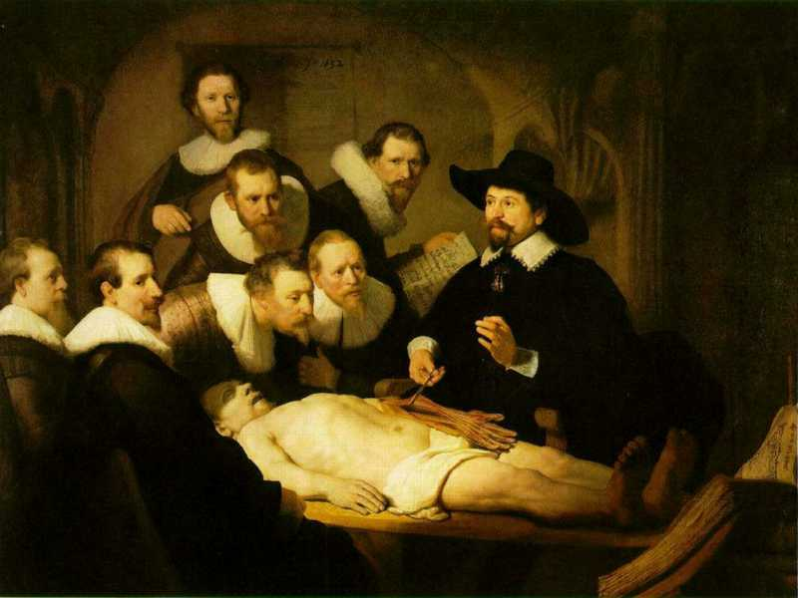
L3
Linguistic representations about (L1⁻), (L2) or (L3)
L2
Beliefs about (1)
Representations
First Order Reality
Entities (particular or generic) with objective existence which are not about anything
L1⁻

Slide 6
Research and Development
data
organization
model development
observation &
measurement
further R&D
(instrument and
study optimization)
add
verify
use
Δ = outcome
Generic
beliefs
application

Slide 7
First-Order Representation Reality
data
organization
model development
observation &
measurement
further R&D
(instrument and
study optimization)
add
verify
use
Δ = outcome
Generic
beliefs
application

Slide 8
First-order Research (e.g. biomedical)
data
organization
Topic
model development
observation &
measurement
further R&D
(instrument and
study optimization)
add
verify
use
Δ = outcome
Generic
beliefs
application

Slide 9
Second-order Research (e.g. BMI)
data
organization
Topic
model development
observation &
measurement
further R&D
(instrument and
study optimization)
add
verify
use
Δ = outcome
Generic
beliefs
application

Slide 10
Second-order Research (e.g. ‘data science’)
10
data
organization
Topic
model development
observation &
measurement
further R&D
(instrument and
study optimization)
add
verify
use
Generic
beliefs
application

Slide 11
Thomas D. Grant, PhD, research assistant professor of structural biology, has been awarded a four-year, $1.33 million R01 grant by the National Institutes of Health (NIH) to develop new computational tools to visualize and understand how drugs interact with proteins, with the ultimate aim of speeding up the drug discovery process.
http://medicine.buffalo.edu/news_and_events/news/2019/10/grant-nih-drugs-10340.html

Slide 12
Directionality of research and application
Biomedical research
Medical Informatics Research
Data Science

Slide 13
Some key principles in how to do research
Objective observation: measurement and data (possibly although not necessarily using mathematics as a tool),
http://sciencecouncil.org/about-us/our-definition-of-science/

Slide 14
Some Data Quality Dimensions
Dimension | # cited | Dimension | # cited | Dimension | # cited
Accuracy | 25 | Format | 4 | Comparability | 2
Reliability | 22 | Interpretability | 4 | Conciseness | 2
Timeliness | 19 | Content | 3 | Freedom from bias | 2
Relevance | 16 | Efficiency | 3 | Informativeness | 2
Completeness | 15 | Importance | 3 | Level of detail | 2
Currency | 9 | Sufficiency | 3 | Quantitativeness | 2
Consistency | 8 | Usableness | 3 | Scope | 2
Flexibility | 5 | Usefulness | 3 | Understandability | 2
Precision | 5 | Clarity | 2
Wang, R.Y., Storey, V.C., and Firth, C.P.
A framework for analysis of data quality research.
IEEE Trans. on Knowl. Data Eng. 7, 4 (1995), pp. 623–640.

Slide 15
Precision and accuracy of representations
Precision
The degree to which distinct representations (references) about the same portion of reality (the referent) are similar when derived under similar circumstances.
Accuracy
The degree to which a representation actually represents what it was intended to represent.
How close is a representation to the truth, the facts?

Slide 16
‘Classical’ picture

Slide 17
Validity and reliability of representational methods/procedures
Validity
The extent to which a method or procedure allows or is able to derive representations of what is intended to be represented.
Reliability
The degree to which a method or procedure allows or is able to derive similar representations under similar circumstances.

Slide 18
Reliability Validity of method
Relations between reliability, validity, accuracy and precision.

Slide 19
Some key principles in how to do research
Objective observation: measurement and data (possibly although not necessarily using mathematics as a tool),
Evidence,
http://sciencecouncil.org/about-us/our-definition-of-science/

Slide 20
Design partially determines level of evidence
Evidence
level
https://guides.library.vcu.edu/humphrey/journal-club

Slide 21
Some key principles in how to do research
Objective observation: measurement and data (possibly although not necessarily using mathematics as a tool),
Evidence,
Experiment and/or observation as benchmarks for testing hypotheses,
Induction: reasoning to establish general rules or conclusions drawn from facts or examples,
http://sciencecouncil.org/about-us/our-definition-of-science/

Slide 22
Four notions of Logic
(L1) The study of artificial formal languages;
→ e.g. properties of predicate logic studied in model theory.
(L2) The study of formally valid inferences and logical consequence;
→ e.g. IF A then B:
A, therefor: B
not B, therefor: not A
(L3) The study of logical truths;
the most general truths, ones that are contained in any other body of truths that any other science aims to describe.
(L4) The study of the general features, or form, of judgements (Kant).

Slide 23
Deduction and induction (1)
A deductive argument is an argument that is intended by the arguer to be (deductively) valid, that is, to provide a guarantee of the truth of the conclusion provided that the argument's premises (assumptions) are true.
http://www.iep.utm.edu/ded-ind/

Slide 24
Valid and sound (deductive) arguments
A deductive argument is said to be valid if and only if it takes a form that makes it impossible for the premises to be true and the conclusion nevertheless to be false. Otherwise, a deductive argument is said to be invalid.
A deductive argument is sound if and only if it is both valid, and all of its premises are actually true. Otherwise, a deductive argument is unsound.
http://www.iep.utm.edu/val-snd/

Slide 25
Valid argument?
A deductive argument is said to be valid if and only if it takes a form that makes it impossible for the premises to be true and the conclusion nevertheless to be false. Otherwise, a deductive argument is said to be invalid.
Patients, when sick, always consult a doctor and follow the advice given.
Doctors’ advices are always such that when they are followed, patients get better.
Therefore, patients always get better when sick.
http://www.iep.utm.edu/val-snd/

Slide 26
Sound argument?
A deductive argument is sound if and only if it is both valid, and all of its premises are actually true. Otherwise, a deductive argument is unsound.
If I get stuck in a traffic jam, I come home late.
If I come home late, I eat late.
If I eat late, I eat.
Yesterday, I got stuck in a traffic jam.
Therefore, I ate yesterday.
If I ate yesterday, was that because I was in a traffic jam?

Slide 27
Deduction and induction (2)
A deductive argument is an argument that is intended by the arguer to be (deductively) valid, that is, to provide a guarantee of the truth of the conclusion provided that the argument's premises (assumptions) are true.
An inductive argument is an argument that is intended by the arguer merely to establish or increase the probability of its conclusion. In an inductive argument, the premises are intended only to be so strong that, if they were true, then it would be unlikely that the conclusion is false.
http://www.iep.utm.edu/ded-ind/

Slide 28
Identifying pseudoscience
Belief in authority: It is contended that some have a special ability to determine what is true or false. Others must accept their judgments.
Unrepeatable experiments: Reliance is put on experiments that cannot be repeated by others with the same outcome.
Handpicked examples: are used although they are not representative of the general category that the investigation refers to.
Unwillingness to test: A theory is not tested although it can be.
Disregard of refuting information: Observations or experiments that conflict with a theory are neglected.
Built-in subterfuge: The testing of a theory is so arranged that the theory can only be confirmed, never disconfirmed, by the outcome.
Explanations are abandoned without replacement. Tenable explanations are given up without being replaced, so that the new theory leaves much more unexplained than the previous one.
Hansson, Sven Ove, "Science and Pseudo-Science", The Stanford Encyclopedia of Philosophy (Spring 2015 Edition), Edward N. Zalta (ed.). https://plato.stanford.edu/archives/spr2015/entries/pseudo-science/.

Slide 29
A List Of Fallacious Arguments
http://www.don-lindsay-archive.org/skeptic/arguments.html
E.g.: False Compromise:
if one does not understand a debate, it must be "fair" to split the difference, and agree on a compromise between the opinions. (But one side is very possibly wrong, and in any case one could simply suspend judgment.) Journalists often invoke this fallacy in the name of "balanced" coverage.
"Some say the sun rises in the east, some say it rises in the west; the truth lies probably somewhere in between."
Television reporters like balanced coverage so much that they may give half of their report to a view held by a small minority of the people in question. There are many possible reasons for this, some of them good. However, viewers need to be aware of this tendency.

Slide 30
Some key principles in how to do research
Objective observation: measurement and data (possibly although not necessarily using mathematics as a tool),
Evidence,
Experiment and/or observation as benchmarks for testing hypotheses,
Induction: reasoning to establish general rules or conclusions drawn from facts or examples,
Repetition,
Critical analysis,
Verification and testing: critical exposure to scrutiny, peer review and assessment.
http://sciencecouncil.org/about-us/our-definition-of-science/

Slide 31
‘The Scientific Method’
A name for a quite generally accepted research method

Slide 32
By ArchonMagnus - Own work, CC BY-SA 4.0, https://commons.wikimedia.org/w/index.php?curid=42164616

Slide 33
The Scientific Method
principles and procedures for the systematic pursuit of knowledge involving:
the recognition and formulation of a problem,
the collection of data through observation and experiment, and
the formulation and testing of hypotheses.
http://www.merriam-webster.com/dictionary/scientific%20method

Slide 34
Steps in scientific research
Specify the question you are asking.
Put the question in the form of a null hypothesis and alternative hypothesis.
Put the question in the form of a statistical null hypothesis and alternative hypothesis.
Determine which variables are relevant to the question.
Determine what kind of variable each one is.
Design an experiment that controls or randomizes the confounding variables.
Based on the number of variables, the kinds of variables, the expected fit to the parametric assumptions, and the hypothesis to be tested, choose the best statistical test to use.
If possible, do a power analysis to determine a good sample size for the experiment.
Do the experiment.
Examine the data to see if it meets the assumptions of the statistical test you chose. If it doesn't, choose a more appropriate test.
Apply the statistical test you chose, and interpret the results.
Communicate your results effectively, usually with a graph or table.
John H. McDonald. The Handbook of Biological Statistics ©. 2014. http://www.biostathandbook.com/

Slide 35
Fifteen common mistakes encountered in clinical research. Failure to …
carefully examine the literature for similar, prior research
critically assess the prior literature
specify the inclusion and exclusion criteria for your subjects
determine and report the error of your measurement methods
specify the exact statistical assumptions made in the analysis
perform sample size analysis before the study begins
implement adequate bias control measures
write and stick to a detailed time line
vigorously recruit and retain subjects
have a detailed, written and vetted protocol
examine for normality of the data
report missing data, dropped subjects and use of an intention to treat analysis
perform and report power calculations
point out the weaknesses of your own study
understand and use correct scientific
Journal of Prosthodontic Research 55 (2011) 1–6

Slide 36
Research proposal content (1)
introduction
problem statement
Overview
Research Questions
Hypotheses
OBJECTIVES AND AIMS
BACKGROUND AND SIGNIFICANCE
Published Research
Significance

Slide 37
Research proposal content (2)
research design and methods
Overview
Population and Study Sample
Sample Size and Selection Methods
Sources of Data
Collection of Data
Exposure Assessment
Data Management
Data Analysis Strategies
Ethics and Human Subjects Issues
Timeframes

Slide 38
Research proposal content (3)
Strengths and Weaknesses of the Study
Budget and Motivation
references
Appendices

