Slide 1
Do mental disorders exist?
Explorations through biomedical ontology.
Lecture in BMI199: What is Biomedical Informatics?
Oct 10, 2019
5 Diefendorf, University at Buffalo
Werner CEUSTERS, MD
Departments of Biomedical Informatics and Psychiatry,
UB Institute for Healthcare Informatics,
Ontology Research Group, Center of Excellence in Bioinformatics and Life Sciences,
University at Buffalo, NY, USA

Slide 2
Assignment
Read prior to W8: Casey BJ et al (2013). DSM-5 and RDoC: progress in psychiatry research? Nat Rev Neurosci. 2013 Nov; 14(11): 810–814. https://www.ncbi.nlm.nih.gov/pmc/articles/PMC4372467/.
In-class quiz on paper. (Q4)

Slide 3
Learning objectives
NOT: knowing the ins and outs of mental disorders!
But: understanding some pitfalls in interpreting statistics.
Where numbers come from and what they are about,
Why statistics may be contradictory,
Why appropriate naming is key,
How classifications influence numbers.

Slide 4
Worldwide prevalence of mental disorders
Disorder | Share of global population with disorder (2017) [difference across countries] | Number of people with the disorder (2017) | Share of males:females with disorder (2017)
Any mental or substance use disorder | 13% [11-18%] | 970 million | 12.6% males 13.3% females
Depression | 3.40% [2-6%] | 264 million | 2.7% males 4.1% females
Anxiety disorders | 3.80% [2.5-7%] | 284 million | 2.8% males 4.7% females
Bipolar disorder | 0.60% [0.3-1.2%] | 46 million | 0.55% males 0.65% females
Eating disorders (clinical anorexia & bulimia) | 0.20% [0.1-1%] | 16 million | 0.13% males 0.29% females
Schizophrenia | 0.30% [0.2-0.4%] | 20 million | 0.26% males 0.25% females
Alcohol use disorder | 1.40% [0.5-5%] | 107 million | 2% males 0.8% females
Drug use disorder (excluding alcohol) | 0.90% [0.4-3.5%] | 71 million | 1.3% males 0.6% females
https://ourworldindata.org/mental-health

Slide 5
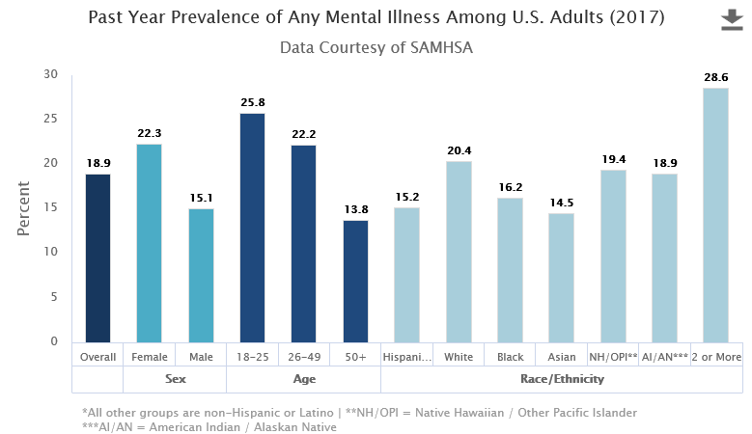
https://www.nimh.nih.gov/health/statistics/mental-illness.shtml

Slide 6
Genetic epidemiology of some MDs
 | Prevalence (%) | Age onset | Mortality | Fertility | Heritability | Paternal age effect
Autism | 0.3 | 1 | 2 | 0.05 | 0.9 | 1.4
Anorexia nervosa | 0.6 | 15 | 6.2 | 0.33 | 0.56 | —
Schizophrenia | 0.7 | 22 | 2.6 | 0.4 | 0.81 | 1.4
Bipolar affective disorder | 1.25 | 25 | 2 | 0.65 | 0.85 | 1.2
Unipolar depression | 10.22 | 32 | 1.8 | 0.9 | 0.37 | 1
Anxiety disorders | 28.8 | 11 | 1.2 | 0.9 | 0.32 | —
Lifetime prevalence, median age of onset (years), mortality >1 indicates increased mortality compared to general population, fertility <1 = decreased fertility compared to general population, heritability (estimated contribution of additive genetic effects from twin studies) and an index of paternal age effect (risk ratio for 10-year increase in fathers age > 30 years).
R Uher. The role of genetic variation in the causation of mental illness: an evolution-informed framework
Molecular Psychiatry volume 14, pages1072–1082 (2009) |

Slide 7
Mental disorders in the USA
Lifetime prevalence estimates:
  anxiety disorders: 28.8%;
  mood disorders: 20.8%;
  impulse-control disorders: 24.8%;
  substance use disorders: 14.6%;
  any mental disorder: 46.4%.
Half of all lifetime cases start by age 14 years and three fourths by age 24 years.
About half of Americans will meet the criteria for a DSM-IV mental disorder sometime in their life, with first onset usually in childhood or adolescence.
Kessler RC1, Berglund P, Demler O, Jin R, Merikangas KR, Walters EE. Lifetime prevalence and age-of-onset distributions of DSM-IV disorders in the National Comorbidity Survey Replication. Arch Gen Psychiatry. 2005 Jun;62(6):593-602.

Slide 8
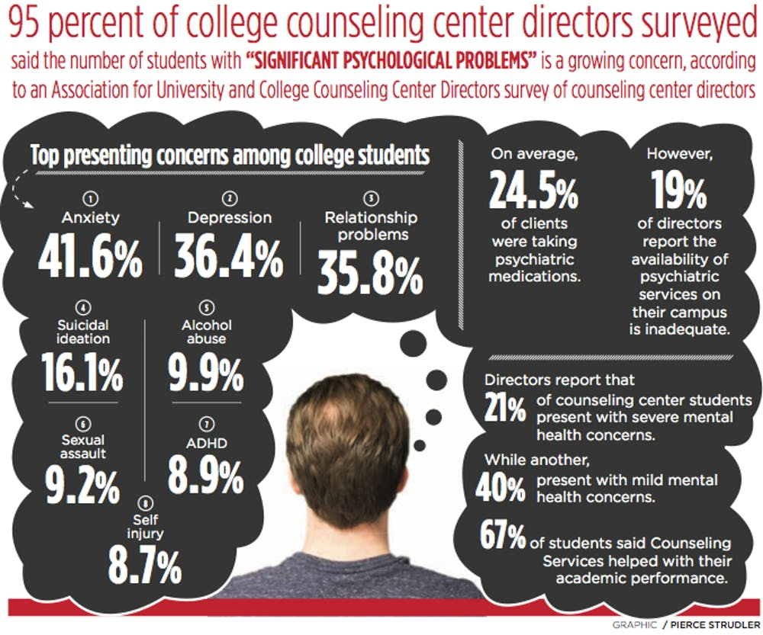
https://www.ubspectrum.com/article/2017/11/mental-illness-a-growing-problem-among-college-students

Slide 9
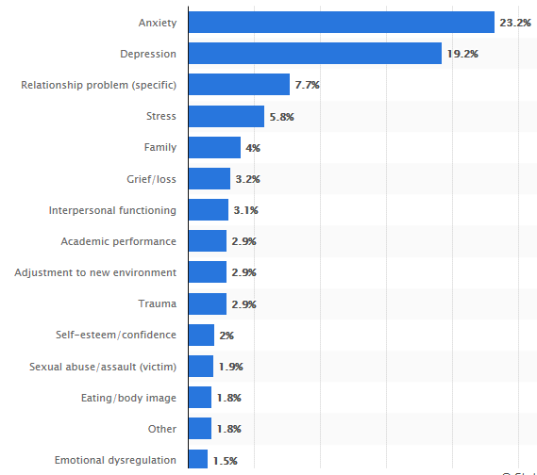
Percentage of mental health clinicians who stated select issues were the top concerns of their college student patients during the 2017-2018 academic school year
https://www.statista.com/statistics/827374/clinician-chosen-top-mental-health-concerns-for-college-students/

Slide 10
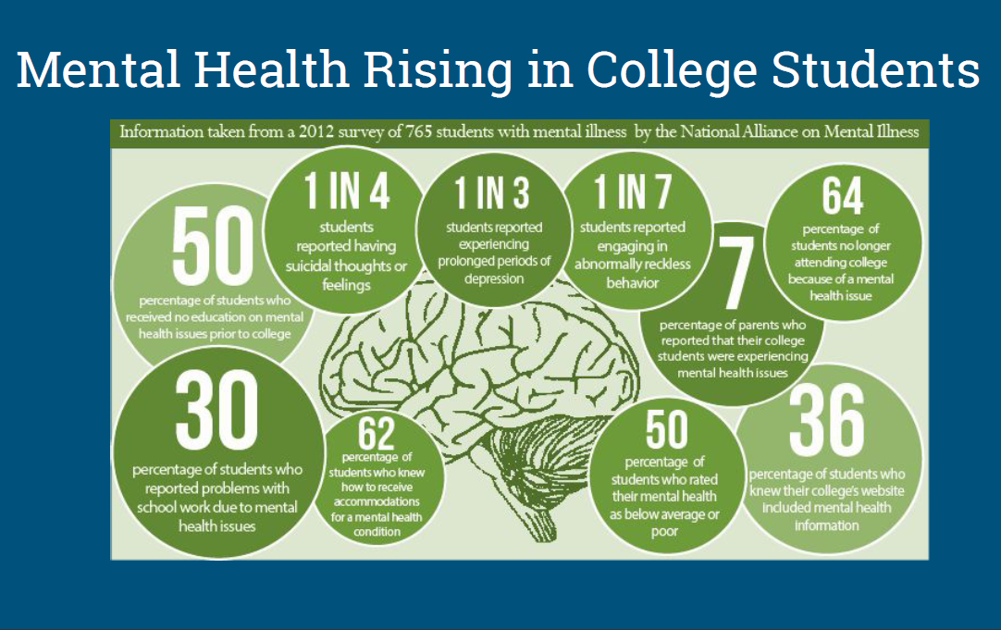
https://fcihe.com/wp-content/uploads/2018/07/Mental-Health-in-PSE-Kelchner-2018.pdf

Slide 11
Anything odd about all these numbers?

Slide 12
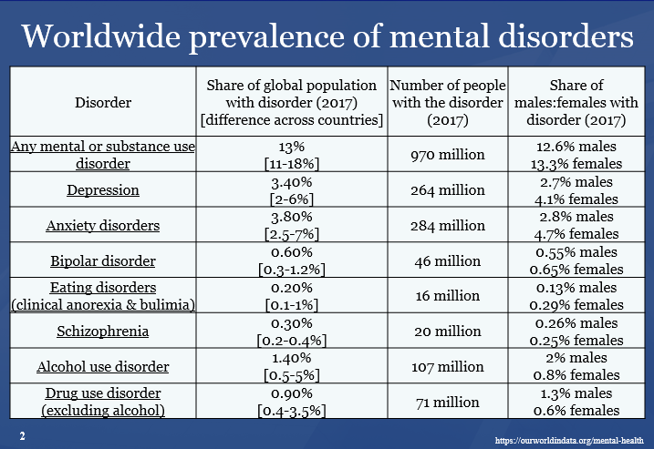
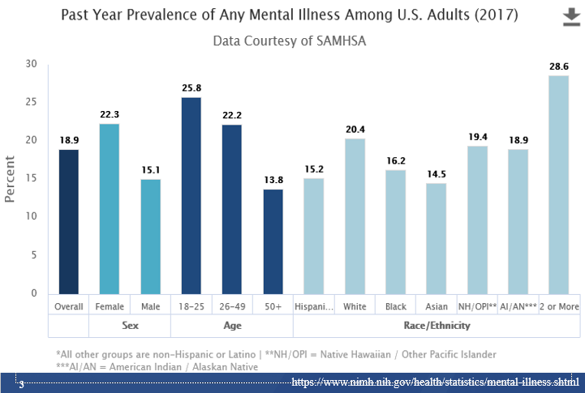
Substance use disorders are even excluded from this study.

Slide 13
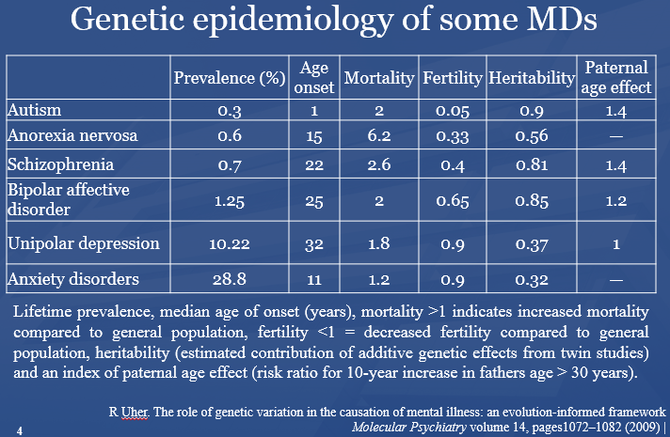

Slide 14
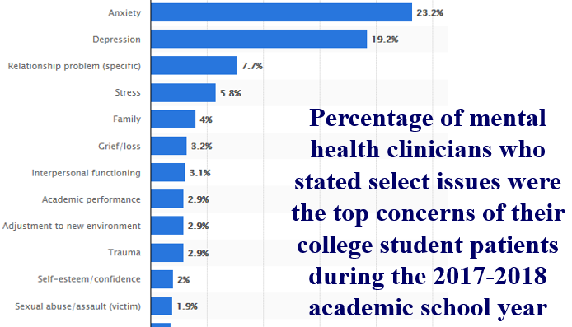

Slide 15
Whenever looking at numbers, obtain (at least) a correct view on:
(1) what the numbers are exactly about,
(2) from what population they are taken.

Slide 16
Prevalence
Prevalence is the total number of individuals in a population who have a disease or health condition at a specific period of time, usually expressed as a percentage of the population.
Gordis, Leon. Epidemiology (5). Saint Louis, US: Saunders, 2013. ProQuest ebrary. Web. 2 March 2017

Slide 17
Prevalence
Prevalence is the total number of individuals in a population who have a disease or health condition at a specific period of time, usually expressed as a percentage of the population.
Gordis, Leon. Epidemiology (5). Saint Louis, US: Saunders, 2013. ProQuest ebrary. Web. 2 March 2017

Slide 18
Population: all people in USA
Time: any individual’s lifetime
Population: all humans
Time: 2017
Population: college students in the US seeking counceling
Time: time of counceling

Slide 19
Population: health clinicians!!!
Time: 2017-2018 academic year
Population: college students in the US seeking counceling
Time: time of counceling

Slide 20
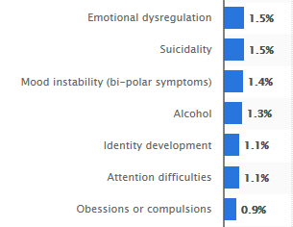
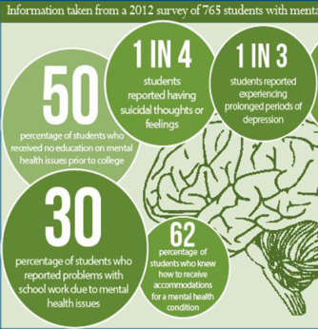
Population: college students in the US seeking counceling and already having a mental disorder
Time: time of counceling

Slide 21
Incidence
The number of new cases or events occurring in a defined population during a specified time period.

Slide 22
Is in light of the data on the previous slides
‘Do mental disorders exist?’ a sensible question?

Slide 23
There are many facets to the question
‘Do mental disorders exist?’
(We will cover only two)

Slide 24
Facet 1:
Substance use disorders are even excluded from this study.

Slide 25
Facet 1: if mental disorders exist, what things qualify to be included?
Substance use disorders are even excluded from this study.

Slide 26
Risk factors for mental disorders
Level | Adverse Factors | Protective Factors
Individual attributes | Low self-esteem | Self-esteem, confidence
 | Cognitive/emotional immaturity | Ability to solve problems & manage stress or adversity
 | Difficulties in communicating | Communication skills
 | Medical illness, substance use | Physical health, fitness
Social circumstances | Loneliness, bereavement | Social support of family & friends
 | Neglect, family conflict | Good parenting/family interaction
 | Exposure to violence/abuse | Physical security & safety
 | Low income & poverty | Economic security
 | Difficulties or failure at school | Scholastic achievement
 | Work stress, unemployment | Satisfaction & success at work
Environmental factors | Poor access to basic services | Equality of access to basic services
 | Injustice & discrimination | Social justice, tolerance, integration
 | Social & gender inequalities | Social & gender equality
 | Exposure to war or disaster | Physical security & safety
https://ourworldindata.org/mental-health

Slide 27
Risk factors for mental disorders
Level | Adverse Factors | Protective Factors
Individual attributes | Low self-esteem | Self-esteem, confidence
 | Cognitive/emotional immaturity | Ability to solve problems & manage stress or adversity
 | Difficulties in communicating | Communication skills
 | Medical illness, substance use | Physical health, fitness
Social circumstances | Loneliness, bereavement | Social support of family & friends
 | Neglect, family conflict | Good parenting/family interaction
 | Exposure to violence/abuse | Physical security & safety
 | Low income & poverty | Economic security
 | Difficulties or failure at school | Scholastic achievement
 | Work stress, unemployment | Satisfaction & success at work
Environmental factors | Poor access to basic services | Equality of access to basic services
 | Injustice & discrimination | Social justice, tolerance, integration
 | Social & gender inequalities | Social & gender equality
 | Exposure to war or disaster | Physical security & safety
https://ourworldindata.org/mental-health

Slide 28
Risk factors for mental disorders
Level | Adverse Factors | Protective Factors
Individual attributes | Low self-esteem | Self-esteem, confidence
 | Cognitive/emotional immaturity | Ability to solve problems & manage stress or adversity
 | Difficulties in communicating | Communication skills
 | Medical illness, substance use | Physical health, fitness
Social circumstances | Loneliness, bereavement | Social support of family & friends
 | Neglect, family conflict | Good parenting/family interaction
 | Exposure to violence/abuse | Physical security & safety
 | Low income & poverty | Economic security
 | Difficulties or failure at school | Scholastic achievement
 | Work stress, unemployment | Satisfaction & success at work
Environmental factors | Poor access to basic services | Equality of access to basic services
 | Injustice & discrimination | Social justice, tolerance, integration
 | Social & gender inequalities | Social & gender equality
 | Exposure to war or disaster | Physical security & safety
Why would these be risk factors for mental disorder and not mental disorders themselves?
https://ourworldindata.org/mental-health

Slide 29
There are many facets to the question
‘Do mental disorders exist?’
If mental disorders exist, what would qualify to be one?
…

Slide 30

The Antipsychiatry Coalition:
‘mental disorders do not exist!’
Their argument:
  ‘there are no biological abnormalities responsible for so-called mental illness, mental disease, or mental disorder, therefore mental illness has no biological existence.
  Perhaps more importantly, however, mental illness also has no non-biological existence,
  except in the sense that the term is used to indicate disapproval of some aspect of a person's mentality.’
  Lawrence Stevens, J.D, 1999
http://www.antipsychiatry.org/
Notes:
Social construct of mental illness

Slide 31
The “Myth of Mental Illness”
Szasz: ‘mental illness is a myth whose function it is to disguise and thus render more palatable the bitter pill of moral conflicts in human relations’
  Szasz TS: The Myth of Mental Illness. American Psychologist 1960, 15:113-118.

Slide 32

‘Psychiatry is not medicine or “medical science— it's fraud in the service of social control’.
Don Weitz
https://www.youtube.com/watch?v=Sg8f7V0Atek
http://psychiatrized.org/DonWeitz/PsychiatryAsSocialControl.pdf

Slide 33
Scientific Objectivity
Objectivity as Faithfulness to Facts.
Objectivity as Absence of Normative Commitments and the Value-Free Ideal.
Objectivity as Freedom from Personal Biases.
  Measurement and Quantification.
  Inductive and Statistical Inference.

Slide 34
There are many facets to the question
‘Do mental disorders exist?’
If mental disorders exist, what would qualify to be one?
‘Mental disorder’ is a misnomer.

Slide 35
‘Do mental disorders exist?’ rephrased as
‘Does what is commonly referred to as ‘mental disorder’ exist?’

Slide 36
Our interpretation of Szasz (1)
the group of persons ‘known to manifest various peculiarities or disorders of thinking and behavior’ and about which it is therefore said that they have a mental illness, consists of two subgroups:
  (1) those for which there is an underlying brain disorder perhaps not yet discoverable by what the state of the art is able to offer; and
  (2) those who exhibit in their behavior a ‘deviance … from certain psychosocial, ethical, or legal norms’ as judged by themselves, by clinicians, or by others.

Slide 37
Our interpretation of Szasz (2)
  those for which there is an underlying brain disorder perhaps not yet discoverable by what the state of the art is able to offer
  would be better described as having a brain disorder,
those who exhibit in their behavior a ‘deviance … from certain psychosocial, ethical, or legal norms’ as judged by themselves, by clinicians, or by others
  while they might indeed have ‘problems of living’, and thus be suffering, are not suffering because of some disorder of a special, mental kind.

Slide 38
Differing views on mental disorder
The social-constructivist position:
  mental disorder is a value-laden social construct with no counterpart in biomedical reality.
The objectivist position:
  mental disorders are natural entities that could be understood in biological terms.
The hybrid position:
  Mental disorder is harmful dysfunction.
    the social definition of "harm" is counterbalanced by a factual component of a malfunctioning internal mechanism causing objective dysfunction.
Jablensky A: Does psychiatry need an overarching concept of "mental disorder"? World Psychiatry 2007, 6:157-158.

Slide 39
A terminological and ontological problem (1)
  WHO: Lexicon of psychiatric and mental health terms. Second ed. Geneva: WHO; 1994.
  ‘mental disorder’: an imprecise term designating any disorder of the mind, acquired or congenital
  organic mental disorder: a range of mental disorders grouped together on the basis of their having in common a demonstrable etiology in cerebral disease, brain injury, or other insult, leading to cerebral dysfunction.
Does WHO rule out the existence of mental disorders which are not due to brain disorder?

Slide 40
The old debate on the “body-mind problem”…
Dualistic views in Philosophy of Mind:
  asserts the separate existence of mind and body
  comes in various flavours:
    Ontological dualism
      Substance dualism
      Property dualism
      Predicate dualism
    Interaction dualism
Monistic views in Philosophy of Mind:
    Behaviourism
    Identity theory
    Functionalism
    Non-reductive physicalism
…

Slide 41
… and its impact on Psychiatry
Mental health professionals continue to employ a mind-brain dichotomy when reasoning about clinical cases.
The more a behavioral problem is seen as originating in “psychological” processes, the more a patient tends to be viewed as responsible and blameworthy for his or her symptoms;
conversely, the more behaviors are attributed to neurobiological causes, the less likely patients are to be viewed as responsible and blameworthy.
Miresco MJ, Kirmayer LJ.
The Persistence of Mind-Brain Dualism in Psychiatric Reasoning About Clinical Scenarios.
Am J Psychiatry 2006; 163:913–918
But:
  Conducted in one institution.
  Based on a questionnaire with voluntary submission, thus risk for major bias.

Slide 42
A terminological and ontological problem (2)
Adoption of a generic, presumably universal, definition of "mental disorder" would be premature. It may cause more harm than good to psychiatry.
  Jablensky A: Does psychiatry need an overarching concept of "mental disorder"? World Psychiatry 2007, 6:157-158.

Slide 43
Jablensky’s arguments (1)
A terminological argument
  Neither disease nor health has ever been strictly and unambiguously defined in terms of finite sets of observable referential phenomena.
Arguments of utility:
  the medical person is least concerned with what healthy and sick mean in general ... we do not need the concept of ‘illness in general’ at all
    Jaspers K. General psychopathology. Birmingham: Birmingham University Press; 1963.
  doctors do not concern themselves with maximizing the evolutionary advantages of the human race as a whole, but with aiding individuals
    Toon PD. Defining "disease" - classification must be distinguished from evaluation. J Med Ethics. 1981;7:197–201.

Slide 44
Jablensky’s arguments (2)
Ontological argument:
  we now know that no such general and uniform concept exists.
    Jaspers K. General psychopathology ,Birmingham: Birmingham University Press; 1963.
Epistemological argument:
  the emergence of molecular genetic classifications of large groups of diseases, and the concomitant availability of genetic diagnostic tests, raise the possibility that the entire taxonomy of human disease may eventually be revised.

Slide 45
The ‘categorical – dimensional’ debate on the classification of mental disorders
Rough distinction:
  “Categorical”: ‘mental disorders’ can be classified as single, discrete and mutually exclusive types, of which a particular patient does or does not exhibit an instance.
  “Dimensional”: any particular ‘mental disorder’ in a patient is an instance of just one single type and differences between cases are a matter of ‘scale’.
‘Rough’, because
  the literature is huge and vague
  descriptions are (philosophically) very incoherent

Slide 46
Nosologia Methodica sistens Morborum Classes
Disease class 1
Disease class 2
…
Disease
order 1.1
Disease
order 1.2
Disease
order 2.1
Disease
order 2.2
…
…
Disease
genus 1.1.1
Disease
genus 1.1.2
Disease
genus 2.1.1
Disease
genus 2.1.2
…
…
Disease
species 1.1.1.1
Disease
species 1.1.1.2
Disease
species 2.1.1.1
…
…

Slide 47
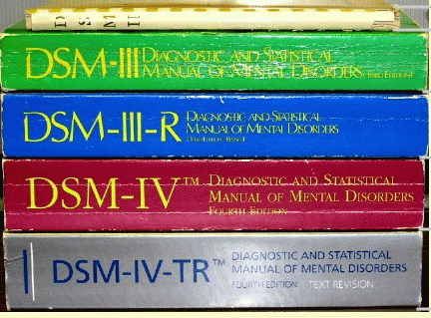
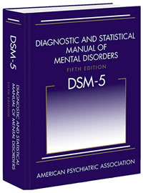
The categorical view
Recognizes various mental disorder types;
Accepts that disorders are manifested through signs and symptoms, either ‘marker’ or ‘constitutional’;
Provides diagnostic criteria to guide the clinician in making a diagnosis.

Slide 48
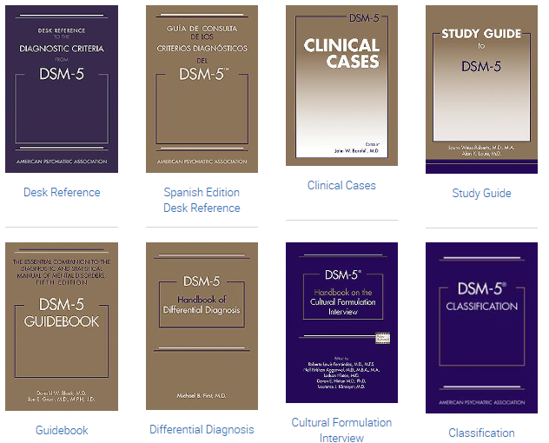
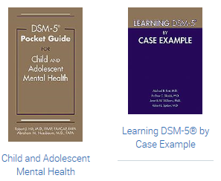

‘Essential Guides to DSM-5’
https://www.appi.org/products/dsm-manual-of-mental-disorders
Notes:
Diagnostic and Statistical Manual of Mental Disorders (DSM–5), published on May 18, 2013

Slide 49
Evolution of the DSM (1)
Psychodynamic period: I and II, 1952-1980
  no sharp distinction between normal and abnormal.
  psychosis / neurosis scale
  all disorders viewed as reactions (leading to behavior) to environmental events,
  everyone is more or less abnormal,
  inclusion in the manual presumes abnormality.
DSM-II contained “homosexuality” as mental disorder which was removed in 1973 by vote.

Slide 50
Evolution of the DSM (2)
Adoption of biomedical model: III, IV 1980 -
  Clear distinction between normal/abnormal
  Introduction of diagnostic criteria
  Latest version is from 2000
DSM-V: since 2013
  Move towards dimensional approach

Slide 51
DSM under fire (1)
severely ill inpatients often meet criteria for more than one DSM-IV personality disorder
  → suggests a high rate of co-morbidity, however in absence of any medical or etiologic reason for such a situation
many outpatients do not meet the criteria for any of the specific categories identified in DSM-IV;
patients with the same categorical diagnosis often vary substantially with respect to which diagnostic criteria were used to make the diagnosis, so that two patients with the same diagnosis can manifest very different signs and symptoms;

Slide 52
DSM under fire (2)
frequent revision of the diagnostic thresholds separating what is normal from what is disordered
  → it is as if given disorders would appear and disappear in course of time;
a number of the diagnostic categories mentioned in DSM-IV lack any developing scientific base for an understanding of the corresponding disorder types

Slide 53
The Dimensional Approach (1)
Mental processes and behavior follow traits/phenomena which are to be seen as continuous variables along continua on which all members of the population can be located. These continua extend to both normal and pathological phenotypes.
These traits are on a par with properties such as temperature, weight, …
  → Homo sapiens is not further subdivided in subspecies according to weight, temperature, …

Slide 54

Is there empirical evidence for this boundary ?
And if not, do these mountains exist ?

Slide 55
Attempts to resolve the problem (1)
Mental disorders as ‘practical kinds’
  ‘stable patterns that can be identified with varying levels of reliability and validity’ and which are justified by their usefulness for specific purposes – such as giving an appropriate treatment
Zachar, P. 2000b. Psychiatric disorders are not natural kinds. Philosophy, Psychiatry and Psychology 7:167–94.

Slide 56
Basis: ‘epistemic value commitments’
‘values involved in making and advancing epistemologically-relevant claims, such as scientific ones’:
Coherence
Consistency
Comprehensiveness
Fecundity
Simplicity
Instrumental efficacy
Originality
Relevance
Precision
JZ. Sadler. Epistemic Value Commitments in the Debate over Categorical vs. Dimensional Personality Diagnosis. Philosophy, Psychiatry, & Psychology 3.3 (1996) 203-222

Slide 57
Attempts to resolve the problem (2)
Non-arbitrary basis for drawing a categorical distinction
No Yes
Haslam N. Kinds of Kinds: A Conceptual Taxonomy of Psychiatric Categories. Philosophy, Psychiatry, & Psychology, 9 (2002), 203-218
Non-kind
This basis is an objective discontinuity
‘severity’
‘neuroticism’
No Yes
The discontinuity is sharp and binary
Practical kind
‘essential hypertension’
‘depression’
No Yes
Fuzzy kind
The discontinuity is constituted by an ‘essence’
‘borderline personality’
No Yes
Discrete kind
Natural kind
‘melancholia’
‘Williams syndrome’

Slide 58
The Dimensional Approach (2)
“Diagnostic categories defined by their syndromes should be regarded as valid only if they have been shown to be discrete entities with natural boundaries that separate them from other disorders.”
“there is no empirical evidence for natural boundaries between major syndromes” … “the categorical approach is fundamentally flawed”
Kendell R, Jablensky A. Distinguishing between the validity and utility of psychiatric diagnoses. Am J Psychiatry 2003; 160:4–12.
Cloninger CR: A new conceptual paradigm from genetics and psychobiology for the science of mental health. Aust N Z J Psychiatry 33:174–186, 1999.

Slide 59
Attempts to standardize research variables

Slide 60
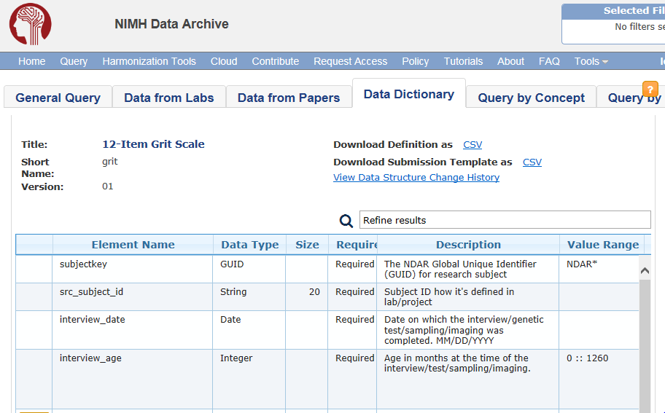
‘Interview age’ ?
https://ndar.nih.gov/data_structure.html?short_name=grit01

Slide 61
‘Interview age’ under the Grit perspective
Label: interview age
Theoretical definition (?):
    Age in months at the time of the interview / test / sampling / imaging.
Operational definition (?):
    Age is rounded to chronological month. If the research participant is 15-days-old at time of interview, the appropriate value would be 0 months. If the participant is 16-days-old, the value would be 1 month.
    Range: 0 -1260 [0 – 105 years]
https://ndar.nih.gov/data_structure.html?short_name=grit01

Slide 62
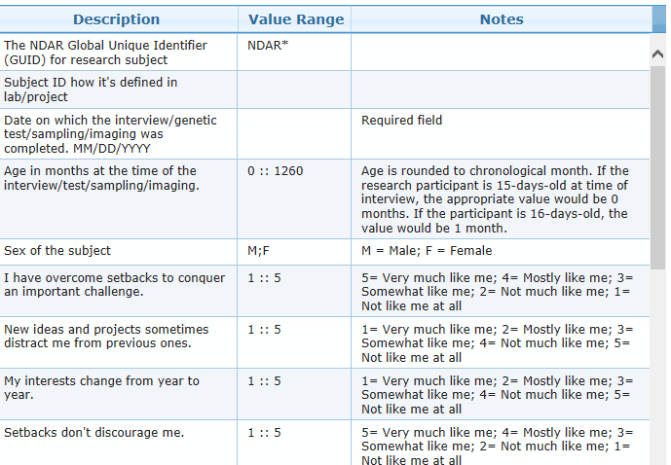
https://ndar.nih.gov/data_structure.html?short_name=grit01

Slide 63
The RDoC approach
Research Diagnostic Criteria for mental disorders

Slide 64
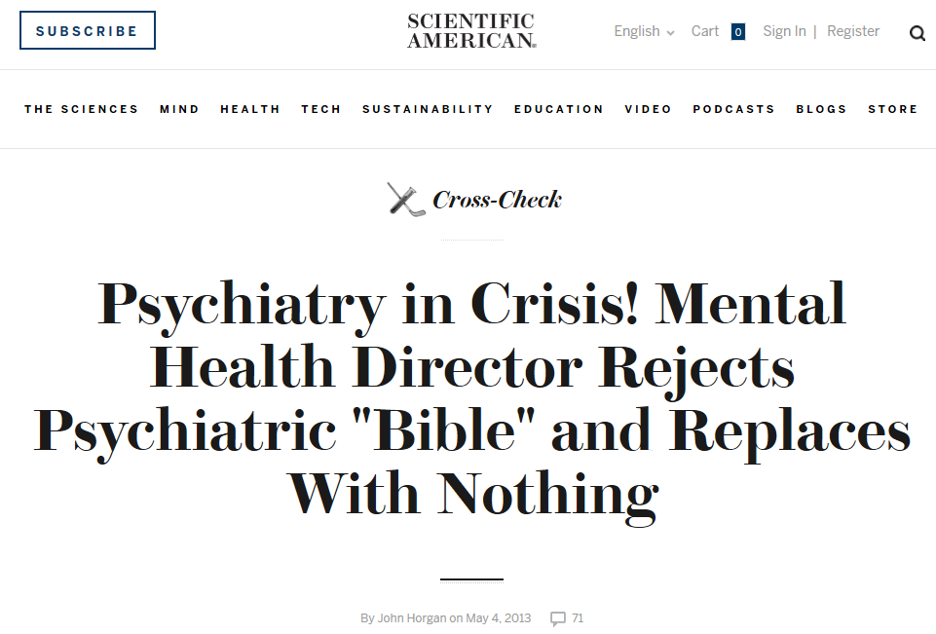

Slide 65
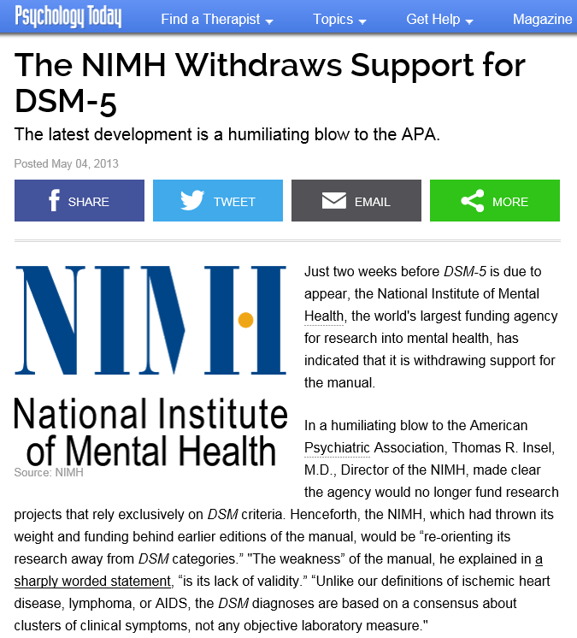
The weakness is its lack of validity. Unlike our definitions of ischemic heart disease, lymphoma, or AIDS, the DSM diagnoses are based on a consensus about clusters of clinical symptoms, not any objective laboratory measure. In the rest of medicine, this would be equivalent to creating diagnostic systems based on the nature of chest pain or the quality of fever. Indeed, symptom-based diagnosis, once common in other areas of medicine, has been largely replaced in the past half century as we have understood that symptoms alone rarely indicate the best choice of treatment.

Slide 66
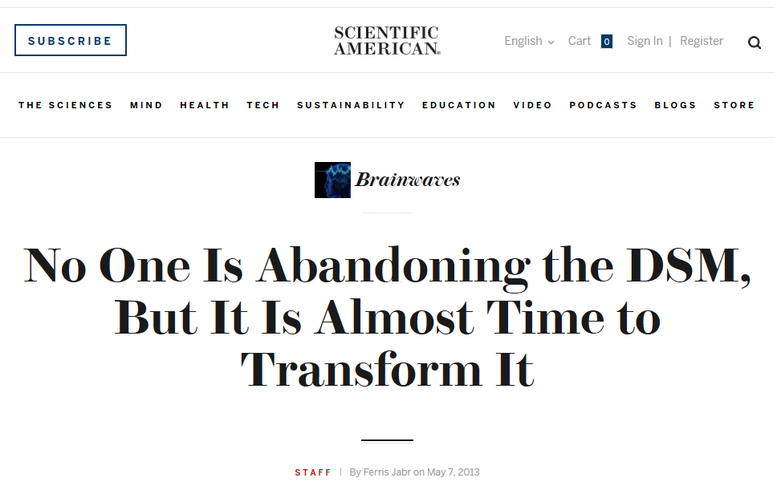

Slide 67
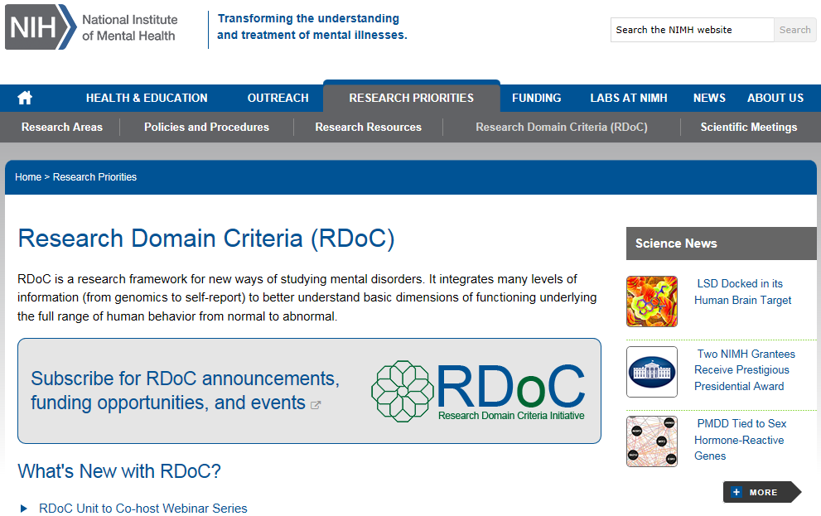
Most recent evolution

Slide 68
Research Domain Criteria (RDoC)
2008 NIMH Strategic Plan:
  ‘objectives include redefining mental disorders into observable and measurable components that are more closely aligned with the biology of the brain; fostering broad sharing of data and resources [supporting] researchers in ways that inspire creativity and innovation’.
Explicitly based on premise that mental disorder are disorders of brain circuits.
“The tools of clinical neuroscience [...] can be used to identify dysfunction in neural circuits” (Morris & Cuthbert 2012).
Goal to support translational neuroscience in mental health research.

Slide 69
Motivations for RDoC
Failure of DSM-ICD, a categorical approach, to offer insight into underlying etiology and causal mechanisms common to all instances of same diagnosis;
Inability to predict effective treatments;
Lack of universal biomarkers for DSM-ICD categories;
Heterogeneity of DSM-ICD populations;
E.g., in 2011 two major pharmaceutical companies stopped research into psychiatric drugs (Cowen 2011).

Slide 70
The RDoC approach
Research Diagnostic Criteria for mental disorders
Remember Jablensky: ‘Neither disease nor health has ever been strictly and unambiguously defined in terms of finite sets of observable referential phenomena.’
RDoC is an attempt to do so!

Slide 71
RDoC’s ‘matrix’
Domain | ————— Units of Analysis —————
 | Genes | Molecules | Cells | Circuits | Physiology | Behavior | Self-Reports | (Paradigms)
Negative Valence Systems Positive Valence Systems Cognitive Systems Working Memory Systems for Social Processes Arousal and Regulatory Systems
Expandable in:
  number of domains and units of analysis,
  Subtyping of domains and units of analysis.
Interestingly: no mention of mental disorders at all!
http://www.nimh.nih.gov/research-priorities/rdoc/nimh-research-domain-criteria-rdoc.shtml

Slide 72
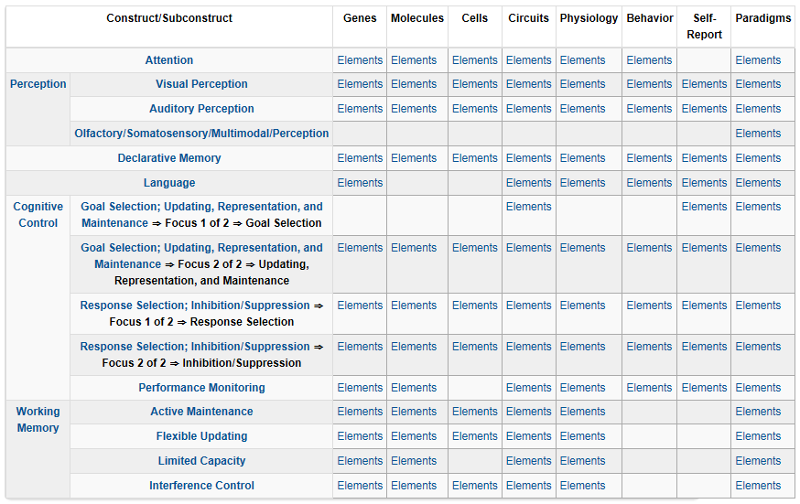
RDoC Matrix for the Cognitive domain

Slide 73
Cognitive Systems > Auditory Perception
Genes: BDNF
Molecules: Acetylcholine, GABA, Glutamate, NMDA, Serotonin
Cells: Cochlear hair cells, Cortical and limbic inhibitory interneurons, Ribbon synapses
Circuits:
  Nodes in Circuits: A1, Anterior insula, Brainstem, Cochlea, Inferior colliculus, MGN, STG
  Circuits: Corticofugal Dorsal/ventral streams
Physiology: Adaptation/ habituation, Auditory steady-state response (ASSR), fMRI, Intracortical EEG, Metabolic changes, Mismatch negativity (MMN), N1, Neural oscillations, P3a, P50, startle and PPI
Behavior: Perceptual identification, Perceptual learning, Perceptual priming, Spatial localization, Stimulus detection
Self-Report: Auditory hallucinations, Hyperacusis
Paradigms: Action-Perception loops, Auditory masking, auditory scene perception (e.g., streaming), Categorization, Cross-modal interactions, …

Slide 74
Cognitive Systems > Auditory Perception
Genes: BDNF
Molecules: Acetylcholine, GABA, Glutamate, NMDA, Serotonin
Cells: Cochlear hair cells, Cortical and limbic inhibitory interneurons, Ribbon synapses
Circuits:
  Nodes in Circuits: A1, Anterior insula, Brainstem, Cochlea, Inferior colliculus, MGN, STG
  Circuits: Corticofugal Dorsal/ventral streams
Physiology: Adaptation/ habituation, Auditory steady-state response (ASSR), fMRI, Intracortical EEG, Metabolic changes, Mismatch negativity (MMN), N1, Neural oscillations, P3a, P50, startle and PPI
Behavior: Perceptual identification, Perceptual learning, Perceptual priming, Spatial localization, Stimulus detection
Self-Report: Auditory hallucinations, Hyperacusis
Paradigms: Action-Perception loops, Auditory masking, auditory scene perception (e.g., streaming), Categorization, Cross-modal interactions, …

Slide 75
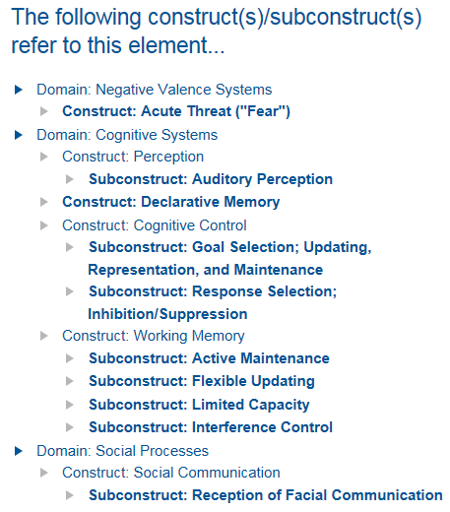
Brain Derived Neurotrophic Factor (BDNF)

Slide 76
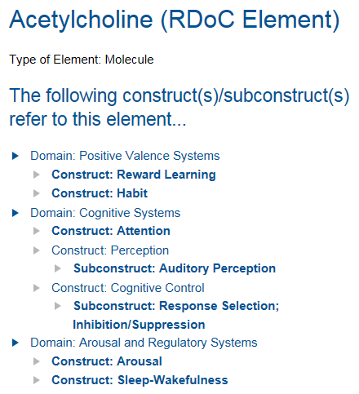
Acetylcholine

Slide 77
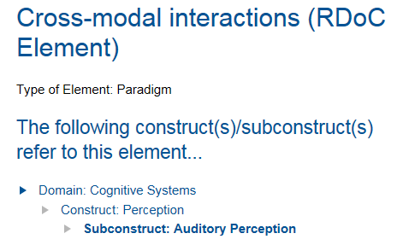
Cross-modal interactions

Slide 78
Foundations for an ontology for mental health.

Slide 79
Ontology for General Medical Science
DISORDER | A causally relatively isolated combination of physical components that is (a) clinically abnormal and (b) maximal, in the sense that it is not a part of some larger such combination.
DISEASE | A DISPOSITION (i) to undergo PATHOLOGICAL PROCESSes that (ii) exists in an ORGANISM because of one or more DISORDERs in that ORGANISM.
DISEASE COURSE | The totality of all PROCESSes through which a given DISEASE instance is realized.
PATHOLOGICAL PROCESS | A bodily process that is a manifestation of a DISORDER and is clinically abnormal.
Scheuermann R, Ceusters W, Smith B. Toward an Ontological Treatment of Disease and Diagnosis. 2009 AMIA Summit on Translational Bioinformatics, San Francisco, California, March 15-17, 2009;: 116-120. Omnipress ISBN:0-9647743-7-2

Slide 80
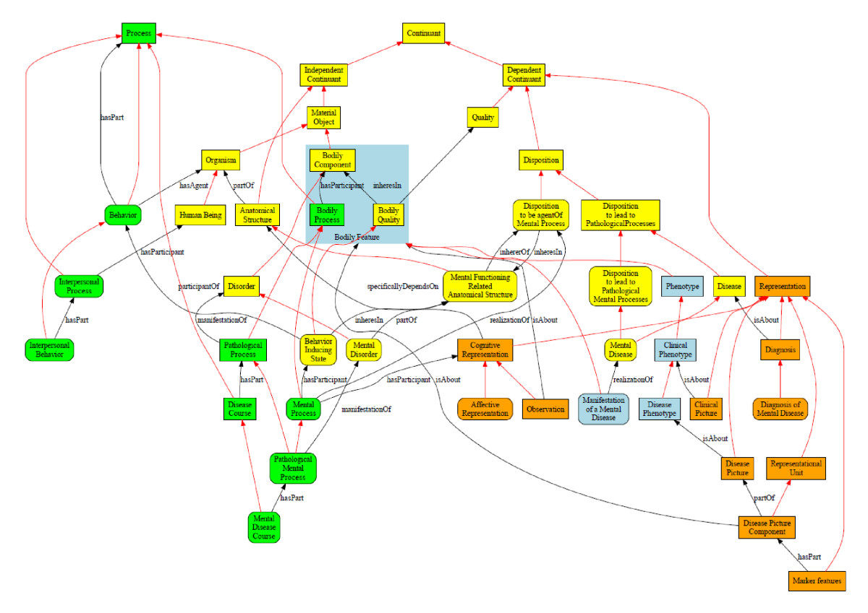
Werner Ceusters and Barry Smith
Foundations for a realist ontology of mental disease
Journal of Biomedical Semantics20101:10 DOI: 10.1186/2041-1480-1-10

