Slide 1
Clarity in biomedical language: terminologies and classification systems.
Lecture in BMI199: What is Biomedical Informatics?
Oct 3, 2019
5 Diefendorf, University at Buffalo
Werner CEUSTERS, MD
Departments of Biomedical Informatics and Psychiatry,
UB Institute for Healthcare Informatics,
Ontology Research Group, Center of Excellence in Bioinformatics and Life Sciences,
University at Buffalo, NY, USA

Slide 2
Language is ambiguous
‘I know that you believe that you understood what you think I said, but I am not sure you realize that what you heard is not what I meant.’
  Robert McCloskey, State Department spokesman (attributed).
    http://www.quotationspage.com/quotes/Robert_McCloskey/

Slide 3
From students in last week’s test
‘The thing that we saw might be different than the thing that someone else saw because there were other ways to look at and perceive it.’
‘If the Soldier had PTSD they would sense that there was a bomb/gunfire when it is just a loud bang, because they have a mental illness where reality is automatically sensed as combat.’
‘There is something that actually exists, as opposed to a notional idea of it.’

Slide 4
Relevance to Healthcare?
‘Nuances in the English language can be both challenging and amusing, however, when variants in language impact treatment, safety and billing, it is all challenge and no humor.’
‘Although English contains a reasonable degree of conformity, divergence in phrasing and meaning can compound comprehension problems and impact patient safety. These language "woes" can be minimized through the use of sophisticated healthcare IT systems ...’
Schwend GT. The language of healthcare. Variance in the English language is harming patients and hospitals' bottom lines. Is healthcare IT the solution? Health Manag Technol. 2008 Feb;29(2):14, 16, 18

Slide 5
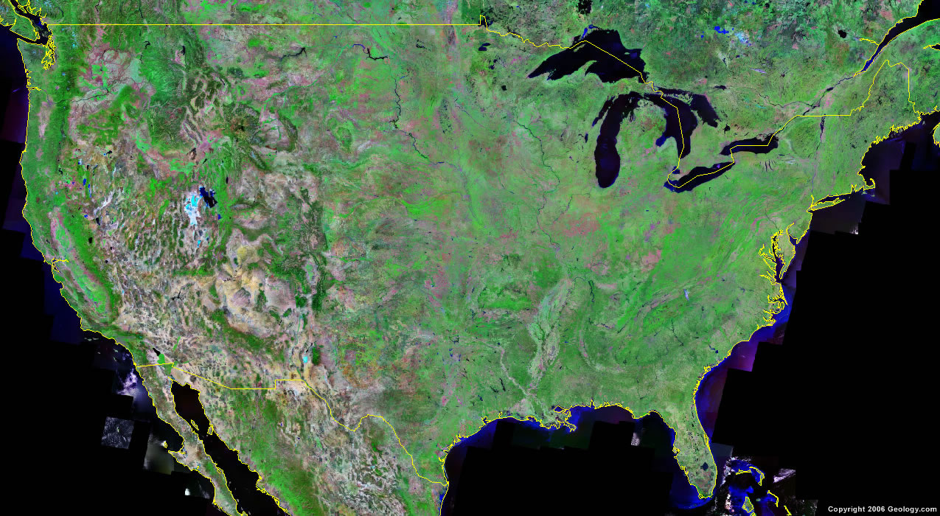

Indeed, these days, not just people communicate …

Slide 6
Understanding content (1)
We see:
“John Doe has a pyogenic granuloma of the left thumb”
The machine sees:
John Doe has a pyogenic granuloma of the left thumb

Slide 7
Understanding content (2)
The XML misunderstanding
We see:
<record>
  <patient>John Doe</patient>
  <diagnosis>pyogenic granuloma of the left thumb</diagnosis>
</record>
The machine sees:
<record>
  <subject> John Doe </subject>
  <diagnosis> pyogenic granuloma of the left thumb </diagnosis>
</record>

Slide 8
Some early goals of
Healthcare Information Technology (HIT)
supporting the creation and use of adequate biomedical terminology.
supporting the creation of adequate coding and classification systems.

Slide 9
Terminology (is) for dummies

Slide 10
The word ‘Terminology’ has two meanings
The discipline of terminology management
  synonymous with terminology work (used in ISO 704)
The set of designations used in the special language of a subject field, such as the terminology of medicine
  Used in both the singular and plural
  Used with an article in the singular: a terminology

Slide 11
Terminology is VERY standardised
ISO 704: 2000 Terminology work – Principles and methods
ISO 860: 1996 Terminology work – Harmonization of concepts and terms
ISO 1087-1: 2000 Terminology work – Vocabulary – Part 1: Theory and application
ISO 15188: 2001 Project management guidelines for terminology standardization
ISO 1087-2:2000 Terminology work – Vocabulary – Part 2: Computer applications
ISO 12620: 1999 Computer applications in terminology – Data categories
ISO 16642: 2003 Computer applications in terminology – Terminological markup framework
ISO 2788: 1986 Documentation – Guidelines for the establishment and development of monolingual thesauri

Slide 12
ISO Standards in Terminology: building blocks
Objects
    perceived or conceived, concrete or abstract
    abstracted or conceptualized into concepts
Concepts
    depict or correspond to a set of objects based on a defined set of characteristics
    represented or expressed in language by designations or by definitions
    organized into concept systems
Designations
    represented as terms, names (appellations) or symbols
    designate or represent a concept
    attributed to a concept by consensus within a special language community

Slide 13
Fundamental Activities of Terminology Work
Identifying ‘concepts’ and ‘concept relations’;
  Analyzing and modeling concept systems on the basis of identified concepts and concept relations;
  Establishing representations of concept systems through concept diagrams;
  Crafting concept-oriented definitions;
  Attributing designations (predominantly terms) to each concept in one or more languages; and,
  Recording and presenting terminological data, principally in terminological entries stored in print and electronic media (terminography).

Slide 14
Why terminologies ?
As such ?
  Fixing/stabilizing the language within a domain and a linguistic community;
  Unambiguous communication.
In Healthcare Information Technology ?
  Semantic Indexing;
  Information exchange and linking between heterogeneous systems;
  Terminologies as basis for documentation through coding and classification

Slide 15
Classification (is) for dummies

Slide 16
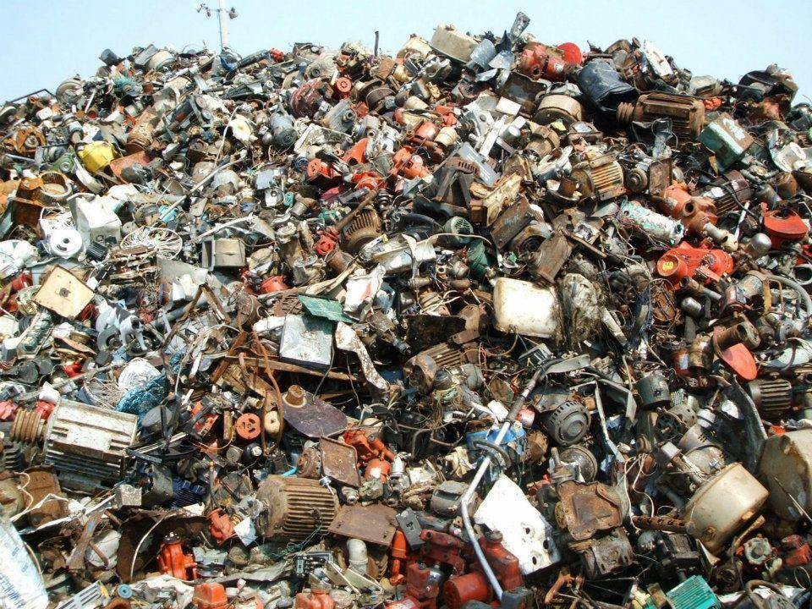
A large collection of individual entities
https://clipartfest.com/download/c2bd0a0071663cef17ac2126d73bf9350a9d15e2.html

Slide 17
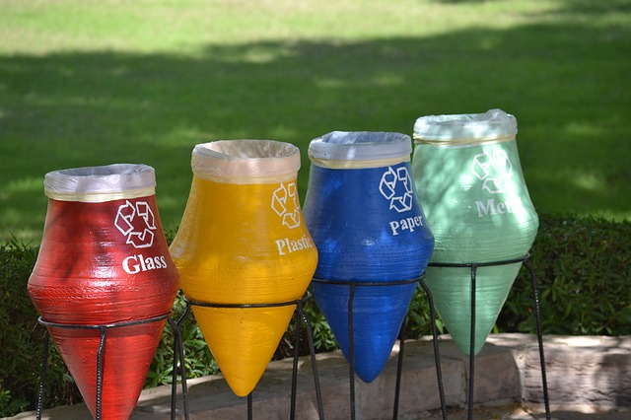
Groups based on material composition

Slide 18
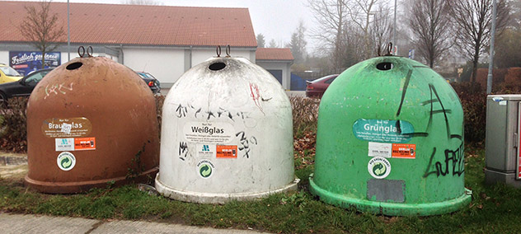
Groups for glass divided by color

Slide 19


Slide 20


Slide 21
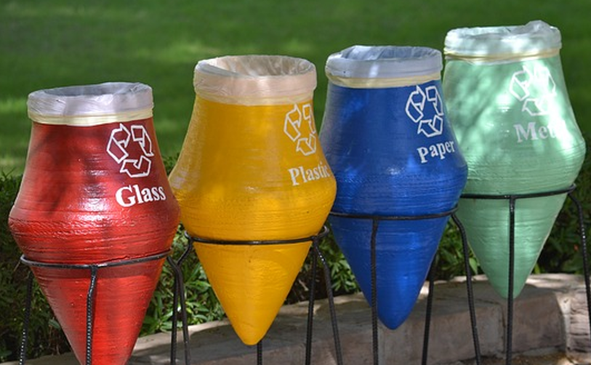


Slide 22


Slide 23
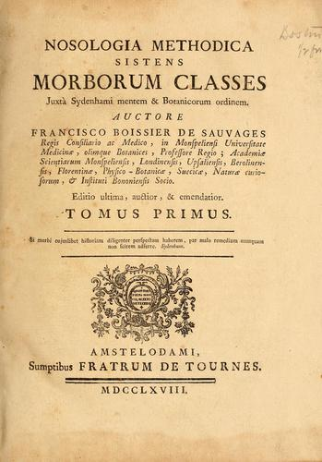
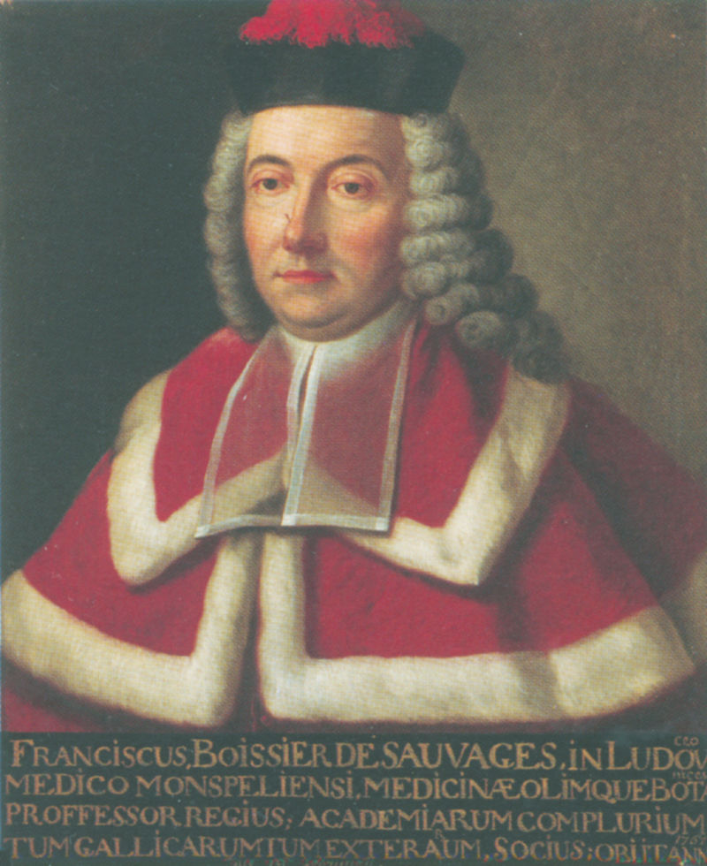
François Boissier de Sauvages de Lacroix
Public Domain, https://commons.wikimedia.org/w/index.php?curid=338615

Slide 24
Nosologia Methodica sistens Morborum Classes
Disease class 1
Disease class 2
…
Disease
order 1.1
Disease
order 1.2
Disease
order 2.1
Disease
order 2.2
…
…
Disease
genus 1.1.1
Disease
genus 1.1.2
Disease
genus 2.1.1
Disease
genus 2.1.2
…
…
Disease
species 1.1.1.1
Disease
species 1.1.1.2
Disease
species 2.1.1.1
…
…

Slide 25

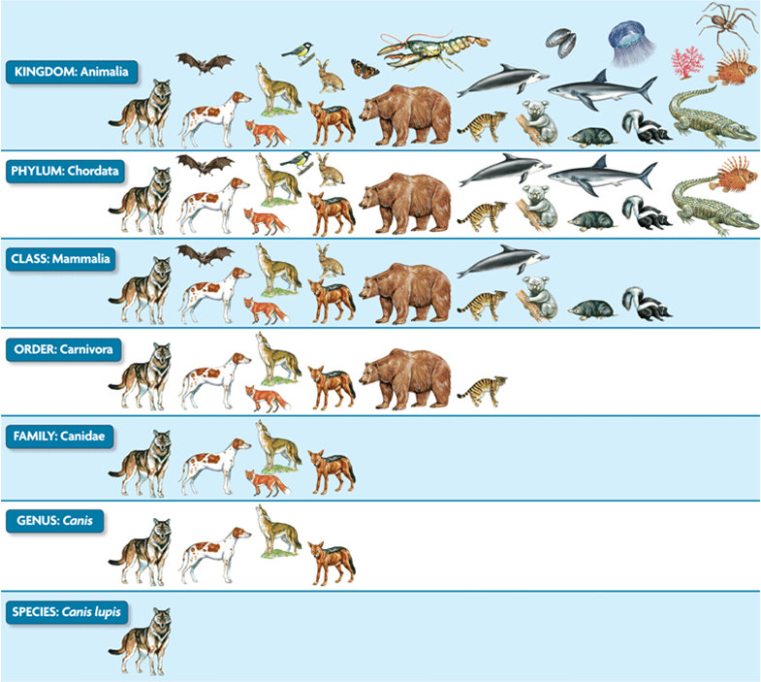
Sauvages was inspired by Linnaeus
http://www.robinsonlibrary.com/science/natural/biography/graphics/linnaeus2.jpg
http://s3.amazonaws.com/engrade-myfiles/4042767483300984/kingdom_taxonomy.png

Slide 26

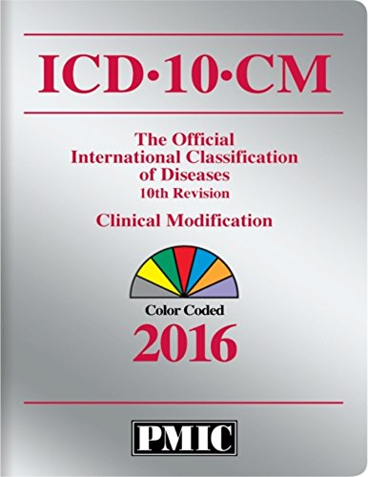
International Classification of Diseases

Slide 27
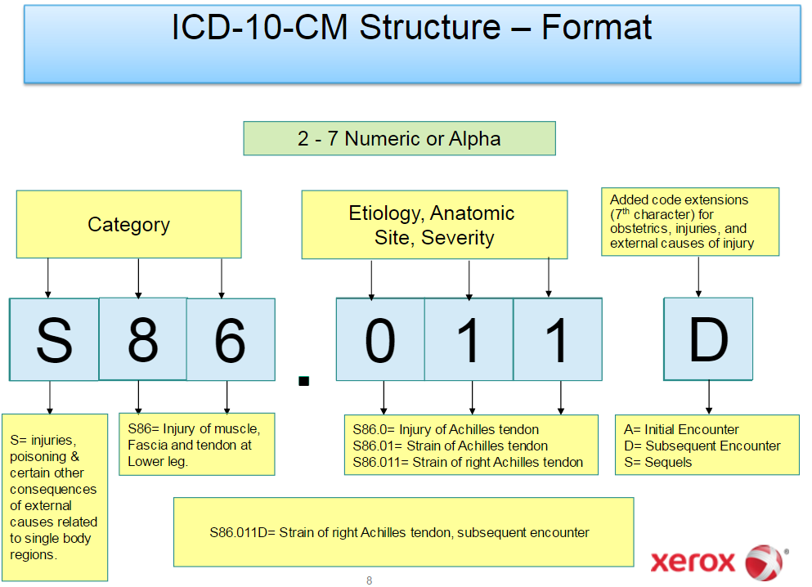

Slide 28
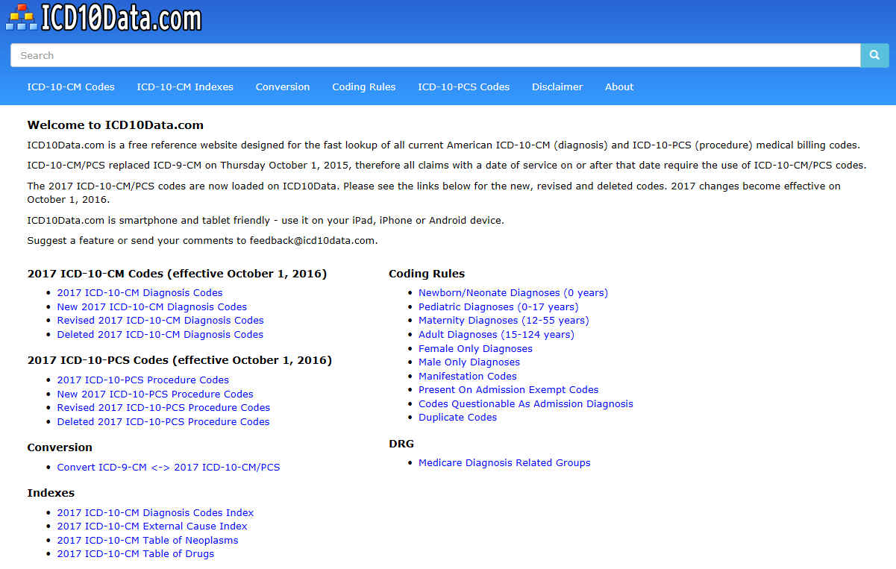
http://www.icd10data.com/

Slide 29
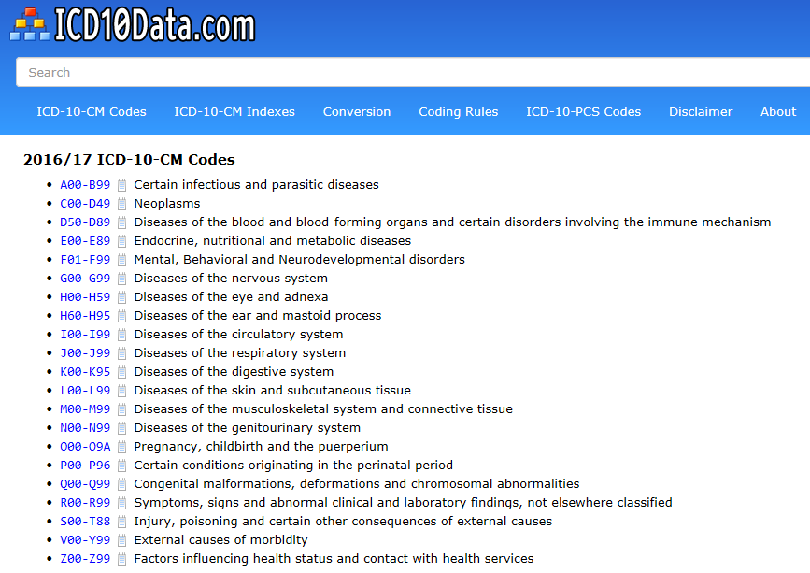
http://www.icd10data.com/ICD10CM/Codes
Would respiratory infections be
here
or
there?

Slide 30

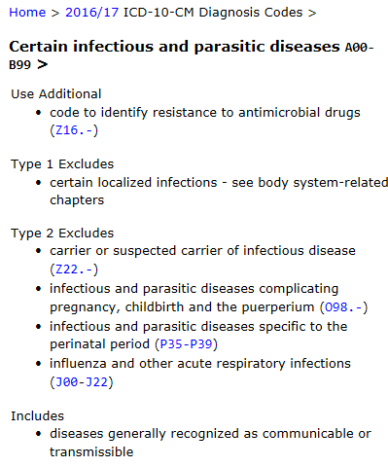
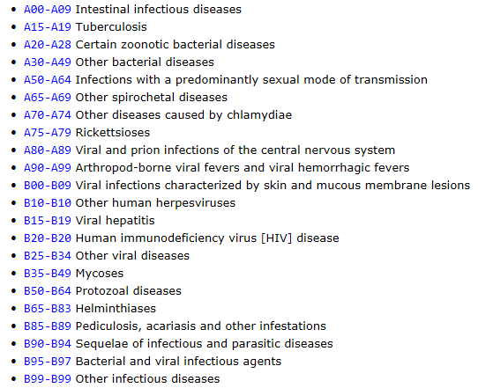
http://www.icd10data.com/ICD10CM/Codes

Slide 31
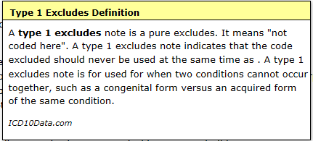
http://www.icd10data.com/ICD10CM/Codes

Slide 32
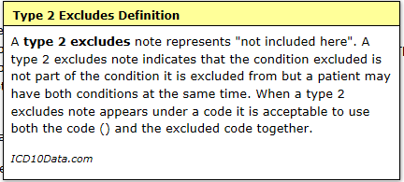
http://www.icd10data.com/ICD10CM/Codes

Slide 33
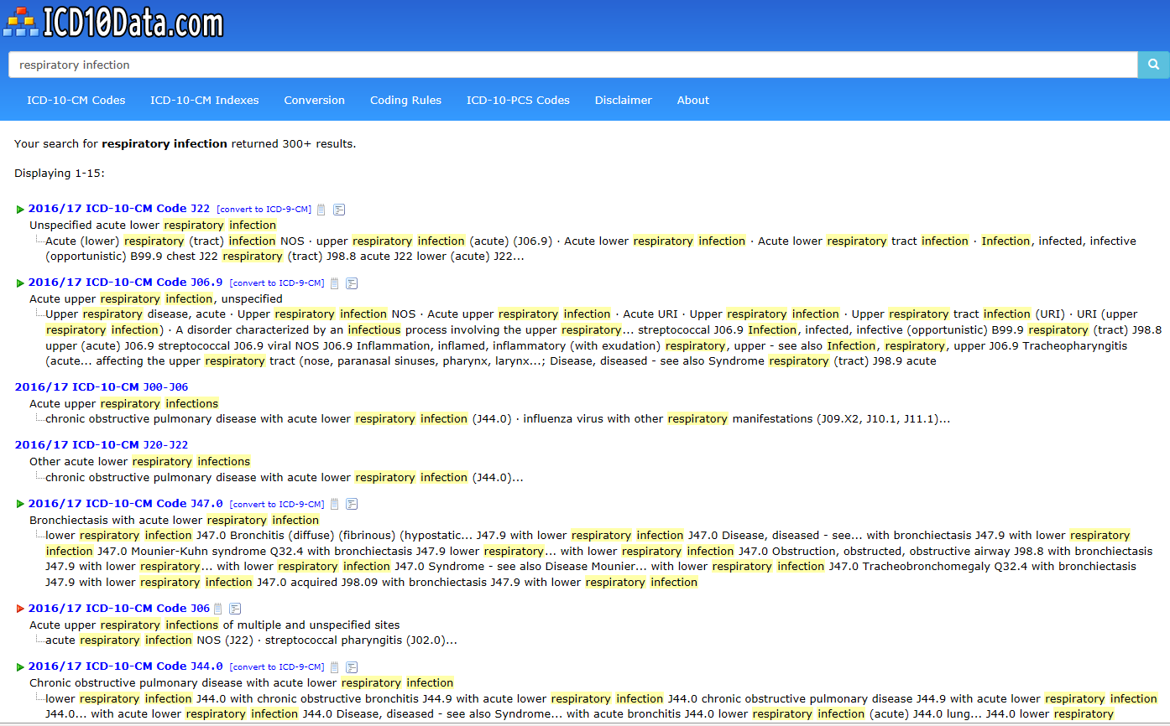
http://www.icd10data.com/ICD10CM/Codes

Slide 34
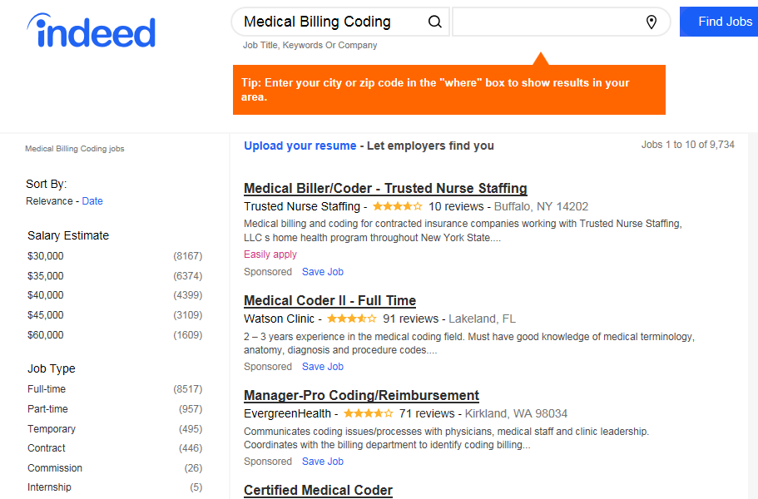
Job market for coding for billing
Nov 28, 2017

Slide 35
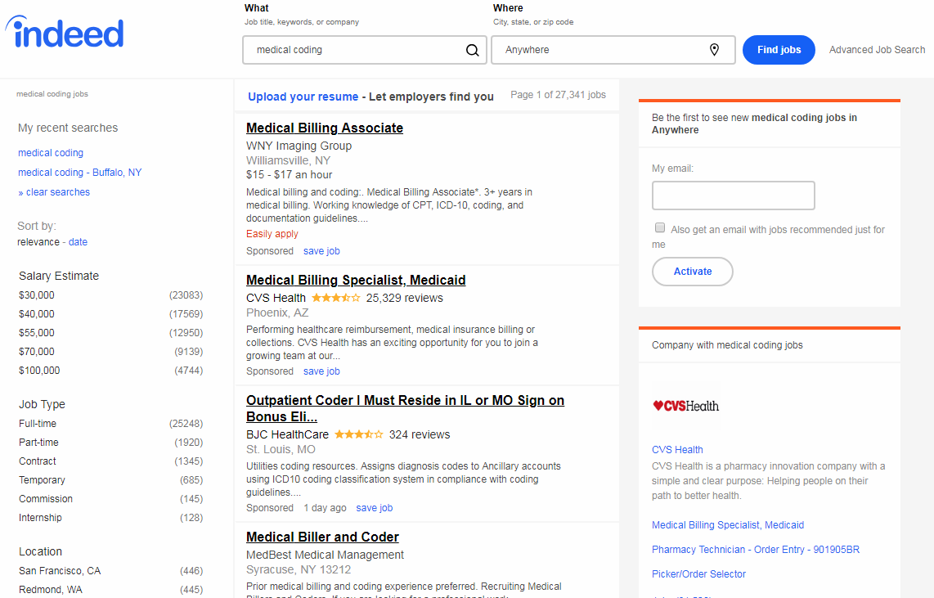
Nov 29, 2018

Slide 36
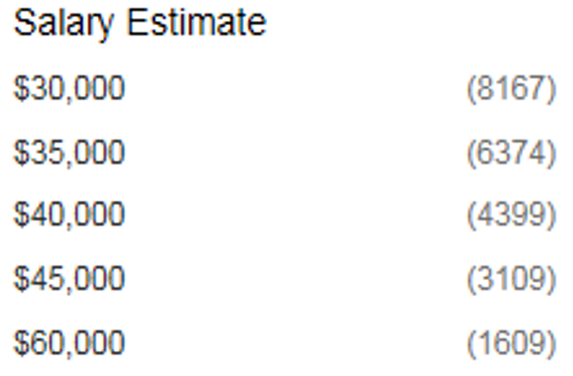
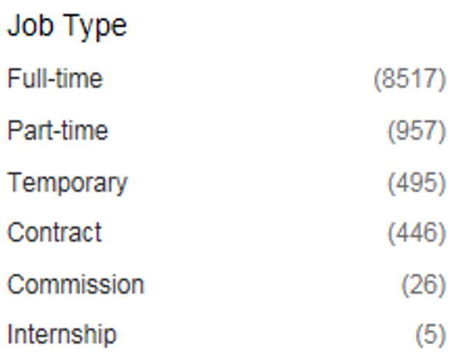
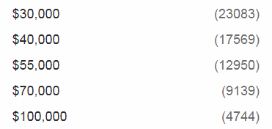
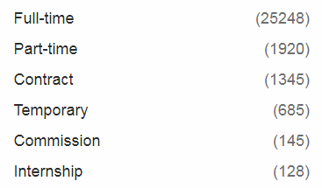
Differences ‘Medical coding’ 2017 → 2018
2017
2018

Slide 37
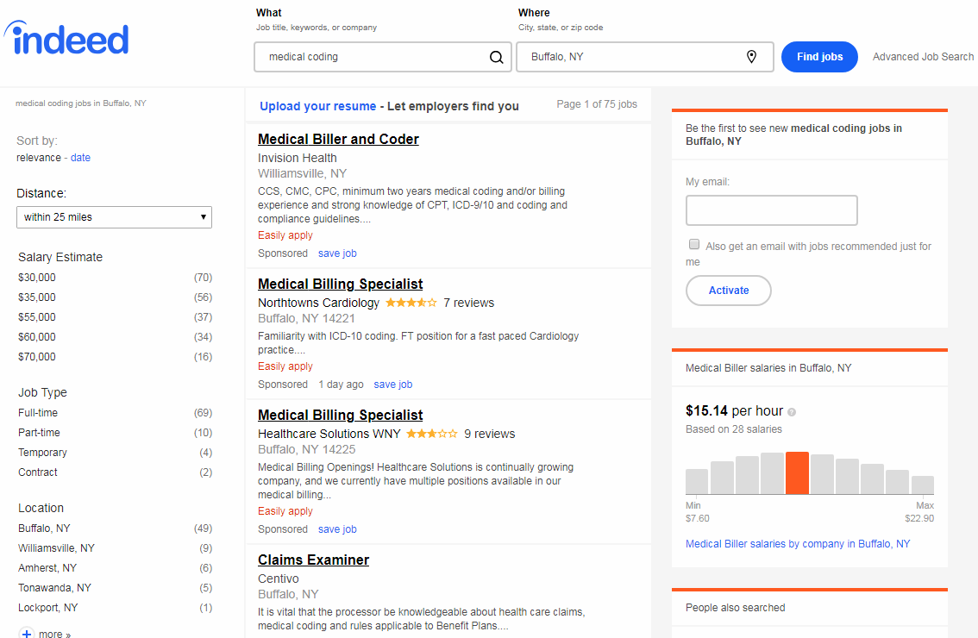
Nov 29, 2018

Slide 38

More info
http://www.medicalbillingandcoding.org

Slide 39
Adequate taxonomy design and classification
Taxonomy design:
Identify examples of particulars (‘individuals’, ‘things’, ‘entities’, …) you want to classify;
Identify the various characteristics that are possessed by (all or some of) these individual entities;
Identify groups (classes) on the basis of combinations of characteristics that co-occur;
Organize the groups hierarchically (‘parent-child’) so that characteristics that apply to a ‘parent’ (‘grandparent’,…) group apply to ALL groups beneath it;
Name the groups with terms that have face value.
Classification:
Assign individual entities to the groups that correspond with the combination of characteristics they exhibit.

Slide 40
Terminologies and Classification Systems
Ideally: the terminology makes it clear what entities belong to which class.
Usually: it doesn’t and extra inclusion and exclusion criteria are used.

Slide 41
Terminologies and Classification Systems
Ideally: the terminology makes it clear what entities belong to which class.
Usually: it doesn’t and extra inclusion and exclusion criteria are used.
Nearly always: it goes badly wrong!!!

Slide 42
Most often overlooked
MUST hold for ALL instances of the descendant class!!!
Ancestor/Parent
Class
Isa
subclassOf
subsumes
Descendant/Child
Class

Slide 43
A Fragment of (is-a) Relation in WordNet
Joe Raad, Christophe Cruz. A Survey on Ontology Evaluation Methods. HAL Id: hal-01274199. https://hal.archives-ouvertes.fr/hal-01274199. Submitted on 1 Feb 2018

Slide 44
Border’s classification of medicine: what’s wrong ?
Medicine
  Mental health
  Internal medicine
    Endocrinology
      Oversized endocrinology
    Gastro-enterology
    ...
  Pediatrics
  ...
  Oversized medicine
Refer to the size of the books that do not fit on a normal Border’s Bookshop shelf

Slide 45
Similar mistake in ICHD
‘13.1.2.4 Painful trigeminal neuropathy attributed to MS plaque’
‘attributed to’ relates to somebody’s opinion about what is the case, not to what is the case.
  the mistake: a feature on the side of the clinician – his (not) knowing - is taken to be a feature on the side of the patient.
Similar mistakes:
  ‘Probable migraine’
  ‘facial pain of unknown origin’ (not in ICHD).

Slide 46
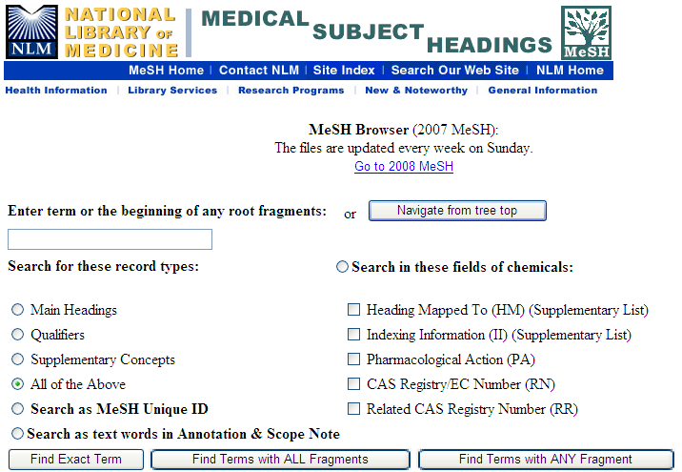
MeSH

Slide 47
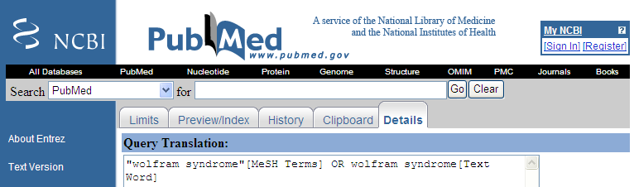
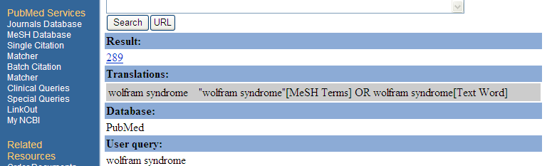
Use of MeSH in PUBMED
Wolfram syndrome

Slide 48
MeSH: Medical Subject Headings
Designed for bibliographic indexing, eg Index Medicus
Basis for MedLINE → Pubmed
focuses on biomedicine and other basic healthcare sciences
clinically very impoverished
Consistency amongst indexers:
  60% for headings
  30% for sub-headings

Slide 49
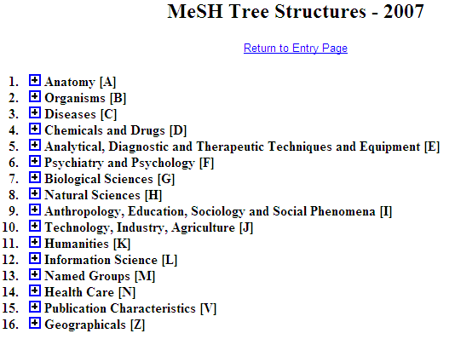
Is this a good idea ?
Cover subject matter of papers
Cover the form of papers

Slide 50
Principle
A representation should not mix object language and meta language
  object language describes the referents in the subject domain
  meta language describes the object language

Slide 51
Geographic Locations: a good hierarchy ?
Africa [Z01.058] +
Americas [Z01.107] +
Antarctic Regions [Z01.158]
Arctic Regions [Z01.208]
Asia [Z01.252] +
Atlantic Islands [Z01.295] +
Australia [Z01.338] +
Cities [Z01.433] +
Europe [Z01.542] +
Historical Geographic Locations [Z01.586] +
Indian Ocean Islands [Z01.600] +
Oceania [Z01.678] +
Oceans and Seas [Z01.756] +
Pacific Islands [Z01.782] +
mereological mess:
mixture of geographic entities with socio-political entities
mixture of space and time

Slide 52
Geographic Locations [Z01]
Africa [Z01.058] +
Americas [Z01.107] +
Antarctic Regions [Z01.158]
Arctic Regions [Z01.208]
Asia [Z01.252] +
Atlantic Islands [Z01.295] +
Australia [Z01.338] +
Cities [Z01.433] +
Europe [Z01.542] +
Historical Geographic Locations [Z01.586] +
Indian Ocean Islands [Z01.600] +
Oceania [Z01.678] +
Oceans and Seas [Z01.756] +
Pacific Islands [Z01.782] +
Ancient Lands [Z01.586.035] +
Austria-Hungary [Z01.586.117]
Commonwealth of Independent States [Z01.586.200] +
Czechoslovakia [Z01.586.250] +
European Union [Z01.586.300]
Germany [Z01.586.315] +
Korea [Z01.586.407]
Middle East [Z01.586.500] +
New Guinea [Z01.586.650]
Ottoman Empire [Z01.586.687]
Prussia [Z01.586.725]
Russia (Pre-1917) [Z01.586.800]
USSR [Z01.586.950] +
Yugoslavia [Z01.586.980] +

Slide 53
Geographic Locations [Z01]
Africa [Z01.058] +
Americas [Z01.107] +
Antarctic Regions [Z01.158]
Arctic Regions [Z01.208]
Asia [Z01.252] +
Atlantic Islands [Z01.295] +
Australia [Z01.338] +
Cities [Z01.433] +
Europe [Z01.542] +
Historical Geographic Locations [Z01.586] +
Indian Ocean Islands [Z01.600] +
Oceania [Z01.678] +
Oceans and Seas [Z01.756] +
Pacific Islands [Z01.782] +
Ancient Lands [Z01.586.035] +
Austria-Hungary [Z01.586.117]
Commonwealth of Independent States [Z01.586.200] +
Czechoslovakia [Z01.586.250] +
European Union [Z01.586.300]
Germany [Z01.586.315] +
Korea [Z01.586.407]
Middle East [Z01.586.500] +
New Guinea [Z01.586.650]
Ottoman Empire [Z01.586.687]
Prussia [Z01.586.725]
Russia (Pre-1917) [Z01.586.800]
USSR [Z01.586.950] +
Yugoslavia [Z01.586.980] +

Slide 54
Principle
A hierarchical structure should not represent distinct hierarchical relations unless they are formally characterized

Slide 55
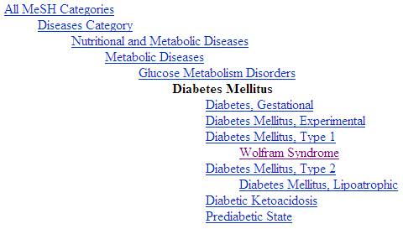
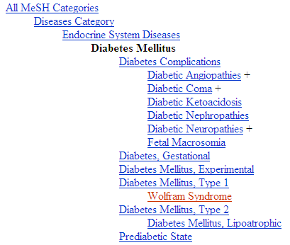
Diabetes Mellitus in MeSH 2008
?
Different set of more specific terms when different path from the top is taken.

Slide 56
MeSH: some paths from top to Wolfram Syndrome
All MeSH Categories
Diseases Category
Nervous System Diseases
Female Urogenital Diseases
and Pregnancy Complications
Eye Diseases
Male Urogenital
Diseases
Cranial Nerve
Diseases
Female Urogenital Diseases
Optic Nerve
Diseases
Neurodegenerative
Diseases
Optic Nerve
Diseases
Eye Diseases,
Hereditary
Heredodegenerative
Disorders,
Nervous System
Urologic Diseases
Optic Atrophy
Kidney Diseases
Optic Atrophies,
Hereditary
Diabetes Insipidus
Wolfram Syndrome

Slide 57

What would it mean if used in the context of a patient ?
All MeSH Categories
???
Diseases Category
Nervous System Diseases
Female Urogenital Diseases
and Pregnancy Complications
Eye Diseases
Male Urogenital
Diseases
Cranial Nerve
Diseases
Female Urogenital Diseases
…
Neurodegenerative
Diseases
Optic Nerve
Diseases
Optic Nerve
Diseases
Eye Diseases,
Hereditary
has
Heredodegenerative
Disorders,
Nervous System
Urologic Diseases
Optic Atrophy
Kidney Diseases
Optic Atrophies,
Hereditary
Diabetes Insipidus
has
Wolfram Syndrome

Slide 58
Principle
If a particular (individual) is related in a specific way to a ‘class’, it should also be related in the same way to all the ‘superclasses’ of that class
  Technically: “… to all the classes that subsume that class”

Slide 59
MeSH Tree Structures – 2007
Body Regions [A01]
  Extremities [A01.378]
    Lower Extremity [A01.378.610]
      Buttocks [A01.378.610.100]
      Foot [A01.378.610.250]
        Ankle [A01.378.610.250.149]
        Forefoot, Human [A01.378.610.250.300] +
        Heel [A01.378.610.250.510]
      Hip [A01.378.610.400]
      Knee [A01.378.610.450]
      Leg [A01.378.610.500]
      Thigh [A01.378.610.750]
What is bad practice ?

Slide 60
MeSH Tree Structures – 2007
Body Regions [A01]
  Abdomen [A01.047] +
  Back [A01.176] +
  Breast [A01.236] +
  Extremities [A01.378]
    Amputation Stumps [A01.378.100]
    Lower Extremity [A01.378.610] +
    Upper Extremity [A01.378.800] +
  Head [A01.456] +
  Neck [A01.598]
  Pelvis [A01.673] +
  Perineum [A01.719]
  Thorax [A01.911] +
  Viscera [A01.960]
What is wrong ?

Slide 61
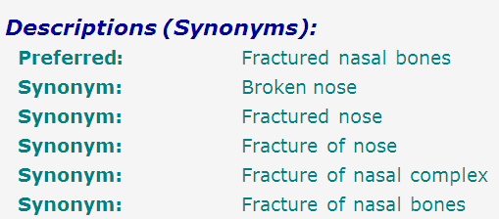
SNOMED-CT: what is wrong here?
bones
nose
fracture
false synonymy

Slide 62
Coding / Classification confusion
P + X
P + Y
P + Z
A patient with a fractured nasal bone
A patient with a fractured nasal bone
=
=
A patient with a broken nose
A patient with a broken nose
=
=
A patient with a fracture of the nose
A patient with a fracture of the nose

Slide 63
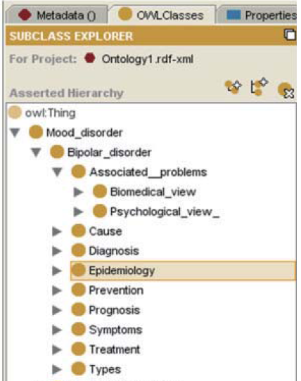
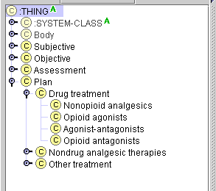
Be extremely critical when re-using.
Some people do not understand the representation language they are using!

Slide 64
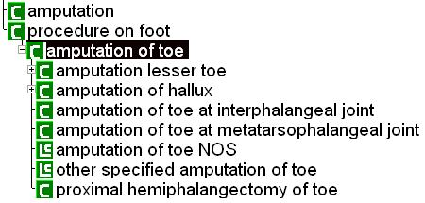

Do not have blind faith in computation
SNOMED-RT (2000)
SNOMED-CT (2003)

Slide 65
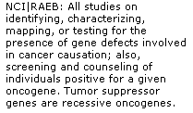

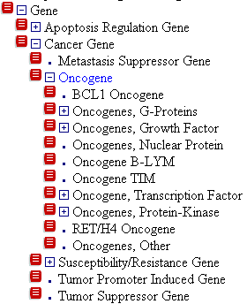
Let definitions reflect what is in the taxonomy

Slide 66
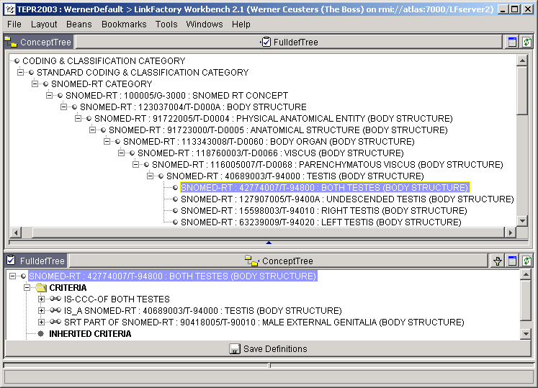
Be careful with mereological sums

Slide 67
Summary of current deficiencies in terminologies and classification systems (1)
Terms often require “reading in context”
Agrammatical constructions (paper-based indexing)
Semantic drift as one moves between hierarchies
Not (yet) useful for natural language understanding by software (but were not designed for that purpose)

Slide 68
Summary of current deficiencies in terminologies and classification systems (2)
labels for terms do not correspond with formal meaning
underspecification (leading to erroneous classification in DL-based systems)
overspecification (leading to wrong assumptions with respect to instances)

Slide 69
Next week: hands-on work
http://www.icd10data.com/
http://apps.who.int/classifications/icd10/browse/2016/en
The International Classification of Diseases (ICD) is by law required to be used as a standard code set for documenting diagnoses. ICD is developed by the World Health Organization which offers an online browser for finding the most accurate code(s) that correspond to the condition(s) a clinician wants to report on (http://apps.who.int/classifications/icd10/browse/2016/en#). E-cigarettes are not yet represented in that system. Students will explore how to use this browser, develop search strategies for finding acceptable related codes and identify issues in interpreting ICD in function of what they want to document about patients with different types of e-cigarette use.

