Slide 1
‘Disorder’, ‘disease’, ‘illness’, ‘sickness’: is there a difference?
Lecture in BMI199: What is Biomedical Informatics?
Sept 26, 2019
5 Diefendorf, University at Buffalo
Werner CEUSTERS, MD
Departments of Biomedical Informatics and Psychiatry,
UB Institute for Healthcare Informatics,
Ontology Research Group, Center of Excellence in Bioinformatics and Life Sciences,
University at Buffalo, NY, USA

Slide 2
Remember from last week
Ontology
Terminology

Slide 3

Remember from last week
Ontology
What entities exist?
How do entities relate to each other?
Terminology
What entities, if any at all, are denoted by words or terms?
‘Earth’ ‘Aarde’ ‘La Terre’
Reality
Representation

Slide 4
Canonical case: faithful representation
Ontology
Terminology
Reality
Representation
‘Earth’
‘Aarde’
‘La Terre’
…
denotes
means
represents

Slide 5
Delusions, fantasies, imaginations, …
Ontology
Terminology
Reality
Representation
‘unicorn’

Slide 6

Delusions, fantasies, imaginations, …
Ontology
Terminology
Reality
Representation
‘unicorn’

Slide 7

Delusions, fantasies, imaginations, …
Ontology
Terminology
Reality
Representation
‘unicorn’
Graphics

Slide 8
Delusions, fantasies, imaginations, …
Conceptualism
Terminology
Reality or
Imagination
Representation
‘unicorn’
Graphics
unicorn concept

Slide 9
Semiotic / semantic triangle
(Ogden & Richards, 1923:
The meaning of ‘meaning’)
concept
term
referent

Slide 10
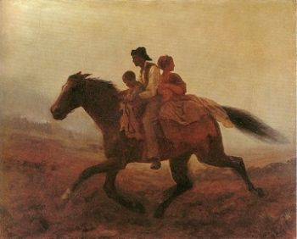
Prehistoric ‘psychiatry’: drapetomania
disease which causes slaves to suffer from an unexplainable propensity to run away
…
concept
term
referent
painting by Eastman Johnson. A Ride for Liberty: The Fugitive Slaves. 1860.
‘drapetomania’

Slide 11
Conceptualism versus Ontological Realism
First order reality
concept
type
term
referent
representational
unit
particular
Conceptualism
Ontological Realism

Slide 12
Ontological Realism offers three ways of relating, without assigning beliefs (concepts) a central status
drapetomania
slave
running away
mental disorder
propensity
Social science
Linguistics
Ontology
How beliefs are / can
be related
How terms are related
How referents (in
reality) are related

Slide 13
What is the case ?
Ontology
Terminology
Reality
Representation
‘disorder’
‘disease’
‘illness’
‘sickness’
U1
Synonymy

Slide 14
What is the case ?
Ontology
Terminology
Reality
Representation
U1
‘disorder’
‘disease’
‘illness’
‘sickness’
U2

Slide 15
What is the case ?
Ontology
Terminology
Reality
Representation
U1
‘disorder’
‘disease’
‘illness’
‘sickness’
U2
U3
U4

Slide 16
What is the case ?
Ontology
Terminology
Reality
Representation
U1
‘disorder’
‘disease’
‘illness’
‘sickness’
U2
U3
U4

Slide 17
What do you think?

Slide 18
How can we find out?

Slide 19
1. Terminological inquiry

Slide 20
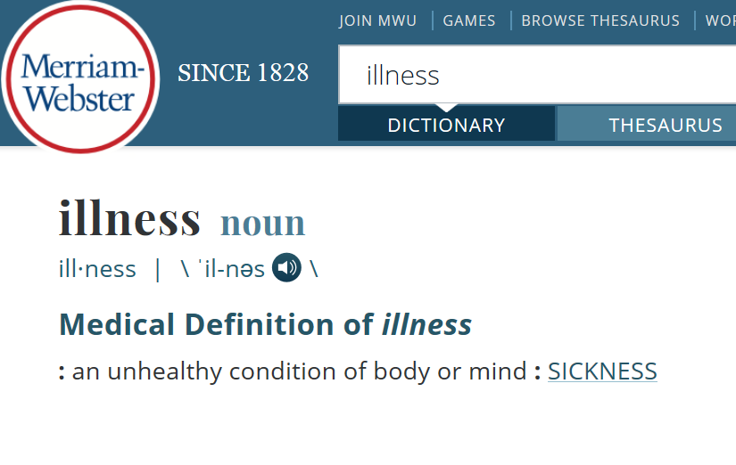

Slide 21
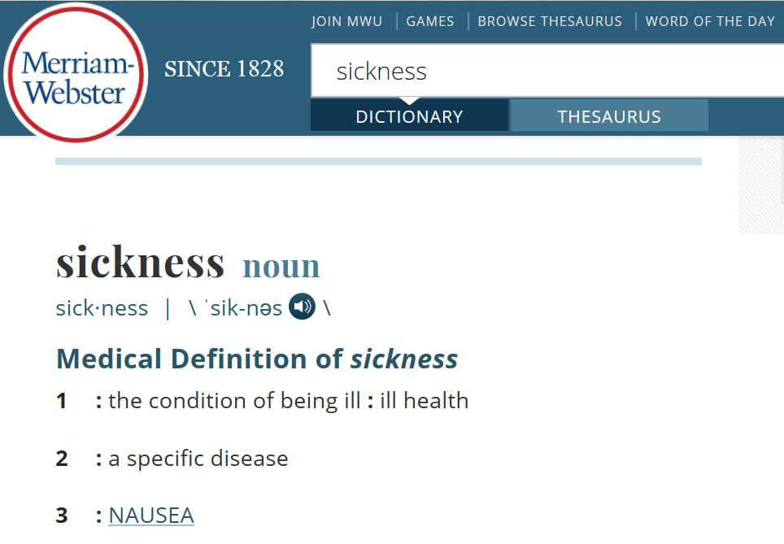

Slide 22
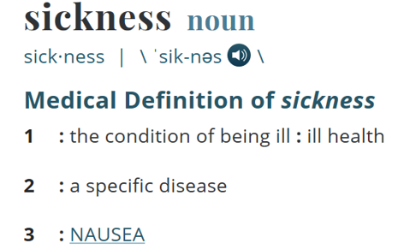
What is the case ?
Ontology
Terminology
Reality
Representation
‘sickness’
U2
Homonymy
U3
U4

Slide 23
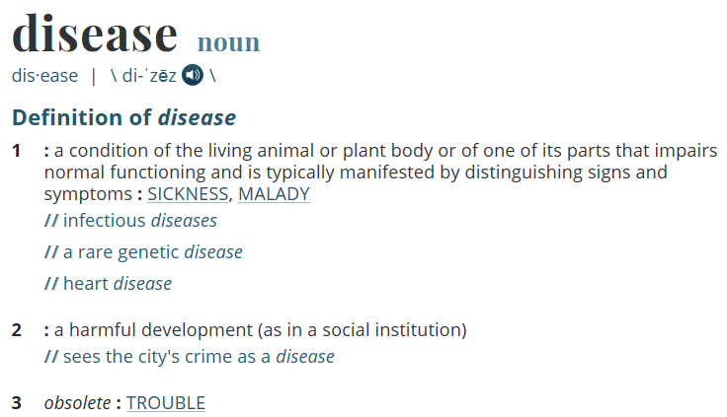

Slide 24
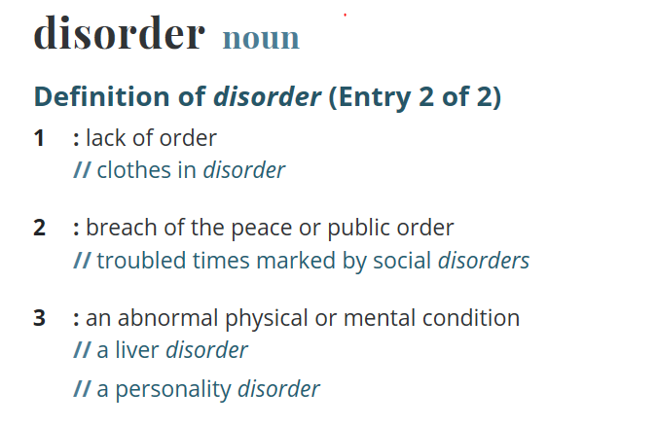

Slide 25
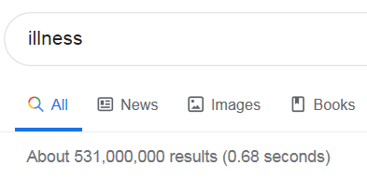
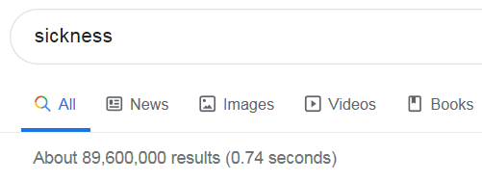
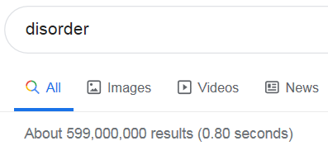
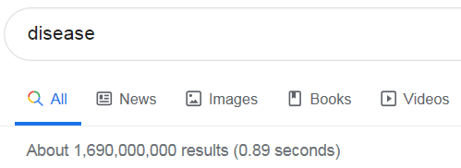
How often are the words used in Google?
3
4
2
1

Slide 26
2. Metaphysical inquiry

Slide 27
2. Metaphysical inquiry
Define terms precisely so that what is intended by (ideally) all uses of the corresponding terms in the language under scrutiny falls under it;
Investigate how what is intended by these uses relate to each other.

Slide 28
The objective Bio-Psycho-Social perspective
‘T-Disease’:
  a health problem that consists of a physiological malfunction that results in an actual or potential reduction in physical capacities and/or a reduced life expectancy
‘T-Illness’:
  a subjectively interpreted undesirable state of health, consisting of subjective feeling states (e.g., pain, weakness), perceptions of the adequacy of their bodily functioning, and/or feelings of competence
‘T-Sickness’:
  a social entity in virtue of the poor health or the health problem(s) of an individual defined by others with reference to the social activity of that individual
Twaddle, A. (1994a). Disease, illness and sickness revisited.
In: A. Twaddle & L. Nordenfelt. (Eds.) Disease, Illness and Sickness: Three Central Concepts in the Theory of Health
(pp. 1–18). Link€oping: Studies on Health and Society, 18.

Slide 29
The subjective Bio-Psycho-Social perspective
T-Disease:
  when there are negative bodily occurrences as conceived of by the medical profession.
T-Illness:
  when there are negative bodily occurrences as conceived of by the person himself.
T-Sickness:
  when there are negative bodily occurrences as conceived of by the society and/or its institutions.
‘Occurrence’ here means ‘process’, ‘state’ or ‘event’.
Bjørn Hofmann. On the Triad Disease, Illness and Sickness.
Journal of Medicine and Philosophy 2002, Vol. 27, No. 6, pp. 651–673

Slide 30
Overlap in the Bio-Psycho-Social perspective
T-Illness
6
3
4
1
5
7
2
T-Disease
T-Sickness
Bjørn Hofmann. On the Triad Disease, Illness and Sickness.
Journal of Medicine and Philosophy 2002, Vol. 27, No. 6, pp. 651–673

Slide 31
3. Ontological inquiry
OGMS:
Ontology for General Medical Science

Slide 32
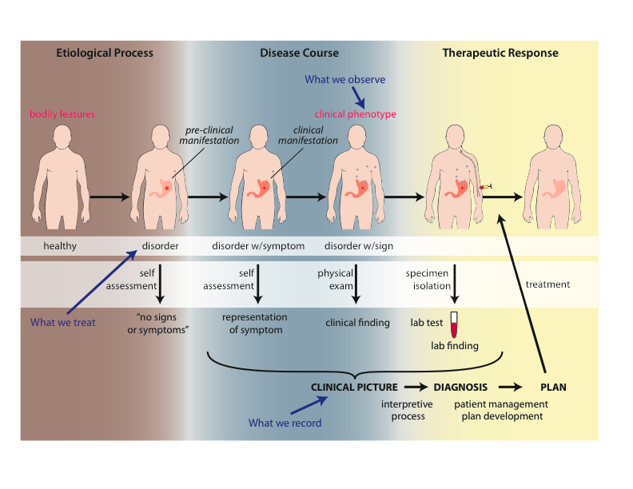
What happens in the body
Scheuermann R, Ceusters W, Smith B. Toward an Ontological Treatment of Disease and Diagnosis. 2009 AMIA Summit on Translational Bioinformatics, San Francisco, California, March 15-17, 2009;: 116-120.
Notes:
font was too small, color inside green boxes was hardly readable

Slide 33
Goals of OGMS
To serve as a consistent, logically well-defined extensible framework (ontology) for the representation of:
    features of disease;
    clinical processes;
    results of tests and diagnostic processes.

Slide 34
Foundational Terms (1)
Disorder =def. – A causally linked combination of physical components of the extended organism that is
  (a) clinically abnormal and
  (b) maximal, in the sense that it is not a part of some larger such combination.

Slide 35
Basic Formal Ontology
Continuant
Occurrent
(Process)
Independent
Continuant
(molecule,
cell, organ,
organism)
Dependent
Continuant
(quality,
function,
disease)
..... ..... .... .....

Slide 36
Physical Disorder
  – independent continuant
    objects
    fiat object parts
    object aggregates
    A causally linked combination of physical components of the extended organism.

Slide 37
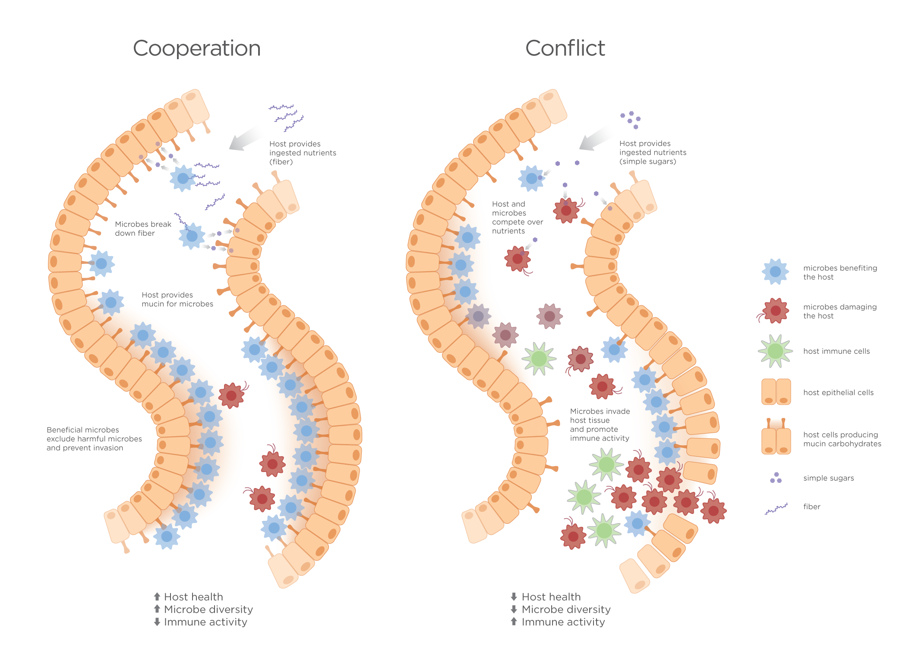
Extended organism
Harth R. War and peace in the human gut: probing the microbiome
https://biodesign.asu.edu/sites/default/files/news/AthenaHostcooperation7.png

Slide 38
Clinically abnormal
something is clinically abnormal if:
  is not part of the life plan for an organism of the relevant type (unlike aging or pregnancy),
  is causally linked to an elevated risk either of pain or other feelings of illness, or of death or dysfunction, and
  is such that the elevated risk exceeds a certain threshold level.

Slide 39
Foundational Terms (2)
Disorder =def. – A causally linked combination of physical components of the extended organism that is
  (a) clinically abnormal and
  (b) maximal, in the sense that it is not a part of some larger such combination.
Pathological Process =def. – A bodily process that is a manifestation of a disorder and is clinically abnormal.

Slide 40
Basic Formal Ontology
Continuant
Occurrent
(Process)
Independent
Continuant
(molecule,
cell, organ,
organism)
Dependent
Continuant
(quality,
function,
disease)
..... ..... .... .....

Slide 41
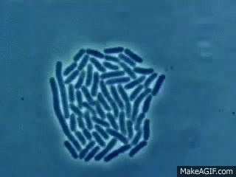

Slide 42
Foundational Terms (3)
Disorder =def. – A causally linked combination of physical components of the extended organism that is (a) clinically abnormal and (b) maximal, in the sense that it is not a part of some larger such combination.
Pathological Process =def. – A bodily process that is a manifestation of a disorder and is clinically abnormal.
Disease =def. – A disposition (i) to undergo pathological processes that (ii) exists in an organism because of one or more disorders in that organism.

Slide 43
Continuant
Independent
Continuant
Dependent
Continuant
Non-realizable
Dependent
Continuant
(quality)
Realizable
Dependent
Continuant
(function, role,
disposition)
..... .....

Slide 44
Realizable dependent continuants
plan
function
role
disposition
capability
tendency
continuants

Slide 45
Their realizations
execution
expression
exercise
realization
application
course
occurrents

Slide 46
Disposition
- of a glass vase, to shatter if dropped
- of a human, to eat
- of a banana, to ripen
- of John, to lose hair
dispositions must have some physical basis

Slide 47
Disposition
if it ceases to exist, then its bearer and/or its immediate surrounding environment is physically changed;
its realization occurs when its bearer is in some special physical circumstances;
its realization is what it is in virtue of the bearer’s physical make-up.

Slide 48
Dispositions are realized in processes
dependent
continuant
occurrent
process
disposition
ripening
to ripen
disposition of this
fruit: to ripen
process of ripening
in this fruit

Slide 49
independent
continuant
dependent
continuant
occurrent
disposition
process
integumentary
system
process of going bald
to go bald
John’s
integumentary
system
John’s
disposition:
to go bald
John’s going
bald

Slide 50
Dependence
on the instance level
a depends_on b =def. a is necessarily such that if b ceases to exist than a ceases to exist
on the type level
A depends_on B =def. for every instance a of A, there is some instance b of B such that a depends_on b.

Slide 51
realization depends_on realizable
Continuant
Occurrent
Independent
Continuant
bearer
Dependent
Continuant
disposition
Process of
realization
.... ..... .......

Slide 52
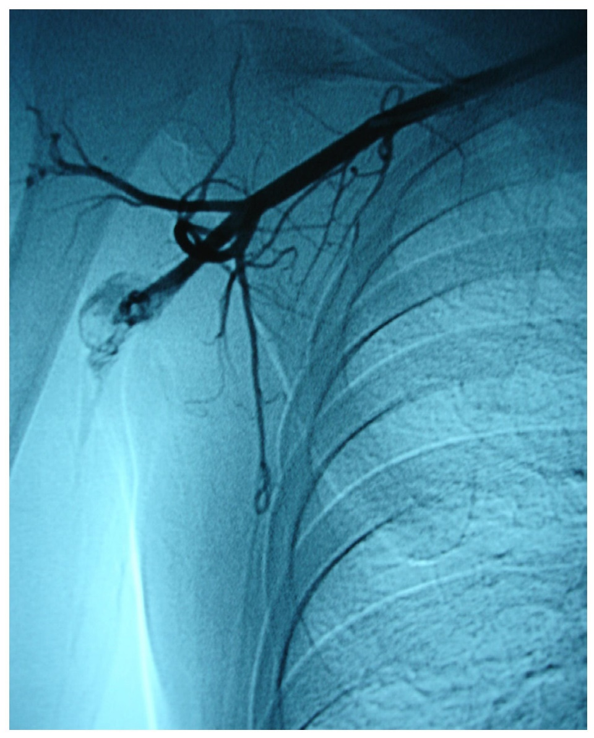
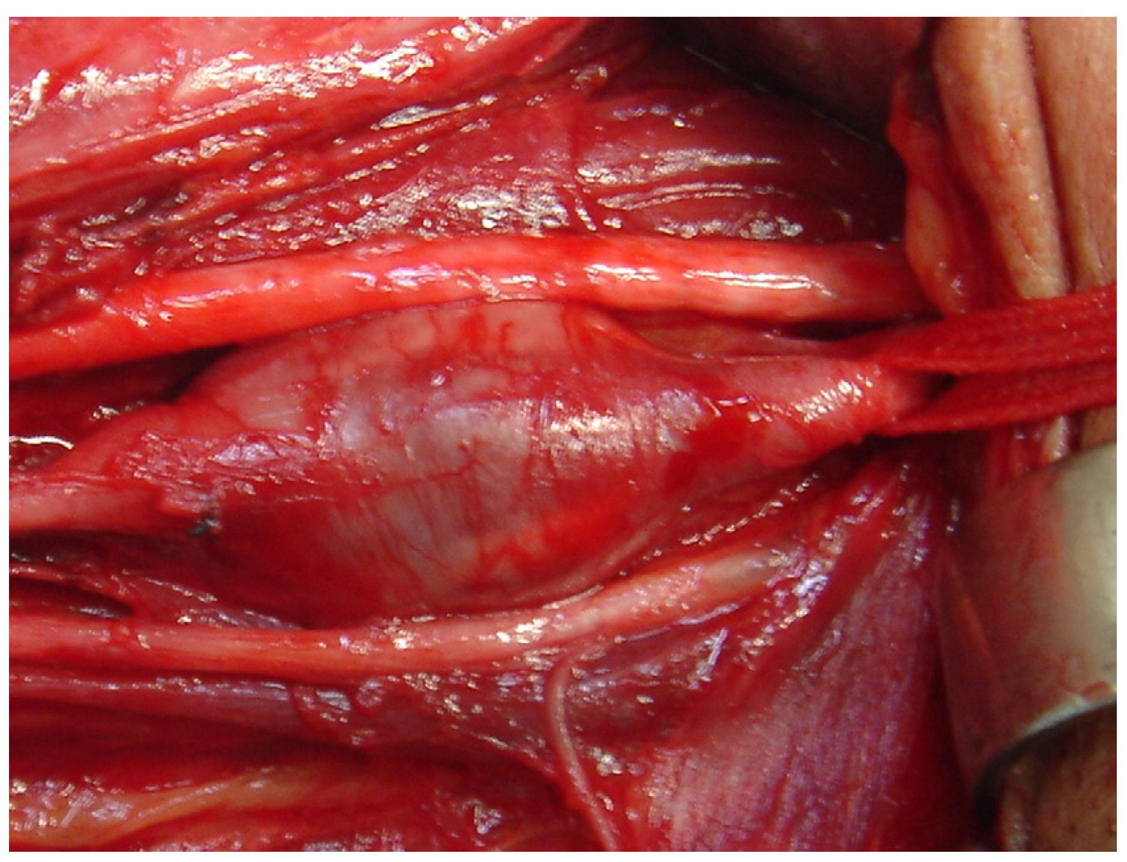
Arterial aneurysm
Jornal Vascular Brasileiro Print version ISSN 1677-5449
J. vasc. bras. vol.12 no.4 Porto Alegre Oct./Dec. 2013 Epub Dec 15, 2013
http://dx.doi.org/10.1590/jvb.2013.054
Subclavian and axillary arterial aneurysms: two case reports
Fernando Pinho Esteves¹ , André Ventura Ferreira¹ , Vanessa Prado dos Santos² , Gabriel Santos Novaes¹ , Álvaro Razuk Filho¹ , Roberto Augusto Caffaro¹

Slide 53
Arterial Aneurysm
Disposition – atherosclerosis
  realized in
Pathological process – fatty material collects within the walls of arteries
  produces
Disorder – artery with weakened wall
  bears
Disposition – of artery to become distended
  realized_in
Pathological process – process of distending
  produces
Disorder – arterial aneurysm
  bears
Disposition – of artery to rupture
  realized in
Pathological process – (catastrophic event) of rupturing
  produces
Disorder – ruptured artery, arterial system with dangerously low blood pressure
  bears
Disposition – circulatory failure
  realized in
Pathological process – exsanguination, failure of homeostasis
  produces
Death

Slide 54
coronary heart disease
disease associated with early lesions and small fibrous plaques
disease associated with asymptomatic (‘silent’) infarction
disease associated with surface disruption of plaque
unstable angina
stable angina
instantiates at t₂
instantiates at t₃
instantiates at t₄
instantiates at t₅
instantiates at t₁
John’s coronary heart disease
time

Slide 55
independent
continuant
dependent
continuant
occurrent
disposition
process
heart
disease course
coronary heart disease
John’s heart
John’s coronary
heart disease
course of John’s
coronary heart disease

Slide 56
Disease course
The totality of all PROCESSes through which a given DISEASE instance is realized.

Slide 57
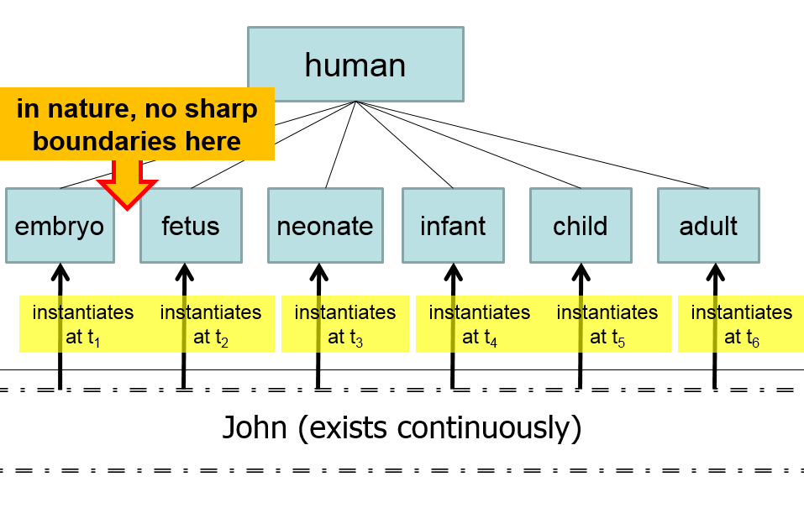
Compare with

Slide 58
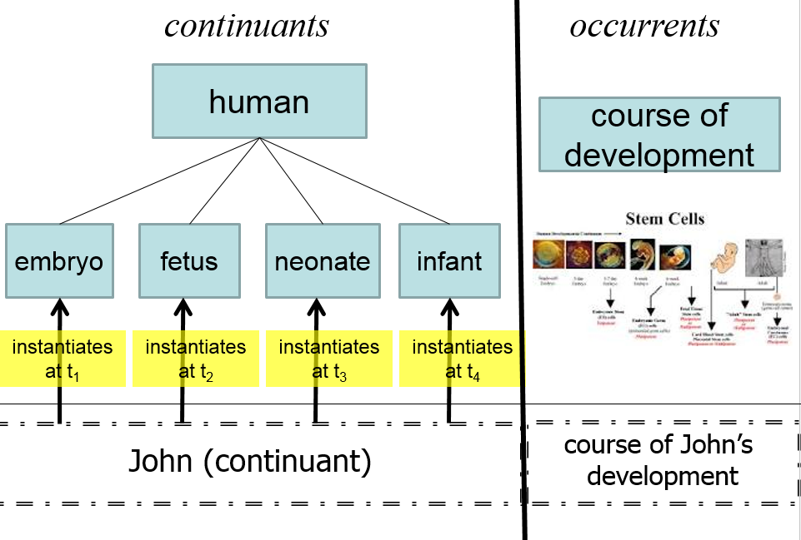

Slide 59
Etiology
Etiological Process =def. – A process in an organism that leads to a subsequent disorder.
Examples:
  toxic chemical exposure resulting in a mutation in the genomic DNA of a cell;
  infection of a human with a pathogenic virus;
  inheritance of two defective copies of a metabolic gene.
The etiological process creates the physical basis of that disposition to pathological processes which is the disease.

Slide 60
Dispositions and Predispositions
All diseases are dispositions; not all dispositions are diseases.
A predisposition is a disposition.
Predisposition to Disease of Type X =def. – A disposition in an organism that constitutes an increased risk of the organism’s subsequently developing the disease X.
Hereditary Non-polyposis Colorectal Cancer (HNPCC) is caused by a:
  disorder (mutation) in a DNA mismatch repair gene that
  disposes to the acquisition of additional mutations from defective DNA repair processes, and thus
  predisposition to the development of colon cancer.

Slide 61
Hereditary Non-polyposis Colorectal Cancer HNPCC - genetic pre-disposition
Etiological process - inheritance of a mutant mismatch repair gene
  produces
Disorder - chromosome 3 with abnormal hMLH1
  bears
Disposition (disease) - Lynch syndrome
  realized_in
Pathological process - abnormal repair of DNA mismatches
  produces
Disorder - mutations in proto-oncogenes and tumor suppressor genes with microsatellite repeats (e.g. TGF-beta R2)
  bears
Disposition (disease) - non-polyposis colon cancer

Slide 62
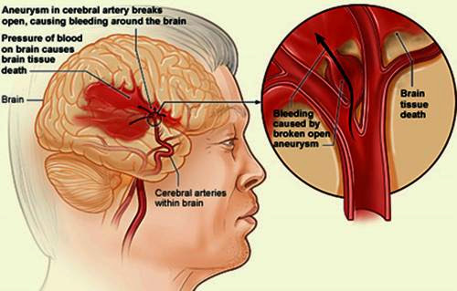
Hemorrhagic stroke
http://www.tomfit247.com/2013/05/stroke-what-is-it-what-causes-it-and.html

Slide 63
Hemorrhagic stroke
Disorder – cerebral arterial aneurysm
  bears
Disposition – of weakened artery to rupture
  realized in
Pathological process – rupturing of weakened blood vessel
  produces
Disorder – Intraparenchymal cerebral hemorrhage
  bears
Disposition (disease) – to increased intra-cranial pressure
  realized in
Pathological process – increasing intra-cranial pressure, compression of brain structures
  produces
Disorder – Cerebral ischemia, Cerebral neuronal death
  bears
Disposition (disease) – stroke
  realized in
Symptoms – weakness/paralysis, loss of sensation, etc

Slide 64
Disorder related configurations
No disorder instance → no disease instance,
→ no pathological processes;
A disorder instance can eliminate the range of circumstances under which another disorder instance can lead to pathological processes → no disease instance;
Disorders of the same type in distinct patients, or in the same patient at distinct times, may lead to diseases of distinct types;
Diseases of the same type may lead to disease courses of distinct types;
Diseases of distinct types may lead to disease courses of the same type;
…

Slide 65
Next week
Quiz about:
‘disorder’, ‘disease’, ‘illness’, ‘sickness’:
is there a difference?

