Slide 1
UB Summer Informatics Data Science Bootcamp
Department of Biomedical Informatics, University at Buffalo
July – August, 2026
Topic: Biomedical Ontology
July 13: Elements of Logic for Ontology Design.
July 15: Principles of Realism-Based (Biomedical) Ontology.
July 16: Using First-Order Logic to Develop Realism-based Ontologies.
Werner CEUSTERS, MD
Professor and Division Chief Biomedical Ontology, Dept of Biomedical Informatics
Professor, Dept of Psychiatry
University at Buffalo, NY, USA

Slide 2
Learning Objectives of days 1, 2 and 3
Explain the distinctions between:
  ‘ontology’ and ‘ontologies’;
  ‘ontologies’ and other types of knowledge representations (KR);
  concept-based ontologies and realism-based ontologies;
  logic(s), logic programming and formal representations;
  logical and ontological principles in KR;
  the principles used in the Basic Formal Ontology (BFO), the OBO Foundry and the ‘BioPortal ontologies’.
Describe the realism-based principles underlying the BFO (and, time permitting, the Ontology for General Medical Science (OGMS)).
Understand that distinct non-realism-based ontologies rarely use the same set of principles.
Acquire the basics of writing ontology axioms in First Order Logic embedded in CLIF.

Slide 3
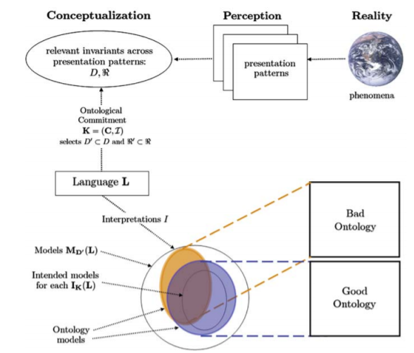
Ontological principles
Logical principles
What Is an Ontology?
Nicola Guarino, Daniel Oberle, and Steffen Staab
S. Staab and R. Studer (eds.), Handbook on Ontologies, International Handbooks 1
on Information Systems, DOI 10.1007/978-3-540-92673-3,
Springer-Verlag Berlin Heidelberg 2009

Slide 4
Common Logic Interchange Format
(CLIF)
John is going to Boston by bus
mainstream representation with predicates expressing ‘properties’ and relations:
(exists (x y)
(and (Go x) (Person John) (City Boston)
(Bus y) (Agnt x John) (Dest x Boston) (Inst x y)))
quantifier
variable
predicate
individuals
connective
https://standards.iso.org/ittf/PubliclyAvailableStandards/c066249_ISO_IEC_24707_2018.zip

Slide 5
CLIF-axiom from BFO2020
‘No role changes type during its existence [bks-1]’
Realism-based representation with predicates expressing (almost) exclusively relations:
(forall (o)
(if (exists (t) (instance-of o role t))
(forall (u)
(if (exists (t) (instance-of o u t))
(forall (t) (iff (instance-of o role t)
(instance-of o u t))))))))

Slide 6
Ambiguous working example
(Source: The International Classification of Headache Disorders)
‘Persistent idiopathic facial pain (PIFP)’
  = ‘persistent facial pain with varying presentations …’
persistent
facial pain
presentation
type1
presentation
type2
presentation
type3
types
t₂
t₃
t₁
t₁
t₁
t₂
t₂
t₃
t₁
t₃
parti-
culars
t₁
t₂
t₂
t₁
t₃
t₂
t₃
t₃
my pain
her pain
his pain

Slide 7
PIFP in ICOP
(International Classification of Orofacial Pain, https://journals.sagepub.com/doi/10.1177/0333102419893823 derived from The International Classification of Headache Disorders)
Persistent facial pain, with variable features, recurring daily for more than 2 hours per day for more than 3 months, in the absence of clinical neurological deficit or preceding causative event.
Diagnostic criteria:
Facial pain fulfilling criteria B and C;
Recurring daily for >2 hours/day for >3 months;
Pain has both of the following characteristics:
  poorly localized, and not following the distribution of a peripheral nerve
  dull, aching or nagging quality;
Clinical and radiographic examinations are normal, and local causes have been excluded;
Not better accounted for by another ICOP or ICHD-3 diagnosis.

Slide 8
FOL ontology development tools
BFO2020–FOL CLIF template,
  https://github.com/BFO-ontology/BFO-2020/tree/master/21838-2/common-logic
  https://bfo-ontology.github.io/browse-clif.html
A Prolog-program combining:
  a parser that reads and validates one or more of such templates and generates error messages and warnings,
  a transformer that generates a variety of output formats when no errors found, e.g.:
    Prenex DNF, Kowalski-rules, Prover9 axioms, …
  a heuristics-based reasoner that suggests possible improvements on the axiom set;
Prover9 for theorem proving;
  https://www.cs.unm.edu/~mccune/prover9/index_mar2026.html
All working together in a pipeline.

