Slide 1
UB Summer Informatics Data Science Bootcamp
Department of Biomedical Informatics, University at Buffalo
July – August, 2024
Topic: Biomedical Ontology
July 16: (wc) Elements of Logic for (Biomedical) Ontology.
July 17: (wc) Principles of Realism-Based (Biomedical) Ontology.
July 18: (wc) Referent Tracking for Biomedical Informatics.
July 26: (ad) SPARQL-queries
Werner CEUSTERS, MD
Professor and Division Chief Biomedical Ontology, Dept of Biomedical Informatics
Professor, Dept of Psychiatry
University at Buffalo, NY, USA

Slide 2
Learning Objectives of days 1, 2 and 3
Explain the distinctions between:
  ‘ontology’ and ‘ontologies’;
  ‘ontologies’ and other types of knowledge representations (KR);
  concept-based ontologies and realism-based ontologies;
  logic(s), logic programming and formal representations;
  logical and ontological principles in KR;
  the principles used in the Basic Formal Ontology (BFO), the OBO Foundry and the ‘BioPortal ontologies’.
Describe the realism-based principles underlying the BFO and the Ontology for General Medical Science (OGMS).
Understand that distinct non-realism-based ontologies rarely use the same set of principles.
Use Referent Tracking as a methodology to:
  Design high-quality realism-based ontologies;
  Identify shortcomings in information systems;
  Perform ontology-based quality control on databases.

Slide 3
Realism-based ontology
General principles:
  What to represent
    → ‘ontology’: philosophical discipline,
    Basic principles to classify what exists
  How to represent
    → ‘ontology’: formal representation,

Slide 4
Ontology is much more than classification!
Classification: based on ‘properties’ ‘in common’
  being human, being pregnant, being poisonous,
  having cancer, having a parent, having mass,
  …
Ontology:
  Mainstream ‘ontology’: merely classification
  Realism-based ontology:
    Analyzing the ‘properties’ themselves:
      If x has property p, can x exist without p?
      If x acquired property p, can x ever lose p?
      Can x and y share property p?
      …

Slide 5
Mimicking the nature of things in the representation of these things !
‘Some red ball’:
ball(x) ∧ red(x) ?
ball(x) ∧ has-color(x, red) ?
ball(x) ∧ red(y) ∧ has-color(x, y) ?
instance-of(x, ball) ∧ instance-of(y, red) ∧ has-color(x, y) ?
instance-of(x, ball, t) ∧ instance-of(y, red, t) ∧
instance-of(t, temporal-interval, t) ∧ has-color(x, y) ?
Realism-based

Slide 6
Essential distinctions made in Realism-based ontologies
Reality versus representations
Particulars versus types

Slide 7
Portions of reality versus representations thereof

Slide 8


Reality ←→ Representation

Slide 9
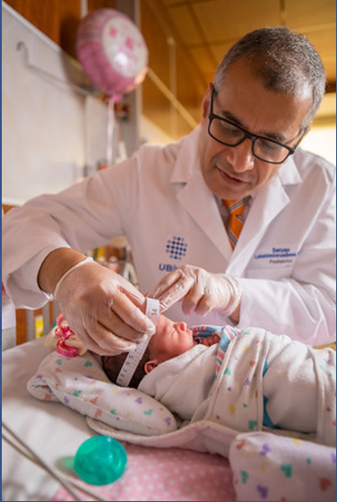
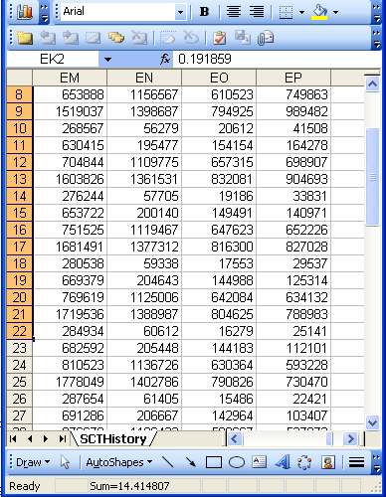
Reality ←→ Representation
(research) domain
(research) data
Referents
References

Slide 10

Realism-based Ontology (RBO)
Referents
  are (meta-) physically the way they are,
  relate to each other in an objective way,
  follow ‘laws of nature’.
Window on reality
  restricted by:
  what is physically and technically observable,
  fit between what is measured and what we think is measured,
  fit between established knowledge and ‘laws of nature’.
References
  follow, ideally, the syntactic-semantic conventions of some representation language,
  are restricted by the expressivity of that language,
  reference collections need to come, for correct interpretation, with documentation outside the representation.

Slide 11
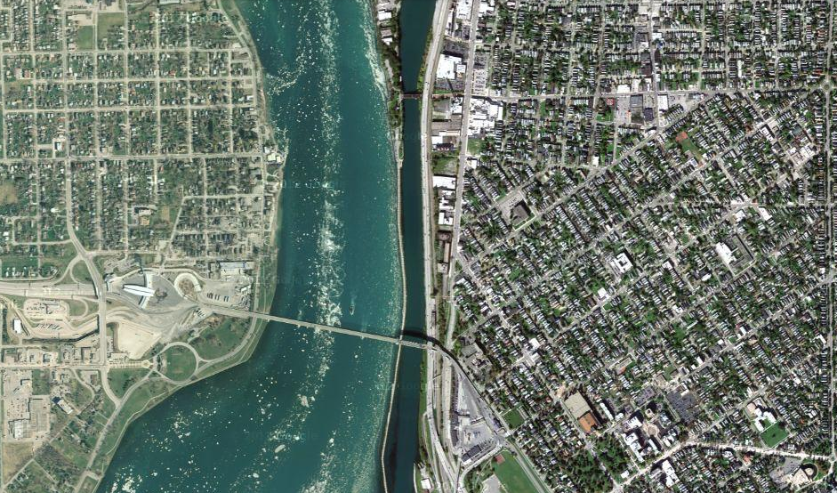
Satellite view

Slide 12
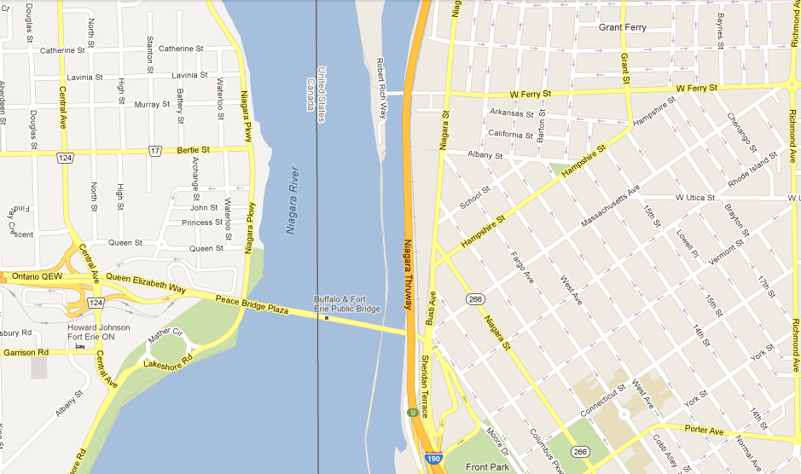
Map

Slide 13
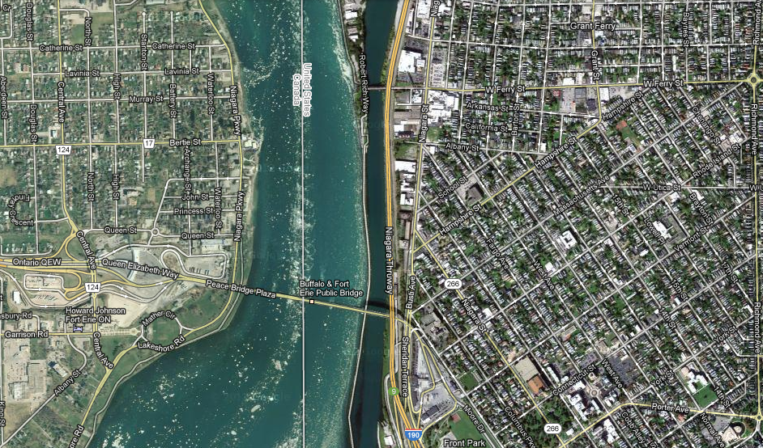
Map overlay

Slide 14
particulars versus types
(universals and defined classes)

Slide 15
‘Type’
Names for something generic in main-stream ontology:
  ‘concept’
  ‘kind’
  ‘category’
  ‘class’
  ‘prototype’
  …
In realism-based ontology:
  ‘Type’:
    ‘Universal’: human being
    ‘Defined class’: human being in Buffalo
  ‘Class’: all human beings

Slide 16
Realism-based terminology for referents
Particular (individual):
  individual entity that exist(ed) in space and time, that exist(ed) only once and carries identity.
Type:
  counterpart in reality of some non-empty general term used in the formulation of some scientific theory.
Universal: type which has particulars as instances (= is instantiated by particulars).
Class: extension (=maximal collection) of a non-empty general term.
Defined class: collection of particulars defined by selection or combination of terms denoting particulars or types.
Smith B, Ceusters W. Ontological Realism as a Methodology for Coordinated Evolution of Scientific Ontologies. Applied Ontology, 2010;5(3-4):139-188.
https://www.ncbi.nlm.nih.gov/pmc/articles/PMC3104413/

Slide 17
Universals versus particulars
for every universal there is or has been at least one instance
some universal
instance-of at t
entities on either site cannot ‘cross’ this boundary
every particular is an instance of at least one universal
some particular

Slide 18
Universal/particular declaration in BFO2020
At all times, there is at least one particular and one universal that is instantiated by that particular.
(forall (t)
  (if (instance-of t temporal-region t)
  (exists (u i)
  (and (not (= i t))
  (universal u)
  (particular i)
  (instance-of i u t))))))

Slide 19




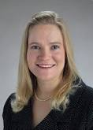
Types versus particulars
Human being
instance of at t
particulars

Slide 20
Types versus particulars
Reality versus representation !
Photograph
instance of at t
particulars

Slide 21
Instances are the objects of classification …
Organism
Vertebrate
Mammal
Human being
instance of at t
particulars

Slide 22
Formal BFO definition for is_a
(aka subClassOf)
The is_a relation is the subtype or subuniversal relation between universals or types.
  C is_a C1 =def.:
    C and C1 are universals, and
    for all c, t, if c instance_of C at t then c instance_of C1 at t

Slide 23
Some BFO2020-FOL ‘subclass’ axioms
(cl:comment "specifically-dependent-continuant is subclass of continuant [dhv-1]"
(forall (t x)
(if (instance-of x specifically-dependent-continuant t)
(instance-of x continuant t))))
(cl:comment "quality is subclass of specifically-dependent-continuant [nbm-1]"
(forall (t x)
(if (instance-of x quality t)
(instance-of x specifically-dependent-continuant t))))
(cl:comment "relational-quality is subclass of quality [taj-1]"
(forall (t x)
(if (instance-of x relational-quality t)
(instance-of x quality t))))

Slide 24
Instances are the objects of classification …
isa
Organism
isa
Vertebrate
isa
Mammal
Human being
instance of at t
particulars

Slide 25
Compare with RDFS / OWL
If the class description C1 is defined as a subclass of class description C2, then the set of individuals in the class extension of C1 should be a subset of the set of individuals in the class extension of C2.
Differences with BFO:
  subClassOf is primitive, being a subset is a consequence
  You just have to declare it
    → how you want the domain to be,
      not how the domain is!
  No time indexing.

Slide 26
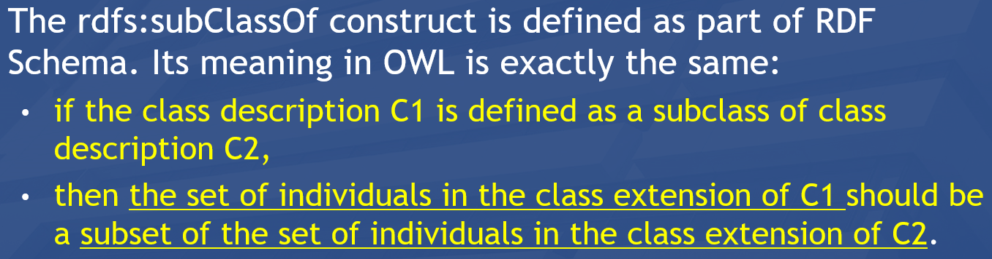
Instances are the objects of classification …
isa
Organism
isa
Vertebrate
isa
Mammal
Human being
instance of at t
particulars

Slide 27
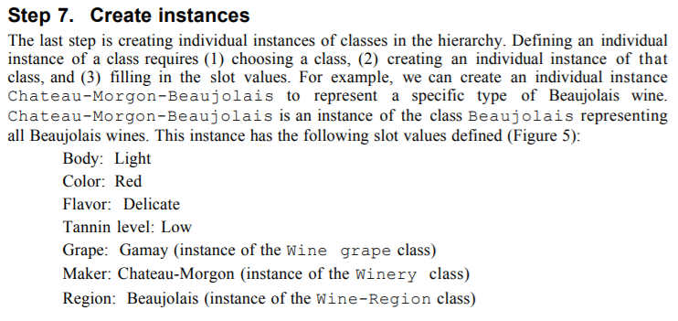
Whether something is a particular or a type is NOT a matter of choice, but a matter of reality!!!
Wrong!!!
https://protege.stanford.edu/publications/ontology_development/ontology101.pdf, p11

Slide 28
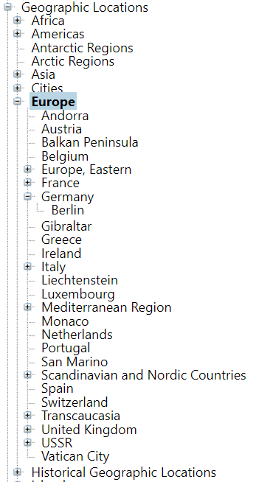
MeSH: several mistakes per RBO rules !!!
Particulars are represented as types;
    Lame excuse: ‘we mean that this type has only one instance’.
Particulars have other particulars as instances;
    The lame excuse breaks down: a class with one instance cannot have a subclass.
subClassOf overload.

Slide 29
Importance of the particular/universal distinction (1)
Ignoring the distinction may lead to assertions in which
  Different interpretations are possible depending on which terms intend particulars and which universals,

Slide 30
Importance of being clear
The International Classification of Headache Disorders has
‘Persistent idiopathic facial pain (PIFP)’
  = ‘persistent facial pain with varying presentations …’
  Imagine three patients:
  all three have continuously facial pain,
  the first one has always pain which presents itself in the same way,
  the second one has also always pain which presents itself in the same way, but in a different way than in the first patient,
  the third one’s pain presents itself sometimes like in the first patient, sometimes like in the second patient, and sometimes different from those.
  Which patients satisfy the definition for PIFP ?

Slide 31
Do you see the ambiguity ?
‘Persistent idiopathic facial pain (PIFP)’
  = ‘persistent facial pain with varying presentations …’
persistent
facial pain
presentation
type1
presentation
type2
presentation
type3
types
t₂
t₃
t₁
t₁
t₁
t₂
t₂
t₃
t₁
t₃
parti-
culars
t₁
t₂
t₂
t₁
t₃
t₂
t₃
t₃
my pain
her pain
his pain

Slide 32
Make it clear whether assertions are about particulars or types
‘Persistent idiopathic facial pain (PIFP)’
  = ‘persistent facial pain with varying presentations …’
  if the description is about types, then the three particular pains fall under PIFP.
  if the description is about (arbitrary) particulars, then only her pain falls under PIFP.

Slide 33
Importance of the particular/universal distinction (2)
Ignoring the distinction may lead to assertions in which
  Different interpretations are possible depending on which terms intend particulars and which universals,
  the authors run together forms of speech governed by different logical rules.

Slide 34
How to analyze these assertions?
Examples:
  ‘Stating that (sleep) bruxism is a behavior in no way precludes the possibility (at some to-be-specified and validated cut point) of it being more than a behavior, either a risk factor or disorder’.
  ‘Bruxism is a continuously distributed behavior’
        Raphael KG, Santiago V, Lobbezoo F. Bruxism is a continuously distributed behaviour, but disorder decisions are dichotomous (Response to letter by Manfredini, De Laat, Winocur, & Ahlberg (2016)). J Oral Rehabil. 2016 Oct;43(10):802-3. https://www.ncbi.nlm.nih.gov/pmc/articles/PMC5538380/

Slide 35
  ‘ … bruxism is a behavior …’
This is a statement about universals:
Bruxism
isa
Behavior
Ceusters W, Smith B. On Defining Bruxism.
Medical Informatics Europe (MIE2018), Goteborg, Sweden, April 24-26, 2018.
Stud Health Technol Inform. 2018;247:551-555.
https://ebooks.iospress.nl/publication/48852

Slide 36
  ‘ … bruxism is a behavior …’
This is a statement about universals:
here is an instance
Bruxism
isa
Behavior
Instance of at t
John’s repetitive jaw muscle activity of last night

Slide 37
  ‘ … bruxism is a behavior …’
This is a statement about universals:
here is an instance
Bruxism
isa
Behavior
Instance of at t
Instance of at t
John’s repetitive jaw muscle activity of last night

Slide 38
  ‘ … bruxism is a behavior …’
  ‘Bruxism is a continuously distributed behavior’
Are these statements about universals ?
continuously distributed behavior
isa
Bruxism
isa
Behavior
???
Instance of at t
Instance of at t
John’s repetitive jaw muscle activity of last night

Slide 39
  ‘ … bruxism is a behavior …’
  ‘Bruxism is a continuously distributed behavior’
Are these statements about universals ?
continuously distributed behavior
isa
Bruxism
isa
Behavior
???
Instance of at t
Instance of ???
Instance of at t
John’s repetitive jaw muscle activity of last night

Slide 40
  ‘ … bruxism is a behavior …’
  ‘Bruxism is a continuously distributed behavior’
Are these statements about universals ?
continuously distributed behavior
isa
Bruxism
isa
Behavior
???
Instance of at t
Instance of ???
Instance of at t
This is ‘in’ all particulars that are instances of bruxism
John’s repetitive jaw muscle activity of last night

Slide 41
  ‘ … bruxism is a behavior …’
  ‘Bruxism is a continuously distributed behavior’
Are these statements about universals ?
continuously distributed behavior
isa
Bruxism
isa
Behavior
???
Instance of at t
Instance of ???
Instance of at t
This is ‘in’ no particular at all!!!
This is rather a ‘type of universal’, a construct outside the particular/universal realm.
John’s repetitive jaw muscle activity of last night

Slide 42
The Basic Formal Ontology
(BFO)

Slide 43
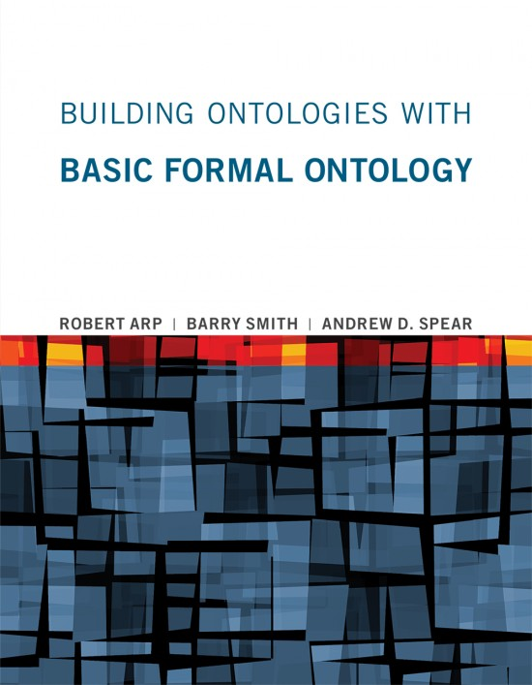
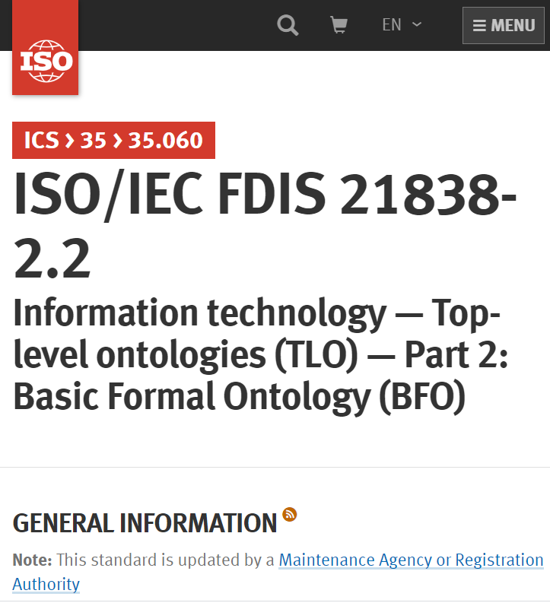
BFO’s major references
https://mitpress.mit.edu/books/building-ontologies-basic-formal-ontology
https://github.com/BFO-ontology/BFO-2020

Slide 44
The many faces of ‘BFO’
BFO text definitions:
Object is a Material Entity =Def.
for all x, t, if x is an instance of Object at t then x is an instance of Material Entity at t
BFO-OWL:
  <owl:Class rdf:about="http://purl.obolibrary.org/obo/BFO_0000030">
  <rdfs:label xml:lang="en">object</rdfs:label>
  <rdfs:subClassOf rdf:resource="http://purl.obolibrary.org/obo/BFO_0000040"/>
  </owl:Class>
BFO2020 axiomatization:
(not (exists (x) (and (universal x) (particular x))))
(forall (i u t) (if (instance-of i u t)
(and (particular i) (universal u) (instance-of t temporal-region t)))
(universal object)
(forall (t x) (if (instance-of x object t) (instance-of x material-entity t)))
44
Fabian Neuhaus: BFO-FOL for Domain Ontologies. https://ncorwiki.buffalo.edu/index.php/Basic_Formal_Ontology_Summit_Meeting/abstracts

Slide 45
BFO 2.0 top
Entity
Elucidation:
An entity is anything that exists or has existed (or will exist).

Slide 46
Continuants versus
Occurrents

Slide 47
BFO 2.0 top
Entity
Continuant
Occurrent
me my life
my intelligence my reasoning
my heart function the functioning of my heart
my instructor role my teaching
… …

Slide 48
BFO 2020
universal
particular all three are unary relations !
entity
Examples in predicate logic notation:
  universal(a)
  particular(b)
  instanceOf(b, a, t)

Slide 49
Continuants ←→ Occurrents
 | Continuant | Occurrent
Entities that at any time they exist,
exist
in total
Entities that at any time they exist,
exist only
partially
Smith B, Ceusters W. Ontological Realism as a Methodology for Coordinated Evolution of Scientific Ontologies. Applied Ontology, 2010;5(3-4):139-188.

Slide 50
An ontological square
 | Continuant | Occurrent
Types | Tooth | Teeth grinding
Particulars | My left maxillary first molar | My teeth grinding

Slide 51
An ontological square
 | Continuant | Occurrent
Types | Tooth | Teeth grinding
Particulars | My left maxillary first molar | My teeth grinding
Instance
of at t
Instance
of at t
(Instance of
prior to BFO2020)

Slide 52




Continuants preserve identity while changing
human
being
me
me
t
Instance-of
in 1960
child
Instance-of
since 1980
adult
living
creature
animal
caterpillar
butterfly

Slide 53
The importance of temporal indexing
(note: this is totally ignored in mainstream ontologies!)
benign
tumor
malignant
tumor
stomach
instanceOf at t₂
instanceOf at t₁
instanceOf at t₂
instanceOf at t₁
continuant-part-of at t₁
this-4
this-1’s stomach
continuant-part-of at t₂

Slide 54
The importance of temporal indexing
benign
tumor
malignant
tumor
stomach
instanceOf at t₂
instanceOf at t₁
instanceOf at t₂
instanceOf at t₁
this-4
continuant-part-of at t₁
this-1’s stomach
this-5
continuant-part-of at t₂

Slide 55
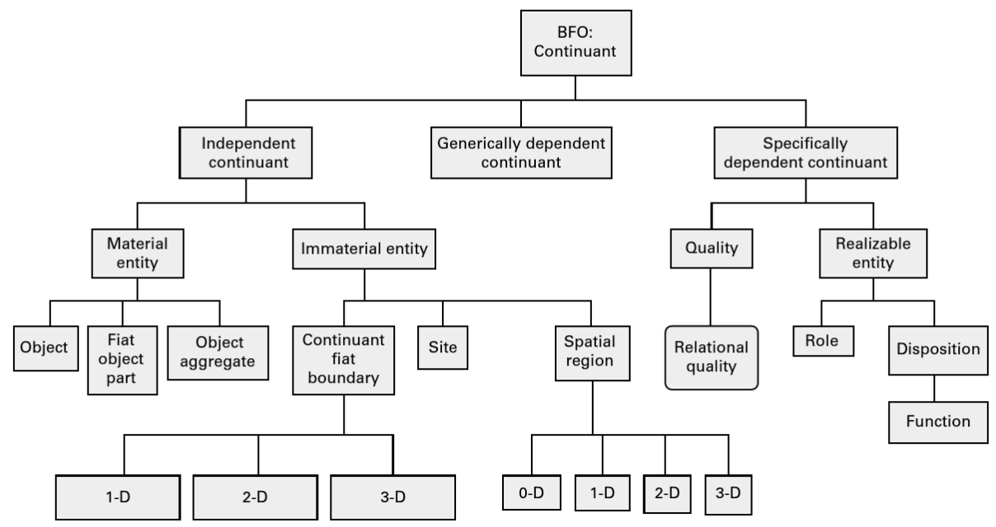
Continuants in BFO

Slide 56
Three major continuant types in BFO
Continuant
Independent
Continuant
IC
Specifically
dependent
continuant
Generically
dependent
continuant
SDC
GDC

Slide 57
Generically Dependent Continuants
Generically
Dependent
Continuant
if one bearer ceases to exist, then the entity can survive, because there are other bearers
(copyability)
the pdf file on my laptop
the DNA (sequence) in this chromosome
A diagnosis
Information
Content
Entity
Gene
Sequence

Slide 58
Specifically Dependent Continuant
Specifically Dependent Continuant
Quality
Realizable
Entity
Relational
Quality
Disposition
Role
Function
Arp, R., B. Smith, and A.D. Spear,
Building ontologies with basic formal ontology. 2015,
The MIT Press,: Cambridge, Massachusetts. p. 1 online resource (245 p).

Slide 59
Specifically Dependent Continuant
Specifically Dependent Continuant
Quality
Realizable
Entity
Elucidation: a quality is a specifically dependent continuant that, in contrast to roles and dispositions, does not require any further process in order to be realized.
Elucidation: b is a realizable entity means: b is a specifically dependent continuant that inheres in some independent continuant which is not a spatial region and is of a type some instances of which are realized in processes of a correlated type.
  ISO/IEC PRF 21838-2:2020(E)

Slide 60
Realizables and realizations
Continuant
Occurrent
Realizable entity
Process
Fragility of a glass
Skill of a craftsman
Role of a student
Function of a heart
Breaking
Constructing
Studying
Beating

Slide 61
Realizables: dispositions versus roles
Disposition:
  if it ceases to exist, then its bearer and/or its immediate surrounding environment is physically changed;
  its realization occurs when its bearer is in some special physical circumstances;
  its realization is what it is in virtue of the bearer’s physical make-up.
Role:
  exists because the bearer is in some special physical, social, or institutional set of circumstances in which the bearer does not have to be, and
  is not such that, if it ceases to exist, then the physical make-up of the bearer is thereby changed.

Slide 62
Occurrent
Occurrent
Process
Temporal Region
unfolds itself in time
Process
Boundary
Spatiotemporal
Region
start or end of process

Slide 63
Relational entities versus formal relations

Slide 64
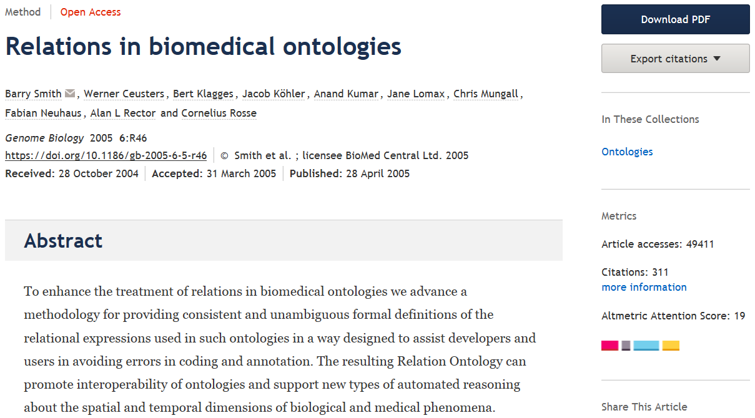
Not to be confused with what is currently called the ‘OBO Relation Ontology’ !
https://genomebiology.biomedcentral.com/articles/10.1186/gb-2005-6-5-r46

Slide 65
Essentials
Distinguishing what is denoted by ‘relation’ in technical sense (‘formal relations’) from what is denoted by ‘relation’ in non-formal language (‘material relations’);
Differences between type-level formal relations, particular-level formal relations and particular-type-level formal relations;
Arity and other properties of formal relations and differences thereof between particular-type formal relations and their corresponding type-level formal relations;
Elucidation versus definition of formal relations;
‘Basic’ formal relations versus ‘shortcut’ formal relations;
Axiomatic characterization of formal relations.

Slide 66
‘Relations’
(mainstream view)
Relations:
  ‘entities that glue together other entities’
  Formal relations:
    ‘hold between two or more entities directly, without any further intervening individual’.
  Material relations:
    ‘have material structure on their own’.
        = are entities
    Guizzardi & Wagner. What’s in a Relationship: An Ontological Analysis. In: Qing Li, Stefano Spaccapietra, Eric Yu, Antoni Olivé (Eds.), Conceptual Modeling - ER 2008. Lecture Notes in Computer Science, Vol. 5231, 83-97, 2008 https://doi.org/10.1007/978-3-540-87877-3_8↗

Slide 67
Material relation
‘John is friends with Mary’
isAbout at t
J&M’s
friendship
John
Mary

Slide 68
Material relation
‘John is friends with Mary’
isAbout at t
J&M’s
friendship
John
Mary
instanceOf at t
BFO:Object
BFO:Relational Quality

Slide 69
Material relation
‘John is friends with Mary’
isAbout at t
inheres-in
J&M’s
friendship
inheres-in
John
Mary
instanceOf at t
BFO:Object
BFO:Relational Quality

Slide 70
Material relation
‘John is friends with Mary’
isAbout at t
inheres-in
J&M’s
friendship
inheres-in
John
Mary
instanceOf at t
BFO:Object
BFO:Relational Quality

Slide 71
Material relations
‘have material structure on their own’
Are entities in their own right.
Relate other entities to each other by means of formal relations.
Examples: what might by some be denoted by:
  ‘patient’,
  ‘treatment’,
  ‘driver’.
Examples in BFO:
  relational qualities
      Have independent continuants as their bearers.
  relational processes: kissing, buying, …

Slide 72
Formal relations
‘John is friends with Mary’
isAbout at t
inheres-in
J&M’s
friendship
inheres-in
John
Mary
instanceOf at t
BFO:Object
BFO:Relational Quality

Slide 73
Formal relations
‘hold between two or more entities directly, without any further intervening individual’
Basic formal relations:
  ontological dependence, inherence, subtype-of, part-of, subset-of, instantiation, …
Domain formal relations:
  ‘relations that exhibit similar characteristics, i.e., those relations of comparison such as is taller than, is older than, knows more Greek than’.
    Guizzardi & Wagner. What’s in a Relationship: An Ontological Analysis. In: Qing Li, Stefano Spaccapietra, Eric Yu, Antoni Olivé (Eds.), Conceptual Modeling - ER 2008. Lecture Notes in Computer Science, Vol. 5231, 83-97, 2008 https://doi.org/10.1007/978-3-540-87877-3_8↗

Slide 74
Arity of a relation
Binary:
  My youth partOf my life
1 2
Ternary:
  My hand partOf me now
1 2 3
Quaternary:
  My left middle finger between my left index finger
    1 2
  and my left ring finger now
  3 4
…

Slide 75
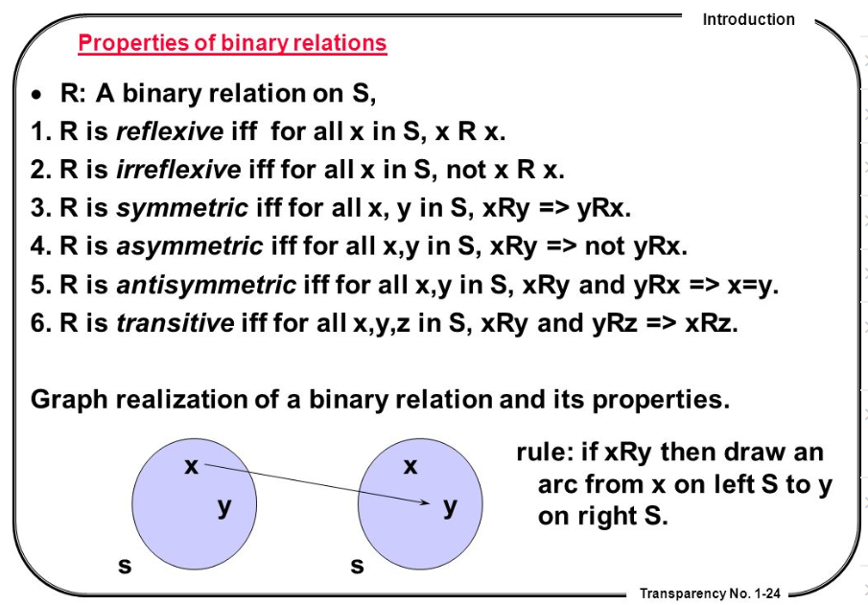
Properties of binary relations
http://en.ndncdc.org/page/symmetric-binary-relation-on-set/

Slide 76
Relations in Ontological Realism
Instance-level relations
  Your heart (instance-level) continuant_part_of your body at t
  Your heart beating (instance-level) has_participant your heart at t
Instance-type relations
  John’s heart instantiates human heart at t
  John’s heart beating instantiates human heart beating at t
Type-level relations
  human heart continuant_part­_of human body
  human heart beating process has_occurrent_part beat profile

Slide 77
Features of relations on the level of instances may not hold on the level of universals
nucleus adjacent_to cytoplasm
  Not: cytoplasm adjacent_to nucleus
    Red blood cells don’t have a nucleus
seminal vesicle adjacent_to urinary bladder
  Not: urinary bladder adjacent_to seminal vesicle
    Women don’t have seminal vesicles
Adjacency as a relation between universals is not symmetric while it is symmetric at particular level.

Slide 78
Type-level relations presuppose the underlying instance-level relations
A part_of B =def(roughly). All instances of A are instance-level-parts-of some instance of B
  e.g. human heart part_of human
A has_participant B =def(roughly). All instances of A have some instance of B as instance-level participant
  e.g. cell binding has_participant cell

Slide 79
the all-some form
A continuant_part_of B =def.
  for all particulars a and times t,
  If a is an instance of the universal A at t,
  then there is some instance b of the universal B
  such that
  a is an instance-level part_of b at t
Domain: Continuant
Range: Continuant

Slide 80
Remember !!!
Formal relations expressed in the BFO are all type-type relations.
    IC isa Continuant
    SDC specifically depends on IC
However !!!!: BFO’s type-type relations don’t express anything about types, but only what is the case for all particulars in the domain position of the relation.
BFO’s type-type relations are defined / elucidated on the basis of instance-level relations.

Slide 81
Elucidation versus definition
x is_about y means:
  x refers to or is cognitively directed towards y. Domain: representations; Range: portions of reality. Axiom: if x is_about y then y exists (veridicality).
‘A means B’:
    If A is the case, you can conclude that B holds.
    If B is the case, you cannot conclude anything re A.
x is_a_representation_of y =def.
  x is a representa­tion & x is_about y (where y is a portion of reality). Note that not all representations are about something.
‘A =def. B’ :
    If A is the case, you can conclude that B holds.
    If B is the case, you can conclude that A holds.
    If one doesn’t hold, the other one doesn’t hold.

Slide 82
Avoid at all cost!!!
‘X hasY Y’
Disease hasSymptom Symptom
Object hasTemperature Temperature
…
(unless you define such relations explicitly as ‘shortcut’ relations)

Slide 83
Basics of the
Ontology for General Medical Science
Scheuermann R, Ceusters W, Smith B. Toward an Ontological Treatment of Disease and Diagnosis., San Francisco, California, March 15-17, 2009;: 116-120. Omnipress ISBN:0-9647743-7-2
http://www.referent-tracking.com/RTU/files/AMIA-0075-T2009/1.0/AMIA-0075-T2009.pdf

Slide 84
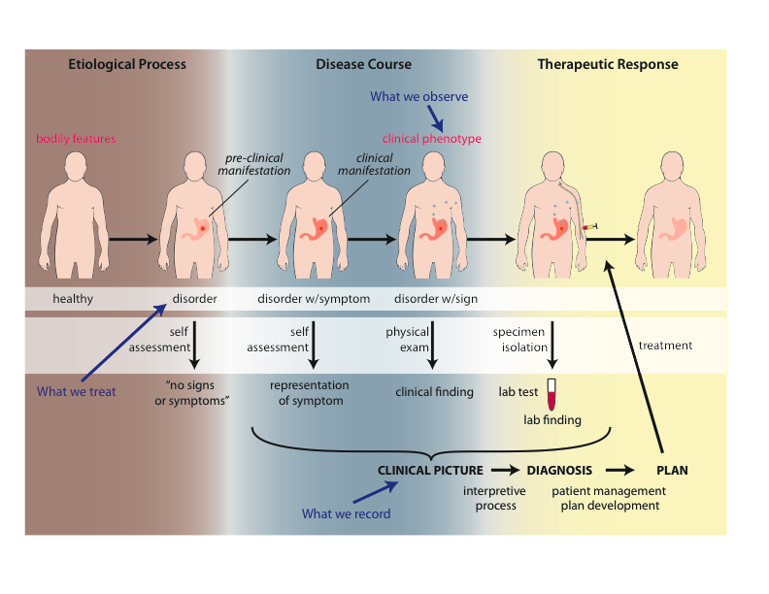
Big Picture of OGMS

Slide 85
Approach
a disease is a disposition rooted in a physical disorder in the organism and realized in pathological processes.
produces
bears
realized_in
etiological process
disorder
disposition
pathological process
produces
diagnosis
interpretive process
signs & symptoms
abnormal bodily features
produces
participates_in
recognized_as
Notes:
font was too small, color inside green boxes was hardly readable

Slide 86
Key OGMS definitions
DISORDER | A causally relatively isolated combination of physical components that is (a) clinically abnormal and (b) maximal, in the sense that it is not a part of some larger such combination.
DISEASE
DISEASE COURSE
DIAGNOSIS
Scheuermann R, Ceusters W, Smith B. Toward an Ontological Treatment of Disease and Diagnosis. 2009 AMIA Summit on Translational Bioinformatics, San Francisco, California, March 15-17, 2009;: 116-120. Omnipress ISBN:0-9647743-7-2

Slide 87
Clinically abnormal
something is clinically abnormal if:
  is not part of the life plan for an organism of the relevant type (unlike aging or pregnancy),
  is causally linked to an elevated risk either of pain or other feelings of illness, or of death or dysfunction, and
  is such that the elevated risk exceeds a certain threshold level.

Slide 88
Key OGMS definitions
DISORDER | A causally relatively isolated combination of physical components that is (a) clinically abnormal and (b) maximal, in the sense that it is not a part of some larger such combination.
DISEASE | A DISPOSITION (i) to undergo PATHOLOGICAL PROCESSes that (ii) exists in an ORGANISM because of one or more DISORDERs in that ORGANISM.
DISEASE COURSE
DIAGNOSIS
Scheuermann R, Ceusters W, Smith B. Toward an Ontological Treatment of Disease and Diagnosis. 2009 AMIA Summit on Translational Bioinformatics, San Francisco, California, March 15-17, 2009;: 116-120. Omnipress ISBN:0-9647743-7-2

Slide 89
Pathological process
Pathological Process =def. – A bodily process that is a manifestation of a disorder and is clinically abnormal.

Slide 90
Disease particulars can instantiate distinct universals at distinct times
coronary heart disease
disease associated with early lesions and small fibrous plaques
disease associated with asymptomatic (‘silent’) infarction
disease associated with surface disruption of plaque
unstable angina
stable angina
instantiates at t₂
instantiates at t₃
instantiates at t₄
instantiates at t₅
instantiates at t₁
John’s coronary heart disease
time

Slide 91
Key OGMS definitions
DISORDER | A causally relatively isolated combination of physical components that is (a) clinically abnormal and (b) maximal, in the sense that it is not a part of some larger such combination.
DISEASE | A DISPOSITION (i) to undergo PATHOLOGICAL PROCESSes that (ii) exists in an ORGANISM because of one or more DISORDERs in that ORGANISM.
DISEASE COURSE | The totality of all PROCESSes through which a given DISEASE instance is realized.
DIAGNOSIS
Scheuermann R, Ceusters W, Smith B. Toward an Ontological Treatment of Disease and Diagnosis. 2009 AMIA Summit on Translational Bioinformatics, San Francisco, California, March 15-17, 2009;: 116-120. Omnipress ISBN:0-9647743-7-2

Slide 92
Key OGMS definitions
DISORDER | A causally relatively isolated combination of physical components that is (a) clinically abnormal and (b) maximal, in the sense that it is not a part of some larger such combination.
DISEASE | A DISPOSITION (i) to undergo PATHOLOGICAL PROCESSes that (ii) exists in an ORGANISM because of one or more DISORDERs in that ORGANISM.
DISEASE COURSE | The totality of all PROCESSes through which a given DISEASE instance is realized.
DIAGNOSIS | A conclusion of an interpretive PROCESS that has as input a CLINICAL PICTURE of a given patient and as output an assertion (diagnostic statement) to the effect that the patient has a DISEASE of such and such a type.
Scheuermann R, Ceusters W, Smith B. Toward an Ontological Treatment of Disease and Diagnosis. 2009 AMIA Summit on Translational Bioinformatics, San Francisco, California, March 15-17, 2009;: 116-120. Omnipress ISBN:0-9647743-7-2

Slide 93
Clinical picture
Clinical Picture =def. – A representation of a clinical phenotype that is inferred from the combination of laboratory, image and clinical findings about a given patient.
Representations are information content entities (IAO)
Information content entities are generically dependent continuants
Smith B, Ceusters W. Aboutness: Towards Foundations for the Information Artifact Ontology. International Conference on Biomedical Ontologies, ICBO 2015, Lisbon, Portugal, July 27-30, 2015;47-51.
http://www.referent-tracking.com/RTU/files/ICBO2015Proceedings-Smith-Ceusters/1.0/ICBO2015Proceedings-Smith-Ceusters.pdf

Slide 94
No conflation of diagnosis, disease, and disorder
produces
bears
realized_in
etiological process
disorder
disease
pathological process
produces
diagnosis
interpretive process
signs & symptoms
abnormal bodily features
produces
participates_in
recognized_as
Notes:
font was too small, color inside green boxes was hardly readable

Slide 95
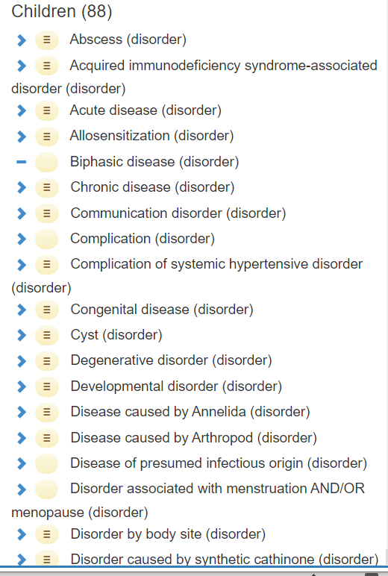
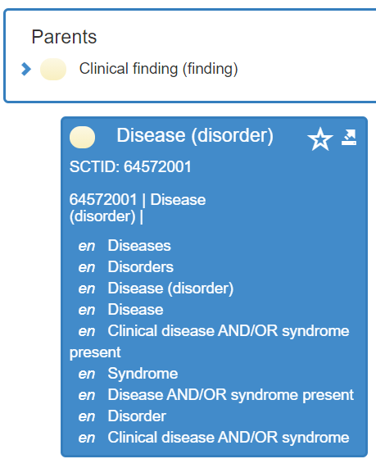
‘Disease’ in Snomed CT

Slide 96
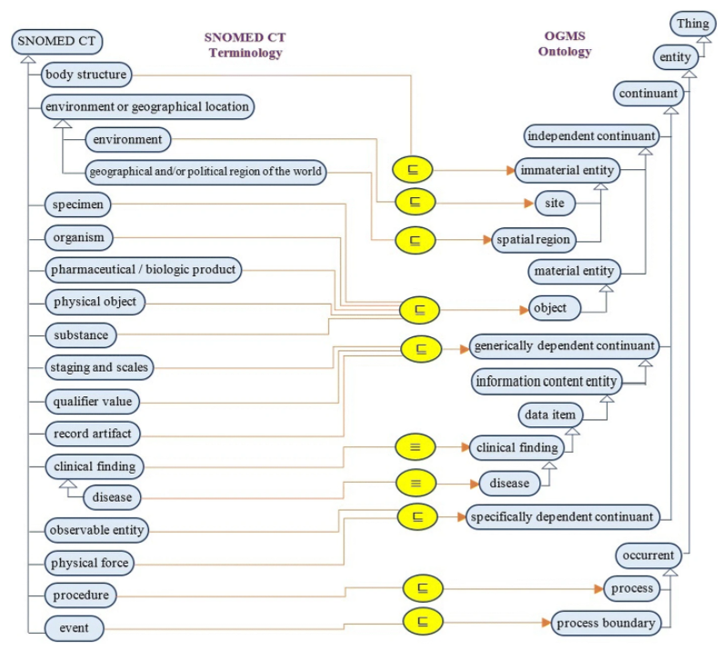
No!!!
El-Sappagh, S., Franda, F., Ali, F. et al. SNOMED CT standard ontology based on the ontology for general medical science. BMC Med Inform Decis Mak 18, 76 (2018).
https://doi.org/10.1186/s12911-018-0651-5

Slide 97
Bad ‘disease ontologies’
Despite being listed in the OBO-Foundry: http://www.obofoundry.org/ontology/doid.html
Mondo Disease Ontology: collection of several other ‘ontologies’:
  https://mondo.monarchinitiative.org/
  https://www.ebi.ac.uk/ols/ontologies/mondo
The Semantic Science Ontology: incoherent foundation
https://bioportal.bioontology.org/ontologies/SIO?p=classes&conceptid=http%3A%2F%2Fsemanticscience.org%2Fresource%2FSIO_010299

