Slide 1
UB Summer Informatics Data Science Bootcamp
Department of Biomedical Informatics, University at Buffalo
July 5 – August 21, 2023
Topic: Biomedical Ontology
July 26: (wc) Elements of Logic for (Biomedical) Ontology.
July 27: (wc) Principles of Realism-Based (Biomedical) Ontology.
July 28: (ad) SPARQL-queries
Aug 14: (wc) Referent Tracking for Biomedical Informatics.
Werner CEUSTERS, MD
Professor and Division Chief Biomedical Ontology, Dept of Biomedical Informatics
Professor, Dept of Psychiatry
University at Buffalo, NY, USA

Slide 2
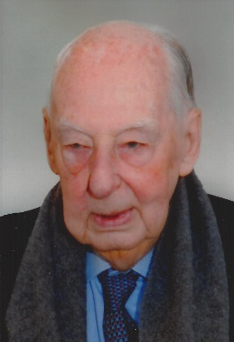

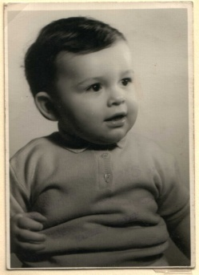
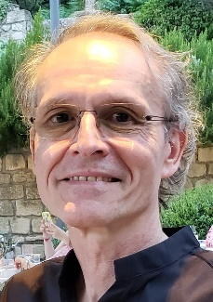












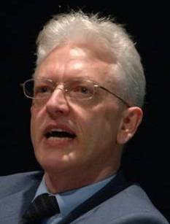

Educational & professional environments
Paul
Kluyskens
Alan
Ruttenberg
1977
2014
1959 -
2012
2006
1989
1992
2004
2002
1993
1995
1998
Georges
Demoor
Barry
Smith

Slide 3
Learning Objectives of days 1, 2 and 4
Explain the distinctions between:
  ‘ontology’ and ‘ontologies’;
  ‘ontologies’ and other types of knowledge representations (KR);
  concept-based ontologies and realism-based ontologies;
  logic(s), logic programming and formal representations;
  logical and ontological principles in KR;
  the principles used in the Basic Formal Ontology (BFO), the OBO Foundry and the ‘BioPortal ontologies’.
Describe the realism-based principles underlying the BFO and the Ontology for General Medical Science (OGMS).
Understand that distinct non-realism-based ontologies rarely use the same set of principles.
Use Referent Tracking as a methodology to:
  Design high-quality realism-based ontologies;
  Identify shortcomings in information systems;
  Perform ontology-based quality control on databases .

Slide 4

A must read !

Slide 5
At least remember this forever!
‘ The words “ontology” and “ontological”, the Web Ontology Language, OWL, and the description logics on which OWL is based continue to cause confusion.
Description logics (DLs) and OWL are major advances for representing logical definitions for terminologies. However, they are severely limited in representing other kinds of statements. As a result, their standard semantics is often ignored or distorted with unintended consequences.’
Rector A, Schulz S, Rodrigues JM, Chute CG, Solbrig H.
On beyond Gruber: "Ontologies" in today's biomedical information systems and the limits of OWL.
J Biomed Inform. 2019;100S:100002. doi: 10.1016/j.yjbinx.2019.100002. Epub 2019 Mar 9. PMID: 34384571.
https://www.sciencedirect.com/science/article/pii/S2590177X19300010

Slide 6
‘Ontology’ versus ontologies versus
‘ontologies’

Slide 7
Most cited definition
An ontology is an explicit specification of a conceptualization.
…
T. R. Gruber. A Translation Approach to Portable Ontologies.
Knowledge Acquisition, 5(2):199–220, 1993.
http://tomgruber.org/writing/ontolingua-kaj-1993.pdf

Slide 8
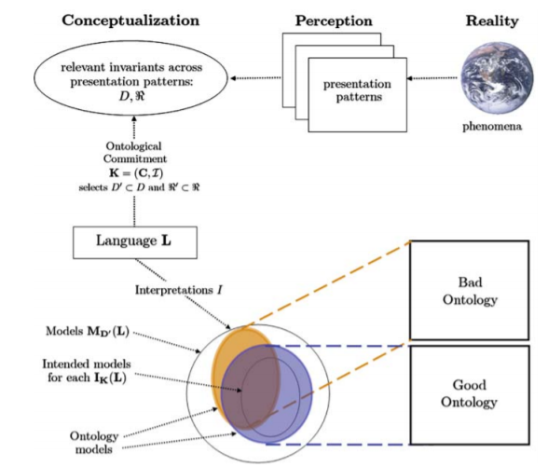
Ontology and conceptualization
Fig. 2. The relationships between phenomena occurring in reality, their perception (at different times), their abstracted conceptualization, the language used to talk about such conceptualization, its intended models, and an ontology.
What Is an Ontology?
Nicola Guarino, Daniel Oberle, and Steffen Staab
S. Staab and R. Studer (eds.), Handbook on Ontologies, International Handbooks 1
on Information Systems, DOI 10.1007/978-3-540-92673-3,
Springer-Verlag Berlin Heidelberg 2009

Slide 9
Computer science approach to ontology the representation language(s) is/(are) hidden in tools and applications
Ontology
Authoring Tools
create
Domain
Ontologies
Reasoners
Semantic
Applications
use

Slide 10
Computer science approach to ontology
logical principles
Ontology
Authoring Tools
the logic in reasoners:
guarantees consistent reasoning,
does not guarantee the faithfulness of the representation.
create
Domain
Ontologies
Reasoners
Semantic
Applications
use
ontological principles

Slide 11
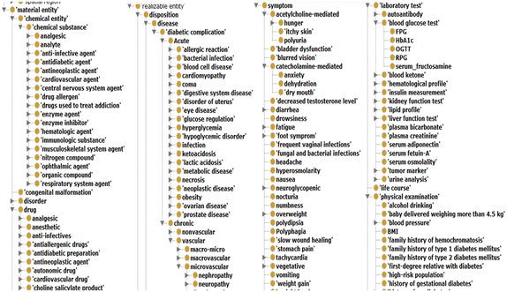
Abusing Protégé, BFO and OGMS
No reference provided due to vicarious embarrassment

Slide 12
Stated goals and purposes of ontologies
Investigating a domain,
Representing a domain,
Enhancing collaboration,
Supporting data-related processing
  annotating, searching, indexing, merging, comparing, …,
Supporting ontology-related process
  comparing, merging, (re-)using, aligning, emulating, …,
Providing reasoning facilities for specific applications.
Towards modelling the intended purpose of ontologies: A case study in geography.
R Denaux, AG Cohn, V Dimitrova, G Hart
Proceedings of the Terra Cognita Workshop in conjunction with the 8th International Semantic Web Conference, CEUR-WS. Org. 2009. http://ceur-ws.org/Vol-518/terra09_submission_9.pdf

Slide 13
Stated goals and purposes of ontologies
Investigating a domain,
Representing a domain,
Enhancing collaboration,
Supporting data-related processing
  annotating, searching, indexing, merging, comparing, …,
Supporting ontology-related process
  comparing, merging, (re-)using, aligning, emulating, …,
Providing reasoning facilities for specific applications.
for people
for computers
Towards modelling the intended purpose of ontologies: A case study in geography.
R Denaux, AG Cohn, V Dimitrova, G Hart
Proceedings of the Terra Cognita Workshop in conjunction with the 8th International Semantic Web Conference, CEUR-WS. Org. 2009. http://ceur-ws.org/Vol-518/terra09_submission_9.pdf

Slide 14
Ontologies and ‘ontologies’
‘ontologies’
Direct
usefulness
for
people
Terminological
systems
Knowledge representation
systems
Realism-based
Ontologies
Direct usefulness for computers
Inspired by: Rector, A.. “Clinical terminology: why is it so hard?” Methods of information in medicine 38 4-5 (1999): 239-52 .

Slide 15
Early goals of Biomedical Ontology in
Healthcare Information Technology (HIT)
supporting the creation and use of adequate biomedical terminology.
supporting the creation of adequate coding and classification systems.
→ Terminological systems

Slide 16
Additional goals of Biomedical Ontology in
Healthcare Information Technology (HIT)
solving the semantic interoperability problem for heterogeneous biomedical information systems.
improving biomedical decision support applications.
Knowledge representation
systems

Slide 17
Additional Goals of Realism-based Biomedical Ontology in HIT
supporting the identification of what sorts of biomedical entities exist, how they relate to each other and how they are best represented.

Slide 18
Most cited definition
‘An ontology is an explicit specification of a conceptualization.’
‘The term is borrowed from philosophy, where an ontology is a systematic account of Existence. For knowledge-based systems, what “exists” is exactly that which can be represented.’
T. R. Gruber. A Translation Approach to Portable Ontologies.
Knowledge Acquisition, 5(2):199–220, 1993.
http://tomgruber.org/writing/ontolingua-kaj-1993.pdf

Slide 19
‘Ontology’ in philosophy
Ontology (no plural) is the study of what entities exist and how they relate to each other;
by some philosophers taken to be synonymous with ‘metaphysics’ while others draw distinctions in many distinct ways (the distinctions being irrelevant for this talk), but almost agreeing on the following classification:
  metaphysics → studies ‘how is the world?’
    general metaphysics → studies general principles and ‘laws’ about the world
      ontology → studies what type of entities exist in the world
    special metaphysics → focuses on specific principles and entities
distinct from ‘epistemology’ which is the study of how we can come to know about what exists.
distinct from ‘terminology’ which is the study of what terms mean and how to name things.

Slide 20
Concept-based versus
Realism-based
Ontology

Slide 21
What do we really want to represent ?
Representation of
?
Concepts
or
Reality
?
Figure modified from: What Is an Ontology? Nicola Guarino, Daniel Oberle, and Steffen Staab
S. Staab and R. Studer (eds.), Handbook on Ontologies, International Handbooks 1 on Information Systems, DOI 10.1007/978-3-540-92673-3, Springer-Verlag Berlin Heidelberg 2009
http://citeseerx.ist.psu.edu/viewdoc/download?doi=10.1.1.175.2138&rep=rep1&type=pdf

Slide 22
Commitment to generic entities
Nominalism:
  there are no generic entities in reality: there is no personhood, there are only individual persons.
Conceptualism: ← the mainstream approach
  generalizations are in our ‘minds’. Personhood is a concept construed in our ‘mind’ that allows us to reason about persons without any particular person in mind.
Realism: ← the scientific approach
  generic entities do exist and are called ‘universals’. Each particular person is an instance of the universal we call ‘person’.

Slide 23
Conceptualism versus Ontological Realism
concept
term
referent
Conceptualism

Slide 24
Conceptualism versus Ontological Realism
First order reality
concept
universal
term
referent
representational
unit
particular
Conceptualism
Ontological Realism

Slide 25
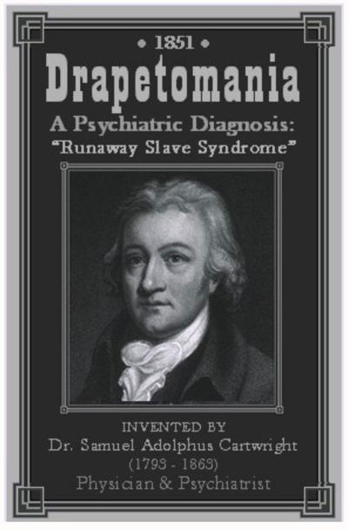
Conceptualism versus Ontological Realism
concept
term
referent
Conceptualism
https://www.phillytrib.com/commentary/drapetomania-compliant-blacks-sane-resisting-blacks-insane/article_0087a2d0-1acb-5364-870c-1205212e0a13.html

Slide 26
Ontological Realism offers three ways of relating, without assigning beliefs (concepts) a central status
drapetomania
slave
running away
mental disorder
propensity
How terms are related
How beliefs are / can
be related
How referents (in
reality) are related

Slide 27
drapetomania
slave
running away
mental disorder
propensity
How terms are
related
How beliefs are / can
be related
How referents
(in reality)
are related
Knowledge representation
systems
Terminological
systems
Realism-based
Ontologies

Slide 28

Philosophical approach to ontology
Ontological Realism: uses ontology as philosophical discipline to build ontologies as faithful representations of reality.
Smith B, Ceusters W. Ontological Realism as a Methodology for Coordinated Evolution of Scientific Ontologies. Applied Ontology, 2010;5(3-4):139-188.
https://www.ncbi.nlm.nih.gov/pmc/articles/PMC3104413/

Slide 29
Further readings on the issue
Incoherencies and inconsistencies in how ‘concept’ is defined and in how concepts are used for representation:
Essential distinctions between concept-based and realism-based representations and how they might co-exist:
Differing views on what computational ontologies should be, how to be designed, and what determines their quality:
Barry Smith, Beyond Concepts, or: Ontology as Reality Representation. Achille Varzi and Laure Vieu (eds.), Formal Ontology and Information Systems. Proceedings of the Third International Conference (FOIS 2004), Amsterdam: IOS Press, 2004, 73–84. http://ontology.buffalo.edu/bfo/BeyondConcepts.pdf
Gunnar O. Klein and Barry Smith. Concept Systems and Ontologies: Recommendations for Basic Terminology. Trans Jpn Soc Artif Intell. 2010 Jan 1; 25(3): 433–441. https://www.ncbi.nlm.nih.gov/pmc/articles/PMC3034144/
M Brochhausen 1, A Burgun, W Ceusters, A Hasman, T Y Leong, M Musen, J L Oliveira, M Peleg, A Rector, S Schulz.
Discussion of "biomedical ontologies: toward scientific debate". Methods Inf Med. 2011;50(3):217-36..
https://ink.library.smu.edu.sg/cgi/viewcontent.cgi?article=4011&context=sis_research

Slide 30
Logic and Ontology

Slide 31
Ontological principles (tomorrow)
Logical principles
What Is an Ontology?
Nicola Guarino, Daniel Oberle, and Steffen Staab
S. Staab and R. Studer (eds.), Handbook on Ontologies, International Handbooks 1
on Information Systems, DOI 10.1007/978-3-540-92673-3,
Springer-Verlag Berlin Heidelberg 2009

Slide 32
What is ‘a logic’
A formal or informal language together with a deductive system and/or a model-theoretic semantics.
The language has components that correspond to a part of a natural language like English or Greek.
The deductive system is to capture, codify, or simply record arguments that are valid for the given language.
The semantics is to capture, codify, or record the meanings, or truth-conditions for at least part of the language.
Shapiro, Stewart and Teresa Kouri Kissel, "Classical Logic",
The Stanford Encyclopedia of Philosophy (Spring 2021 Edition), Edward N. Zalta (ed.).
https://plato.stanford.edu/archives/spr2021/entries/logic-classical/

Slide 33
Propositional Logic (PL) essentials

Slide 34
Language and semantics of PL
A well-formed formula is either atomic or composed following allowed composition rules.
Atomic formulae stand for propositions that must either be true or false:
  A: ‘John eats too much’.
  B: ‘John has a normal BMI’.
  C: ‘John is careful’.
Formula connectors:
  Negation (not): ¬ ~
  Conjunction (and): ∧ & ∙
  Disjunction (or): ∨
  Material implication (if...then): → ⇒ ⊃
  Biconditional (if and only if): ↔ ⬄ ≡ =

Slide 35
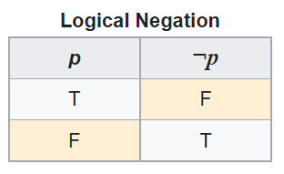
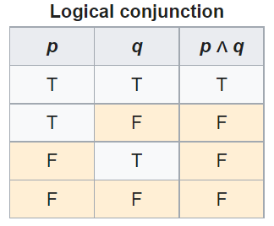
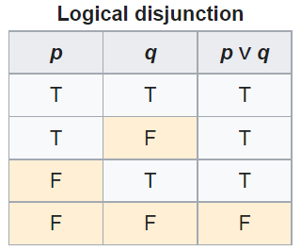
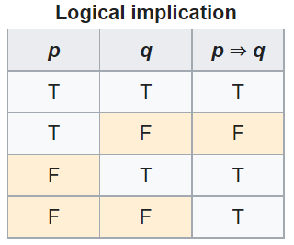
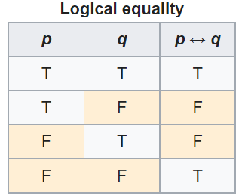
PL’s Deductive system: truth tables

Slide 36
Some PL laws
Truth tables can be used to prove laws, e.g.:
  a Λ (b V c) = (a Λ b) V (a Λ c)
  ¬ (a Λ b) = ¬ a V ¬b
  (a Λ (a → b)) → b
  (a→ b) Λ ¬b) → ¬a
  ((a V b) Λ ¬a) → b
  ((a → b) Λ (b → c)) → (a → c)
  …
  More examples:
    https://math.stackexchange.com/questions/1449866/catalogue-of-propositional-logic-laws
    http://mathonline.wikidot.com/the-laws-of-propositional-logic#toc0
Both truth tables and laws can be used to solve puzzles.

Slide 37
Exercise
Given:
  If John eats too much, then he does not have a normal BMI.
  If John is not careful, then he eats too much.
  John has a normal BMI.
Question
  Is John careful?

Slide 38
Translate sentences into PL
Propositions
John eats too much |  |  | a
John has a normal BMI |  |  | b
John is careful |  |  | c
Given
If John eats too much, then he does not have a normal BMI |  |  | a → ¬b
If John is not careful, then he eats too much. |  |  | ¬c → a
John has a normal BMI |  |  | b
Determine the truth value of: |  | (a → ¬b) ∧ (¬c → a) ∧ b

Slide 39

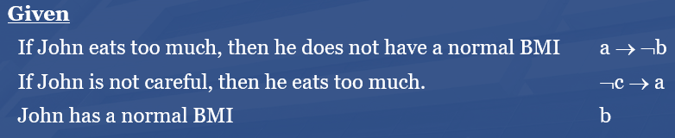
Method 1: Determine with tables

Slide 40
Method 2: Determine using laws
Propositions
John eats too much |  | a
John has a normal BMI |  | b
John is careful |  | c
Given
If John eats too much, then he does not have a normal BMI |  | a → ¬b | g1
If John is not careful, then he eats too much. |  | ¬c → a | g2
John has a normal BMI |  | b | g3
Rule application: | (x→ y) Λ ¬y) → ¬x | ¬a | g3/g1 | g4
 | (x→ y) Λ ¬y) → ¬x | c | g2/g4

Slide 41
Another exercise
Solve this puzzle:
  Given:
    Everybody who eats too much, does not have a normal BMI.
    Everybody who is not careful, eats too much.
    Everybody has a normal BMI.
  Question
    Is everybody careful?
Same as before: yes.

Slide 42
What about this one?
Solve this puzzle:
  Given:
    Everybody who eats too much, does not have a normal BMI.
    Everybody who is not careful, eats too much.
    John has a normal BMI.
  Question
    Is John careful?
Can not be done with propositional logic!
  There is no way to create propositions (within the syntax and semantics of propositional logic) so that ‘everybody’ and ‘John’ can be represented as related.

Slide 43
First Order Logics (FOL)
(Predicate Logic)

Slide 44
First-order logic
Propositional logic with predicates, variables and quantifiers.
Predicate: a proposition that some property holds for some entity, or a relation between entities.
  Prop.L. : A = ‘everybody eats too much’
  FOL: A = ‘eats too much’ A(x)
Quantifiers:
  ‘all’ ∀ ∀x.A(x) everything eats too much
  ‘some’ ∃ ∃x.A(x) something eats too much

Slide 45
First-order logic
Propositional logic with predicates, variables and quantifiers.
Predicate: a proposition that some property holds for some entity, or a relation between entities.
  Prop.L. : A = ‘everybody eats too much’
  FOL: A = ‘eats too much’ A(x)
Quantifiers:
  ‘all’ ∀ ∀x.A(x) everything eats too much
  ‘some’ ∃ ∃x.A(x) something eats too much
‘everybody eats too much’
  ∀x.(person(x) → A(x))

Slide 46
First-Order Logic (FOL) - Syntax
User defines these primitives:
  Constant symbols (i.e., the "individuals" in the world) e.g.: bfo, 3
  Function symbols (mapping individuals to individuals) e.g.: author-of(bfo) = barry_smith
  Predicate symbols (mapping from individuals to truth values)
e.g.: greater(5,3) = true,
smart(barry_smith) = true

Slide 47
First-Order Logic (FOL) - Syntax…
FOL supplies these primitives:
  Variable symbols. E.g., x,y
  Connectives.
    Same as in PL:
      not (~),
      and (^),
      or (v),
      implies (→),
      if and only if (<=>)
  Quantifiers: Universal (∀) and Existential (∃)

Slide 48
Truth values of quantified expressions
Statement | True when | False when
∀x.A(x) | A(x) is true for every x. | There is an x for which A(x) is false
∃x.A(x) | There is an x for which A(x) is true. | A(x) is false for every x.
Open World !!!
Reality
Represented Reality

Slide 49
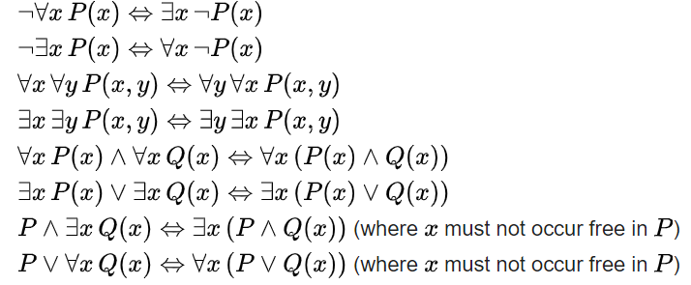
Some equivalences
A free variable is a variable not bound by a quantifier:
∀x.P(x) → Q(x) in contradistinction to ∀x.(P(x) → Q(x))

Slide 50

Flexibility in predicate formation
Some people eat too much:
  ∃x (person(x) Λ eats_too_much(x))
  ∃x (person(x) Λ eats(x, ‘too much’))
  ∃x ∃y (person(x) Λ eats(x, y) Λ quantity(y, ‘too much’))
However:
  Are not equivalent,
  Are based on a different ontology (in philosophical sense).
As a realist ontologist, make your choice on the basis of the ontological principles described in
https://genomebiology.biomedcentral.com/articles/10.1186/gb-2005-6-5-r46

Slide 51
Logic and Ontology
LOGICIAN:
ONTOLOGIST:
LOGICIAN:
ONTOLOGIST:
LOGICIAN:
SOCIAL ACTIVIST:
Hey guys, I just became father!
My sincere condolences! Boy or girl?
True!
Ok, boomer, which of the two?
Boy!
How dare you!!!
How could they have already self-identified?
Postmodernism

Slide 52
Be careful with quantifiers
Order is important!
  ∀x ∃y symptomOf(x, y)
    For all x, there exist some y such that x is a symptom of y
      Everything that exists is a symptom of something;
      Does not exclude that there is only one thing of which all things are symptoms.
  ∃y ∀x symptomOf(x, y)
    There exist some y, such that for all x, x is a symptom of y

Slide 53
Be aware of ambiguities in language
‘Every patient has some provider’
  Can mean:
    ∀x ∃y patientOf(x, y)
      For all x, there exist some y such that x is a patient of y
        Every patient has some provider.
    ∃y ∀x patientOf(x, y)
      There exist some y, such that for all x, x is a patient of y
        There is some provider that provides for all patients.

Slide 54
Description Logic(s)
A DL is a fragment of FOL.
DLs come in many varieties, most of which are decidable.
  A logic is decidable if there is an effective method for determining whether arbitrary formulas of the logic are logically valid formulas.
  A FOL is not decidable if its signature (i.e. the list and description of non-logical symbols) includes equality and at least one other predicate with two or more arguments.
  Flavors: https://en.wikipedia.org/wiki/Description_logic .

Slide 55
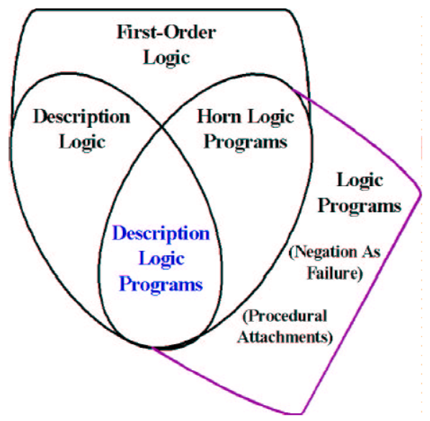
Relations between some logics
DL
Benjamin Grosof , Ian Horrocks, Raphael Volz, Stefan Decker.
Description Logic Programs: Combining Logic Programs with Description Logic. 2004 Research Papers in Economics.. http://www.cs.man.ac.uk/~horrocks/Publications/download/2003/p117-grosof.pdf

Slide 56
Description Logic(s)
Three essential components of a DL system:
  Abox: Father(john). concept assertion
  fatherOf(john, barry). role assertion
  john ≠ barry
  …
  Tbox: Father Parent concept inclusion
  Person ≡ Human concept equivalence
  …
  Rbox: fatherOf parentOf role inclusion
  disjoint(parentOf, childOf) disjointness of roles
  …
Assertions need to be interpreted as being about sets.

Slide 57
SubClassOf hierarchies = concept inclusion!
No reference provided due to vicarious embarrassment

Slide 58
DL constructors
Male Parent intersection / conjunction
Male Female union / disjunction
¬ Male complement / negation
…
Can be used in Tbox axioms, e.g.
  Father ≡ Male Parent
  T Male Female everything is included in the set of males and females
  Male Female ⊥ the intersection of the set of males and the set of females is empty
  …
Markus Krötzsch, Frantisek Simancik, Ian Horrocks. A Description Logic Primer. https://arxiv.org/pdf/1201.4089.pdf

Slide 59
Role restrictions
Universal restriction:
  ∀parentOf.Female
    The set of individuals all of whose children are female including those that have no children at all.
Existential restriction:
  ∃parentOf.T
    The set of individuals that are parents of at least one individual.
Combinations:
  construct: ∃parentOf.T ∀parentOf.Female
    The set of all individuals with at least one child, all children being female.
  axiom: ∃sonOf.T male
    The set of individuals that are the son of at least one individual is a subset of the set of males.
Markus Krötzsch, Frantisek Simancik, Ian Horrocks. A Description Logic Primer. https://arxiv.org/pdf/1201.4089.pdf

Slide 60
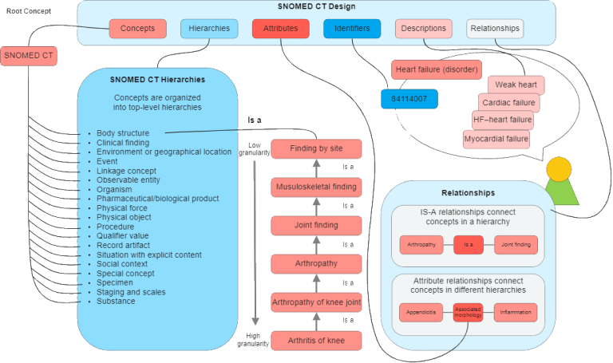
An example: Snomed CT
https://enonic.com/blog/what-is-snomed-ct

Slide 61
Snomed’s DL is EL++ (1)
The description logic EL allows the following concepts:
C, D → A | (atomic concept)
T | (universal concept)
⊥ | (bottom concept)
{a} | (singular enumeration)
C D | (intersection / conjunction)
∃R.C | (existential restriction)
With the following axioms:
  C D and C ≡ D for concept descriptions C and D.
  P Q and P ≡ Q for roles P, Q.
  C(a) and R(a, b) for concept C, role R and individuals a, b

Slide 62
Snomed’s DL is EL++ (2)
It lacks:
  negation, (only disjointness of classes: C D ⊥),
  disjunction,
  universal quantification,
  cardinalities,
  inverse roles,
  some role characteristics

Slide 63
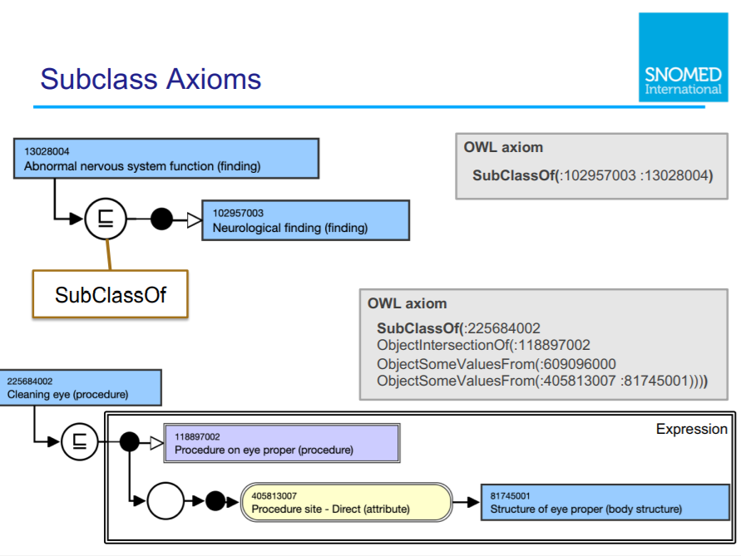

Slide 64
Existential restriction

Slide 65
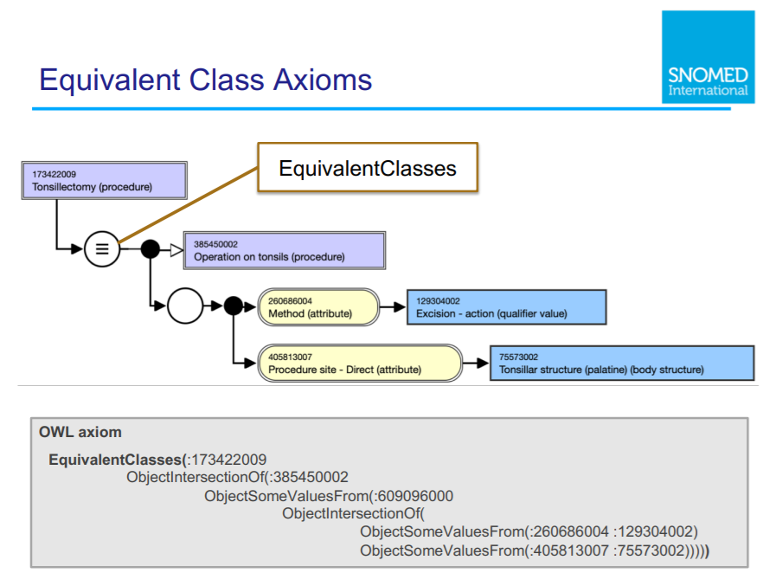

Slide 66
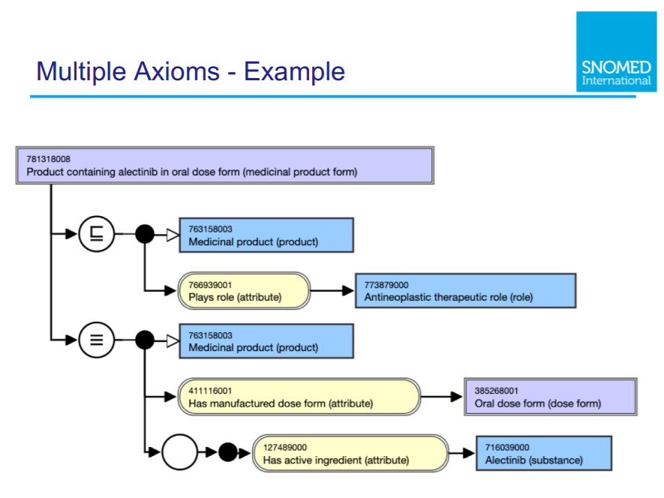

Slide 67
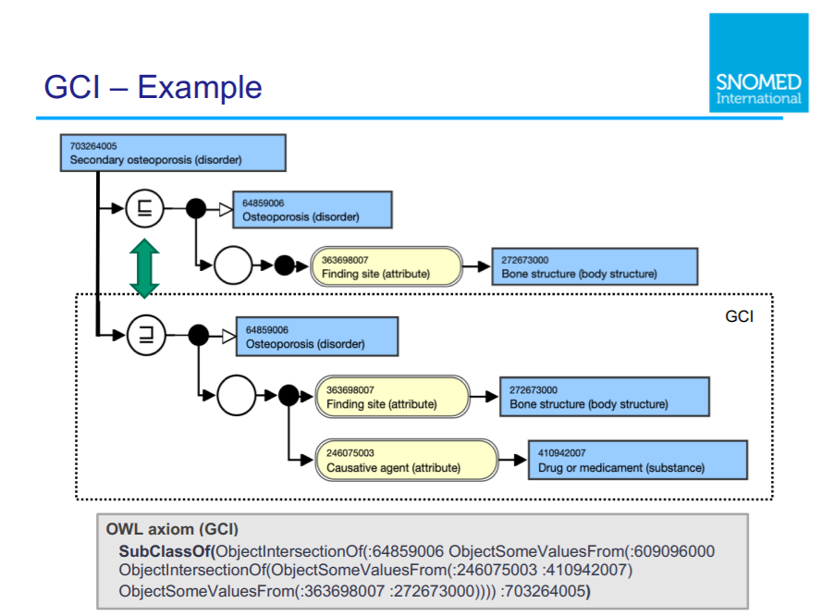

Slide 68
Characteristics of OWL-based DLs
Ideal for fixing the terminology of a domain
  → constructors
  DL-reasoners can detect contradicting definitions and classify terms automatically
    But only if axioms are used of a sort the reasoner can work with!

Slide 69
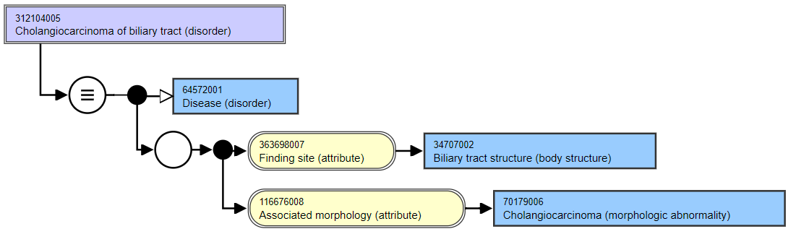
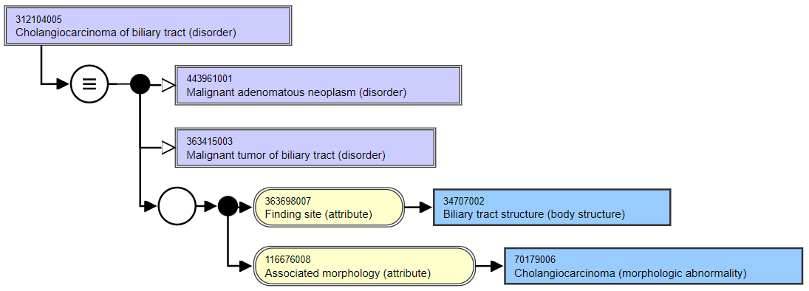
Asserted
Inferred

Slide 70
Characteristics of OWL-based DLs
Ideal for fixing the terminology of a domain
  → constructors
  DL-reasoners can detect contradicting definitions and classify terms automatically
Drawbacks:
  Based on non-defeasible logic, hence no exceptions are possible
  One cannot:
    represent classes of classes,
    make statements about classes
  ‘Tweaking’ axioms for desired outcomes though ontologically nonsensical

Slide 71
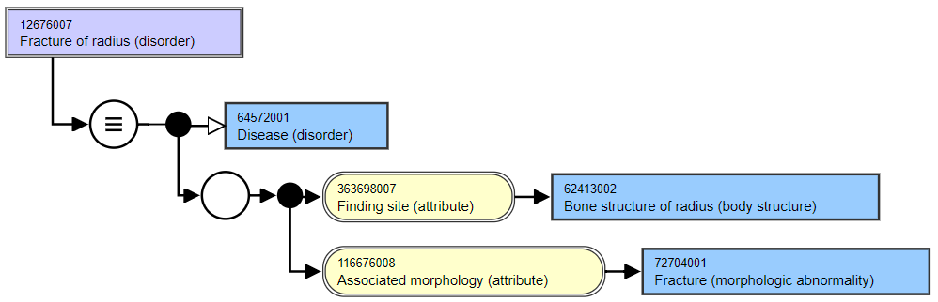
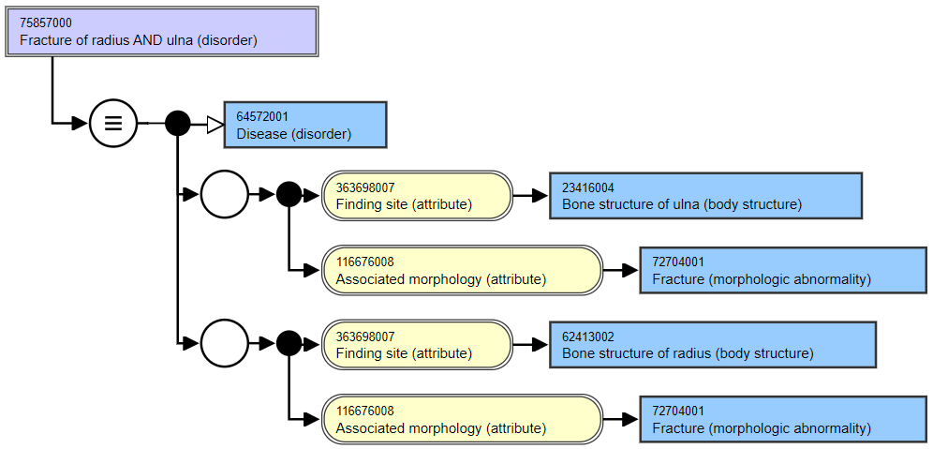
Asserted
Asserted

Slide 72
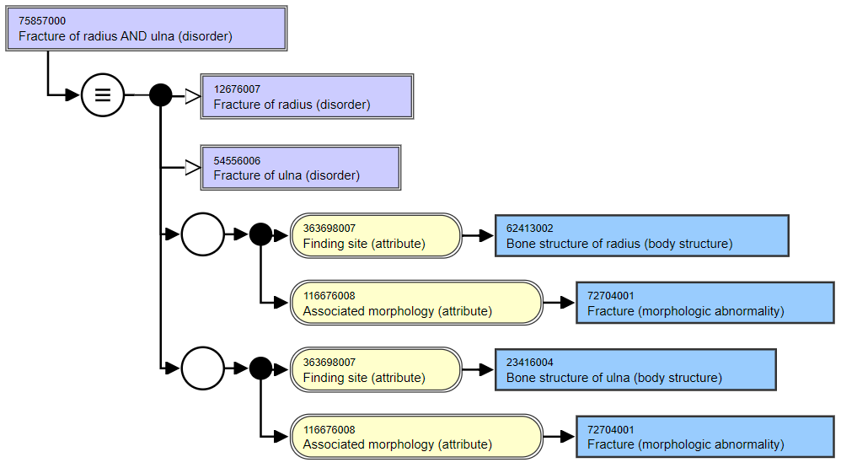
Role groups in
Snomed CT: odd
consequences by design

Slide 73
Common Logic (CL)
CL is a family of first-order logics which share a common abstract syntax and model theory, and an XML framework for encoding and transmitting them, or their content, on an open network.
CL syntax is very relaxed in the expressions it allows, in some ways going beyond classical FO logic.
ISO standard: https://standards.iso.org/ittf/PubliclyAvailableStandards/c066249_ISO_IEC_24707_2018.zip
https://www.w3.org/2004/12/rules-ws/slides/pathayes.pdf

Slide 74
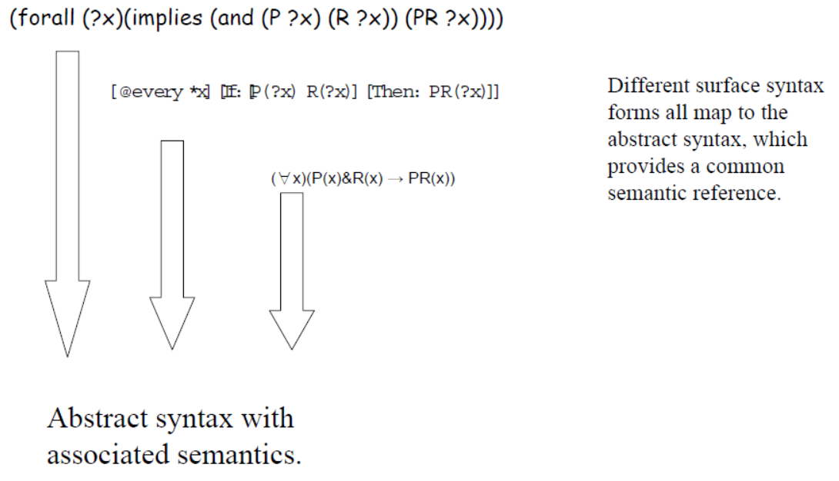
CL dialects
https://www.w3.org/2004/12/rules-ws/slides/pathayes.pdf

Slide 75
Common Logic Interchange Format
(CLIF)
John is going to Boston by bus
(exists (x y)
(and (Go x) (Person John) (City Boston)
(Bus y) (Agnt x John) (Dest x Boston) (Inst x y)))
https://standards.iso.org/ittf/PubliclyAvailableStandards/c066249_ISO_IEC_24707_2018.zip

Slide 76
Common Logic Interchange Format
(CLIF)
John is going to Boston by bus
(exists (x y)
(and (Go x) (Person John) (City Boston)
(Bus y) (Agnt x John) (Dest x Boston) (Inst x y)))
quantifier
variable
predicate
literals
connective
https://standards.iso.org/ittf/PubliclyAvailableStandards/c066249_ISO_IEC_24707_2018.zip

Slide 77
BFO2020-style CLIF constructs for FOL (1)
Predicate: (predicate_name {arguments})
  where ‘{arguments}’ is a list of terms and/or variables.
  (universal site)
  (instance-of werner human-being yesterday)
  (inheres-in this-color that-ball)
Quantified construct: (quantifier ({vars}) <construct>)
  where ‘{vars}’ is a list of variables.
  (exists (t) (instance-of werner human-being t))
  (forall (x y) (instance-of x entity y))
Negation: (not <construct>)
  (not (= object history))
  (not (exists (t) (instance-of werner quality t)))

Slide 78
BFO2020-style CLIF constructs for FOL (2)
Construct-list: (and/or {constructs})
  (and (instance-of werner human-being yesterday)
  (instance-of werner human-being today))
  (or (inheres-in this-color this-ball)
  (inheres-in this-color that-ball))
Implication: (if/iff <construct> <construct>)
  (iff (occurrent-part-of a b)
  (has-occurrent-part b a))
  (if (exists (t) (instance-of a occurrent t))
  (occurrent-part-of a a))

Slide 79
Advantages of using FOL/CLIF (1)
Allows for precise, unambiguous and machine-processible descriptions of what one ontologically commits to;
  Example from BFO2020:
    (forall (t)
      (if (instance-of t temporal-region t)
      (exists (u i)
      (and (not (= i t))
      (universal u)
      (particular i)
      (instance-of i u t))))))
    At all times, there is at least one particular and one universal that is instantiated by that particular.
‘machine-processable’ → syntax can be checked by parser.

Slide 80
Advantages of using FOL/CLIF (2)
Allows for precise, unambiguous and machine-processible descriptions of what one ontologically commits to;
Allows for transformations to other formats such as Kowalski rules.

Slide 81
From FOL axioms to Kowalski rules
Eliminate the implications.
Move the negations down to the atomic formulas.
Eliminate the existential quantifiers.
Rename the variables, if necessary.
Move the universal quantifiers to the left.
Move the disjunctions down to the literals.
Eliminate the conjunctions.
Rename the variables, if necessary.
Eliminate the universal quantifiers.
For each disjunction obtained: move negations to the left and rewrite ‘not P or Q’ as ‘P → Q’.
https://www.cs.cornell.edu/courses/cs4700/2011fa/lectures/16_FirstOrderLogic.pdf
https://www.cs.miami.edu/home/geoff/Courses/COMP6210-10M/Content/FOFToCNF.shtml#:~:text=Clause%20Normal%20Form%20(CNF)%20is,%7C%2C%20e.g.%2C%20C%7C.

Slide 82
Example from BFO2020
    (forall (t)
      (if (instance-of t temporal-region t)
      (exists (u i)
      (and (not (= i t))
      (universal u)
      (particular i)
      (instance-of i u t))))))
    becomes:
      (instance-of t temporal-region t) → (instanceof sk9(t) sk8(t) t)
      (instance-of t temporal-region t) → (particular sk9(t))
      (instance-of t temporal-region t) → (universal sk8(t))
      (instance-of t temporal-region t) ∧ (= sk9(t) t) → false

Slide 83
Advantages of using FOL/CLIF (3)
Allows for precise, unambiguous and machine-processible descriptions of what one ontologically commits to;
Allows for transformations to other formats such as Kowalski rules;
Kowalski rules can be processed by relatively simple logic programs for satisfiability testing, model development, term expansion, rule-base optimization, data-integrity checking, ...
  (demo, time permitting).

Slide 84
Don’t forget !
Register ahead of time for my two forthcoming ontology classes on July 27 and August 14.

