Slide 1
Basic Formal Ontology Summit
Keynote presentation
May 23, 2023 – Buffalo, NY
BFO2020’s axiomatization: the good, the bad, and the ugly.
Werner CEUSTERS^{1,2}
¹ Department of Biomedical Informatics, University at Buffalo, USA
² Department of Psychiatry, University at Buffalo, USA

Slide 2
Overview
Essential background:
  Before I saw the light ( … - 2001)
  How it happened (2001 – 2021)
BFO2020 axiomatization in CLIF
  Relation to Referent Tracking
  Development and use of educational tools
  Experiences

Slide 3
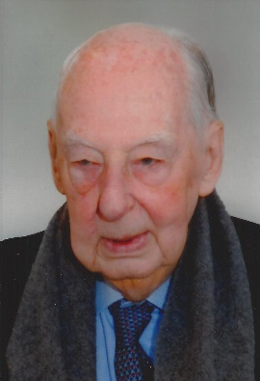
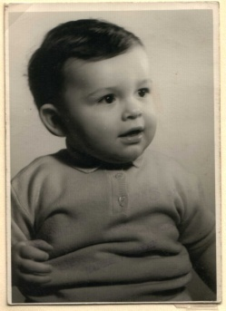
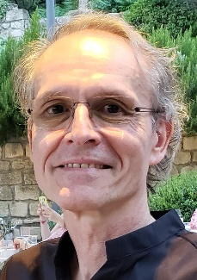


Educational environments
Paul
Kluyskens
1977
1959 -
1989

Slide 4

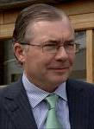



Educational & professional environments
Paul
Kluyskens
1977
1959 -
1989
1992
1993
1995
1998
Georges
Demoor

Slide 5
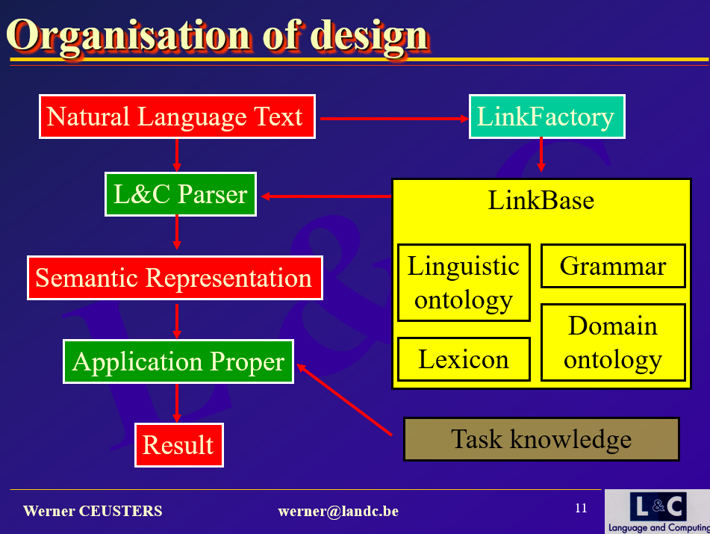
Down memory lane (2000)

Slide 6
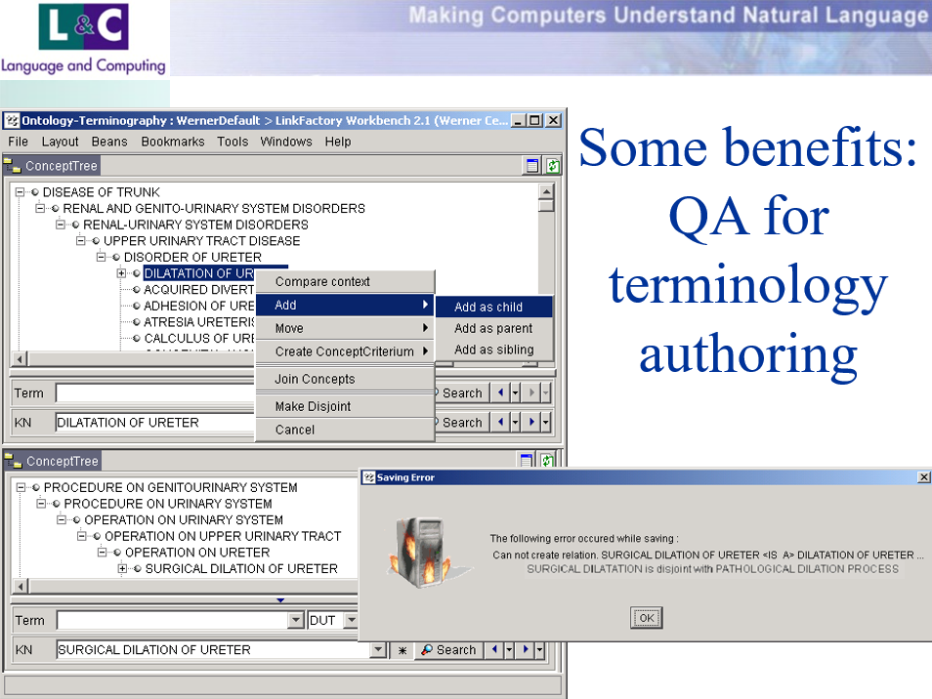
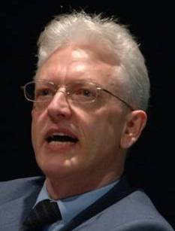
Down memory lane (2000)

Slide 7
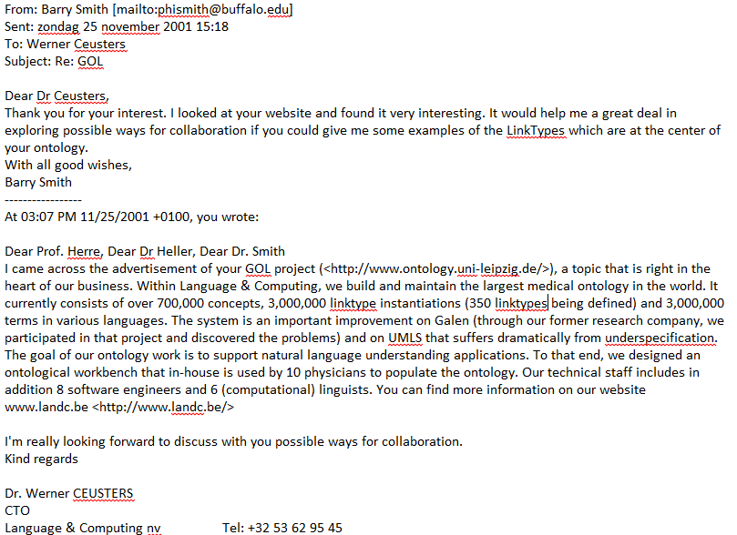

Slide 8
Down memory lane (2000)
Impressive, but all wrong !!!

Slide 9






Educational & professional environments
Paul
Kluyskens
1977
2014
1959 -
2012
2006
1989
1992
2004
2002
1993
1995
1998
Georges
Demoor
Barry
Smith

Slide 10
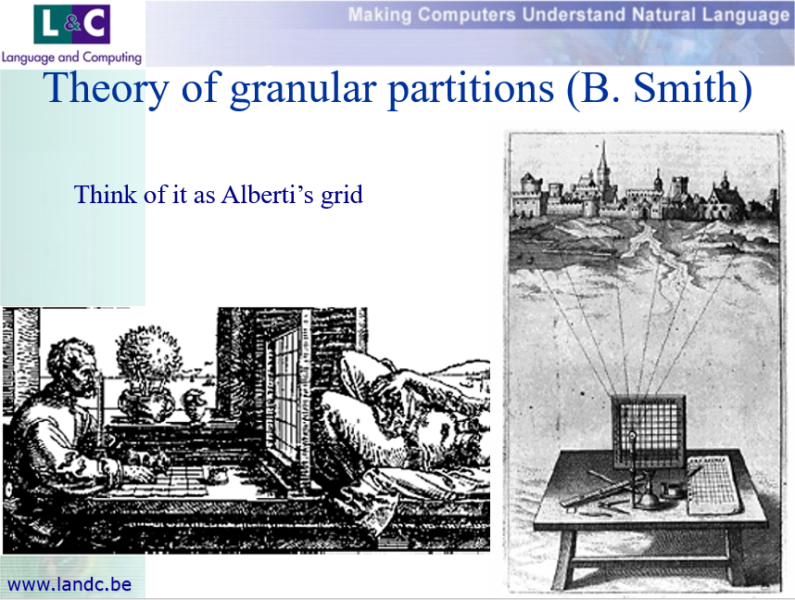
Down memory lane (2001)
Why I became a BFO ‘early adopter’ (1)

Slide 11
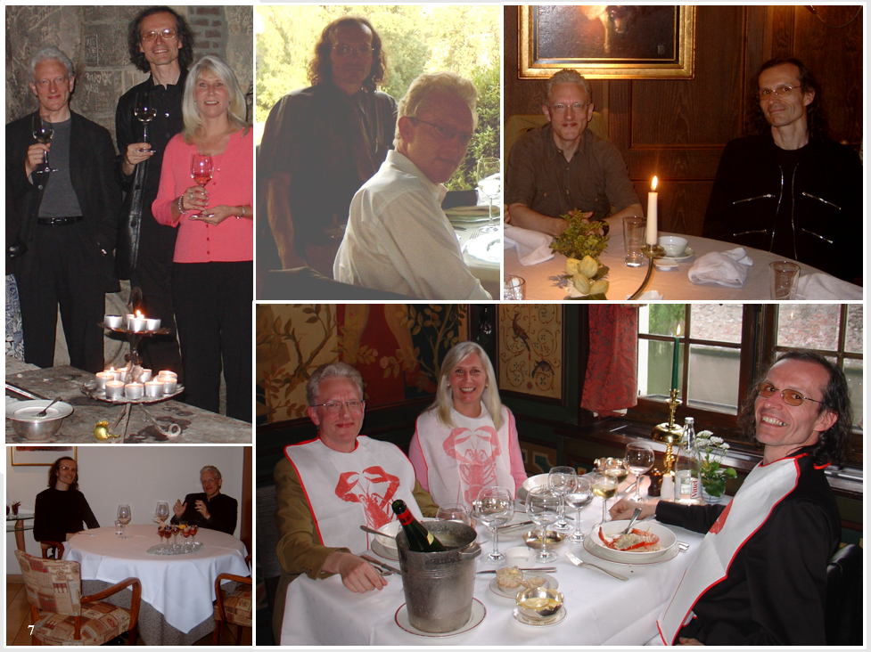
Why I became a BFO ‘early adopter’ (2)

Slide 12
Why I became a BFO ‘early adopter’ (3)
The pieces started to come together
William Kent. Data and Reality (1978).
    Reality as benchmark
Alan Rector et.al. A framework for modelling the electronic medical record (1993).
    Descriptions as benchmark
Welty and Guarino. Supporting ontological analysis of taxonomic relationships (2001).
    Concepts as benchmark
Barry Smith. Beyond Concepts: Ontology as reality representation (2004).
Barry Smith. Against fantology (2005).
    Use FOL wisely (… in multiple interpretations).

Slide 13
BFO’s selling points
Distinctions between:
  ‘Ontology’ and ‘ontologies’
  Continuants and occurrents
  Dependent entities and independent entities
  Particulars and universals
    Referent Tracking ←→ BFO
  Descriptions and what descriptions are about.
    NLU ←→ ground truth
Need for temporal indexing.

Slide 14
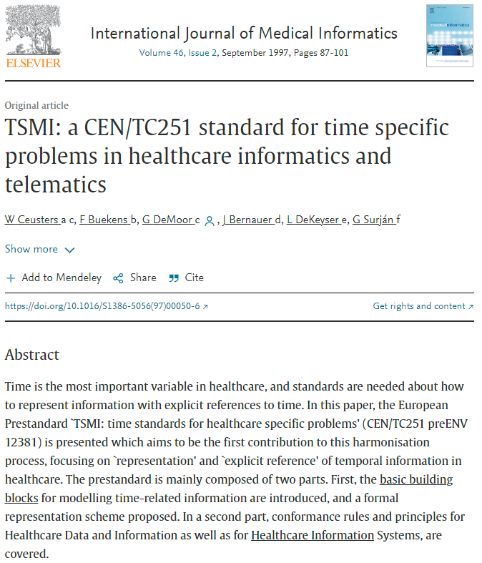
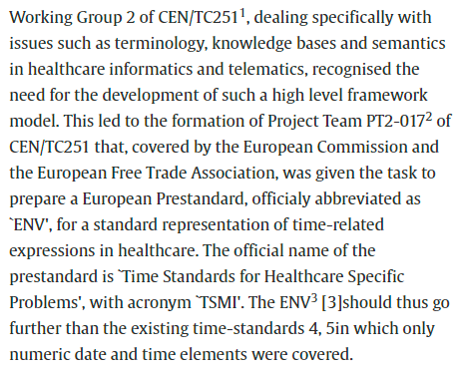
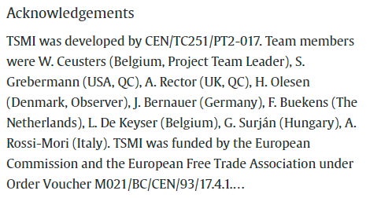

Slide 15
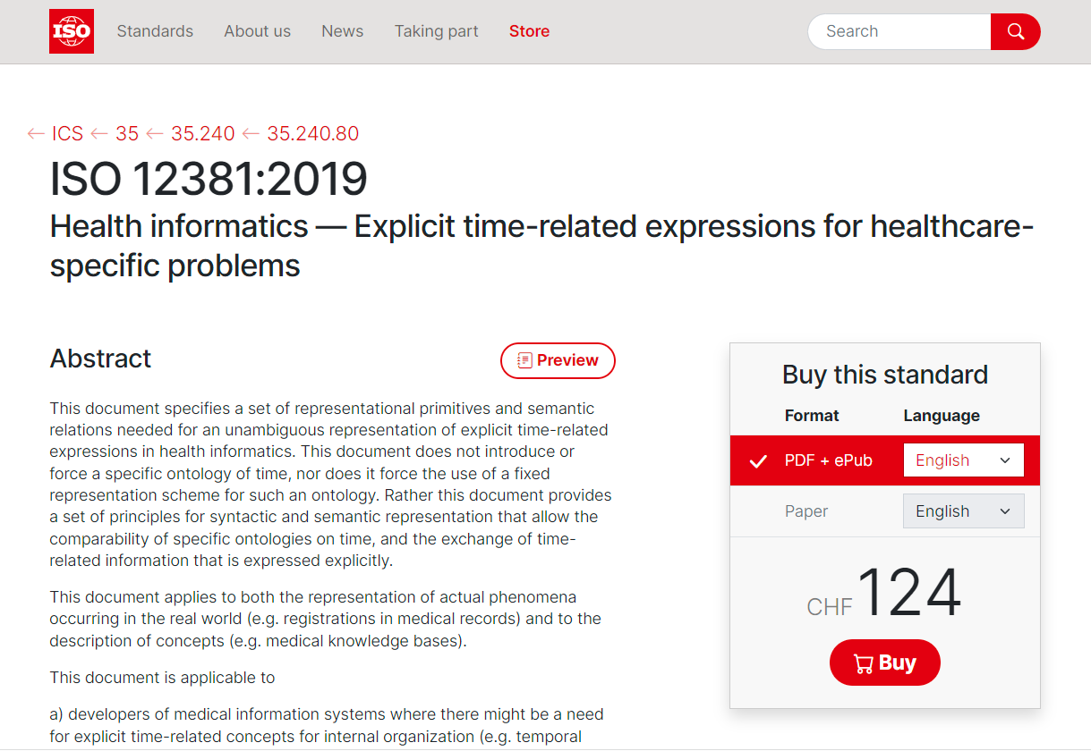

Slide 16
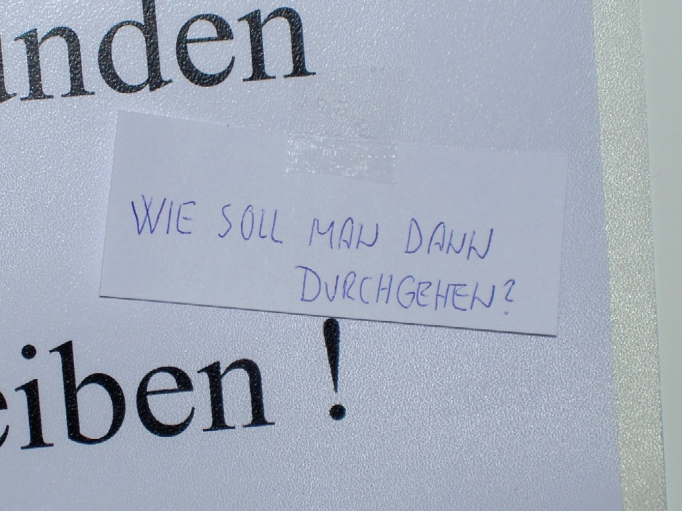
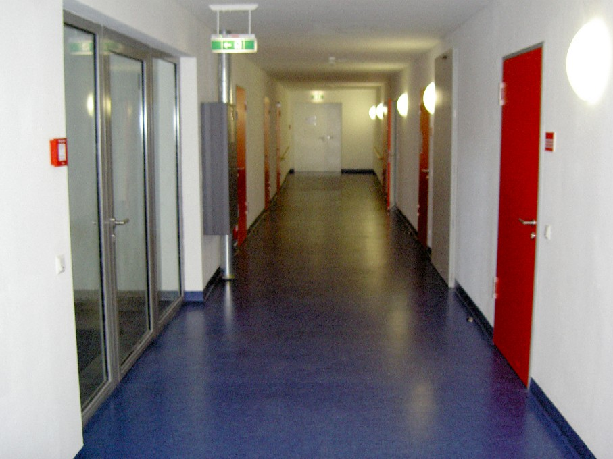

IFOMIS, Saarbrücken, Germany (2005)

Slide 17
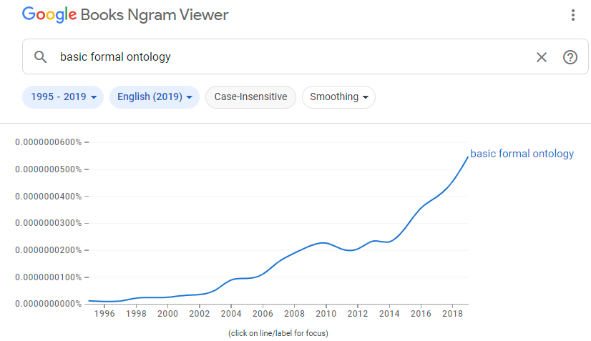
Looks like a success

Slide 18
However !!!
Some of my frustrations re (not about) BFO:
  Inappropriate reference to BFO in ‘ontology’ work described in the literature,

Slide 19
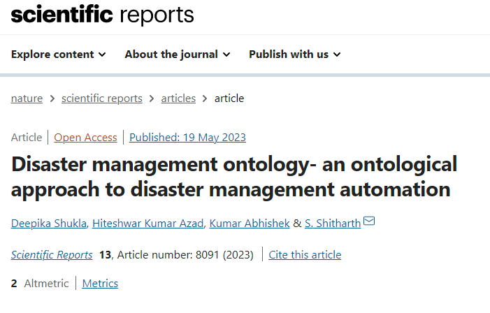
The latest ontology disaster
https://www.nature.com/articles/s41598-023-34874-6#Fig4

Slide 20
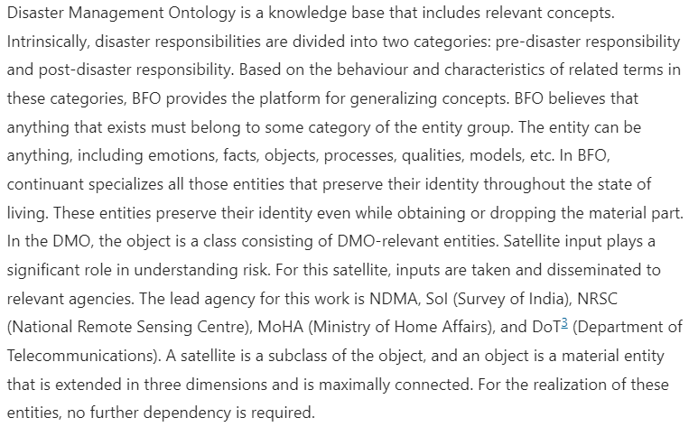
ChatGPT at work ?
https://www.nature.com/articles/s41598-023-34874-6#Fig4

Slide 21
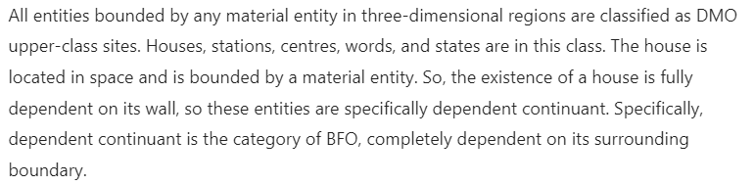
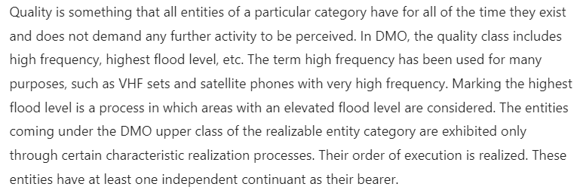
ChatGPT at work ?
https://www.nature.com/articles/s41598-023-34874-6#Fig4

Slide 22
However !!!
Some of my frustrations re (not about) BFO:
  Inappropriate reference to BFO in ‘ontology’ work described in the literature,
  Confusion between BFO and OBO Foundry.

Slide 23
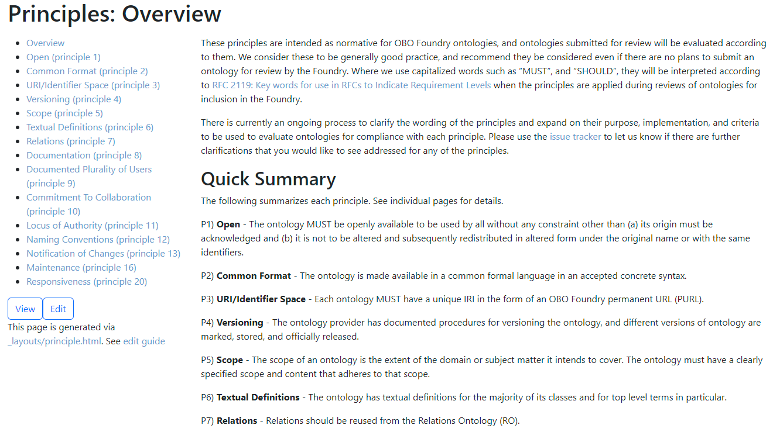
Confusion between BFO and OBO Foundry

Slide 24
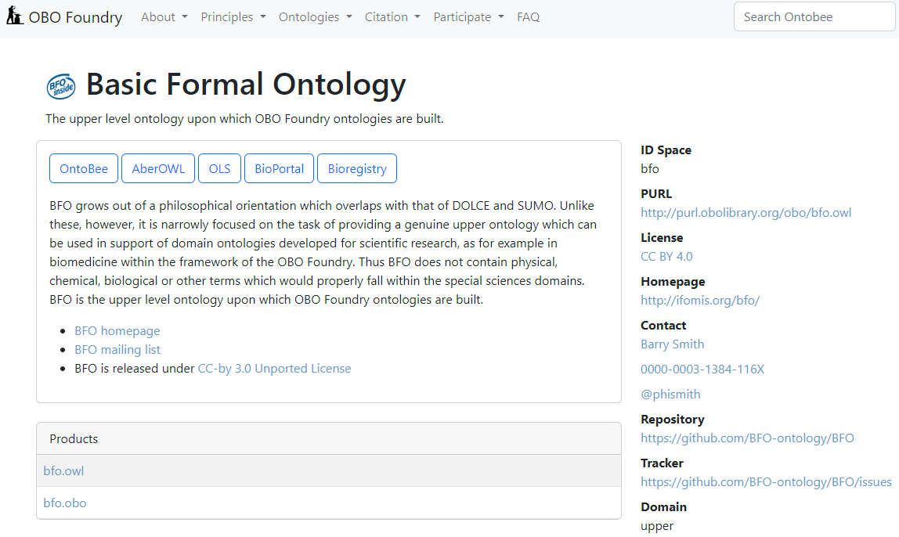
BFO not anymore OBO’s upper ontology
https://obofoundry.org/ontology/bfo.html

Slide 25
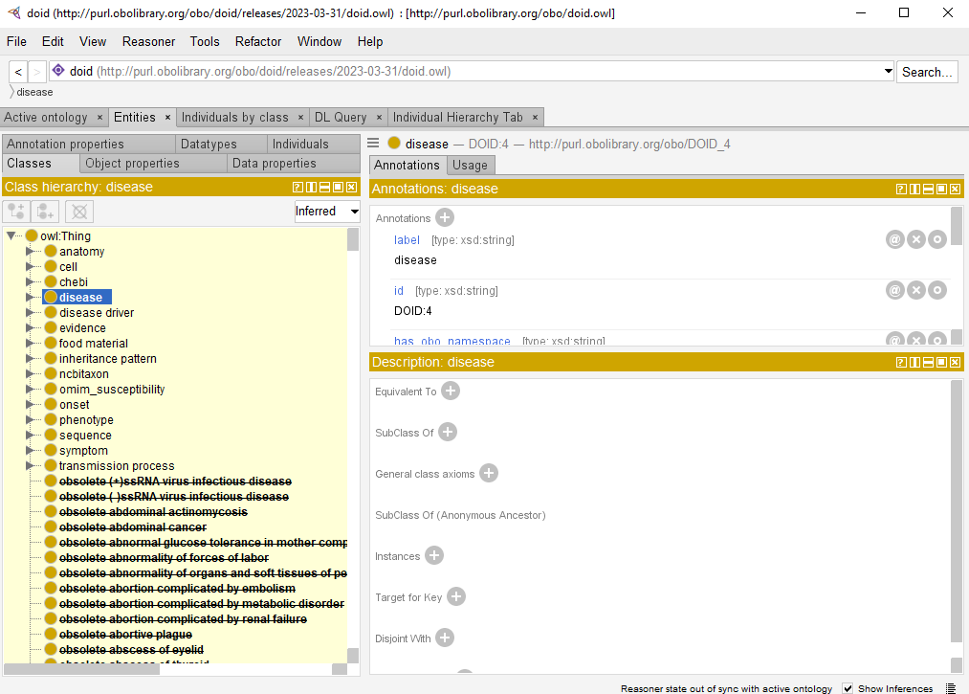

Slide 27


Relation Ontology
https://genomebiology.biomedcentral.com/articles/10.1186/gb-2005-6-5-r46

Slide 28
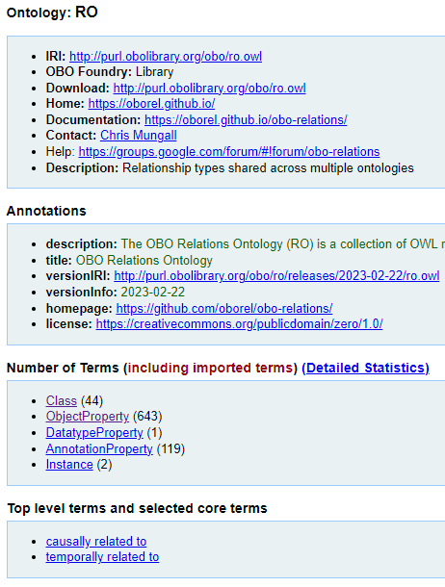
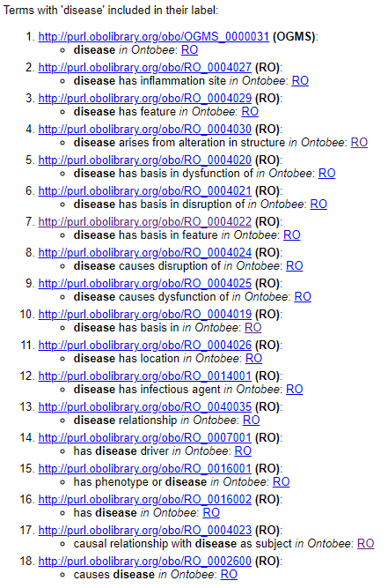
Relation Ontology
https://ontobee.org/ontology/ro

Slide 29
Relation Ontology
https://ontobee.org/ontology/ro

Slide 30
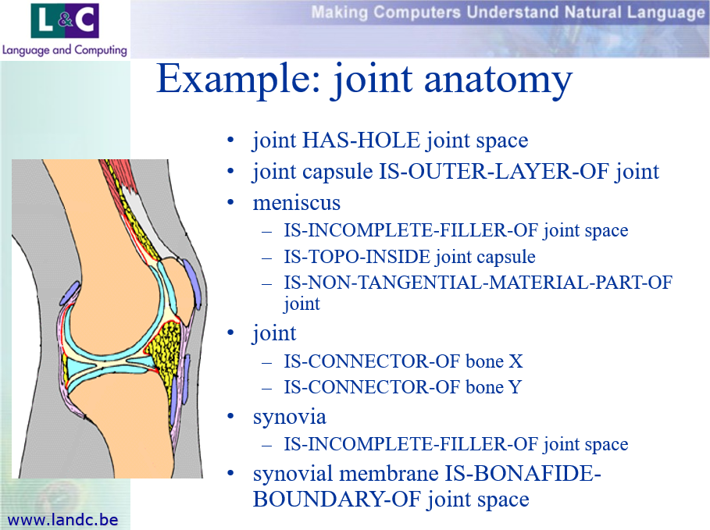
Down memory lane (2000)
Impressive, but all wrong !!!

Slide 31

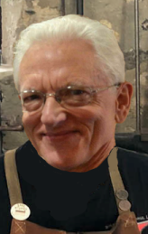

Slide 32
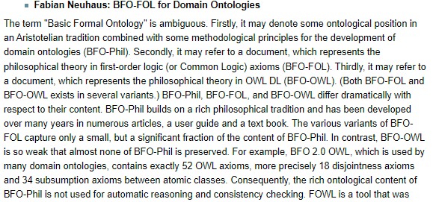
What happened ?
Part of the answer: next keynote

Slide 33
Some other pet peeves …
Inappropriate reference to BFO in ‘ontology’ work described in the literature,
OWL too much used as an exchange format rather than a language with formal semantics,

Slide 34

A ‘must read’

Slide 35
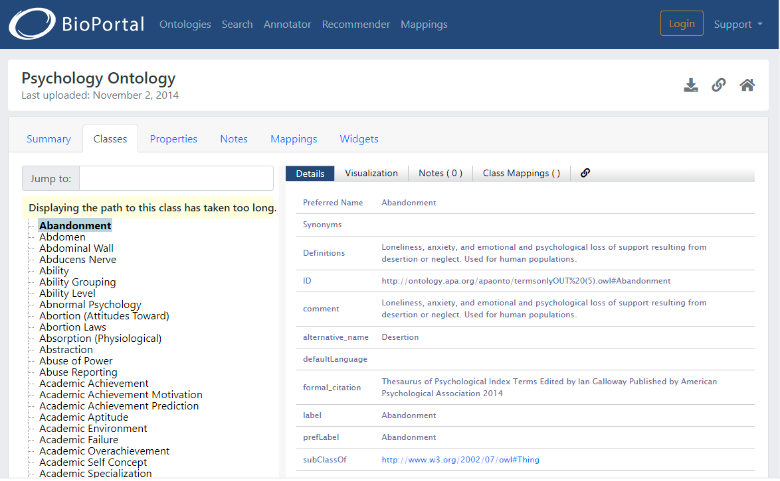
The only ‘ontology’ in the BioPortal using OWL correctly

Slide 36
Some other pet peeves …
Inappropriate reference to BFO in ‘ontology’ work described in the literature,
OWL too much used as an exchange format rather than a language with formal semantics,
Existing tools make it too easy to:
  make something that looks like an ontology (e.g. Protégé)
  re-use content from something that looks like an ontology (e.g. Robot)

Slide 37
My biggest frustration!
Inappropriate reference to BFO in ‘ontology’ work described in the literature,
OWL too much used as an exchange format rather than a language with formal semantics,
Existing tools make it too easy to:
  make something that looks like an ontology (e.g. Protégé)
  re-use content from something that looks like an ontology (e.g. Robot)
Students in my 700-level classes still making basic mistakes re BFO-principles, i.e. BFO-Phil
…

Slide 38
A step towards improvement?
BFO2020
Axiomatization in FOL/CLIF

Slide 39
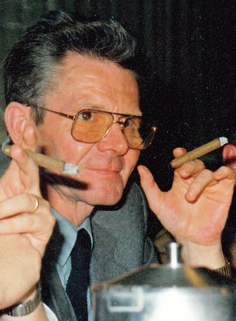
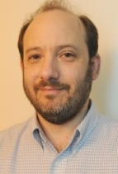
Educational & professional environments
Etienne
Ceusters
Paul
Kluyskens
Alan
Ruttenberg
1977
2014
1959 -
2012
2006
1989
1992
2004
2002
1993
1995
1998
Georges
Demoor
Barry
Smith

Slide 40
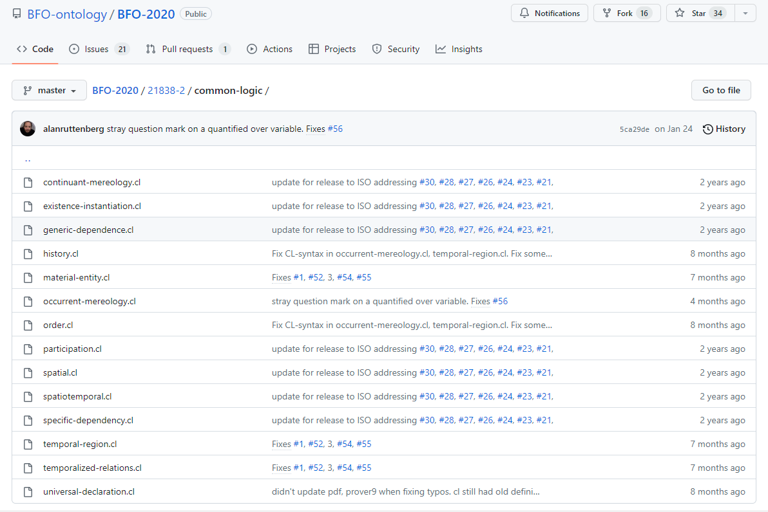
BFO2020-CLIF
https://github.com/BFO-ontology/BFO-2020/tree/master/21838-2/common-logic

Slide 41
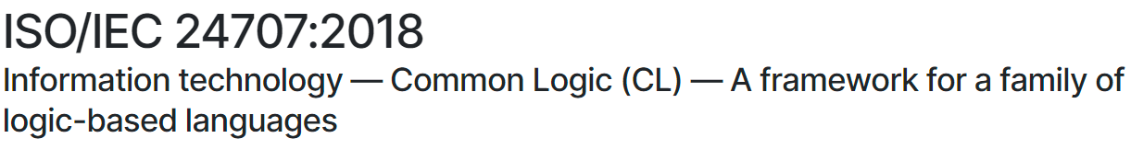
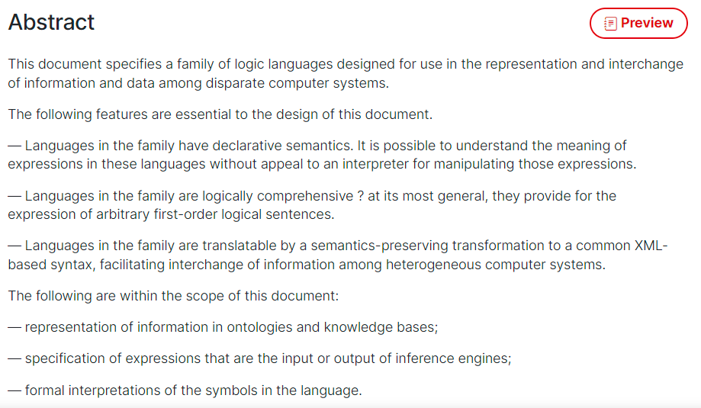
CLIF ISO Standard
https://www.iso.org/standard/66249.html

Slide 42
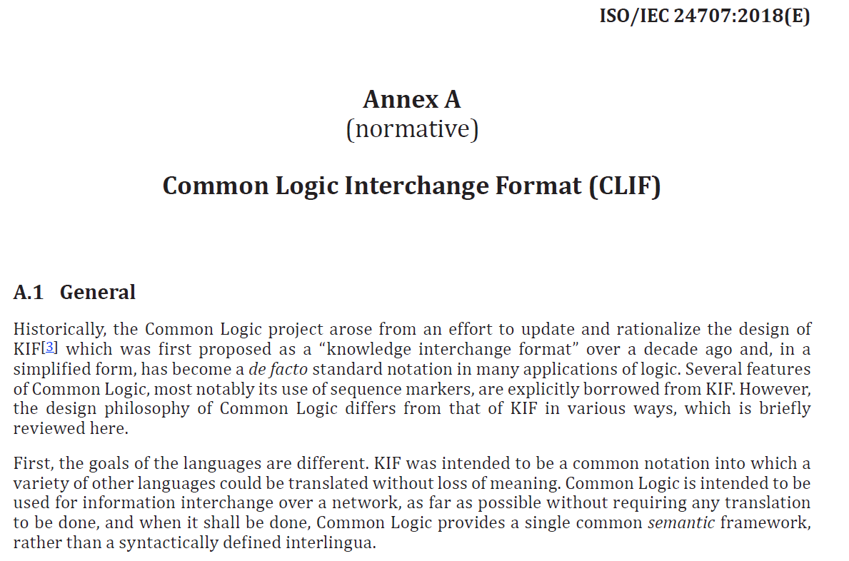
CLIF

Slide 43
BFO2020 axiomatization in CLIF
Uses only parts of the CLIF specifications.
Expressed in FOL with as important features:
  use of equality,
  (1-,) 2-, and 3-ary predicates,
  no functions,
  standard connectives
    OR, AND, IF, IFF, NOT
  universal and existential quantification
    FORALL, EXISTS
  ‘Realism-based’ choice of predicates.

Slide 44
‘Realism-based’ predicates
Criteria:
  Restricted to formal relations.
  Grounded in the distinction between types (universals and defined classes) and particulars.
  Use of temporal indexing.
Example: ‘all soccer balls are round’
  FOL with properties ‘fantologically conceived’:
    (forall (x) (if (soccer-ball x) (round x)))
  Realism-based:
    (forall (x t)
      (if (instance-of x soccer-ball t)
      (exists (y)
      (and (instance-of y round t)
      (inheres-in y x)))))
http://ontology.buffalo.edu/bfo/Against_Fantology.pdf

Slide 45

Deflated soccer balls are not round
No problem for fantologists:
  (forall (x) (if (deflated-soccer-ball x)
  (not-round x)))
For realism-based ontologists:
  One should not cram everything
  together in a predicate
  Explicit time-indexing draws attention to issues of generalization
  …
Trying to adhere to realism-based principles requires thinking beyond merely applying logic.
https://soccerlifestyle.com/how-to-deflate-a-soccer-ball/

Slide 46
Logic and Ontology
LOGICIAN:
ONTOLOGIST:
LOGICIAN:
ONTOLOGIST:
LOGICIAN:
Hey guys, I just became father!
My sincere condolences! Boy or girl?
True!
Ok, boomer, which of the two?
Boy!

Slide 47
Logic and Ontology
LOGICIAN:
ONTOLOGIST:
LOGICIAN:
ONTOLOGIST:
LOGICIAN:
SOCIAL ACTIVIST:
Hey guys, I just became father!
My sincere condolences! Boy or girl?
True!
Ok, boomer, which of the two?
Boy!
How dare you!!!
How could they have already self-identified?
Postmodernism

Slide 48
Why a possible improvement?
Making it easier to grasp what BFO really says about reality
  Way less, and more, than I thought!
Improving quality of ontology design by using FOL as a basis:
  Detecting inconsistencies
  Identifying unintended consequences
Improving quality of information systems, especially electronic healthcare records and repositories.
  Leveraging Referent Tracking.

Slide 49
What is ‘referent tracking’?
In general:
  ‘referent’:
    an entity denoted by some reference in a representation;
  ‘reference’:
    a representation that denotes some entity;
  ‘referent tracking’:
    keeping track of how entities stand in relation to each other by keeping track of how their references are used in representations.

Slide 50
RT issues in language
Various forms with non-standard definitions:
  Reference resolution
  Co-reference resolution
  Anaphora resolution
Example:

Slide 51

My child doesn’t like fish. What replacement would you suggest?
A cat would work! All cats like fish!

Slide 52
RT issues in EHRs: the ‘problem list’
PtID
Date
ConceptCode
Concept
5572
04/07/1990
26442006
closed fracture of shaft of femur
5572
04/07/1990
81134009
Fracture, closed, spiral
5572
12/07/1990
26442006
closed fracture of shaft of femur
5572
12/07/1990
9001224
Accident in public building (supermarket)
5572
04/07/1990
79001
Essential hypertension
0939
24/12/1991
255174002
benign polyp of biliary tract
2309
21/03/1992
26442006
closed fracture of shaft of femur
2309
21/03/1992
9001224
Accident in public building (supermarket)
47804
03/04/1993
58298795
Other lesion on other specified region
5572
17/05/1993
79001
Essential hypertension
298
22/08/1993
2909872
Closed fracture of radial head
298
22/08/1993
9001224
Accident in public building (supermarket)
5572
01/04/1997
26442006
closed fracture of shaft of femur
5572
01/04/1997
79001
Essential hypertension
0939
20/12/1998
255087006
malignant polyp of biliary tract

Slide 53
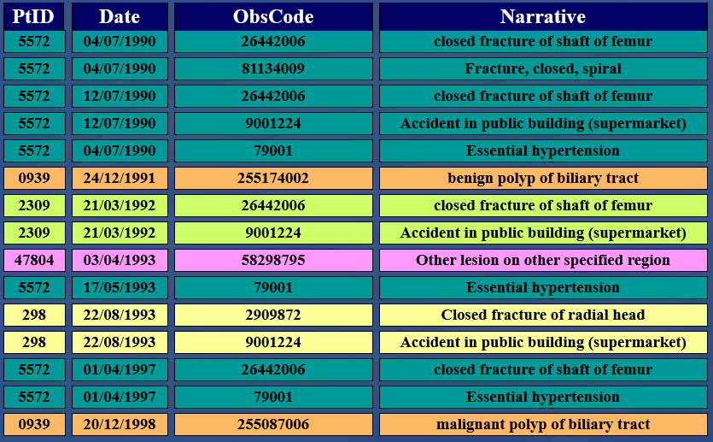
Predicate (fanta)logic analogue
has-disorder(john, fracture, date1)
or?
has-diagnosis(john, fracture, date1)
To what entity precisely is ‘fracture’ ascribed?

Slide 54
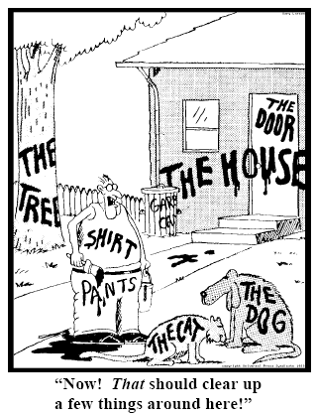
Essence of Referent Tracking
explicit reference to the individual entities
relevant to the accurate description of some
portion of reality, ...
Ceusters W, Smith B. Strategies for Referent Tracking in Electronic Health Records. J Biomed Inform. 2006 Jun;39(3):362-78.

Slide 55
IUI = Instance Unique Identifier
There is for any particular only one identifier within all systems in which the entity is represented
Globally and Singularly Unique Identifier for a Particular
there is for any particular only one identifier within a given representation system
Basic rule for RT-based information systems:
accept only assertions about explicitly identified particulars!

Slide 56
RT issues in EHRs: the ‘problem list’
PtID
Date
ConceptCode
Concept
5572
04/07/1990
26442006
closed fracture of shaft of femur
5572
04/07/1990
81134009
Fracture, closed, spiral
5572
12/07/1990
26442006
closed fracture of shaft of femur
5572
12/07/1990
9001224
Accident in public building (supermarket)
5572
04/07/1990
79001
Essential hypertension
0939
24/12/1991
255174002
benign polyp of biliary tract
2309
21/03/1992
26442006
closed fracture of shaft of femur
2309
21/03/1992
9001224
Accident in public building (supermarket)
47804
03/04/1993
58298795
Other lesion on other specified region
5572
17/05/1993
79001
Essential hypertension
298
22/08/1993
2909872
Closed fracture of radial head
298
22/08/1993
9001224
Accident in public building (supermarket)
5572
01/04/1997
26442006
closed fracture of shaft of femur
5572
01/04/1997
79001
Essential hypertension
0939
20/12/1998
255087006
malignant polyp of biliary tract

Slide 57
RT issues in EHRs: the ‘problem list’
PtID
Date
IUI
ConceptCode
Concept
5572
04/07/1990
#1
26442006
closed fracture of shaft of femur
5572
04/07/1990
#1
81134009
Fracture, closed, spiral
5572
12/07/1990
#1
26442006
closed fracture of shaft of femur
5572
12/07/1990
#2
9001224
Accident in public building (supermarket)
5572
04/07/1990
#3
79001
Essential hypertension
0939
24/12/1991
#4
255174002
benign polyp of biliary tract
2309
21/03/1992
#5
26442006
closed fracture of shaft of femur
2309
21/03/1992
#6
9001224
Accident in public building (supermarket)
47804
03/04/1993
#7
58298795
Other lesion on other specified region
5572
17/05/1993
#3
79001
Essential hypertension
298
22/08/1993
#8
2909872
Closed fracture of radial head
298
22/08/1993
#9
9001224
Accident in public building (supermarket)
5572
01/04/1997
#10
26442006
closed fracture of shaft of femur
5572
01/04/1997
#3
79001
Essential hypertension
0939
20/12/1998
#4
255087006
malignant polyp of biliary tract

Slide 58
Common practice: types as proxies for particulars (1)
What you see in the record
benign
tumor
malignant
tumor
stomach
t1 t2

Slide 59
Common practice: types as proxies for particulars (1)
What might be the case
benign
tumor
malignant
tumor
stomach
t1 t2
instanceOf at t₂
instanceOf at t₁
instanceOf at t₂
instanceOf at t₁
continuant-part-of at t₁
this-4
this-1’s stomach
continuant-part-of at t₂

Slide 60
Common practice: types as proxies for particulars (2)
What you see in the record
benign
tumor
malignant
tumor
stomach
t1 t2

Slide 61
Common practice: types as proxies for particulars (2)
What might also be the case
benign
tumor
malignant
tumor
stomach
t1 t2
instanceOf at t₂
instanceOf at t₁
instanceOf at t₂
instanceOf at t₁
this-4
continuant-part-of at t₁
this-1’s stomach
this-5
continuant-part-of at t₂

Slide 62
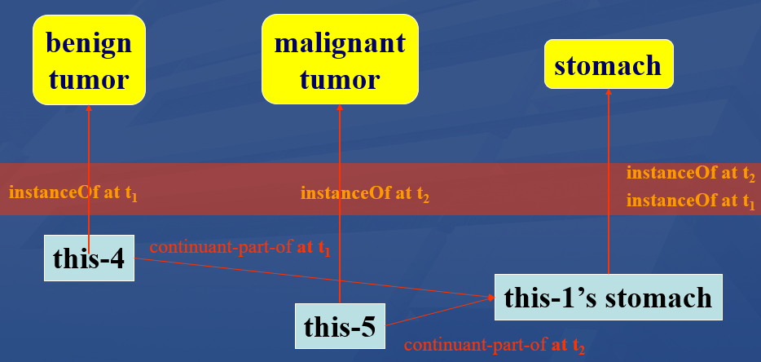
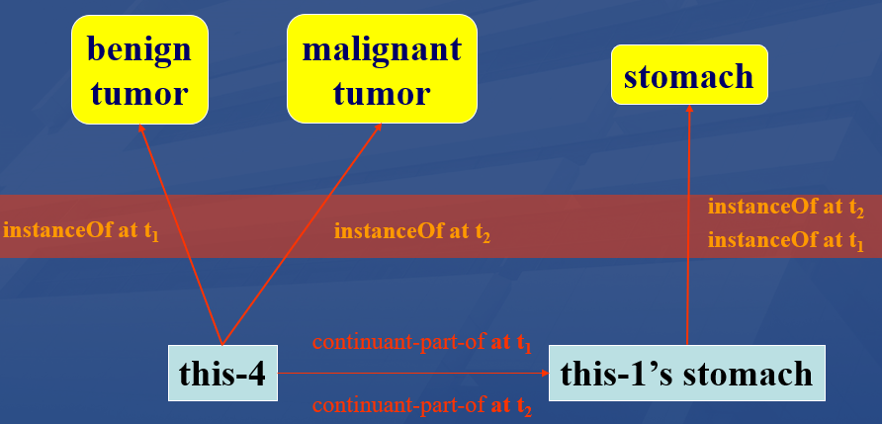
Types as proxies for particulars: a very bad practice !!!
References on the basis of types only cannot always differentiate between distinct configurations of the intended referents!
Two tumors
One tumor

Slide 63
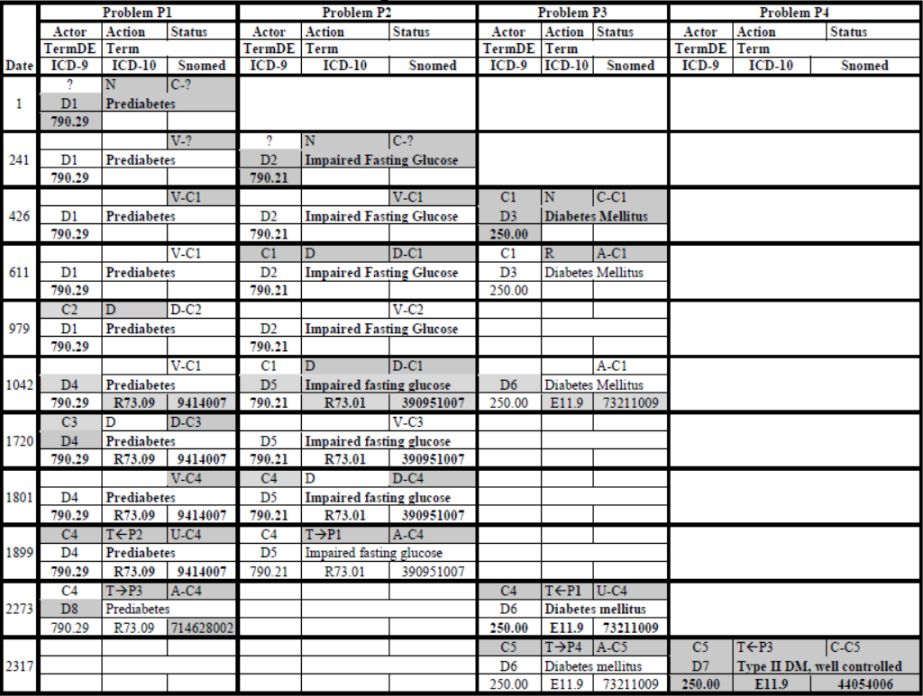

Slide 64
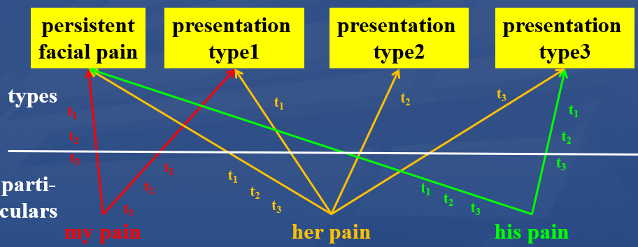
Not only medical records but also many biomedical terminologies suffer from an unwarranted focus on types
‘Persistent idiopathic facial pain (PIFP)’
textual definition:
  = ‘persistent facial pain with varying presentations …’
Which of the three instances of pain qualify for PIFP?

Slide 65
Not only medical records but also many biomedical terminologies suffer from an unwarranted focus on types
‘Persistent idiopathic facial pain (PIFP)’
textual definition:
  = ‘persistent facial pain with varying presentations …’
Which of the three instances of pain qualify for PIFP?
Depends on the definition’s interpretation: about types or about particulars?

Slide 66
Predicate logic analogue for RT
part-of(this-4, this-1, date1)
part-of(this-5, this-1, date2)
instance-of(this-4, benign-tumor, date-1)
instance-of(this-5, malignant-tumor, date-2)
part-of(this-4, this-1, date1)
instance-of(this-4, benign-tumor, date-1)
instance-of(this-4, malignant-tumor, date-2)

Slide 67
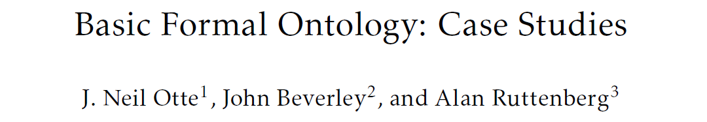
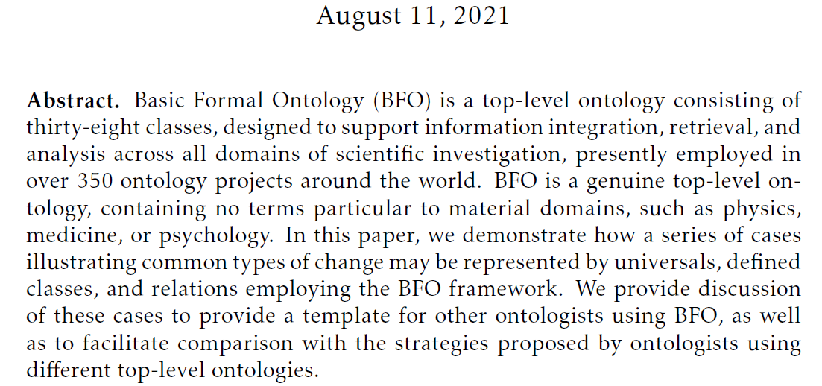
https://philarchive.org/archive/OTTBBF

Slide 68
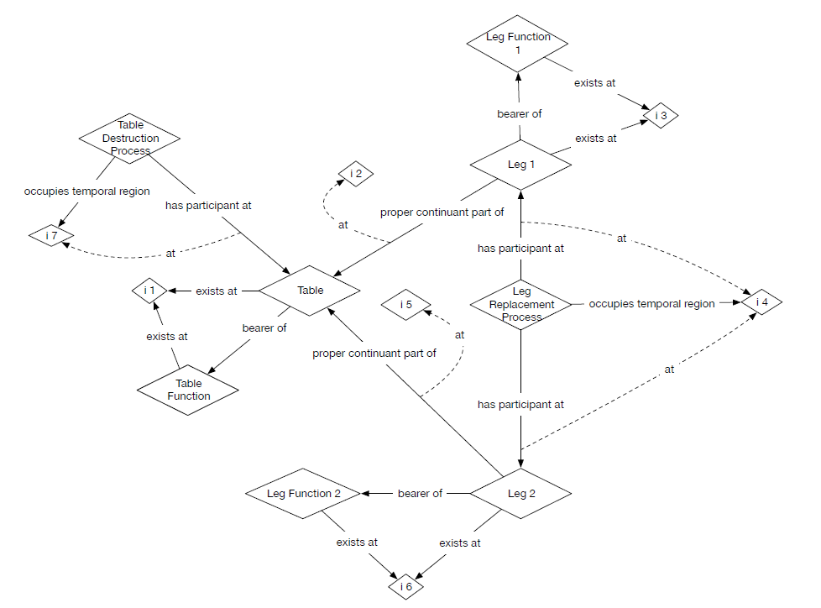
Table talk

Slide 69
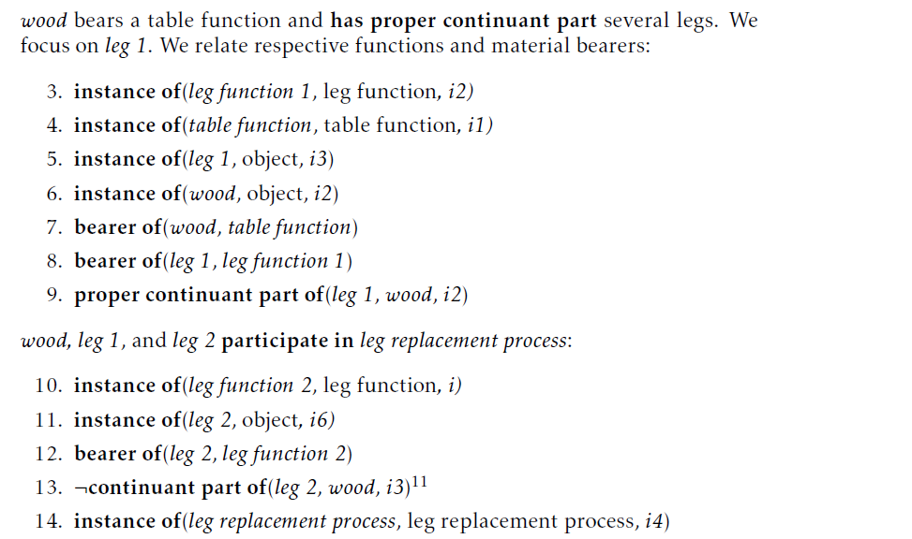
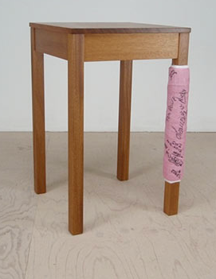
Table talk
https://www.designboom.com/design/george-dubinsky/

Slide 70
Can I use BFO-CLIF to provide better education ?

Slide 71
Educational tools to train logical AND ontological thinking
For working with BFO2020-style CLIF:
  BFO2020-style CLIF template,
  BFO2020-style CLIF parser with:
    Various error-checking functions,
    Warnings,
    Tracking ontology-dependencies,
    Conversion to various formats.
      CLIF → CNF → CF → Kowalski rules
Kowalski-rule-based reasoner:
  Consistency checking for fact-based scenarios,
  Predicate derivation.

Slide 72
BFO2020 axiomatization
Example (in CLIF):
(cl:comment "Definition of specifically dependent continuant. [akq-1]"
(forall (s)
(iff (exists (t)
(instance-of s specifically-dependent-continuant t))
(exists (c t)
(and (instance-of s continuant t)
(instance-of c independent-continuant t)
(not (instance-of c spatial-region t))
(specifically-depends-on s c))))))

Slide 73
‘BFO2020-style’ CLIF template
(cl:comment
" SOMETEXT
"
(cl:text
(cl:ttl "SOMETEXT"
(cl:outdiscourse PREDICATE-NAMES
)
(cl:comment "SOMETEXT"
( ...CLAUSE...)
)
)))

Slide 74
Parser: converts FOL → CNF → Kowalski-rules
% Definition of specifically dependent continuant. [akq-1]
r(469,1,[138],[],"akq-1",kow(if([[instance-of,B,specifically-dependent-continuant,A]]),then([instance-of,B,continuant,[e,138,[B]]]))).
r(470,1,[137,138],[],"akq-1",kow(if([[instance-of,B,specifically-dependent-continuant,A]]),then([instance-of,[e,137,[B]],independent-continuant,[e,138,[B]]]))).
r(471,2,[],[137,138],"akq-1",kow(if([[instance-of,B,specifically-dependent-continuant,A],[instance-of,[e,137,[B]],spatial-region,[e,138,[B]]]]),false)).
r(472,1,[137],[],"akq-1",kow(if([[instance-of,B,specifically-dependent-continuant,A]]),then([specifically-depends-on,B,[e,137,[B]]]))).
r(473,3,[139],[],"akq-1",kow(if([[instance-of,A,independent-continuant,B],[instance-of,C,continuant,B],[specifically-depends-on,C,A]]),then_or([[instance-of,A,spatial-region,B],[instance-of,C,specifically-dependent-continuant,[e,139,[C]]]]))).

Slide 75
5 forms of Kowalski rules
‘if-then’-rules:
  ( A & B & … ) → P
  true → P
‘if-then-or’-rules:
  ( A & B & …) → ( P v Q v … )
  true → ( P v Q v … )
‘false-hood’-rules:
  ( A & B & … ) → false

Slide 76
Current reasoning modes
Classic Propositional
  Modus ponendo ponens
  Modus ponendo tollens
  Modus tollendo tollens
  Modus tollendo ponens
Possible world approach to assumptions
Heuristics
  Limits on function embedding
  Tame incompleteness

Slide 77
‘BFO2020-style’ CLIF reasoner current reasoning modes (1)
ont = defined in ontology
mpp = modus ponendo ponens:
A ( ...& ... ) → B
A ( ...& ... )
---------------------
B
mpt = modus ponendo tollens:
(A & ...) & B → false
(A & ...)
--------------------------
not B

Slide 78
‘BFO2020-style’ CLIF reasoner current reasoning modes (2)
mtt = modus tollendo tollens:
A → B
not B
------
not A
A & B & C → D
not D
A
B
------
not C
mtp = modus tollendo ponens:
A → B v C
A
not B
------
C
alternative generation
A → B v C
A
------
B v C

Slide 79
‘BFO2020-style’ CLIF reasoner current reasoning modes (4)
Reductio ad absurdum:
rana = ra with negative assumption
B v C
assume not B
------
inconsistent → B
rapa = ra with positive assumption
B v C
assume B
------
inconsistent → not B
repl: replicate
fact with A
A = B
--------
fact with B

Slide 80
‘BFO2020-style’ CLIF reasoner current reasoning modes (3)
Computing undeniables from remaining alternatives ...
  mtpa: mtp on alternatives
(B v C v D) & not B & not D → C
  tapw: true in all possible worlds
    Process one by one all instantiated rule R of form: ‘true → A v B v …’
    Assume each consequent of R to be true in its own possible world and further inference using proven facts from the base world and the specific possible world
    Processing in a possible world stops when either
      inconsistency derived, → assumed alternative false in the base world
      If no further facts can be derived, evaluate all possible worlds (PW) for R
        if all PW inconsistent: then either the set of axioms is inconsistent or the input facts
        if all but one possible worlds leads to an inconsistency: then the orginal assumption for that one world is true in the base world as well as all derivations made
        if at least two PW not inconsistent: the derivations which are exactly similar in all PW are true in the base world. The original assumptions for these PW are then NOT proven.

Slide 81
Why possible worlds?
Some very odd conversions, eg [ild-1]
(cl:comment "participates-in is time indexed and has domain: independent-continuant but not spatial-region or specifically-dependent-continuant or generically-dependent-continuant and range: process [ild-1]"
(forall (a b t)
(if (participates-in a b t)
(and (or (and (instance-of a independent-continuant t)
(not (instance-of a spatial-region t)))
(instance-of a specifically-dependent-continuant t)
(instance-of a generically-dependent-continuant t))
(instance-of b process t)
(instance-of t temporal-region t)))))
‘or’ here reads as XOR but is not XOR!

Slide 82
ILD-1 generates 4 rules
If([participates-in,A,B,C]) →
then_or([ [instance-of,A,generically-dependent-continuant,C],
[instance-of,A,independent-continuant,C],
[instance-of,A,specifically-dependent-continuant,C] ]).
if([participates-in,A,B,C]),then([instance-of,B,process,C]).
if([participates-in,A,B,C]),then([instance-of,C,temporal-region,C]).
if([ [instance-of,A,spatial-region,C],
[participates-in,A,B,C]]) →
then_or( [ [instance-of,A,generically-dependent-continuant,C],
[instance-of,A,specifically-dependent-continuant,C] ]).

Slide 83
Reasoner input
Kowalski-rule base from axiomatized ontologies,
Assertions in referent tracking style:
  Example:
    t([true,instance-of, john, object, t]).
    t([true,proper-continuant-part-of, tumor-of-john, john, t1]).
    t([true,instance-of, tumor-of-john, benign-tumor, t1]).
    t([true,instance-of, tumor-of-john, cancer, t2]).

Slide 84
Reasoner at work …
BFO2020 Style CLIF reasoner, Version Oct22, 2022
Copyright: Werner Ceusters. All rights reserved.
PRE-PROCESSING
Checking start conditions ...OK!
Optimizing Kowalski input ...
Reading data input ...
Total facts: 4
REASONING
modus ponendo ponens ...
Total facts: 316
modus ponendo tollens ...
% 1,240,643 inferences, 0.188 CPU in 0.183 seconds (102% CPU, 6616763 Lips)
Listing remaining alternatives ...
modus tollendo ponens ...

Slide 85
… oh bugger
BFO2020 Style CLIF reasoner, Version Oct22, 2022
Copyright: Werner Ceusters. All rights reserved.
PRE-PROCESSING
Checking start conditions ...OK!
Optimizing Kowalski input ...
Reading data input ...
Total facts: 4
REASONING
modus ponendo ponens ...
Total facts: 316
modus ponendo tollens ...
% 1,240,643 inferences, 0.188 CPU in 0.183 seconds (102% CPU, 6616763 Lips)
Listing remaining alternatives ...
modus tollendo ponens ...
INCONSISTENCY FOUND: []
Rule: 128
Axiom: ilw-1
[]
Inconsistent facts: [[specifically-depends-on,tumor-of-john,[e,137,[tumor-of-john]]],[instance-of,tumor-of-john,independent-continuant,t1]]
Saving inconsistency proof to CLIFreasoner-inconsistency-proof.csv
Writing skolem constants to CLIFreasoner-skolems.txt
Press any character key to finish.

Slide 86
Inconsistency proof
FactID | T/F | predicate | Arg1 | Arg2 | Arg3 |  | Rule | Axiom | Mode | Triggers
400 | ERROR | inconsistency |  |  |  | ← | 128 | ilw-1 | inc | 92 | 192
192 | TRUE | specifically-depends-on | tumor-of-john | sk25 |  | ← | 472 | akq-1 | mpp | 176
176 | TRUE | instance-of | tumor-of-john | specifically-dependent-continuant | t2 | ← | 828 | qix-1 | mpp | 79
92 | TRUE | instance-of | tumor-of-john | independent-continuant | t1 | ← | 811 | faf-1 | mpp | 48
79 | TRUE | instance-of | tumor-of-john | realizable-entity | t2 | ← | 800 | fxd-1 | mpp | 60
60 | TRUE | instance-of | tumor-of-john | disposition | t2 | ← | 216 | ogms-dis-2 | mpp | 8
48 | TRUE | instance-of | tumor-of-john | material-entity | t1 | ← | 219 | ogms-diso-2 | mpp | 12
12 | TRUE | instance-of | tumor-of-john | disorder | t1 | ← | 218 | ogms-btu-2 | mpp | 3
8 | TRUE | instance-of | tumor-of-john | disease | t2 | ← | 217 | ogms-can-2 | mpp | 4
4 | TRUE | instance-of | tumor-of-john | cancer | t2 | ← | 0 | unmarked | input
3 | TRUE | instance-of | tumor-of-john | benign-tumor | t1 | ← | 0 | unmarked | input
(cl:comment "Any continuant that doesn't s-depend or g-depend on something is an independent continuant [ilw-1]"
(forall (c1)
(iff (exists (t) (instance-of c1 independent-continuant t))
(and (exists (t) (instance-of c1 continuant t))
(not (exists (c2 t) (or (specifically-depends-on c1 c2)
(generically-depends-on c1 c2 t))))))))

Slide 87
Relevant OGMS fragment
(cl:comment "diseases are dispositions [ogms-dis-2]"
(forall (t x)
(if (instance-of x disease t)
(instance-of x disposition t))))
(cl:comment "cancer is a disease [ogms-can-2]"
(forall (t x)
(if (instance-of x cancer t)
(instance-of x disease t))))
(cl:comment "benign tumors are disorders [ogms-btu-2]"
(forall (t x)
(if (instance-of x benign-tumor t)
(instance-of x disorder t))))
(cl:comment "disorders are material entities [ogms-diso-2]"
(forall (t x)
(if (instance-of x disorder t)
(instance-of x material-entity t))))
From BFO:
Dispositions, being SDCs, s-depend on something and therefor cannot be independent continuants, i.e. what material-entities are.

Slide 88
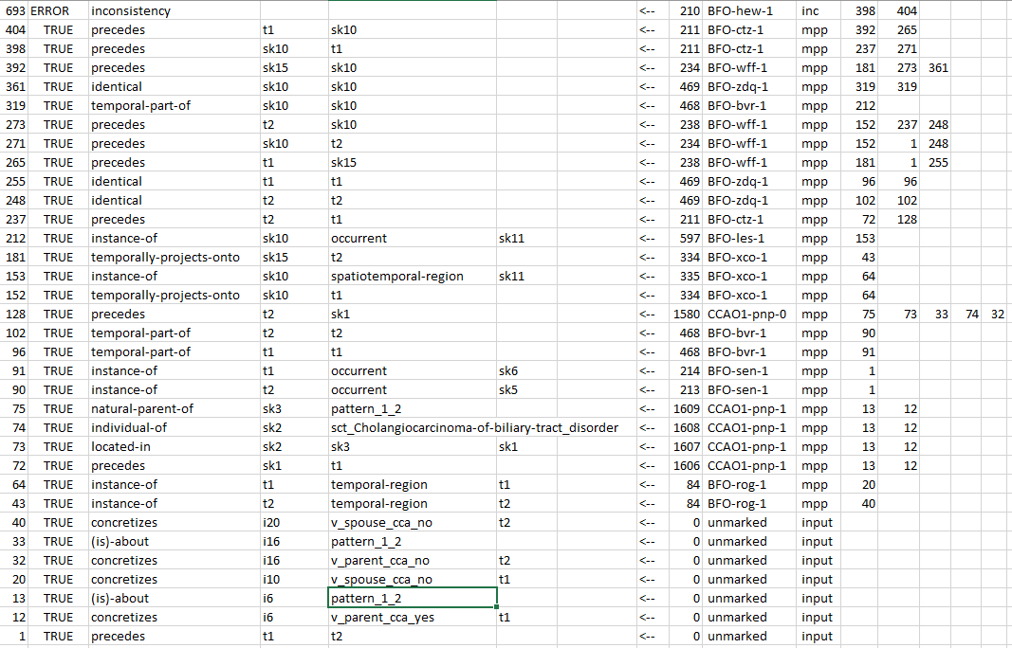

Slide 89
To do
Making tools fool-proof,
Continue thorough debugging,
  Three most common mistakes: boundary conditions and off-by-one,
Better control of skolem functions,
Creation of minimal models,
Time lines,
Parthood and type taxonomies
Input queries
    Current alternative: input the logical opposite of X, if inconsistency found → X is true
CLIF style data input
  E.g.: (not (exists (x) (instance-of tumor-of-john malignant-tumor x)))
…

Slide 90
The axiomatization:
Good, bad, ugly ?

Slide 91
What I like
It exists!
Forces one to think.
  Can an object be in two distinct spatial regions at the same time?

Slide 92
What I like
It exists!
Forces one to think.
  Can an object be in two distinct spatial regions at the same time? → yes, if they overlap!
Brings surprises:
  Particulars are allowed to come out and back in existence.

Slide 93
Dislike: change in time-indexing
Does not adhere to the original principles of time-indexing:
  If in a relation at least one of the arguments is a continuant → time-indexing is required;
  If in a relation only occurrents are involved → no time-indexing.
Violations: e.g.
  (specifically-depends-on c1 c2)
  (bearer-of c1 c2)
  (inheres-in c1 c2)
  (instance-of o1 occurrent t)

Slide 94
Dislike: ‘Useless truths’, e.g.
(cl:comment "There is always something that exists [nis-1]"
  (forall (t) (if (instance-of t temporal-region t)
  (exists (u i) (and (not (= i t))
  (universal u)
  (particular i)
  (instance-of i u t))))))
r(63,1,[8,9],[],"nis-1",kow(if([[instance-of,A,temporal-region,A]]),then([instance-of,[e,9,[A]],[e,8,[A]],A]))).
r(64,1,[9],[],"nis-1",kow(if([[instance-of,A,temporal-region,A]]),then([particular,[e,9,[A]]]))).
r(65,1,[8],[],"nis-1",kow(if([[instance-of,A,temporal-region,A]]),then([universal,[e,8,[A]]]))).
r(66,2,[],[9],"nis-1",kow(if([[identical,[e,9,[A]],A],[instance-of,A,temporal-region,A]]),false)).

Slide 95
Automatic Identification of non-informative axioms?
sk54 [e,9,[[e,97,[room1,[e,90,[my-brain,room1,t2]],[e,91,[my-brain,room1,t2]]]]]]
sk53 [e,97,[room1,[e,90,[my-brain,room1,t2]],[e,91,[my-brain,room1,t2]]]]
sk52 [e,9,[[e,97,[room2,[e,87,[[e,90,[me,room2,t2]],[e,91,[me,room2,t2]]]],[e,91,[me,room2,t2]]]]]]
sk51 [e,97,[room2,[e,87,[[e,90,[me,room2,t2]],[e,91,[me,room2,t2]]]],[e,91,[me,room2,t2]]]]
sk50 [e,9,[[e,109,[[e,61,[[e,20,[me]]]],[e,62,[[e,20,[me]]]]]]]]
sk49 [e,109,[[e,61,[[e,20,[me]]]],[e,62,[[e,20,[me]]]]]]
sk48 [e,9,[[e,114,[[e,20,[me]],[e,100,[[e,20,[me]]]]]]]]
sk47 [e,114,[[e,20,[me]],[e,100,[[e,20,[me]]]]]]
sk46 [e,159,[[e,146,[t2]],[e,146,[t2]]]]
sk45 [e,159,[[e,10,[me]],[e,10,[me]]]]
sk44 [e,52,[[e,20,[me]],[e,20,[me]]]]
sk43 [e,53,[[e,45,[[e,20,[me]]]],[e,45,[[e,20,[me]]]]]]
sk42 [e,4,[room2,room2,t2]]
sk41 [e,4,[room1,room1,t2]]
sk40 [e,4,[my-brain,my-brain,[e,91,[me,room2,t2]]]]
sk39 [e,4,[my-brain,my-brain,t2]]
sk38 [e,9,[t2]]
sk37 [e,9,[[e,91,[me,room2,t2]]]]
sk36 [e,9,[[e,91,[my-brain,room1,t2]]]]
sk35 [e,9,[[e,146,[t2]]]]
sk34 [e,9,[[e,104,[t2]]]]
sk33 [e,9,[[e,26,[room2]]]]
sk32 [e,9,[[e,26,[room1]]]]
sk31 [e,9,[[e,10,[me]]]]
sk30 [e,9,[[e,154,[t2,[e,144,[t2]]]]]]
sk29 [e,9,[[e,111,[[e,90,[me,room2,t2]]]]]]
sk28 [e,9,[[e,46,[[e,20,[me]]]]]]
sk27 [e,9,[[e,62,[[e,20,[me]]]]]]
Generation of skolem constants from skolem functions:
Some are created in abundance, e.g. [e,9,… ]

Slide 96
Dislike: redundancy in .cl files
% Axiom indices occurring in multiple axiom files:
% BFO-uns-1: [continuant-mereology.cl,existence-instantiation.cl]
% BFO-suk-1: [order.cl,temporal-region.cl]
% BFO-rzv-1: [order.cl,temporal-region.cl]
% BFO-qqv-1: [order.cl,temporal-region.cl]
% BFO-qnf-1: [order.cl,temporal-region.cl]
% BFO-qga-1: [order.cl,temporal-region.cl]
% BFO-qaf-1: [existence-instantiation.cl,temporal-region.cl]
% BFO-owb-1: [order.cl,temporal-region.cl]
% BFO-njq-1: [temporal-region.cl,universal-declaration.cl]
% BFO-miz-1: [order.cl,temporal-region.cl]
% BFO-fmm-1: [generic-dependence.cl,participation.cl]
% BFO-cgn-1: [participation.cl,specific-dependency.cl]
% BFO-adm-1: [continuant-mereology.cl,material-entity.cl]
% BFO-acg-1: [order.cl,temporal-region.cl]

Slide 97
Dislikes
Not all axioms are phrased in the most economic way.
Partial redundancy in the axiom collection.
Several uses of ‘OR’ would better be ‘XOR’s.
Lack of ‘useful’ theorems.
But: all dislikes are fixable!

Slide 98
Final suggestion
Add a typology of universals.

Slide 99
Questions?

