Slide 1
EFMI Special Topic Conference 2018
Decision Support Systems and Education – Help and Support in Healthcare
October 14-16, 2018, Zagreb, Croatia.
Caveats for the use of the active problem list as ground truth for decision support.
Werner CEUSTERS^{1,2,3} and Jonathan BLAISURE^{1,3}
¹ Department of Biomedical Informatics, University at Buffalo, USA
² Department of Psychiatry, University at Buffalo, USA
³ Institute for Healthcare Informatics, University at Buffalo, USA

Slide 2


Slide 3
Data aggregation and use
Operational
systems
IHI Clinical
Integrated
Data Repository
Secondary
use
Cohort selection
EHR
Data Marts
EHR
EHR
EHR
Cost effectiveness
research
Bio Bank
Decision support
Health
Insurers
Quality assurance
Health
Insurers
Health
Insurers

Slide 4
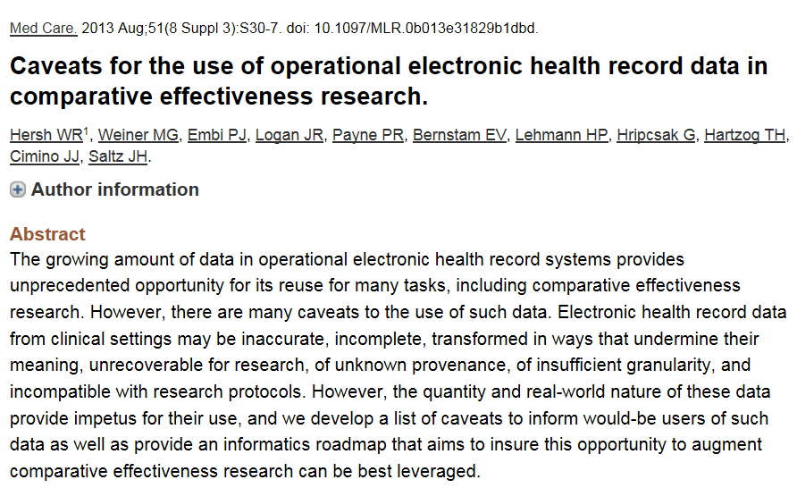

Slide 5
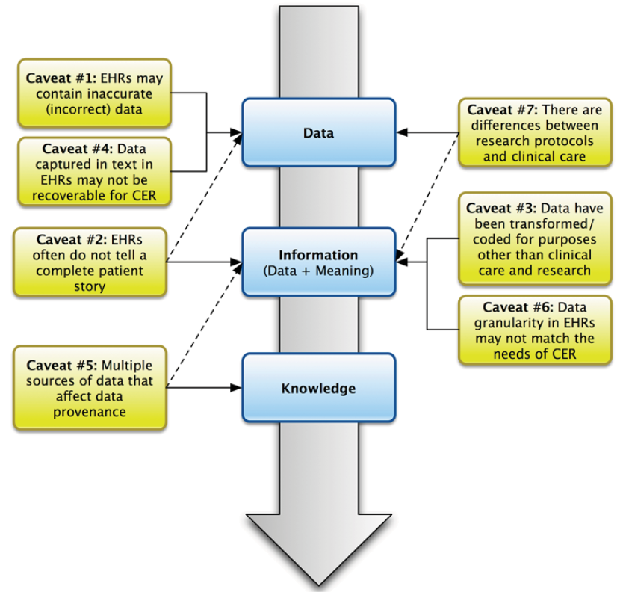
W.R Hersh, M.G. Weiner, P.J. Embi, J.R. Logan, P.R. Payne, E.V. Bernstam, H.P. Lehmann, G. Hripcsak, T.H. Hartzog, J.J. Cimino, J.H. Saltz.
Caveats for the use of operational electronic health record data in comparative effectiveness research,
Medical care 51 (2013), 30-37.

Slide 6
Data aggregation and use
Operational
systems
IHI Clinical
Integrated
Data Repository
Secondary
use
Cohort selection
EHR
Data Marts
EHR
EHR
EHR
Cost effectiveness
research
Common Data Models
Bio Bank
Decision support
Health
Insurers
Quality assurance
Health
Insurers
Health
Insurers

Slide 7
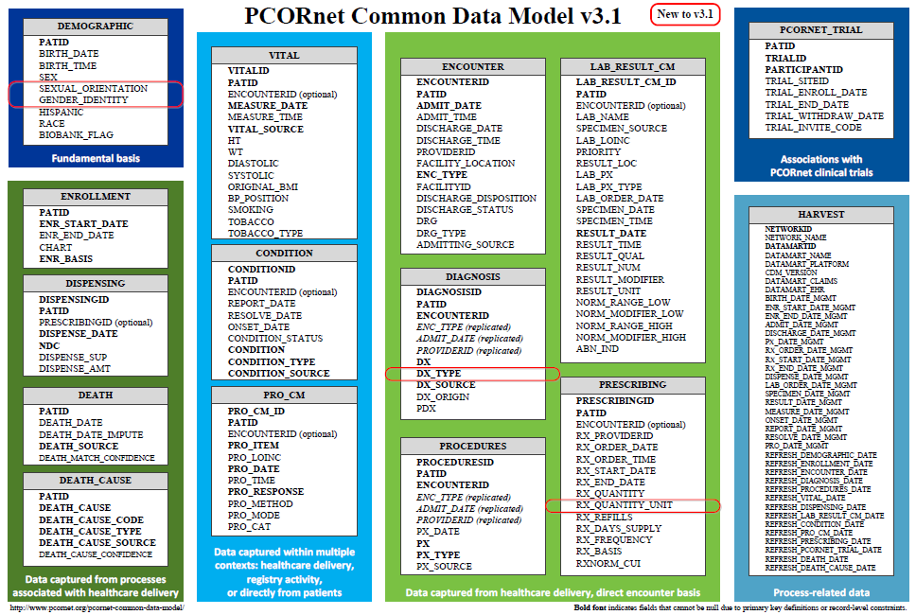
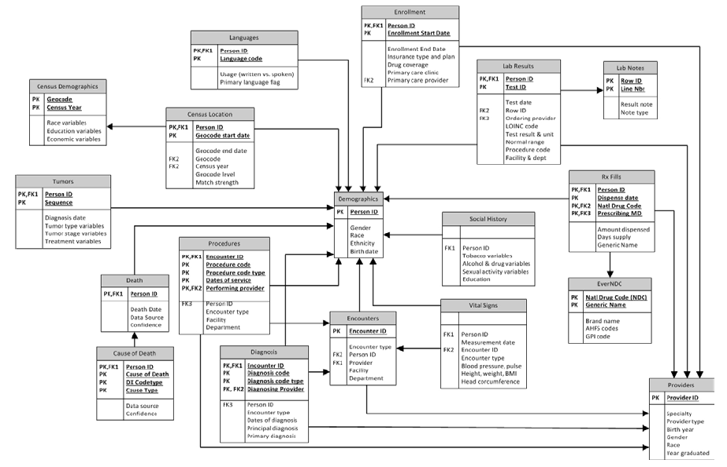
Common Data Models for Secondary Use
The Observational Medical Outcomes Partnership (OMOP)
Health Care Systems Research Network (HCSRN)
The National Patient-Centered Clinical Research Network (PCORNet)

Slide 8
CDMs introduce mistakes
Blaisure J, Ceusters W. Business Rules to Improve Secondary Data Use of Electronic Healthcare Systems. Informatics for Health 2017, Manchester Central, UK, April 24-26, 2017. Stud Health Technol Inform. 2017;235:303-307.
Ceusters W, Blaisure J. A Realism-Based View on Counts in OMOP’s Common Data Model. 14th International Conference on Wearable, micro & Nano Technologies (pHealth 2017), Eindhoven, The Netherlands, May 14-16, 2017. Studies in Health Technology and Informatics 2017;237:55-62.
Blaisure J, Ceusters W. Improving the Fitness for Purpose of Common Data Models through Realism Based Ontology. AMIA 2017 Annual Symposium, Washington DC, Nov 04-08, 2017. AMIA Annu Symp Proc. 2017; 2017: 440–447.

Slide 9
Data aggregation and use
Operational
systems
IHI Clinical
Integrated
Data Repository
Secondary
use
Cohort selection
EHR
Data Marts
EHR
EHR
EHR
Cost effectiveness
research
Common Data Models
Bio Bank
Decision support
Health
Insurers
Realist Ontology (RO) & Referent Tracking (RT)- based
Data Repository
Health
Insurers
Quality assurance
Health
Insurers

Slide 10

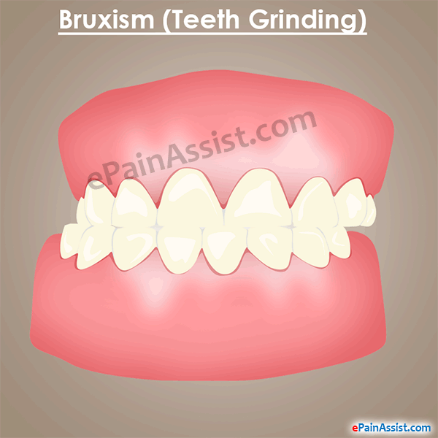
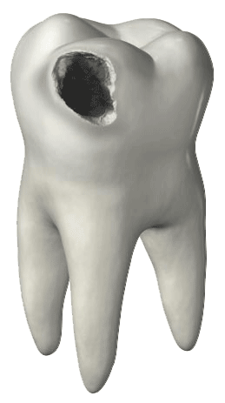
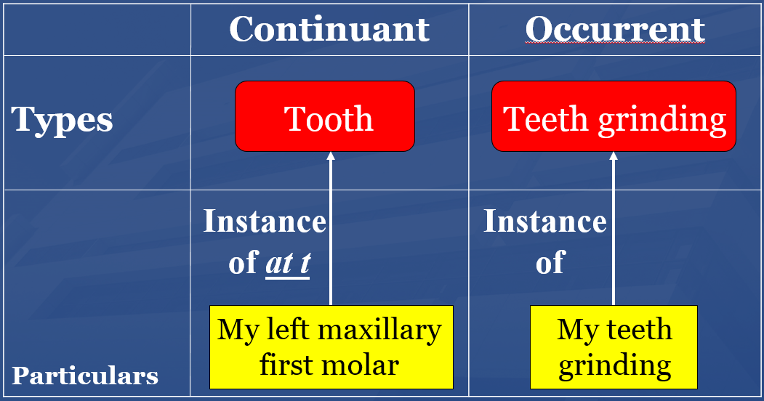
RO and RT make 4 crucial distinctions
1
Reality ←→ representation

Slide 11
RO and RT make 4 crucial distinctions
Ontology ←→ an ontology
2

Slide 12
RO and RT make 4 crucial distinctions
3

Slide 13
RO and RT make 4 crucial distinctions
4

Slide 14
Research question
Can these principles be applied to assess the extent to which the transactions registered in the EHR’s database resulting from managing the problem list provide insight in:
the adequacy of the clinical user interface to capture
what the clinician had in mind, with the goal
to reconstruct the clinical reality of the patient?

Slide 15
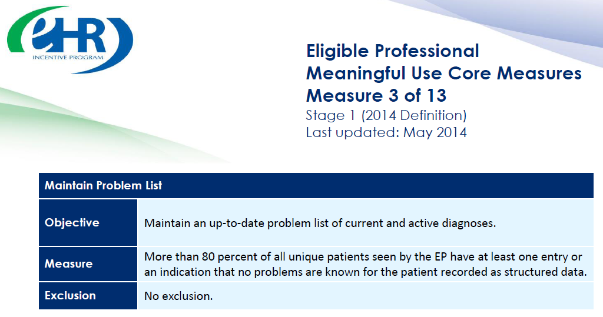

https://www.cms.gov/Regulations-and-Guidance/Legislation/EHRIncentivePrograms/downloads/3_Maintain_Problem_ListEP.pdf

Slide 16
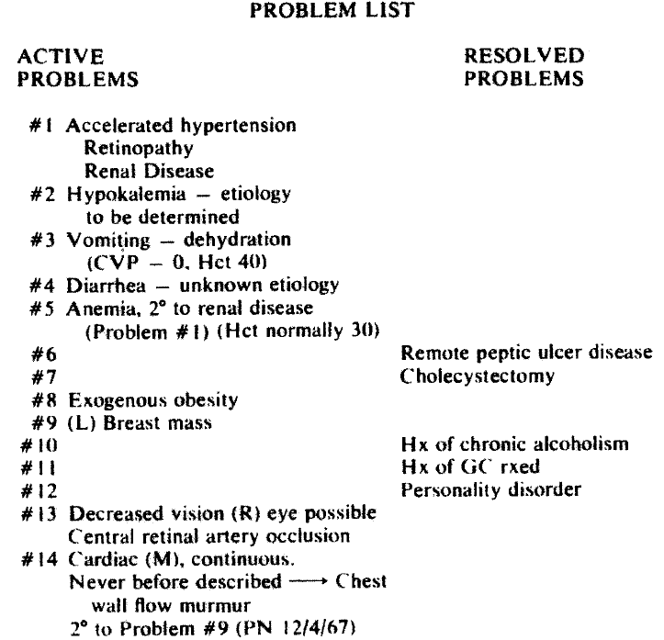

L. Weed.
Medical records that guide and teach.
New England Journal of Medicine 278 (1968), 593-600.

Slide 17
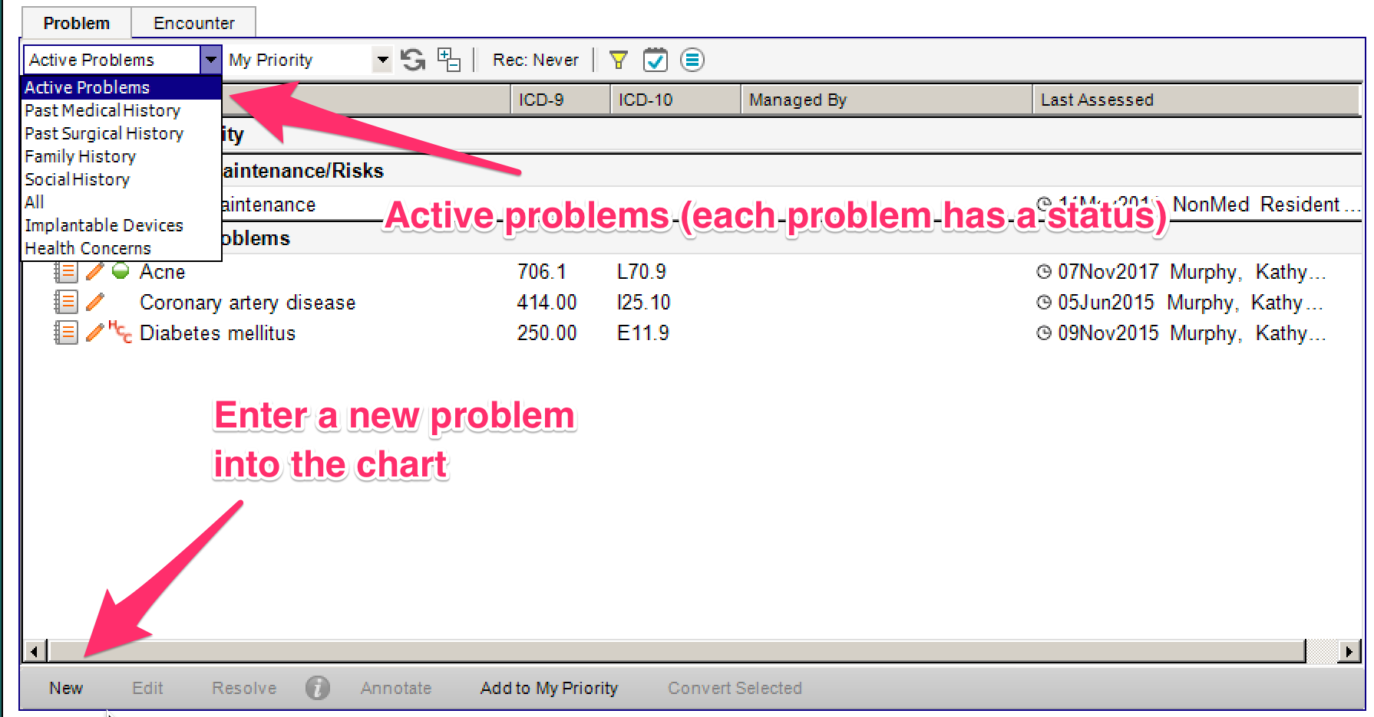

Slide 18
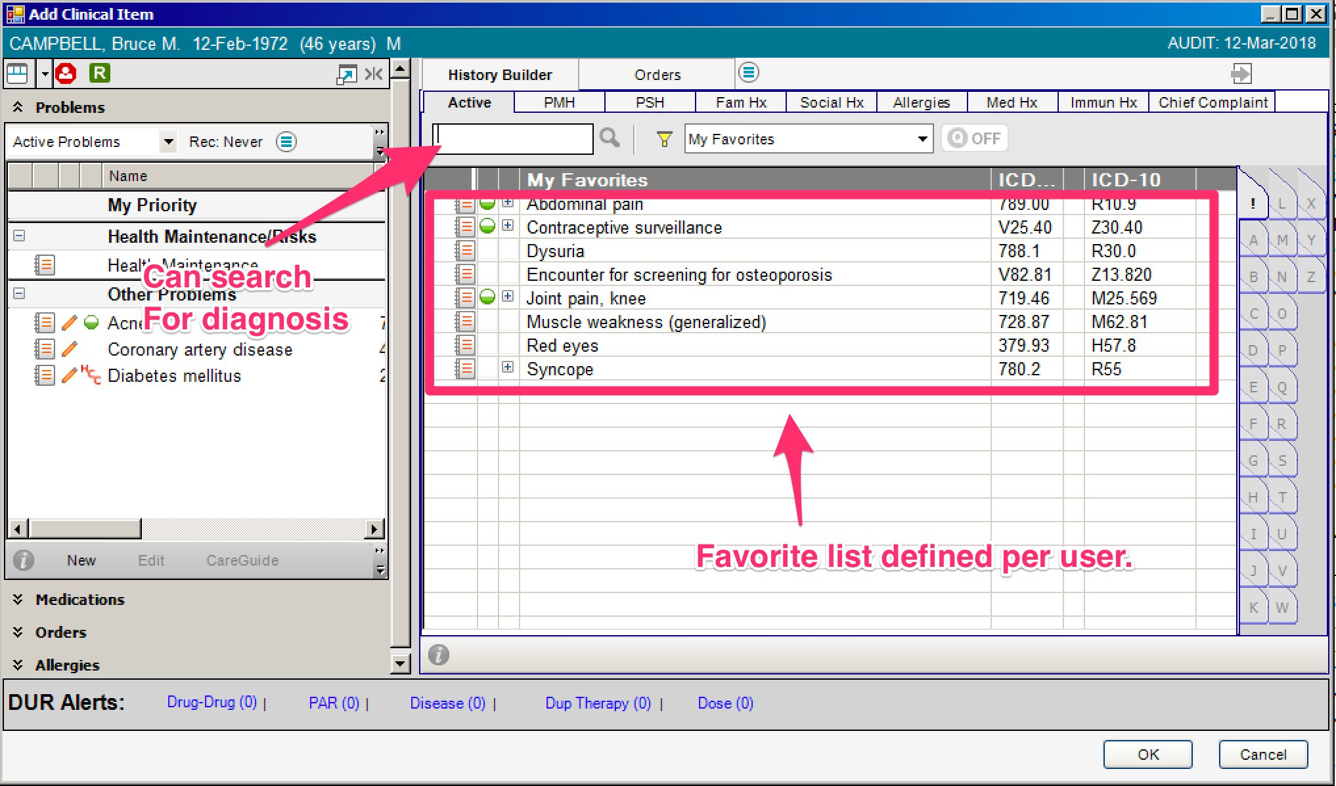

Slide 19
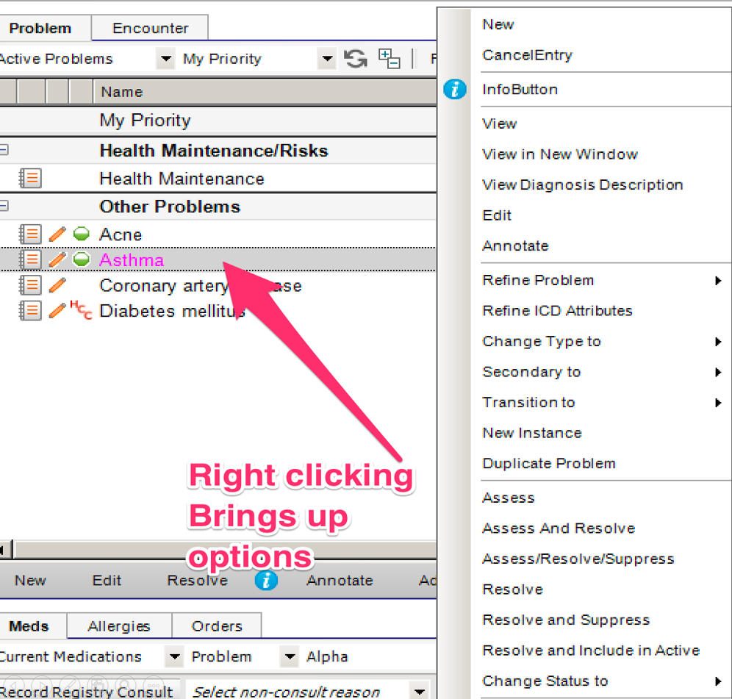
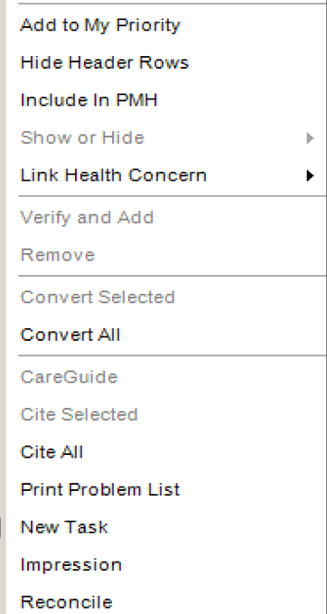
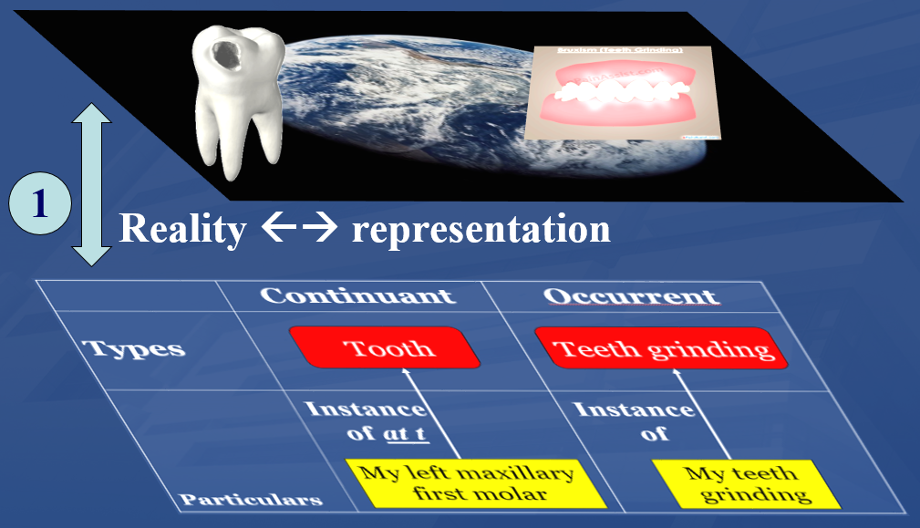
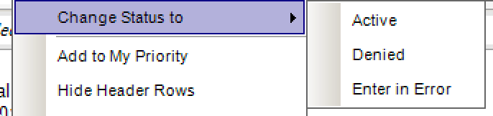

Slide 20
Transitioning a problem

Slide 21
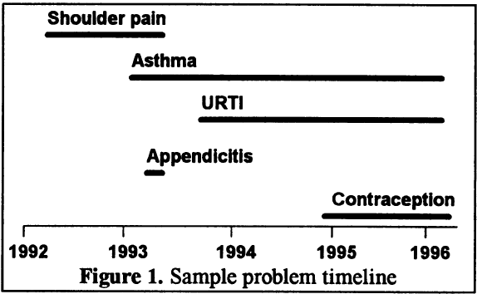
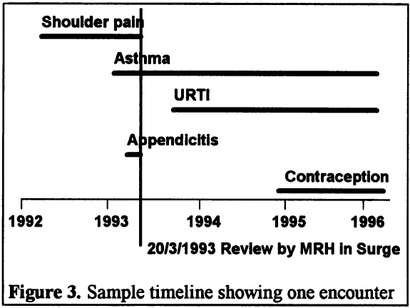
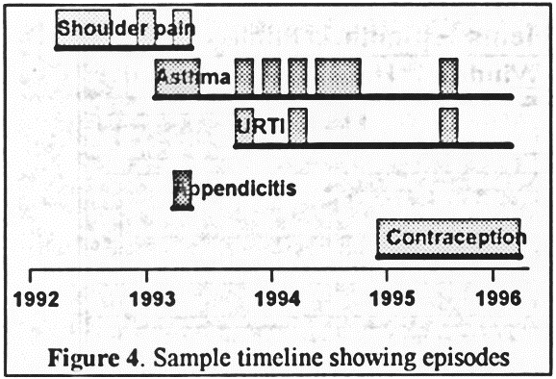
Problems
Encounters
Episodes
Salmon P, Rappaport A, Bainbridge M, Hayes G, Williams J. Taking the problem oriented medical record forward. Proc AMIA Annu Fall Symp. 1996:463-7.

Slide 22
Methodology
Problem
Type
Problem
Status
Problem
Category
Problem
Header
Problem
Instance
Encounter
~6,000,000
~6,000,000
Transition
Patient
~500,000
Problem Header
Change Record

Slide 23
Results
Problem
Type
Problem
Status
Problem
Category
Problem
Header
Problem
Instance
Encounter
~370,000
~6,000,000
~765,000
Transition
Patient
~23,000
~500,000
~80,000
Problem Header
Change Record
~395,000 rec. / ~664,000 ch.

Slide 24
Change count distributions
Changes | Frequency | Cumulative %
1 | 349,361 | 94.52%
2 | 16,325 | 98.94%
3 | 3,426 | 99.86%
4 | 312 | 99.95%
5 | 147 | 99.99%
6 | 14 | 99.99%
7 to 34 | 26 | 100.00%
Transitions | Frequency | %
1 | 21819 | 94.202%
2 | 1154 | 4.982%
3 | 150 | 0.648%
4 | 34 | 0.147%
5 | 4 | 0.017%
6 | 1 | 0.004%

Slide 25
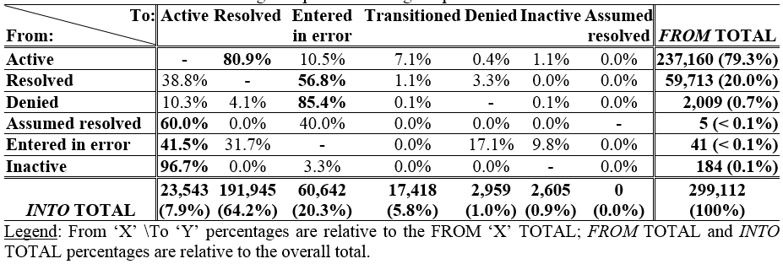
Problem status changes

Slide 26
Active / Resolved
 |  |  |  | EHR update event
PtID | PrID | Problem | 0 | 1 | 2 | 3 | 4 | 5 | 6 | 7 | 8 | 9 | 10 | 11 | 12 | 13 | 14 | 15
B1 | 1 | Cerumen Impaction In Both Ears | N | D |  | D | D | D | D | R | A
 | 2 | Impacted cerumen of right ear |  |  |  |  |  |  |  |  |  | N
B2 | 1 | Cerumen Impaction | N | D | R | A | R | A | R | A | D | D
C1 | 1 | Acute Sinusitis | N | D | D | R | A | R | A | D | R | A
C2 | 1 | Acute Sinusitis | N | D | D | D | D | D | R | A | D | D | R | A | R | A | D
Legend: ‘PtID’: patient identifier; ‘PrID’: problem header identifier; ‘N’: Problem header added and marked active; ‘D’: problem documentation added; ‘A’: problem header marked active; ‘R’: problem resolved; Arrow: problem ‘transitioned’ into the problem pointed at by the arrow. Solid background: problem ‘active’.

Slide 27
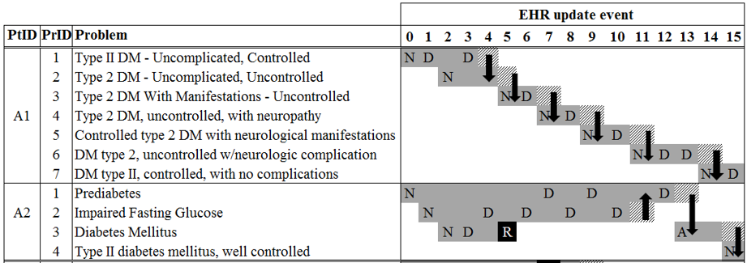
Transitions in two diabetes patients

Slide 28
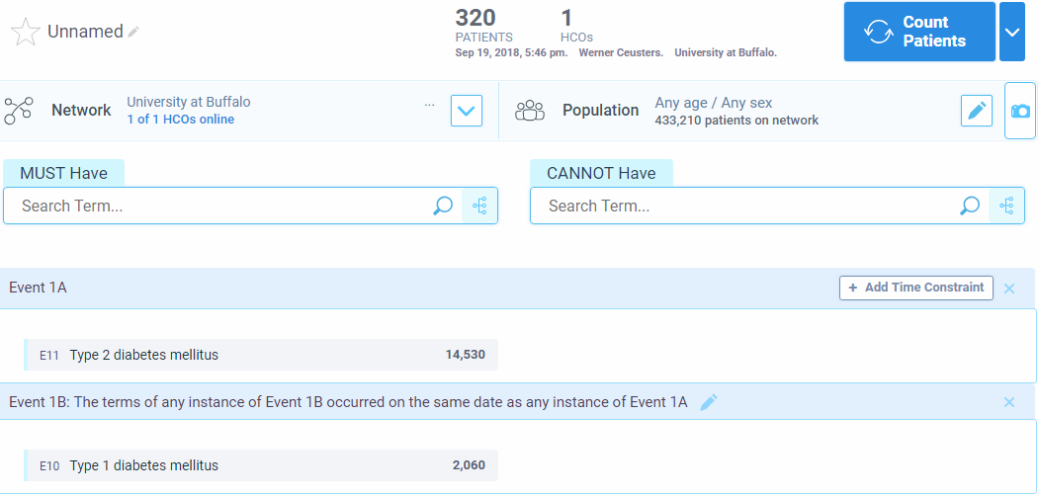
Note: 1A and 1B any time: 650 patients

Slide 29
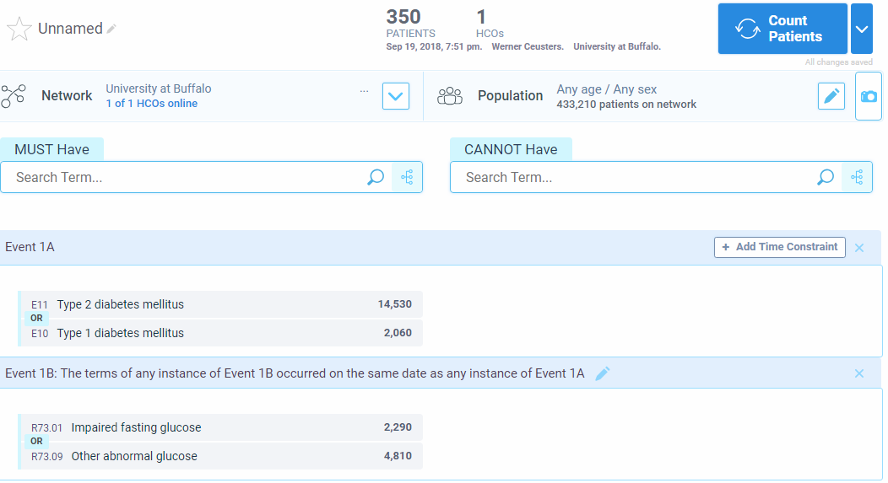

Slide 30
Future work: towards an OGMS-based
Referent Tracking Interpretation

Slide 31
Conclusions
Poor reality / representation correspondence:
  Impossible co-morbidity assertions;
  Resolved disorders appear again:
    ‘problem’ as type rather than particular, or,
    ‘problem’ as assertion rather than first-order entity;
  Use of ‘inactive’ poorly related to presence or absence of disease entity.
User-interface itself is conducive to reality and representation confusion.
Secondary use for knowledge acquisition and decision report requires much caution.

