Slide 1
e-Cigarettes and the International Classification of Diseases (ICD-10). Recitation part of BMS 199 New Frontiers in Biomedical Sciences: Everyday medicine Fall 2018
Werner CEUSTERS, MD
Ontology Research Group, Center of Excellence in Bioinformatics and Life Sciences;
UB Institute for Healthcare Informatics,
Departments of Biomedical Informatics and Psychiatry,
University at Buffalo, NY, USA

Slide 2
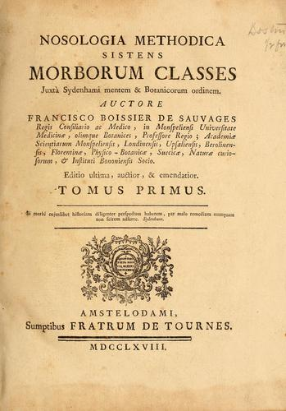
François Boissier de Sauvages de Lacroix
Public Domain, https://commons.wikimedia.org/w/index.php?curid=338615

Slide 3
Nosologia Methodica sistens Morborum Classes
Disease class 1
Disease class 2
…
Disease
order 1.1
Disease
order 1.2
Disease
order 2.1
Disease
order 2.2
…
…
Disease
genus 1.1.1
Disease
genus 1.1.2
Disease
genus 2.1.1
Disease
genus 2.1.2
…
…
Disease
species 1.1.1.1
Disease
species 1.1.1.2
Disease
species 2.1.1.1
…
…

Slide 4
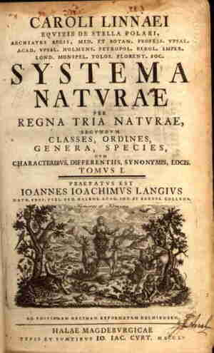
Sauvages was inspired by Linnaeus
http://www.robinsonlibrary.com/science/natural/biography/graphics/linnaeus2.jpg
http://s3.amazonaws.com/engrade-myfiles/4042767483300984/kingdom_taxonomy.png

Slide 5
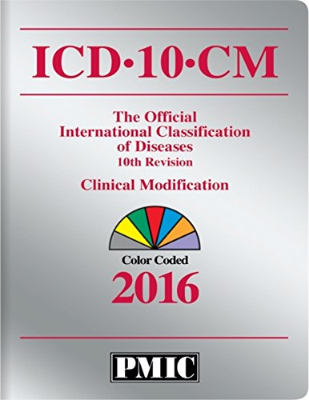
International Classification of Diseases

Slide 7
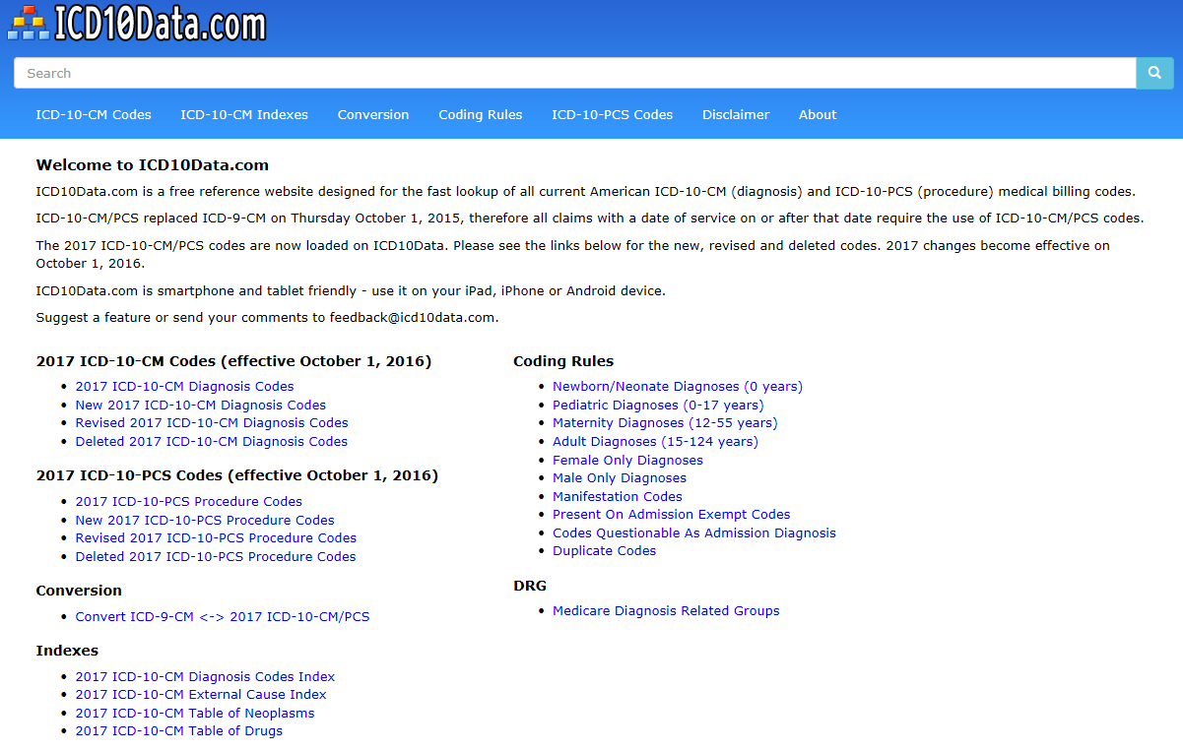
http://www.icd10data.com/

Slide 8
http://www.icd10data.com/ICD10CM/Codes
Would respiratory infections be
here
or
there?

Slide 9
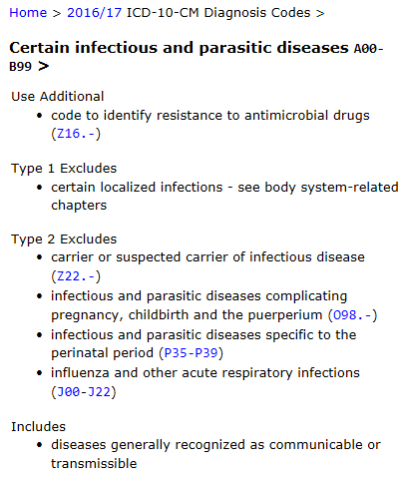
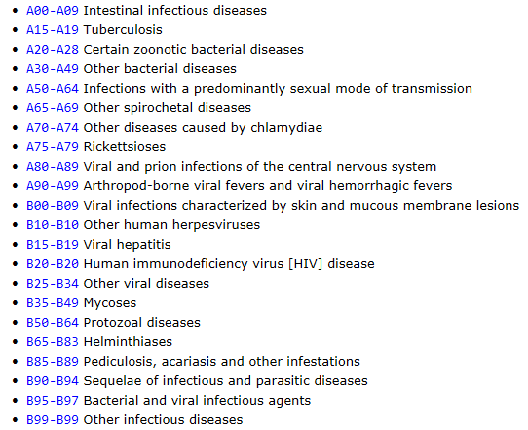
http://www.icd10data.com/ICD10CM/Codes

Slide 10
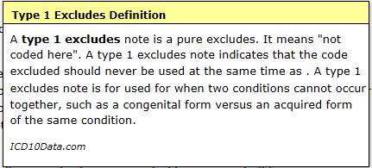
http://www.icd10data.com/ICD10CM/Codes

Slide 11
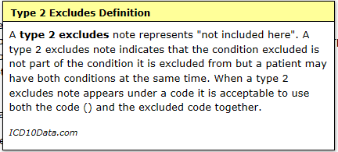
http://www.icd10data.com/ICD10CM/Codes

Slide 12
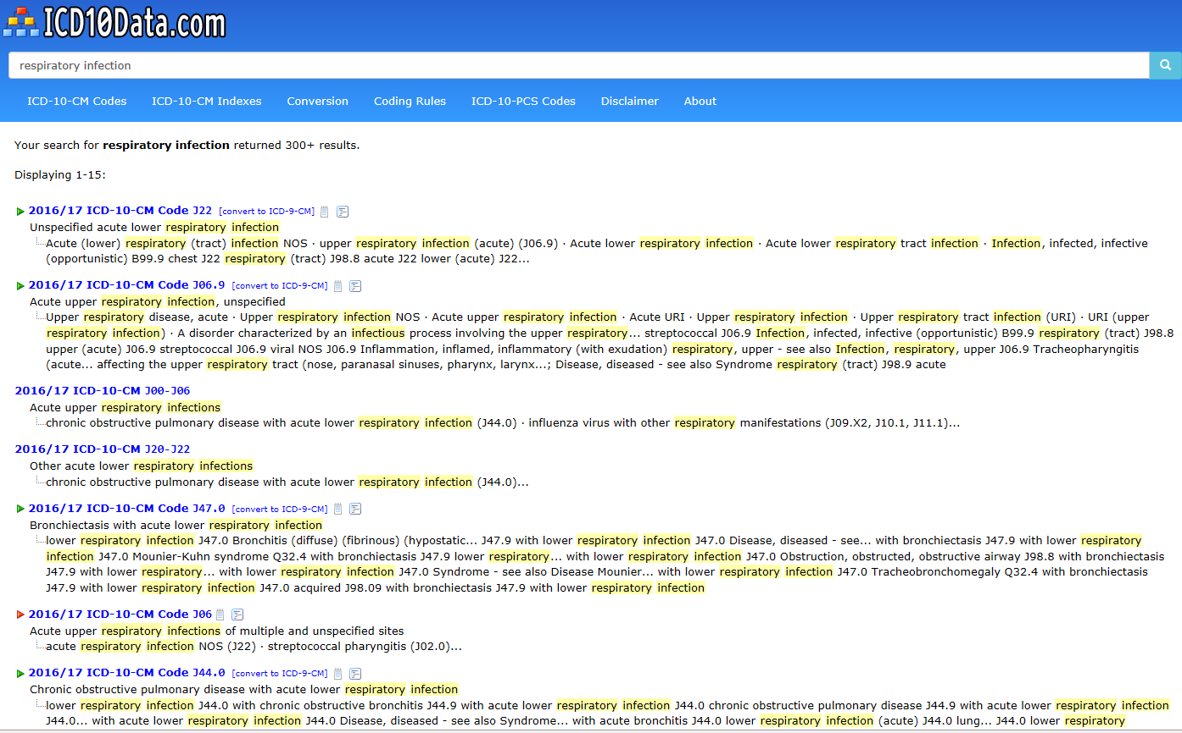
http://www.icd10data.com/ICD10CM/Codes

Slide 13
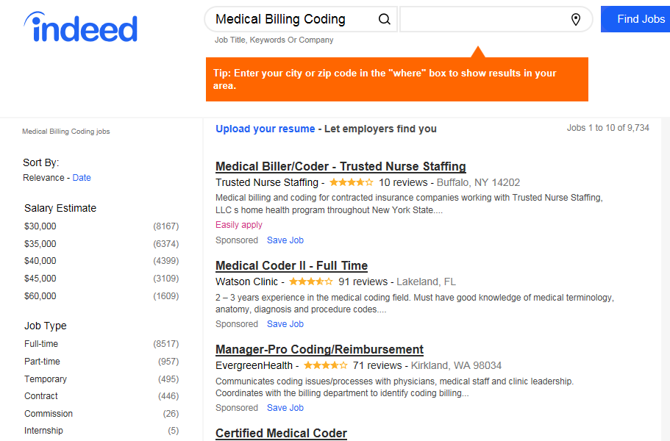
Job market for coding for billing
Nov 28, 2017

Slide 14
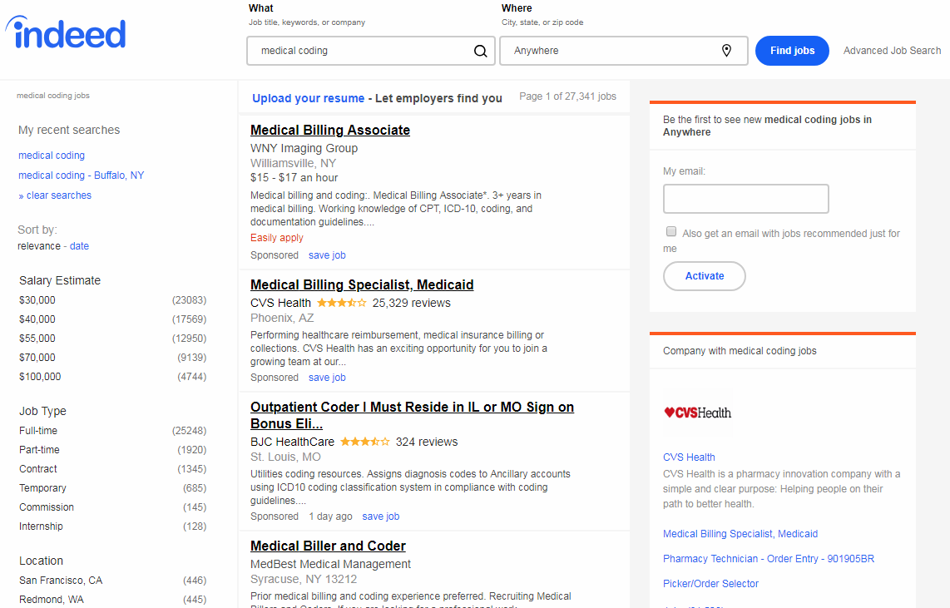
Nov 29, 2018

Slide 15
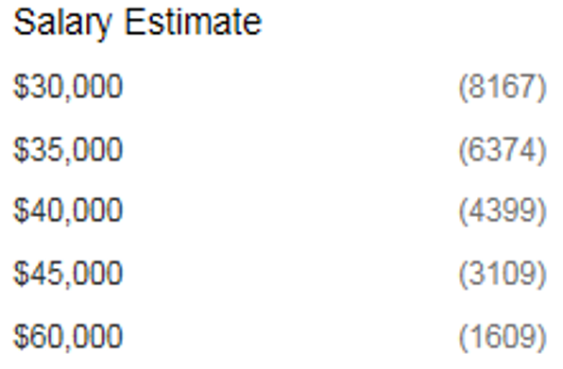
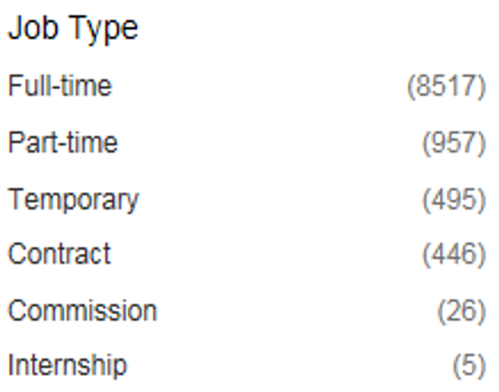
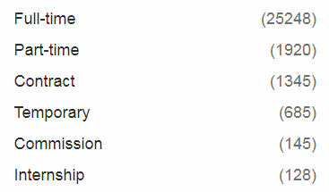
Differences ‘Medical coding’ 2017 → 2018
2017
2018

Slide 16
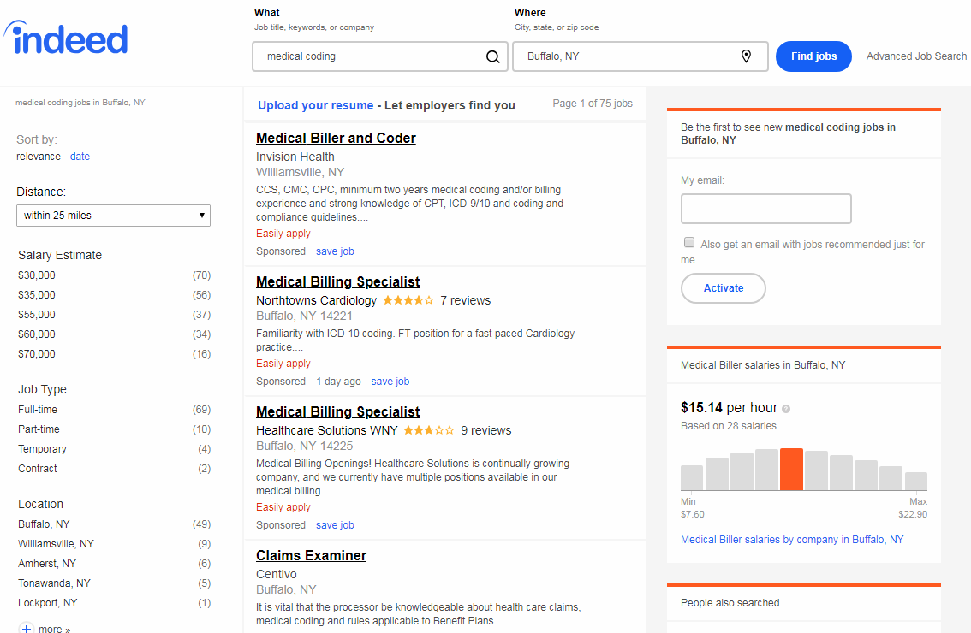
Nov 29, 2018

Slide 17
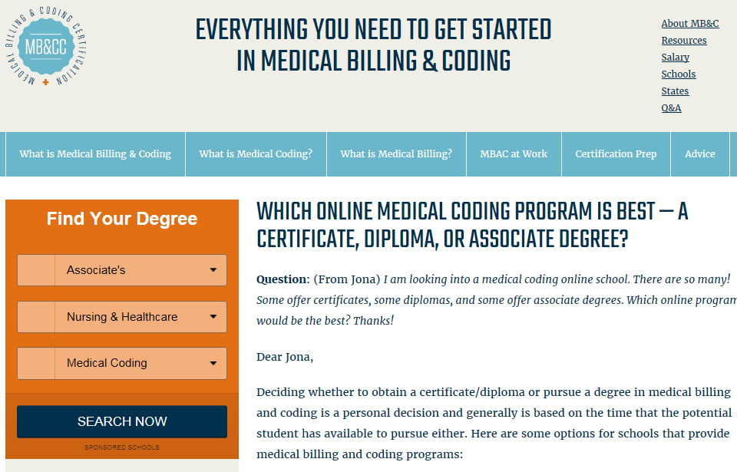
More info
http://www.medicalbillingandcoding.org

Slide 18
What about e-Cigarettes?
Electronic cigarettes are battery-powered vaporizer devices that turn liquid nicotine into a vapor that can be inhaled

Slide 19
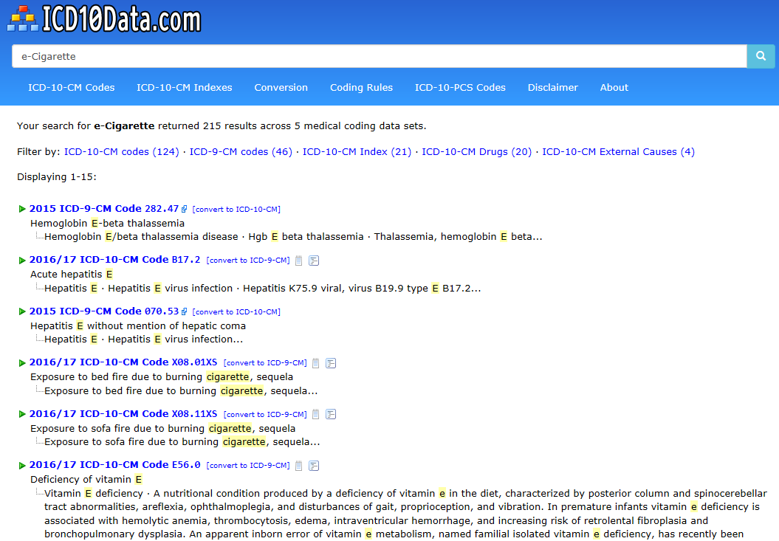
http://www.icd10data.com/ICD10CM/Codes

Slide 20
Hands-on work with
http://www.icd10data.com/
http://apps.who.int/classifications/icd10/browse/2016/en

