Slide 1
Patient data analysis and Ontologies.
January 7/8, 2016
University at Buffalo, South Campus
Werner CEUSTERS, MD
Ontology Research Group, Center of Excellence in Bioinformatics and Life Sciences,
UB Institute for Healthcare Informatics,
Departments of Biomedical Informatics and Psychiatry,
University at Buffalo, NY, USA

Slide 2

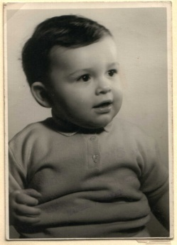
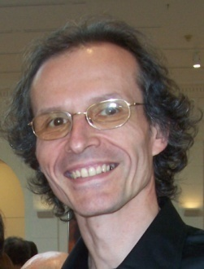



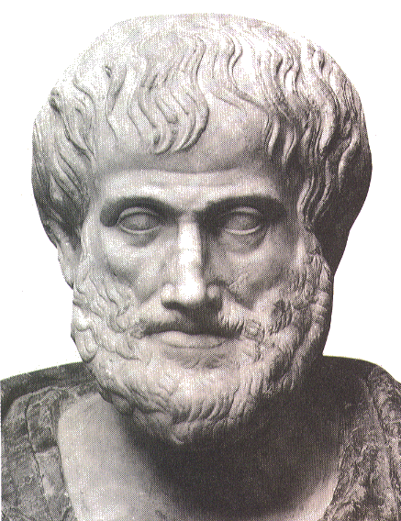










Short personal history
2012
1977
1959 -
2006
1989
2004
1992
2002
1995
1998
1993

Slide 3
Students’ need addressed
Use of electronic healthcare records (EHRs)
with not only billing in mind,
but also
optimal individual patient care and
secondary use of data for research

Slide 4
Aim of this session
Introduce you to some ontological principles that will help you in
recognizing and dealing with idiosyncrasies in EHRs
to improve healthcare data quality

Slide 5
What you MUST know at the end
Distinction between data and what data are about
Distinction between terminologies, ontologies and data repositories
Distinction between disease, disorder and diagnosis from the perspective of the Ontology of General Medical Science
The role of EHR data in the research enterprise

Slide 6
What you SHOULD know at the end
Principles of the Semantic/Semiotic Triangle and flaws in the theory as applied to medical terminology
Basic categories of the Ontology of General Medical Science

Slide 7
What would be fantastic to know
The principles for how to use the categories in the Basic Formal Ontology as a guide on how to assess prior dependencies between research variables.

Slide 8
1. Traditional data analysis

Slide 9

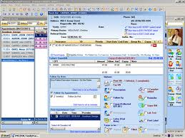
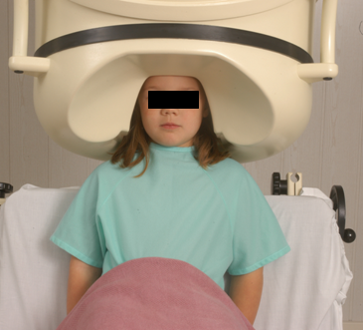

Clinical data registration and use
Register in EHR
observation &
measurement
research
Δ = outcome
application

Slide 10
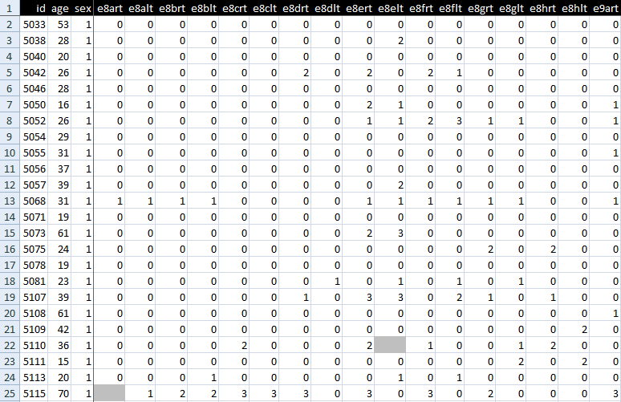
An EHR data collection

Slide 11
Standard approach in data analysis
Cases | Characteristics
 | ch1 | ch2 | ch3 | ch4 | ch5 | ch6 | ...
case1
case2
case3
case4
case5
case6
...
phenotypic
genotypic
treatment
outcome …

Slide 12
Standard approach in data analysis (1)
Cases | Characteristics
 | ch1 | ch2 | ch3 | ch4 | ch5 | ch6 | ...
case1
case2
case3
case4
case5
case6
...
finding correlations
phenotypic
genotypic
treatment
outcome …

Slide 13
Standard approach in data analysis (2)
Cases | Characteristics
 | ch1 | ch2 | ch3 | ch4 | ch5 | ch6 | ...
case1
case2
case3
case4
case5
case6
...
{
finding correlations
therefore
expectation
phenotypic
genotypic
treatment
outcome …

Slide 14
Standard approach in data analysis (3)
Cases | Characteristics
 | ch1 | ch2 | ch3 | ch4 | ch5 | ch6 | ...
case1
case2
case3
case4
case5
case6
...
generalization ?
{
finding correlations
therefore
expectation
phenotypic
genotypic
treatment
outcome …

Slide 15
Pitfalls in statistics
Three broad categories:
  Sources of bias.
    These are conditions or circumstances which affect the external validity of statistical results.
  Errors in methodology,
    which can lead to inaccurate or invalid results.
  Interpretation errors,
    misapplication of statistical results to real world issues (e.g. confounding).

Slide 16
Major problem with EHRs for data analysis
The information model behind current EHRs is optimized for individual patient care, reflecting ‘care models’, without being a faithful model of how medical reality is structured in its entirety.
data
organization
observation &
measurement
Δ = outcome
application

Slide 17
EHR Information Models (simplified)
diagnosis
finding
finding
patient
patient
encounter
drug
drug
diagnosis

Slide 18
Observation / Claim
Patient data,
as currently gathered through EHRs,
communicated over RHIOs, and
collected and aggregated in data warehouses,
have minimal, if not missing at all, background information,
and
are insufficiently precise to allow the construction of a completely accurate view on what is (and has been) the case in reality.

Slide 19
Current approaches to data management and analysis ignore too much where data come from
2. Data ←→ What data are about

Slide 20

Correlation with reality
What type of relationship is there between data items and the part of reality they are obtained from?
What, if anything at all, do variable names in header rows correspond to?
Do correlations between data items mimic the relationships between the entities in reality the data items are obtained from?

Slide 21

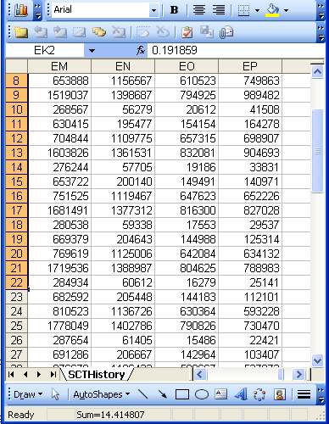
A non-trivial relation
Referents
References

Slide 22

For instance: source and impact of changes
Are differences in data about the same entities in reality at different points in time due to:
  changes in first-order reality ?
  changes in our understanding of reality ?
  inaccurate observations ?
  differences in perspectives ?
  registration mistakes ?
Ceusters W, Smith B. A Realism-Based Approach to the Evolution of Biomedical Ontologies. AMIA 2006 Proceedings, Washington DC, 2006;:121-125. http://www.referent-tracking.com/RTU/sendfile/?file=CeustersAMIA2006FINAL.pdf

Slide 23
What makes it non-trivial?
Referents
  are (meta-) physically the way they are,
  relate to each other in an objective way,
  follow laws of nature.
Window on reality
  restricted by:
  what is physically and technically observable,
  fit between what is measured and what we think is measured,
  fit between established knowledge and laws of nature.
References
  follow, ideally, the syntactic-semantic conventions of some representation language,
  are restricted by the expressivity of that language,
  to be interpreted correctly, reference collections need external documentation.

Slide 24
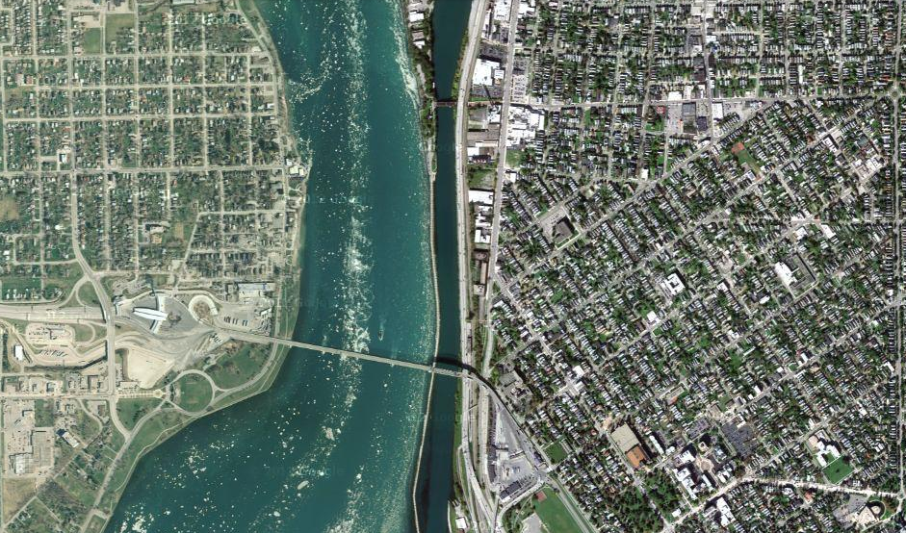
Satellite view

Slide 25
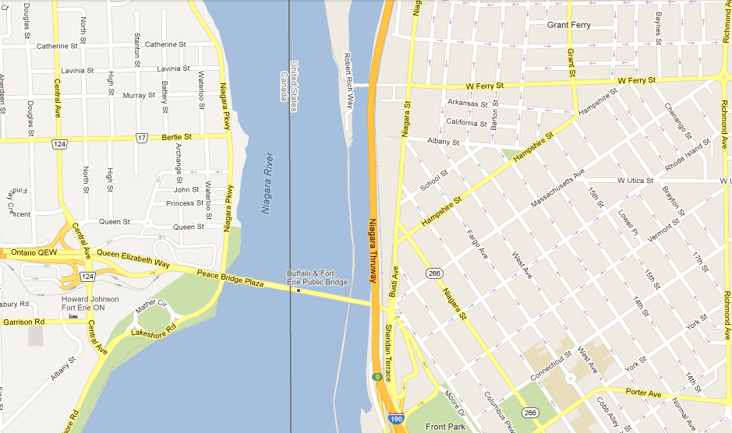
Map

Slide 26
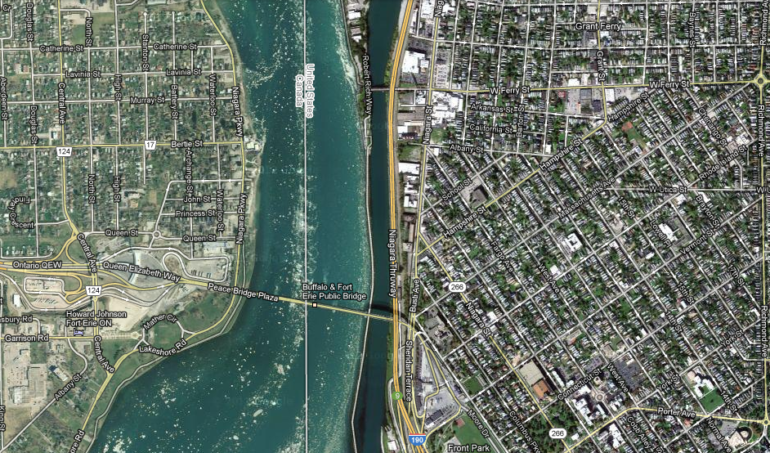
Map overlay

Slide 27
3. Different perspectives on the relation between data (language in general) and what is referred to.

Slide 28

Map ←→ Reality
A message to map makers: “Highways are not painted red, rivers don’t have county lines running down the middle, and you can’t see contour lines on a mountain”
W. Kent. Data and Reality. North-Holland, Amsterdam, the Netherlands, 1978.

Slide 29
Main data ←→ reality views
Nominalism:
  there are no generic entities in reality: there is no ‘personhood’, there are only individual persons.
Conceptualism:
  generalizations are in our minds. ‘personhood’ is a concept construed in our mind that allows us to reason about persons without any particular person in mind.
Realism:
  generic entities do exist and are called ‘universals’. Each particular person is an instance of the universal we call ‘person’.

Slide 30
Main data ←→ reality views
Nominalism:
  there are no generic entities in reality: there is no ‘personhood’, there are only individual persons.
Conceptualism: ← mainstream approach
  generalizations are in our minds. ‘personhood’ is a concept construed in our mind that allows us to reason about persons without any particular person in mind.
Realism: ← our approach
  generic entities do exist and are called ‘universals’. Each particular person is an instance of the universal we call ‘person’.

Slide 31

The semantic/semiotic triangle
Ludwig van Beethoven
that great German composer that became deaf
…
concept
term
referent
‘Beethoven’

Slide 32
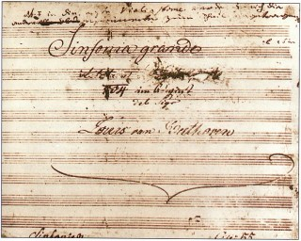
The semantic triangle works sometimes fine
Beethoven’s symphony dedicated to Bonaparte
the symphony played after the Munich Olympics massacre
…
concept
term
referent
‘Eroica’
‘Beethoven's Symphony No. 3’
‘Beethoven's Opus 55’

Slide 33
Sometimes the semantic triangle fails
the symphony Beethoven wrote after the tenth
…
concept
term
referent
‘Beethoven's Symphony No. 11’

Slide 34
Sometimes the semantic triangle fails
the symphony Beethoven wrote after the tenth
…
some hold this term has meaning
concept
term
referent
‘Beethoven's Symphony No. 11’

Slide 35

Sometimes the semantic triangle fails
the one assembled by Barry Cooper from fragmentary sketches
Beethoven’s hypothetical symphony
…
concept
term
referent
‘Beethoven's Symphony No. 10’

Slide 36

Prehistoric ‘psychiatry’: drapetomania
disease which causes slaves to suffer from an unexplainable propensity to run away
…
concept
term
referent
painting by Eastman Johnson. A Ride for Liberty: The Fugitive Slaves. 1860.
‘drapetomania’

Slide 37
SNOMED about diseases and concepts (until 2010)
‘Disorders are concepts in which there is an explicit or implicit pathological process causing a state of disease which tends to exist for a significant length of time under ordinary circumstances.’
And also: “Concepts are unique units of thought”.
      College of American Pathologists. SNOMED Clinical Terms® User Guide. January 2003 Release.
Thus: Disorders are unique units of thoughts in which there is a pathological process …???
And thus: to eradicate all diseases in the world at once we simply should stop thinking ?

Slide 38
4. Ontological Realism

Slide 39

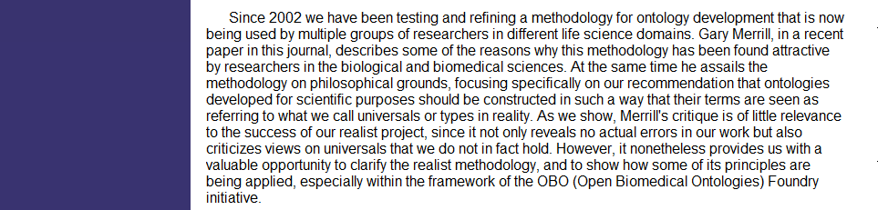
An alternative: Ontological Realism

Slide 40
Conceptualism versus Ontological Realism
First order reality
concept
universal
term
referent
representational
unit
particular
Conceptualism
Ontological Realism

Slide 41
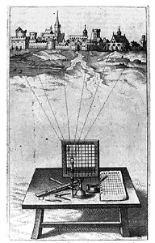
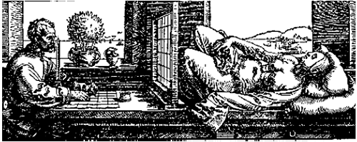
A useful parallel: Alberti’s grid
reality
Ontological
theory
representation

Slide 42
‘Ontology’
In philosophy:
  Ontology (no plural) is the study of what entities exist and how they relate to each other;
  by some philosophers taken to be synonymous with ‘metaphysics’ while others draw distinctions in many distinct ways (the distinctions being irrelevant for this talk), but almost agreeing on the following classification:
    metaphysics → studies ‘how is the world?’
      general metaphysics → studies general principles and ‘laws’ about the world
        ontology → studies what type of entities exist in the world
      special metaphysics → focuses on specific principles and entities
  distinct from ‘epistemology’ which is the study of how we can come to know about what exists.
  distinct from ‘terminology’ which is the study of what terms mean and how to name things.

Slide 43
‘Ontology’
In philosophy:
  Ontology (no plural) is the study of what entities exist and how they relate to each other;
In computer science and many biomedical informatics applications:
  An ontology (plural: ontologies) is a shared and agreed upon conceptualization of a domain;

Slide 44
Distinct questions. What type are they of?
Terminological:
  what does ‘pain’ mean ?
Metaphysical:
  what have all pains in common in virtue of which they are pains?
Ontological:
  what type of entity is pain?
Onto-terminological:
  what, if anything at all, does ‘pain’ denote?
Epistemological:
  how can we find out whether something is pain?

Slide 45

The basis of Ontological Realism (O.R.)
There is an external reality which is ‘objectively’ the way it is;
That reality is accessible to us;
We build in our brains cognitive representations of reality;
We communicate with others about what is there, and what we believe there is there.
Smith B, Kusnierczyk W, Schober D, Ceusters W. Towards a Reference Terminology for Ontology Research and Development in the Biomedical Domain. Proceedings of KR-MED 2006, Biomedical Ontology in Action, November 8, 2006, Baltimore MD, USA

Slide 46
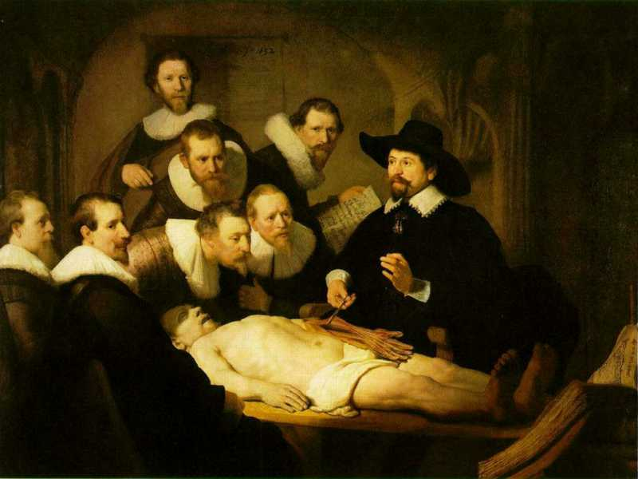
L3
Linguistic representations about (L1⁻), (L2) or (L3)
L2
Beliefs about (1)
Representations
First Order Reality
Entities (particular or generic) with objective existence which are not about anything
L1⁻

Slide 47
What is out there …
(… we want/need to deal with)?
portions of reality
relations
configurations
?
participation
me participating in my life
universals
entities
?
particulars
continuants
occurrents
me
my life
organism

Slide 48




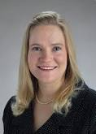
Universal versus particular
person
instance of …
particulars

Slide 49
Ontological Realism in OBO Foundry ontologies
Continuant
has_participant
Occurrent
e.g. pathological
process
is_a
is_a
Independent
Continuant
e.g. organism
Dependent
Continuant
e.g. patient
role
inheres_in
instance_of
universals
.... ..... .......
particulars

Slide 50




Continuants preserve identity while changing
human
being
me
me
t
Instance-of
in 1960
child
Instance-of
since 1980
adult
living
creature
animal
caterpillar
butterfly

Slide 51
5. Ontology of General Medical Science
(OGMS)

Slide 52
Example: The dimensions/axes of the
Ontology of General Medical Science (OGMS)
produces
bears
realized_in
etiological process
disorder
disease
pathological process
produces
diagnosis
interpretive process
signs & symptoms
abnormal bodily features
produces
participates_in
recognized_as
Scheuermann R, Ceusters W, Smith B. Toward an Ontological Treatment of Disease and Diagnosis. 2009 AMIA Summit on Translational Bioinformatics, San Francisco, California, March 15-17, 2009;: 116-120.
http://www.referent-tracking.com/RTU/sendfile/?file=AMIA-0075-T2009.pdf
http://code.google.com/p/ogms/
Notes:
font was too small, color inside green boxes was hardly readable

Slide 53
Key OGMS definitions
DISORDER | A causally relatively isolated combination of physical components that is (a) clinically abnormal and (b) maximal, in the sense that it is not a part of some larger such combination.
DISEASE
DISEASE COURSE
DIAGNOSIS
Scheuermann R, Ceusters W, Smith B. Toward an Ontological Treatment of Disease and Diagnosis. 2009 AMIA Summit on Translational Bioinformatics, San Francisco, California, March 15-17, 2009;: 116-120. Omnipress ISBN:0-9647743-7-2

Slide 54
Key OGMS definitions
DISORDER | A causally relatively isolated combination of physical components that is (a) clinically abnormal and (b) maximal, in the sense that it is not a part of some larger such combination.
DISEASE | A DISPOSITION (i) to undergo PATHOLOGICAL PROCESSes that (ii) exists in an ORGANISM because of one or more DISORDERs in that ORGANISM.
DISEASE COURSE
DIAGNOSIS
Scheuermann R, Ceusters W, Smith B. Toward an Ontological Treatment of Disease and Diagnosis. 2009 AMIA Summit on Translational Bioinformatics, San Francisco, California, March 15-17, 2009;: 116-120. Omnipress ISBN:0-9647743-7-2

Slide 55
Key OGMS definitions
DISORDER | A causally relatively isolated combination of physical components that is (a) clinically abnormal and (b) maximal, in the sense that it is not a part of some larger such combination.
DISEASE | A DISPOSITION (i) to undergo PATHOLOGICAL PROCESSes that (ii) exists in an ORGANISM because of one or more DISORDERs in that ORGANISM.
DISEASE COURSE | The totality of all PROCESSes through which a given DISEASE instance is realized.
DIAGNOSIS
Scheuermann R, Ceusters W, Smith B. Toward an Ontological Treatment of Disease and Diagnosis. 2009 AMIA Summit on Translational Bioinformatics, San Francisco, California, March 15-17, 2009;: 116-120. Omnipress ISBN:0-9647743-7-2

Slide 56
Key OGMS definitions
DISORDER | A causally relatively isolated combination of physical components that is (a) clinically abnormal and (b) maximal, in the sense that it is not a part of some larger such combination.
DISEASE | A DISPOSITION (i) to undergo PATHOLOGICAL PROCESSes that (ii) exists in an ORGANISM because of one or more DISORDERs in that ORGANISM.
DISEASE COURSE | The totality of all PROCESSes through which a given DISEASE instance is realized.
DIAGNOSIS | A conclusion of an interpretive PROCESS that has as input a CLINICAL PICTURE of a given patient and as output an assertion (diagnostic statement) to the effect that the patient has a DISEASE of such and such a type.
Scheuermann R, Ceusters W, Smith B. Toward an Ontological Treatment of Disease and Diagnosis. 2009 AMIA Summit on Translational Bioinformatics, San Francisco, California, March 15-17, 2009;: 116-120. Omnipress ISBN:0-9647743-7-2

Slide 57
Disorder related configurations
No disorder instance → no disease instance,
→ no pathological processes;
A disorder instance can eliminate the range of circumstances under which another disorder instance can lead to pathological processes → no disease instance;
Disorders of the same type in distinct patients, or in the same patient at distinct times, may lead to diseases of distinct types;
Diseases of the same type may lead to disease courses of distinct types;
Diseases of distinct types may lead to disease courses of the same type;
…

Slide 58
What are diagnoses in EHRs possibly about?
DISORDER | A causally relatively isolated combination of physical components that is (a) clinically abnormal and (b) maximal, in the sense that it is not a part of some larger such combination.
DISEASE | A DISPOSITION (i) to undergo PATHOLOGICAL PROCESSes that (ii) exists in an ORGANISM because of one or more DISORDERs in that ORGANISM.
DISEASE COURSE | The totality of all PROCESSes through which a given DISEASE instance is realized.
DIAGNOSIS | A conclusion of an interpretive PROCESS that has as input a CLINICAL PICTURE of a given patient and as output an assertion (diagnostic statement) to the effect that the patient has a DISEASE of such and such a type.
Scheuermann R, Ceusters W, Smith B. Toward an Ontological Treatment of Disease and Diagnosis. 2009 AMIA Summit on Translational Bioinformatics, San Francisco, California, March 15-17, 2009;: 116-120. Omnipress ISBN:0-9647743-7-2

Slide 59
What are diagnoses in EHRs possibly about?
DISORDER | A causally relatively isolated combination of physical components that is (a) clinically abnormal and (b) maximal, in the sense that it is not a part of some larger such combination.
DISEASE | A DISPOSITION (i) to undergo PATHOLOGICAL PROCESSes that (ii) exists in an ORGANISM because of one or more DISORDERs in that ORGANISM.
DISEASE COURSE | The totality of all PROCESSes through which a given DISEASE instance is realized.
DIAGNOSIS | A conclusion of an interpretive PROCESS that has as input a CLINICAL PICTURE of a given patient and as output an assertion (diagnostic statement) to the effect that the patient has a DISEASE of such and such a type.
749.01 - Cleft palate, unilateral, complete

Slide 60
What are diagnoses in EHRs possibly about?
DISORDER | A causally relatively isolated combination of physical components that is (a) clinically abnormal and (b) maximal, in the sense that it is not a part of some larger such combination.
DISEASE | A DISPOSITION (i) to undergo PATHOLOGICAL PROCESSes that (ii) exists in an ORGANISM because of one or more DISORDERs in that ORGANISM.
DISEASE COURSE | The totality of all PROCESSes through which a given DISEASE instance is realized.
DIAGNOSIS | A conclusion of an interpretive PROCESS that has as input a CLINICAL PICTURE of a given patient and as output an assertion (diagnostic statement) to the effect that the patient has a DISEASE of such and such a type.
256.0 - Hyperestrogenism

Slide 61
What are diagnoses in EHRs possibly about?
DISORDER | A causally relatively isolated combination of physical components that is (a) clinically abnormal and (b) maximal, in the sense that it is not a part of some larger such combination.
DISEASE | A DISPOSITION (i) to undergo PATHOLOGICAL PROCESSes that (ii) exists in an ORGANISM because of one or more DISORDERs in that ORGANISM.
DISEASE COURSE | The totality of all PROCESSes through which a given DISEASE instance is realized.
DIAGNOSIS | A conclusion of an interpretive PROCESS that has as input a CLINICAL PICTURE of a given patient and as output an assertion (diagnostic statement) to the effect that the patient has a DISEASE of such and such a type.
250.23 Diabetes with hyperosmolarity, type I, uncontrolled

Slide 62
What are diagnoses in EHRs possibly about?
DISORDER | A causally relatively isolated combination of physical components that is (a) clinically abnormal and (b) maximal, in the sense that it is not a part of some larger such combination.
DISEASE | A DISPOSITION (i) to undergo PATHOLOGICAL PROCESSes that (ii) exists in an ORGANISM because of one or more DISORDERs in that ORGANISM.
DISEASE COURSE | The totality of all PROCESSes through which a given DISEASE instance is realized.
DIAGNOSIS | A conclusion of an interpretive PROCESS that has as input a CLINICAL PICTURE of a given patient and as output an assertion (diagnostic statement) to the effect that the patient has a DISEASE of such and such a type.
781.2 Abnormality of gait

Slide 63
What are diagnoses in EHRs possibly about?
DISORDER | A causally relatively isolated combination of physical components that is (a) clinically abnormal and (b) maximal, in the sense that it is not a part of some larger such combination.
DISEASE | A DISPOSITION (i) to undergo PATHOLOGICAL PROCESSes that (ii) exists in an ORGANISM because of one or more DISORDERs in that ORGANISM.
DISEASE COURSE | The totality of all PROCESSes through which a given DISEASE instance is realized.
DIAGNOSIS | A conclusion of an interpretive PROCESS that has as input a CLINICAL PICTURE of a given patient and as output an assertion (diagnostic statement) to the effect that the patient has a DISEASE of such and such a type.
V65.5 - Person with feared complaint in whom no diagnosis was made

Slide 64
6. Diagnostic coding versus disorder coding

Slide 65
Data must be unambiguous and faithful to reality …
Referents
organized in reality
References organized
in a data collection

Slide 66
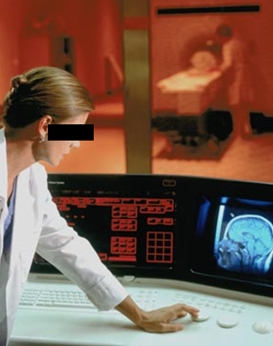
Example: Conflation of diagnosis and disease/disorder
The diagnosis is here
The disorder is there
The disease is there

Slide 67
The distinctions applied to diabetes management
Generic
Specific
3. Representation
‘person’
‘drug’
‘insulin’
‘W. Ceusters’
‘my sugar’
2. Beliefs (knowledge)
DIAGNOSIS
my doctor’s
work plan
my doctor’s
diagnosis
INDICATION
1.
First-order reality
PATHOLOGICAL
STRUCTURE
my doctor
my doctor’s computer
PERSON
DISEASE
me
my NIDDM
DRUG
PORTION OF
INSULIN
my blood glucose
level
MOLECULE
Basic Formal Ontology
Referent Tracking

Slide 68
Coding systems used naively preserve certain ambiguities
PtID
Date
ObsCode
Narrative
5572
04/07/1990
26442006
closed fracture of shaft of femur
5572
04/07/1990
81134009
Fracture, closed, spiral
5572
12/07/1990
26442006
closed fracture of shaft of femur
5572
12/07/1990
9001224
Accident in public building (supermarket)
5572
04/07/1990
79001
Essential hypertension
0939
24/12/1991
255174002
benign polyp of biliary tract
2309
21/03/1992
26442006
closed fracture of shaft of femur
2309
21/03/1992
9001224
Accident in public building (supermarket)
47804
03/04/1993
58298795
Other lesion on other specified region
5572
17/05/1993
79001
Essential hypertension
298
22/08/1993
2909872
Closed fracture of radial head
298
22/08/1993
9001224
Accident in public building (supermarket)
5572
01/04/1997
26442006
closed fracture of shaft of femur
5572
01/04/1997
79001
Essential hypertension
0939
20/12/1998
255087006
malignant polyp of biliary tract

Slide 69
Codes for ‘types’ AND identifiers for instances
PtID
Date
ObsCode
Narrative
5572
04/07/1990
26442006
IUI-001
closed fracture of shaft of femur
5572
04/07/1990
81134009
IUI-001
Fracture, closed, spiral
5572
12/07/1990
26442006
IUI-001
closed fracture of shaft of femur
5572
12/07/1990
9001224
IUI-007
Accident in public building (supermarket)
5572
04/07/1990
79001
IUI-005
Essential hypertension
0939
24/12/1991
255174002
IUI-004
benign polyp of biliary tract
2309
21/03/1992
26442006
IUI-002
closed fracture of shaft of femur
2309
21/03/1992
9001224
IUI-007
Accident in public building (supermarket)
47804
03/04/1993
58298795
IUI-006
Other lesion on other specified region
5572
17/05/1993
79001
IUI-005
Essential hypertension
298
22/08/1993
2909872
IUI-003
Closed fracture of radial head
298
22/08/1993
9001224
IUI-007
Accident in public building (supermarket)
5572
01/04/1997
26442006
IUI-012
closed fracture of shaft of femur
5572
01/04/1997
79001
7 distinct disorders
IUI-005
Essential hypertension
0939
20/12/1998
255087006
IUI-004
malignant polyp of biliary tract

Slide 70
Take home messages
Statements, even scientific jargon, as well as data collections can make sense and be about something, without each part thereof making sense or being about something.
  (a + b)² = a² + 2ab + b² is true whatever a and b are,
  c² = a² + b² is sometimes true, for instance if a, b, and c are the lengths of certain sides of a rectangular triangle.
For data collections to be interpretable and comparable, each part of it needs to be documented as to what it intends to denote.
Ontological Realism is a method to achieve this.

