Slide 1
Reality and Perception
Recitation part of BMS 199
New Frontiers in Biomedical Sciences: Everyday medicine
Registration 24536 – Fall 2016
Werner CEUSTERS, MD
Ontology Research Group, Center of Excellence in Bioinformatics and Life Sciences;
UB Institute for Healthcare Informatics,
Departments of Biomedical Informatics and Psychiatry,
University at Buffalo, NY, USA

Slide 2
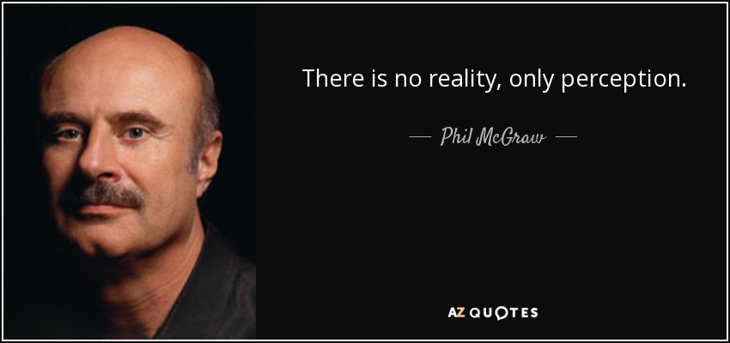
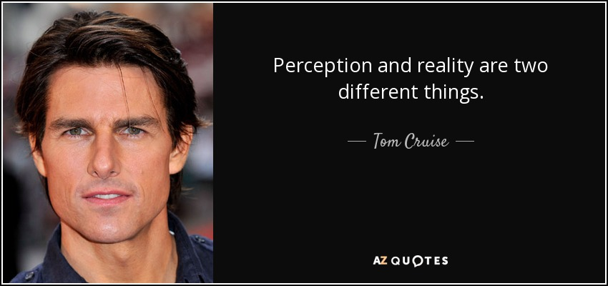
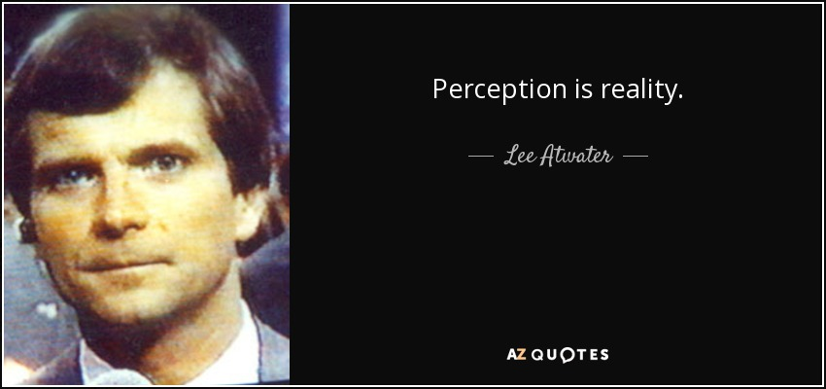
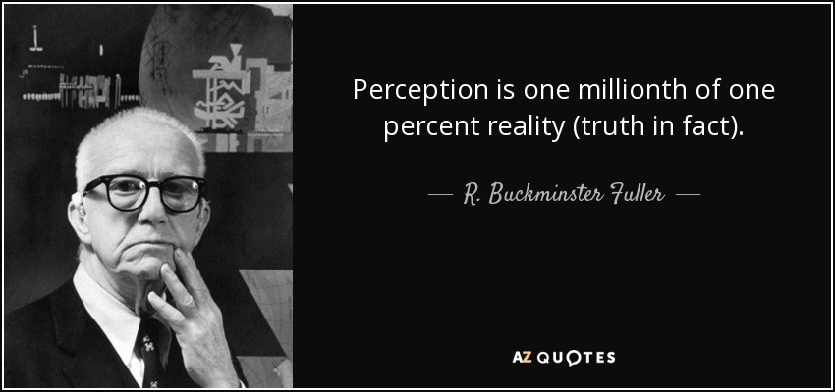
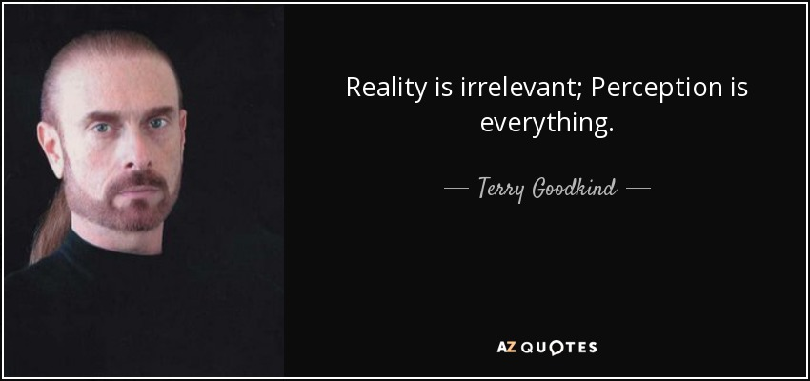
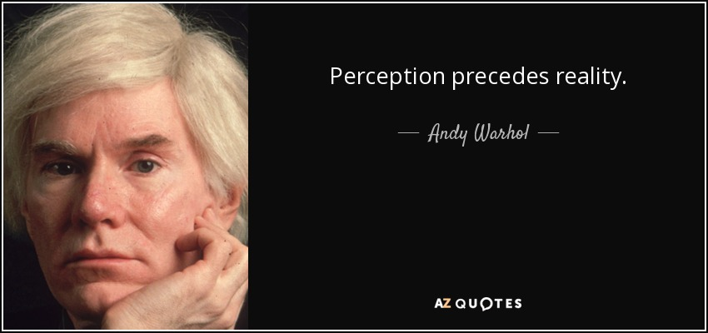
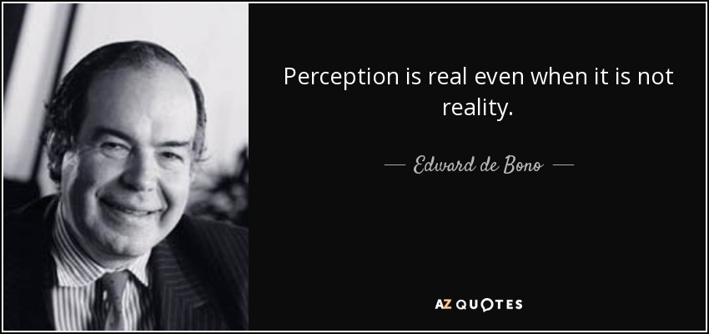
‘perception’ versus ‘reality’ http://www.azquotes.com/

Slide 3
Current mainstream thinking
wisdom
(- representation)
References
knowledge
- representation
information
- representation
data
- representation
Questions not often enough asked:
What part of our data corresponds with something out there in reality ?
What part of reality is not captured by our data, but should because it is relevant ?
Reality
What is there on the side of the patient
Referents

Slide 4

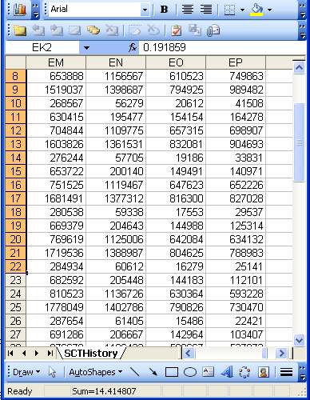
A non-trivial relation
Referents
References

Slide 5

For instance: source and impact of changes
What are differences in data about the same entities in reality at different points in time due to?

Slide 6
For instance: source and impact of changes
What are differences in data about the same entities in reality at different points in time due to?
  changes in first-order reality ?
  changes in our understanding of reality ?
  inaccurate observations ?
  differences in perspectives ?
  registration mistakes ?
Ceusters W, Smith B. A Realism-Based Approach to the Evolution of Biomedical Ontologies. AMIA 2006 Proceedings, Washington DC, 2006;:121-125. http://www.referent-tracking.com/RTU/sendfile/?file=CeustersAMIA2006FINAL.pdf

Slide 7


The theory: Ontological Realism
There is an external reality which is ‘objectively’ the way it is;
That reality is accessible to us;
We build in our brains cognitive representations of reality;
We communicate with others about what is there, and what we believe there is there.
Smith B, Kusnierczyk W, Schober D, Ceusters W. Towards a Reference Terminology for Ontology Research and Development in the Biomedical Domain. Proceedings of KR-MED 2006, Biomedical Ontology in Action, November 8, 2006, Baltimore MD, USA

Slide 8
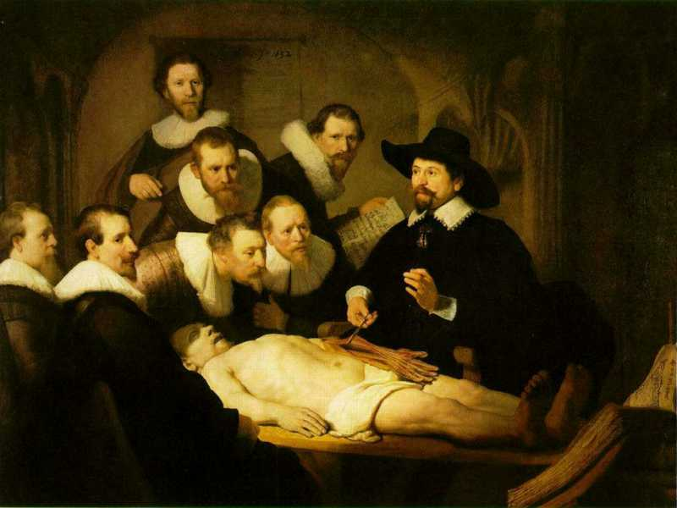
L3
Linguistic representations about (L1⁻), (L2) or (L3)
L2
Beliefs about (1)
Representations
First Order Reality
Entities (particular or generic) with objective existence which are not about anything
L1⁻

Slide 9
What makes it non-trivial?
Referents
  are (meta-) physically the way they are,
  relate to each other in an objective way,
  follow ‘laws of nature’.
Window on reality
  restricted by:
  what is physically and technically observable,
  fit between what is measured and what we think is measured,
  fit between established knowledge and ‘laws of nature’.
References
  follow, ideally, the syntactic-semantic conventions of some representation language,
  are restricted by the expressivity of that language,
  reference collections need to come, for correct interpretation, with documentation outside the representation.
Correspondence with levels of reality?
L1: what is real L2: beliefs L3: representations

Slide 10
Another causal chain
interpreting
perceiving
sensing
Reality

Slide 11
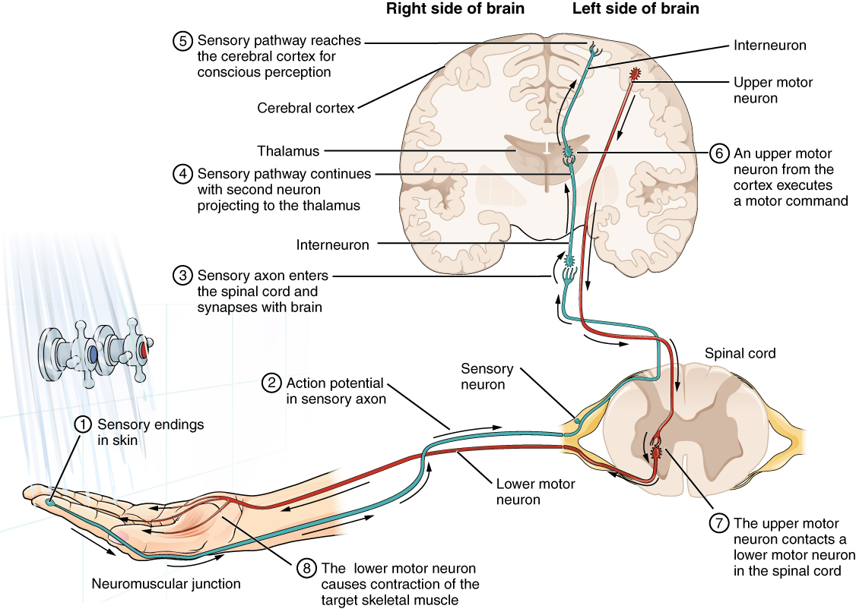
3. Perceiving
1. Reality
2. Sensing
http://oerpub.github.io/epubjs-demo-book/content/m46531.xhtml

Slide 12
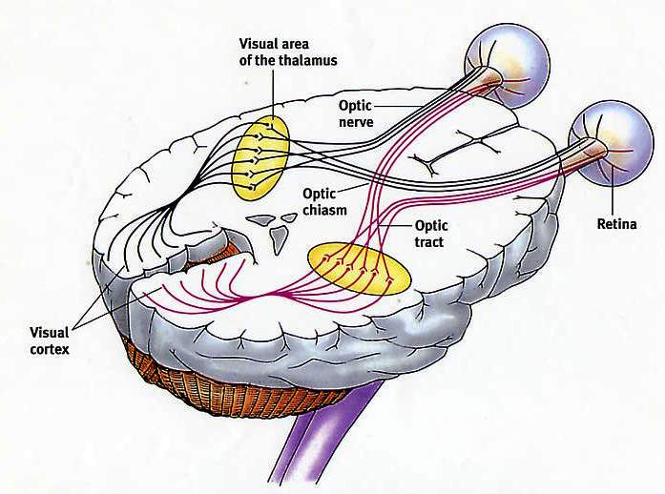
1. Reality
2. Sensing
3. Perceiving
http://www.edoctoronline.com/medical-atlas.asp?
c=4&id=21878&m=4

Slide 13

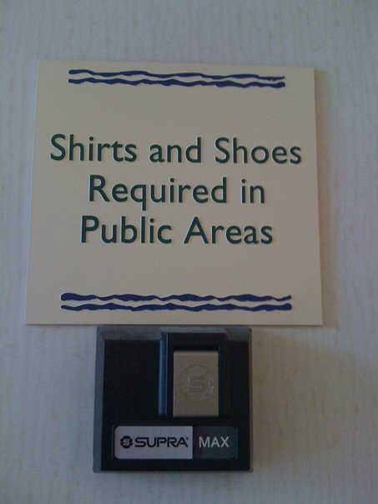

Interpreting linguistic statements
Often we can figure ambiguity out …
warning on plastic bag
in Miami hotel lobby
in Miami bar

Slide 14
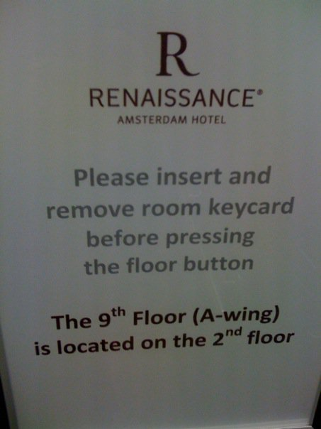
Interpreting linguistic statements
Sometimes, we can not …
in Amsterdam hotel elevator

Slide 15
A double mystery
(It is argued that) On September 9th, 1935, Carl Austin Weiss shot Senator Huey Long in the Louisiana State Capitol with a .35 calibre pistol. Long died from this wound thirty hours later on September 10th. Weiss, on the other hand, received between thirty-two and sixty .44 and .45 calibre hollow point bullets from Long's agitated bodyguards and died immediately.
        Sorensen, R., 1985, "Self-Deception and Scattered Events", Mind, 94: 64-69.
Questions:
  Did Weiss kill Senator Long ?
  If so, when did he kill him ?

Slide 16
Interplay of reality, sensing perceiving and interpreting
 | Reality | Sensing | Perceiving | Interpreting
 | Dog | Dog-stimulus | Dog | Dog
 | Dog | Cat-like stimuli | Cat | Cat / Cat? / x?
 | - | - | Dog | Dog
 | - | - | Dog | No dog
 | - | - | - | Dog
 | Dog | - | - | -
 | Dog | Dog | - | Dog
 | Dog | Dog | Dog | -

Slide 17
Interplay of reality, sensing perceiving and interpreting
 | Reality | Sensing | Perceiving | Interpreting
Canonical case | Dog | Dog-stimulus | Dog | Dog
 | Dog | Cat-like stimuli | Cat | Cat / Cat? / x?
 | - | - | Dog | Dog
 | - | - | Dog | No dog
 | - | - | - | Dog
 | Dog | - | - | -
 | Dog | Dog | - | Dog
 | Dog | Dog | Dog | -

Slide 18
Interplay of reality, sensing perceiving and interpreting
 | Reality | Sensing | Perceiving | Interpreting
Canonical case | Dog | Dog-stimulus | Dog | Dog
Illusion | Dog | Cat-like stimuli | Cat | Cat / Cat? / x?
 | - | - | Dog | Dog
 | - | - | Dog | No dog
 | - | - | - | Dog
 | Dog | - | - | -
 | Dog | Dog | - | Dog
 | Dog | Dog | Dog | -

Slide 19
Interplay of reality, sensing perceiving and interpreting
 | Reality | Sensing | Perceiving | Interpreting
Canonical case | Dog | Dog-stimulus | Dog | Dog
Illusion | Dog | Cat-like stimuli | Cat | Cat / Cat? / x?
Hallucination | - | - | Dog | Dog
 | - | - | Dog | No dog
 | - | - | - | Dog
 | Dog | - | - | -
 | Dog | Dog | - | Dog
 | Dog | Dog | Dog | -

Slide 20
Interplay of reality, sensing perceiving and interpreting
 | Reality | Sensing | Perceiving | Interpreting
Canonical case | Dog | Dog-stimulus | Dog | Dog
Illusion | Dog | Cat-like stimuli | Cat | Cat / Cat? / x?
Hallucination | - | - | Dog | Dog
Belief in false perception | - | - | Dog | No dog
 | - | - | - | Dog
 | Dog | - | - | -
 | Dog | Dog | - | Dog
 | Dog | Dog | Dog | -

Slide 21
Interplay of reality, sensing perceiving and interpreting
 | Reality | Sensing | Perceiving | Interpreting
Canonical case | Dog | Dog-stimulus | Dog | Dog
Illusion | Dog | Cat-like stimuli | Cat | Cat / Cat? / x?
Hallucination | - | - | Dog | Dog
Belief in false perception | - | - | Dog | No dog
Delusion | - | - | - | Dog
 | Dog | - | - | -
 | Dog | Dog | - | Dog
 | Dog | Dog | Dog | -

Slide 22
Interplay of reality, sensing perceiving and interpreting
 | Reality | Sensing | Perceiving | Interpreting
Canonical case | Dog | Dog-stimulus | Dog | Dog
Illusion | Dog | Cat-like stimuli | Cat | Cat / Cat? / x?
Hallucination | - | - | Dog | Dog
Belief in false perception | - | - | Dog | No dog
Delusion | - | - | - | Dog
Sensory loss | Dog | - | - | -
 | Dog | Dog | - | Dog
 | Dog | Dog | Dog | -

Slide 23
Interplay of reality, sensing perceiving and interpreting
 | Reality | Sensing | Perceiving | Interpreting
Canonical case | Dog | Dog-stimulus | Dog | Dog
Illusion | Dog | Cat-like stimuli | Cat | Cat / Cat? / x?
Hallucination | - | - | Dog | Dog
Belief in false perception | - | - | Dog | No dog
Delusion | - | - | - | Dog
Sensory loss | Dog | - | - | -
Anosognosia | Dog | Dog | - | Dog
 | Dog | Dog | Dog | -

Slide 24
Interplay of reality, sensing perceiving and interpreting
 | Reality | Sensing | Perceiving | Interpreting
Canonical case | Dog | Dog-stimulus | Dog | Dog
Illusion | Dog | Cat-like stimuli | Cat | Cat / Cat? / x?
Hallucination | - | - | Dog | Dog
Belief in false perception | - | - | Dog | No dog
Delusion | - | - | - | Dog
Sensory loss | Dog | - | - | -
Anosognosia | Dog | Dog | - | Dog
Denial | Dog | Dog | Dog | -

Slide 25
‘Ontology’
In philosophy:
  Ontology (no plural) is the study of what entities exist and how they relate to each other;

Slide 26
‘Ontology’
In philosophy:
  Ontology (no plural) is the study of what entities exist and how they relate to each other;
  by some philosophers taken to be synonymous with ‘metaphysics’ while others draw distinctions in many distinct ways (the distinctions being irrelevant for this talk), but almost agreeing on the following classification:
    metaphysics → studies ‘how is the world?’
      general metaphysics → studies general principles and ‘laws’ about the world
        ontology → studies what type of entities exist in the world
      special metaphysics → focuses on specific principles and entities
  distinct from ‘epistemology’ which is the study of how we can come to know about what exists.
  distinct from ‘terminology’ which is the study of what terms mean and how to name things.

Slide 27
Distinct questions. What type are they of?
Terminological:
  what does ‘pain’ mean ?
Metaphysical:
  what have all pains in common in virtue of which they are pains?
Ontological:
  what type of entity is pain?
Onto-terminological:
  what, if anything at all, does ‘pain’ denote?
Epistemological:
  how can we find out whether something is pain?

Slide 28
Scientific Realism
Three dimensions:
Metaphysically: commits to the mind-independent existence of the world investigated by the sciences.
Semantically: commits to a literal interpretation of scientific claims about the world. Claims about scientific entities, processes, properties, and relations, whether they be observable or unobservable, should be construed literally as having truth values, whether true or false.
Epistemologically: commits to the idea that theoretical claims (interpreted literally as describing a mind-independent reality) constitute knowledge of the world.
http://plato.stanford.edu/entries/scientific-realism/#WhaSciRea

Slide 29
Scientific Realism
Our best scientific theories give true or approximately true descriptions of observable and unobservable aspects of a mind-independent world.
http://plato.stanford.edu/entries/scientific-realism/#WhaSciRea

Slide 30
Scientific Objectivity (1)
Objectivity as Faithfulness to Facts
Objectivity as Absence of Normative Commitments and the Value-Free Ideal
Objectivity as Freedom from Personal Biases
  Measurement and Quantification
  Inductive and Statistical Inference

Slide 31
Scientific Objectivity (2)
Science is objective in that, or to the extent that:
its products—theories, laws, experimental results and observations—constitute accurate representations of the external world. The products of science are not tainted by human desires, goals, capabilities or experience.
  product objectivity
the processes and methods that characterize it neither depend on contingent social and ethical values, nor on the individual bias of a scientist
  → process objectivity.
http://plato.stanford.edu/entries/scientific-objectivity

Slide 32
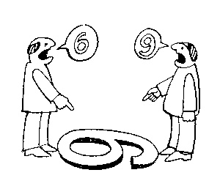
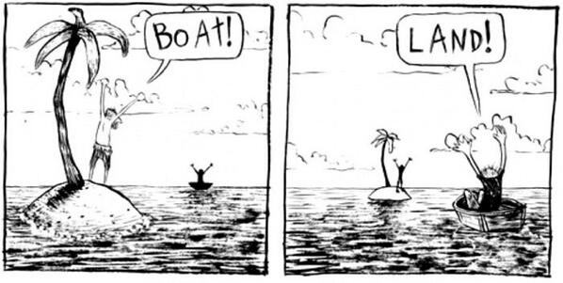
The view from nowhere
There are two kinds of qualities:
ones that vary with the perspective one has or takes, and
ones that remain constant through changes of perspective (objective properties).
http://plato.stanford.edu/entries/scientific-objectivity

Slide 33
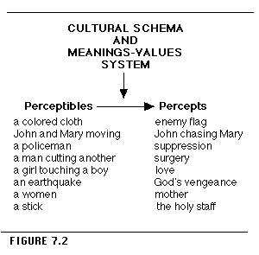
Chapter 7 in R.J. Rummel, The Dynamic Psychological Field, 1975.
https://www.hawaii.edu/powerkills/DPF.CHAP7.HTM

Slide 34
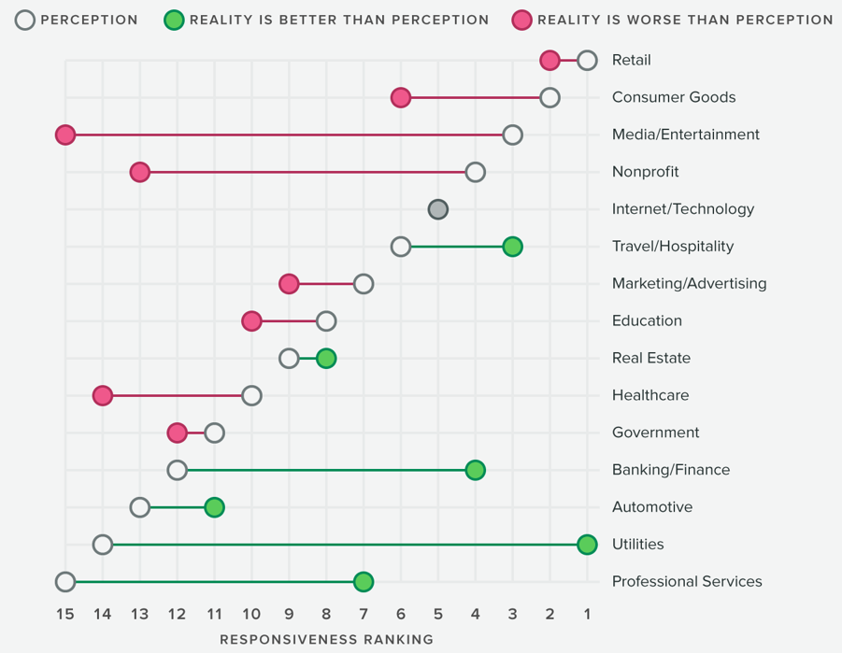
http://sproutsocial.com/insights/data/q3-2016/

Slide 35

What level?

Slide 36

What level?

Slide 37
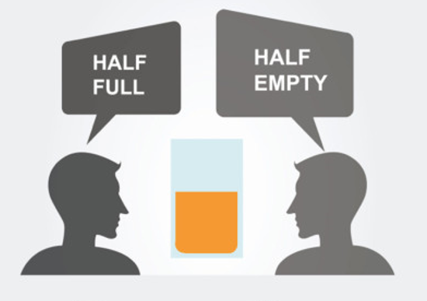
What level?

Slide 38
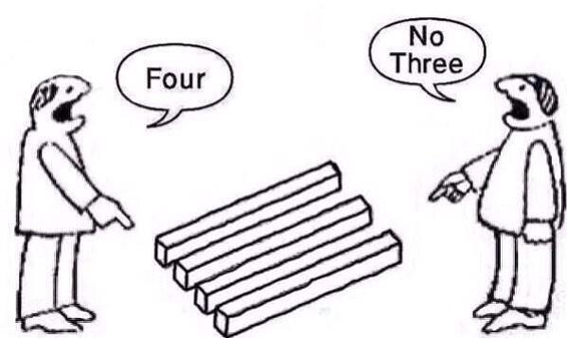
What level?

Slide 39
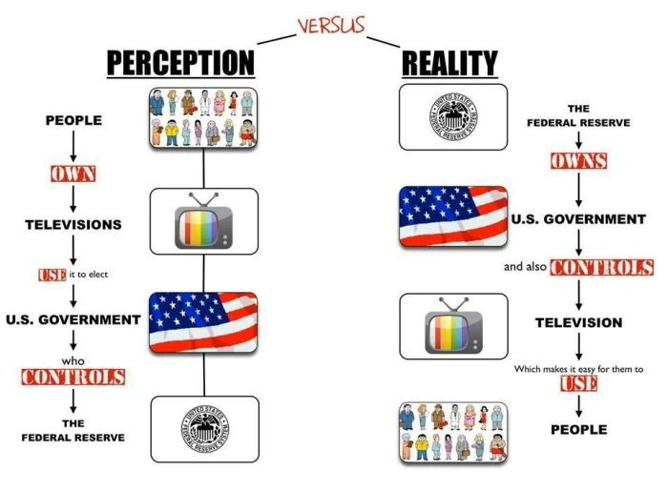
http://www.lawfulpath.com/img/perceptionVSreality.jpg

Slide 40
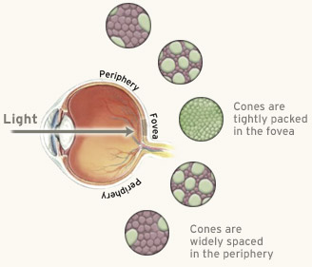
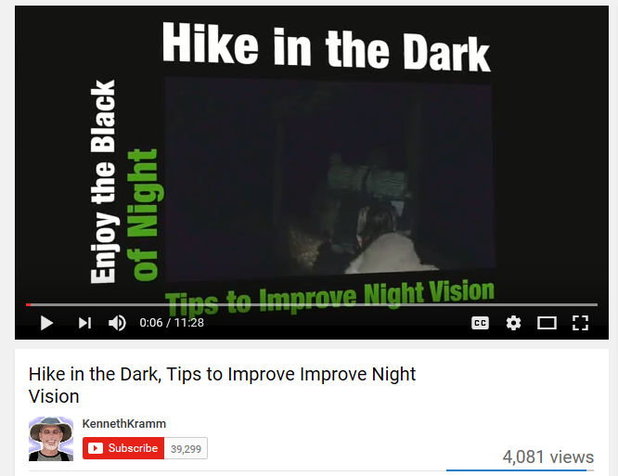
Peripheral vision
Better perception of motion at night through peripheral vision
http://www.webexhibits.org/colorart/ag.html

Slide 41
Reality → Interpretation
Touching forehead with straight right hand, forearm 45° angle | Shifting eyes to peripheral position
Military salutation ← | Improved ‘peripheral’ vision at night ←
Drawing attention to eyes | Sign of PTSD
Hinting to smaller orbitofrontal cortex | Hinting to glaucoma treatment
 | Eye wandering

Slide 42
Correct?
‘For example, soldiers that come back from war may hear a loud band and perceive and hallucinate that they are back in combat’.

Slide 43
Correct?
‘For example, soldiers that come back from war may hear a loud band and perceive and hallucinate that they are back in combat’.
Might be intended well, but thoughts are expressed too cryptically. Needs elaboration.
E.g.: illusion triggering a hallucination

Slide 44
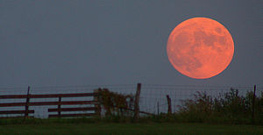
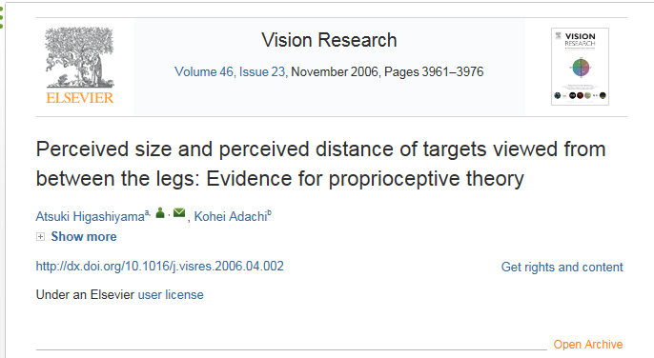
The Moon illusion
The Moon illusion is an optical illusion which causes the Moon to appear larger near the horizon than it does higher up in the sky. It has been known since ancient times and recorded by various cultures.
https://en.wikipedia.org/wiki/Moon_illusion
The proprioceptive theory assumes that the visual skill that is needed to achieve accurate size and distance judgments is conditioned to normal posture.

Slide 45

Moon verb
gerund or present participle: mooning
1. behave or move in a listless and aimless manner.
"lying in bed eating candy, moning around"
  act in a dreamily infatuated manner.
"Timothy's mooning over her like a schoolboy"
2. informal
expose one's buttocks to (someone) in order to insult or amuse them.
"Dan had whipped around, bent over, and mooned the crowd"

Slide 46
Correct?
‘When you look upside down you see different things than when you are upright’

Slide 47
Correct?
‘When you look upside down you see different things than when you are upright’
‘When you look upside down you see things differently than when you are upright’

Slide 48
Correct?
The thing that we saw might be wrong because there were other ways to look at it.

Slide 49
Correct?
The thing that we saw might be wrong because there were other ways to look at it.
The thing that we saw might be wrongly perceived/interpreted because there were other ways to look at it.

Slide 50
Excellent format for answering
(thanks, Taylor)
For the first clues you gave us, I think that was … .
I think this because … and because … .
For the second clue, I think you were … . … is a relevant … because it is the X … .
After researching X, I learned that … .
Because the difference …, most people wouldn’t ….
However, most people argue that … because of ….
One of the biggest contributors to this is … .
Because of this, …..
Another way … is through something called “…”. This is when people … .
These are the websites that I gathered information from when researching …:

Slide 51
So, who cannot be right under any interpretation? http://www.azquotes.com/

Slide 52
So, who cannot be right under any interpretation? http://www.azquotes.com/

