Slide 1

Discovery Seminar #17336 – Spring 2015 Translational Pharmacogenomics: Linking Genetics Research to Drug and Diagnostics Development and New Treatment Approaches Ontology: Developing a Systematic Approach to Translational Pharmacogenomic Research Data Collection April 22, 2015
Werner CEUSTERS, MD
Professor, Department of Biomedical Informatics and
Department of Psychiatry, University at Buffalo
Director, National Center for Ontological Research
Director of Research, UB Institute for Healthcare Informatics

Slide 2


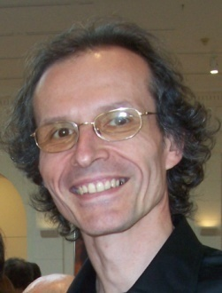



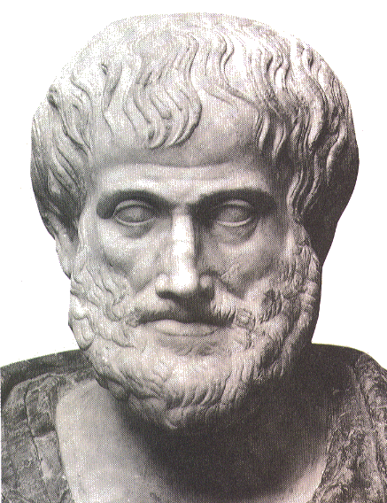







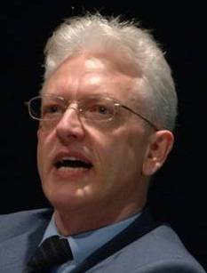


Short personal history
2012
1977
1959 -
2006
1989
2004
1992
2002
1995
1998
1993

Slide 3
Key topics for this talk
Ontology
Pharmacogenomics
Research Data Collection

Slide 4
‘Ontology’
In philosophy:
Ontology (no plural) is the study of what entities exist and how they relate to each other;
by some philosophers taken to be synonymous with ‘metaphysics’ while others draw distinctions in many distinct ways (the distinctions being irrelevant for this talk), but almost agreeing on the following classification:
metaphysics → studies ‘how is the world?’
general metaphysics → studies general principles and ‘laws’ about the world
ontology → studies what type of entities exist in the world
special metaphysics → focuses on specific principles and entities

Slide 5
‘Pharmacogenomics’
‘The branch of pharmacology which deals with the influence of genetic variation on drug response in patients by correlating gene expression or single-nucleotide polymorphisms with a drug's efficacy or toxicity’.
‘Pharmacogenomics is the whole genome application of pharmacogenetics, which examines the single gene interactions with drugs’.
http://en.wikipedia.org/wiki/Pharmacogenomics

Slide 6
‘Pharmacogenomics’
‘The branch of pharmacology which deals with the influence of genetic variation on drug response in patients by correlating gene expression or single-nucleotide polymorphisms with a drug's efficacy or toxicity’.
‘Pharmacogenomics is the whole genome application of pharmacogenetics, which examines the single gene interactions with drugs’.
http://en.wikipedia.org/wiki/Pharmacogenomics

Slide 7
‘Ontology’ and ‘Pharmacogenomics’
metaphysics → studies ‘how is the world?’
general metaphysics → studies general principles and ‘laws’ about the world
ontology → studies what type of entities exist in the world
Some questions:
How do gene expression and gene interaction work?
Do gene expression and gene interaction exist ?
What do genes do?
Do genes exist?
What type of entities are – if they exist – gene expressions, gene interactions and genes ?

Slide 8
One more question …
If the answer to the question ‘Do genes exist?’ is ‘no’, would the question ‘What do genes do?’ be a sensible question?

Slide 9
What are genes?
There is not much consensus of opinion among geneticists as to what genes are — whether they are real or purely fictitious — because at the level at which the genetic experiments lie, it does not make the slightest difference whether the gene is a hypothetical unit, or whether the gene is a material particle.
Morgan, T. H. (1934). The relation of genetics to physiology and medicine.
In Nobelprize.org (1965). Nobel Lectures, Physiology or Medicine, 1922–1941.
Amsterdam: Elsevier Publishing Company, 1965.
(http://nobelprize.org/nobel_organizations/nobelfoundation/publications/lectures/medicine.html).

Slide 10
What are genes?
Bloß die einfache Vorstellung soll Ausdruck finden, daß durch ‘‘etwas’’ in den Gameten eine Eigenschaft des sich entwickelnden Organismus bedingt oder mitbestimmt wird oder werden kann. Keine Hypothese über das Wesen dieses ‘‘etwas’’ sollte dabei aufgestellt oder gestüzt werden. Das Wort Gen ist völlig frei von jeder Hypothese; es drückt nur die sichergestellte Tatsache aus,daß jedenfalls viele Eigenschaften des Organismus durch in den Gameten vorkommende besondere, trennbare und somit selbstständige ‘‘Zustände’’, ‘‘Grundlagen’’, ‘‘Anlagen’’— kurz, was wir eben Gene nennen wollen—bedingt sind.
Johannsen, W. (1909). Elemente der exakten Erblichkeitslehre. Jena: Gustav Fischer.
See: Raphael Falk. What is a gene?—Revisited.
Studies in History and Philosophy of Biological and Biomedical Sciences 41 (2010) 396–406

Slide 11
One more question …
If the answer to the question ‘Do genes exist?’ is ‘no’, would the question ‘What do genes do?’ be a sensible question?
Yes:
‘What do genes do?’ → metaphysical question
‘Do genes exist?’ → ontological question
This raises two further questions: which one?

Slide 12
Two further questions
To be able to answer the question ‘Do genes exist?’ one must ask …
How can we find out whether genes exist?
→ epistemological question
If the answer to the question ‘Do genes exist?’ is ‘no’, and the answer to the question ‘What do genes do?’ is sensible, one may ask …
What does the word ‘gene’ then mean?
→ terminological question

Slide 13
‘Ontology’
In philosophy:
Ontology (no plural) is the study of what entities exist and how they relate to each other;
by some philosophers taken to be synonymous with ‘metaphysics’ while others draw distinctions in many distinct ways (the distinctions being irrelevant for this talk), but almost agreeing on the following classification:
metaphysics → studies ‘how is the world?’
general metaphysics → studies general principles and ‘laws’ about the world
ontology → studies what type of entities exist in the world
special metaphysics → focuses on specific principles and entities
distinct from ‘epistemology’
which is the study of how we can come to know about what exists.
distinct from ‘terminology’
which is the study of what terms mean and how to name things.

Slide 14
Terminological versus Ontological approach
The terminologist defines:
‘a clinical drug is a pharmaceutical product given to (or taken by) a patient with a therapeutic or diagnostic intent’. (RxNorm)
The (good, real) ontologist thinks:
Does ‘given’ includes ‘prescribed’?
Is manufactured with the intent to … not sufficient?
Are newly marketed products – available in the pharmacy, but not yet prescribed – not clinical drugs?
Are products stolen from a pharmacy not clinical drugs?
What about such products taken by persons that are not patients?
e.g. children mistaking tablets for candies.

Slide 15
Is the question ‘what is a gene?’ answered?
Obviously, the century-old discussion of ‘what is a gene’ has not been resolved, …
Does this mean pharmacogenomic research is nonsense and building pharmacogenomic research data collections futile?
Raphael Falk. What is a gene?—Revisited.
Studies in History and Philosophy of Biological and Biomedical Sciences 41 (2010) 396–406

Slide 16
Pharmacogenomic research ‘data collection’
A huge matrix with data representing patient cases in one dimension and patient characteristics in the other dimension
genotypic
phenotypic

Slide 17
Goal of research data collection: analysis
Use statistical correlation techniques to find associations between characteristics and (dis)similarities between cases
genotypic
phenotypic

Slide 18
Goal of research data collection: analysis
Does it make sense to do so if we are not sure whether the notion of ‘gene’ is a faithful one, it is whether ‘gene’ denotes an entity?
genotypic
phenotypic

Slide 19
Fundamental questions to answering that
What are data and where do they come from ?

Slide 20
What must exist for these data to exist ?

Slide 21

What must exist for these data to exist ?
things that are able to measure:
instruments
people
things that are measurable
measurements
representation formalisms
information bearers
observation &
measurement

Slide 22
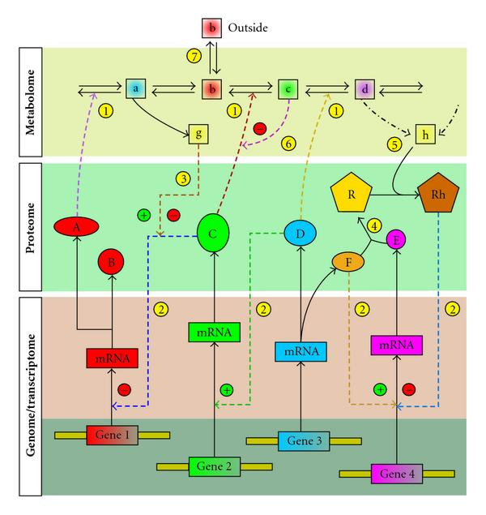
Measurable/ observable things in pharmaco-genomics
VA. Likić, MJ. McConville, T. Lithgow, and A. Bacic. Systems Biology: The Next Frontier for Bioinformatics. Advances in Bioinformatics (2010), doi:10.1155/2010/268925

Slide 23
Interactions displayed on previous slide
enzyme catalysis,
posttranscriptional control of gene expression
effect of metabolite on gene transcription mediated by a protein,
protein-protein interaction,
effect of a downstream (“reporter”) metabolite on transcription through binding to a protein,
feedback inhibition/activation of an enzyme by a downstream metabolite,
exchange of a metabolite with outside of the system

Slide 24
Fundamental questions to answering that
What are data and where do they come from ?
What can we do with data?

Slide 25
What can we do with data?
data
organization
model development
observation &
measurement
further R&D
(instrument and
study optimization)
add
verify
use
Δ = outcome
Generic
beliefs
application

Slide 26
Fundamental questions to answering that
What are data and where do they come from ?
What can we do with data?
How do data relate to what they are data of?

Slide 27

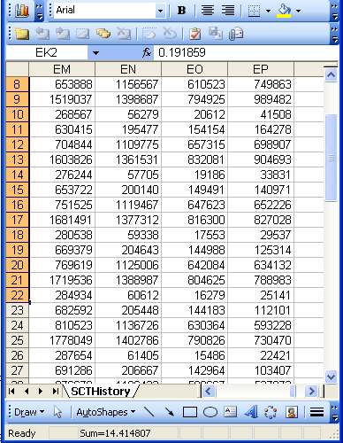
A non-trivial relation
Referents
References

Slide 28
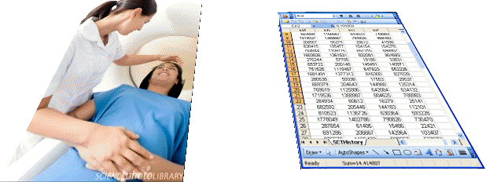
For instance: meaning and impact of changes
Are differences in data about the same entities in reality at different points in time due to:
changes in first-order reality ?
changes in our understanding of reality ?
inaccurate observations ?
registration mistakes ?
Ceusters W, Smith B. A Realism-Based Approach to the Evolution of Biomedical Ontologies. AMIA 2006 Proceedings, Washington DC, 2006;:121-125. http://www.referent-tracking.com/RTU/sendfile/?file=CeustersAMIA2006FINAL.pdf

Slide 29
What makes it non-trivial?
Referents
are (meta-) physically the way they are,
relate to each other in an objective way,
follow laws of nature.
Window on reality
restricted by:
what is physically and technically observable,
fit between what is measured and what we think is measured,
fit between established knowledge and laws of nature.
References
follow, ideally, the syntactic-semantic conventions of some representation language,
are restricted by the expressivity of that language,
to be interpreted correctly, reference collections need external documentation.

Slide 30

The basis of Ontological Realism (O.R.)
There is an external reality which is ‘objectively’ the way it is;
That reality is accessible to us;
We build in our brains cognitive representations of reality;
We communicate with others about what is there, and what we believe there is there.
Smith B, Kusnierczyk W, Schober D, Ceusters W. Towards a Reference Terminology for Ontology Research and Development in the Biomedical Domain. Proceedings of KR-MED 2006, Biomedical Ontology in Action, November 8, 2006, Baltimore MD, USA

Slide 31
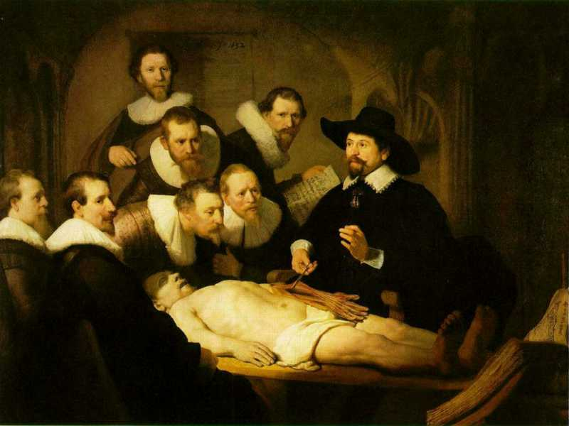
L3
Linguistic representations about (L1⁻), (L2) or (L3)
L2
Beliefs about (1)
Representations
First Order Reality
Entities (particular or generic) with objective existence which are not about anything
L1⁻

Slide 32
A crucial distinction: data and what they are about
data
organization
First-
Order
Reality
is about
model development
observation &
measurement
Representation
further R&D
(instrument and
study optimization)
add
verify
use
Δ = outcome
Generic
beliefs
application

Slide 33
Fundamental questions to answering that
What are data and where do they come from ?
What can we do with data?
How do data relate to what they are data of?
How can we make research data collections comparable?

Slide 34
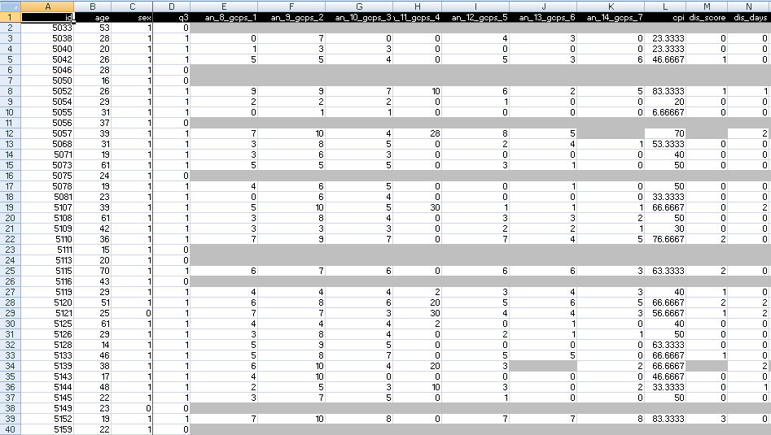
A colleague shares his research data set

Slide 35
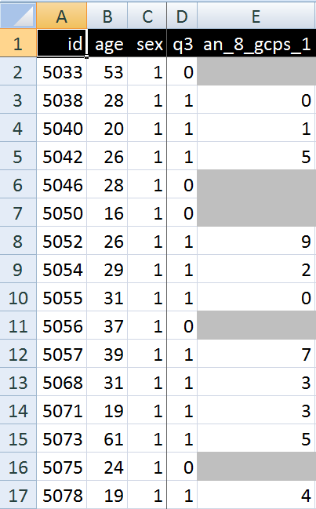
A closer look
What are you going to ask him right away?
What do these various values stand for and how do they relate to each other?
Might this mean that patient #5057 had only once sex at the age of 39?

Slide 36

Documenting datasets
Sources | Data generation | Data organization
Data collection sheets
Instruction manuals
Interpretation criteria
Diagnostic criteria
Assessment instruments
Terminologies
Data validation procedures
Data dictionaries
Ontologies
If not used for data collection and organization, these sources can be used post hoc to document, and perhaps increase, the level of data clarity and faithfulness in and comparability of existing data collections.

Slide 37
‘Ontology’ denotes ambiguously
In philosophy:
Ontology (no plural) is the study of what entities exist and how they relate to each other;
In computer science and many biomedical informatics applications:
An ontology (plural: ontologies) is a shared and agreed upon conceptualization of a domain;

Slide 38
Computer science approach to ontology
Ontology
Authoring Tools
create
Domain
Ontologies
Reasoners
Semantic
Applications
use

Slide 39
Computer science approach to ontology
Ontology
Authoring Tools
the logic in reasoners:
guarantees consistent reasoning,
does not guarantee the faithfulness of the representation.
create
Domain
Ontologies
Reasoners
Semantic
Applications
use

Slide 40
Philosophical approach to ontology
Ontological Realism: uses ontology as philosophical discipline to build ontologies as faithful representations of reality.

Slide 41
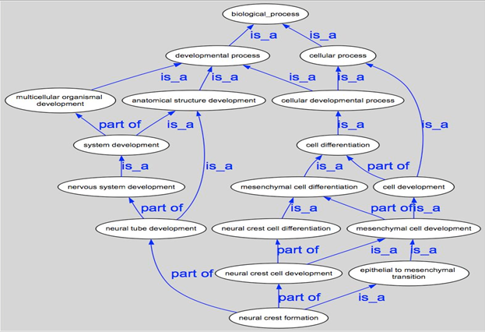
Building an ontology using ontology

Slide 42
Using ontologies to map data collections

Slide 43
The positive effects of appropriate mappings
more precise and comparable semantics of what data items in distinct data collections denote
identification of ontological relations prior to statistical correlation:
ch1 and ch4
ch1 and ch5
ch1 and ch2
…

Slide 44
Take home messages
Statements, even scientific jargon, as well as data collections can make sense and be about something, without each part thereof making sense or being about something.
(a + b)² = a² + 2ab + b² is true whatever a and b are,
c² = a² + b² is sometimes true, for instance if a, b, and c are the lengths of certain sides of a rectangular triangle.
For data collections to be interpretable and comparable, each part of it needs to be documented as to what it intends to denote.
Ontological Realism is a method to achieve this.

