Slide 1
Clinical Population Research and Ontologies.
January 8/9, 2014
University at Buffalo, South Campus
Werner CEUSTERS, MD
Ontology Research Group, Center of Excellence in Bioinformatics and Life Sciences,
UB Institute for Healthcare Informatics,
Departments of Biomedical Informatics and Psychiatry,
University at Buffalo, NY, USA

Slide 2

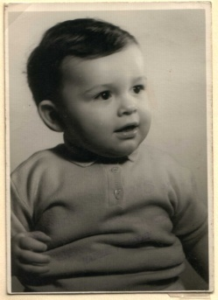
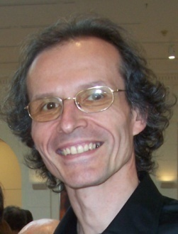



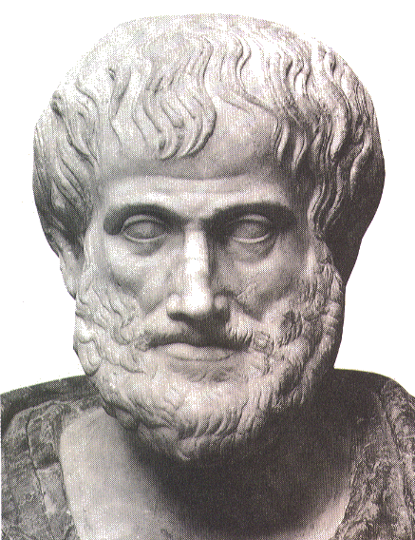







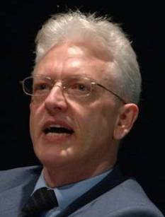


Short personal history
2012
1977
1959 -
2006
1989
2004
1992
2002
1995
1998
1993

Slide 3

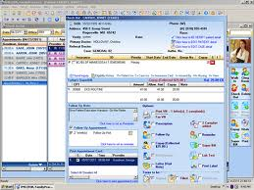
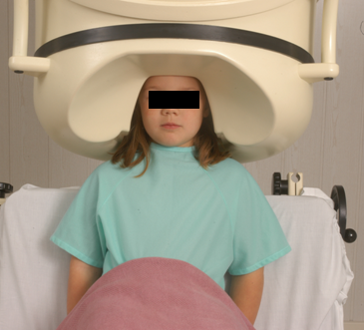

Clinical data registration and use
Register in EHR
observation &
measurement
research
Δ = outcome
application

Slide 4
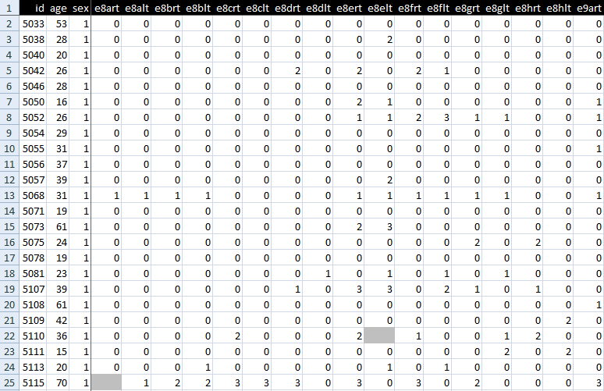
An EHR data collection

Slide 5
Standard approach in data analysis (1)
Cases | Characteristics
 | ch1 | ch2 | ch3 | ch4 | ch5 | ch6 | ...
case1
case2
case3
case4
case5
case6
...
finding correlations
phenotypic
genotypic
treatment
outcome …

Slide 6
Standard approach in data analysis (2)
Cases | Characteristics
 | ch1 | ch2 | ch3 | ch4 | ch5 | ch6 | ...
case1
case2
case3
case4
case5
case6
...
{
finding correlations
therefore
expectation
phenotypic
genotypic
treatment
outcome …

Slide 7
Standard approach in data analysis (3)
Cases | Characteristics
 | ch1 | ch2 | ch3 | ch4 | ch5 | ch6 | ...
case1
case2
case3
case4
case5
case6
...
generalization ?
{
finding correlations
therefore
expectation
phenotypic
genotypic
treatment
outcome …

Slide 8
Is it that easy?

Slide 9
Pitfalls in statistics
Three broad categories:
  Sources of bias.
    These are conditions or circumstances which affect the external validity of statistical results.
  Errors in methodology,
    which can lead to inaccurate or invalid results.
  Interpretation errors,
    misapplication of statistical results to real world issues.

Slide 10
Example: confounding in epidemiology
Confounders are:
  not part of the real association between exposure and disease,
  predictors of disease,
  unequally distributed between exposure groups.
Example: grey hair
  take from the street the first 100 people you encounter with grey hair and the first 100 that don’t have grey hair;
  check them for heart disease;
  you will very likely find that there are significantly more people in the grey hair group that have heart disease than in the other group because
  both grey hair and heart disease are more prevalent in elderly;
  therefore (?): grey hair causes heart disease (or the other way round?)

Slide 11
Some strategies to reduce confounding
randomization (distribute - known and measurable - confounders between study groups)
restriction (restrict entry to study of individuals with confounding factors
  risks: introduce bias
matching, stratification, adjustment, …
  → check your course in medical statistics,
    if you didn’t take one: shame on you.

Slide 12

However !

Slide 13
Major problem with EHRs for data analysis
The information model behind current EHRs is optimized for individual patient care, reflecting ‘care models’, without being a faithful model of how medical reality is structured in its entirety.
data
organization
observation &
measurement
Δ = outcome
application

Slide 14
EHR Information Models (simplified)
diagnosis
finding
finding
patient
patient
encounter
drug
drug
diagnosis

Slide 15
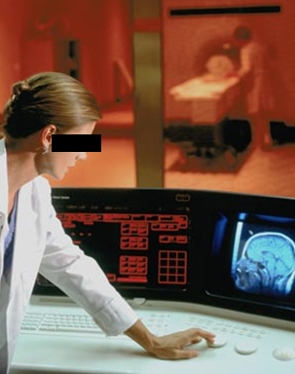
Example: Conflation of diagnosis and disease/disorder
The diagnosis is here
The disorder is there
The disease is there

Slide 16
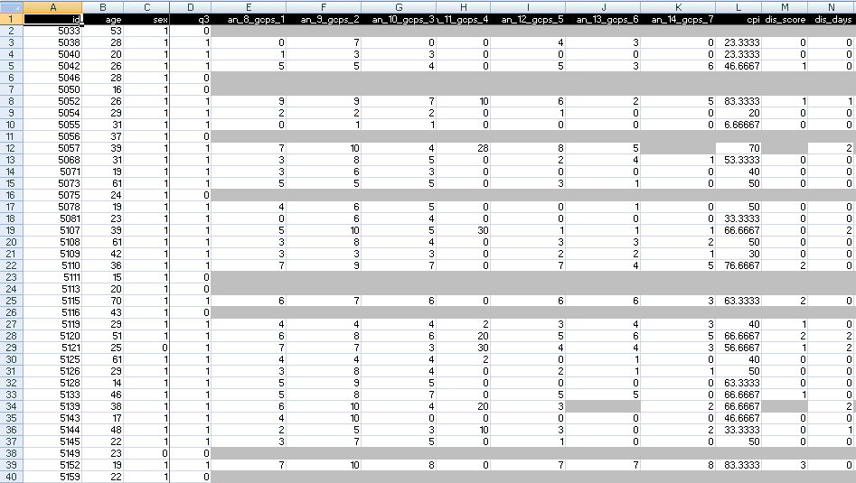
A colleague shares his research data set

Slide 17
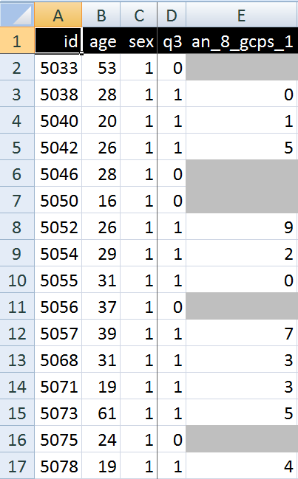
A closer look
What are you going to ask him right away?
What do these various values stand for and how do they relate to each other?
  Might this mean that patient #5057 had only once sex at the age of 39?

Slide 18
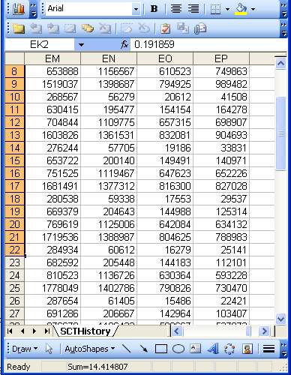


Documenting datasets
Sources | Data generation | Data organization
Data collection sheets
Instruction manuals
Interpretation criteria
Diagnostic criteria
Assessment instruments
Terminologies
Data validation procedures
Data dictionaries
Ontologies
If not used for data collection and organization, these sources can be used post hoc to document, and perhaps increase, the level of data clarity and faithfulness in and comparability of existing data collections.

Slide 19
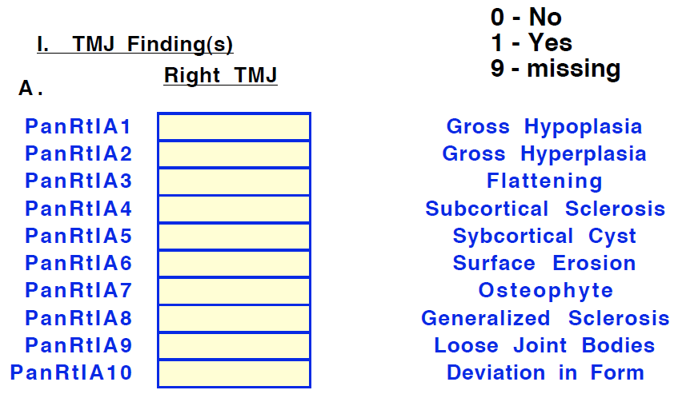
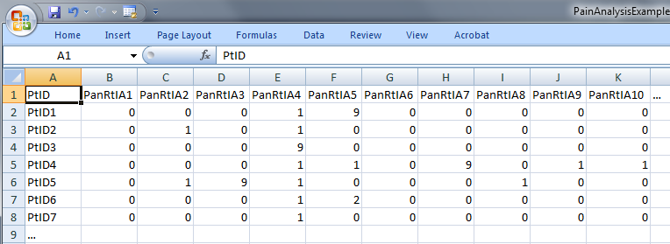
‘meaning’ of values in data collections
‘The patient with patient identifier ‘PtID4’ is stated to have had a panoramic X-ray of the mouth which is interpreted to show subcortical sclerosis of that patient’s condylar head of the right temporomandibular joint’
meaning
1

Slide 20
Current approaches to data management and analysis ignore too much where data come from

Slide 21
Generalization: data generation and use
data
organization
model development
observation &
measurement
further R&D
(instrument and
study optimization)
add
verify
use
Δ = outcome
Generic
beliefs
application

Slide 22
Correlation with reality
What type of relationship is there between data items and the part of reality they are obtained from?
What, if anything at all, do variable names in header rows correspond to?
Do correlations between data items mimic the relationships between the entities in reality the data items are obtained from?

Slide 23
Reality as benchmark for data organization and representation
data
organization
model development
observation &
measurement
further R&D
(instrument and
study optimization)
add
verify
use
Δ = outcome
Generic
beliefs
application

Slide 24
The focus on (big) data …

Slide 25

… makes one forget what data – ideally – are about
Referents
References

Slide 26
A non-trivial relation
Referents
References

Slide 27

For instance: source and impact of changes
Are differences in data about the same entities in reality at different points in time due to:
  changes in first-order reality ?
  changes in our understanding of reality ?
  inaccurate observations ?
  differences in perspectives ?
  registration mistakes ?
Ceusters W, Smith B. A Realism-Based Approach to the Evolution of Biomedical Ontologies. AMIA 2006 Proceedings, Washington DC, 2006;:121-125. http://www.referent-tracking.com/RTU/sendfile/?file=CeustersAMIA2006FINAL.pdf

Slide 28
What makes it non-trivial?
Referents
  are (meta-) physically the way they are,
  relate to each other in an objective way,
  follow laws of nature.
Window on reality
  restricted by:
  what is physically and technically observable,
  fit between what is measured and what we think is measured,
  fit between established knowledge and laws of nature.
References
  follow, ideally, the syntactic-semantic conventions of some representation language,
  are restricted by the expressivity of that language,
  to be interpreted correctly, reference collections need external documentation.

Slide 29
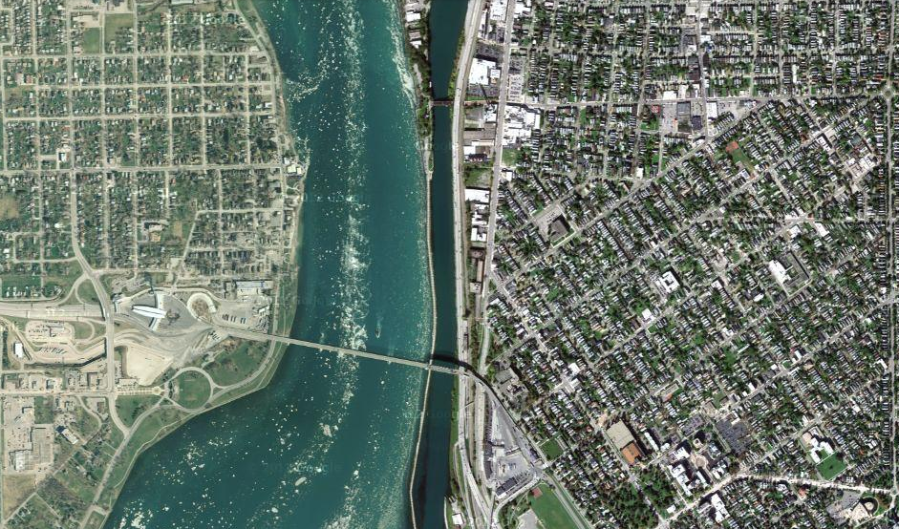
Satellite view

Slide 30
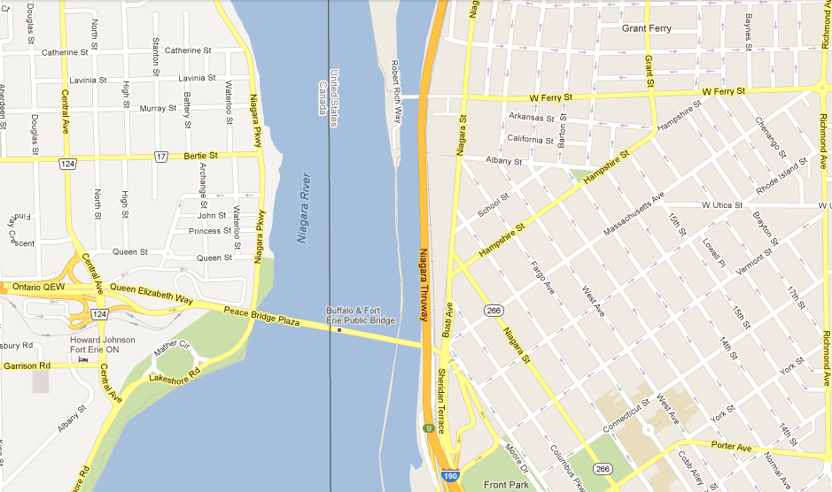
Map

Slide 31
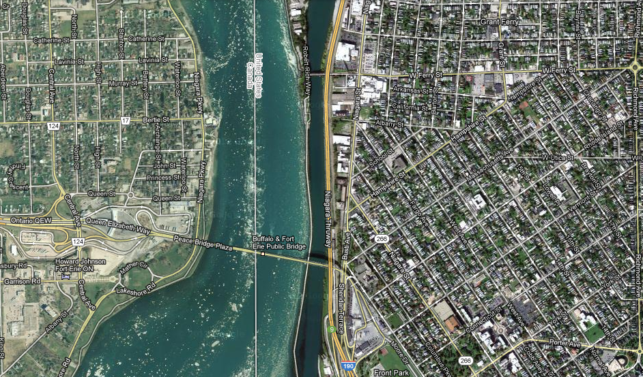
Map overlay

Slide 32
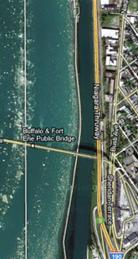
Map ←→ Reality
A message to map makers: “Highways are not painted red, rivers don’t have county lines running down the middle, and you can’t see contour lines on a mountain”
W. Kent. Data and Reality. North-Holland, Amsterdam, the Netherlands, 1978.

Slide 33
Main data ←→ reality views
Nominalism:
  there are no generic entities in reality: there is no ‘personhood’, there are only individual persons.
Conceptualism:
  generalizations are in our minds. ‘personhood’ is a concept construed in our mind that allows us to reason about persons without any particular person in mind.
Realism:
  generic entities do exist and are called ‘universals’. Each particular person is an instance of the universal we call ‘person’.

Slide 34
Main data ←→ reality views
Nominalism:
  there are no generic entities in reality: there is no ‘personhood’, there are only individual persons.
Conceptualism: ← mainstream approach
  generalizations are in our minds. ‘personhood’ is a concept construed in our mind that allows us to reason about persons without any particular person in mind.
Realism: ← our approach
  generic entities do exist and are called ‘universals’. Each particular person is an instance of the universal we call ‘person’.

Slide 35
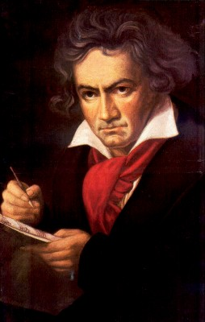
The semantic/semiotic triangle
Ludwig van Beethoven
that great German composer that became deaf
…
concept
term
referent
‘Beethoven’

Slide 36
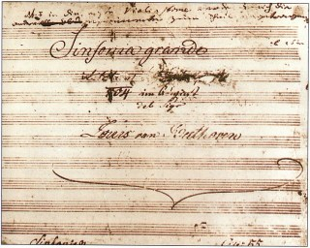
The semantic triangle works sometimes fine
Beethoven’s symphony dedicated to Bonaparte
the symphony played after the Munich Olympics massacre
…
concept
term
referent
‘Eroica’
‘Beethoven's Symphony No. 3’
‘Beethoven's Opus 55’

Slide 37
Sometimes the semantic triangle fails
the symphony Beethoven wrote after the tenth
…
concept
term
referent
‘Beethoven's Symphony No. 11’

Slide 38
Sometimes the semantic triangle fails
the symphony Beethoven wrote after the tenth
…
some hold this term has meaning
concept
term
referent
‘Beethoven's Symphony No. 11’

Slide 39

Sometimes the semantic triangle fails
the one assembled by Barry Cooper from fragmentary sketches
Beethoven’s hypothetical symphony
…
concept
term
referent
‘Beethoven's Symphony No. 10’

Slide 40
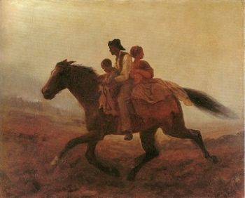
Prehistoric ‘psychiatry’: drapetomania
disease which causes slaves to suffer from an unexplainable propensity to run away
…
concept
term
referent
painting by Eastman Johnson. A Ride for Liberty: The Fugitive Slaves. 1860.
‘drapetomania’

Slide 41
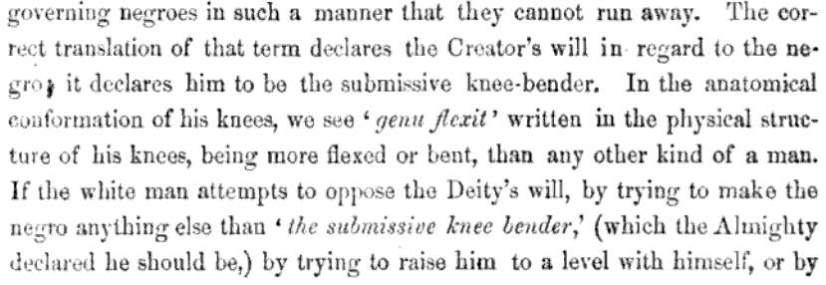
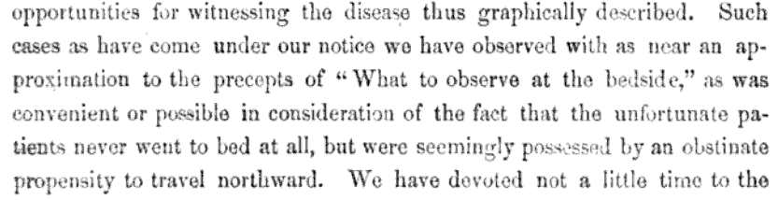
Some etiologic and diagnostic reflections

Slide 42
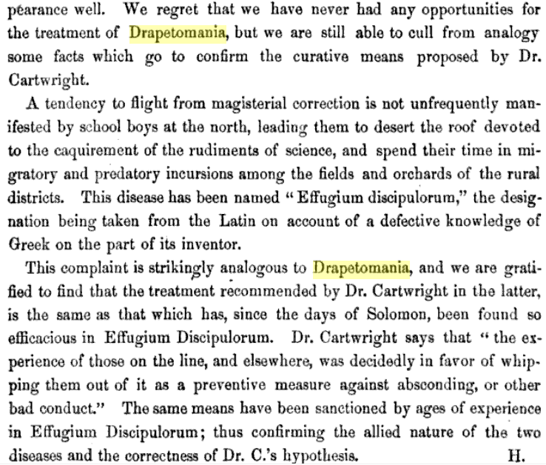
The North’s ‘Effugium Discipulorum’

Slide 43
The questions the triangle raises become trickier
Is …
  Beethoven’s 10th symphony a symphony ?
  Beethoven’s 10th symphony a hypothetical symphony ?
  a hypothetical symphony a symphony ?
In medicine, is …
  a prevented abortion an abortion ?
  an absent nipple a nipple ?

Slide 44
SNOMED about diseases and concepts (until 2010)
‘Disorders are concepts in which there is an explicit or implicit pathological process causing a state of disease which tends to exist for a significant length of time under ordinary circumstances.’
And also: “Concepts are unique units of thought”.
      College of American Pathologists. SNOMED Clinical Terms® User Guide. January 2003 Release.
Thus: Disorders are unique units of thoughts in which there is a pathological process …???
And thus: to eradicate all diseases in the world at once we simply should stop thinking ?

Slide 45


An alternative: Ontological Realism

Slide 46
Conceptualism versus Ontological Realism
First order reality
concept
universal
term
referent
representational
unit
particular
Conceptualism
Ontological Realism

Slide 47
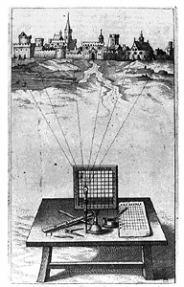
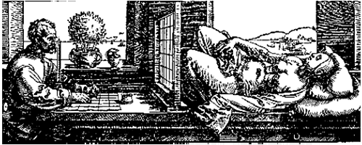
A useful parallel: Alberti’s grid
reality
Ontological
theory
representation

Slide 48
‘Ontology’
In philosophy:
  Ontology (no plural) is the study of what entities exist and how they relate to each other;
  by some philosophers taken to be synonymous with ‘metaphysics’ while others draw distinctions in many distinct ways (the distinctions being irrelevant for this talk), but almost agreeing on the following classification:
    metaphysics → studies ‘how is the world?’
      general metaphysics → studies general principles and ‘laws’ about the world
        ontology → studies what type of entities exist in the world
      special metaphysics → focuses on specific principles and entities
  distinct from ‘epistemology’ which is the study of how we can come to know about what exists.
  distinct from ‘terminology’ which is the study of what terms mean and how to name things.

Slide 49
‘Ontology’
In philosophy:
  Ontology (no plural) is the study of what entities exist and how they relate to each other;
In computer science and many biomedical informatics applications:
  An ontology (plural: ontologies) is a shared and agreed upon conceptualization of a domain;

Slide 50
Computer science approach to ontology
Ontology
Authoring Tools
create
Domain
Ontologies
Reasoners
Semantic
Applications
use

Slide 51
Computer science approach to ontology
Ontology
Authoring Tools
the logic in reasoners:
guarantees consistent reasoning,
does not guarantee the faithfulness of the representation.
create
Domain
Ontologies
Reasoners
Semantic
Applications
use

Slide 52
Philosophical approach to ontology
Ontological Realism: uses ontology as philosophical discipline to build ontologies as faithful representations of reality.

Slide 53

The basis of Ontological Realism (O.R.)
There is an external reality which is ‘objectively’ the way it is;
That reality is accessible to us;
We build in our brains cognitive representations of reality;
We communicate with others about what is there, and what we believe there is there.
Smith B, Kusnierczyk W, Schober D, Ceusters W. Towards a Reference Terminology for Ontology Research and Development in the Biomedical Domain. Proceedings of KR-MED 2006, Biomedical Ontology in Action, November 8, 2006, Baltimore MD, USA

Slide 54
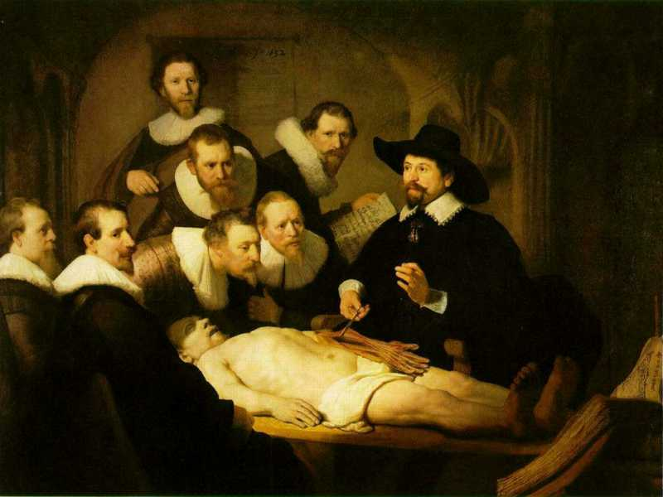
L3
Linguistic representations about (L1⁻), (L2) or (L3)
L2
Beliefs about (1)
Representations
First Order Reality
Entities (particular or generic) with objective existence which are not about anything
L1⁻

Slide 55
What is out there …
(… we want/need to deal with)?
portions of reality
relations
configurations
?
participation
me participating in my life
universals
entities
?
particulars
continuants
occurrents
me
my life
organism

Slide 56



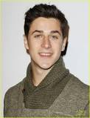
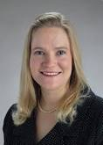
Universal versus particular
person
instance of …
particulars

Slide 57
Universal versus particular
person
image
instance of …
particulars

Slide 58
Ontological Realism in OBO Foundry ontologies
Continuant
has_participant
Occurrent
e.g. pathological
process
is_a
is_a
Independent
Continuant
e.g. organism
Dependent
Continuant
e.g. patient
role
inheres_in
instance_of
universals
.... ..... .......
particulars

Slide 59

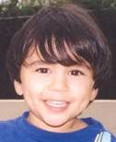


Change
child
instance of …

Slide 60
Change
child
instance of at t

Slide 61
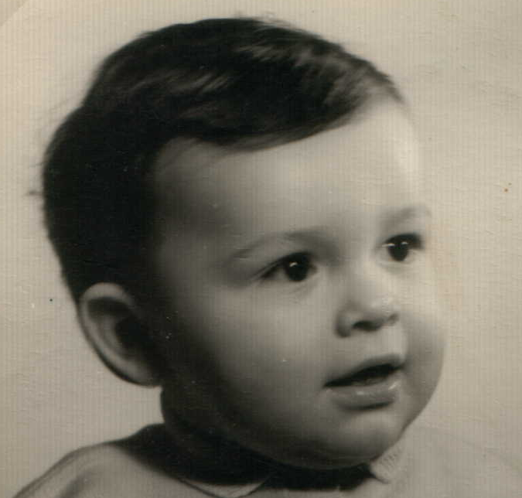



Continuants preserve identity while changing
human
being
me
me
t
Instance-of
in 1960
child
Instance-of
since 1980
adult
living
creature
animal
caterpillar
butterfly

Slide 62
Data must be unambiguous and faithful to reality …
Referents
organized in reality
References organized
in a data collection

Slide 63
The distinctions applied to diabetes management
Generic
Specific
3. Representation
‘person’
‘drug’
‘insulin’
‘W. Ceusters’
‘my sugar’
2. Beliefs (knowledge)
DIAGNOSIS
my doctor’s
work plan
my doctor’s
diagnosis
INDICATION
1.
First-order reality
PATHOLOGICAL
STRUCTURE
my doctor
my doctor’s computer
PERSON
DISEASE
me
my NIDDM
DRUG
PORTION OF
INSULIN
my blood glucose
level
MOLECULE
Basic Formal Ontology
Referent Tracking

Slide 64
Coding systems used naively preserve certain ambiguities
PtID
Date
ObsCode
Narrative
5572
04/07/1990
26442006
closed fracture of shaft of femur
5572
04/07/1990
81134009
Fracture, closed, spiral
5572
12/07/1990
26442006
closed fracture of shaft of femur
5572
12/07/1990
9001224
Accident in public building (supermarket)
5572
04/07/1990
79001
Essential hypertension
0939
24/12/1991
255174002
benign polyp of biliary tract
2309
21/03/1992
26442006
closed fracture of shaft of femur
2309
21/03/1992
9001224
Accident in public building (supermarket)
47804
03/04/1993
58298795
Other lesion on other specified region
5572
17/05/1993
79001
Essential hypertension
298
22/08/1993
2909872
Closed fracture of radial head
298
22/08/1993
9001224
Accident in public building (supermarket)
5572
01/04/1997
26442006
closed fracture of shaft of femur
5572
01/04/1997
79001
Essential hypertension
0939
20/12/1998
255087006
malignant polyp of biliary tract

Slide 65
Codes for ‘types’ AND identifiers for instances
PtID
Date
ObsCode
Narrative
5572
04/07/1990
26442006
IUI-001
closed fracture of shaft of femur
5572
04/07/1990
81134009
IUI-001
Fracture, closed, spiral
5572
12/07/1990
26442006
IUI-001
closed fracture of shaft of femur
5572
12/07/1990
9001224
IUI-007
Accident in public building (supermarket)
5572
04/07/1990
79001
IUI-005
Essential hypertension
0939
24/12/1991
255174002
IUI-004
benign polyp of biliary tract
2309
21/03/1992
26442006
IUI-002
closed fracture of shaft of femur
2309
21/03/1992
9001224
IUI-007
Accident in public building (supermarket)
47804
03/04/1993
58298795
IUI-006
Other lesion on other specified region
5572
17/05/1993
79001
IUI-005
Essential hypertension
298
22/08/1993
2909872
IUI-003
Closed fracture of radial head
298
22/08/1993
9001224
IUI-007
Accident in public building (supermarket)
5572
01/04/1997
26442006
IUI-012
closed fracture of shaft of femur
5572
01/04/1997
79001
7 distinct disorders
IUI-005
Essential hypertension
0939
20/12/1998
255087006
IUI-004
malignant polyp of biliary tract

Slide 66
Take home messages
Statements, even scientific jargon, as well as data collections can make sense and be about something, without each part thereof making sense or being about something.
  (a + b)² = a² + 2ab + b² is true whatever a and b are,
  c² = a² + b² is sometimes true, for instance if a, b, and c are the lengths of certain sides of a rectangular triangle.
For data collections to be interpretable and comparable, each part of it needs to be documented as to what it intends to denote.
Ontological Realism is a method to achieve this.

