Slide 1

Referent Tracking:
Use of Ontologies in Tracking Systems
Guest Lecture for Ontological Engineering
September 22, 2014 - 322 Clemens, UB North Campus, Buffalo, NY
Department of Industrial and Systems Engineering: IE 500 (Section 001) - #12656
Department of Computer Science and Engineering: CSE 510 - #23684
Department of Philosophy: PHI 598 - #22690
Werner CEUSTERS, MD
Professor, Department of Biomedical Informatics, University at Buffalo
Director, National Center for Ontological Research
Director of Research, UB Institute for Healthcare Informatics

Slide 2
Referent Tracking:
Use of Ontologies in Tracking Systems
Part 1
Basics of Referent Tracking

Slide 3
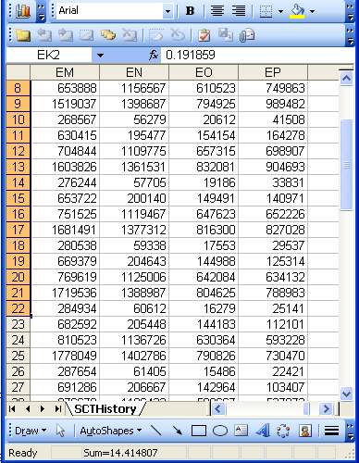
The focus on (big) data …

Slide 4
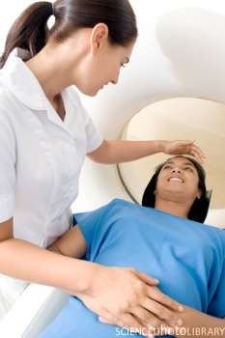
… makes one forget what data – ideally – are about
Referents
References

Slide 5
A non-trivial relation
Referents
References

Slide 6

For instance: source and impact of changes
Are differences in data about the same entities in reality at different points in time due to:
  changes in first-order reality ?
  changes in our understanding of reality ?
  inaccurate observations ?
  differences in perspectives ?
  registration mistakes ?
Ceusters W, Smith B. A Realism-Based Approach to the Evolution of Biomedical Ontologies. AMIA 2006 Proceedings, Washington DC, 2006;:121-125. http://www.referent-tracking.com/RTU/sendfile/?file=CeustersAMIA2006FINAL.pdf

Slide 7
What makes it non-trivial?
Referents
  are (meta-) physically the way they are,
  relate to each other in an objective way,
  follow ‘laws of nature’.
Window on reality
  restricted by:
  what is physically and technically observable,
  fit between what is measured and what we think is measured,
  fit between established knowledge and ‘laws of nature’.
References
  follow, ideally, the syntactic-semantic conventions of some representation language,
  are restricted by the expressivity of that language,
  reference collections need to come, for correct interpretation, with documentation outside the representation.
L1: what is real L2: beliefs L3: representations

Slide 8
Two sorts of referents: ‘generic’ and ‘specific’
Generic
Specific
L3. Representation
pain classification
EHR
ICHD
my EHR
humans are vertebrates
my doctor manages my EHR
DIAGNOSIS
L2. Beliefs
my doctor’s
work plan
my doctor’s
diagnosis
INDICATION
L1⁻.
Non-representational first-order reality
my doctor
my doctor’s computer
DISORDER
PERSON
me
DRUG
DISEASE
my migraine
PAIN
my headache
MIGRAINE
HEADACHE

Slide 9

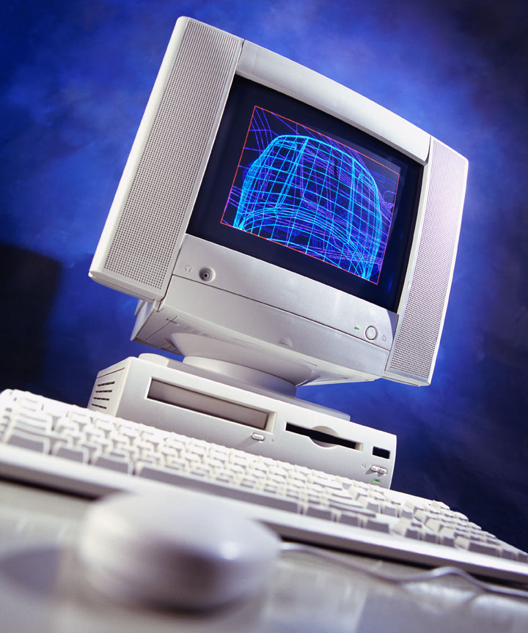
Ultimate goal of Referent Tracking
A digital copy of the world

Slide 10
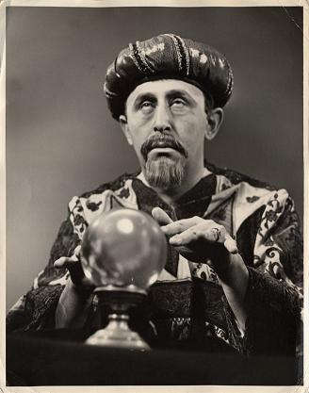

In fact … the ultimate crystal ball

Slide 11


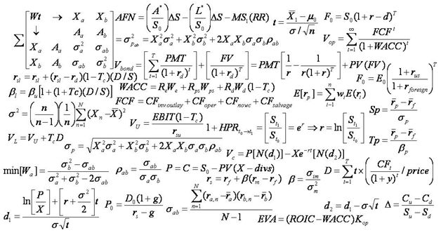
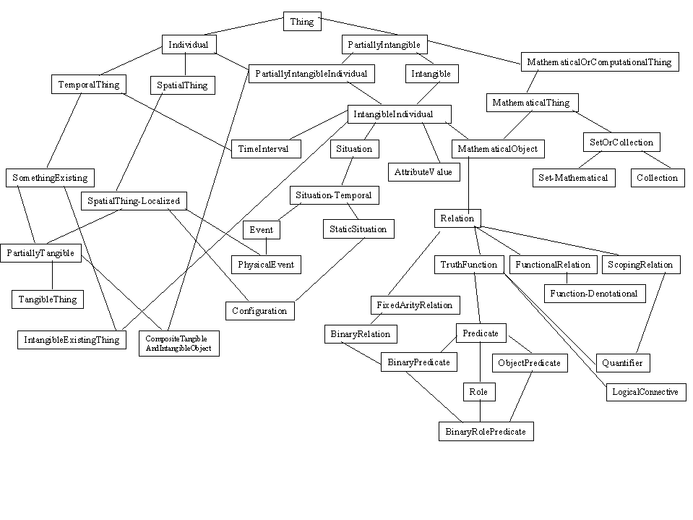
Two major representational components
formulae representing ‘laws of nature’
symbols denoting what these ‘laws’ govern

Slide 12
Representations mimicking reality
→ The Time Lords’ Matrix on the planet Gallifrey (Dr. Who, 1976)

Slide 13


Major problem: the ‘binding’ wall
How to do it right ?
gives you a cartoon of the world

Slide 14
Requirements for this digital copy
R1: A faithful representation of reality
R2 … of everything that is digitally registered,
        what is generic → scientific theories
        what is specific → what individual entities exist and how they relate ontologically rather than statistically
R3: … throughout reality’s entire history,
R4 … which is computable in order to …
        … allow queries over the world’s past and present,
        … make predictions,
        … fill in gaps,
        … identify mistakes,
        … understand ‘the why’ about realities
        ...

Slide 15
What is out there …
(… we want/need to deal with)?
portions of reality
relations
configurations
?
participation
me participating in my life
universals
entities
?
particulars
continuants
occurrents
me
my life
organism

Slide 16
A faithful representation of reality through BFO
dependent continuant
material
object
spacetime
region
spatial
region
temporal
region
history
t
t
instanceOf
t
participantOf at t
occupies
some temporal region
some quality
my life
my 4D STR
projectsOn
me
… at t
projectsOn at t
some spatial
region
located-in at t
BFO = Basic Formal Ontology

Slide 17
BFO is adequate for R1 … R3
Generic entities
Particulars
Time indexing

Slide 18
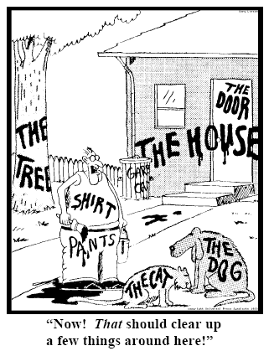
Representing specific entities
explicit reference to the individual entities relevant to the accurate description of some portion of reality, ...
Ceusters W, Smith B. Strategies for Referent Tracking in Electronic Health Records. J Biomed Inform. 2006 Jun;39(3):362-78.

Slide 19
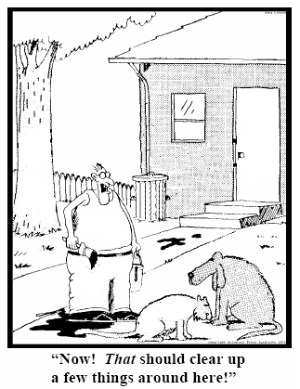
Method: IUI assignment
  Introduce an Instance Unique Identifier (IUI) for each relevant particular (individual) entity
78
235
5678
321
322
666
427
Ceusters W, Smith B. Strategies for Referent Tracking in Electronic Health Records. J Biomed Inform. 2006 Jun;39(3):362-78.

Slide 20
Referent Tracking System Components
Referent Tracking Software
    Manipulation of statements about facts and beliefs
Referent Tracking Datastore:
    IUI repository
    A collection of globally unique singular identifiers denoting particulars
    Referent Tracking Database
    A collection of facts and beliefs about the particulars denoted in the IUI repository
Manzoor S, Ceusters W, Rudnicki R. Implementation of a Referent Tracking System. International Journal of Healthcare Information Systems and Informatics 2007;2(4):41-58.

Slide 21
Key mechanism: IUI assignment
= an act carried out by the first ‘cognitive agent’ feeling the need to acknowledge the existence of a particular it has information about by labelling it with a universally unique singular identifier.
‘cognitive agent’:
  A person;
  An organisation;
  A device or software agent, e.g.
    Bank note printer,
    Image analysis software.

Slide 22
Criteria for IUI assignment (1)
The particular’s existence must be determined:
  Easy for persons in front of you, tools, ...
  Easy for ‘planned acts’: they do not exist before the plan is executed !
    Only the plan exists and possibly the statements made about the future execution of the plan
  More difficult: a subject’s intensions, emotions
    But the statements observers make about them do exist !
  However:
    no need to know what the particular exactly is, i.e. which universal it instantiates
    No need to be able to point to it precisely
      A member of a specific organization
      But: this is not a matter of choice, not ‘any’ out of ...

Slide 23
Criteria for IUI assignment (2)
The particular’s existence ‘may not already have been determined as the existence of something else’:
    Morning star and evening star / Himalaya
    ➔ 2 observers not knowing they observed the same thing
May not have already been assigned a IUI.
It must be relevant to do so:
    Personal decision, (scientific) community guideline, ...
    Possibilities offered by the annotation system
    If a IUI has been assigned by somebody, everybody else making statements about the particular should use it

Slide 24
Assertion of assignments
IUI assignment is an act of which the execution has to be asserted in the IUI-repository:
  <d_{a}, A_{i}, t_{d}>
    d_{a} IUI of the registering agent
    A_{i} the assertion of the assignment <p_{a}, p_{p}, t_{ap}>
        p_{a} IUI of the author of the assertion
        p_{p} IUI of the particular
        t_{ap} time of the assignment
    t_{d} time of registering A_{i} in the IUI-repository
Neither t_{d} or t_{ap} give any information about when #p_{p} started to exist ! That might be asserted in statements providing information about #p_{p} .

Slide 25
Referent Tracking assertions
Use these identifiers in expressions using a language that acknowledges the structure of reality:
e.g.: a yellow ball:
then not : yellow(#1) and ball(#1)
rather: #1: the ball #2: #1’s yellow
Then still not:
  ball(#1) and yellow(#2) and hascolor(#1, #2)
  but rather:
  instance-of(#1, ball, since t1)
  instance-of(#2, yellow, since t2)
  inheres-in(#1, #2, since t2)

Slide 26
The shift envisioned
From:
  ‘a guy accepts a phone from somebody in a red car’
To (very roughly):
  ‘this-1, which is in this-2 in which inheres this-3, and this-4 are agents in this-5 in which participates this-6’, where
    this-1 instanceOf human being …
    this-2 instanceOf car …
    this-3 qualityOf this-2 …
    this-3 instanceOf red …
    this-1 containedIn this-2 …
    this-4 instanceOf human being …
    this-5 instanceOf transfer-of-possession …
    this-1 agentOf this-5 …
    this-4 agentOf this-5 …
    …

Slide 27
The shift envisioned
From:
  ‘a guy accepts a phone from somebody in a red car’
To (very roughly):
  ‘this-1, which is in this-2 in which inheres this-3, and this-4 are agents in this-5 in which participates this-6’, where
    this-1 instanceOf human being …
    this-2 instanceOf car …
    this-3 qualityOf this-2 …
    this-3 instanceOf red …
    this-1 containedIn this-2 …
    this-4 instanceOf human being …
    this-5 instanceOf transfer-of-possession …
    this-1 agentOf this-5 …
    this-4 agentOf this-5 …
    …
denotators for particulars

Slide 28
The shift envisioned
From:
  ‘a guy accepts a phone from somebody in a red car’
To (very roughly):
  ‘this-1, which is in this-2 in which inheres this-3, and this-4 are agents in this-5 in which participates this-6’, where
    this-1 instanceOf human being …
    this-2 instanceOf car …
    this-3 qualityOf this-2 …
    this-3 instanceOf red …
    this-1 containedIn this-2 …
    this-4 instanceOf human being …
    this-5 instanceOf transfer-of-possession …
    this-1 agentOf this-5 …
    this-4 agentOf this-5 …
    …
denotators for appropriate relations

Slide 29
The shift envisioned
From:
  ‘a guy accepts a phone from somebody in a red car’
To (very roughly):
  ‘this-1, which is in this-2 in which inheres this-3, and this-4 are agents in this-5 in which participates this-6’, where
    this-1 instanceOf human being …
    this-2 instanceOf car …
    this-3 qualityOf this-2 …
    this-3 instanceOf red …
    this-1 containedIn this-2 …
    this-4 instanceOf human being …
    this-5 instanceOf transfer-of-possession …
    this-1 agentOf this-5 …
    this-4 agentOf this-5 …
    …
denotators for universals or particulars

Slide 30
The shift envisioned
From:
  ‘a guy accepts a phone from somebody in a red car’
To (very roughly):
  ‘this-1, which is in this-2 in which inheres this-3, and this-4 are agents in this-5 in which participates this-6’, where
    this-1 instanceOf human being …
    this-2 instanceOf car …
    this-3 qualityOf this-2 …
    this-3 instanceOf red …
    this-1 containedIn this-2 …
    this-4 instanceOf human being …
    this-5 instanceOf transfer-of-possession …
    this-1 agentOf this-5 …
    this-4 agentOf this-5 …
    …
time stamp in
case of continuants

Slide 31
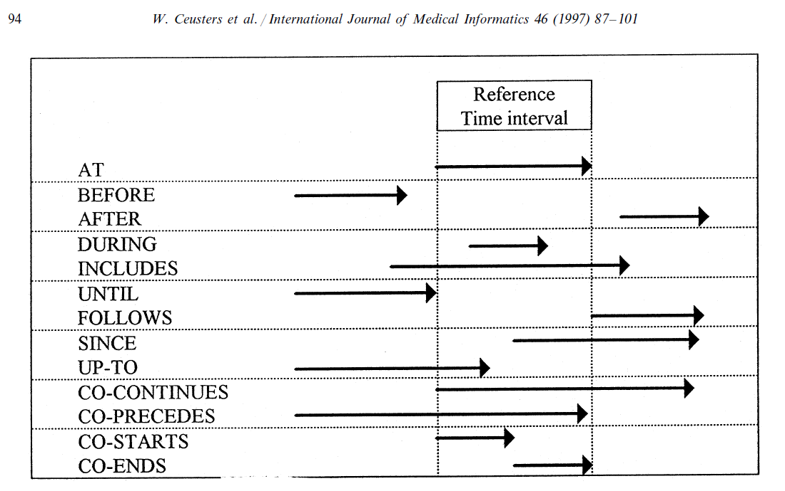
Representation of relation with time intervals

Slide 32
Elementary Referent Tracking tuple types
Relationships between particulars taken from a realism-based relation ontology
Instantiation of a universal
Annotation using terms from a non-realist terminology
‘Negative findings’ such as absences, missing parts, preventions, …
Names for a particular

Slide 33
Dealing with mistakes
This change involves RTS entries becoming assigned IUIs of their own which in the restructured D-template is symbolized by IUITi.
Di = <IUId, IUITi, t, E, C, S>.
  IUId: the IUI of the entity annotating IUITi by means of the Di entry,
  E: either the symbol ‘I’ (for insertion) or any of the error type symbols,
  C: a symbol for the applicable reason for change
  t: the time the tuple denoted by IUITi is inserted or ‘retired’,
  S: a list of IUIs denoting the tuples, if any, that replace the retired one.

Slide 34
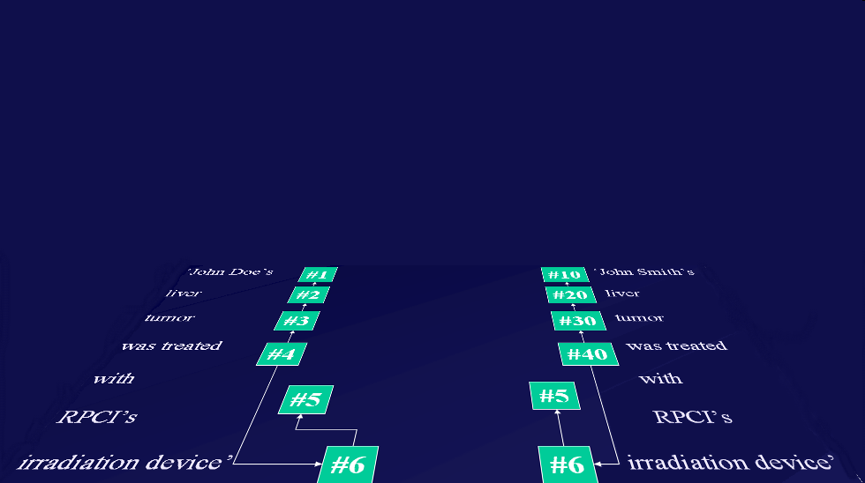
Ontology and Referent Tracking: division of labor
instance-of at t
caused
by
#105

Slide 35
Questions?

Slide 36
Referent Tracking:
Use of Ontologies in Tracking Systems
Part 2
RT and Video Surveillance

Slide 37
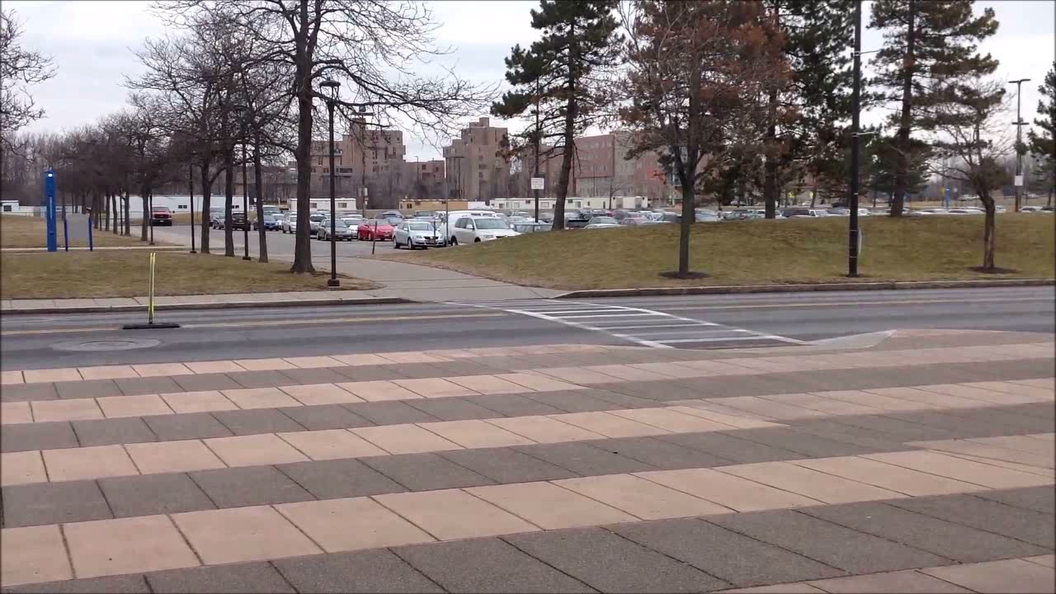
Tracking events

Slide 38
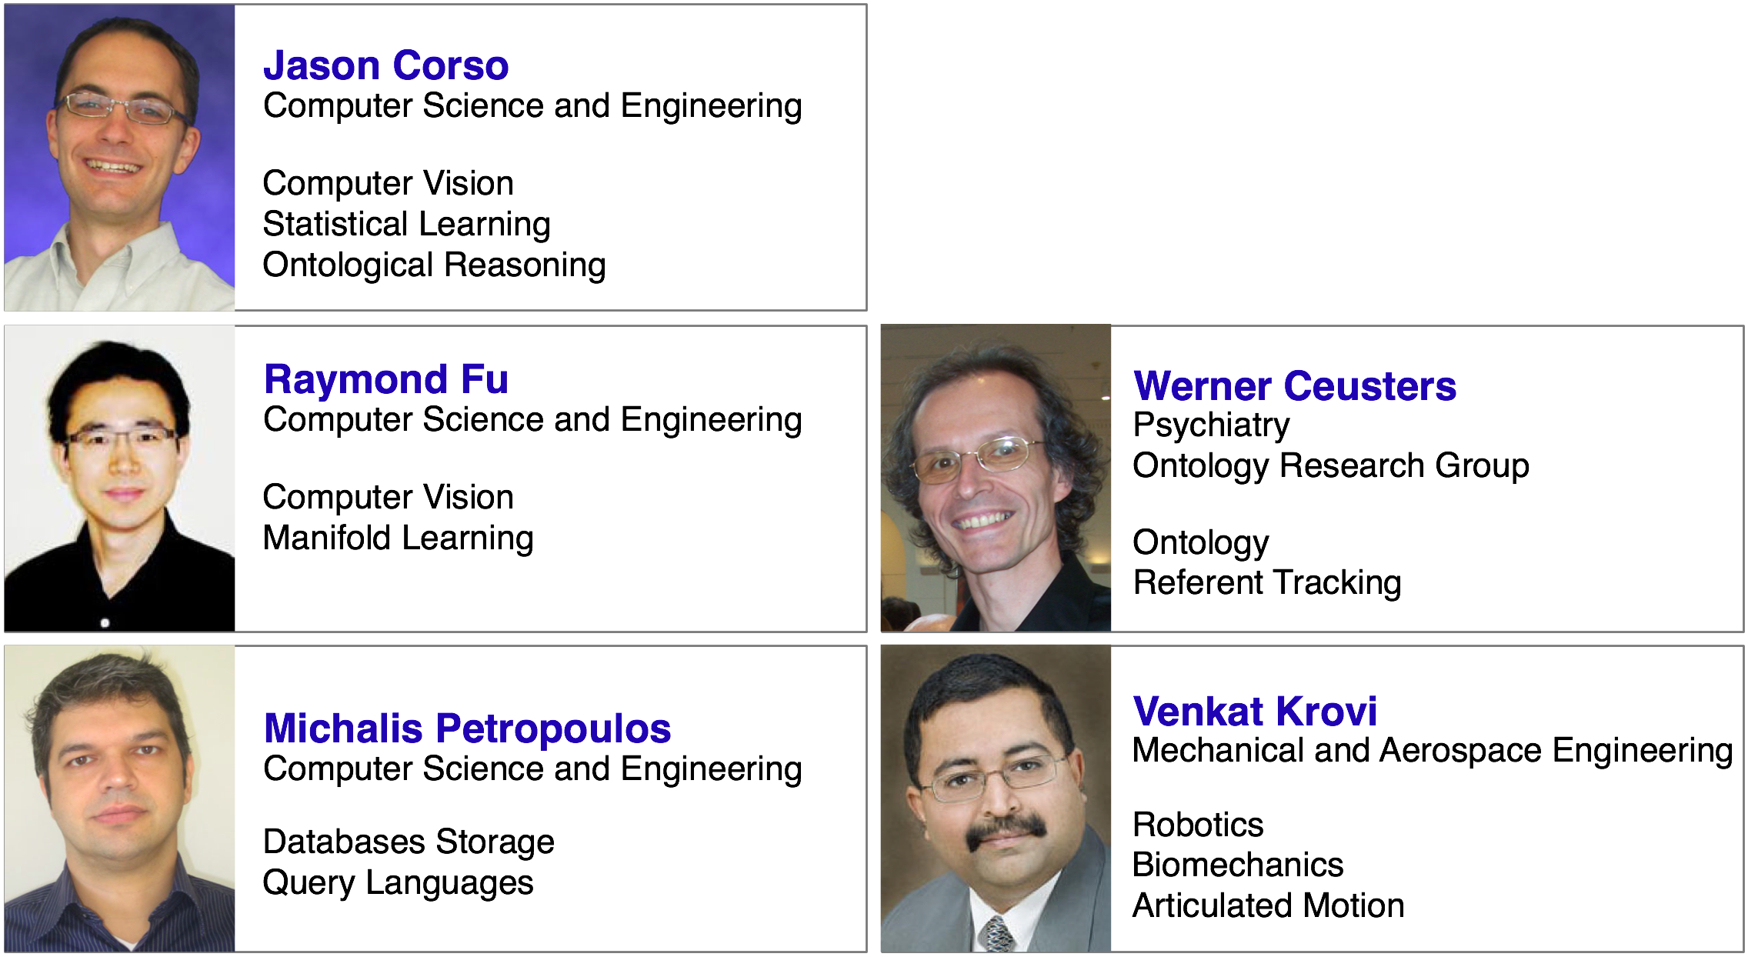
The ISTARE Team (2010)
ISTARE
Intelligent Spatiotemporal
Activity Reasoning Engine

Slide 39
DARPA’s Mind’s Eye Program (1)
Purpose: develop software for a smart camera, which is mountable on, f.i., man-portable UGVs and which exhibits capabilities necessary to perform surveillance in operational missions.
Capabilities requested:
  recognize the primitive actions that take place between objects in the visual input, with a particular emphasis on actions that are relevant in typical operational scenarios (e.g., vehicle APPROACHES checkpoint; person EXITS building).

Slide 40
DARPA’s Mind’s Eye Program (2)
Capabilities requested (continued):
  learning and cross-scene application of invariant spatio-temporal patterns,
  issuing alerts to activities of interest,
  performing interpolation to fill in likely explanations for gaps in the perceptual experience,
  explaining its reasoning by displaying relevant video segments for what has been observed, and by generating visualizations for what is hypothesized.

Slide 41
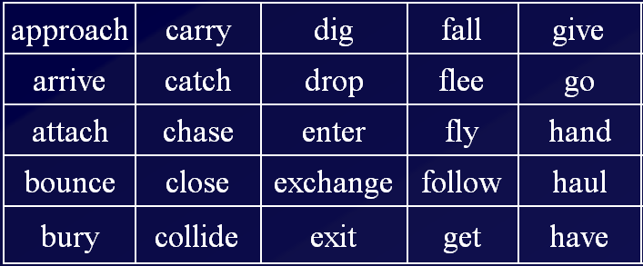
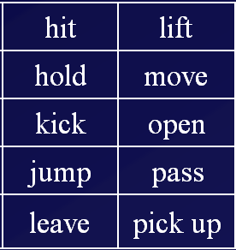
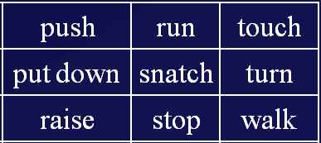
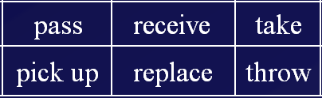
Actions of interest

Slide 42
Required ontology coverage for computer vision: reality of …
marks of interest
video files
natural language
how do human beings move
how are human beings different from animals and inanimate objects
what makes entities being of certain types
what must exist for something else to exist
what is of interest
…
what can be captured
how do actions of marks project on manifolds
in what way correspond motions of manifolds to actions of marks
what manifolds and changes correspond to marks of interest
to what extent are distinctions in marks preserved in video
…
what terms are used to denote marks and actions they engage in
how must terms be stringed together to form meaningful sentences
how to preserve perceived distinctions despite the intrinsic ambiguity of language
…

Slide 43
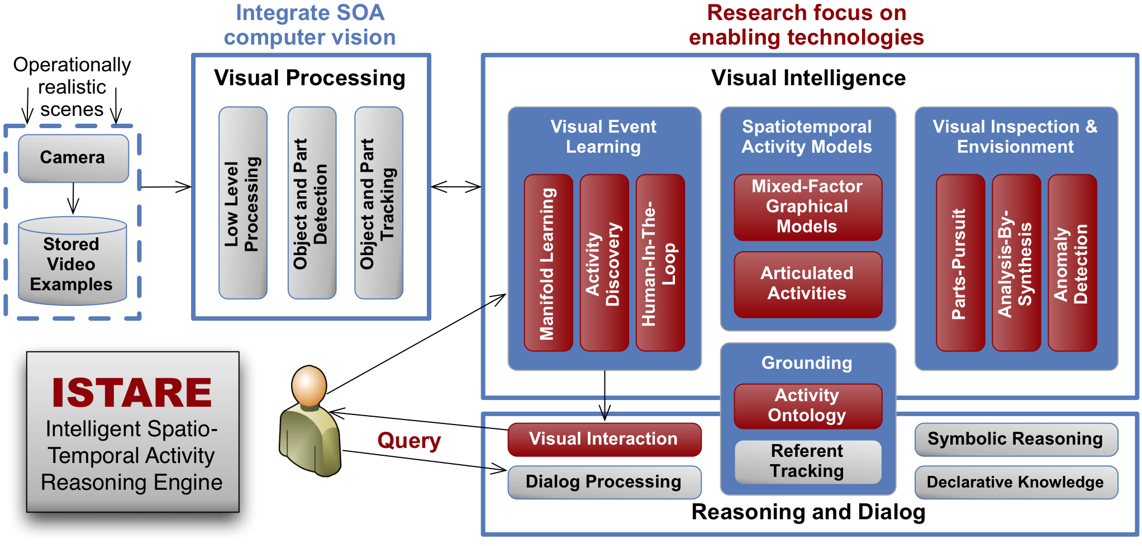
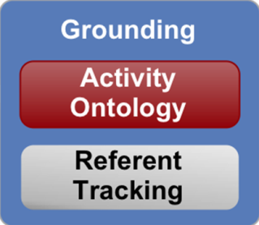
ISTARE project overview

Slide 44
ISTARE Ontology (2010 – 2011)
Roles:
  Learning: help guide a learning algorithm to remain in plausible configurations.
  Inference: support reasoning of plausible explanations of objects and activities in existing and missing parts of the signal.
Components:
  L1 ⬄ L1:
    How humans interact with objects and other humans in various scenarios.
    How motions of object-parts contribute to full object motion.
  L1 ⬄ L3:
    How manifolds in the video correspond to entities videotaped.
  L1 ⬄ L2 ⬄ L3:
    How analysts interpret videos and corresponding reality.

Slide 45
Region Connection Calculus (RCC8)
8 possible relations between regions at a time
TPP
NTPP
EQ
DC
EC
PO
TPPI
NTPPI
Randell, D., Cui, Z., Cohn, A.: A Spatial Logic based on Regions and Connection.
In: Proceedings of the International Conference on Knowledge Representation and Reasoning, pp. 165–176 (1992)

Slide 46
RCC8 reasoning
rel₁(x,y,t) Λ rel₂(y,z,t) → rel₃(x,z,t) ?
e.g. DC(x,y,t) Λ DC(y,z,t)
maintained in tables
x
x
x
x
z
x
z
z
z
z
y
y
y
y
y
…
Randell, D., Cui, Z., Cohn, A.: A Spatial Logic based on Regions and Connection.
In: Proceedings of the International Conference on Knowledge Representation and Reasoning, pp. 165–176 (1992)

Slide 47
RCC8: conceptual neighborhood
If rel₁ at t₁, what possible relations at t₂ ?
TPP
NTPP
EQ
DC
EC
PO
TPPI
NTPPI
Randell, D., Cui, Z., Cohn, A.: A Spatial Logic based on Regions and Connection.
In: Proceedings of the International Conference on Knowledge Representation and Reasoning, pp. 165–176 (1992)

Slide 48
Basic ‘Motion Classes’
Ends
DC
EC
PO
TPP
NTPP
EQ
TPPI
NTPPI
Starts
DC
External
Hit
Reach
EC
Split
Peripheral
PO
Leave
Leave or Reach
TPP
Internal
Expand
NTPP
EQ
Shrink
Internal
TPPI
Internal
NTPPI
Zina Ibrahim, and Ahmed Y. Tawfik, An Abstract Theory and Ontology of Motion Based on the Regions Connection Calculus, Symposium of Abstraction, Reformulation and Approximation (SARA 2007), LNAI, Springer, 2007.

Slide 49
Compound motion classes
hit-split
peripheral-
reach
peripheral-leave
leave-reach
reach-leave
Zina Ibrahim, and Ahmed Y. Tawfik, An Abstract Theory and Ontology of Motion Based on the Regions Connection Calculus, Symposium of Abstraction, Reformulation and Approximation (SARA 2007), LNAI, Springer, 2007.

Slide 50
Reasoning with motion classes
mc₁(x,y,t) Λ mc₂(y,z,t) → mc₃(x,z,t) ?
e.g. leave(x,y,t) Λ leave(y,z,t)
z
y
x
internal
Zina Ibrahim, and Ahmed Y. Tawfik, An Abstract Theory and Ontology of Motion Based on the Regions Connection Calculus, Symposium of Abstraction, Reformulation and Approximation (SARA 2007), LNAI, Springer, 2007.

Slide 51
Reasoning with motion classes
mc₁(x,y,t) Λ mc₂(y,z,t) → mc₃(x,z,t) ?
e.g. leave(x,y,t) Λ leave(y,z,t)
z
y
x
external
Zina Ibrahim, and Ahmed Y. Tawfik, An Abstract Theory and Ontology of Motion Based on the Regions Connection Calculus, Symposium of Abstraction, Reformulation and Approximation (SARA 2007), LNAI, Springer, 2007.

Slide 52
Reasoning with motion classes
mc₁(x,y,t) Λ mc₂(y,z,t) → mc₃(x,z,t) ?
e.g. leave(x,y,t) Λ leave(y,z,t)
all possibilities also in tables
z
y
x
Zina Ibrahim, and Ahmed Y. Tawfik, An Abstract Theory and Ontology of Motion Based on the Regions Connection Calculus, Symposium of Abstraction, Reformulation and Approximation (SARA 2007), LNAI, Springer, 2007.

Slide 53
RCC8/MC14 and Ontological Realism
In ontological realism:
  regions don’t move
  material entities are located in regions
  while material entities move or shrink/expand:
    they are located at each t in a different region
    each such region is part of the region formed by all the regions visited, thus constituting a path
    …
An unambiguous mapping is possible

Slide 54
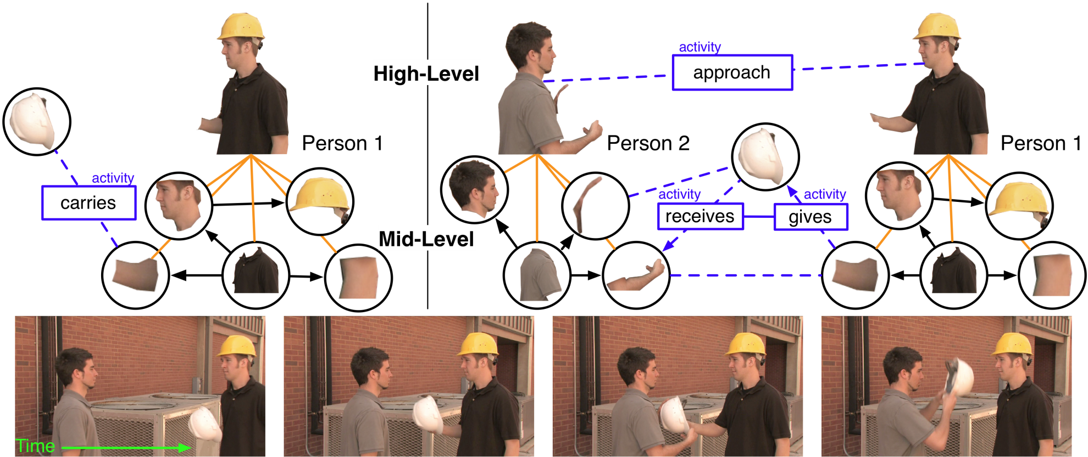
Representation of activities

Slide 55
RCC8/MC14 and action verbs
‘approach’

Slide 56
RCC8/MC14 and action verbs
‘approach’
Invariant:
  shrink of the region between the entities involved in an approach

Slide 57
RCC8/MC14 and action verbs
approach
carry
dig
fall
give
hit
lift
push
run
touch
arrive
catch
drop
flee
go
hold
move
put down
snatch
turn
attach
chase
enter
fly
hand
kick
open
raise
stop
walk
bounce
close
exchange
follow
haul
jump
pass
receive
take
bury
collide
exit
get
have
leave
pick up
replace
throw
all can be expressed in terms of mc14 (with the addition of direction and some other features)
from mc to the verbs: requires additional information on the nature of the entities involved
  to be encoded in the ontology

Slide 58
Action verbs and Ontological Realism
Many caveats:
  the way matters are expressed in natural language does not correspond faithfully with the way matters are
‘approach’
x orbiting around y
x taking distance from y ?
x approaching y ?
x taking distance from y ?
→ x’s process of orbiting didn’t change when y started to move
→ ‘to approach’ is a verb, but it does not represent a process, rather implies a process.

Slide 59
Action verbs and Ontological Realism
Approaching following a forced path

Slide 60
RCC8/MC14 & video as 2D+T representation of 3D+T
man entering building: the first-order view

Slide 61
RCC8/MC14 & video as 2D+T representation of 3D+T
man entering building: the video view

Slide 62
RCC8/MC14 & video as 2D+T representation of 3D+T
egg crashing on wall: the video view
Requires additional mapping from the motion of manifolds in the video to the corresponding motion of the corresponding entities in reality

Slide 63
Human physiology (L1)
c1 member-of Canonically-Limbed Human Being at t, then:
  sdc1 inheres-in c1 at t
  sdc1 instance-of Disposition-to-Walk at t
  sdc2 inheres-in c1 at t
  sdc2 instance-of Disposition-to-Run at t
  …
approach
carry
dig
fall
give
hit
lift
push
run
touch
arrive
catch
drop
flee
go
hold
move
put down
snatch
turn
attach
chase
enter
fly
hand
kick
open
raise
stop
walk
bounce
close
exchange
follow
haul
jump
pass
receive
take
bury
collide
exit
get
have
leave
pick up
replace
throw
impossible
under certain circumstances

Slide 64
Human physiology (L1)
o1 member-of Canonical-Human-Walking, then:
  o1 realization-of sdc1
  sdc1 instance-of Disposition-to-Walk at t
  sdc1 inheres-in c1 at t
  c1 instance-of Canonically-Limbed Human Being at t
  o1 has-agent c1 at t
  o1 has-part o2
  o2 instance-of Walking Leg Motion
  o2 has-agent c2 at t
  c2 part-of c1 at t
  c2 instance-of Left Lower Limb at t
  o3 instance-of Walking Leg Motion
  o3 has-agent c3 at t
  c3 part-of c1 at t
  c3 instance-of Right Lower Limb at t
  c1 located-in r1 at t0
  t0 earlier t
  c1 located-in r2 at t1
  t earlier t1
  …
But: elliptical work-out, walking in circle, …

Slide 65
Elements of ontology-based reasoning
Projection of RCC and MCC in L3 to portions of reality in L1:
  EC → adjacent-to
  shrink → shrinking
  → moving away from camera
  hit → approach in front or behind object
  hit < shrink → ‘shrinking’ object passed behind
  …
Human in the loop

Slide 66
IF: input(rel3(p(0), instanceOf, canonicalHumanWalking))
entity(p(0), hasExistencePeriod, p(1))
entity(p(1), hasFirstInstant, p(2))
entity(p(1), hasLastInstant, p(3))
entity(p(0), hasFourDregion, p(4))
entity(p(0), isAlong, p(5))
entity(p(0), hasAgent, p(6))
entity(p(6), hasHistory, p(7))
entity(p(7), hasFourDregion, p(8))
entity(p(6), hasExistencePeriod, p(9))
entity(p(7), hasExistencePeriod, p(10))
entity(p(10), hasFirstInstant, p(11))
entity(p(10), hasLastInstant, p(12))
entity(p(6), hasShape, p(13))
entity(p(6), hasLeftLowerLimb, p(14))
entity(p(6), hasRightLowerLimb, p(15))
entity(p(0), firstFullCanonicalHumanWalkingSwing, p(16))
entity(p(16), hasExistencePeriod, p(17))
entity(p(17), hasFirstInstant, p(18))
entity(p(17), hasLastInstant, p(19))
entity(p(16), hasFourDregion, p(20))
entity(p(15), hasHistory, p(21))
entity(p(21), hasFourDregion, p(22))
entity(p(15), hasExistencePeriod, p(23))
entity(p(21), hasExistencePeriod, p(24))
entity(p(24), hasFirstInstant, p(25))
entity(p(24), hasLastInstant, p(26))
entity(p(15), hasShape, p(27))
entity(p(14), hasHistory, p(28))
entity(p(28), hasFourDregion, p(29))
entity(p(14), hasExistencePeriod, p(30))
entity(p(28), hasExistencePeriod, p(31))
entity(p(31), hasFirstInstant, p(32))
entity(p(31), hasLastInstant, p(33))
entity(p(14), hasShape, p(34))
entity(p(6), hasLife, p(35))
→ at least 35 other particulars must exist

Slide 67
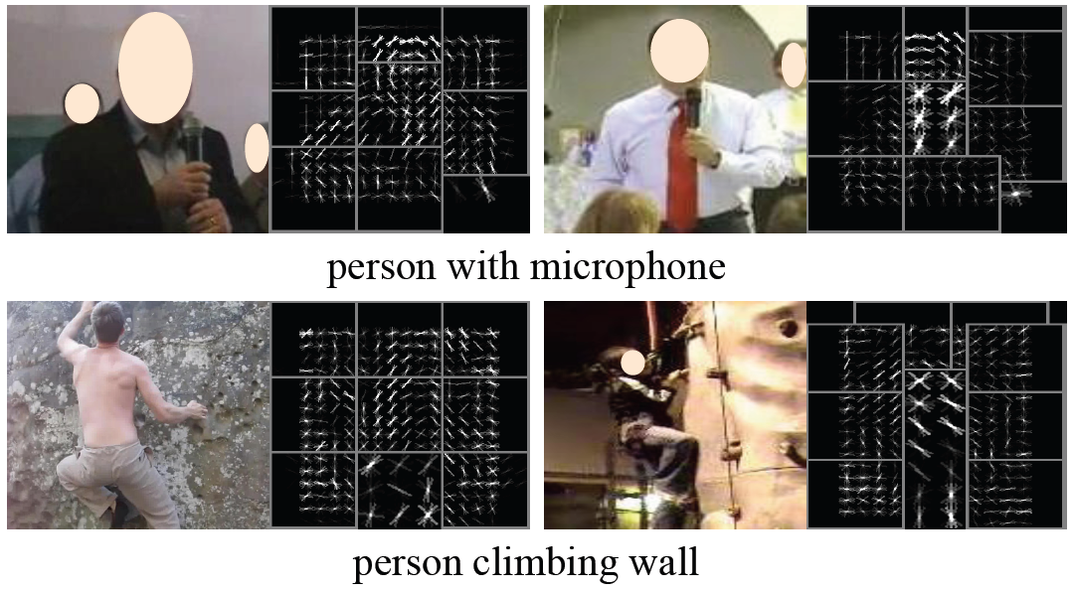
Short-cuts: aggregate detection
P. Das, C. Xu, R. F. Doell, and J. J. Corso,
“A thousand frames in just a few words: Lingual description of videos through latent topics and sparse object stitching,”
in Proceedings of IEEE Conference on Computer Vision and Pattern Recognition, 2013.

Slide 68

UB Vision Lab’s VOICE system (2013)
P. Das, C. Xu, R. F. Doell, and J. J. Corso,
“A thousand frames in just a few words: Lingual description of videos through latent topics and sparse object stitching,”
in Proceedings of IEEE Conference on Computer Vision and Pattern Recognition, 2013.

Slide 69
Questions?

Slide 70
Referent Tracking:
Use of Ontologies in Tracking Systems
Part 3
RT and Data descriptions

Slide 71
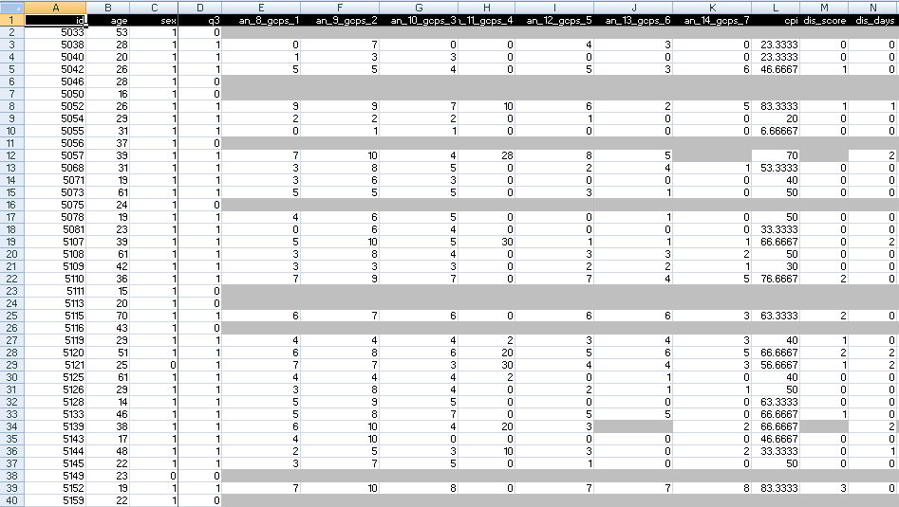
A colleague shares his research data set

Slide 72
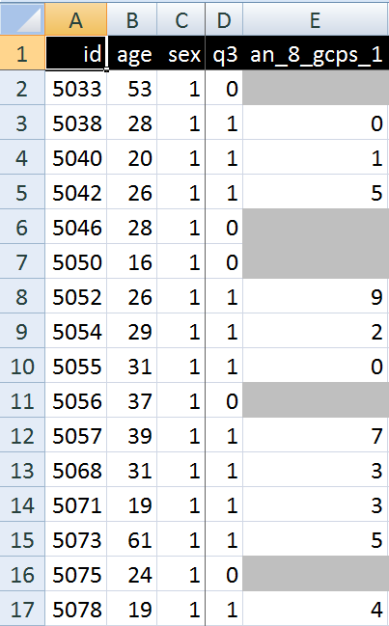
A closer look
What are you going to ask him right away?
What do these various values stand for and how do they relate to each other?
  Might this mean that patient #5057 had only once sex at the age of 39?

Slide 73
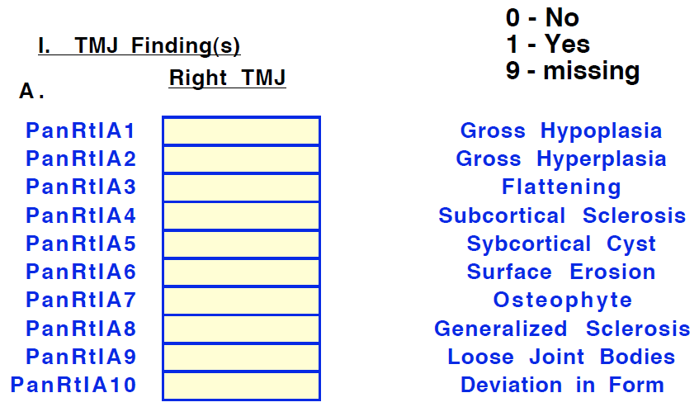
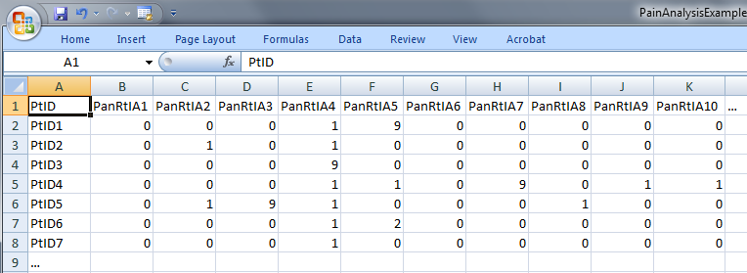
Step 1: ‘meaning’ of values in data collections
‘The patient with patient identifier ‘PtID4’ is stated to have had a panoramic X-ray of the mouth which is interpreted to show subcortical sclerosis of that patient’s condylar head of the right temporomandibular joint’
meaning
1

Slide 74
Step 2 (1): list the entities denoted
1(The patient) with 2(patient identifier ‘PtID4’) 3(is stated) 4(to have had) a 5(panoramic X-ray) of 6(the mouth) which 7(is interpreted) to 8(show) 9(subcortical sclerosis of 10(that patient’s condylar head of the 11(right temporomandibular joint)))’
CLASS | INSTANCE IDENTIFIER
person | IUI-1
patient identifier | IUI-2
assertion | IUI-3
technically investigating | IUI-4
panoramic X-ray | IUI-5
mouth | IUI-6
interpreting | IUI-7
seeing | IUI-8
diagnosis | IUI-9
condylar head of right TMJ | IUI-10
right TMJ | IUI-11
notes: colors have no meaning here, just provide easy reference,
this first list can be different, any such differences being resolved in step 3

Slide 75
Step 2 (2): provide directly referential descriptions
CLASS | INSTANCE IDENTIFIER | DIRECTLY REFERENTIAL DESCRIPTIONS
person | IUI-1 | the person to whom IUI-2 is assigned
patient identifier | IUI-2 | the patient identifier of IUI-1
assertion | IUI-3 | 'the patient with patient identifier PtID4 has had a panoramic X-ray of the mouth which is interpreted to show subcortical sclerosis of that patient’s right temporomandibular joint'
technically investigating | IUI-4 | the technically investigating of IUI-6
panoramic X-ray | IUI-5 | the panoramic X-ray that resulted from IUI-4
mouth | IUI-6 | the mouth of IUI-1
interpreting | IUI-7 | the interpreting of the signs exhibited by IUI-5
seeing | IUI-8 | the seeing of IUI-5 which led to IUI-7
diagnosis | IUI-9 | the diagnosis expressed by means of IUI-3
condylar head of right TMJ | IUI-10 | the condylar head of the right TMJ of IUI-1
right TMJ | IUI-11 | the right TMJ of IUI-1

Slide 76
Step 3: identify further entities that ontologically must exist for each entity under scrutiny to exist.
assigner role | IUI-12 | the assigner role played by the entity while it performed IUI-21
assigning | IUI-21 | the assigning of IUI-2 to IUI-1 by the entity with role IUI-12
asserting | IUI-20 | the asserting of IUI-3 by the entity with asserter role IUI-13
asserter role | IUI-13 | the asserter role played by the entity while it performed IUI-20
investigator role | IUI-14 | the investigator role played by the entity while it performed IUI-4
panoramic X-ray machine | IUI-15 | the panoramic X-ray machine used for performing IUI-4
image bearer | IUI-16 | the image bearer in which IUI-5 is concretized and that participated in IUI-8
interpreter role | IUI-17 | the interpreter role played by the entity while it performed IUI-7
perceptor role | IUI-18 | the perceptor role played by the entity while it performed IUI-8
diagnostic criteria | IUI-19 | the diagnostic criteria used by the entity that performed IUI-7 to come to IUI-9
study subject role | IUI-22 | the study subject role which inheres in IUI-1

Slide 77
Step 3: some remarks
interpreter role, perceptor role, …
  reference to roles rather than the entity in which the roles inhere because it may be the same entity and one should not assign several IUIs to the same entity
each description follows similar principles as Aristotelian definitions but is about particulars rather than universals

Slide 78
Step 4: classify all entities in terms of realism-based ontologies
CLASS | HIGHER CLASS
person | BFO: Object
patient identifier | IAO: Information Content Entity
assertion | IAO: Information Content Entity
technically investigating | OBI: Assay
panoramic X-ray | IAO: Image
mouth | FMA: Mouth
interpreting | MFO: Assessing
seeing | BFO: Process
diagnosis | IAO: Information Content Entity
condylar head of right TMJ | FMA: Right condylar process of mandible
right TMJ | FMA: Right temporomandibular joint
assigner role | BFO: Role
assigning | BFO: Process
study subject role | OBI: Study subject role
requires more ontological and philosophical skills than domain expertise or expertise with Protégé,
not just term matching

Slide 79
Step 5: specify relationships between these entities
For instance:
  at least during the taking of the X-ray the study subject role inheres in the patient being investigated:
    IUI-23 inheres-in IUI-1 during t1
  the patient participates at that time in the investigation
    IUI-4 has-participant IUI-1 during t1
These relations need to follow the principles of the Relation Ontology.
Smith B, Ceusters W, Klagges B, Koehler J, Kumar A, Lomax J, Mungall C, Neuhaus F, Rector A, Rosse C. Relations in biomedical ontologies, Genome Biology 2005, 6:R46.

Slide 80
Step 6: outline all possible configurations of such entities for the sentence to be true (a one semester course on its own)
Such outlines are collections of relational expressions of the sort just described,
Variant configurations for the example:
  perceptor and interpreter are the same or distinct human beings,
  the X-ray machine is unreliable and produced artifacts which the interpreter thought to be signs motivating his diagnosis, while the patient has indeed the disorder specified by the diagnosis (the clinician was lucky)
  …

Slide 81
Methodology (2): for each dataset
Build a formal template which describes:
  the results of steps 4-6 of the 1st order analysis,
  the relationships between:
    the 1st order entities and the corresponding data items in the data set,
    data items themselves.
Build a prototype able to generate on the basis of the template for each subject (patient) in the dataset an RT-compatible representation of his 1st and 2nd order entities.

Slide 82
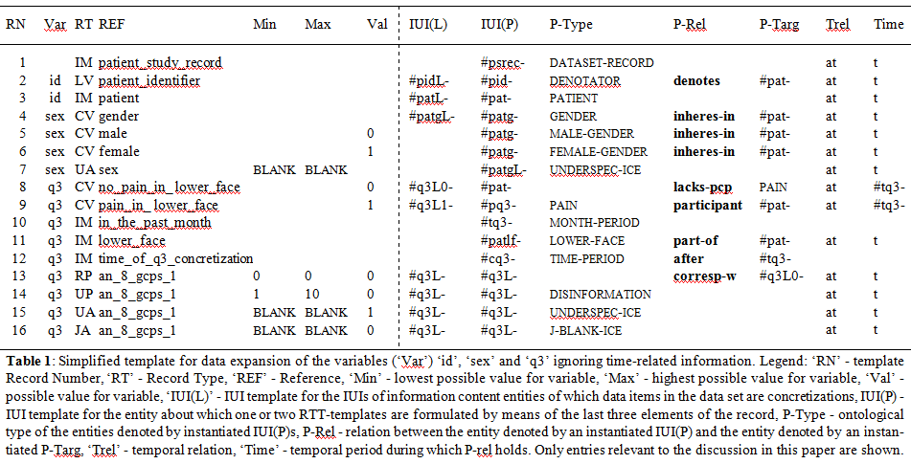
The template

Slide 83
Partial Template for 3 variables (in the ‘German’ dataset)
RN | Var | RT | REF | Min | Max | Val
1 |  | IM | patient_study_record
2 | id | LV | patient_identifier
3 | id | IM | patient
4 | sex | CV | gender
5 | sex | CV | male |  |  | 0
6 | sex | CV | female |  |  | 1
7 | sex | UA | sex | BLANK | BLANK
8 | q3 | CV | no_pain_in_ lower_face |  |  | 0
9 | q3 | CV | pain_in_ lower_face |  |  | 1
10 | q3 | IM | in_the_past_month
11 | q3 | IM | lower_face
12 | q3 | IM | time_of_q3_concretization
13 | q3 | RP | an_8_gcps_1 | 0 | 0 | 0
14 | q3 | UP | an_8_gcps_1 | 1 | 10 | 0
15 | q3 | UA | an_8_gcps_1 | BLANK | BLANK | 1
16 | q3 | JA | an_8_gcps_1 | BLANK | BLANK | 0

Slide 84
3 variables in the ‘German’ dataset
RN | Var | RT | REF | Min | Max | Val
1 |  | IM | patient_study_record
2 | id | LV | patient_identifier
3 | id | IM | patient
4 | sex | CV | gender
5 | sex | CV | male |  |  | 0
6 | sex | CV | female |  |  | 1
7 | sex | UA | sex | BLANK | BLANK
8 | q3 | CV | no_pain_in_ lower_face |  |  | 0
9 | q3 | CV | pain_in_ lower_face |  |  | 1
10 | q3 | IM | in_the_past_month
11 | q3 | IM | lower_face
12 | q3 | IM | time_of_q3_concretization
13 | q3 | RP | an_8_gcps_1 | 0 | 0 | 0
14 | q3 | UP | an_8_gcps_1 | 1 | 10 | 0
15 | q3 | UA | an_8_gcps_1 | BLANK | BLANK | 1
16 | q3 | JA | an_8_gcps_1 | BLANK | BLANK | 0
Answer to the question: ‘Have you had pain in the face, jaw, temple, in front of the ear or in the ear in the past month?’
Answer to the question: ‘’ How would you rate your facial pain on a 0 to 10 scale at the present time, that is right now, where 0 is "no pain" and 10 is "pain as bad as could be"?

Slide 85
Record Types in the template
RN | Var | RT | REF | Min | Max | Val
1 |  | IM | patient_study_record
2 | id | LV | patient_identifier
3 | id | IM | patient
4 | sex | CV | gender
5 | sex | CV | male |  |  | 0
6 | sex | CV | female |  |  | 1
7 | sex | UA | sex | BLANK | BLANK
8 | q3 | CV | no_pain_in_ lower_face |  |  | 0
9 | q3 | CV | pain_in_ lower_face |  |  | 1
10 | q3 | IM | in_the_past_month
11 | q3 | IM | lower_face
12 | q3 | IM | time_of_q3_concretization
13 | q3 | RP | an_8_gcps_1 | 0 | 0 | 0
14 | q3 | UP | an_8_gcps_1 | 1 | 10 | 0
15 | q3 | UA | an_8_gcps_1 | BLANK | BLANK | 1
16 | q3 | JA | an_8_gcps_1 | BLANK | BLANK | 0
LV: Literal value
CV: Coded Value
IM: Implicit
JA: Justified Absence
UA: Unjustified Absence
UP: Unjustified Presence
RP: Redundant Presence

Slide 86
Condition-based xA/xP determination
RN | Var | RT | REF | Min | Max | Val
7 | sex | UA | sex | BLANK | BLANK
13 | q3 | RP | an_8_gcps_1 | 0 | 0 | 0
14 | q3 | UP | an_8_gcps_1 | 1 | 10 | 0
15 | q3 | UA | an_8_gcps_1 | BLANK | BLANK | 1
16 | q3 | JA | an_8_gcps_1 | BLANK | BLANK | 0
If
the value of REF is either outside the range of Min/Max or ‘BLANK’
and
the value for Var is as indicated by Val, including no value at all,
then
the presence or absence of the corresponding data item is of a sort indicated by RT.

Slide 87
Conditional selection of descriptions

Slide 88
RT compatible part of the template
RN | IUI(L) | IUI(P) | P-Type | P-Rel | P-Targ | Trel | Time
1 |  | #psrec- | dataset-record |  |  | at | t
2 | #pidL- | #pid- | denotator | denotes | #pat- | at | t
3 | #patL- | #pat- | patient |  |  | at | t
4 | #patgL- | #patg- | gender | inheres-in | #pat- | at | t
5 |  | #patg- | male-gender | inheres-in | #pat- | at | t
6 |  | #patg- | female-gender | inheres-in | #pat- | at | t
7 |  | #patgL- | underspec-ice |  |  | at | t
8 | #q3L0- | #pat- |  | lacks-pcp | pain | at | #tq3-
9 | #q3L1- | #pq3- | pain | participant | #pat- | at | #tq3-
10 |  | #tq3- | month-period
11 |  | #patlf- | lower-face | part-of | #pat- | at | t
12 |  | #cq3- | time-period | after | #tq3-
13 | #q3L- | #q3L- |  | corresp-w | #q3L0- | at | t
14 | #q3L- | #q3L- | disinformation |  |  | at | t
15 | #q3L- | #q3L- | underspec-ice |  |  | at | t
16 | #q3L- | #q3L- | j-blank-ice |  |  | at | t

Slide 89
RT compatible part of the template
RN | IUI(L) | IUI(P) | P-Type | P-Rel | P-Targ | Trel | Time
1 |  | #psrec- | dataset-record |  |  | at | t
2 | #pidL- | #pid- | denotator | denotes | #pat- | at | t
3 | #patL- | #pat- | patient |  |  | at | t
4 | #patgL- | #patg- | gender | inheres-in | #pat- | at | t
5 |  | #patg- | male-gender | inheres-in | #pat- | at | t
6 |  | #patg- | female-gender | inheres-in | #pat- | at | t
7 |  | #patgL- | underspec-ice |  |  | at | t
8 | #q3L0- | #pat- |  | lacks-pcp | pain | at | #tq3-
9 | #q3L1- | #pq3- | pain | participant | #pat- | at | #tq3-
10 |  | #tq3- | month-period
11 |  | #patlf- | lower-face | part-of | #pat- | at | t
12 |  | #cq3- | time-period | after | #tq3-
13 | #q3L- | #q3L- |  | corresp-w | #q3L0- | at | t
14 | #q3L- | #q3L- | disinformation |  |  | at | t
15 | #q3L- | #q3L- | underspec-ice |  |  | at | t
16 | #q3L- | #q3L- | j-blank-ice |  |  | at | t
denotes (when instantiated) the gender of the patient
denotes (when instantiated) the data item concretized in the dataset in relation to the gender of the patient

Slide 90
RT compatible part of the template
RN | IUI(L) | IUI(P) | P-Type | P-Rel | P-Targ | Trel | Time
1 |  | #psrec- | dataset-record |  |  | at | t
2 | #pidL- | #pid- | denotator | denotes | #pat- | at | t
3 | #patL- | #pat- | patient |  |  | at | t
4 | #patgL- | #patg- | gender | inheres-in | #pat- | at | t
5 |  | #patg- | male-gender | inheres-in | #pat- | at | t
6 |  | #patg- | female-gender | inheres-in | #pat- | at | t
7 |  | #patgL- | underspec-ice |  |  | at | t
8 | #q3L0- | #pat- |  | lacks-pcp | pain | at | #tq3-
9 | #q3L1- | #pq3- | pain | participant | #pat- | at | #tq3-
10 |  | #tq3- | month-period
11 |  | #patlf- | lower-face | part-of | #pat- | at | t
12 |  | #cq3- | time-period | after | #tq3-
13 | #q3L- | #q3L- |  | corresp-w | #q3L0- | at | t
14 | #q3L- | #q3L- | disinformation |  |  | at | t
15 | #q3L- | #q3L- | underspec-ice |  |  | at | t
16 | #q3L- | #q3L- | j-blank-ice |  |  | at | t

Slide 91
Work in progress: IAO (?) related types
UNDERSPECIFIED-ICE
  ICE which describes a portion of reality at determinable rather than determinate level
DISINFORMATION
  GDC which provides erroneous information
J-BLANK-ICE
  GDC which conveys there should not be an ICE concretized.

Slide 92
Acknowledgement
The work described is funded in part by
grant 1R01DE021917-01A1
from the National Institute of Dental and Craniofacial Research (NIDCR). The content of this presentation is solely the responsibility of the author and does not necessarily represent the official views of the NIDCR or the National Institutes of Health.

Slide 93
Questions?

