Slide 1

Ontology and Imaging Informatics
Third Clinical and Translational Science Ontology Workshop
Referent Tracking:
How to Use Ontologies to Deal with Instance Data?
June 25, 2014
Ramada Hotel & Conference Center, Amherst, NY 14068, USA
Werner CEUSTERS, MD
Center of Excellence in Bioinformatics and Life Sciences, Ontology Research Group
UB Institute for Healthcare Informatics
University at Buffalo, NY, USA

Slide 2

Data and Reality
data
organization
model development
observation &
measurement
further R&D
(instrument and
study optimization)
add
verify
use
Δ = outcome
Generic
beliefs
application

Slide 3
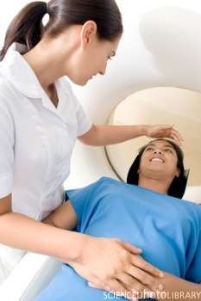
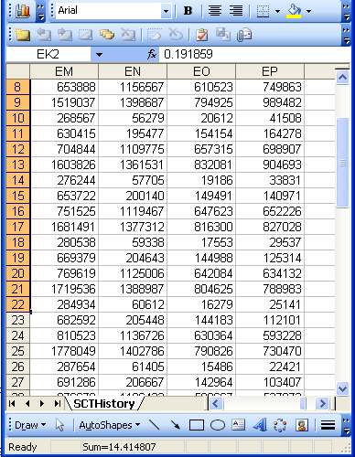
A non-trivial relation
Referents
References

Slide 4
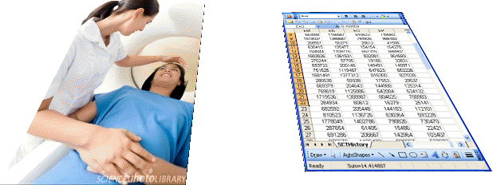
For instance: source and impact of changes
Are differences in data about the same entities in reality at different points in time due to:
  changes in first-order reality ?
  inaccurate observations ?
  differences in perspectives ?
  corrections because of:
    registration mistakes ?
    changes in our understanding of reality ?
Ceusters W, Smith B. A Realism-Based Approach to the Evolution of Biomedical Ontologies. AMIA 2006 Proceedings, Washington DC, 2006;:121-125. http://www.referent-tracking.com/RTU/sendfile/?file=CeustersAMIA2006FINAL.pdf

Slide 5
What makes it non-trivial?
Referents
  are (meta-) physically the way they are,
  relate to each other in an objective way,
  follow ‘laws of nature’
    (including Bell’s theorem).
Window on reality
  restricted by:
  what is physically and technically observable,
  fit between what is measured and what we think is measured,
  fit between established knowledge and ‘laws of nature’.
References
  follow, ideally, the syntactic-semantic conventions of some representation language,
  are restricted by the expressivity of that language,
  reference collections need to come, for correct interpretation, with documentation outside the representation.
L1: what is real L2: beliefs L3: representations

Slide 6
Two sorts of referents: ‘generic’ and ‘specific’
Generic
Generic
Specific
Specific
L3. Representation
pain classification
EHR
ICHD
my EHR
humans are vertebrates
my doctor manages my EHR
DIAGNOSIS
L2. Beliefs
my doctor’s
work plan
my doctor’s
diagnosis
INDICATION
L1⁻.
Non-representational first-order reality
my doctor
my doctor’s computer
DISORDER
PERSON
me
DRUG
DISEASE
my migraine
PAIN
my headache
MIGRAINE
HEADACHE

Slide 7
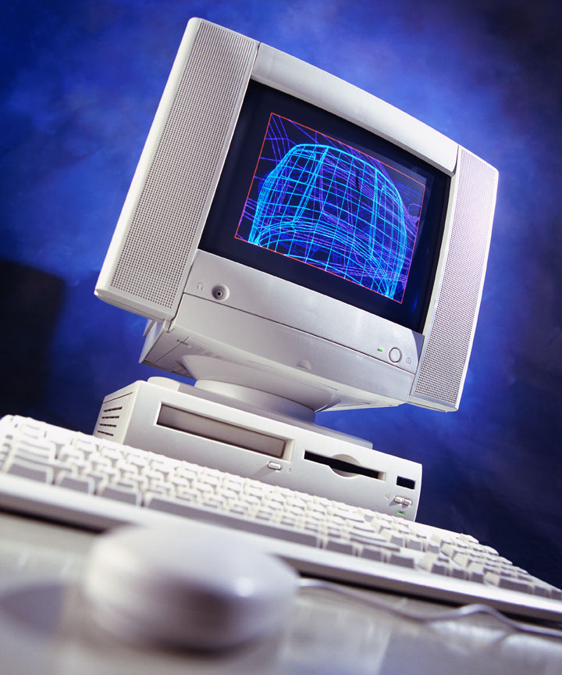
Ultimate goal of Referent Tracking
A digital copy of the world

Slide 8
Requirements for an ‘RT-style’ digital copy
R1: A faithful representation of the portion of reality (PoR) to be covered
R2 … of everything that is digitally registered,
        what is generic → scientific theories
        what is specific → what individual entities exist and how they relate
R3: … throughout the PoR’s entire history,
R4 … which is computable in order to …
        … allow queries over the PoR’s past and present,
        … make predictions,
        … fill in gaps,
        … identify mistakes,
        ...

Slide 9
What is out there (we want/need to deal with)?
portions of reality
relations
configurations
?
participation
me participating in my life
entities
?
universals
particulars
me
occurrents
Image
continuants
my life

Slide 10
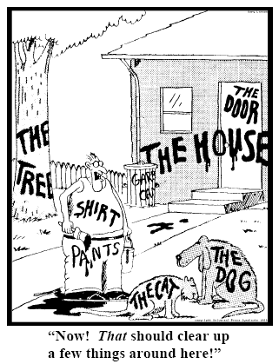
Representing specific entities
explicit reference to the individual entities relevant to the accurate description of some portion of reality, ...
Ceusters W, Smith B. Strategies for Referent Tracking in Electronic Health Records. J Biomed Inform. 2006 Jun;39(3):362-78.

Slide 11
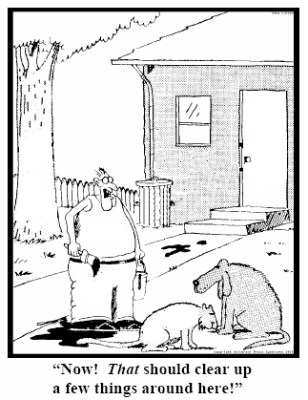
Method: IUI assignment
  Introduce an Instance Unique Identifier (IUI) for each relevant particular (individual) entity
78
235
5678
321
322
666
427
Ceusters W, Smith B. Strategies for Referent Tracking in Electronic Health Records. J Biomed Inform. 2006 Jun;39(3):362-78.

Slide 12
Referent Tracking System Components
Referent Tracking Software
    Manipulation of statements about PoRs
Referent Tracking Datastore:
    IUI repository
    A collection of globally unique singular identifiers denoting particulars within PoRs
    Referent Tracking Database
    A collection of assertions about the particulars denoted in the IUI repository
Manzoor S, Ceusters W, Rudnicki R. Implementation of a Referent Tracking System. International Journal of Healthcare Information Systems and Informatics 2007;2(4):41-58.

Slide 13
Referent Tracking assertions abstract syntax
Use these identifiers in expressions using a language that acknowledges the structure of reality:
e.g.: a yellow ball:
then not : yellow(#1) and ball(#1)
rather: #1: the ball #2: #1’s yellow
Then still not:
  ball(#1) and yellow(#2) and hascolor(#1, #2)
  but rather:
  instance-of(#1, ball, since t1)
  instance-of(#2, yellow, since t2)
  inheres-in(#1, #2, since t2)
  → follows the abstract syntax for instance level relation definitions in the Relation Ontology paper

Slide 14
The shift envisioned
From:
  ‘this man is a 40 year old patient with a stomach tumor’
To (something like):
  ‘#1 on which depends #2 has-part #3’, where
    #1 instanceOf human being at #4
    #4 instanceOf temporal region
    #4 overlaps #5
    #5 instanceOf TR-of-40yr
    #2 inheres-in #1 at #6
    #6 instanceOf temporal region
    #4 overlaps #6
    #2 instanceOf patient-role at #6
    #3 instanceOf tumor at #7
    #3 part of #1 at #8
    …

Slide 15
The shift envisioned
From:
  ‘this man is a 40 year old patient with a stomach tumor’
To (something like):
  ‘#1 on which depends #2 has-part #3’, where
    #1 instanceOf human being at #4
    #4 instanceOf temporal region
    #4 overlaps #5
    #5 instanceOf TR-of-40yr
    #2 inheres-in #1 at #6
    #6 instanceOf temporal region
    #4 overlaps #6
    #2 instanceOf patient-role at #6
    #3 instanceOf tumor at #7
    #3 part of #1 at #8
    …
denotators for particulars

Slide 16
The shift envisioned
From:
  ‘this man is a 40 year old patient with a stomach tumor’
To (something like):
  ‘#1 on which depends #2 has-part #3’, where
    #1 instanceOf human being at #4
    #4 instanceOf temporal region
    #4 overlaps #5
    #5 instanceOf TR-of-40yr
    #2 inheres-in #1 at #6
    #6 instanceOf temporal region
    #4 overlaps #6
    #2 instanceOf patient-role at #6
    #3 instanceOf tumor at #7
    #3 part of #1 at #8
    …
denotators for appropriate relations from realism-based ontologies

Slide 17
The shift envisioned
From:
  ‘this man is a 40 year old patient with a stomach tumor’
To (something like):
  ‘#1 on which depends #2 has-part #3’, where
    #1 instanceOf human being at #4
    #4 instanceOf temporal region
    #4 overlaps #5
    #5 instanceOf TR-of-40yr
    #2 inheres-in #1 at #6
    #6 instanceOf temporal region
    #4 overlaps #6
    #2 instanceOf patient-role at #6
    #3 instanceOf tumor at #7
    #3 part of #1 at #8
    …
denotators for universals, defined classes or particulars

Slide 18
The shift envisioned
From:
  ‘this man is a 40 year old patient with a stomach tumor’
To (something like):
  ‘#1 on which depends #2 has-part #3’, where
    #1 instanceOf human being at #4
    #4 instanceOf temporal region
    #4 overlaps #5
    #5 instanceOf TR-of-40yr
    #2 inheres-in #1 at #6
    #6 instanceOf temporal region
    #4 overlaps #6
    #2 instanceOf patient-role at #6
    #3 instanceOf tumor at #7
    #3 part of #1 at #8
    …
time stamp in
case of continuants

Slide 19
Application to imaging: several actors are involved
Patients, their parts and their pathological entities.
Modalities, capable to :
  recognize some entities on the side of patients;
  build representational units referring to the recognized entities;
  introduce units that don’t represent at all.
Radiologists, imaging specialists having the task to associate the representational units in an image to what is out there in reality.

Slide 20
Representational artifacts involved
Ontologies
  Canonical and variant anatomy (FMA)
  Pathological anatomy
    Pathological formations
    Pathological anatomical structures
  Modalities
  Image features
Repositories
  Clinical data
  Results from technical investigations
  Images
  Image analysis reports

Slide 21
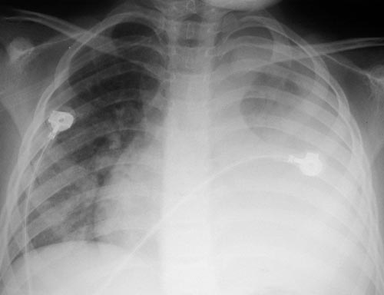
Images as representations: need for various assertions
An image is a represen-tation of reality itself;
It may suffer from various types of errors:
  Some image portions represent wrongly;
These things are not IN the body

Slide 22
Images as representations: need for various assertions
An image is a represen-tation of reality itself;
It may suffer from various types of errors:
  Some image portions represent wrongly;
  Some image portions do not represent at all;
  …
This shadow is an artifact

Slide 23
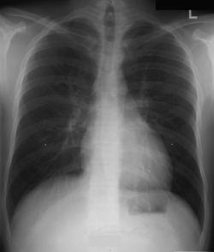
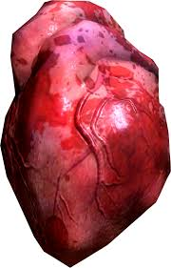
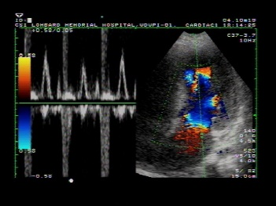
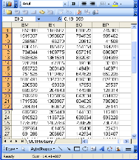
Overall picture
RT assertions
  RT tuple
    IUI Assignment tuple
    Elementary tuple
  Meta RT tuple
describes
describes

Slide 24
IUI assignment tuples
IUI assignment is an act of which the execution has to be asserted in the IUI-repository:
  <d_{a}, A_{i}, t_{d}>
    d_{a} IUI of the registering agent
    A_{i} the assertion of the assignment <p_{a}, p_{p}, t_{ap}>
        p_{a} IUI of the author of the assertion
        p_{p} IUI of the particular
        t_{ap} time of the assignment
    t_{d} time of registering A_{i} in the IUI-repository
Neither t_{d} or t_{ap} give any information about when #p_{p} started to exist ! That might be asserted in statements providing information about #p_{p} .

Slide 25
Elementary Referent Tracking tuple types
Relationships between particulars taken from a realism-based relation ontology
Instantiation of a universal
Annotation using terms from a non-realist terminology
‘Negative findings’ such as absences, missing parts, preventions, …
Names for a particular

Slide 26
Meta RT tuples (D-template)
RT assertions are assigned IUIs of their own which in the D-template is symbolized by IUIt_{i}.
D_{i} = <IUId, IUIt_{i}, t, E, C, S>.
  IUId: the IUI of the entity annotating IUIt_{i} by means of the D_{i} entry,
  E: either the symbol ‘I’ (for insertion) or any of the error type symbols,
  C: a symbol for the applicable reason for change
  t: the time the tuple denoted by IUIt_{i} is inserted or ‘retired’,
  S: a list of IUIs denoting the tuples, if any, that replace the retired one.

Slide 27
Repository – Ontology ‘collaboration’
‘John Doe’s ‘John Smith’s
liver liver
tumor tumor
was treated was treated
with with
RPCI’s RPCI’s
irradiation device’ irradiation device’
‘John Doe’s
liver
tumor
was treated
with
RPCI’s
irradiation device’
#1
instance-of at t₁
person
inst-of
at t₂
#10
#2
instance-of at t₁
liver
inst-of
at t₂
#20
#3
instance-of at t₁
tumor
inst-of
at t₂
#30
#4
instance-of at t₁
treating
inst-of
at t₂
#40
#5
clinic
#5
instance-of at t₁
inst-of
at t₂
device
#6
#6

Slide 28
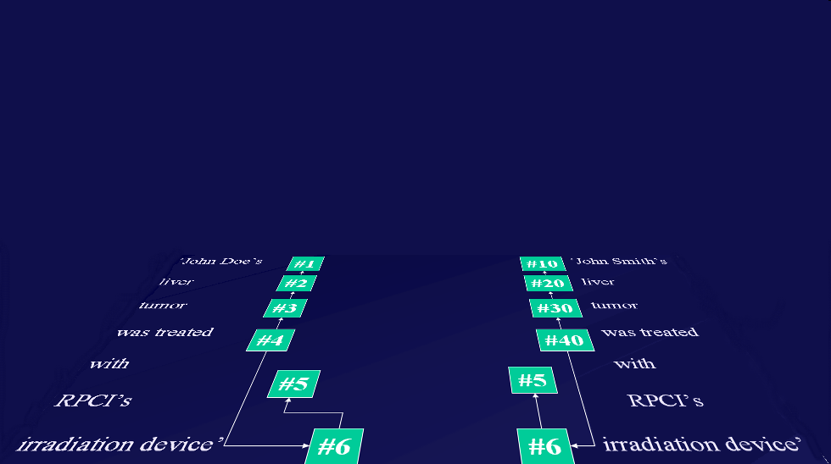
Repository – Ontology ‘collaboration’
Instance-of at t

Slide 29
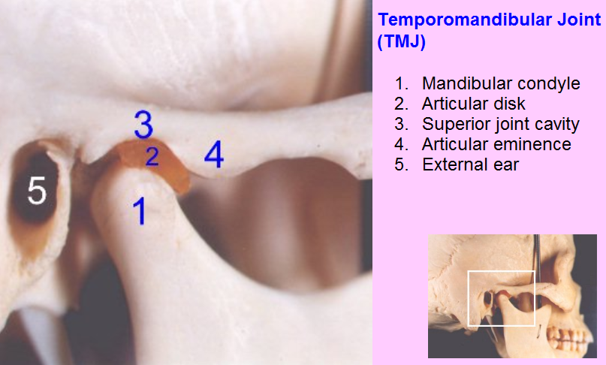
Example: assessing TMJ Anatomy

Slide 30
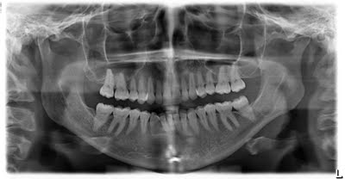
Panoramic X-ray of mouth

Slide 31
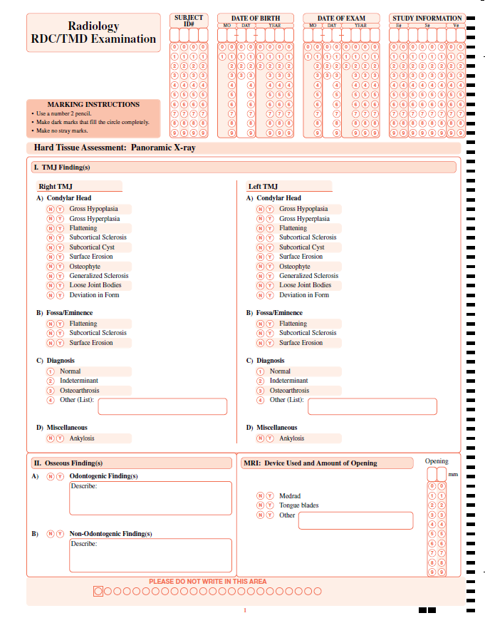
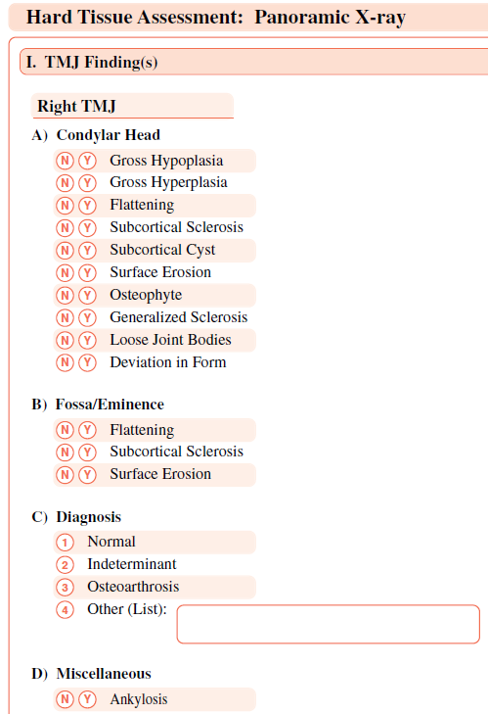
Radiology RDC/TMD Examination: data collection sheet

Slide 32
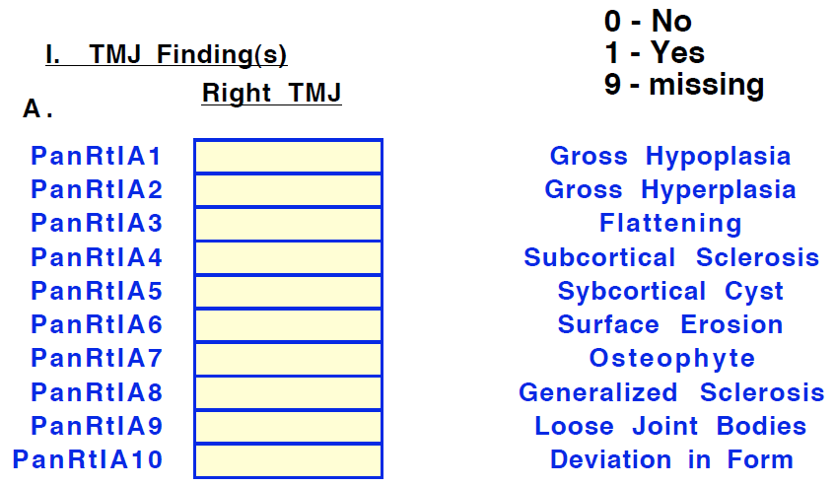
RDC/TMD: a collaborator’s data dictionary
Fieldnames in that collaborator’s data collection
Allowed values for the fields

Slide 33
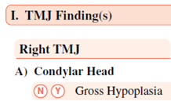
Anybody sees something disturbing ?

Slide 34
This data dictionary alone is not reliable!
That these variables are about the condylar head of the TMJ is ‘lost in translation’!

Slide 35
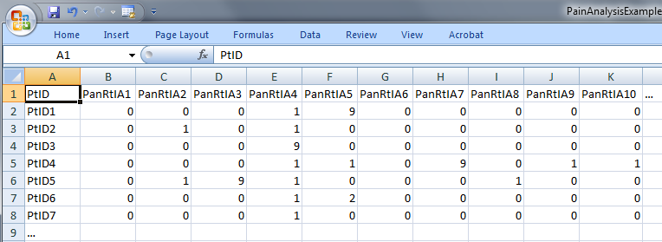
‘meaning’ of values in data collections
‘The patient with patient identifier ‘PtID4’ is stated to have had a panoramic X-ray of the mouth which is interpreted to show subcortical sclerosis of that patient’s condylar head of the right temporomandibular joint’
meaning
1

Slide 36
Objectives of the ‘sources’ analysis
Find for each value V in the data collections all possible configurations of entities (according to our best scientific understanding) for which the following can be true:
  V
  ‘it is stated that V’
Describe these possible configurations by means of sentences from a formal language that mimic the structure of reality.

Slide 37
Objectives of the ‘sources’ analysis (2)
For example,
  for the value stating that ‘The patient with patient identifier ‘PtID4’ has had a panoramic X-ray of the mouth which is interpreted to show subcortical sclerosis of that patient’s condylar head of the right temporomandibular joint’ to be true,
  this statement must have been made,
  for the statement to be true, there must have been that patient, an X-ray, etc, …
  BUT! It is not necessarily true that that patient has indeed the sclerosis as diagnosed.

Slide 38
Methodology
Formulate for each variable in the data collection a sentence explaining as accurately as possible what the variable stands for,
list the entities in reality that the terms in the sentence denote,
list recursively for all entities listed further entities that ontologically must exist for the entity under scrutiny to exist,
classify all entities in terms of realism-based ontologies (RBO),
specify all obtaining relationships between these entities,
outline all possible configurations of such entities for the sentence to be true.

Slide 39
Step 1: formulate a statement
‘The patient with patient identifier ‘PtID4’ is stated to have had a panoramic X-ray of the mouth which is interpreted to show subcortical sclerosis of that patient’s condylar head of the right temporomandibular joint’
meaning
1

Slide 40
Step 2 (1): list the entities denoted
1(The patient) with 2(patient identifier ‘PtID4’) 3(is stated) 4(have had) a 5(panoramic X-ray) of 6(the mouth) which 7(is interpreted) to 8(show) 9(subcortical sclerosis of 10(that patient’s condylar head of the 11(right temporomandibular joint)))’
CLASS | INSTANCE IDENTIFIER
person | IUI-1
patient identifier | IUI-2
assertion | IUI-3
technically investigating | IUI-4
panoramic X-ray | IUI-5
mouth | IUI-6
interpreting | IUI-7
seeing | IUI-8
diagnosis | IUI-9
condylar head of right TMJ | IUI-10
right TMJ | IUI-11
notes: colors have no meaning here, just provide easy reference,
this first list can be different, any such differences being resolved in step 3

Slide 41
Step 2 (2): provide directly referential descriptions
CLASS | INSTANCE IDENTIFIER | DIRECTLY REFERENTIAL DESCRIPTIONS
person | IUI-1 | the person to whom IUI-2 is assigned
patient identifier | IUI-2 | the patient identifier of IUI-1
assertion | IUI-3 | 'the patient with patient identifier PtID4 has had a panoramic X-ray of the mouth which is interpreted to show subcortical sclerosis of that patient’s right temporomandibular joint'
technically investigating | IUI-4 | the technically investigating of IUI-6
panoramic X-ray | IUI-5 | the panoramic X-ray that resulted from IUI-4
mouth | IUI-6 | the mouth of IUI-1
interpreting | IUI-7 | the interpreting of the signs exhibited by IUI-5
seeing | IUI-8 | the seeing of IUI-5 which led to IUI-7
diagnosis | IUI-9 | the diagnosis expressed by means of IUI-3
condylar head of right TMJ | IUI-10 | the condylar head of the right TMJ of IUI-1
right TMJ | IUI-11 | the right TMJ of IUI-1

Slide 42
Step 3: identify further entities that ontologically must exist for each entity under scrutiny to exist.
assigner role | IUI-12 | the assigner role played by the entity while it performed IUI-21
assigning | IUI-21 | the assigning of IUI-2 to IUI-1 by the entity with role IUI-12
asserting | IUI-20 | the asserting of IUI-3 by the entity with asserter role IUI-13
asserter role | IUI-13 | the asserter role played by the entity while it performed IUI-20
investigator role | IUI-14 | the investigator role played by the entity while it performed IUI-4
panoramic X-ray machine | IUI-15 | the panoramic X-ray machine used for performing IUI-4
image bearer | IUI-16 | the image bearer in which IUI-5 is concretized and that participated in IUI-8
interpreter role | IUI-17 | the interpreter role played by the entity while it performed IUI-7
perceptor role | IUI-18 | the perceptor role played by the entity while it performed IUI-8
diagnostic criteria | IUI-19 | the diagnostic criteria used by the entity that performed IUI-7 to come to IUI-9
study subject role | IUI-22 | the study subject role which inheres in IUI-1

Slide 43
Step 3: some remarks
interpreter role, perceptor role, …
  reference to roles rather than the entity in which the roles inhere because it may be the same entity and one should not assign several IUIs to the same entity
each description follows similar principles as Aristotelian definitions but is about particulars rather than universals

Slide 44
Step 4: classify all entities in terms of realism-based ontologies
CLASS | HIGHER CLASS
person | BFO: Object
patient identifier | IAO: Information Content Entity
assertion | IAO: Information Content Entity
technically investigating | OBI: Assay
panoramic X-ray | IAO: Image
mouth | FMA: Mouth
interpreting | MFO: Assessing
seeing | BFO: Process
diagnosis | IAO: Information Content Entity
condylar head of right TMJ | FMA: Right condylar process of mandible
right TMJ | FMA: Right temporomandibular joint
assigner role | BFO: Role
assigning | BFO: Process
study subject role | OBI: Study subject role
requires more ontological and philosophical skills than domain expertise or expertise with Protégé,
not just term matching

Slide 45
Step 5: specify relationships between these entities
For instance:
  at least during the taking of the X-ray the study subject role inheres in the patient being investigated:
    IUI-23 inheres-in IUI-1 during t1
  the patient participates at that time in the investigation
    IUI-4 has-participant IUI-1 during t1
These relations need to follow the principles of the Relation Ontology.
Smith B, Ceusters W, Klagges B, Koehler J, Kumar A, Lomax J, Mungall C, Neuhaus F, Rector A, Rosse C. Relations in biomedical ontologies, Genome Biology 2005, 6:R46.

Slide 46
Step 6: outline all possible configurations of such entities for the sentence to be true (a one semester course on its own)
Such outlines are collections of relational expressions of the sort just described,
Variant configurations for the example:
  perceptor and interpreter are the same or distinct human beings,
  the X-ray machine is unreliable and produced artifacts which the interpreter thought to be signs motivating his diagnosis, while the patient has indeed the disorder specified by the diagnosis (the clinician was lucky)
  …

Slide 47

Further Reading
http://www.referent-tracking.com/RTU/?page=papers.phtml

