Slide 1


Making Electronic Health Record Data
Useful for Research.
January 10, 2014
University at Buffalo, South Campus
Werner CEUSTERS, MD
Ontology Research Group, Center of Excellence in Bioinformatics and Life Sciences,
Institute for Healthcare Informatics,
Department of Psychiatry,
University at Buffalo, NY, USA

Slide 2

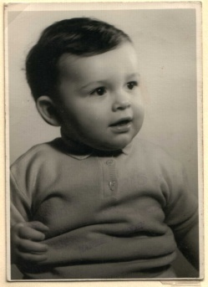
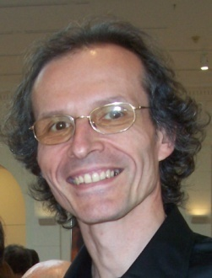

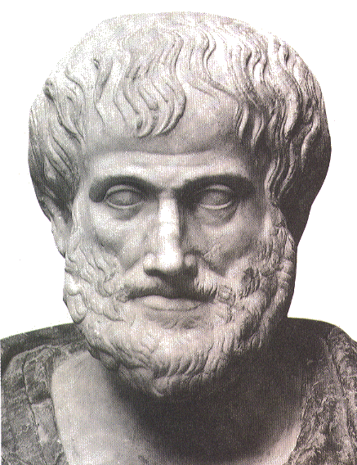





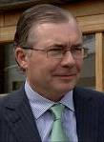

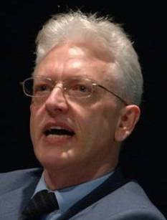


Short personal history
2012
1977
1959 -
2006
1989
2004
1992
2002
1995
1998
1993

Slide 3

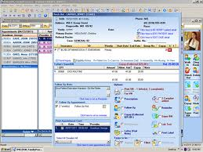
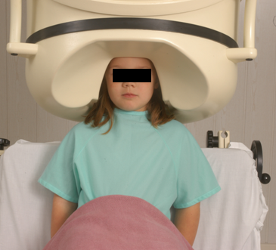

Clinical data registration and use
Register in EHR
observation &
measurement
research
Δ = outcome
application

Slide 4
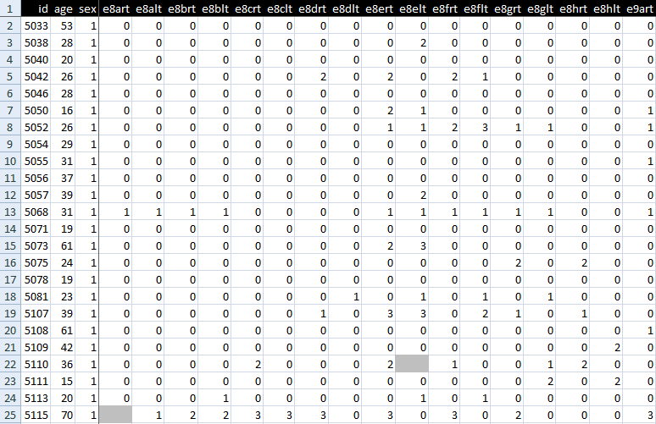
An EHR data collection

Slide 5
Standard approach in data analysis (1)
Cases | Characteristics
 | ch1 | ch2 | ch3 | ch4 | ch5 | ch6 | ...
case1
case2
case3
case4
case5
case6
...
finding correlations
phenotypic
genotypic
treatment
outcome …

Slide 6
Standard approach in data analysis (2)
Cases | Characteristics
 | ch1 | ch2 | ch3 | ch4 | ch5 | ch6 | ...
case1
case2
case3
case4
case5
case6
...
{
finding correlations
therefore
expectation
phenotypic
genotypic
treatment
outcome …

Slide 7
Standard approach in data analysis (3)
generalization ?
Cases | Characteristics
 | ch1 | ch2 | ch3 | ch4 | ch5 | ch6 | ...
case1
case2
case3
case4
case5
case6
...
{
finding correlations
therefore
expectation
phenotypic
genotypic
treatment
outcome …

Slide 8
Is it that easy?

Slide 9
Pitfalls in statistics
Three broad categories:
  Sources of bias.
    These are conditions or circumstances which affect the external validity of statistical results.
  Errors in methodology,
    which can lead to inaccurate or invalid results.
  Interpretation errors,
    misapplication of statistical results to real world issues.

Slide 10
Example: confounding in epidemiology
Confounders are:
  not part of the real association between exposure and disease,
  predictors of disease,
  unequally distributed between exposure groups.
Example: grey hair
  take from the street the first 100 people you encounter with grey hair and the first 100 that don’t have grey hair;
  check them for heart disease;
  you will very likely find that there are significantly more people in the grey hair group that have heart disease than in the other group because
  both grey hair and heart disease are more prevalent in elderly;
  therefore (?): grey hair causes heart disease (or the other way round?)

Slide 11
Some strategies to reduce confounding
randomization (distribute - known and measurable - confounders between study groups)
restriction (restrict entry to study of individuals with confounding factors
  risks: introduce bias
matching, stratification, adjustment, …
  → check your course in medical statistics,
    if you didn’t take one: shame on you.

Slide 12

However !

Slide 13
Major problem with EHRs for data analysis
The information model behind current EHRs is optimized for individual patient care, reflecting ‘care models’, without being a faithful model of how medical reality is structured in its entirety.
data
organization
observation &
measurement
Δ = outcome
application

Slide 14
EHR Information Models (simplified)
diagnosis
finding
finding
patient
patient
encounter
drug
drug
diagnosis

Slide 15
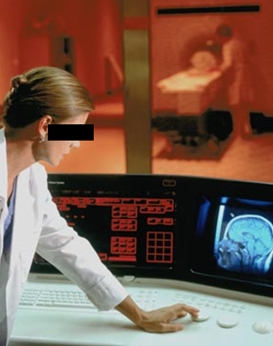
Example: Conflation of diagnosis and disease/disorder
The diagnosis is here
The disorder is there
The disease is there

Slide 16
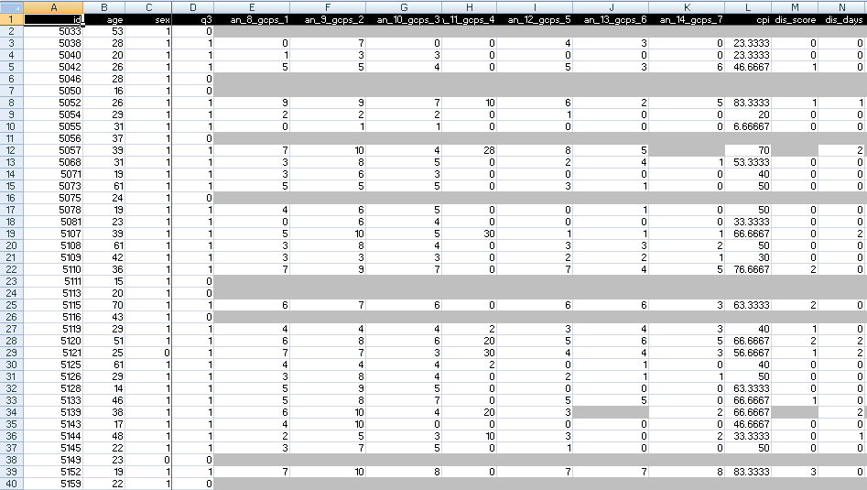
A colleague shares his research data set

Slide 17
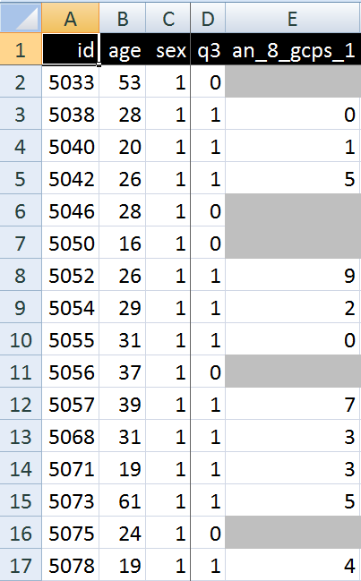
A closer look
What are you going to ask him right away?
What do these various values stand for and how do they relate to each other?
  Might this mean that patient #5057 had only once sex at the age of 39?

Slide 18
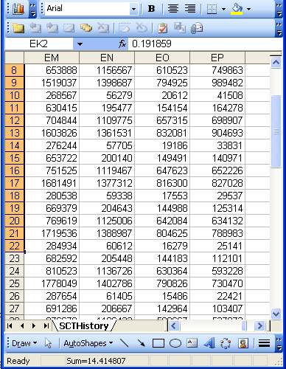


Documenting datasets
Sources | Data generation | Data organization
Data collection sheets
Instruction manuals
Interpretation criteria
Diagnostic criteria
Assessment instruments
Terminologies
Data validation procedures
Data dictionaries
Ontologies
If not used for data collection and organization, these sources can be used post hoc to document, and perhaps increase, the level of data clarity and faithfulness in and comparability of existing data collections.

Slide 19
Issues with data documentation and data quality tools

Slide 20
The dataset’s data dictionary (codebook)
Field Name | Description | Type | Missing Value | Range | Coding Values
id | Subject id | numeric | none | [5033,6387]
age | Subject’s age | Numeric | None | [14,85] | Age in years
sex | Subject’s gender | 0/1 | none |  | 0 – male, 1 - female
q3 | Have you had pain in the face, jaw, temple, in front of the ear or in the ear in the past month? | 0/1 | none |  | 0 – no, 1 - yes
an_8_gcps_1 | How would you rate your facial pain on a 0 to 10 scale at the present time, that is right now, where 0 is "no pain" and 10 is "pain as bad as could be"? | numeric | “.” | 0-10 | 0 – no pain to 10 - Pain as bad as could be
an_9_gcps_2 | In the past six months, how intense was your worst pain rated on a 0 to 10 scale where 0 is "no pain" and 10 is "pain as bad as could be"? | numeric | “.” | 0-10 | 0 – no pain to 10 - Pain as bad as could be

Slide 21
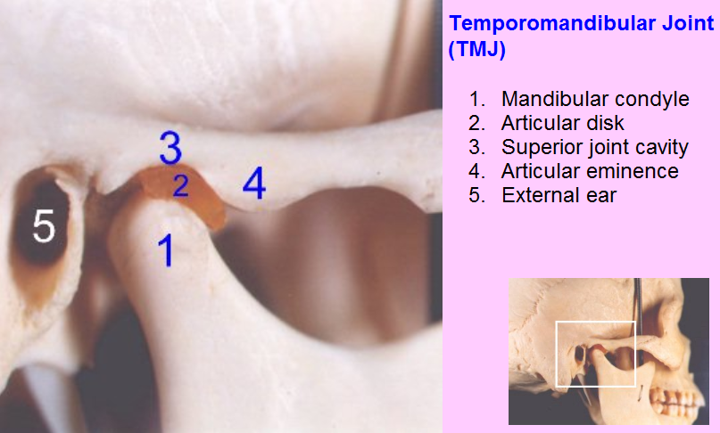
Example: assessing TMJ Anatomy

Slide 22
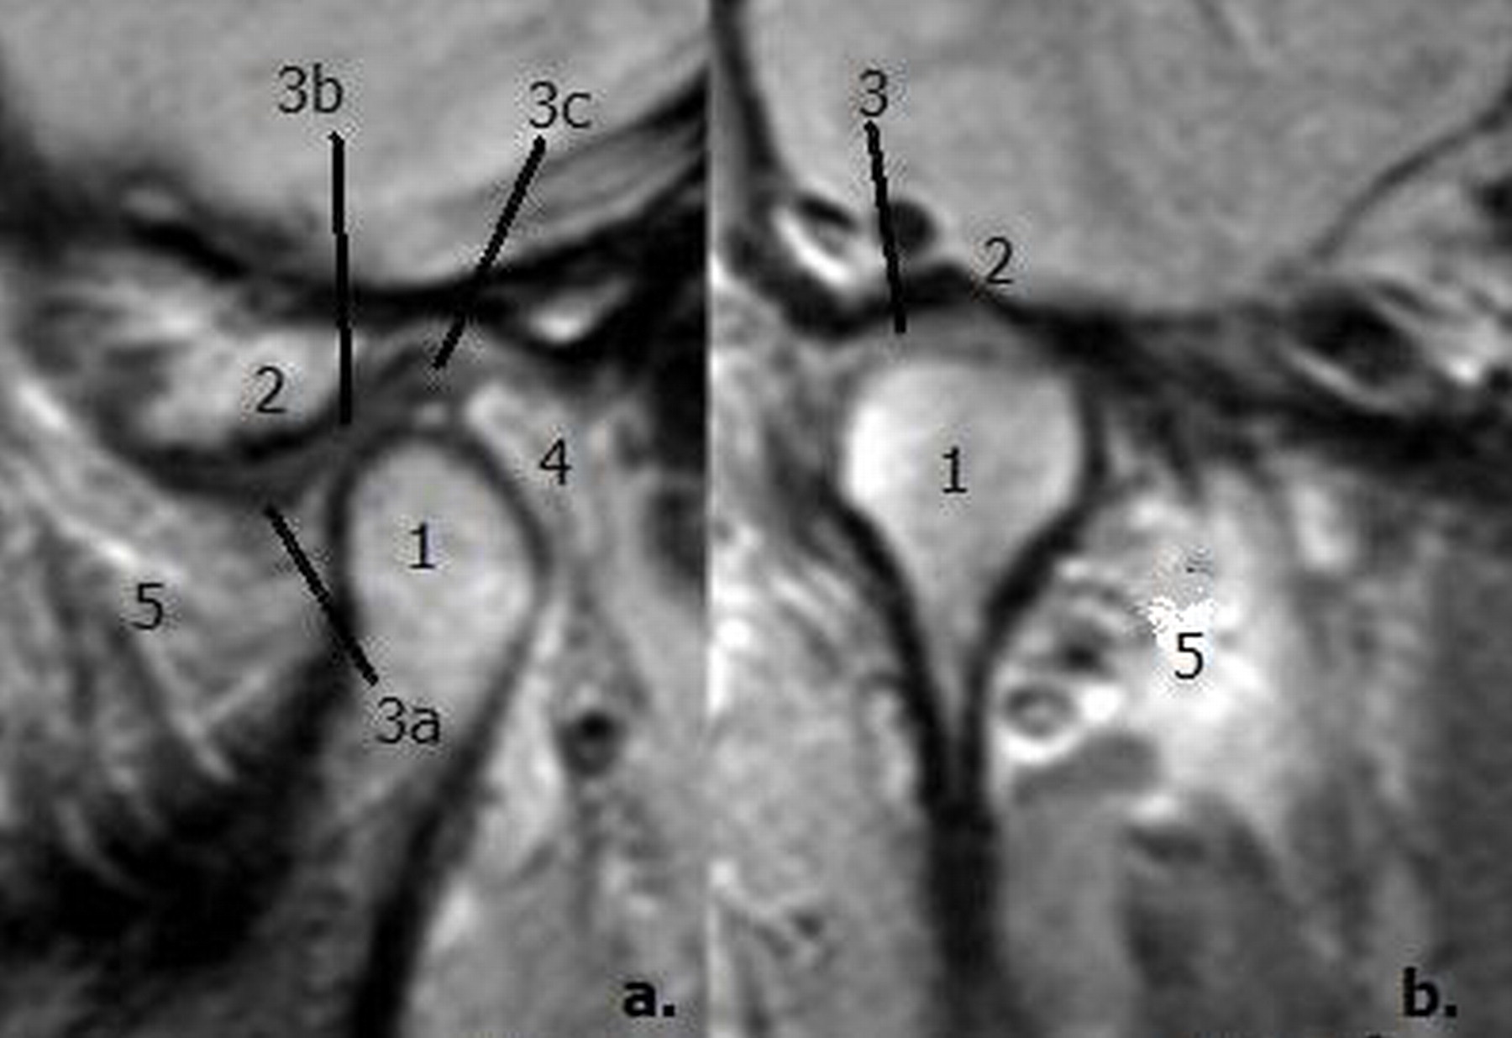
Sagittal and coronal MR images of a TMJ
©2003 by Radiological Society of North America
Sommer O J et al. Radiographics 2003;23:e14-e14

Slide 23
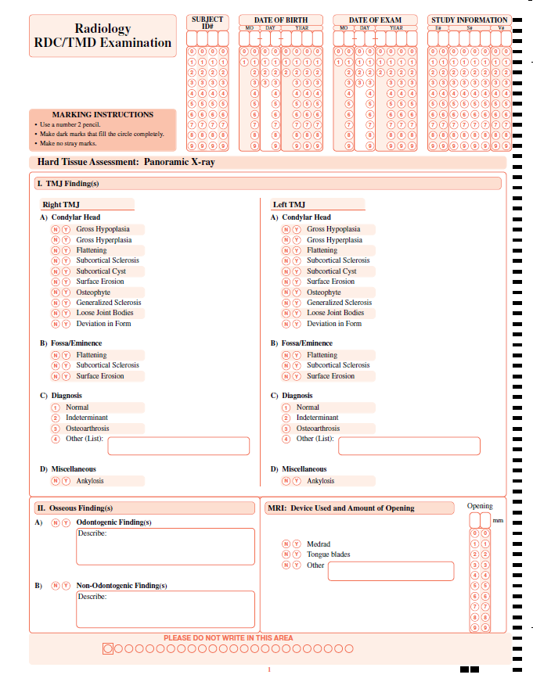
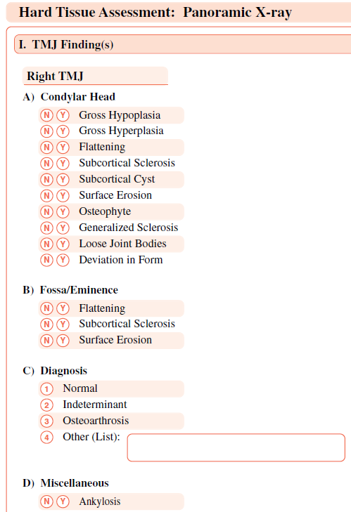
Radiology RDC/TMD Examination: data collection sheet

Slide 24
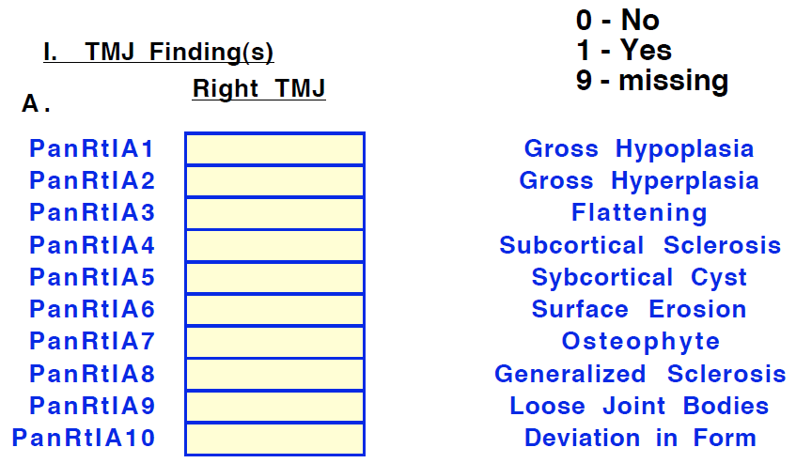
RDC/TMD: a collaborator’s data dictionary
Fieldnames in that collaborator’s data collection
Allowed values for the fields

Slide 25
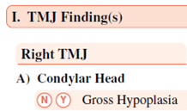
Anybody sees something disturbing ?

Slide 26
This data dictionary alone is not reliable!
That these variables are about the condylar head of the TMJ is ‘lost in translation’!

Slide 27
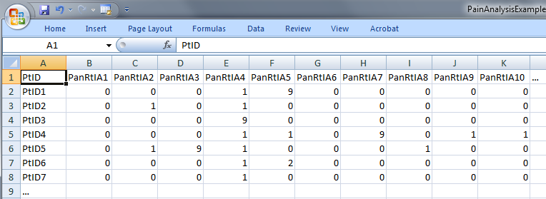
‘meaning’ of values in data collections
‘The patient with patient identifier ‘PtID4’ is stated to have had a panoramic X-ray of the mouth which is interpreted to show subcortical sclerosis of that patient’s condylar head of the right temporomandibular joint’
meaning
1

Slide 28
Current approaches to data management and analysis ignore too much where data come from

Slide 29
Generalization: data generation and use
data
organization
model development
observation &
measurement
further R&D
(instrument and
study optimization)
add
verify
use
Δ = outcome
Generic
beliefs
application

Slide 30
Correlation with reality
What type of relationship is there between data items and the part of reality they are obtained from?
What, if anything at all, do variable names in header rows correspond to?
Do correlations between data items mimic the relationships between the entities in reality the data items are obtained from?

Slide 31
Reality as benchmark for data organization and representation
data
organization
model development
observation &
measurement
further R&D
(instrument and
study optimization)
add
verify
use
Δ = outcome
Generic
beliefs
application

Slide 32
The focus on (big) data …

Slide 33
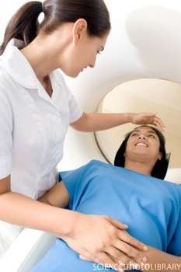
… makes one forget what data – ideally – are about
Referents
References

Slide 34
A non-trivial relation
Referents
References

Slide 35

For instance: source and impact of changes
Are differences in data about the same entities in reality at different points in time due to:
  changes in first-order reality ?
  changes in our understanding of reality ?
  inaccurate observations ?
  differences in perspectives ?
  registration mistakes ?
Ceusters W, Smith B. A Realism-Based Approach to the Evolution of Biomedical Ontologies. AMIA 2006 Proceedings, Washington DC, 2006;:121-125. http://www.referent-tracking.com/RTU/sendfile/?file=CeustersAMIA2006FINAL.pdf

Slide 36
What makes it non-trivial?
Referents
  are (meta-) physically the way they are,
  relate to each other in an objective way,
  follow ‘laws of nature’.
Window on reality
  restricted by:
  what is physically and technically observable,
  fit between what is measured and what we think is measured,
  fit between established knowledge and ‘laws of nature’.
References
  follow, ideally, the syntactic-semantic conventions of some representation language,
  are restricted by the expressivity of that language,
  reference collections need to come, for correct interpretation, with documentation outside the representation.

Slide 37
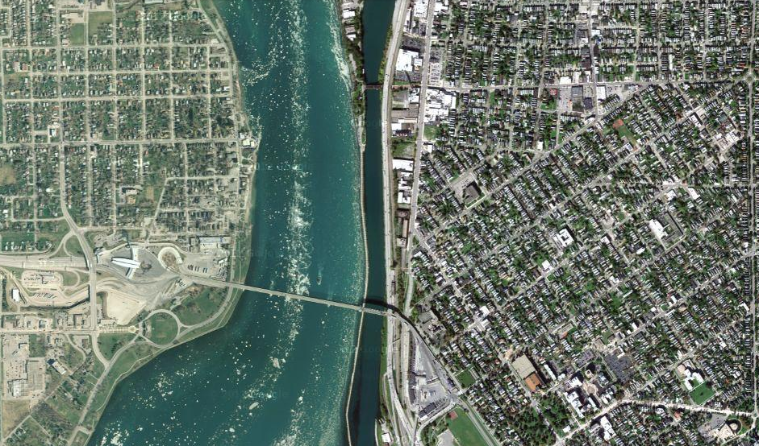
Satellite view

Slide 38
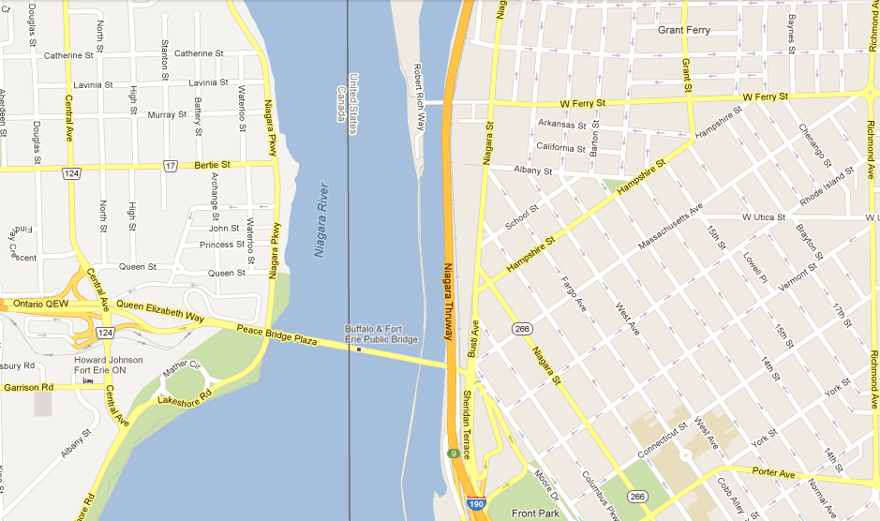
Map

Slide 39
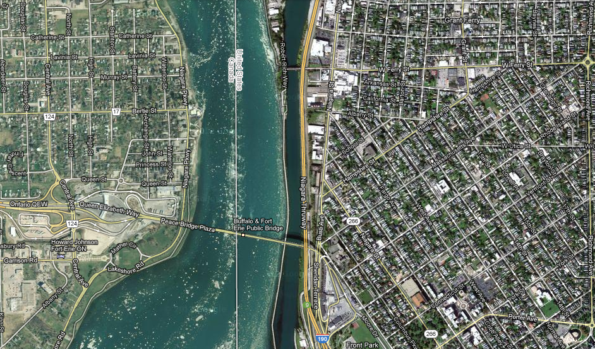
Map overlay

Slide 40
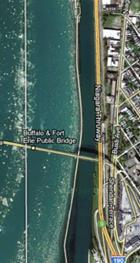
Map ←→ Reality
A message to map makers: “Highways are not painted red, rivers don’t have county lines running down the middle, and you can’t see contour lines on a mountain”
W. Kent. Data and Reality. North-Holland, Amsterdam, the Netherlands, 1978.

Slide 41
Main data ←→ reality views
Nominalism:
  there are no generic entities in reality: there is no ‘personhood’, there are only individual persons.
Conceptualism:
  generalizations are in our minds. ‘personhood’ is a concept construed in our mind that allows us to reason about it without any particular person in mind.
Realism:
  generic entities do exist and are called ‘universals’. Each particular person is an instance of the universal we call ‘person’.

Slide 42
Main data ←→ reality views
Nominalism:
  there are no generic entities in reality: there is no ‘personhood’, there are only individual persons.
Conceptualism: ← mainstream approach
  generalizations are in our minds. ‘personhood’ is a concept construed in our mind that allows us to reason about persons without any particular person in mind.
Realism: ← our approach
  generic entities do exist and are called ‘universals’. Each particular person is an instance of the universal we call ‘person’.

Slide 43
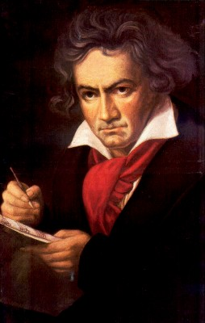
The semantic/semiotic triangle
Ludwig van Beethoven
that great German composer that became deaf
…
concept
term
referent
‘Beethoven’

Slide 44
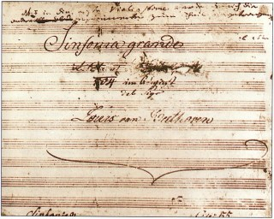
The semantic triangle works sometimes fine
Beethoven’s symphony dedicated to Bonaparte
the symphony played after the Munich Olympics massacre
…
concept
term
referent
‘Eroica’
‘Beethoven's Symphony No. 3’
‘Beethoven's Opus 55’

Slide 45
Sometimes the semantic triangle fails
the symphony Beethoven wrote after the tenth
…
concept
term
referent
‘Beethoven's Symphony No. 11’

Slide 46
Sometimes the semantic triangle fails
the symphony Beethoven wrote after the tenth
…
some hold this term has meaning
concept
term
referent
‘Beethoven's Symphony No. 11’

Slide 47

Sometimes the semantic triangle fails
the one assembled by Barry Cooper from fragmentary sketches
Beethoven’s hypothetical symphony
…
concept
term
referent
‘Beethoven's Symphony No. 10’

Slide 48
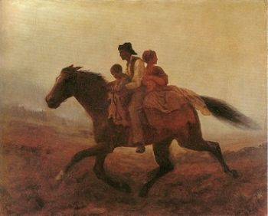
Prehistoric ‘psychiatry’: drapetomania
disease which causes slaves to suffer from an unexplainable propensity to run away
…
concept
term
referent
painting by Eastman Johnson. A Ride for Liberty: The Fugitive Slaves. 1860.
‘drapetomania’

Slide 49
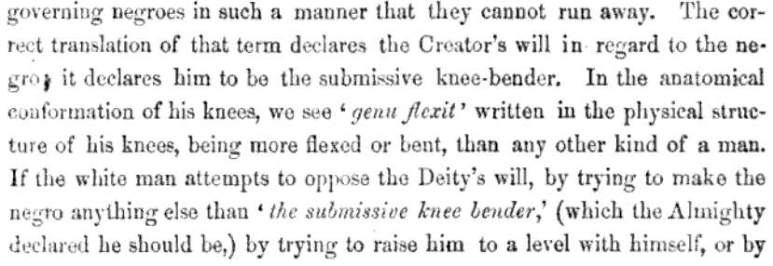
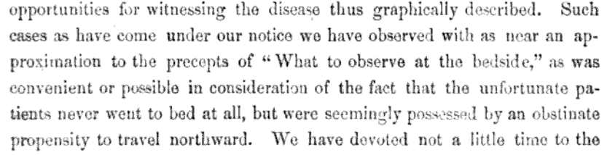
Some etiologic and diagnostic reflections

Slide 50
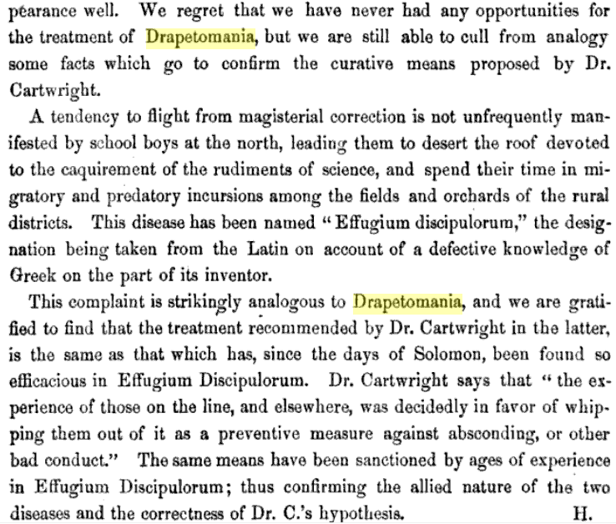
The North’s ‘Effugium Discipulorum’

Slide 51
The questions the triangle raises become trickier
Is …
  Beethoven’s 10th symphony a symphony ?
  Beethoven’s 10th symphony a hypothetical symphony ?
  a hypothetical symphony a symphony ?
In medicine, is …
  a prevented abortion an abortion ?
  an absent nipple a nipple ?

Slide 52
SNOMED about diseases and concepts (until 2010)
‘Disorders are concepts in which there is an explicit or implicit pathological process causing a state of disease which tends to exist for a significant length of time under ordinary circumstances.’
And also: “Concepts are unique units of thought”.
      College of American Pathologists. SNOMED Clinical Terms® User Guide. January 2003 Release.
Thus: Disorders are unique units of thoughts in which there is a pathological process …???
And thus: to eradicate all diseases in the world at once we simply should stop thinking ?

Slide 53


An alternative: Ontological Realism

Slide 54
Conceptualism versus Ontological Realism
First order reality
concept
universal
term
referent
representational
unit
particular
Conceptualism
Ontological Realism

Slide 55
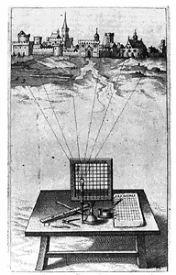
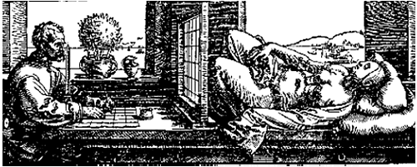
A useful parallel: Alberti’s grid
reality
Ontological
theory
representation

Slide 56



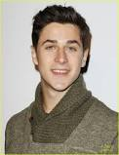
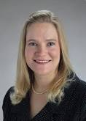
Universal versus particular
person
instance of …
particulars

Slide 57
Universal versus particular
person
image
instance of …
particulars

Slide 58
Ontological Realism in OBO Foundry ontologies
Continuant
has_participant
Occurrent
e.g. pathological
process
is_a
is_a
Independent
Continuant
e.g. organism
Dependent
Continuant
e.g. patient
role
inheres_in
instance_of
universals
.... ..... .......
particulars

Slide 59

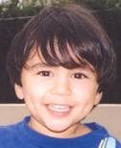

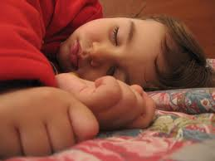
Change
child
instance of …

Slide 60
Change
child
instance of at t

Slide 61
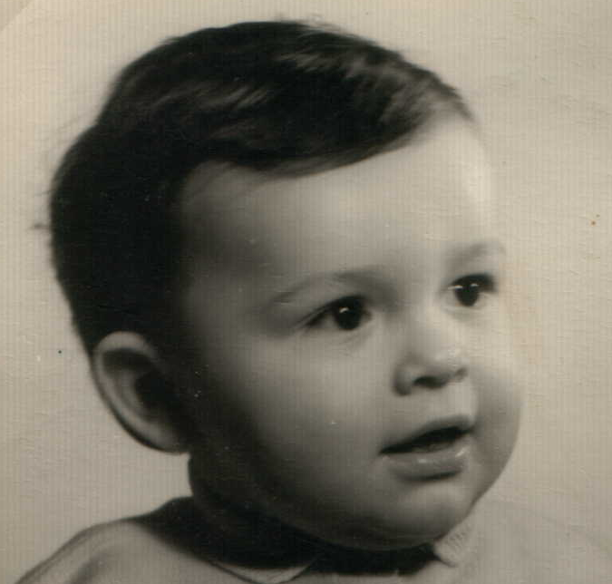



Continuants preserve identity while changing
human
being
me
me
t
Instance-of
in 1960
child
Instance-of
since 1980
adult
living
creature
animal
caterpillar
butterfly

Slide 62
Ontology as it should be done
In philosophy:
  Ontology (no plural) is the study of what entities exist and how they relate to each other;
In computer science and many biomedical informatics applications:
  An ontology (plural: ontologies) is a shared and agreed upon conceptualization of a domain;
The realist view within the Ontology Research Group combines the two:
  We use Ontological Realism, a specific methodology that uses ontology as the basis for building high quality ontologies, using reality as benchmark.

Slide 63
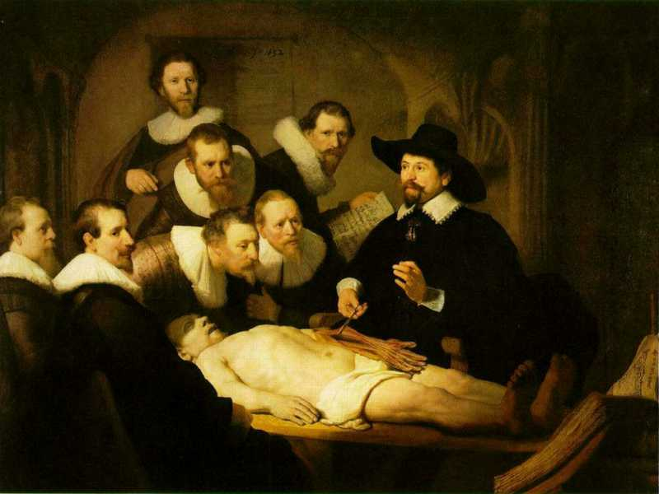
L3
Linguistic representations about (1), (2) or (3)
L2
Clinicians’ beliefs about (1)
Representations
First Order Reality
Entities (particular or generic) with objective existence which are not about anything
L1⁻

Slide 64
Data must be unambiguous and faithful to reality …
Referents
organized in reality
References organized
in a data collection

Slide 65
The distinctions applied to diabetes management
Generic
Specific
3. Representation
‘person’
‘drug’
‘insulin’
‘W. Ceusters’
‘my sugar’
2. Beliefs (knowledge)
DIAGNOSIS
my doctor’s
work plan
my doctor’s
diagnosis
INDICATION
1.
First-order reality
PATHOLOGICAL
STRUCTURE
my doctor
my doctor’s computer
PERSON
DISEASE
me
my NIDDM
DRUG
PORTION OF
INSULIN
my blood glucose
level
MOLECULE
Basic Formal Ontology
Referent Tracking

Slide 66
This allows us to see various sorts of mistakes in (biomedical) statements

Slide 67
Prevailing EHR models get it wrong twice (at least)
Confusion about the levels of reality primarily because of this confusion in terminologies and coding systems used.

Slide 68
Un-‘realistic’ SNOMED hierarchy
‘Fractured nasal bones (disorder)’
  is_a ‘bone finding’
    synonym: ‘bone observation’
Confusion between
  L3. ‘fractured nose’ [appearing in some record]: the expression of an observation)
  L2. ☺fractured nose😐 [in someone’s mind]: content of an act of observation
  L1. fractured nose: a type of nose, a particular nose

Slide 69
Prevailing EHR models get it wrong twice (at least)
Confusion about the levels of reality primarily because of this confusion in terminologies and coding systems used.
The wrong belief that it is enough to use generic terms (ideally denoting universals) to denote particulars.

Slide 70
Coding systems used naively preserve certain ambiguities
PtID
Date
ObsCode
Narrative
5572
04/07/1990
26442006
closed fracture of shaft of femur
5572
04/07/1990
81134009
Fracture, closed, spiral
5572
12/07/1990
26442006
closed fracture of shaft of femur
5572
12/07/1990
9001224
Accident in public building (supermarket)
5572
04/07/1990
79001
Essential hypertension
0939
24/12/1991
255174002
benign polyp of biliary tract
2309
21/03/1992
26442006
closed fracture of shaft of femur
2309
21/03/1992
9001224
Accident in public building (supermarket)
47804
03/04/1993
58298795
Other lesion on other specified region
5572
17/05/1993
79001
Essential hypertension
298
22/08/1993
2909872
Closed fracture of radial head
298
22/08/1993
9001224
Accident in public building (supermarket)
5572
01/04/1997
26442006
closed fracture of shaft of femur
5572
01/04/1997
79001
Essential hypertension
0939
20/12/1998
255087006
malignant polyp of biliary tract

Slide 71
Codes for ‘types’ AND identifiers for instances
PtID
Date
ObsCode
Narrative
5572
04/07/1990
26442006
IUI-001
closed fracture of shaft of femur
5572
04/07/1990
81134009
IUI-001
Fracture, closed, spiral
5572
12/07/1990
26442006
IUI-001
closed fracture of shaft of femur
5572
12/07/1990
9001224
IUI-007
Accident in public building (supermarket)
5572
04/07/1990
79001
IUI-005
Essential hypertension
0939
24/12/1991
255174002
IUI-004
benign polyp of biliary tract
2309
21/03/1992
26442006
IUI-002
closed fracture of shaft of femur
2309
21/03/1992
9001224
IUI-007
Accident in public building (supermarket)
47804
03/04/1993
58298795
IUI-006
Other lesion on other specified region
5572
17/05/1993
79001
IUI-005
Essential hypertension
298
22/08/1993
2909872
IUI-003
Closed fracture of radial head
298
22/08/1993
9001224
IUI-007
Accident in public building (supermarket)
5572
01/04/1997
26442006
IUI-012
closed fracture of shaft of femur
5572
01/04/1997
79001
7 distinct disorders
IUI-005
Essential hypertension
0939
20/12/1998
255087006
IUI-004
malignant polyp of biliary tract

Slide 72
Ambiguities: are assertions about particulars or types?
‘Persistent idiopathic facial pain (PIFP)’
  = ‘persistent facial pain with varying presentations …’
persistent
facial pain
presentation
type1
presentation
type2
presentation
type3
types
t₂
t₃
t₁
t₁
t₁
t₂
t₂
t₃
t₁
t₃
parti-
culars
t₁
t₂
t₂
t₁
t₃
t₂
t₃
t₃
my pain
her pain
his pain

Slide 73
Ambiguities: are assertions about particulars or types?
‘Persistent idiopathic facial pain (PIFP)’
  = ‘persistent facial pain with varying presentations …’
  if the description is about types, then the three particular pains fall under PIFP.
  if the description is about (arbitrary) particulars, then only her pain falls under PIFP.

Slide 74
Separate knowledge from what it is about.
‘13.1.2.4 Painful trigeminal neuropathy attributed to MS plaque’
‘attributed to’ relates to somebody’s opinion about what is the case, not to what is the case.
  the mistake: a feature on the side of the clinician – his (not) knowing - is taken to be a feature on the side of the patient.
Similar mistakes:
  ‘Probable migraine’
  ‘facial pain of unknown origin’ (not in ICHD).

Slide 75
ICHD diagnostic criteria for PIFP
Persistent idiopathic facial pain (PIFP):
  Facial or oral pain for at least three months fulfilling criteria B-F
  Pain occurs daily for more than 2 hours per day
  Pain has the following features
    Poorly localized, does not following a peripheral nerve distribution.
    Dull, aching, nagging
  Clinical neurological examination is normal
  Simple laboratory investigations including imaging of the face and jaws exclude dental cause.
  Not better accounted for by another ICHD-III diagnosis.
http://ihs-classification.org (current version)

Slide 76
Criteria do not replace definitions
‘13.1.1.1 Classical trigeminal neuralgia, purely paroxysmal’, has the criterion ‘at least three attacks of facial pain fulfilling criteria B-E’.
This does not mean: a patient with 2 such attacks does not exhibit this type of neuralgia;
It rather means: do not diagnose the patient (yet) as exhibiting this type of neuralgia.
If ‘chronic pain’ is defined as ‘pain lasting longer than three months’, at what point in time starts a patient to have that type of pain?

Slide 77
Ontology of General Medical Science
First ontology in which the
L1/L2/L3 distinction is used
Scheuermann R, Ceusters W, Smith B. Toward an Ontological Treatment of Disease and Diagnosis. 2009 AMIA Summit on Translational Bioinformatics, San Francisco, California, March 15-17, 2009;: 116-120. Omnipress ISBN:0-9647743-7-2

Slide 78
Goal of OGMS
To be a consistent, logical and extensible framework (ontology) for the representation of
  features of disease
  clinical processes
  results

Slide 79
Motivation
Clarity about:
  disease etiology and progression
  disease and the diagnostic process
  phenotype and signs/symptoms

Slide 80
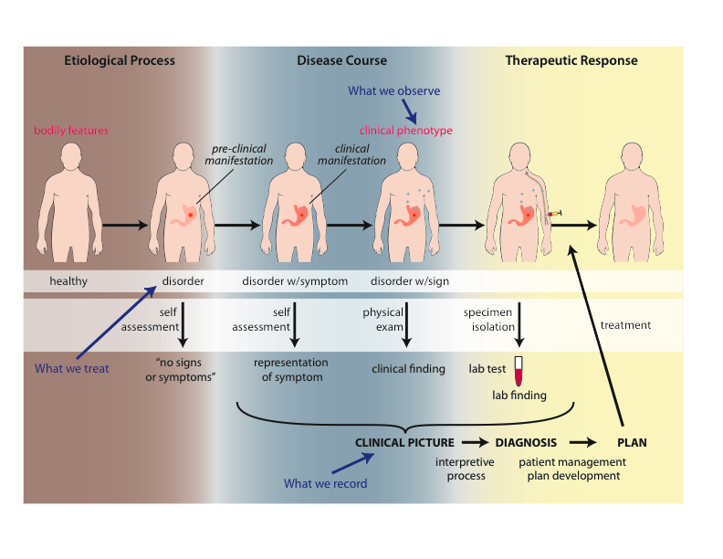
Big Picture

Slide 81
Approach
a disease is a disposition rooted in a physical disorder in the organism and realized in pathological processes.
produces
bears
realized_in
etiological process
disorder
disposition
pathological process
produces
diagnosis
interpretive process
signs & symptoms
abnormal bodily features
produces
participates_in
recognized_as
Notes:
font was too small, color inside green boxes was hardly readable

Slide 82
Cirrhosis - environmental exposure
Etiological process - phenobarbitol-induced hepatic cell death
  produces
Disorder - necrotic liver
  bears
Disposition (disease) - cirrhosis
  realized_in
Pathological process - abnormal tissue repair with cell proliferation and fibrosis that exceed a certain threshold; hypoxia-induced cell death
  produces
Abnormal bodily features
  recognized_as
Symptoms - fatigue, anorexia
Signs - jaundice, splenomegaly
Symptoms & Signs
  used_in
Interpretive process
  produces
Hypothesis - rule out cirrhosis
  suggests
Laboratory tests
  produces
Test results – documentation of elevated liver enzymes in serum
  used_in
Interpretive process
  produces
Result - diagnosis that patient X has a disorder that bears the disease cirrhosis

Slide 83
Foundational Terms (1)
Disorder =def. – A causally linked combination of physical components that is
  (a) clinically abnormal and
  (b) maximal, in the sense that it is not a part of some larger such combination.
Pathological Process =def. – A bodily process that is a manifestation of a disorder and is clinically abnormal.

Slide 84
Clinically abnormal
- something is clinically abnormal if:
  (1) is not part of the life plan for an organism of the relevant type (unlike aging or pregnancy),
  (2) is causally linked to an elevated risk either of pain or other feelings of illness, or of death or dysfunction, and
  (3) is such that the elevated risk exceeds a certain threshold level.

Slide 85
Foundational Terms (2)
Disorder =def. – A causally linked combination of physical components that is (a) clinically abnormal and (b) maximal, in the sense that it is not a part of some larger such combination.
Pathological Process =def. – A bodily process that is a manifestation of a disorder and is clinically abnormal.
Disease =def. – A disposition (i) to undergo pathological processes that (ii) exists in an organism because of one or more disorders in that organism.

Slide 86
Diagnosis
Clinical Picture =def. – A representation of a clinical phenotype that is inferred from the combination of laboratory, image and clinical findings about a given patient.
Diagnosis =def. – A conclusion of an interpretive process that has as input a clinical picture of a given patient and as output an assertion to the effect that the patient has a disease of such and such a type.

Slide 87
A well-formed diagnosis of ‘pneumococal pneumonia’
A configuration of representational units;
Believed to mirror the person’s disease;
Believed to mirror the disease’s cause;
Refers to the universal of which the disease is believed to be an instance.
Disease
isa
Pneumococcal pneumonia
Instance-of at t1
#78
John’s relevant portion
of pneumococs
#56
John’s
Pneumonia
caused
by

Slide 88
Some motivations and consequences (1)
No use of debatable or ambiguous notions such as proposition, statement, assertion, fact, ...
The same diagnosis can be expressed in various forms.
Disease
Portion of pneumococs
caused
by
isa
isa
Pneumococcal pneumonia
Pneumonia
Instance-of at t1
Instance-of at t1
Instance-of at t1
caused
by
caused
by
#78
#56
#56
#78

Slide 89
Some motivations and consequences (2)
A diagnosis can be of level 2 or level 3, i.e. either in the mind of a cognitive agent, or in some physical form.
Allows for a clean interpretation of assertions of the sort ‘these patients have the same diagnosis’:
  → The configuration of representational units is such that the parts which do not refer to the particulars related to the respective patients, refer to the same portion of reality.

Slide 90
Distinct but similar diagnoses
Pneumococcal pneumonia
Instance-of at t1
Instance-of at t2
#78
John’s portion
of pneumococs
caused
by
#56
John’s
Pneumonia
#956
Bob’s
pneumonia
caused
by
#2087
Bob’s portion
of pneumococs

Slide 91
Some motivations and consequences (3)
Allows evenly clean interpretations for the wealth of ‘modified’ diagnoses:
  With respect to the author of the representation:
    ‘nursing diagnosis’, ‘referral diagnosis’
  When created:
    ‘post-operative diagnosis’, ‘admitting diagnosis’, ‘final diagnosis’
  Degree of belief:
    ‘uncertain diagnosis’, ‘preliminary diagnosis’

Slide 92
Take home messages
Statements, even scientific jargon, as well as data collections can make sense and be about something, without each part thereof making sense or being about something.
  (a + b)² = a² + 2ab + b² is true whatever a and b are,
  c² = a² + b² is sometimes true, for instance if a, b, and c are the lengths of certain sides of a rectangular triangle.
For data collections to be interpretable and comparable, each part of it needs to be documented as to what it intends to denote.
Ontological Realism is a method to achieve this.

