Slide 1


Structured Electronic Health Records and Patient Data Analysis: Pitfalls and Possibilities.
January 7, 2013
Farber Hal G-26, University at Buffalo, South Campus
Werner CEUSTERS, MD
Ontology Research Group, Center of Excellence in Bioinformatics and Life Sciences,
Institute for Healthcare Informatics,
Department of Psychiatry,
University at Buffalo, NY, USA

Slide 2

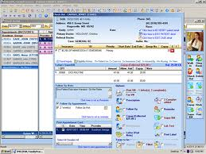
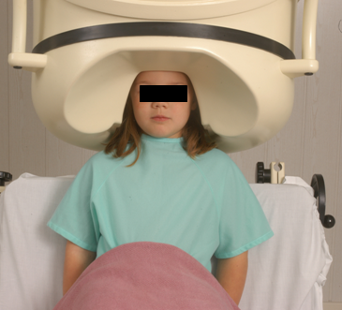

Clinical data registration and use
data
organization
observation &
measurement
Δ = outcome
application

Slide 3

Generalization: data generation and use
data
organization
model development
observation &
measurement
further R&D
(instrument and
study optimization)
add
verify
use
Δ = outcome
Generic
beliefs
application

Slide 4
Standard approach in data analysis: statistics
Cases | Characteristics
 | ch1 | ch2 | ch3 | ch4 | ch5 | ch6 | ...
case1
case2
case3
case4
case5
case6
...
phenotypic
genotypic
treatment
outcome …

Slide 5
Pitfalls in statistics
Three broad categories:
  Sources of bias.
    These are conditions or circumstances which affect the external validity of statistical results.
  Errors in methodology,
    which can lead to inaccurate or invalid results.
  Interpretation errors,
    misapplication of statistical results to real world issues.

Slide 6
Example: confounding in epidemiology
Confounders are:
  not part of the real association between exposure and disease,
  predictors of disease,
  unequally distributed between exposure groups.
Example: grey hair
  take from the street the first 100 people you encounter with grey hair and the first 100 that don’t have grey hair;
  check them for heart disease;
  you will very likely find that there are significantly more people in the grey hair group that have heart disease than in the other group because
  both grey hair and heart disease are more prevalent in elderly;
  therefore (?): grey hair causes heart disease (or the other way round?)

Slide 7
‘Have grey hair’ ←→ ‘Do not have grey hair’
Can you think of a related criterion that makes having grey hair an even stronger confounder?
‘do not have grey hair’: people with …
  black hair
  red hair,
  brown hair,
  no hair !!!
    also more prevalent in elderly.
Stronger confounder:
  ‘Have grey hair’ ←→ ‘Have black hair’

Slide 8
Some strategies to reduce confounding
randomization (distribute - known and measurable - confounders between study groups)
restriction (restrict entry to study of individuals with confounding factors
  risks: introduce bias
matching, stratification, adjustment, …
  → check your course in medical statistics,
    if you didn’t take one: shame on you.

Slide 9

However !

Slide 10
Major problem with EHRs for data analysis
The information model behind current EHRs is optimized for individual patient care, reflecting ‘care models’, without being a faithful model of how medical reality is structured in its entirety.
data
organization
observation &
measurement
Δ = outcome
application

Slide 11
EHR Information Models (simplified)
diagnosis
finding
finding
patient
patient
encounter
drug
drug
diagnosis

Slide 12
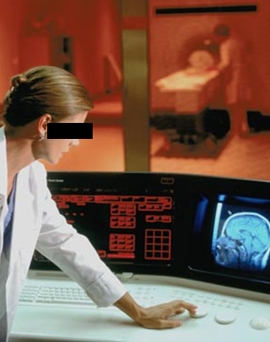
Example: Conflation of diagnosis and disease/disorder
The diagnosis is here
The disorder is there
The disease is there

Slide 13
Using generic representations for specific entities is inadequate
PtID
Date
SNOMED CT code
Narrative
5572
04/07/1990
26442006
closed fracture of shaft of femur
5572
04/07/1990
81134009
Fracture, closed, spiral
5572
12/07/1990
26442006
closed fracture of shaft of femur
5572
12/07/1990
9001224
Accident in public building (supermarket)
5572
04/07/1990
79001
Essential hypertension
0939
24/12/1991
255174002
benign polyp of biliary tract
2309
21/03/1992
26442006
closed fracture of shaft of femur
2309
21/03/1992
9001224
Accident in public building (supermarket)
47804
03/04/1993
58298795
Other lesion on other specified region
5572
17/05/1993
79001
Essential hypertension
298
22/08/1993
2909872
Closed fracture of radial head
298
22/08/1993
9001224
Accident in public building (supermarket)
5572
01/04/1997
26442006
closed fracture of shaft of femur
5572
01/04/1997
79001
Essential hypertension
0939
20/12/1998
255087006
malignant polyp of biliary tract

Slide 14
Needed: adequate ways for purpose independent data organization and model development
data
organization
model development
observation &
measurement
further R&D
(instrument and
study optimization)
add
verify
use
Δ = outcome
Generic
beliefs
application

Slide 15
A new approach: ‘Ontology’
In philosophy:
  Ontology (no plural) is the study of what entities exist and how they relate to each other;

Slide 16
Ontology: asking fundamental questions about variables
For X to exist, must there be some Y?
  hair color ←→ hair , fracture ←→ fracture healing
If X is a feature of Y, and Y changes, does X change? Are there change invariants?
  Y: person
  X: body weight / eye color / place of birth / …
If X is a feature of Y, and X ceases to exist, does Y, ceases to exist? (Y = person)
  X: being a child / being an adult / being a man / being a student / …

Slide 17
‘Ontology’
In philosophy:
  Ontology (no plural) is the study of what entities exist and how they relate to each other;
In computer science and many biomedical informatics applications:
  An ontology (plural: ontologies) is a shared and agreed upon conceptualization of a domain;

Slide 18
Ontology as it should be done
In philosophy:
  Ontology (no plural) is the study of what entities exist and how they relate to each other;
In computer science and many biomedical informatics applications:
  An ontology (plural: ontologies) is a shared and agreed upon conceptualization of a domain;
The realist view within the Ontology Research Group combines the two:
  We use Ontological Realism, a specific methodology that uses ontology as the basis for building high quality ontologies, using reality as benchmark.

Slide 19
A crucial distinction: data and what they are about
data
organization
First-
Order
Reality
is about
model development
observation &
measurement
Representation
further R&D
(instrument and
study optimization)
add
verify
use
Δ = outcome
Generic
beliefs
application

Slide 20
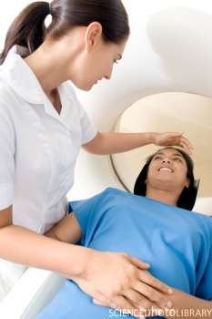
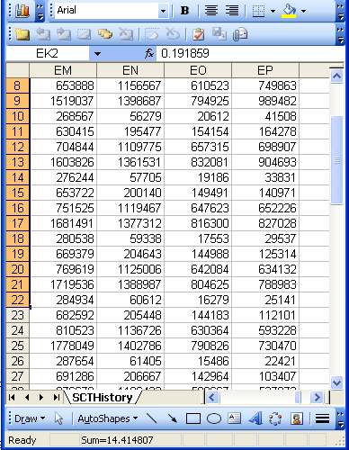
A non-trivial relation
Referent
Reference

Slide 21
Some key questions
What referents, if any at all, are depicted by a putative reference?
How do changes at the level of the referents correspond with changes in the collection of references?
If references are transmitted, how can the receiver know what referents are depicted?
Referent
Reference

Slide 22
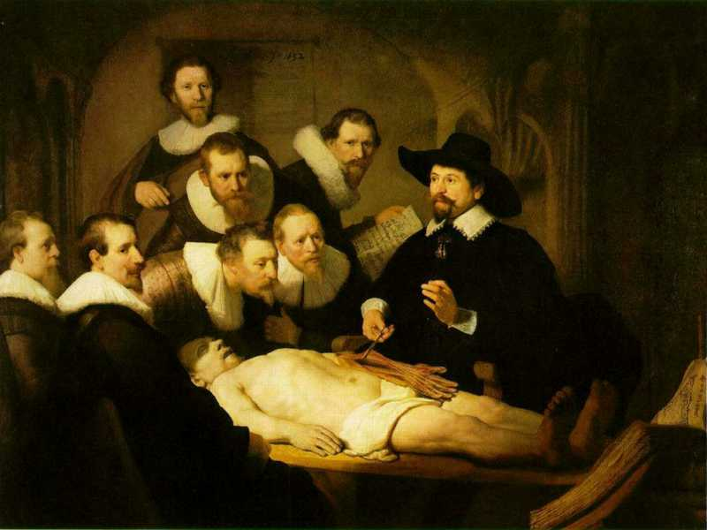

Slide 23
L3
Linguistic representations about (1), (2) or (3)
L2
Clinicians’ beliefs about (1)
Representations
First Order Reality
Entities (particular or generic) with objective existence which are not about anything
L1⁻

Slide 24
Relevance, e.g. current definition of ‘pain’
The IASP definition for ‘pain’:
  ‘an unpleasant sensory and emotional experience associated with actual or potential tissue damage, or described in terms of such damage’.
where is the relevance ?

Slide 25
Relevance, e.g. current definition of ‘pain’
The IASP definition for ‘pain’:
  ‘an unpleasant sensory and emotional experience associated with actual or potential tissue damage, or described in terms of such damage’.
where is the relevance ?

Slide 26
Study the terminology of pain as currently defined
Starting point - the IASP definition for ‘pain’:
  ‘an unpleasant sensory and emotional experience associated with actual or potential tissue damage, or described in terms of such damage’;
what asserts:
  a common phenomenology (‘unpleasant sensory and emotional experience’) to all instances of pain,
  the recognition of three distinct subtypes of pain involving, respectively:
    actual tissue damage,
    what is called ‘potential tissue damage’, and
    a description involving reference to tissue damage whether or not there is such damage.

Slide 27
Language as confounder / ontology as detector
a liver tumor is a special kind of tumor,
grey hair is a special kind of hair,
potential tissue damage is a special kind of … ?
a prevented abortion is a special kind of … ?
an absent spleen is a special kind of … ?

Slide 28
For example: Ontology of General Medical Science
a disease is a disposition rooted in a physical disorder in the organism and realized in pathological processes.
produces
bears
realized_in
etiological process
disorder
disposition
pathological process
about
produces
diagnosis
interpretive process
signs & symptoms
abnormal bodily features
produces
participates_in
recognized_as
Notes:
font was too small, color inside green boxes was hardly readable

Slide 29
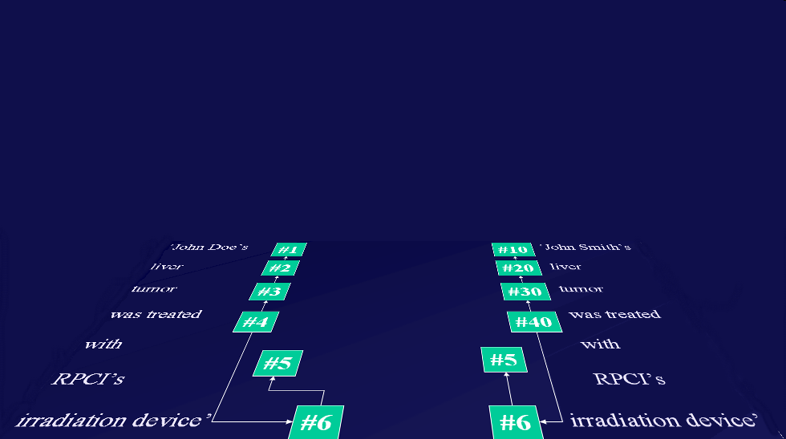
Relevance: the way EHRs ought to interact with representations of generic portions of reality
instance-of at t
caused
by
#105

Slide 30
Ontological analysis predicts/ identifies confounders
unique identification by means of ‘codes’
unique identification by means of ‘instance unique identifiers’

Slide 31
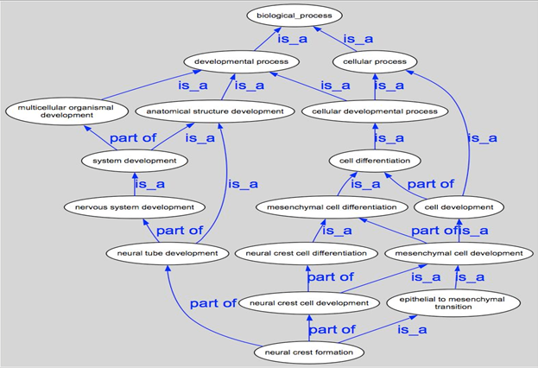
Making data collections comparable

Slide 32
Feedback to clinical care
Finding ‘similar’ patient cases:
  suggestions for prevention, investigation, treatment;
‘Outbreak’ detection;
Comparing outcomes;
  related to disorders, providers, treatments, …
Links to literature;
Clinical trial selection;
…

Slide 33
Further reading
Ceusters W, Capolupo M, De Moor G, Devlies J, Smith B.
An Evolutionary Approach to Realism-Based Adverse Event Representations.
Methods of Information in Medicine, 2011;50(1):62-73.
http://www.ncbi.nlm.nih.gov/pmc/articles/PMC3103706/

