Slide 1


Ontological Perspectives on Data.
January 11, 2013
University at Buffalo, South Campus
Werner CEUSTERS, MD
Ontology Research Group, Center of Excellence in Bioinformatics and Life Sciences,
Institute for Healthcare Informatics,
Department of Psychiatry,
University at Buffalo, NY, USA

Slide 2

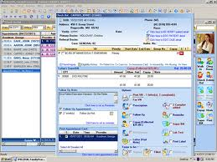
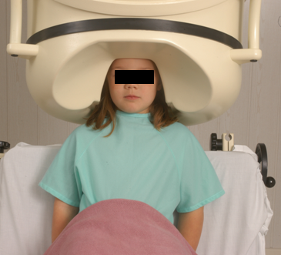

Clinical data registration and use
data
organization
observation &
measurement
Δ = outcome
application

Slide 3

Generalization: data generation and use
data
organization
model development
observation &
measurement
further R&D
(instrument and
study optimization)
add
verify
use
Δ = outcome
Generic
beliefs
application

Slide 4
Reality as benchmark for data organization and representation
data
organization
model development
observation &
measurement
further R&D
(instrument and
study optimization)
add
verify
use
Δ = outcome
Generic
beliefs
application

Slide 5
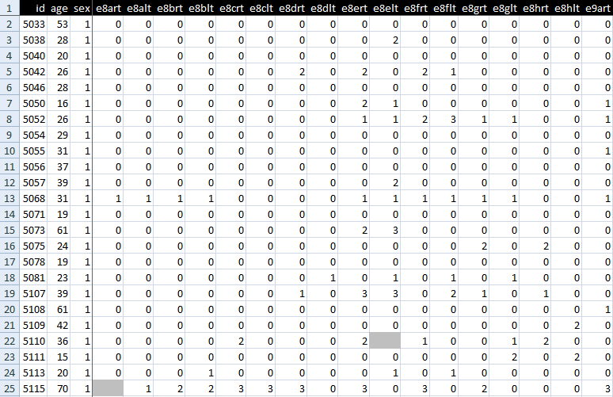
A data collection

Slide 6
Standard approach in data analysis (1)
Cases | Characteristics
 | ch1 | ch2 | ch3 | ch4 | ch5 | ch6 | ...
case1
case2
case3
case4
case5
case6
...
finding correlations
phenotypic
genotypic
treatment
outcome …

Slide 7
Standard approach in data analysis (2)
Cases | Characteristics
 | ch1 | ch2 | ch3 | ch4 | ch5 | ch6 | ...
case1
case2
case3
case4
case5
case6
...
{
finding correlations
therefore
expectation
phenotypic
genotypic
treatment
outcome …

Slide 8
Standard approach in data analysis (3)
generalization ?
Cases | Characteristics
 | ch1 | ch2 | ch3 | ch4 | ch5 | ch6 | ...
case1
case2
case3
case4
case5
case6
...
{
finding correlations
therefore
expectation
phenotypic
genotypic
treatment
outcome …

Slide 9
Correlation with reality
What type of relationship is there between data items and the part of reality they are obtained from?
What, if anything at all, do variable names in header rows correspond to?
Do correlations between data items mimic the relationships between the entities in reality the data items are obtained from?

Slide 10
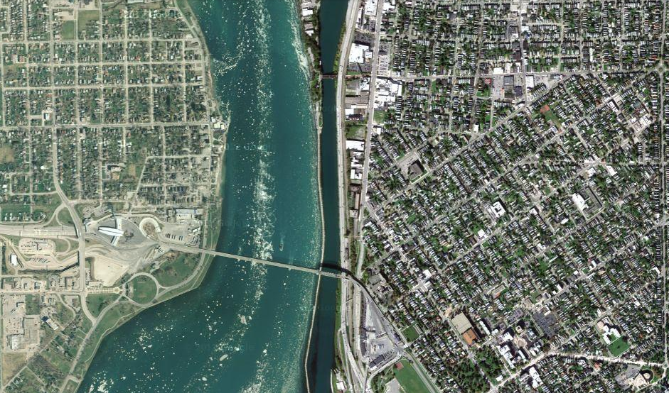
Satellite view

Slide 11
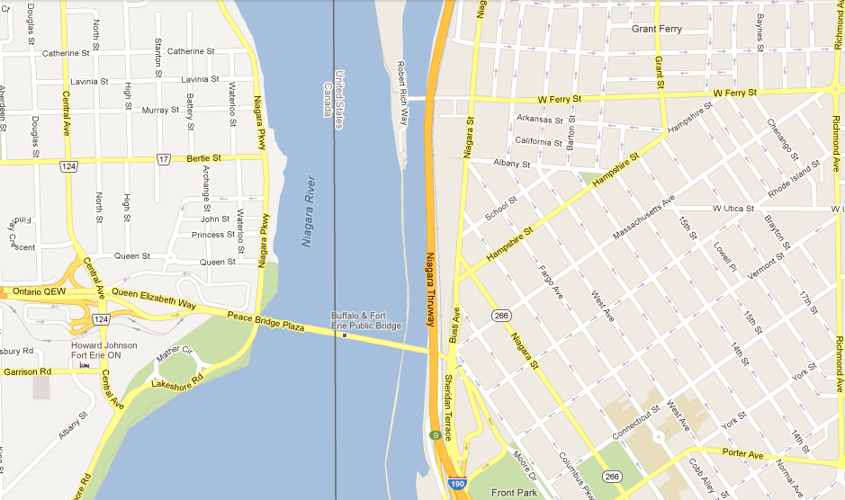
Map

Slide 12
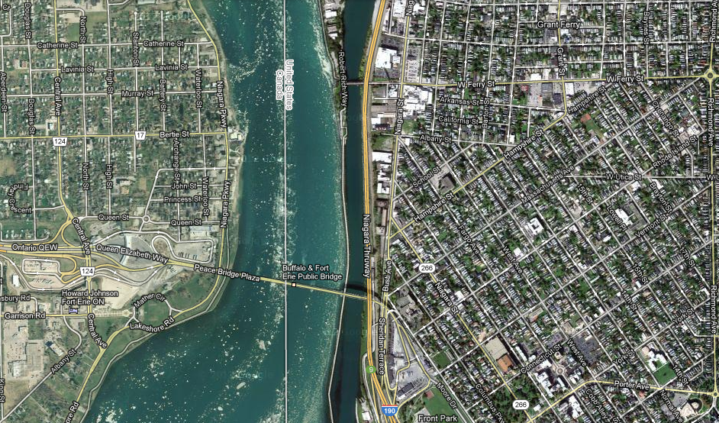
Map overlay

Slide 13
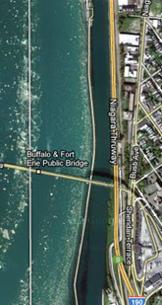
Map ←→ Reality
A message to map makers: “Highways are not painted red, rivers don’t have county lines running down the middle, and you can’t see contour lines on a mountain”
W. Kent. Data and Reality. North-Holland, Amsterdam, the Netherlands, 1978.

Slide 14
Main data ←→ reality views
Nominalism:
  there are no generic entities in reality: there is no ‘personhood’, there are only individual persons.
Conceptualism:
  generalizations are in our minds. ‘personhood’ is a concept construed in our mind that allows us to reason about it without any particular person in mind.
Realism:
  generic entities do exist and are called ‘universals’. Each particular person is an instance of the universal we call ‘person’.

Slide 15
Main data ←→ reality views
Nominalism:
  there are no generic entities in reality: there is no ‘personhood’, there are only individual persons.
Conceptualism: ← mainstream approach
  generalizations are in our minds. ‘personhood’ is a concept construed in our mind that allows us to reason about persons without any particular person in mind.
Realism: ← our approach
  generic entities do exist and are called ‘universals’. Each particular person is an instance of the universal we call ‘person’.

Slide 16
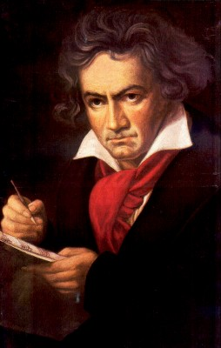
The semantic/semiotic triangle
Ludwig van Beethoven
that great German composer that became deaf
…
concept
term
referent
‘Beethoven’

Slide 17
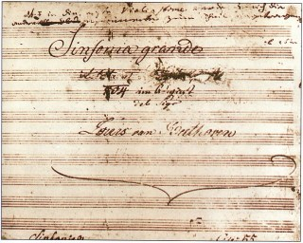
The semantic triangle works sometimes fine
Beethoven’s symphony dedicated to Bonaparte
the symphony played after the Munich Olympics massacre
…
concept
term
referent
‘Eroica’
‘Beethoven's Symphony No. 3’
‘Beethoven's Opus 55’

Slide 18
Sometimes the semantic triangle fails
the symphony Beethoven wrote after the tenth
…
concept
term
referent
‘Beethoven's Symphony No. 11’

Slide 19
Sometimes the semantic triangle fails
the symphony Beethoven wrote after the tenth
…
some hold this term has meaning
concept
term
referent
‘Beethoven's Symphony No. 11’

Slide 20

Sometimes the semantic triangle fails
the one assembled by Barry Cooper from fragmentary sketches
Beethoven’s hypothetical symphony
…
concept
term
referent
‘Beethoven's Symphony No. 10’

Slide 21
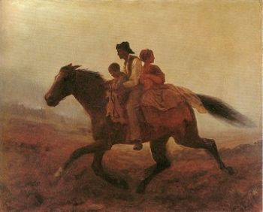
Prehistoric ‘psychiatry’: drapetomania
disease which causes slaves to suffer from an unexplainable propensity to run away
…
concept
term
referent
painting by Eastman Johnson. A Ride for Liberty: The Fugitive Slaves. 1860.
‘drapetomania’

Slide 22
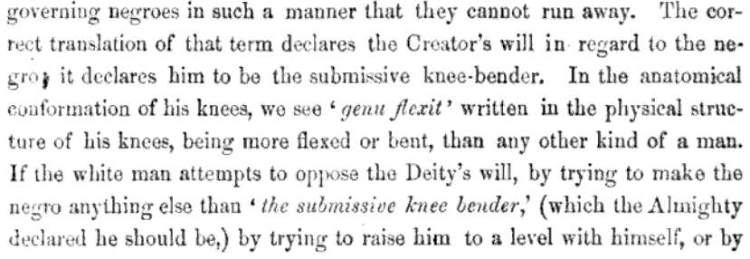
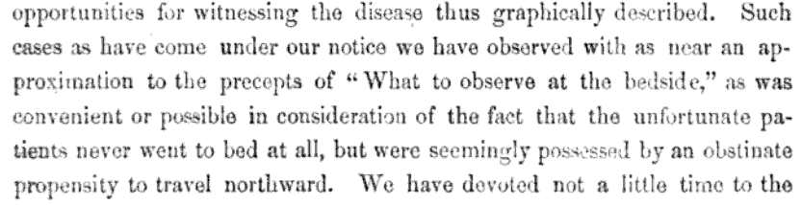
Some etiologic and diagnostic reflections

Slide 23
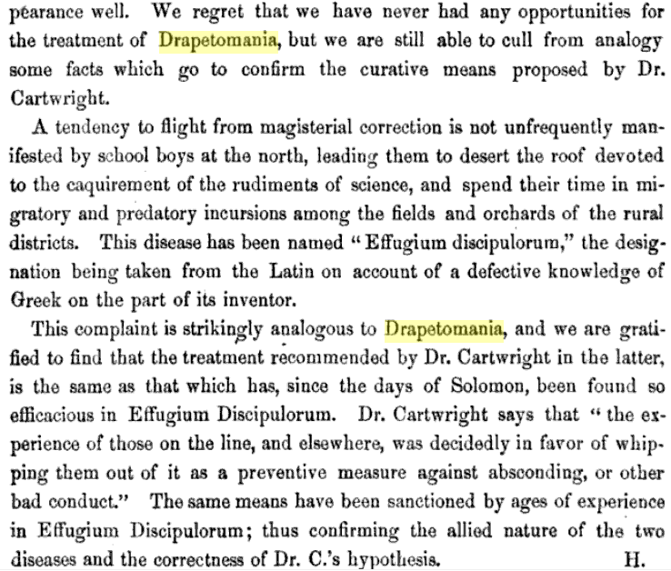
The North’s ‘Effugium Discipulorum’

Slide 24
The questions the triangle raises become trickier
Is …
  Beethoven’s 10th symphony a symphony ?
  Beethoven’s 10th symphony a hypothetical symphony ?
  a hypothetical symphony a symphony ?
In medicine, is …
  a prevented abortion an abortion ?
  an absent nipple a nipple ?

Slide 25
SNOMED about diseases and concepts (until 2010)
‘Disorders are concepts in which there is an explicit or implicit pathological process causing a state of disease which tends to exist for a significant length of time under ordinary circumstances.’
And also: “Concepts are unique units of thought”.
      College of American Pathologists. SNOMED Clinical Terms® User Guide. January 2003 Release.
Thus: Disorders are unique units of thoughts in which there is a pathological process …???
And thus: to eradicate all diseases in the world at once we simply should stop thinking ?

Slide 26
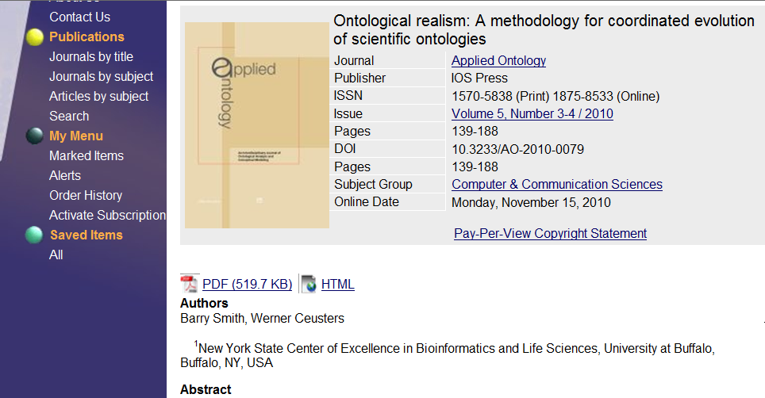
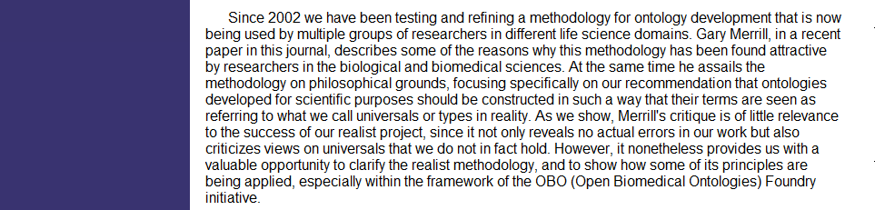
An alternative: Ontological Realism

Slide 27
Conceptualism versus Ontological Realism
First order reality
concept
universal
term
referent
representational
unit
particular
Conceptualism
Ontological Realism

Slide 28
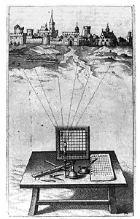
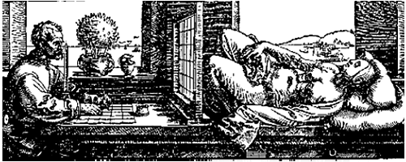
A useful parallel: Alberti’s grid
reality
Ontological
theory
representation

Slide 29



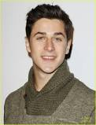
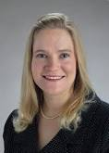
Universal versus particular
person
instance of …
particulars

Slide 30
Universal versus particular
person
image
instance of …
particulars

Slide 31
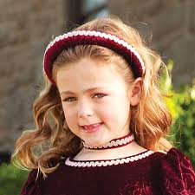
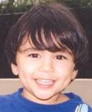

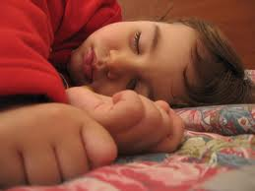
Change
child
instance of …

Slide 32
Change
child
instance of at t

Slide 33
Continuants preserve identity while changing
human
being
me
me
t
Instance-of
in 1960
child
Instance-of
since 1980
adult
living
creature
animal
caterpillar
butterfly

Slide 34
Data must be unambiguous and faithful to reality …
Referents
organized in reality
References organized
in a data collection

Slide 35
Using generic representations for specific entities is inadequate
PtID
Date
SNOMED CT code
Narrative
5572
04/07/1990
26442006
closed fracture of shaft of femur
5572
04/07/1990
81134009
Fracture, closed, spiral
5572
12/07/1990
26442006
closed fracture of shaft of femur
5572
12/07/1990
9001224
Accident in public building (supermarket)
5572
04/07/1990
79001
Essential hypertension
0939
24/12/1991
255174002
benign polyp of biliary tract
2309
21/03/1992
26442006
closed fracture of shaft of femur
2309
21/03/1992
9001224
Accident in public building (supermarket)
47804
03/04/1993
58298795
Other lesion on other specified region
5572
17/05/1993
79001
Essential hypertension
298
22/08/1993
2909872
Closed fracture of radial head
298
22/08/1993
9001224
Accident in public building (supermarket)
5572
01/04/1997
26442006
closed fracture of shaft of femur
5572
01/04/1997
79001
Essential hypertension
0939
20/12/1998
255087006
malignant polyp of biliary tract

Slide 36
Ontology as it should be done
In philosophy:
  Ontology (no plural) is the study of what entities exist and how they relate to each other;
In computer science and many biomedical informatics applications:
  An ontology (plural: ontologies) is a shared and agreed upon conceptualization of a domain;
The realist view within the Ontology Research Group combines the two:
  We use Ontological Realism, a specific methodology that uses ontology as the basis for building high quality ontologies, using reality as benchmark.

Slide 37
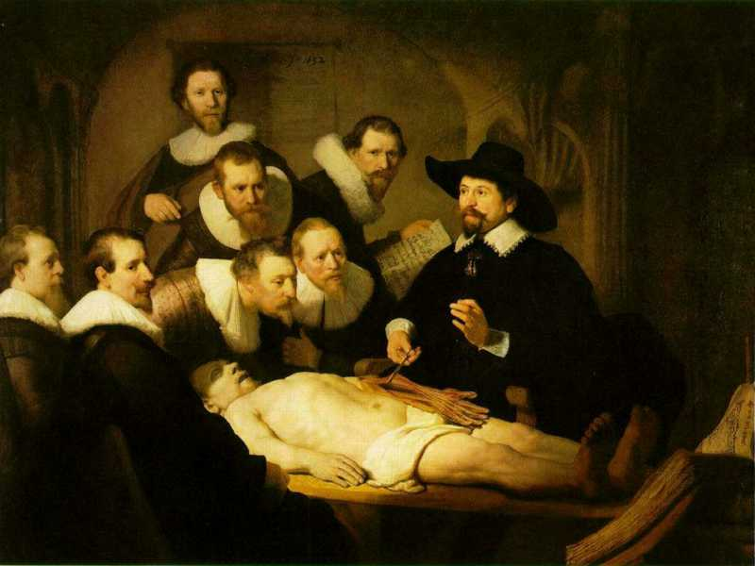
L3
Linguistic representations about (1), (2) or (3)
L2
Clinicians’ beliefs about (1)
Representations
First Order Reality
Entities (particular or generic) with objective existence which are not about anything
L1⁻

Slide 38
Ontology of General Medical Science
First ontology in which the
L1/L2/L3 distinction is used
Scheuermann R, Ceusters W, Smith B. Toward an Ontological Treatment of Disease and Diagnosis. 2009 AMIA Summit on Translational Bioinformatics, San Francisco, California, March 15-17, 2009;: 116-120. Omnipress ISBN:0-9647743-7-2

Slide 39
Goal of OGMS
To be a consistent, logical and extensible framework (ontology) for the representation of
  features of disease
  clinical processes
  results

Slide 40
Motivation
Clarity about:
  disease etiology and progression
  disease and the diagnostic process
  phenotype and signs/symptoms

Slide 41
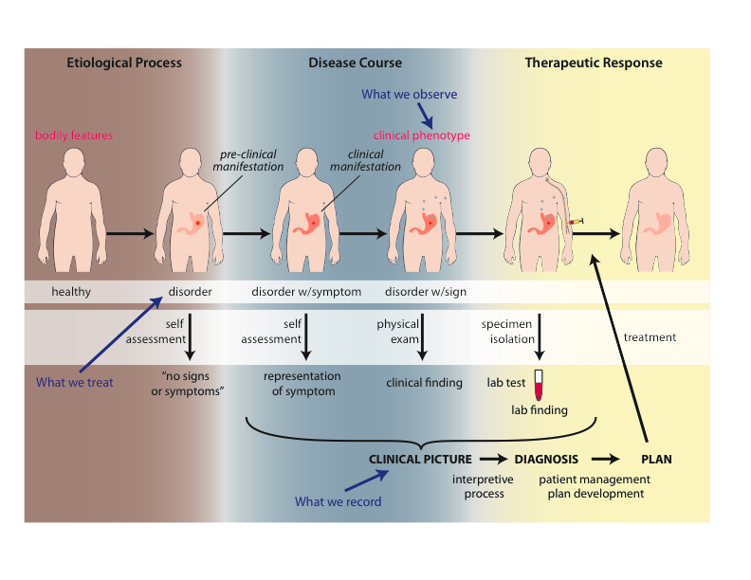
Big Picture

Slide 42
Approach
a disease is a disposition rooted in a physical disorder in the organism and realized in pathological processes.
produces
bears
realized_in
etiological process
disorder
disposition
pathological process
produces
diagnosis
interpretive process
signs & symptoms
abnormal bodily features
produces
participates_in
recognized_as
Notes:
font was too small, color inside green boxes was hardly readable

Slide 43
Cirrhosis - environmental exposure
Etiological process - phenobarbitol-induced hepatic cell death
  produces
Disorder - necrotic liver
  bears
Disposition (disease) - cirrhosis
  realized_in
Pathological process - abnormal tissue repair with cell proliferation and fibrosis that exceed a certain threshold; hypoxia-induced cell death
  produces
Abnormal bodily features
  recognized_as
Symptoms - fatigue, anorexia
Signs - jaundice, splenomegaly
Symptoms & Signs
  used_in
Interpretive process
  produces
Hypothesis - rule out cirrhosis
  suggests
Laboratory tests
  produces
Test results – documentation of elevated liver enzymes in serum
  used_in
Interpretive process
  produces
Result - diagnosis that patient X has a disorder that bears the disease cirrhosis

Slide 44
Foundational Terms (1)
Disorder =def. – A causally linked combination of physical components that is
  (a) clinically abnormal and
  (b) maximal, in the sense that it is not a part of some larger such combination.
Pathological Process =def. – A bodily process that is a manifestation of a disorder and is clinically abnormal.

Slide 45
Clinically abnormal
- something is clinically abnormal if:
  (1) is not part of the life plan for an organism of the relevant type (unlike aging or pregnancy),
  (2) is causally linked to an elevated risk either of pain or other feelings of illness, or of death or dysfunction, and
  (3) is such that the elevated risk exceeds a certain threshold level.

Slide 46
Foundational Terms (2)
Disorder =def. – A causally linked combination of physical components that is (a) clinically abnormal and (b) maximal, in the sense that it is not a part of some larger such combination.
Pathological Process =def. – A bodily process that is a manifestation of a disorder and is clinically abnormal.
Disease =def. – A disposition (i) to undergo pathological processes that (ii) exists in an organism because of one or more disorders in that organism.

Slide 47
Diagnosis
Clinical Picture =def. – A representation of a clinical phenotype that is inferred from the combination of laboratory, image and clinical findings about a given patient.
Diagnosis =def. – A conclusion of an interpretive process that has as input a clinical picture of a given patient and as output an assertion to the effect that the patient has a disease of such and such a type.

Slide 48
A well-formed diagnosis of ‘pneumococal pneumonia’
A configuration of representational units;
Believed to mirror the person’s disease;
Believed to mirror the disease’s cause;
Refers to the universal of which the disease is believed to be an instance.
Disease
isa
Pneumococcal pneumonia
Instance-of at t1
#78
John’s relevant portion
of pneumococs
#56
John’s
Pneumonia
caused
by

Slide 49
Some motivations and consequences (1)
No use of debatable or ambiguous notions such as proposition, statement, assertion, fact, ...
The same diagnosis can be expressed in various forms.
Disease
Portion of pneumococs
caused
by
isa
isa
Pneumococcal pneumonia
Pneumonia
Instance-of at t1
Instance-of at t1
Instance-of at t1
caused
by
caused
by
#78
#56
#56
#78

Slide 50
Some motivations and consequences (2)
A diagnosis can be of level 2 or level 3, i.e. either in the mind of a cognitive agent, or in some physical form.
Allows for a clean interpretation of assertions of the sort ‘these patients have the same diagnosis’:
  → The configuration of representational units is such that the parts which do not refer to the particulars related to the respective patients, refer to the same portion of reality.

Slide 51
Distinct but similar diagnoses
Pneumococcal pneumonia
Instance-of at t1
Instance-of at t2
#78
John’s portion
of pneumococs
caused
by
#56
John’s
Pneumonia
#956
Bob’s
pneumonia
caused
by
#2087
Bob’s portion
of pneumococs

Slide 52
Some motivations and consequences (3)
Allows evenly clean interpretations for the wealth of ‘modified’ diagnoses:
  With respect to the author of the representation:
    ‘nursing diagnosis’, ‘referral diagnosis’
  When created:
    ‘post-operative diagnosis’, ‘admitting diagnosis’, ‘final diagnosis’
  Degree of belief:
    ‘uncertain diagnosis’, ‘preliminary diagnosis’

Slide 53
Adverse events

Slide 54
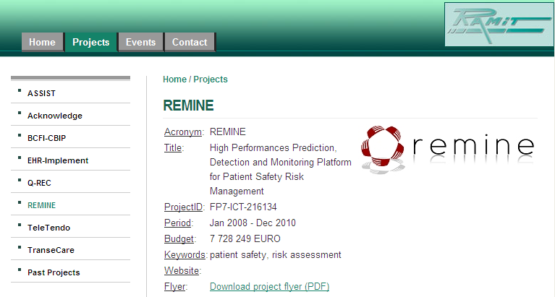
ReMINE Project
Ceusters W, Capolupo M, Smith B, De Moor G. An Evolutionary Approach to the Representation of Adverse Events. In: Medical Informatics Europe 2009, Sarajevo, Bosnia and Herzegovina, August 31, 2009. Studies in health technology and informatics 150;:537-541.

Slide 55
ReMINE’s notion of adverse event
  an ‘incident [that] occurred during the past and [is] documented in a database of adverse events’
      Stefano Arici, Paolo Bertele. ReMINE Deliverable D4.1 – RAPS Taxonomy: approach and definition. V1.0 (Final) August 8, 2008. (p21)
… which is a ‘perdurant’ - ibidem (p26)
… ‘that occurs to a patient’ - ibidem (p23)
  an expectation of some future happening that can be prevented - ibidem (p23)

Slide 56
Terminologists agree, ontologists think …
Can something which is an incident be at the same time an expectation ?
Can something which is an incident a time t, later become an adverse event simply because it [?] has been entered in a database ?
Can adverse events really occur in software ?
…

Slide 57
Intermediate conclusion
The ReMINE taxonomy (and all concept-based terminologies and ‘ontologies’ in general) provides a distorted view of reality.
For good reasons: the distortion is such that
  it reflects a pragmatic view on what is relevant for the purposes it is designed,
  it does away with complexities that do not help human beings in doing a better job.
But with some negative consequences:
  reusability out of the ReMINE context is hampered,
  integration with other descriptive systems becomes cumbersome, and
  advanced reasoning turns out to be impossible.

Slide 58
Using the 3 levels and the particular/universal/class distinctions
Level 1:
  #1: an incident that happened in the past;
Level 2:
  #2: the interpretation by some cognitive agent that #1 is an adverse event;
  #3: the expectation by some cognitive agent that similar incidents might happen in the future;
Level 3:
  #4: an entry in the adverse event database concerning #1;
  #5: an entry in some other system about #3 for mitigation or prevention purposes.

Slide 59
Allows appropriate error management
Some possibilities:
  #1with unjustified absence of #2:
    #1 was not perceived at all, or not assessed as being an adverse event
  Unjustified presence of #2:
    There was no #1 at all, or #1 was not an adverse event
  Unjustified absence of #4
    Same reasons as under (1) above
    Justified presence of #2 but not reported in the database
  …
Ceusters W, Smith B. A Realism-Based Approach to the Evolution of Biomedical Ontologies.
Proceedings of AMIA 2006, Washington DC, 2006;:121-125.

Slide 60
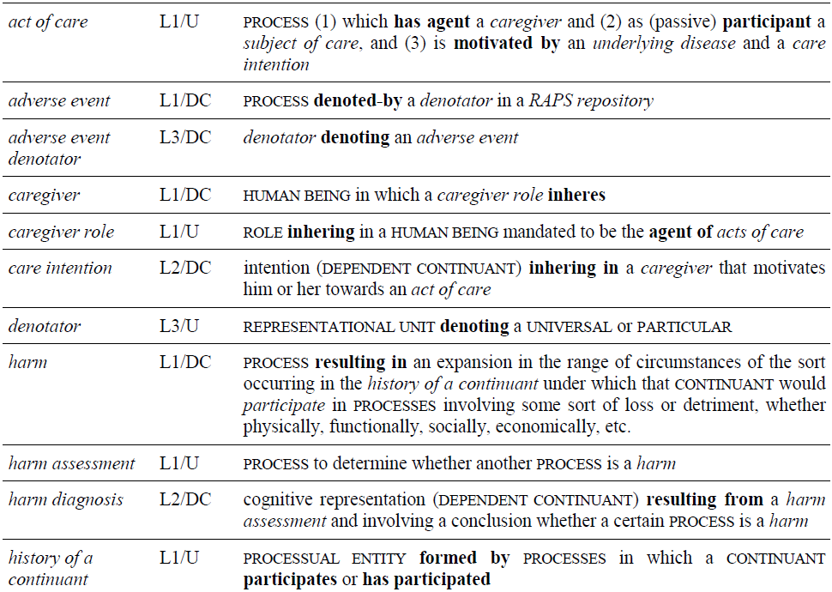
Part of the ReMINE Domain Ontology

Slide 61
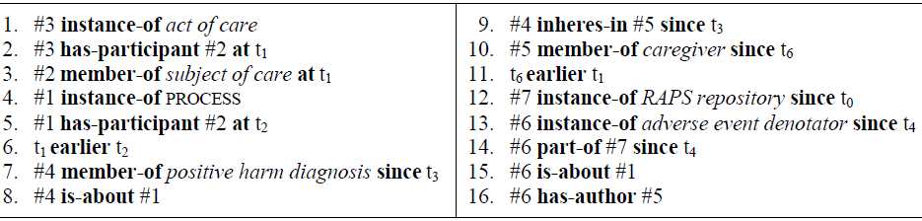
Higher order logical representation
an incident (#1) that happened at time t2 to a patient (#2) after some intervention (#3 at t1)
is judged at t3 to be an adverse event, thereby giving rise to a belief (#4) about #1 on
the part of some person (#5, a caregiver as of time t6).
This requires the introduction (at t4) of an entry (#6) in the adverse event database (#7, installed at t0).

Slide 62
Advantages
Synchronisation of two distinct representations of the same reality:
  taxonomies:
    user-oriented view
    data annotation
Domain ontology compatible with OBO-Foundry ontologies:
  no overlap,
  easier to re-use.
Not only tracking of incidents, but also:
  how well individual clinicians and organizations manage adverse events,
  how well one learns from past experiences.
  ontologies:
    realism-based view
    unconstrained reasoning

