Slide 1
Symposium on Ontology Evaluation
Ontological Realism and the Evolution of Biomedical Ontologies
Buffalo NY, December 3, 2012
Werner CEUSTERS
Center of Excellence in Bioinformatics and Life Sciences
Institute for Healthcare Informatics
University at Buffalo, NY, USA
http://www.org.buffalo.edu/RTU

Slide 2
A realist view of the world
The world exists ‘as it is’ prior to a cognitive agent’s perception thereof;
Cognitive agents build up ‘in their minds’ cognitive representations of the world;
To make these representations publicly accessible in some enduring fashion, these agents create representational artifacts that are fixed in some medium.
Smith B, Kusnierczyk W, Schober D, Ceusters W. Towards a Reference Terminology for Ontology Research and Development in the Biomedical Domain. Proceedings of KR-MED 2006, November 8, 2006, Baltimore MD, USA

Slide 3
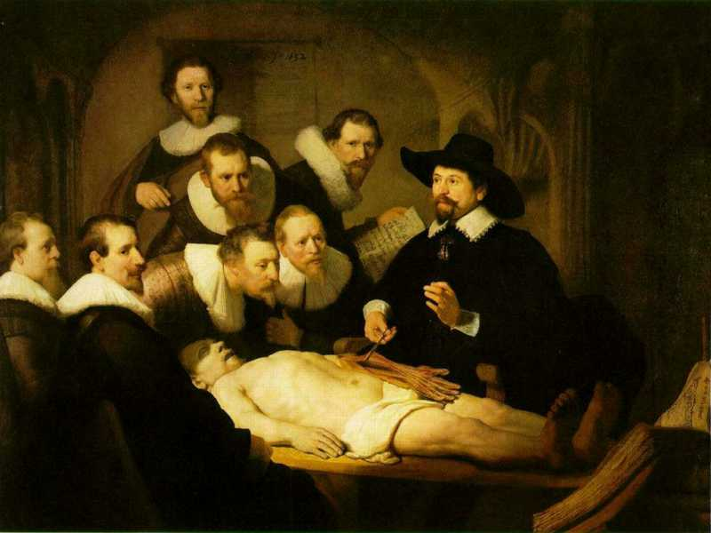
Three levels of reality in Ontological Realism
Representations
L3: linguistic representations about (1), (2) or (3)
L2: clinicians’ beliefs about (1)
L1: entities with objective existence
First Order Reality

Slide 4
Ontologies = Representational artifacts
Ideally built out of representational units and relationships that mirror the entities and their relationships in reality.
 | Non-Formalized | Formalized
Primarily about particulars | Progress notes, discharge letters, medical summaries, maps | Inventories, referent tracking database
Primarily about universals and defined classes | Medical textbooks, scientific theories | Ontologies, terminologies,

Slide 5
Some characteristics of representational units
each unit is assumed by the creators of the representation to be veridical, i.e. to conform to some relevant POR as conceived on the best current scientific understanding
several units may correspond to the same POR by presenting different though still veridical views or perspectives;
what is to be represented by the units in a representation depends on the purposes which the representation is designed to serve.

Slide 6
What influences the development of biomedical ontologies?
Level of biomedical reality:
  Persons, diseases, pathological structures and formations,... do exist as particulars (p, d, ps, pf, ... ) and universals (P, D, PS, PF, ...), and are related in specific ways prior to our perception;
  Biomedical reality changes:
    d’s, p’s, ... come and go; D’s, P’s, ...
Level of biomedical science and case perception:
  Mirrors reality only partially
  Evolves over time towards better understanding

Slide 7
What influences the development of ontologies?
Level of concretizations
  Mirrors biomedical science and case perception only partially
    Editing mistakes
    Leaving out diseases or pathological behaviours for non-biomedical reasons
      Smoking
    Adding non-pathological behaviour as a disease
      Homosexuality
    Leaving out wat is considered not relevant

Slide 8
For example: SNOMED CT’s updating principles
Changes in SNOMED CT are …
‘… driven by changes in understanding of health and disease processes; introduction of new drugs, investigations, therapies and procedures; new threats to health; as well as proposals and work provided by SNOMED partners and licensees’.
SNOMED CT® Technical Reference Guide – January 2007 Release, p43.

Slide 9
SNOMED CT implicitly references the levels
Changes in SNOMED CT are …
‘… driven by changes in understanding of health and disease processes; introduction of new drugs, investigations, therapies and procedures; new threats to health; as well as proposals and work provided by SNOMED partners and licensees’.
L1
L2
L3
SNOMED CT® Technical Reference Guide – January 2007 Release, p43.

Slide 10
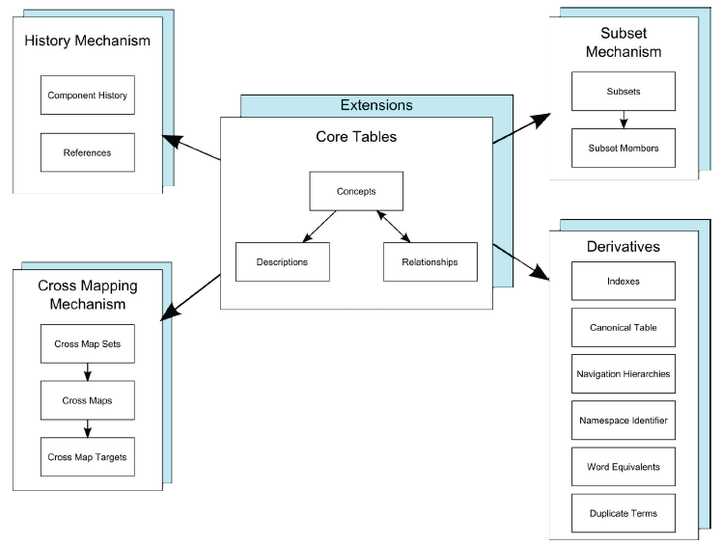
SNOMED CT Data Structure Summary
SNOMED CT® Technical Reference Guide – July 2010 Release, p17.

Slide 11
Reality versus beliefs, both in evolution
t
U1
U2
Reality
p3
IUI-#3
O-#0
O-#2
Belief
O-#1
= “denotes”
= what constitutes the (referential) meaning of representational units
…. Therefore: O-#0 is meaningless

Slide 12
Milestones in scientific discovery and case assessment.
U1
t
U2
R
p3
IUI-#3
O-#0
O-#2
B
O-#1

Slide 13
An “optimal” ontology (1)
Because ontologies, as conceived on realist terms,
  are artifacts created for some purpose (e.g. to serve as controlled vocabulary, or to provide domain knowledge to a software application),
  are at the same time intended to mirror reality,
  should allow reasoning which is efficient from a computational point of view,
we argue that an optimal ontology should constitute a representation of all and only those portions of reality that are relevant for its purpose.

Slide 14
An “optimal” ontology (2)
Each term in such an ontology would designate
  (1) a single portion of reality (POR), which is
  (2) relevant to the purposes of the ontology and such that
  (3) the authors of the ontology intended to use this term to designate this POR, and
  (4) there would be no PORs objectively relevant to these purposes that are not referred to in the ontology.

Slide 15
But things may go wrong …
assertion errors: ontology developers may be in error as to what is the case in their target domain;
relevance errors: they may be in error as to what is objectively relevant to a given purpose;
encoding errors: they may not successfully encode their underlying cognitive representations, so that particular representational units fail to point to the intended PORs.

Slide 16
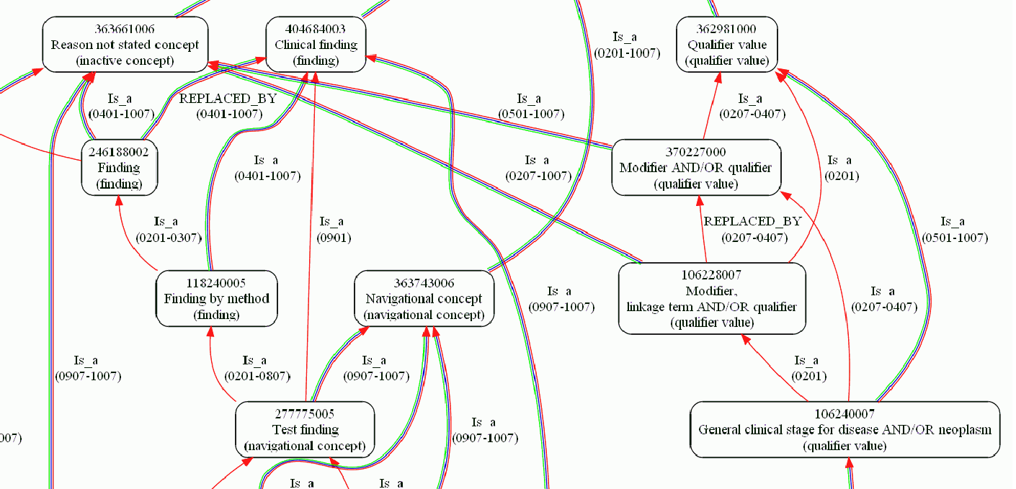
Changes in SNOMED CT

Slide 17
Key requirement for versioning
Any change in an ontology or data repository should be associated with the reason for that change to be able to assess later what kind of mistake has been made !

Slide 18
Example: a person (in this room) ’s gender in the EHR
In John Smith’s EHR:
  At t₁: “male” at t₂: “female”
What are the possibilities ?
Change in reality:
  transgender surgery
  change in legal self-identification
Change in understanding: it was female from the very beginning but interpreted wrongly
Correction of data entry mistake
  (was understood as male, but wrongly transcribed)

Slide 19
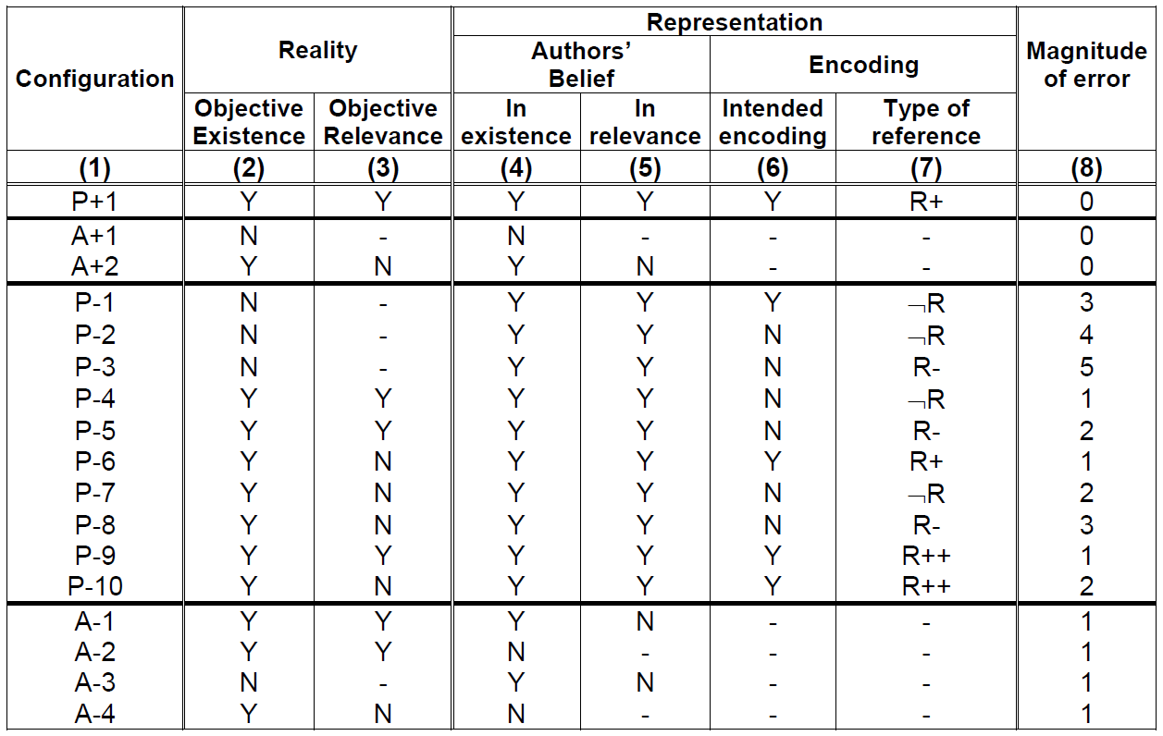
Relations between levels of reality

Slide 20
Ways representational units do or do not refer
OE/BE value pairs
Y/Y: correct assertion of the existence of a POR;
Y/N: lack of awareness of a POR, reflecting an assertion error;
N/N: correct assertion that some putative POR does not exist ;
N/Y: the false belief that some putative POR exists.

Slide 21
Ways representational units do or do not refer
Manners in which a RU refers
R+: the encoding of the belief is correct
¬R: the encoding is incorrect because
it does not refer
R-: it does refer, but to a POR other than the one which was intended
R++: a POR is denoted by
two distinct RUs

Slide 22
Updating is an active process
authors assume in good faith that
  all included representational units are of the P+1 type, and
  all they are aware of, but not included, of A+1 or A+2.
If they become aware of a mistake, they make a change under the assumption that their changes are also towards the P+1, A+1, or A+2 cases.
Thus at that time, they know of what type the previous entry must of have been under the belief what the current one is, and the reason for the change.

Slide 23
Effects of various sorts of changes
When something faithfully represented at t ceases to be faithful at t+1, leaving the ontology unchanged causes a P+1 to become a P-1.
When something faithfully represented at t is not believed to be faithful anymore at t+1 while in fact it still is, removing the representational element causes a P+1 to become a A-2.
…

Slide 24
This leads to a calculus …
NOT:
  to demonstrate how good an individual version of an ontology is,
But rather
  to measure how much it improved (hopefully) as compared to its predecessors.
Principle: recursive belief revision
Ceusters W. Applying Evolutionary Terminology Auditing to SNOMED CT. In American Medical Informatics Association 2010 Annual Symposium (AMIA 2010) Proceedings, Washington DC, November 13-17, 2010:96-100.

Slide 25
Quality of a representation w.r.t. reality
n: number of representational elements in the ontology
m: number of unjustified absences
e_{i}: magnitude of the error, if any, for the i ^{th} representational element
Ceusters W. Applying Evolutionary Terminology Auditing to the Gene Ontology.
Journal of Biomedical Informatics 2009;42:518–529.

Slide 26
Comparing representational artifacts
 | Reality | Terminology 1 |  | Terminology 2 |  | Terminology 3
RU | Config. | Config. | Error | Config. | Error | Config. | Error
animal | P+1 | P+1 | 0 | P+1 | 0 | P+1 | 0
fish | P+1 | P+1 | 0 | P+1 | 0 | P+1 | 0
whale | P+1 | P+1 | 0 | P+1 | 0 | P+1 | 0
mammal | P+1 | P+1 | 0 | P+1 | 0 | P+1 | 0
fish are animals | P+1 | P+1 | 0 | P+1 | 0 | P+1 | 0
mammals are animals | P+1 | P+1 | 0 | P+1 | 0 | P+1 | 0
whales are fish | A+1 | P-1 | 3 | A+1 | 0 | A+1 | 0
whales are animals | P+1 | P+1 | 0 | P+1 | 0 | P+1 | 0
whales are mammals | P+1 | A-2 | 1 | A-2 | 1 | P+1 | 0
SCORE | 8*5/ ((8*5)+(0*4)) = 1.00 | ((7*5)+(1*2))/ ((8*5)+(1*4)) =0.84 |  | 7*5/ ((7*5)+(1*4)) =0.90 |  | 8*5/ ((8*5)+(0*4)) =1.00

Slide 27
Comparing consecutive versions
 | Time t1 |  | Time t2 |  |  |  | Time t3
 | T1 |  | T1 |  | T2 |  | T1 |  | T2 |  | T3
 | C. | E. | C. | E. | C. | E. | C. | E. | C. | E. | C. | E.
animal | P+1 | 0 | P+1 | 0 | P+1 | 0 | P+1 | 0 | P+1 | 0 | P+1 | 0
fish | P+1 | 0 | P+1 | 0 | P+1 | 0 | P+1 | 0 | P+1 | 0 | P+1 | 0
whale | P+1 | 0 | P+1 | 0 | P+1 | 0 | P+1 | 0 | P+1 | 0 | P+1 | 0
mammal | P+1 | 0 | P+1 | 0 | P+1 | 0 | P+1 | 0 | P+1 | 0 | P+1 | 0
fish are animals | P+1 | 0 | P+1 | 0 | P+1 | 0 | P+1 | 0 | P+1 | 0 | P+1 | 0
mammals are animals | P+1 | 0 | P+1 | 0 | P+1 | 0 | P+1 | 0 | P+1 | 0 | P+1 | 0
whales are fish | P+1 | 0 | P-1 | 3 | A+1 | 0 | P-1 | 3 | A+1 | 0 | A+1 | 0
whales are animals | P+1 | 0 | P+1 | 0 | P+1 | 0 | P+1 | 0 | P+1 | 0 | P+1 | 0
whales are mammals | - | - | - | - | - | - | A-2 | 1 | A-2 | 1 | P+1 | 0
SCORE | 1.00 |  | 0.93 |  | 1.00 |  | 0.84 |  | 0.90 |  | 1.00

Slide 28
Detail of calculations
Terminology | Time of assessment | Formula for quality score | Quality Score
 | t1 | (8*5)/(8*5) | 1.00
T1 | t2 | ((7*5)+(1*2))/(8*5) | 0.93
 | t3 | ((7*5)+(1*2))/((8*5)+(1*4)) | 0.84
T2 | t2 | (7*5)/(7*5) | 1.00
 | t3 | (7*5)/((7*5)+(1*4)) | 0.90
T3 | t3 | (8*5)/((8*5)+(0*4)) | 1.00

Slide 29
Example: SNOMED CT’s updating principles (2)
If the Concept’s meaning changes, the Concept is made inactive. One or more new Concepts are usually added to better represent the meaning of the old Concept.
Concepts may become inactive but are never deleted.
Concept identifiers are persistent over time and are never reused.
The link between a Description and a Concept is persistent. If a Description is no longer pertinent for a Concept, the Description is inactivated.
SNOMED CT® Technical Reference Guide – January 2007 Release, p43.

Slide 30
SNOMED CT concept status values
ST
Concept Status
‘Historical relationships’
"SAME AS",
"REPLACED BY",
"WAS A",
"MAYBE A",
"MOVED TO",
"MOVED FROM"
0
active in current use
6
active with limited clinical value (classification concept or an administrative definition)
1
inactive: ‘retired’ without a specified reason
10
inactive because moved elsewhere
2
inactive: withdrawn because duplication
3
inactive because no longer recognized as a valid clinical concept (outdated)
4
inactive because inherently ambiguous.
5
inactive because found to contain a mistake
SNOMED CT® Technical Reference Guide – January 2007 Release, p43.

Slide 31
SNOMED CT concepts’ status (July 2011)
ST
Concept Status
N
%
0
active in current use
292,073
74.677%
6
active with limited clinical value (classification concept or an administrative definition)
20,930
5.35%
1
inactive: ‘retired’ without a specified reason
7,525
1.92%
10
inactive because moved elsewhere
14,451
3.69%
2
inactive: withdrawn because duplication
37,752
9.65%
3
inactive because no longer recognized as a valid clinical concept (outdated)
1,439
0.37%
4
inactive because inherently ambiguous.
15,858
4.05%
5
inactive because found to contain a mistake
1,142
0.29%
TOTAL
391,170
100%

Slide 32
SNOMED CT concept status values
ST
Concept Status
‘Historical relationships’
"SAME AS",
"REPLACED BY",
"WAS A",
"MAYBE A",
"MOVED TO",
"MOVED FROM"
0
active in current use
6
With the exception of ST=3, all are pure internal motivations.
ST=3 just hints to an external motivation, but doesn’t specify which one.
active with limited clinical value (classification concept or an administrative definition)
1
inactive: ‘retired’ without a specified reason
10
inactive because moved elsewhere
2
inactive: withdrawn because duplication
3
inactive because no longer recognized as a valid clinical concept (outdated)
4
inactive because inherently ambiguous.
5
inactive because found to contain a mistake
SNOMED CT® Technical Reference Guide – January 2007 Release, p43.

Slide 33
Is it possible to translate status into error-values?
ST
Concept Status
‘Historical relationships’
"SAME AS",
"REPLACED BY",
"WAS A",
"MAYBE A",
"MOVED TO",
"MOVED FROM"
0
active in current use
6
active with limited clinical value (classification concept or an administrative definition)
1
inactive: ‘retired’ without a specified reason
10
inactive because moved elsewhere
2
inactive: withdrawn because duplication
3
inactive because no longer recognized as a valid clinical concept (outdated)
4
inactive because inherently ambiguous.
5
inactive because found to contain a mistake
SNOMED CT® Technical Reference Guide – January 2007 Release, p43.

Slide 34
Some principles used
all new introductions are unjustifiably missing in earlier versions.
  is adequate for most types of concepts, except for pharmaceutical products and certain information artifacts such as newly constructed rating scales or named guidelines and protocols;
‘duplicate’ translates into P-9;
sample of 1000 changes to find common principles.

Slide 35
Translating SNOMED-status into error types
Status | Existing concept made … | Error Type
0 | active: in current use | A-1
1 | inactive: ‘retired’ without a specified reason | P-1
2 | inactive: withdrawn because duplication | P-9
3 | inactive because no longer recognized as a valid clinical concept (outdated) | P-1
4 | inactive because inherently ambiguous. | P-4
5 | inactive because found to contain a mistake | P-1
6 | active with limited clinical value (classification concept or an administrative definition) | A-1
10 | inactive because moved elsewhere | P-6
11 | pending move | P-6

Slide 36
Views on versions of SNOMED-CT

Slide 37
Evolutionary view on the Jan 2002 release of SNOMED CT
concepts
descriptions
overall
relationships

Slide 38
Quality change of SNOMED CT (200201-200907)
concepts
descriptions
overall
relationships

Slide 39
Limitations (1)
We did not find any principle underlying the assignment of ‘inactive, reason not specified’ and ‘erroneous’.
All concepts with the status ‘outdated’ in our sample involved organisms.
The majority of concepts stated to be inactivated for reasons of ‘ambiguity’ do in our opinion not look ambiguous at all, as further witnessed by the fact that some of them have been replaced by a concept with an identical name.

Slide 40
Limitations (2)
Lack of resources might prevent changes to be introduced although the authors know it has to be done at some point.
  thus a released version is perhaps not assumed to reflect state of the art
the disappearance of a relationship in a newer version might not be a real disappearance since the relationship might still be inferred from the graph structure underlying SNOMED CT.

Slide 41
Conclusions
Our quality assessments are
  upper bounds for concepts and descriptions,
  lower bounds for relationships.
Accurate calculations are only possible if SNOMED would provide reasons for change along the lines described.
The move towards a new information/distribution model might be a good opportunity to start doing so.

Slide 42
Some applications
predicting quality evolutions of ontologies
deciding when to update an information system with a new version of an ontology
Ceusters W.
SNOMED CT Revisions and Coded Data Repositories: When to Upgrade?
In American Medical Informatics Association 2011 Annual Symposium Proceedings, Washington DC, October 22-26, 2011:197-206
Ceusters W.
Applying Evolutionary Terminology Auditing to the Gene Ontology.
Journal of Biomedical Informatics 2009;42:518–529.

Slide 43
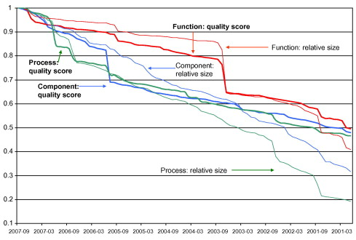
Gene Ontology quality evolution 2001 - 2007

Slide 44
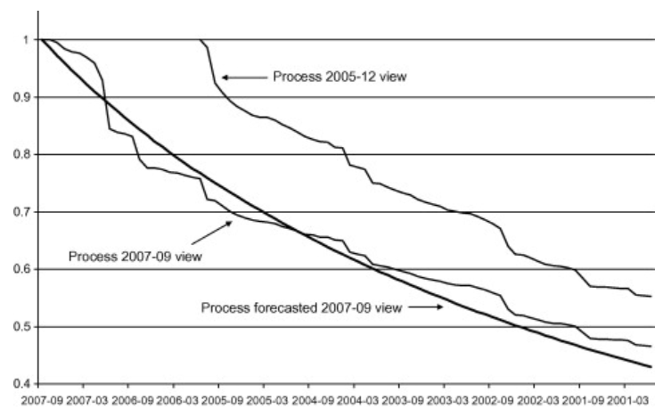
Quality forecasting

Slide 45
When installing a new version of SNOMED CT?
Observations:
    SNOMED CT undergoes considerable changes over time
    applications use typically only a small subset of it
    integrating new SNOMED CT versions is troublesome
Questions:
    does within the scope of a specific application a new version of SNOMED CT contain more - and of better quality - knowledge than its predecessor or is it a mere reformulation of the same amount of knowledge?
    if the former, can this be computed in order to find out when it is worthwhile to upgrade to a new version?

Slide 46
Methodology (1)
Study a subset of 883 SNOMED CT concepts used within a cancer clinic for encoding synoptic pathology reports and tumor registry data and for querying a biospecimen repository (source concepts - SC);
  motivation: real application use case.
Compute for each source concept the transitive closure set (target concepts - TC) of the Is a relation and all historical relations for each SNOMED CT version from January 2002 to July 2010, together with their concept status and path length to the source concept;
  motivation: information content is partially based on the graph structure,
  result: the 883 SCs were linked by means of 15,689 relationships to 1,415 TCs.

Slide 47
Transitive closure sets for Surgical margins involved by tumor (finding)
Rel-ID | Version |  |  |  |  |  |  |  |  |  |  |  |  |  |  |  |  |  | Rel-Type | Target Concept
 | 1 | 2 | 3 | 4 | 5 | 6 | 7 | 8 | 9 | 10 | 11 | 12 | 13 | 14 | 15 | 16 | 17 | 18
H-18608 | 6 | 6 | 7 | 4 | 4 | 4 | 4 | 4 | 4 | 4 | 4 | 4 | 4 | 4 | 4 | 4 | 4 | 4 | Is a | SNOMED CT Concept (SNOMED RT+CTV3)
H-23694 | 5 | 5 | 6 |  |  |  |  |  |  |  |  |  |  |  |  |  |  |  | Is a | Finding (finding)
H-18607 | 4 | 4 | 5 |  |  |  |  |  |  |  |  |  |  |  |  |  |  |  | Is a | Finding by method (finding)
H-12792 | 3 | 3 | 4 |  |  |  |  |  |  |  |  |  |  |  |  |  |  |  | Is a | Test finding (navigational concept)
H-12789 | 3 | 3 | 3 |  |  |  |  |  |  |  |  |  |  |  |  |  |  |  | Is a | Laboratory test finding (navigational concept)
H-07371 | 2 | 2 | 2 |  |  |  |  |  |  |  |  |  |  |  |  |  |  |  | Is a | Sample finding (finding)
H-07373 | 2 | 2 |  |  |  |  |  |  |  |  |  |  |  |  |  |  |  |  | Is a | Morphologic finding (finding)
220039029 | 1 | 1 |  |  |  |  |  |  |  |  |  |  |  |  |  |  |  |  | Is a | Clinical sample finding (finding)
H-07370 |  |  | 3 |  |  |  |  |  |  |  |  |  |  |  |  |  |  |  | Is a | Histopathology finding (finding)
H-07368 |  |  | 2 |  |  |  |  |  |  |  |  |  |  |  |  |  |  |  | Is a | General pathology (finding)
H-07369 |  |  | 2 |  |  |  |  |  |  |  |  |  |  |  |  |  |  |  | Is a | Laboratory finding present (navigational concept)
2030386023 |  |  | 1 |  |  |  |  |  |  |  |  |  |  |  |  |  |  |  | Is a | Pathology examination findings present (finding)
2030387025 |  |  | 1 |  |  |  |  |  |  |  |  |  |  |  |  |  |  |  | Is a | Surgical margin finding (finding)
…

Slide 48
Computations over SNOMED CT’s
‘historical relationships’
C1→C2 | C2→C3 | C1→C3
Is a | Is a | Is a
Is a | IsA | IsA
IsA | Is a | IsA
IsA | IsA | IsA
SAME AS | Is a | IsA
SAME AS | IsA | IsA
Is a | SAME AS | IsA
IsA | SAME AS | IsA

Slide 49
Transitive closure sets for Surgical margins involved by tumor (finding)
Rel-ID | Version |  |  |  |  |  |  |  |  |  |  |  |  |  |  |  |  |  | Rel-Type | Target Concept
 | 1 | 2 | 3 | 4 | 5 | 6 | 7 | 8 | 9 | 10 | 11 | 12 | 13 | 14 | 15 | 16 | 17 | 18
H-18608 | 6 | 6 | 7 | 4 | 4 | 4 | 4 | 4 | 4 | 4 | 4 | 4 | 4 | 4 | 4 | 4 | 4 | 4 | Is a | SNOMED CT Concept (SNOMED RT+CTV3)
H-23694 | 5 | 5 | 6 |  |  |  |  |  |  |  |  |  |  |  |  |  |  |  | Is a | Finding (finding)
H-18182 |  |  |  | 8 | 8 | 8 | 8 | 8 | 8 | 8 | 8 | 8 | 8 | 8 | 7 | 6 | 6 | 6 | IsA | SNOMED CT Concept (SNOMED RT+CTV3)
H-27662 |  |  |  | 7 |  |  |  |  |  |  |  |  |  |  |  |  |  |  | IsA | Finding (finding)
H-23376 |  |  |  | 6 | 6 | 6 | 6 | 6 | 6 | 6 | 6 | 6 | 6 | 6 |  |  |  |  | IsA | Finding by method (finding)
H-18183 |  |  |  | 5 | 5 | 5 | 5 | 5 | 5 | 5 | 5 | 5 | 5 | 5 | 5 |  |  |  | IsA | Test finding (navigational concept)
H-07379 |  |  |  | 4 | 4 | 4 | 4 | 4 | 4 | 4 | 4 | 4 | 4 | 4 | 4 | 3 | 3 | 3 | IsA | Histopathology finding (finding)
H-12412 |  |  |  | 4 | 4 | 4 | 4 | 4 | 4 | 4 | 4 | 4 | 4 | 4 | 4 |  |  |  | IsA | Laboratory test finding (navigational concept)
H-07380 |  |  |  | 4 | 4 | 4 | 4 | 4 | 4 | 4 | 4 | 4 | 4 | 4 | 4 |  |  |  | IsA | Sample finding (finding)
H-12418 |  |  |  | 4 | 4 | 4 | 4 | 4 | 4 | 4 | 4 | 4 | 4 | 4 | 4 |  |  |  | IsA | Morphologic finding (finding)
H-07378 |  |  |  | 3 | 3 | 3 | 3 | 3 | 3 | 3 | 3 | 3 | 3 | 3 | 3 | 3 | 3 | 3 | IsA | General pathology (finding)
H-12793 |  |  |  | 3 | 3 | 3 | 3 | 3 | 3 | 3 | 3 | 3 | 3 | 3 | 3 | 3 | 3 | 3 | Is a | Special concept (special concept)
H-07377 |  |  |  | 3 | 3 | 3 | 3 | 3 | 3 | 3 | 3 | 3 | 3 | 3 | 3 |  |  |  | IsA | Clinical sample finding (finding)
H-07381 |  |  |  | 3 | 3 | 3 | 3 | 3 | 3 | 3 | 3 | 3 | 3 | 3 | 3 |  |  |  | IsA | Laboratory finding present (navigational concept)
H-07374 |  |  |  | 2 | 2 | 2 | 2 | 2 | 2 | 2 | 2 | 2 | 2 | 2 | 2 | 2 | 2 | 2 | Is a | Inactive concept (inactive concept)
H-07382 |  |  |  | 2 | 2 | 2 | 2 | 2 | 2 | 2 | 2 | 2 | 2 | 2 | 2 | 2 | 2 | 2 | IsA | Pathology examination findings present (finding)
H-07384 |  |  |  | 2 | 2 | 2 | 2 | 2 | 2 | 2 | 2 | 2 | 2 | 2 | 2 | 2 | 2 | 2 | IsA | Surgical margin finding (finding)
2228147020 |  |  |  | 1 | 1 | 1 | 1 | 1 | 1 | 1 | 1 | 1 | 1 | 1 | 1 | 1 | 1 | 1 | Is a | Duplicate concept (inactive concept)
2295897028 |  |  |  | 1 | 1 | 1 | 1 | 1 | 1 | 1 | 1 | 1 | 1 | 1 | 1 | 1 | 1 | 1 | SAME AS | Surgical margin involved by tumor (finding)
H-18186 |  |  |  |  | 7 | 7 | 7 | 7 | 7 | 7 | 7 | 7 | 7 | 7 | 6 | 5 | 5 | 5 | IsA | Clinical finding (finding)
H-12417 |  |  |  |  |  |  |  |  |  |  |  |  |  |  |  | 4 | 4 | 4 | IsA | Evaluation finding (finding)

Slide 50
Methodology (2)
compute for each TC in each version of SNOMED CT the genericity:
    i.e. the number of times a TC appears in the paths from all SCs to the root.
3
2
1
1
1

Slide 51
Methodology (2)
compute for each TC in each version of SNOMED CT the genericity:
    i.e. the number of times a TC appears in the paths from all SCs to the root.
compute for each SC in each version its information content:
    i.e. the sum of the values obtained by dividing the genericity of each TC on a path from the SC to the top by the respective path lengths from SC to TC.

Slide 52
IC for SC ‘pN1b: Metastasis in internal mammary lymph nodes with microscopic disease detected by sentinel lymph node dissection but not clinically apparent (breast) (finding)’.
Target Concepts | v1 | v2 | v3 | v4 | v5 | v6 | v7 | v8 | v9 | v10 | v11 | v12 | v13 | v14 | v15 | v16 | v17 | v18
SNOMED CT Concept (SNOMED RT+CTV3) | 0 | 58 | 56 | 103 | 139 | 104 | 104 | 104 | 93 | 93 | 93 | 93 | 93 | 93 | 93 | 93 | 93 | 93
Staging and scales (staging scale) | 0 | 9 | 0 | 0 | 0 | 0 | 0 | 0 | 0 | 0 | 0 | 0 | 0 | 0 | 0 | 0 | 0 | 0
Tumor staging (tumor staging) | 0 | 10 | 0 | 0 | 0 | 0 | 0 | 0 | 0 | 0 | 0 | 0 | 0 | 0 | 0 | 0 | 0 | 0
Cancer staging (tumor staging) | 0 | 5 | 0 | 0 | 0 | 0 | 0 | 0 | 0 | 0 | 0 | 0 | 0 | 0 | 0 | 0 | 0 | 0
Tumor-node-metastasis (TNM) tumor staging system (tumor staging) | 0 | 11 | 0 | 0 | 0 | 0 | 0 | 0 | 0 | 0 | 0 | 0 | 0 | 0 | 0 | 0 | 0 | 0
[cut]
Finding (finding) | 0 | 0 | 19 | 57 | 0 | 0 | 0 | 0 | 0 | 0 | 0 | 0 | 0 | 0 | 0 | 0 | 0 | 0
Clinical history and observation findings (finding) | 0 | 0 | 16 | 54 | 0 | 54 | 54 | 54 | 46 | 46 | 46 | 46 | 46 | 46 | 46 | 46 | 46 | 46
Clinical finding (finding) | 0 | 0 | 19 | 64 | 0 | 0 | 0 | 0 | 0 | 0 | 0 | 0 | 0 | 0 | 0 | 0 | 0 | 0
Tumor finding (finding) | 0 | 0 | 22 | 80 | 81 | 81 | 81 | 81 | 65 | 65 | 65 | 65 | 65 | 65 | 65 | 65 | 65 | 65
Node category finding (finding) | 0 | 0 | 5 | 10 | 11 | 11 | 11 | 11 | 11 | 11 | 11 | 11 | 11 | 11 | 11 | 11 | 11 | 11
Tumor stage finding (finding) | 0 | 0 | 18 | 0 | 0 | 0 | 0 | 0 | 56 | 56 | 56 | 56 | 56 | 56 | 56 | 56 | 56 | 56
Tumor-node-metastasis (TNM) tumor staging finding (finding) | 0 | 0 | 22 | 71 | 73 | 73 | 73 | 73 | 73 | 73 | 73 | 73 | 73 | 73 | 73 | 73 | 73 | 73
pN category finding (finding) | 0 | 0 | 6 | 14 | 15 | 15 | 15 | 15 | 15 | 15 | 15 | 15 | 15 | 15 | 15 | 15 | 15 | 15
N1 category (finding) | 0 | 0 | 3 | 7 | 8 | 8 | 8 | 0 | 0 | 0 | 0 | 0 | 0 | 0 | 0 | 0 | 0 | 0
Breast TNM finding (finding) | 0 | 0 | 10 | 10 | 12 | 12 | 12 | 12 | 12 | 12 | 12 | 12 | 12 | 12 | 12 | 12 | 12 | 12
Clinical finding (finding) | 0 | 0 | 0 | 0 | 88 | 63 | 63 | 63 | 55 | 55 | 55 | 55 | 55 | 55 | 55 | 55 | 55 | 55
Finding of lesion (finding) | 0 | 0 | 0 | 0 | 0 | 65 | 65 | 65 | 54 | 54 | 54 | 54 | 54 | 54 | 54 | 54 | 54 | 54
pN1b category (finding) | 0 | 0 | 0 | 0 | 0 | 0 | 0 | 0 | 0 | 0 | 0 | 0 | 0 | 0 | 0 | 0 | 4 | 4
Total Information content | 0 | 123 | 203 | 484 | 440 | 500 | 500 | 492 | 493 | 493 | 493 | 493 | 493 | 493 | 493 | 493 | 498 | 498

Slide 53
Methodology (2)
compute for each TC in each version of SNOMED CT the genericity:
    i.e. the number of times a TC appears in the paths from all SCs to the root.
compute for each SC in each version its information content:
    i.e. the sum of the values obtained by dividing the genericity of each TC on a path from the SC to the top by the respective path lengths from SC to TC.
compute the relevant information content of a version as the sum of the information contents of all SCs in that version.

Slide 54
Hypothesis
the evolution of the information content of the versions over time can be used as an indicator to decide whether to upgrade to a new version.
IC evolution of 18 SNOMED CT versions relative to the 883 SCs

Slide 55
Methodology (3)
intermediate inspection of the transitive closure sets reveals that the evolution thereof contains indicators for mistakes and corrections thereof:
Target Concepts | v1 | v2 | v3 | v4 | v5 | v6 | v7 | v8 | v9 | v10 | v11 | v12 | v13 | v14 | v15 | v16 | v17 | v18
SNOMED CT Concept (SNOMED RT+CTV3) | 0 | 58 | 56 | 103 | 139 | 104 | 104 | 104 | 93 | 93 | 93 | 93 | 93 | 93 | 93 | 93 | 93 | 93
[cut]
Finding (finding) | 0 | 0 | 19 | 57 | 0 | 0 | 0 | 0 | 0 | 0 | 0 | 0 | 0 | 0 | 0 | 0 | 0 | 0
Clinical history and observation findings (finding) | 0 | 0 | 16 | 54 | 0 | 54 | 54 | 54 | 46 | 46 | 46 | 46 | 46 | 46 | 46 | 46 | 46 | 46
Clinical finding (finding) | 0 | 0 | 19 | 64 | 0 | 0 | 0 | 0 | 0 | 0 | 0 | 0 | 0 | 0 | 0 | 0 | 0 | 0
Tumor finding (finding) | 0 | 0 | 22 | 80 | 81 | 81 | 81 | 81 | 65 | 65 | 65 | 65 | 65 | 65 | 65 | 65 | 65 | 65
Node category finding (finding) | 0 | 0 | 5 | 10 | 11 | 11 | 11 | 11 | 11 | 11 | 11 | 11 | 11 | 11 | 11 | 11 | 11 | 11
Tumor stage finding (finding) | 0 | 0 | 18 | 0 | 0 | 0 | 0 | 0 | 56 | 56 | 56 | 56 | 56 | 56 | 56 | 56 | 56 | 56
pN category finding (finding) | 0 | 0 | 6 | 14 | 15 | 15 | 15 | 15 | 15 | 15 | 15 | 15 | 15 | 15 | 15 | 15 | 15 | 15
N1 category (finding) | 0 | 0 | 3 | 7 | 8 | 8 | 8 | 0 | 0 | 0 | 0 | 0 | 0 | 0 | 0 | 0 | 0 | 0
Breast TNM finding (finding) | 0 | 0 | 10 | 10 | 12 | 12 | 12 | 12 | 12 | 12 | 12 | 12 | 12 | 12 | 12 | 12 | 12 | 12
Clinical finding (finding) | 0 | 0 | 0 | 0 | 88 | 63 | 63 | 63 | 55 | 55 | 55 | 55 | 55 | 55 | 55 | 55 | 55 | 55
Finding of lesion (finding) | 0 | 0 | 0 | 0 | 0 | 65 | 65 | 65 | 54 | 54 | 54 | 54 | 54 | 54 | 54 | 54 | 54 | 54
pN1b category (finding) | 0 | 0 | 0 | 0 | 0 | 0 | 0 | 0 | 0 | 0 | 0 | 0 | 0 | 0 | 0 | 0 | 4 | 4
Total Information content | 0 | 123 | 203 | 484 | 440 | 500 | 500 | 492 | 493 | 493 | 493 | 493 | 493 | 493 | 493 | 493 | 498 | 498

Slide 56
Appearances and disappearances of TCs
 | TimePattern
Relation | Contiguous |  |  |  | Non-contiguous
present in no. |  |  |  |  | Two blocks |  |  |  | Three blocks
of versions | B | BS | SBS | SB | BSB | BSBS | SBSBS | SBSB | BSBSB | SBSBSB | Totals | %
18 | 4316 |  |  |  |  |  |  |  |  |  | 4316 | 27.51%
17 |  | 4 |  | 333 | 37 |  |  |  |  |  | 374 | 2.38%
16 |  | 1 |  | 957 | 22 |  |  | 2 |  |  | 982 | 6.26%
15 |  | 9 | 4 | 2804 | 2 | 5 |  | 111 |  |  | 2935 | 18.71%
14 |  | 17 | 49 | 712 | 17 | 1 |  | 210 |  |  | 1006 | 6.41%
13 |  | 58 | 159 | 471 | 10 | 6 |  |  |  |  | 704 | 4.49%
12 |  | 13 | 362 | 344 |  | 2 |  | 3 |  |  | 724 | 4.61%
11 |  | 8 | 70 | 649 | 7 | 1 |  | 24 | 1 |  | 760 | 4.84%
10 |  | 21 | 22 | 38 | 10 |  |  | 5 |  |  | 96 | 0.61%
9 |  | 251 | 11 | 98 |  |  | 1 | 1 |  |  | 362 | 2.31%
8 |  | 3 | 25 | 112 | 8 |  |  | 4 |  |  | 152 | 0.97%
7 |  | 27 | 9 | 6 | 1 |  |  | 1 |  | 1 | 45 | 0.29%
6 |  | 13 | 35 | 13 |  |  |  |  |  |  | 61 | 0.39%
5 |  | 48 | 60 | 316 |  |  |  | 1 |  |  | 425 | 2.71%
4 |  | 8 | 160 | 75 | 1 | 2 |  | 1 |  |  | 247 | 1.57%
3 |  | 225 | 41 | 307 |  | 2 |  |  |  |  | 575 | 3.66%
2 |  | 280 | 386 | 184 |  |  |  |  |  |  | 850 | 5.42%
1 |  | 224 | 779 | 72 |  |  |  |  |  |  | 1075 | 6.85%
Totals | 4316 | 1210 | 2172 | 7491 | 115 | 19 | 1 | 363 | 1 | 1 | 15689 | 100.00%
 | 15189 |  |  |  | 500 |  |  |  |  |  | 15689 | 100.00%

Slide 57
How to read this table
 | TimePattern
Relation | Contiguous |  |  |  | Non-contiguous
present in no. |  |  |  |  | Two blocks |  |  |  | Three blocks
of versions | B | BS | SBS | SB | BSB | BSBS | SBSBS | SBSB | BSBSB | SBSBSB | Totals | %
18 | 4316 |  |  |  |  |  |  |  |  |  | 4316 | 27.51%
17 |  | 4 |  | 333 | 37 |  |  |  |  |  | 374 | 2.38%
16 |  | 1 |  | 957 | 22 |  |  | 2 |  |  | 982 | 6.26%
15 |  | 9 | 4 | 2804 | 2 | 5 |  | 111 |  |  | 2935 | 18.71%
14 |  | 17 | 49 | 712 | 17 | 1 |  | 210 |  |  | 1006 | 6.41%
13 |  | 58 | 159 | 471 | 10 | 6 |  |  |  |  | 704 | 4.49%
12 |  | 13 | 362 | 344 |  | 2 |  | 3 |  |  | 724 | 4.61%
11 |  | 8 | 70 | 649 | 7 | 1 |  | 24 | 1 |  | 760 | 4.84%
10 |  | 21 | 22 | 38 | 10 |  |  | 5 |  |  | 96 | 0.61%
9 |  | 251 | 11 | 98 |  |  | 1 | 1 |  |  | 362 | 2.31%
8 |  | 3 | 25 | 112 | 8 |  |  | 4 |  |  | 152 | 0.97%
7 |  | 27 | 9 | 6 | 1 |  |  | 1 |  | 1 | 45 | 0.29%
Of the 45 relations that are present in 7 versions, 27 exhibits a ‘BS’ pattern, 9 a ‘SBS’ pattern, …
  ‘B’ stands for ‘block’ thus present, ‘S’ for ‘space’, thus absent
Example (the one ‘SBSBSB’ in the sample):
  000004003334400001 Ulcerative colitis Is a Inflammatory bowel disease
    numbers indicate path distance from SC to TC in each of the 18 versions studied (‘0’ = absence)

Slide 58
Intermediate Findings
in some versions target concepts for the source concept disappeared from the transitive closure set while reappearing in later versions.
when target concepts permanently disappeared from the transitive closure set, this could not always be explained by the retirement of the target concept within the corresponding version.
  Indicates a mistake or correction of a mistake
    → suspicious event.

Slide 59
Methodology (3)
Intermediate inspection of the transitive closure sets reveals that the evolution thereof contains indicators for mistakes and corrections thereof.
Mark each SC / TC pair as being the seat (or not) of a suspicious event on the basis of the concept status of the TC:
  if a TC is retired and the SC/TC pair disappears, then no suspicious event
  if a pair appears or disappears otherwise, there is a suspicious event
If a change is marked in some version as being a suspicious event, it stays marked as such until in some later version – if at all – another change occurs that no longer meets the requirements for being suspicious.
Compute for each version tallies for all such events over all previous versions until another change was effected.

Slide 60
Evolution of suspicious events
N Binary %
Unmarked 15689
Stay unmarked 11182 71.27%
Become suspicious 4507 28.73%
Stay suspicious 1812 40.20%
Become unmarked 2695 59.80%
Stay unmarked 2296 85.19%
Become suspicious 399 14.81%
Stay suspicious 332 83.21%
Become unmarked 67 16.79%
Stay unmarked 66 98.51%
Become suspicious 1 1.49%
Stay suspicious 0 0.00%
Become unmarked 1 100.00%

Slide 61
Hypothesis
the evolution of the information content of the versions over time can be used as an indicator to decide whether to upgrade to a new version.
the evolution of the suspicious event tallies over time, i.e. the suspicious event perseverance, yields a second indicator for migrating to a new version of SNOMED CT.

Slide 62
Evolution of suspicious event perseverance
Evolution of suspicious event perseverance of all source concept/target concept.

Slide 63
First selection of indicators for upgrade
Upgrade from V_{x} to V_{x+n} if:
  the information content of V_{x+n} is greater than of V_{x}
  or
  the suspicious event perseverance is lower in V_{x+n} than in V_{x}

Slide 64
Results
Version |  | Information content | Suspicious event perseverance
v1 | January 2002 | 79,424.5499 | 
v2 | July 2002 | 88,838.2435 | 
v3 | January 2003 | 127,864.0057 | 
v4 | July 2003 | 368,261.2260 | 
v5 | January 2004 | 360,409.8979 | 
v6 | July 2004 | 388,775.7097 | 
v7 | January 2005 | 390,637.7034 | 
v8 | July 2005 | 401,196.6372 | 
v9 | January 2006 | 389,021.8138 | 
v10 | July 2006 | 387,226.2485 | 
v11 | January 2007 | 386,714.4974 | 
v12 | July 2007 | 386,816.9581 | 
v13 | January 2008 | 386,803.0803 | 
v14 | July 2008 | 386,075.3172 | 
v15 | January 2009 | 384,952.4653 | 
v16 | July 2009 | 384,960.7605 | 
v17 | January 2010 | 385,449.7811 | 
v18 | July 2010 | 385,052.7645 | 
Information content evolution
Suspicious event perseverance

Slide 65
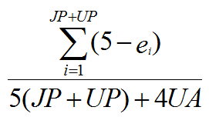
Evaluation
Use a more recent version of SNOMED CT as gold standard for earlier versions, expressing differences in terms of justified presence (JP), justified absence (JA), unjustified presence (UP) and unjustified absence (UA) yielding 17 combinations – change in reality, change in understanding, editorial mistake correction – to each of which corresponds an error value (e_{i}). The overall quality of an earlier version with respect to a chosen later version is then computed by means of formula:
Ceusters W. Applying Evolutionary Terminology Auditing to SNOMED CT. American Medical Informatics Association 2010 Annual Symposium (AMIA 2010) Proceedings. Washington DC, 2010. p. 96-100.

Slide 66
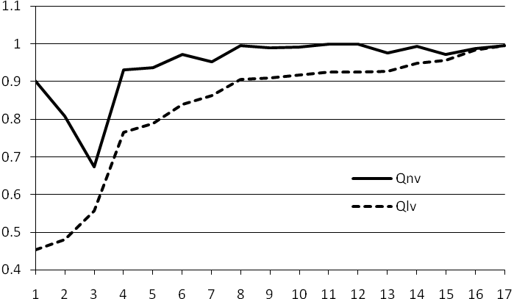
‘next’ and ‘last’ version quality improvement
when the difference between two consecutive points on the Qnv curve shows a large increase, as is the case between v3 and v4, then this means that it is worth upgrading to the next version, thus v5.

Slide 67
Comparison with ‘next’ and ‘last’ version quality improvement
Version |  | Information content | Suspicious event perseverance | ‘Next version’ quality improvement | ‘Last version’ quality improvement
 |  |  |  |  | LQV | 5% | 10% | 15% | 20% | 25%
v1 | January 2002 | 79,424.5499 |  | 0.902158875 | 0.45334
v2 | July 2002 | 88,838.2435 |  | 0.807276754 | 0.47980 | Y
v3 | January 2003 | 127,864.0057 |  | 0.674182895 | 0.55653 | Y | Y | Y | Y
v4 | July 2003 | 368,261.2260 |  | 0.930927215 | 0.76591 | Y | Y | Y | Y | Y
v5 | January 2004 | 360,409.8979 |  | 0.936412939 | 0.78907
v6 | July 2004 | 388,775.7097 |  | 0.970773297 | 0.83995 | Y
v7 | January 2005 | 390,637.7034 |  | 0.952138559 | 0.86259 |  | Y
v8 | July 2005 | 401,196.6372 |  | 0.995326645 | 0.90446 | Y |  | Y
v9 | January 2006 | 389,021.8138 |  | 0.988407635 | 0.90854
v10 | July 2006 | 387,226.2485 |  | 0.992040473 | 0.91776
v11 | January 2007 | 386,714.4974 |  | 0.999406567 | 0.92518 |  |  |  | Y
v12 | July 2007 | 386,816.9581 |  | 0.998631853 | 0.92567
v13 | January 2008 | 386,803.0803 |  | 0.976249334 | 0.92638
v14 | July 2008 | 386,075.3172 |  | 0.992155217 | 0.94874
v15 | January 2009 | 384,952.4653 |  | 0.971849459 | 0.95583 | Y | Y
v16 | July 2009 | 384,960.7605 |  | 0.987649670 | 0.98262 |  |  |  |  | Y
v17 | January 2010 | 385,449.7811 |  | 0.994921958 | 0.99492
v18 | July 2010 | 385,052.7645 |  | - | -

Slide 68
Conclusions (1)
the information content strategy approximates closely the 5% Qlv quality increase requirement, except:
  (1) unnecessary upgrades in January 2005 and July 2007, and
  (2) a failure to upgrade in January 2009 which is corrected in January 2010.
Combining this strategy with the suspicious event perseverance strategy would have led to an upgrade in July 2008 instead of January 2009.

Slide 69
Conclusions (2)
This is promising since:
  it is a completely automatic process;
  IC and SEP can be calculated with each new version, while Qnv gives a delay of one version and Qlv provides a post-hoc assessment;
  the method can be used for internal QA by SNOMED authors.
Limitations:
  for sure: transitive closure computations require serious computer resources;
  just one test case processed thus far;
  not: the uncertainty about whether a suspicious event is a mistake or a correction thereof: the perseverance matters.

Slide 70
Acknowledgements
The work described was funded in part by grant R21LM009824 from the National Library of Medicine. The content of this paper is solely the responsibility of the author and does not necessarily represent the official views of the NLM or the NIH.

