Slide 1


Improving Structured Electronic Health Record
Data for Secondary Research.
December 12, 2011
University at Buffalo, South Campus
Werner CEUSTERS
Ontology Research Group, Center of Excellence in Bioinformatics and Life Sciences
Department of Psychiatry, University at Buffalo, NY, USA

Slide 2
Goals and problems of Healthcare IT in general and Electronic Healthcare Records in particular

Slide 3

Benefits of Electronic Health Records (EHRs) for providers and their patients:
  Complete and accurate information,
    shared, coordinated,
  Better access to information,
    when and where needed,
  Patient empowerment,
    proactive, consent.
ONCHIT: http://healthit.hhs.gov

Slide 4
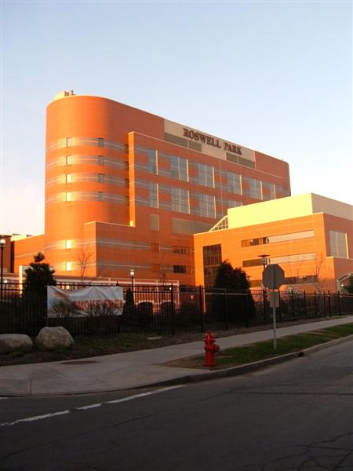

The ultimate goal of Healthcare IT
Everything collected wherever, whenever and about whomever which is relevant to a medical problem in whomever, whenever and wherever, should be accessible without loss of relevant detail.

Slide 5
ONCHIT’s Legislation and Regulations
The Health Information Technology for Economic and Clinical Health (HITECH) Act allows HHS to promote health information technology (HIT) to improve health care quality, safety, and efficiency.
Results:
  Incentive Program for EHRs issued by CMS: Stage I requirements for certified EHR technology in order to qualify for the payments: ‘Meaningful Use’ – 2011-2012;
  Standards and Certification Criteria for EHRs;
  Request for Comment - Stage 2 Definition of Meaningful Use in 2013 - 2014.
ONCHIT: http://healthit.hhs.gov

Slide 6
Unfortunately, there are some fallacies
Crippled idea about ‘problem list of diagnoses’

Slide 7
Crippled idea about ‘problem list of diagnoses’
Basis of Problem List:
  Larry Weed’s Problem Oriented Medical Record
    Each medical record should have a complete list of all the patient's problems, including both clearly established diagnoses and all other unexplained findings that are not yet clear manifestations of a specific diagnosis.
    Includes:
      diagnosis − physical finding
      lab abnormality − physiologic finding
      social issue − symptom
      demographic issue
Weed LL. Medical records that guide and teach. N Engl J Med. 1968 Mar 14;278(11):593-600.

Slide 8
Some fallacies
Crippled idea about ‘problem list of diagnoses’
Conflation of diagnosis and disease/disorder

Slide 9
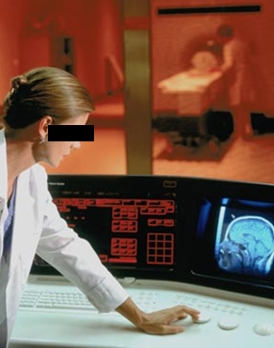
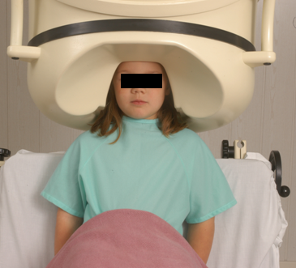
Conflation of diagnosis and disease/disorder
The diagnosis is here
The disorder is there
The disease is there

Slide 10
Some fallacies
Crippled idea about ‘problem list of diagnoses’
Conflation of diagnosis and disease/disorder
The structure of EHR data (information model) is not close enough to the structure of that what the data are about

Slide 11
EHR Information Models (simplified)
diagnosis
finding
finding
patient
patient
encounter
drug
drug
diagnosis

Slide 12
Some fallacies
Crippled idea about ‘problem list of diagnoses’
Conflation of diagnosis and disease/disorder
The structure of EHR data (information model) is not close enough to the structure of that what the data are about
Unjustified belief that the use of unambiguous codes renders EHR data unambiguous

Slide 13
Using generic representations for specific entities is inadequate
PtID
Date
SNOMED CT code
Narrative
5572
04/07/1990
26442006
closed fracture of shaft of femur
5572
04/07/1990
81134009
Fracture, closed, spiral
5572
12/07/1990
26442006
closed fracture of shaft of femur
5572
12/07/1990
9001224
Accident in public building (supermarket)
5572
04/07/1990
79001
Essential hypertension
0939
24/12/1991
255174002
benign polyp of biliary tract
2309
21/03/1992
26442006
closed fracture of shaft of femur
2309
21/03/1992
9001224
Accident in public building (supermarket)
47804
03/04/1993
58298795
Other lesion on other specified region
5572
17/05/1993
79001
Essential hypertension
298
22/08/1993
2909872
Closed fracture of radial head
298
22/08/1993
9001224
Accident in public building (supermarket)
5572
01/04/1997
26442006
closed fracture of shaft of femur
5572
01/04/1997
79001
Essential hypertension
0939
20/12/1998
255087006
malignant polyp of biliary tract

Slide 14
Some fallacies
Crippled idea about ‘problem list of diagnoses’
Conflation of diagnosis and disease/disorder
The structure of EHR data (information model) is not close enough to the structure of that what the data are about
Unjustified belief that the use of unambiguous codes renders EHR data unambiguous
Popular terminologies will solve the problems

Slide 15

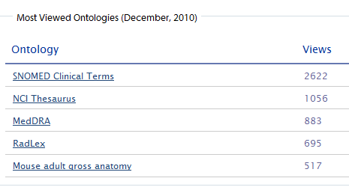

Slide 16
Is there a solution?

Slide 17
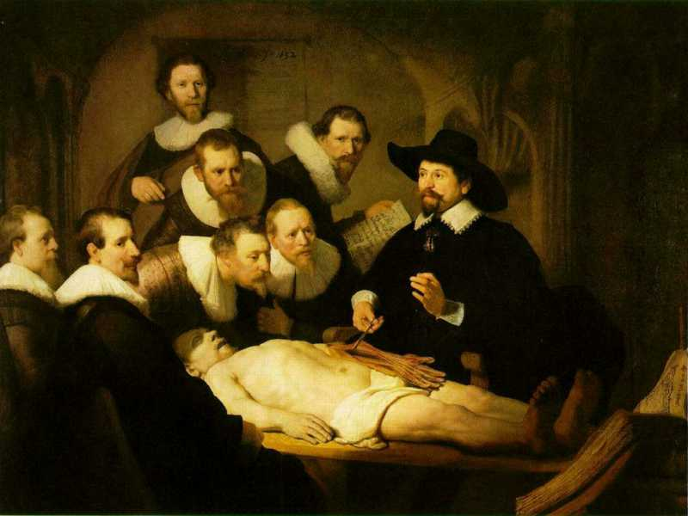

Slide 18
L3
Linguistic representations about (1), (2) or (3)
L2
Clinicians’ beliefs about (1)
Representations
First Order Reality
Entities (particular or generic) with objective existence which are not about anything
L1⁻

Slide 19

A crucial distinction: data and what they are about
data
organization
First-
Order
Reality
is about
model development
observation &
measurement
Representation
further R&D
(instrument and
study optimization)
add
verify
use
Δ = outcome
Generic
beliefs
application

Slide 20

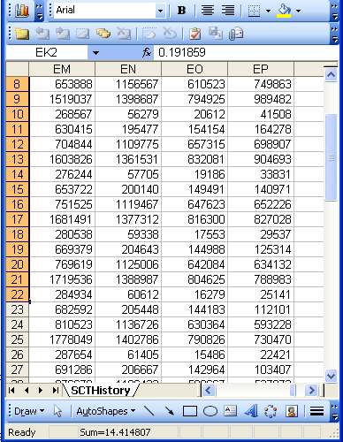
A non-trivial relation
Referent
Reference

Slide 21
Some key questions
What referents, if any at all, are depicted by a putative reference?
How do changes at the level of the referents correspond with changes in the collection of references?
If references are transmitted, how can the receiver know what referents are depicted?
Referent
Reference

Slide 22
The problem in a nutshell
Generic terms used to denote specific entities do not have enough referential capacity
  Usually enough to convey that some specific entity is denoted,
  Not enough to be clear about which one in particular.
For many ‘important’ entities, unique identifiers are used:
  UPS parcels
  Patients in hospitals
  VINs on cars
  …

Slide 23
‘Ontology’
In philosophy:
  Ontology (no plural) is the study of what entities exist and how they relate to each other;

Slide 24
‘Ontology’
In philosophy:
  Ontology (no plural) is the study of what entities exist and how they relate to each other;
In computer science and many biomedical informatics applications:
  An ontology (plural: ontologies) is a shared and agreed upon conceptualization of a domain;

Slide 25
Ontology as it should be done
In philosophy:
  Ontology (no plural) is the study of what entities exist and how they relate to each other;
In computer science and many biomedical informatics applications:
  An ontology (plural: ontologies) is a shared and agreed upon conceptualization of a domain;
The realist view within the Ontology Research Group combines the two:
  We use Ontological Realism, a specific methodology that uses ontology as the basis for building high quality ontologies, using reality as benchmark.

Slide 26
For example: Ontology of General Medical Science
a disease is a disposition rooted in a physical disorder in the organism and realized in pathological processes.
produces
bears
realized_in
etiological process
disorder
disposition
pathological process
produces
diagnosis
interpretive process
signs & symptoms
abnormal bodily features
produces
participates_in
recognized_as
Notes:
font was too small, color inside green boxes was hardly readable

Slide 27
Disease course
the totality of all Processes through which a given Disease instance is realized .
multiple Disease Courses will be associated with the same Disorder type, for example in reflection of the presence or absence of pharmaceutical or other interventions, of differences in environmental influence, and so forth.

Slide 28
Diagnosis
Clinical Picture =def. – A representation of a clinical phenotype that is inferred from the combination of laboratory, image and clinical findings about a given patient.
Diagnosis =def. –
  A conclusion of an interpretive process that has as input a clinical picture of a given patient and as output an assertion to the effect that the patient has a disease of such and such a type.

Slide 29
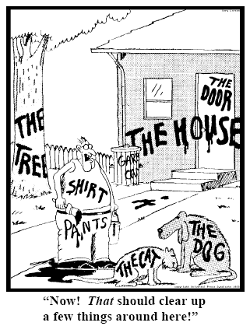
Fundamental goals of ‘our’ Referent Tracking
explicit reference to the concrete individual entities relevant to the accurate description of some portion of reality, ...
Ceusters W, Smith B. Strategies for Referent Tracking in Electronic Health Records. J Biomed Inform. 2006 Jun;39(3):362-78.

Slide 30
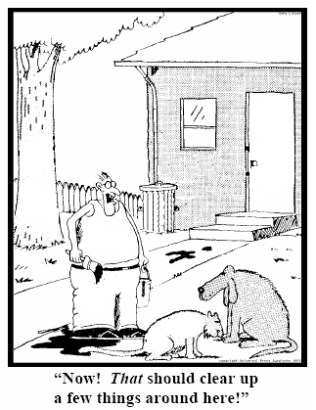
Method: numbers instead of words
  Introduce an Instance Unique Identifier (IUI) for each relevant particular (individual) entity
78
235
5678
321
322
666
427
Ceusters W, Smith B. Strategies for Referent Tracking in Electronic Health Records. J Biomed Inform. 2006 Jun;39(3):362-78.

Slide 31
Codes for ‘types’ AND identifiers for instances
PtID
Date
ObsCode
Narrative
5572
04/07/1990
26442006
IUI-001
closed fracture of shaft of femur
5572
04/07/1990
81134009
IUI-001
Fracture, closed, spiral
5572
12/07/1990
26442006
IUI-001
closed fracture of shaft of femur
5572
12/07/1990
9001224
IUI-007
Accident in public building (supermarket)
5572
04/07/1990
79001
IUI-005
Essential hypertension
0939
24/12/1991
255174002
IUI-004
benign polyp of biliary tract
2309
21/03/1992
26442006
IUI-002
closed fracture of shaft of femur
2309
21/03/1992
9001224
IUI-007
Accident in public building (supermarket)
47804
03/04/1993
58298795
IUI-006
Other lesion on other specified region
5572
17/05/1993
79001
IUI-005
Essential hypertension
298
22/08/1993
2909872
IUI-003
Closed fracture of radial head
298
22/08/1993
9001224
IUI-007
Accident in public building (supermarket)
5572
01/04/1997
26442006
IUI-012
closed fracture of shaft of femur
5572
01/04/1997
79001
7 distinct disorders
IUI-005
Essential hypertension
0939
20/12/1998
255087006
IUI-004
malignant polyp of biliary tract

Slide 32
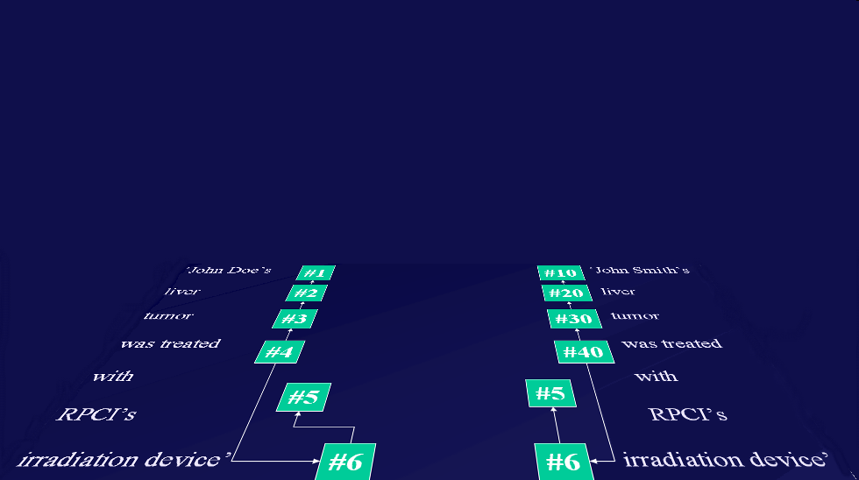
Relevance: the way RT-compatible EHRs ought to interact with representations of generic portions of reality
instance-of at t
caused
by
#105

Slide 33
An example: the standard approach in data analysis
Cases | Characteristics
 | ch1 | ch2 | ch3 | ch4 | ch5 | ch6 | ...
case1
case2
case3
case4
case5
case6
...
phenotypic
genotypic

Slide 34
The Referent Tracking approach (1)
unique identification by means of ‘codes’
unique identification by means of ‘instance unique identifiers’

Slide 35
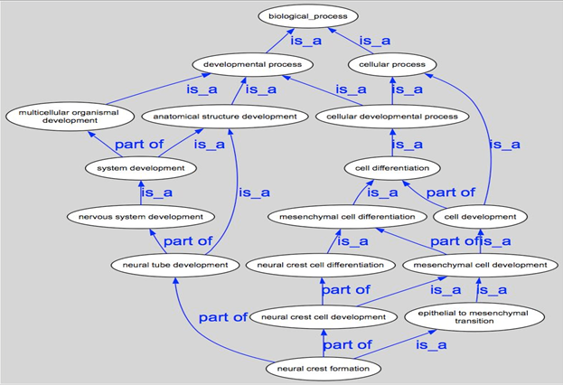
The Referent Tracking approach (2)

Slide 36
Feedback to clinical care
Finding ‘similar’ patient cases:
  suggestions for prevention, investigation, treatment;
‘Outbreak’ detection;
Comparing outcomes;
  related to disorders, providers, treatments, …
Links to literature;
Clinical trial selection;
…

