Slide 1
MHI501 – Introduction to Health Informatics
Key research and system implementation challenges facing the field of health informatics
SUNY at Buffalo - December 7, 2011
Werner CEUSTERS
Center of Excellence in Bioinformatics and Life Sciences
University at Buffalo, NY, USA
http://www.org.buffalo.edu/RTU

Slide 2
The – in my view – most important challenges
All information systems (IS) should be connected in semantically interoperable (SI) ways.
  SI (roughly): systems understand and can use each other’s data for their own purpose.
The achievement of the former satisfying the following conditions:
  lowest-level data storage ensures that each data-element points to one and only one entity in reality,
  access to and use of these data-elements is meticulously governed;
  there is no additional burden to IS users for data entered to be transformed into that format.

Slide 3
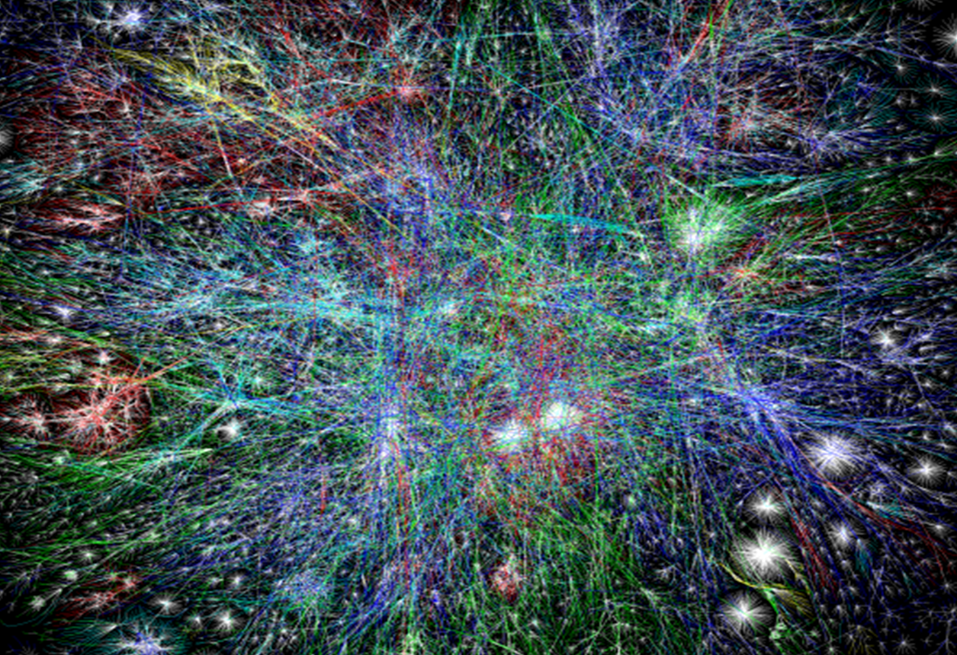
All information systems should be connected in semantically interoperable ways

Slide 4
A terminological wilderness
A large variety of names:
  ‘Computer-based Patient Record’
  ‘Computerized Patient Record’
  ‘Electronic Medical Record’
  ‘Electronic Patient Record’
  ‘Electronic Health Record’
  ‘Personal Health Record’
  …

Slide 5
Heroic attempts to come to definitions
Based on a large variety of (accidental) features:
  Who enters the data:
    clinician, nurse, patient, electronic system (e.g. lab), …
  Where the data are stored:
    private practice (surgery), hospital, web-portal, federated over several institutions, …
  What the data and/or systems are used for:
    archiving, documentation, treatment, …
      ‘data repository ‘ versus ‘data cemetery’ (the late JR Scherrer)
  The format of the data:
    Coded, free text, scanned documents, …
  Who governs the data and grants access,
  ...

Slide 6
But does it really matter ?
Some good reasons:
  Demarcation of medico-legal responsibilities,
  Application of confidentiality and privacy rights,
  Keeping the systems manageable and scalable.
Some unfortunate de facto reasons:
  Failure to see the global picture,
  Competing interests:
    Insurability under corporate managed care,
    Return of investments of old technology.

Slide 7
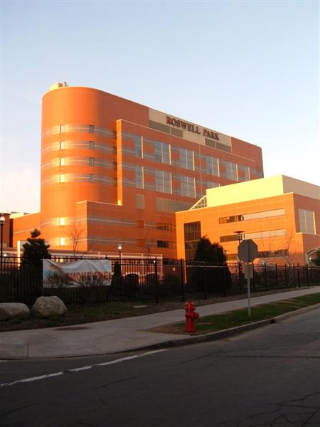
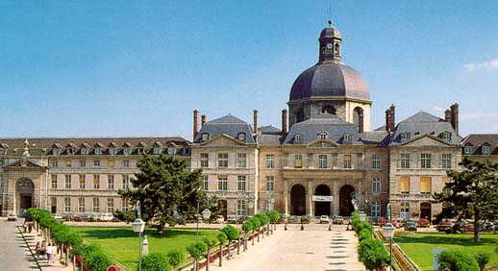
What is then that global picture?
Everything collected wherever, whenever and about whomever which is relevant to a medical problem in whomever, whenever and wherever, should be accessible without loss of relevant detail.

Slide 8
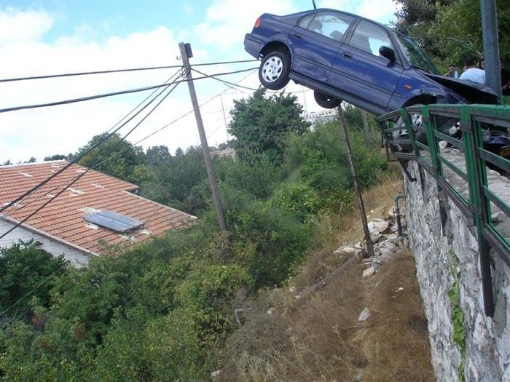
What is then that global picture?
Fingerprint or voice-recognition in car identifies driver and passengers:
  anti-theft, proof of whereabouts (with GPS), …
In case of car accident, through nG - network:
  Alert to traffic surveillance system
    Alert to police, rescue service, family, …
  entry into EHRs of persons involved

Slide 9
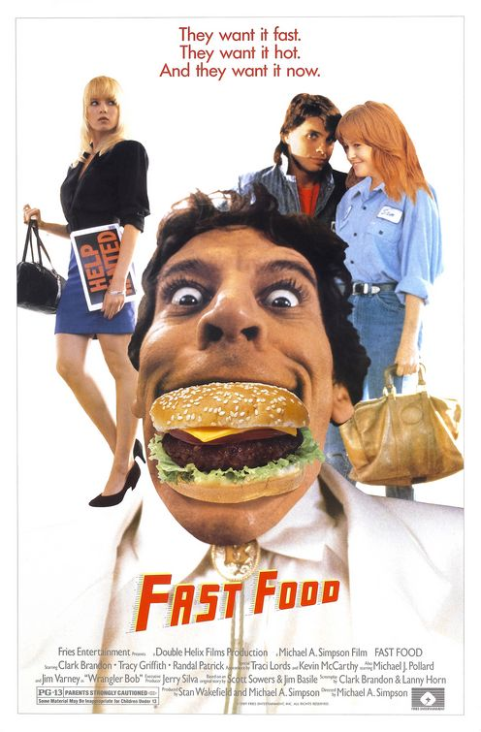
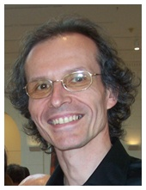
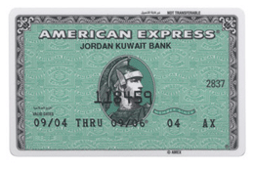
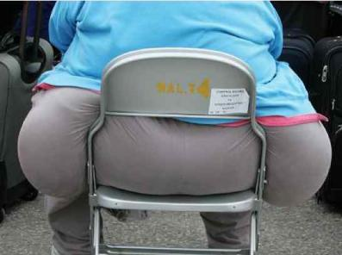
What is then that global picture?
receive
confirmation
call
Note in ‘EHR’ about calories purchased
(or card blocked?)

Slide 10
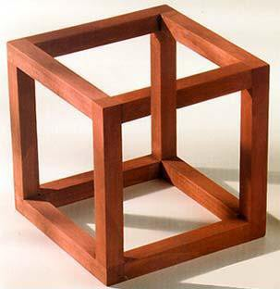
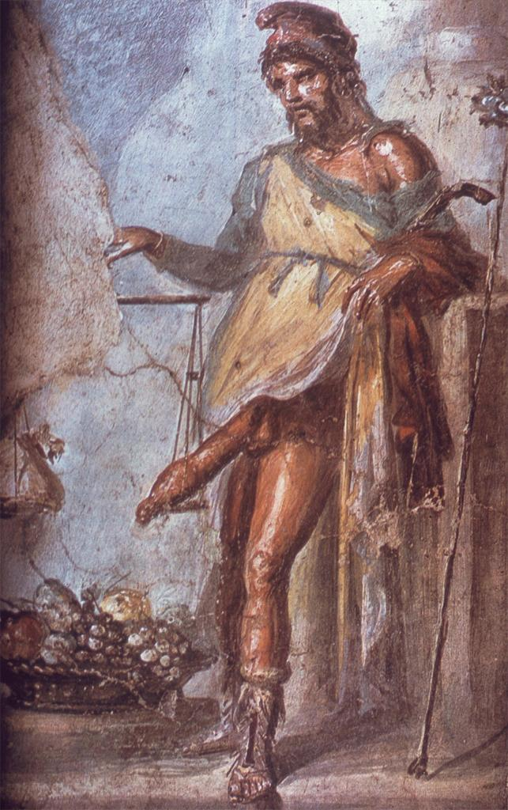
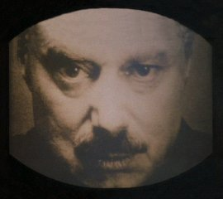
This raises many questions
Is this …
- possible ?
- desirable ?
- scary ?

Slide 11

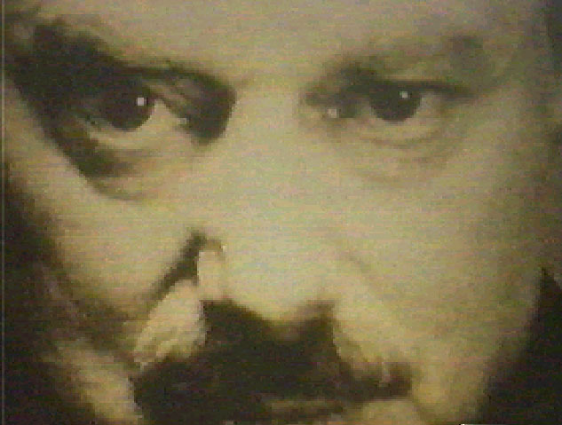
Is this scary?
The misuse of medical records has led to loss of jobs, discrimination, identity theft and embarrassment.
  An Atlanta truck driver lost his job after his insurance company told his employer that he had sought treatment for alcoholism.
  A pharmacist disclosed to a California woman that her ex-spouse was HIV positive, information she later used against him in a custody battle.
  A 30-year employee of the FBI was forced into early retirement when the FBI found his mental health prescription records while investigating the man’s therapist for fraud.
http://www.consumer-action.org/

Slide 12
Is this desirable? (2000)
More than one million patients suffer injuries each year as a result of broken healthcare processes and system failures:
  Institute of Medicine (IOM) Report (2000). To err is human: Building a safer health system.
  Barbara Starfield. Is US Health Really the Best in the World? JAMA. 2000;284:483-485.
Medical errors were (are?) killing more people each year than breast cancer, AIDS, and motor vehicle accidents together.
  Institute of Medicine, Centers for Disease Control and Prevention; National Center for Health Statistics: Preliminary Data for 1998 and 1999, 2000.

Slide 13
Is this desirable? (2003)
Little more than half of United States’ patients receive known ‘best practice’ treatments for their illnesses and less than half of physicians’ practices use recommended processes for care.
  Casalino et al. External Incentives, Information Technology, and Organized Processes to Improve Health Care Quality for Patients With Chronic Diseases - JAMA 2003;289: 434-441.

Slide 14
Is this desirable? (2005)
An estimated thirty to forty cents of every United States’ dollar spent on healthcare, or more than a half-trillion dollars per year, is spent on costs associated with ‘overuse, underuse, misuse, duplication, system failures, unnecessary repetition, poor communication, and inefficiency’.
  Proctor P. Reid, W. Dale Compton, Jerome H. Grossman, and Gary Fanjiang, Editors (2005) Building a Better Delivery System: A New Engineering/Health Care Partnership. Committee on Engineering and the Health Care System, National Academies Press.

Slide 15
Is this desirable? (2006)
At least 1.5 million preventable adverse drug events occur in the United States each year.
  Institute of Medicine. Preventing Medication Errors. 2006

Slide 16
Is this possible?
There are already so many amazing technologies available or ready for clinical trial:
  Smart pills that send emails when taken,
  ‘Blood bots’ for endovascular surgery,
  Thought-controlled artificial limbs,
  ‘Breathalyzer’ for disease diagnosis,
  Implantable nano wires to monitor blood pressure,
  …

Slide 17
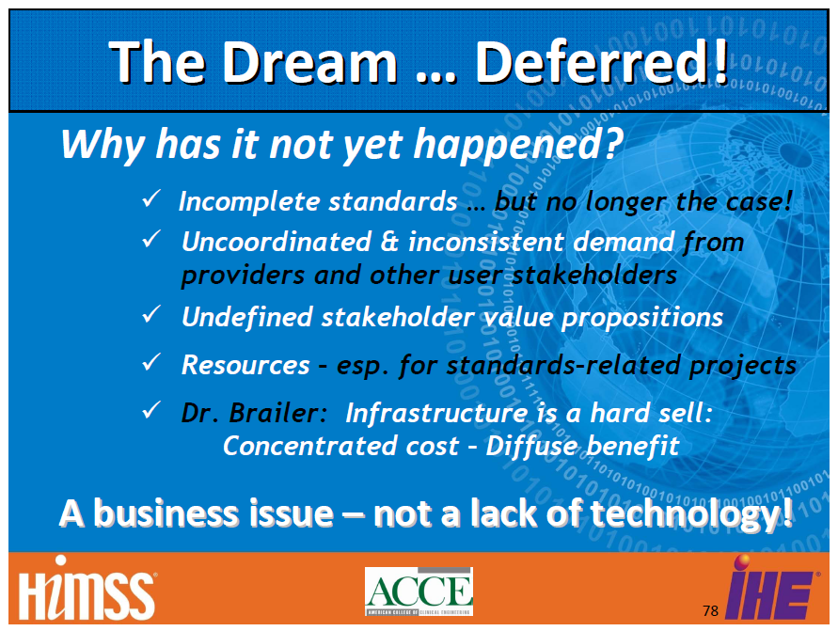
Is this possible?
http://www.interoperabilityshowcase.com/docs/webinarArchives/2010_Webinar_Series_Review_PCD_Domain_2010-8-3f.pdf

Slide 18
I respectfully disagree …
Standards?
  No shortage indeed, but:
    too many,
    too low quality, because,
    too much ad hoc.
Availability of ‘the’ technology?
  Focus on providing patches for old EHR technology rather than developing better systems from solid foundations.

Slide 19
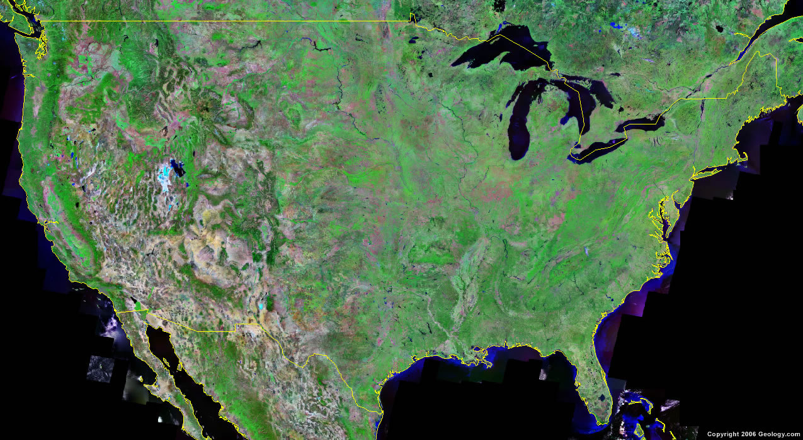

Current state of the art
Standards for data interchange

Slide 20
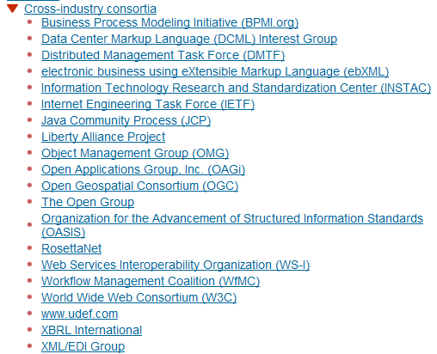
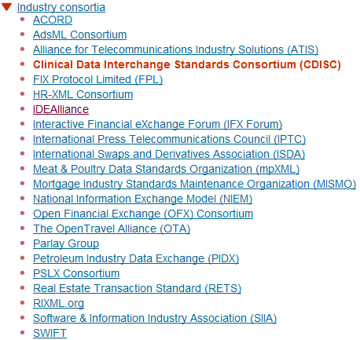

No shortage in standards anymore
Abundance is a problem!

Slide 21
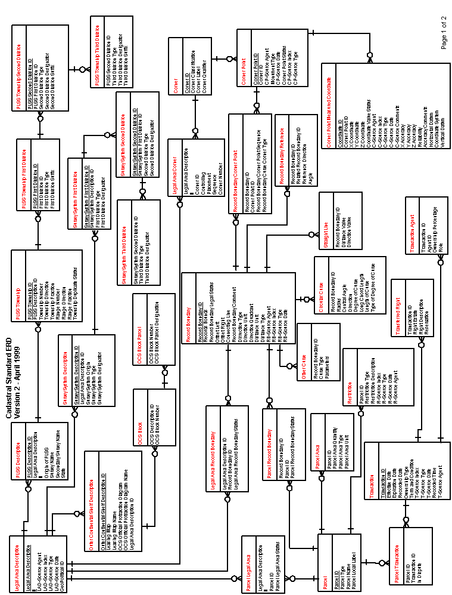
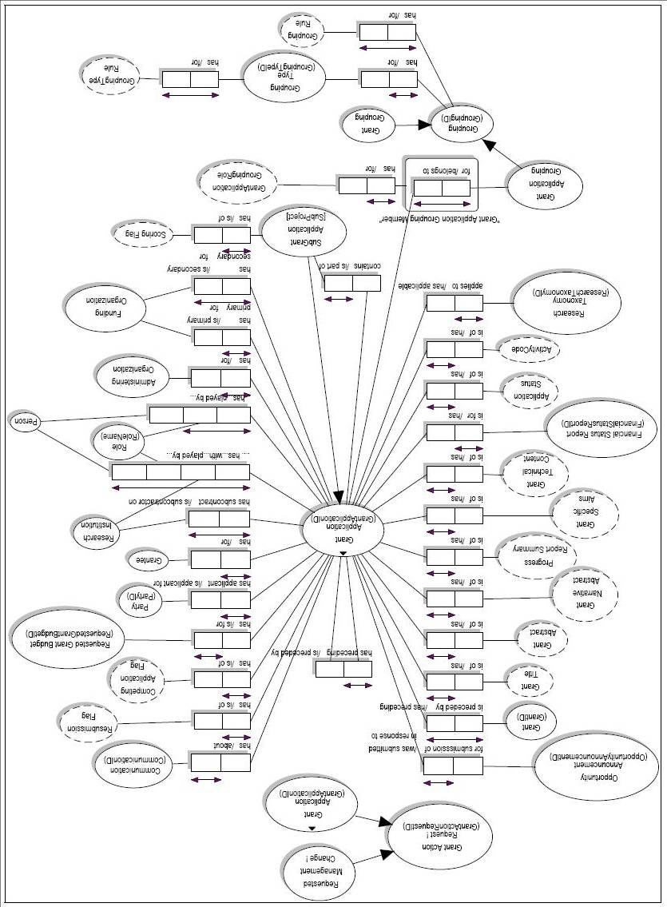
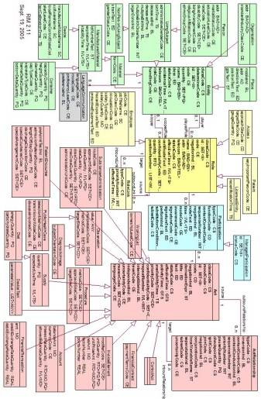
Standard mechanism
‘reformulation’ of syntax and semantics

Slide 22
Current deficiencies in this reformulation
Based on inadequate domain analyses using inadequate methods and tools, resulting in:
loss of detail,
proliferation of ambiguities of various sorts,
unnecessary complexity,
…
  Is there a better, simpler way ?

Slide 23
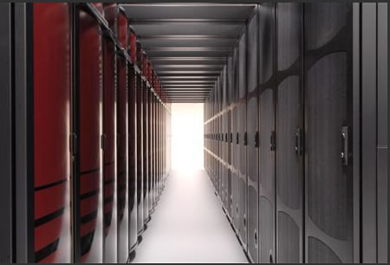

A way forward:
Referent Tracking

Slide 24
What is Referent Tracking ?
A paradigm under development since 2005,¹
  based on Ontological Realism,²
  designed to keep track of relevant portions of reality and what is believed and communicated about them,
  enabling adequate use of realism-based ontologies, terminologies, thesauri, and vocabularies.
1 Ceusters W, Smith B.
Strategies for Referent Tracking in Electronic Health Records. J Biomed Inform. 2006 Jun;39(3):362-78. http://www.referent-tracking.com/RTU/sendfile/?file=Manuscript.pdf
2 Smith B, Ceusters W.
Ontological Realism as a Methodology for Coordinated Evolution of Scientific Ontologies. Applied Ontology, 2010;5(3-4):139-188.
http://iospress.metapress.com/content/1551884412214u67/fulltext.pdf

Slide 25
Prevailing EHR models get it wrong twice (at least)
Confusion about the levels of reality primarily because of this confusion in terminologies and coding systems used.

Slide 26
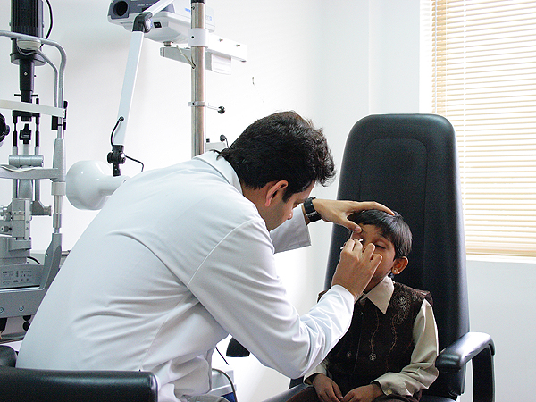


The three levels of Reality
representing
comparing
observing
acting

Slide 27
Un-‘realistic’ SNOMED hierarchy
‘Fractured nasal bones (disorder)’
  is_a ‘bone finding’
    synonym: ‘bone observation’
Confusion between
  L3. ‘fractured nose’ [appearing in some record]: the expression of an observation)
  L2. ‘fractured nose’ [in someone’s mind]: content of an act of observation
  L1. fractured nose: a type of nose, a particular nose

Slide 28
Prevailing EHR models get it wrong twice (at least)
Confusion about the levels of reality primarily because of this confusion in terminologies and coding systems used.
The wrong belief that it is enough to use generic terms (even when, ideally, denoting universals) to denote particulars.

Slide 29
Coding systems used naively preserve certain ambiguities
PtID
Date
ObsCode
Narrative
5572
04/07/1990
26442006
closed fracture of shaft of femur
5572
04/07/1990
81134009
Fracture, closed, spiral
5572
12/07/1990
26442006
closed fracture of shaft of femur
5572
12/07/1990
9001224
Accident in public building (supermarket)
5572
04/07/1990
79001
Essential hypertension
0939
24/12/1991
255174002
benign polyp of biliary tract
2309
21/03/1992
26442006
closed fracture of shaft of femur
2309
21/03/1992
9001224
Accident in public building (supermarket)
47804
03/04/1993
58298795
Other lesion on other specified region
5572
17/05/1993
79001
Essential hypertension
298
22/08/1993
2909872
Closed fracture of radial head
298
22/08/1993
9001224
Accident in public building (supermarket)
5572
01/04/1997
26442006
closed fracture of shaft of femur
5572
01/04/1997
79001
Essential hypertension
0939
20/12/1998
255087006
malignant polyp of biliary tract

Slide 30
Codes for ‘types’ AND identifiers for instances
PtID
Date
ObsCode
Narrative
5572
04/07/1990
26442006
IUI-001
closed fracture of shaft of femur
5572
04/07/1990
81134009
IUI-001
Fracture, closed, spiral
5572
12/07/1990
26442006
IUI-001
closed fracture of shaft of femur
5572
12/07/1990
9001224
IUI-007
Accident in public building (supermarket)
5572
04/07/1990
79001
IUI-005
Essential hypertension
0939
24/12/1991
255174002
IUI-004
benign polyp of biliary tract
2309
21/03/1992
26442006
IUI-002
closed fracture of shaft of femur
2309
21/03/1992
9001224
IUI-007
Accident in public building (supermarket)
47804
03/04/1993
58298795
IUI-006
Other lesion on other specified region
5572
17/05/1993
79001
IUI-005
Essential hypertension
298
22/08/1993
2909872
IUI-003
Closed fracture of radial head
298
22/08/1993
9001224
IUI-007
Accident in public building (supermarket)
5572
01/04/1997
26442006
IUI-012
closed fracture of shaft of femur
5572
01/04/1997
79001
7 distinct disorders
IUI-005
Essential hypertension
0939
20/12/1998
255087006
IUI-004
malignant polyp of biliary tract

Slide 31
The problem of reference in free text
‘The surgeon examined Maria. She found a small tumor on the left side of her liver. She had it removed three weeks later.’
Ambiguities:
  who denotes the first ‘she’: the surgeon or Maria ?
  on whose liver was the tumor found ?
  who denotes the second ‘she’: the surgeon or Maria ?
  what was removed: the tumor or the liver ?
Here referent tracking can come to aid.

Slide 32
Fundamental goals of ‘our’ Referent Tracking
Use these identifiers in expressions using a language that acknowledges the structure of reality:
e.g.: a yellow ball:
then not : yellow(#1) and ball(#1)
rather: #1: the ball #2: #1’s yellow
Then still not:
  ball(#1) and yellow(#2) and hascolor(#1, #2)
  but rather:
  instance-of(#1, ball, since t1)
  instance-of(#2, yellow, since t2)
  inheres-in(#1, #2, since t2)
Strong foundations
in realism-based
ontology

Slide 33
The shift envisioned
From:
  ‘this man is a 40 year old patient with a stomach tumor’
To (something like):
  ‘this-1 on which depend this-2 and this-3 has this-4’, where
    this-1 instanceOf human being …
    this-2 instanceOf age-of-40-years …
    this-2 qualityOf this-1 …
    this-3 instanceOf patient-role …
    this-3 roleOf this-1 …
    this-4 instanceOf tumor …
    this-4 partOf this-5 …
    this-5 instanceOf stomach …
    this-5 partOf this-1 …
    …

Slide 34
The shift envisioned
From:
  ‘this man is a 40 year old patient with a stomach tumor’
To (something like):
  ‘this-1 on which depend this-2 and this-3 has this-4’, where
    this-1 instanceOf human being …
    this-2 instanceOf age-of-40-years …
    this-2 qualityOf this-1 …
    this-3 instanceOf patient-role …
    this-3 roleOf this-1 …
    this-4 instanceOf tumor …
    this-4 partOf this-5 …
    this-5 instanceOf stomach …
    this-5 partOf this-1 …
    …
denotators for particulars

Slide 35
The shift envisioned
From:
  ‘this man is a 40 year old patient with a stomach tumor’
To (something like):
  ‘this-1 on which depend this-2 and this-3 has this-4’, where
    this-1 instanceOf human being …
    this-2 instanceOf age-of-40-years …
    this-2 qualityOf this-1 …
    this-3 instanceOf patient-role …
    this-3 roleOf this-1 …
    this-4 instanceOf tumor …
    this-4 partOf this-5 …
    this-5 instanceOf stomach …
    this-5 partOf this-1 …
    …
denotators for appropriate relations

Slide 36
The shift envisioned
From:
  ‘this man is a 40 year old patient with a stomach tumor’
To (something like):
  ‘this-1 on which depend this-2 and this-3 has this-4’, where
    this-1 instanceOf human being …
    this-2 instanceOf age-of-40-years …
    this-2 qualityOf this-1 …
    this-3 instanceOf patient-role …
    this-3 roleOf this-1 …
    this-4 instanceOf tumor …
    this-4 partOf this-5 …
    this-5 instanceOf stomach …
    this-5 partOf this-1 …
    …
denotators for universals or particulars

Slide 37
The shift envisioned
From:
  ‘this man is a 40 year old patient with a stomach tumor’
To (something like):
  ‘this-1 on which depend this-2 and this-3 has this-4’, where
    this-1 instanceOf human being …
    this-2 instanceOf age-of-40-years …
    this-2 qualityOf this-1 …
    this-3 instanceOf patient-role …
    this-3 roleOf this-1 …
    this-4 instanceOf tumor …
    this-4 partOf this-5 …
    this-5 instanceOf stomach …
    this-5 partOf this-1 …
    …
time stamp in
case of continuants

Slide 38
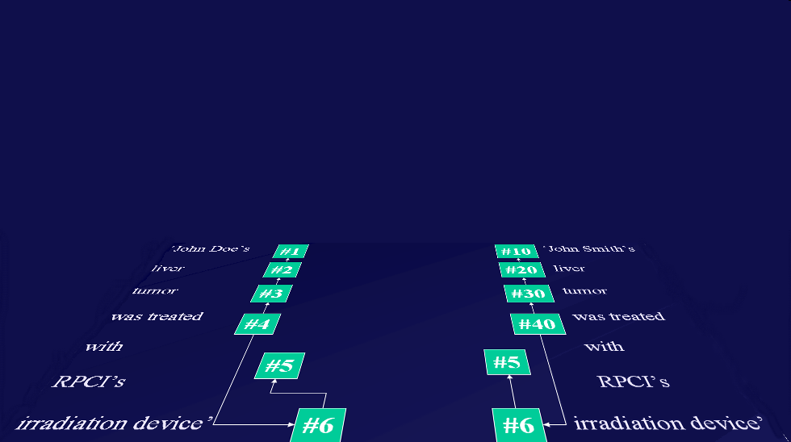
Relevance: the way RT-compatible EHRs ought to interact with representations of generic portions of reality
instance-of at t
caused
by
#105

Slide 39
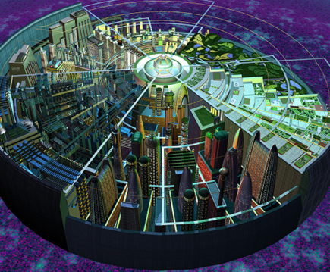
Current state of the art + Referent Tracking

Slide 40
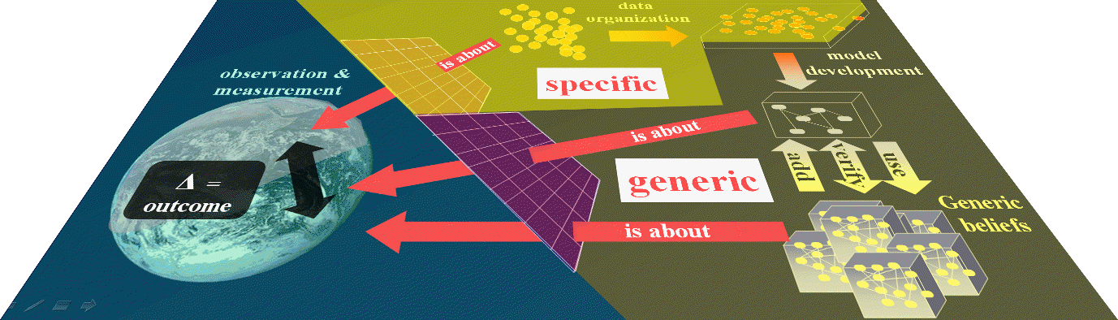

Referent Tracking based data warehousing

Slide 41
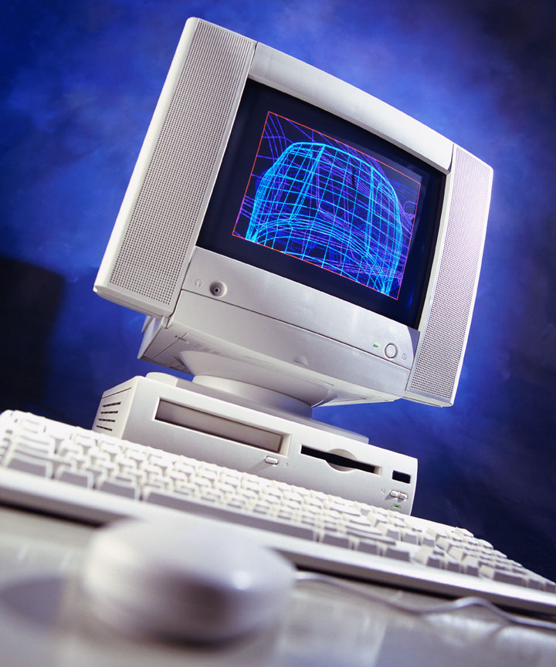
Ultimate goal
A digital copy of the world

Slide 42
Accept that everything may change:
changes in the underlying reality:
  Particulars come, change and go
changes in our (scientific) understanding:
  The plant Vulcan does not exist
reassessments of what is considered to be relevant for inclusion (notion of purpose).
encoding mistakes introduced during data entry or ontology development.

Slide 43
Conclusion (1)
Unique identifier for:
  each data-element and combinations thereof (L3),
  what the data-element is about (L1),
  each generated copy of an existing data-element (L3),
  each transaction involving data-elements (L1);
Identifiers centrally managed in RTS;
Exclusive use of ontologies for type descriptions following OBO-Foundry principles;
Centrally managed data dictionaries, data-ownership, exchange criteria.

Slide 44
Conclusion (2)
Central inventory of ‘attributes’ but peripheral maintenance of ‘values’;
Identifiers function as pseudonyms:
  centrally known that for person IUI-1 there are values about instances of UUI-2 maintained by researcher/clinician IUI-3 for periods IUI-4, IUI-5, …
Disclosure of what the identifiers stand for based on need and right to know;
Generation of off-line datasets for research with transaction-specific identifiers for each element.

